Slide 1

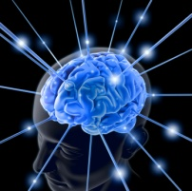
NCS Tutorial: CNS 2012
UNR Brain Computation Lab
Brain Computation Lab
University of Nevada, Reno

Slide 2
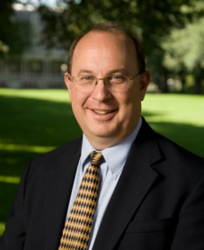
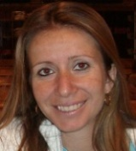


Introduction
People:
  Fred Harris
    Professor – Department of Computer Science and Engineering
  Laurence Bray
    Post Doctoral Research Associate,
      soon to be promoted to Research Assistant Professor
      Ph.D. is in Biomedical Engineering
  Roger Hoang
    Ph.D. Candidate
      planning to graduate this coming school year.
  Emily Barker
    B.S. Student – Majoring in Neuroscience
      Starting her Senior year this fall.

Slide 3

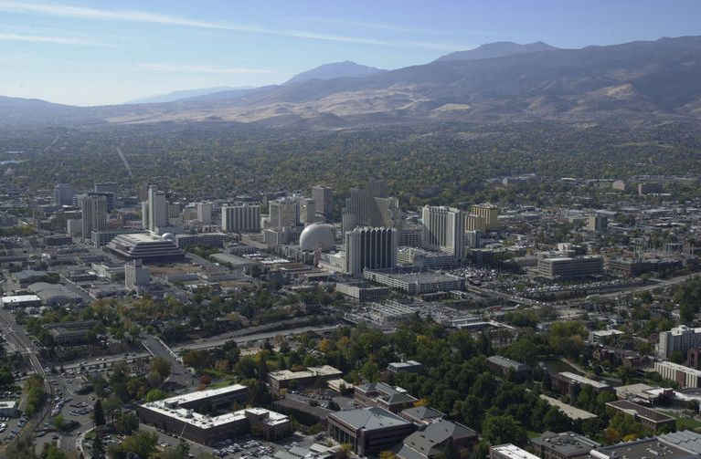
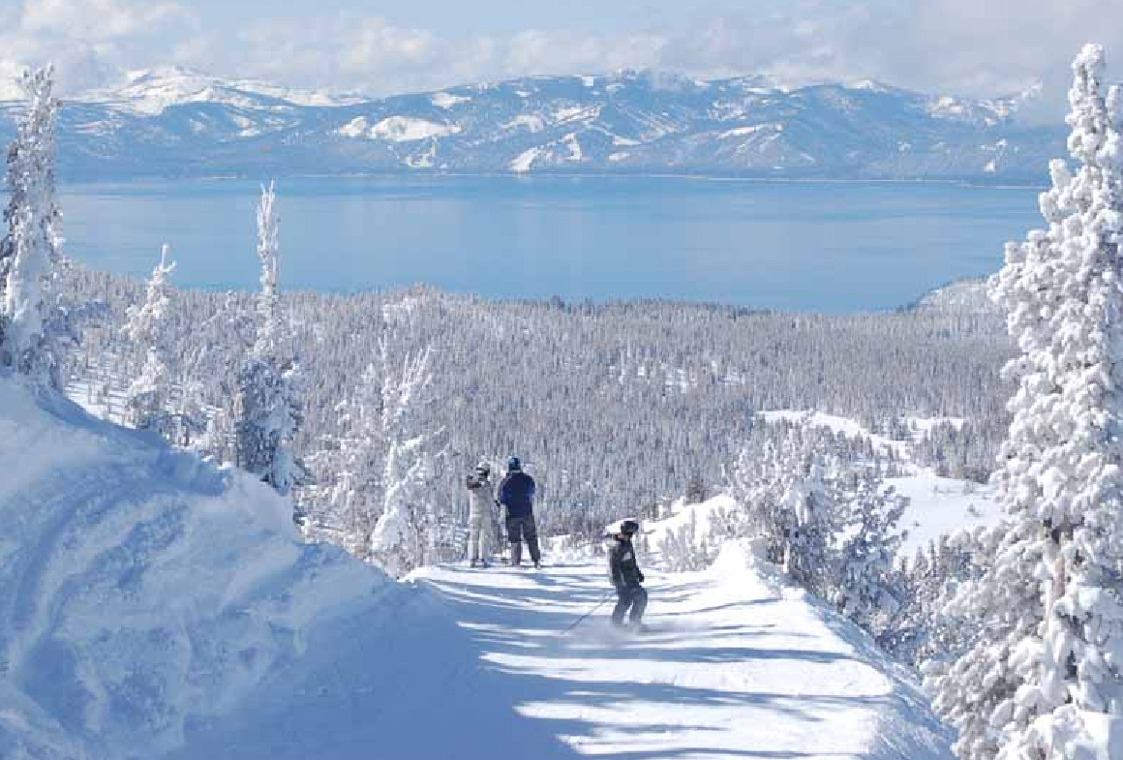
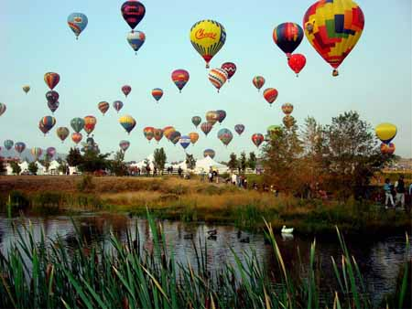
Reno, Nevada

Slide 4
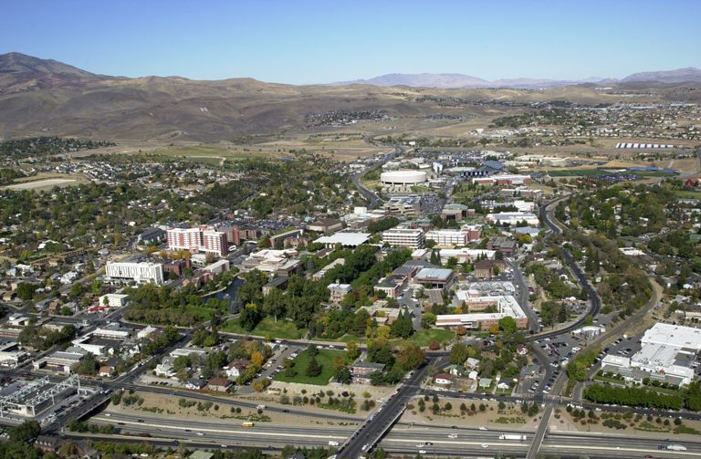
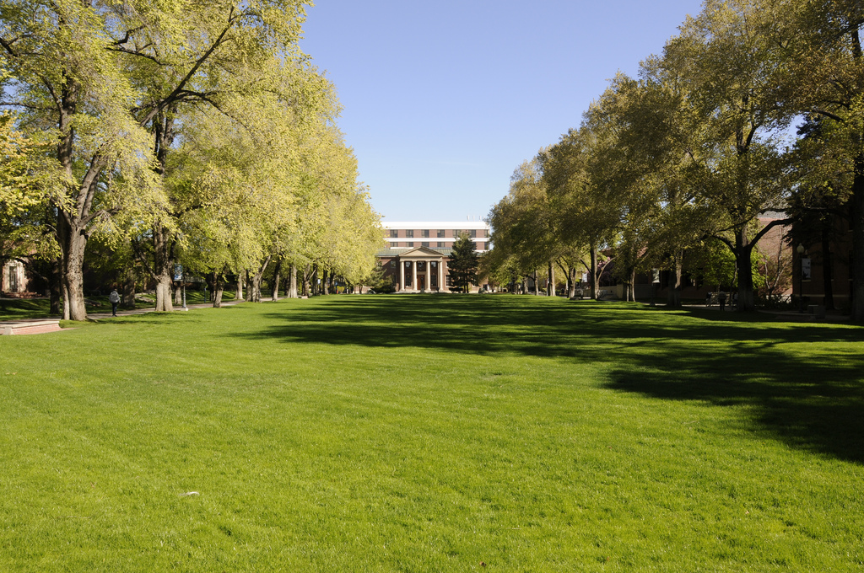
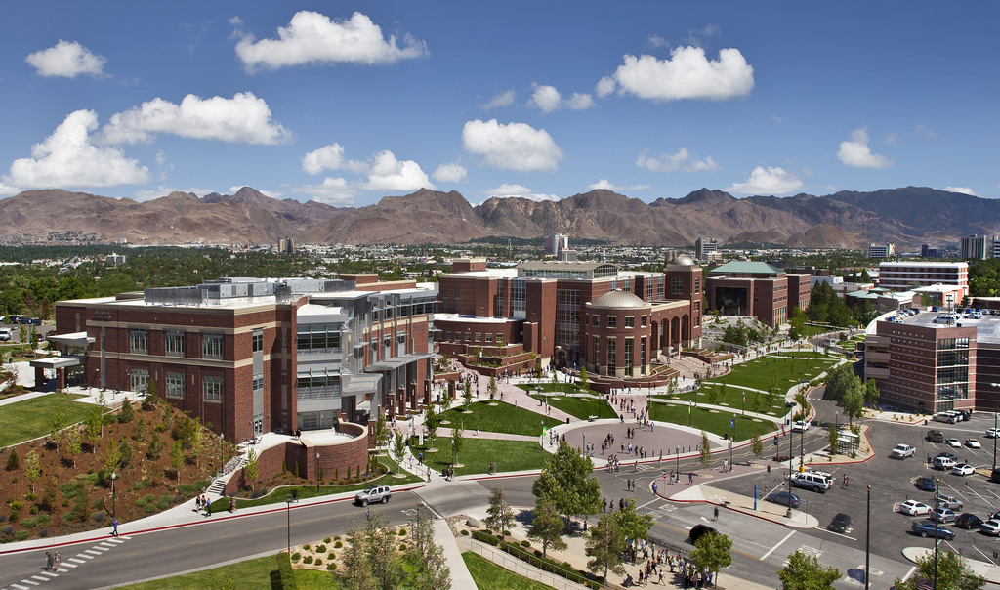
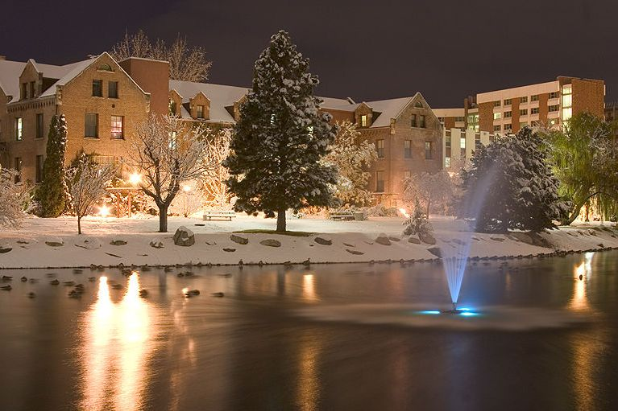
University of Nevada, Reno

Slide 5
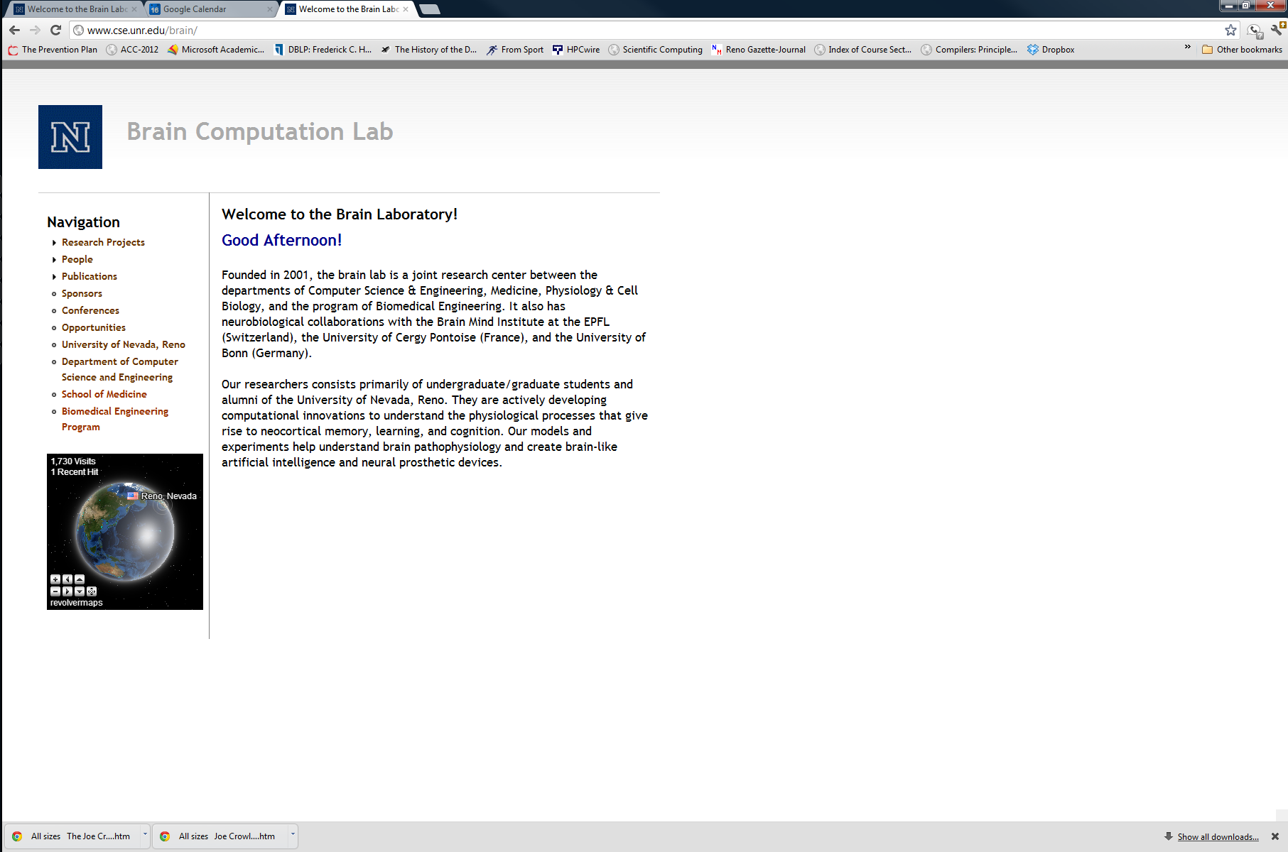
Brain Computation Lab
http://www.cse.unr.edu/brain/

Slide 6
NCS History
Version 1:1999
  Matlab
  160-cell, 2-column architecture
    Each cell was modeled as a single integrative compartment (point neuron) with a spike mechanism,
      calcium-dependent (AHP) channels, and
      voltage-sensitive A and M (muscarinic) potassium channels.
  M.M. Kellog, H.R. Wills, and P.H. Goodman. “A biologically realistic computer model of neocortical associative learning for the study of aging and dementia.” J. Investig. Med., 47(2), February 1999

Slide 7
NCS History
Version 1b: 1999
  Direct translation to C from Matlab
    Ali Etazadi-Amoli and Keith Weslowski
  24 times faster.
  tested on mixed excitatory-inhibitory networks of up to 1,000 cells.

Slide 8
NCS History
Version 2: 1999
  code was then redesigned and rewritten for distributed processing on an existing 20-cpu cluster (Pentium II).
  Initial trials of this code were performed on cortical networks of 2 to 1,000 cells.

Slide 9
NCS History
Version 3: 2001
  completely redesigned using object-oriented design principles and recoded in C++
  objects, such as cells, compartments, channels, and the like, model the corresponding cortical entities.
  The cells, in turn, communicate via messages passed through synapse objects.
  Input parameters allow the user to create many variations of the basic objects, in order to model measured or hypothesized biological properties.
  E. Courtenay Wilson, Phillip H. Goodman, and Frederick C. Harris, Jr. “Implementation of a biologically realistic parallel neocortical-neural network simulator” in Proceedings of the 10th SIAM Conf. on Parallel Process. for Sci. Computing, Portsmouth, Virginia, March 2001.

Slide 10
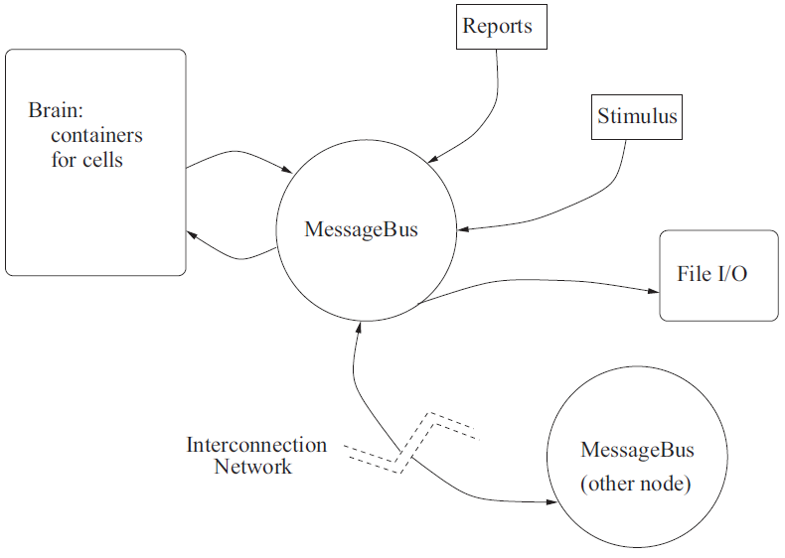
NCS History
E. Courtenay Wilson, Frederick C. Harris, Jr., and Phillip H. Goodman. “A large-scale biologically realistic cortical simulator” in Proceedings of SC 2001, Denver, Colorado, November 2001

Slide 11
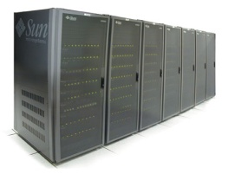
Hardware
2001
2002
Myrinet 2000
P IV Xeon 2.2GHz
(68 CPUs)
PIII 1GHz
(60 CPUs)
ONR DURIP 2002: N000140210557
ONR DURIP 2001: N000140110552

Slide 12
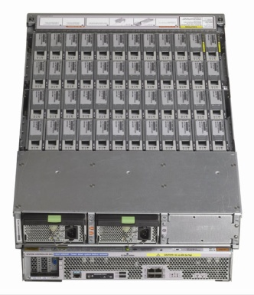
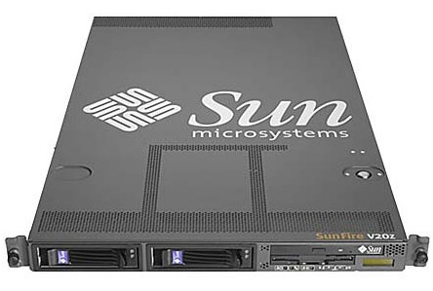
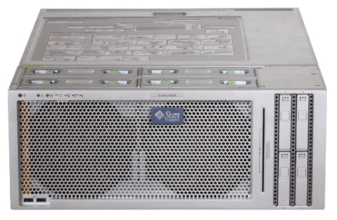
Hardware
2007
2008
Sun 4600s and 4500s
16 core boxes with 200GB of RAM
connected by Infiniband
And several 24TB disk arrays
Sun v20z Opteron
(60 CPUs)
ONR DURIP 2007:
ONR DURIP 2008:

Slide 13
Code Optimization & Revisions
Rewrote the input parser
Worked on code base
  sevenfold sequential speedup over the version 3 code
  added new features while shrinking our code base by more than 25%.
Added More Biological Parameters.
35,000 cells and approximately 6.1 million synapses using 72% of the available 4GB of memory per node.

Slide 14
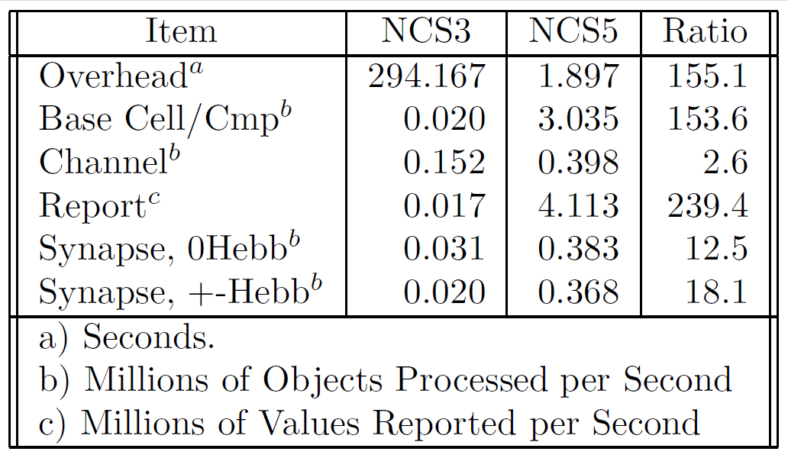
Code Optimization

Slide 15
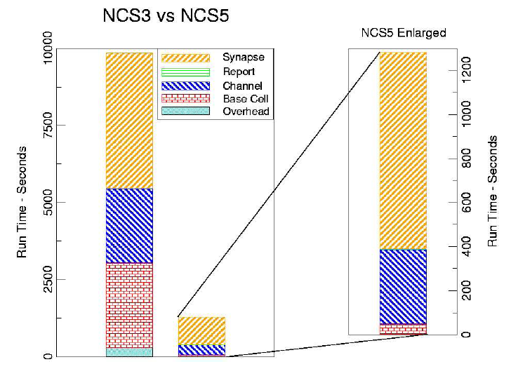
Code Optimization
James Frye, James G. King, Christine J. Wilson, and Frederick C. Harris, Jr. “QQ: Nanoscale timing and profiling” In Proceedings of PMEO-PDS, Denver, CO, April 3-8 2005.

Slide 16



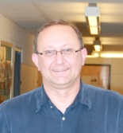
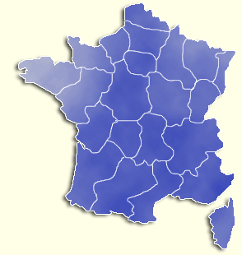


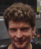


UNR Brain Computation Lab
Brain Computation Laboratory
University of Nevada, Reno
in funded collaboration with
CNRS, Paris, France
Brain Mind Institute, EPFL, Lausanne, Switzerland
  Fred Harris, Jr. Monica Nicolescu Phil Goodman Quan Zou Sergiu Dascalu
  Director
  René Doursat
  Henry Markram
  Jim King
ONR N000140710018: “Large-Scale Biologically Realistic Models of Cortical & Subcortical Dynamics with Social Robotic Applications”
DURIP N000140510525: “Robotic Platform for Security and Service Applications”
DURIP N000140710704: “Parallel Robotic Brains”

Slide 17
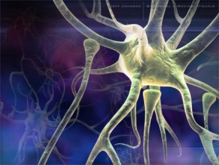
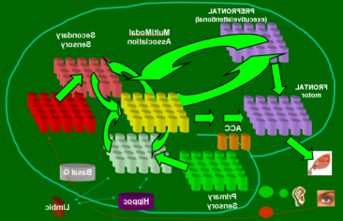

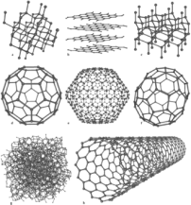

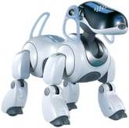
Present Scope of Work
Goals
Neuroscience
Modeling &
Neural Engineering
Robotic/Human Loops

Slide 18
Comparison with other Simulators
Romain Brette, Michelle Rudolph, Ted Carnevale, Michael Hines, David Beeman, James M. Bower, Markus Diesmann, Abigail Morrison, Philip H. Goodman, Frederick C. Harris, Jr., Milind Zirpe, Thomas Natschlager, Dejan Pecevski, Bard Ermentrout, Mikael Djurfeldt, Anders Lansner, Olivier Rochel, Thierry Vieville, Eilif Muller, Andrew P. Davison, Sami El Boustani and Alain Destexhe “Simulation of networks of spiking neurons: A review of tools and strategies" Journal of Computational Neuroscience December 2007 (Vol 23), pp 349-398.

Slide 19
Today’s Outline
First Hour
  Introduction
  How to run on a Single Machine
  Back End Code
  Input Language
Second Hour
  Individual Parameters – presentations and lots of simulation runs
Third Hour
  How to run on multiple machines
  Software Tools
  Completed Loop
  Larger Models
  Future Directions
  Summary

Slide 20
Sample Run

Slide 21
Back End Code
Equations and Implementations
Common Topics (lookup Tables, default values)
IAF
Izhikevich
Channels
Learning

Slide 22
Input Language

Slide 23
Break Time

Slide 24
Today’s Outline
First Hour
  Introduction
  How to run on a Single Machine
  Back End Code
  Input Language
Second Hour
  Individual Parameters – presentations and lots of simulation runs
Third Hour
  How to run on multiple machines
  Software Tools
  Completed Loop
  Larger Models
  Future Directions
  Summary

Slide 25
Individual Parameters

Slide 26
Break Time

Slide 27
Today’s Outline
First Hour
  Introduction
  How to run on a Single Machine
  Back End Code
  Input Language
Second Hour
  Individual Parameters – presentations and lots of simulation runs
Third Hour
  How to run on multiple machines
  Software Tools
  Completed Loop
  Larger Models
  Future Directions
  Summary

Slide 28
Running on Multiple Machines

Slide 29
Software Tools

Slide 30
Completed Loop

Slide 31
Larger Models

Slide 32
Future Directions

Slide 33
Summary

