Slide 1


Real-Time Simulation of Large-Scale Neural Models using NCS
Laurence C. Jayet Bray
Roger V. Hoang
Emily R. Barker
Frederick C. Harris, Jr.
Organization for Computational Neurosciences
2012
Saturday, July 21
UNR Brain Computation Lab

Slide 2
Today’s Outline
First Hour
  Introduction
  Equations and Implementation
  Requirements and Simulation on a Single Machine
  Input Language
Second Hour
  Simple Model
  Parameters Presentation and Testing
  Output Analysis
Third Hour
  Simulation on Multiple Machines
  Software Tools
  Robotic System Configuration
  Larger Networks and Complete Loop Execution
  Future Directions and Summary

Slide 3
Today’s Outline
First Hour
  Introduction
  Equations and Implementation
  Requirements and Simulation on a Single Machine
  Input Language
Second Hour
  Simple Model
  Parameters Presentation and Testing
  Output Analysis
Third Hour
  Simulation on Multiple Machines
  Software Tools
  Robotic System Configuration
  Larger Networks and Complete Loop Execution
  Future Directions and Summary

Slide 4
Introduction

Slide 5
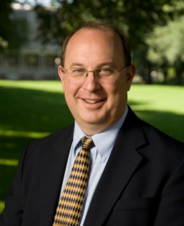
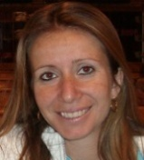


Presenters
Fred Harris
  Professor – Department of Computer Science and Engineering
    Ph.D. in Computer Science
Laurence Bray
  Post Doctoral Research Associate,
    Soon to be promoted to Research Assistant Professor
    Ph.D. in Biomedical Engineering
Roger Hoang
  Ph.D. Candidate
    Planning to graduate this coming school year
    Majoring in Computer Science
Emily Barker
  B.S. Student
    Starting her Senior year this fall
    Majoring in Neuroscience

Slide 6


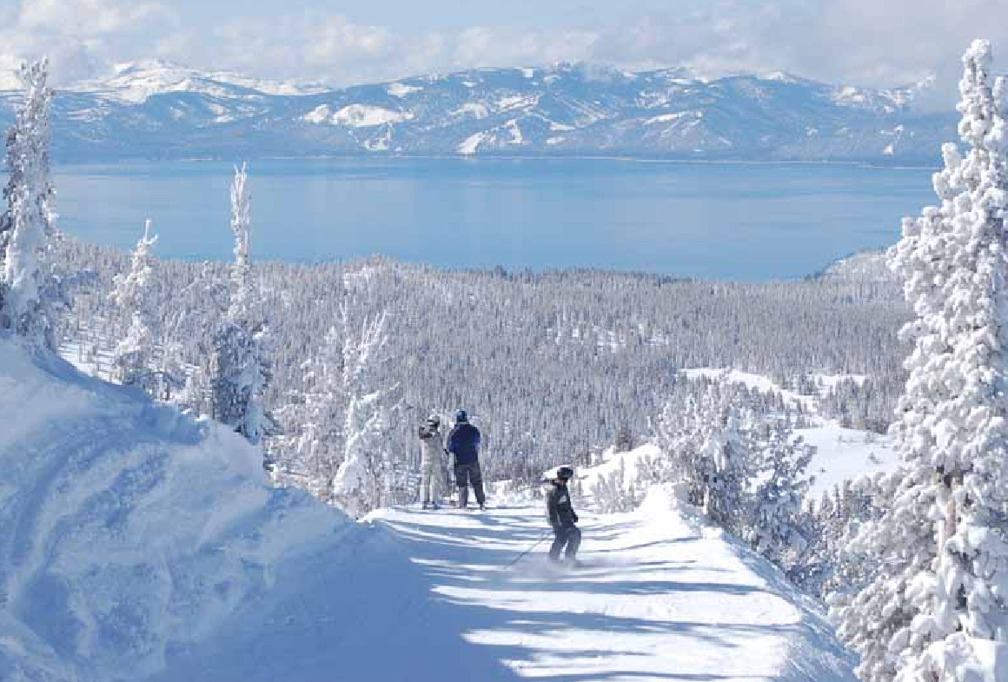
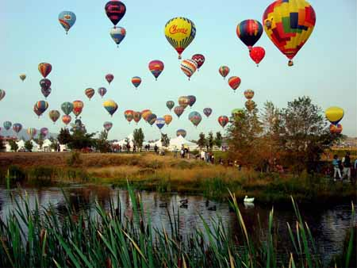
Reno, Nevada

Slide 7
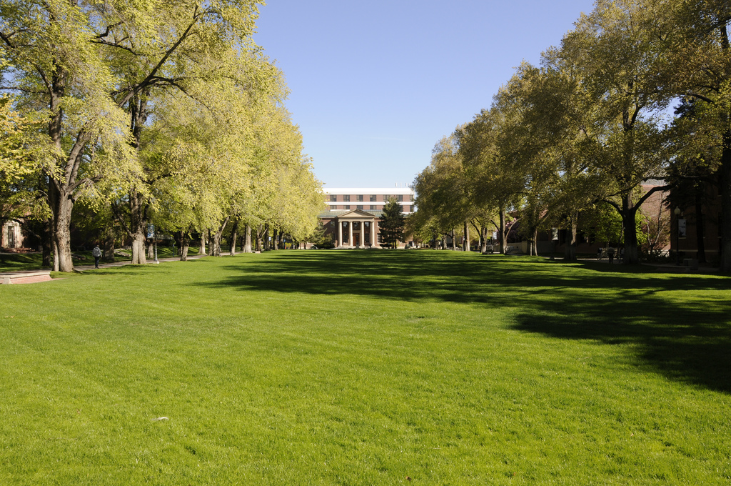
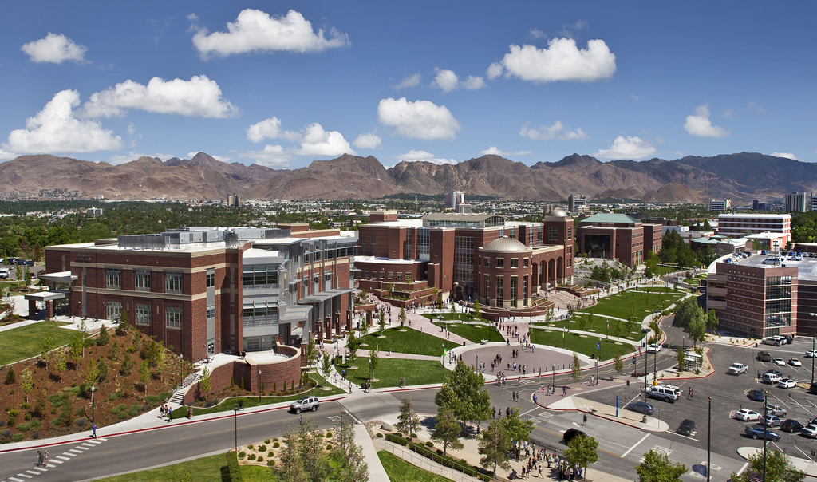
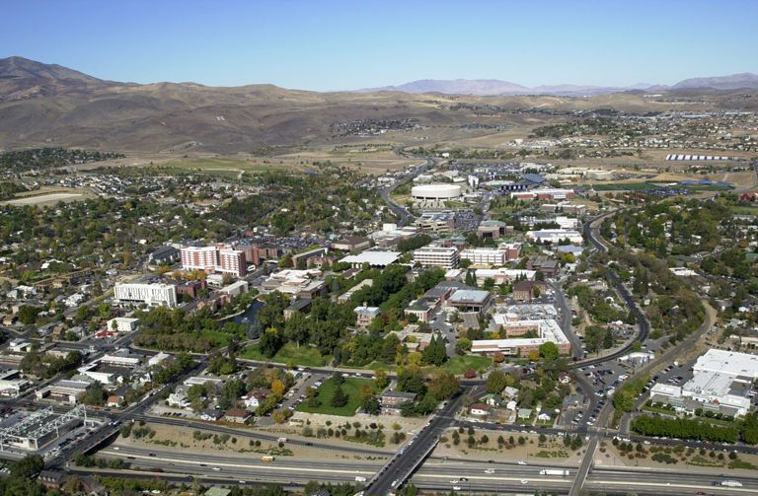

University of Nevada, Reno

Slide 8
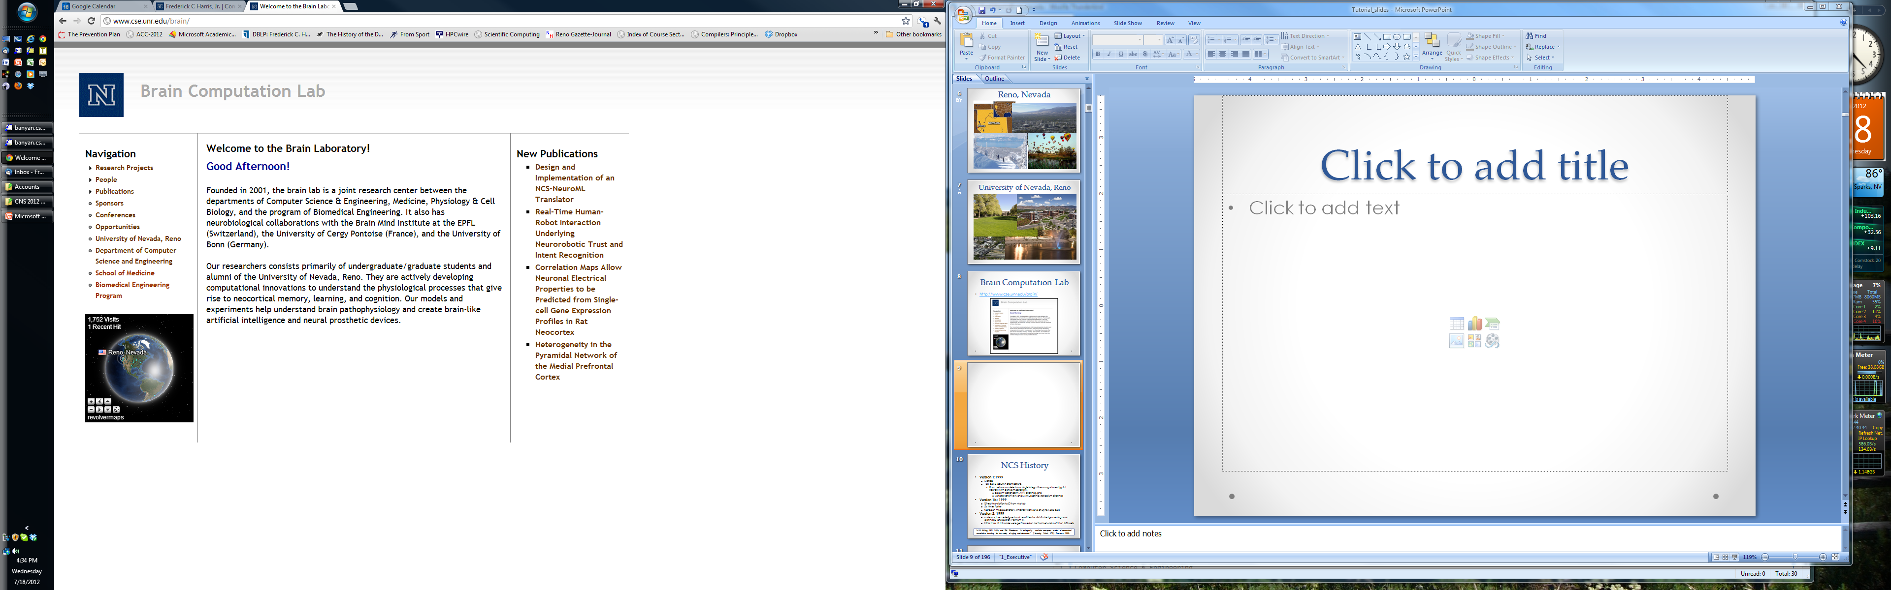
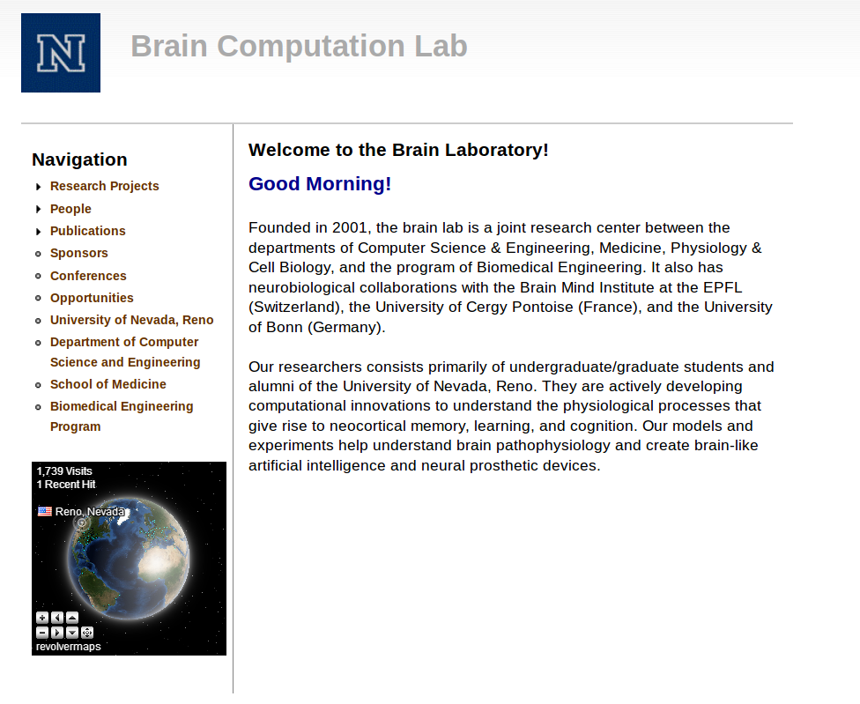
Brain Computation Lab
http://www.cse.unr.edu/brain/

Slide 9
NCS History
Version 1:1999
  Matlab – Goodman, Markram, and McKenna
  160-cell, 2-column architecture
    Each cell was modeled as a single integrative compartment (point neuron) with a spike mechanism,
      calcium-dependent (AHP) channels, and
      voltage-sensitive A and M (muscarinic) potassium channels
Version 1b: 1999
  Direct translation to C from Matlab
  24 times faster.
  tested on mixed excitatory-inhibitory networks of up to 1,000 cells
Version 2: 1999
  code was then redesigned and rewritten for distributed processing on an existing 20-cpu cluster (Pentium II).
  Initial trials of this code were performed on cortical networks of 2 to 1,000 cells
  M.M. Kellog, H.R. Wills, and P.H. Goodman. “A biologically realistic computer model of neocortical associative learning for the study of aging and dementia.” J. Investig. Med., 47(2), February 1999.

Slide 10
NCS History
Version 3: 2001
  completely redesigned using object-oriented design principles and recoded in C++
  objects, such as cells, compartments, channels, and the like, model the corresponding cortical entities.
  The cells, in turn, communicate via messages passed through synapse objects.
  Input parameters allow the user to create many variations of the basic objects, in order to model measured or hypothesized biological properties.
  E. Courtenay Wilson, Phillip H. Goodman, and Frederick C. Harris, Jr. “Implementation of a biologically realistic parallel neocortical-neural network simulator” in Proceedings of the 10th SIAM Conf. on Parallel Process. for Sci. Computing, Portsmouth, Virginia, March 2001.

Slide 11
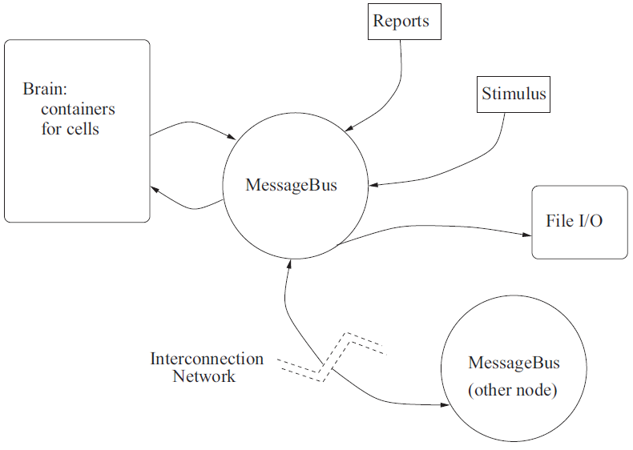
NCS History
E. Courtenay Wilson, Frederick C. Harris, Jr., and Phillip H. Goodman. “A large-scale biologically realistic cortical simulator” in Proceedings of SC 2001, Denver, Colorado, November 2001

Slide 12
Code Optimization & Revisions
Rewrote the input parser
Worked on code base
  sevenfold sequential speedup over the version 3 code
  added new features while shrinking our code base by more than 25%.
Added More Biological Parameters.
35,000 cells and approximately 6.1 million synapses using 72% of the available 4GB of memory per node.

Slide 13
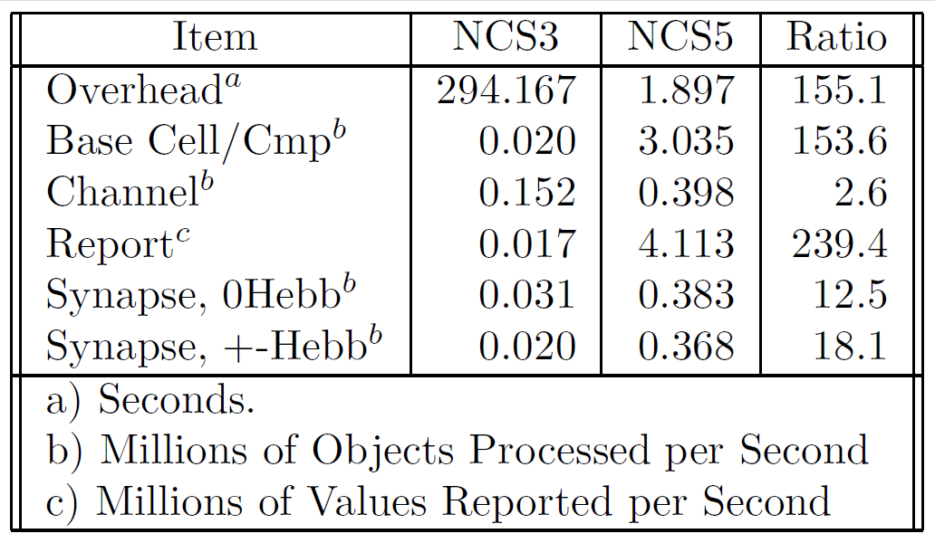
Code Optimization

Slide 14
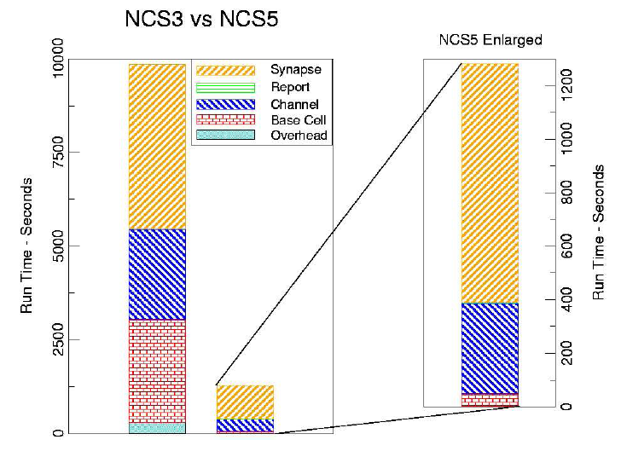
Code Optimization
James Frye, James G. King, Christine J. Wilson, and Frederick C. Harris, Jr. “QQ: Nanoscale timing and profiling” In Proceedings of PMEO-PDS, Denver, CO, April 3-8 2005.

Slide 15
Hardware
2001
2002
Myrinet 2000
P IV Xeon 2.2GHz
(68 CPUs)
PIII 1GHz
(60 CPUs)
ONR DURIP 2002: N000140210557
ONR DURIP 2001: N000140110552

Slide 16
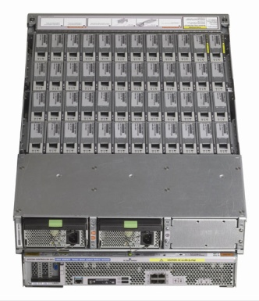
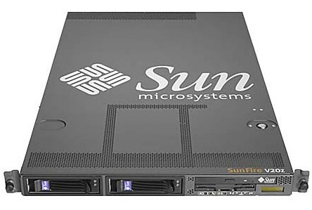
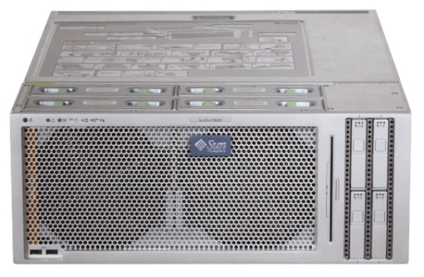
Hardware
2007
2008
Sun 4600s and 4500s
16 core boxes with 200GB of RAM
connected by Infiniband
And several 24TB disk arrays
Sun v20z Opteron
(60 CPUs)
ONR DURIP 2007:
ONR DURIP 2008:

Slide 17
Current NCS version 6
GPU/CPU/cluster-based
Multiple neuron types (version 5 + izhikevich + framework for others)
Ability for multi-scale modeling
C. M. Thibeault, R. V. Hoang, and F. C. Harris, Jr. A novel multi-GPU neural simulator. In Proc. of the 3rd Conference on Bioinformatics and Computational Biology (BICoB). New Orleans, LA, March 2011.

Slide 18
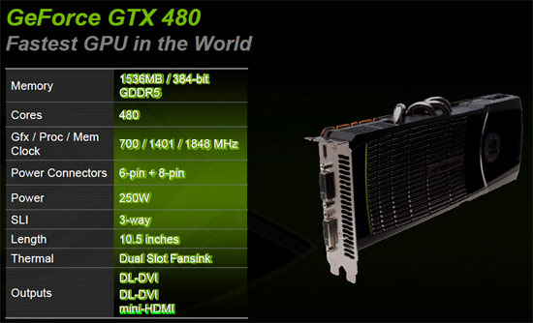
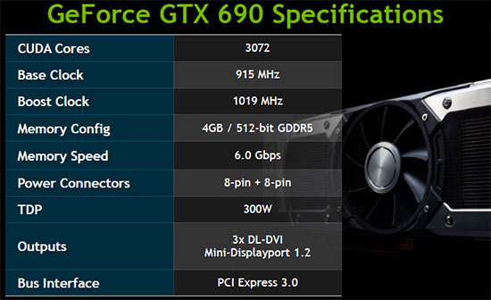
Current Hardware

Slide 19
Current Optimization
C++11
Heavily threaded
  Latency hiding
  Increased occupancy
Modular message passing design
GPU usage for parallel computation
Load-balancing across heterogeneous clusters

Slide 20
Current Optimization
Cell Count | Synapse Count | NCS5 Simulation Time (Sec) | NCS6 Simulation Time (Sec)
~1,000 | ~2700 | 3.3 | <1
~10,000 | ~250,000 | 4.4 | <1
~100,000 | ~25,000,000 | 99.0 | 1.1

Slide 21
Comparison with other Simulators
Advantages:
  No programing language experience
  Large-scale networks simulation
  Real-time Execution
  Good for behavior, systems, and networks
  Framework for different level of abstraction
Disadvantages
  Lack of cellular and subcellular details
  No anatomical visualization yet
Romain Brette, Michelle Rudolph, Ted Carnevale, Michael Hines, David Beeman, James M. Bower, Markus Diesmann, Abigail Morrison, Philip H. Goodman, Frederick C. Harris, Jr., Milind Zirpe, Thomas Natschlager, Dejan Pecevski, Bard Ermentrout, Mikael Djurfeldt, Anders Lansner, Olivier Rochel, Thierry Vieville, Eilif Muller, Andrew P. Davison, Sami El Boustani and Alain Destexhe “Simulation of networks of spiking neurons: A review of tools and strategies" Journal of Computational Neuroscience December 2007 (Vol 23), pp 349-398.

Slide 22
Equations and Implementation

Slide 23
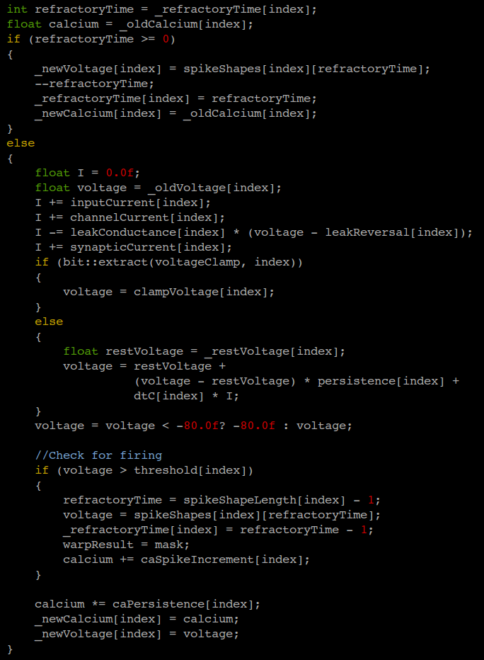
Compartments

Slide 24
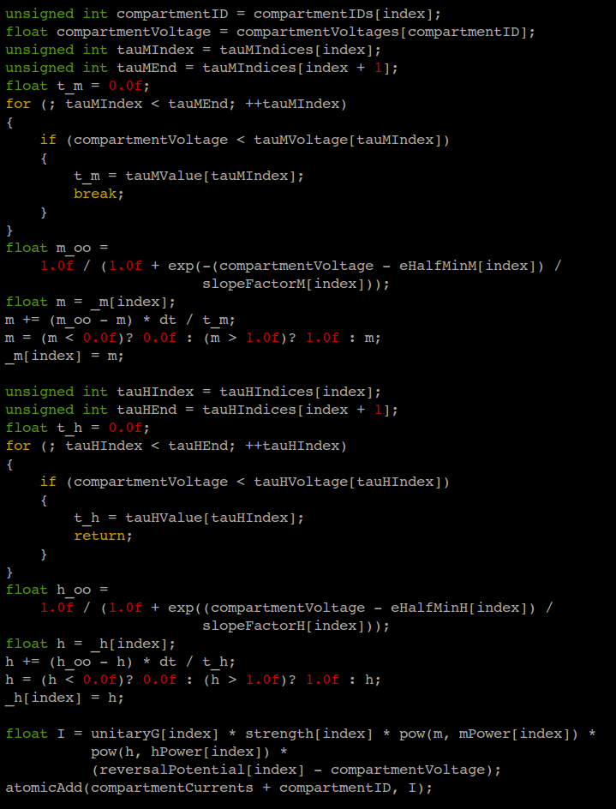
Ka Channels

Slide 25
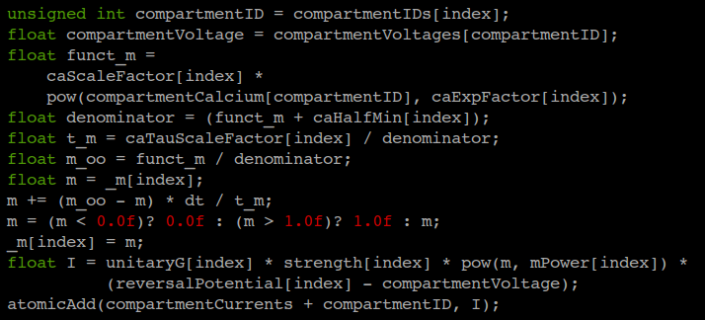
Kahp Channels

Slide 26
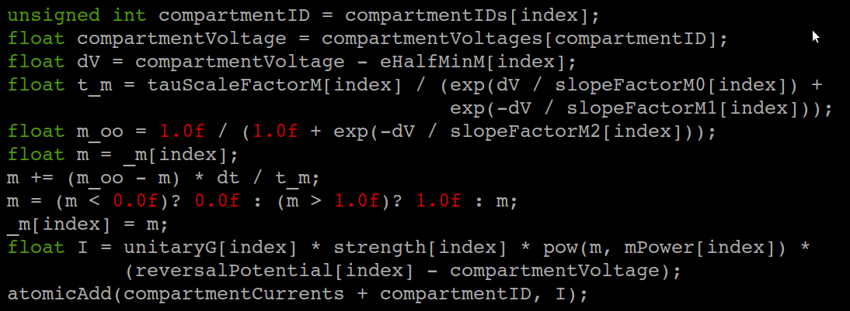
Km Channels

Slide 27
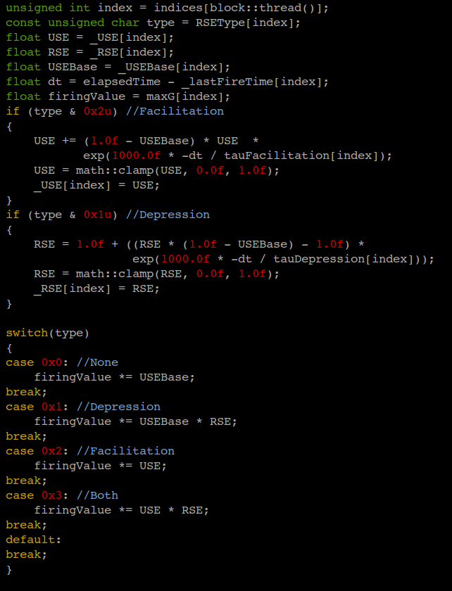
Short-Term Learning

Slide 28
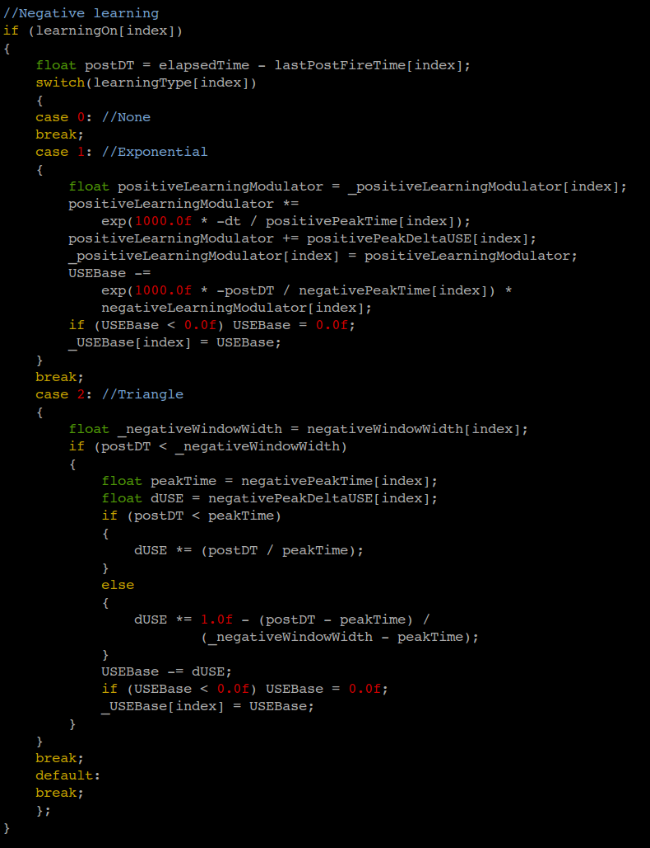
Long-Term Negative Learning

Slide 29
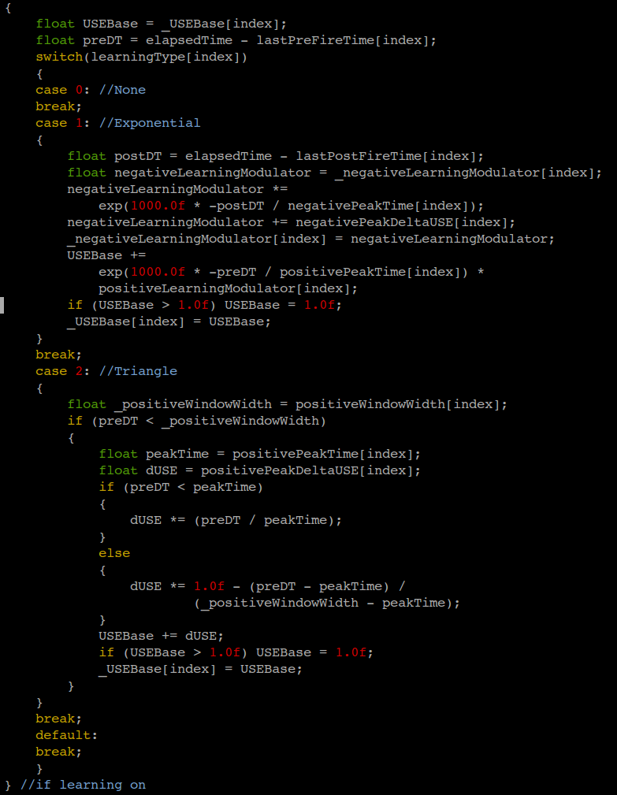
Long-Term Positive
Learning

Slide 30
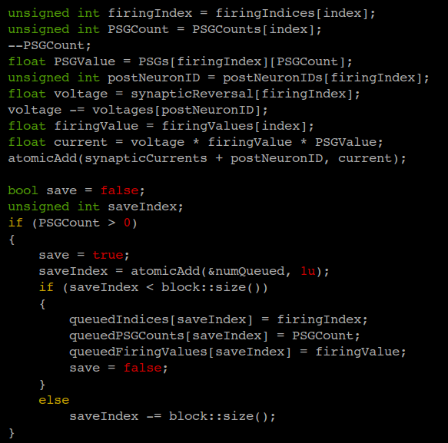
Post Synaptic Conductance

Slide 31
NCS 6 Implementation
Plugin interface for multiple model support
  Currently have:
    NCS 5 LIF Neurons
    Izhikevich Neurons
  ability to design your own
  Have a student working on a Neuron CPU plugin.
Runs on CPUs, CUDA devices, and OpenCL devices simultaneously

Slide 32
Requirements

Slide 33
NCS5 Software / Hardware
Linux based operating system

Slide 34
NCS6 Software / Hardware
Linux based operating system
NVIDIA GPUs

Slide 35
NCS5- Packages Needed
bison : sudo apt-get install bison
flex : sudo apt-get install flex
mpi-run : sudo apt-get install openmpi-bin : sudo apt-get install openmpi-dev

Slide 36
NCS6- Packages Needed
bison : sudo apt-get install bison
cmake : sudo apt-get install cmake
cuda toolkit : http://developer.nvidia.com/
      cd /home/userName/Downloads
      sh <cuda_toolkit_installer_name>
doxygen : sudo apt-get install doxygen
flex : sudo apt-get install flex
g++ version 4.4 : sudo apt-get install g++-4.4
g++ version 4.6+
mercurial : sudo apt-get install mercurial
mpi-run : sudo apt-get install openmpi-bin : sudo apt-get install openmpi-dev

Slide 37
Simulation on a single machine

Slide 38
NCS5 Steps
To compile code:
  Make
After the code is compiled, you run NCS5 in the directory with the input file
To run code:
  ncs5pe <input file>

Slide 39
NCS6 Steps
cd /home/userName/NCS6/NCS6/build
To specify the number of devices available on the computer for the program (Only do this step once)
  mpirun applications/clusterSpecifier/clusterSpecifier single.cluster
  applications/clusterInfo/clusterInfo single.cluster
To compile code:
  applications/ncsDistributor/ncsDistributor <space> ../files/NCS6/folderName/fileName single.cluster ncsout
To run code:
  applications/simulator/simulator/ ncsout

Slide 40
DEMO

Slide 41
Input Language

Slide 42
Brain
Define the simulation as a whole
Preliminary outline of other structures
  Anatomy
  Stimuli
  Reports
Extrinsic connections / synapses
Include files

Slide 43
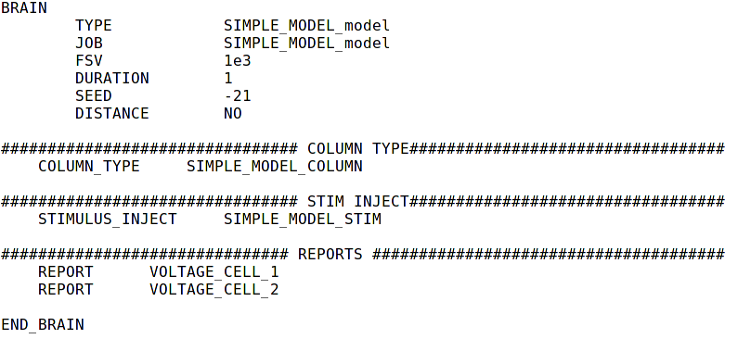
Brain

Slide 44
Anatomy
Columns
Layers
Cells
Compartments
Channels

Slide 45
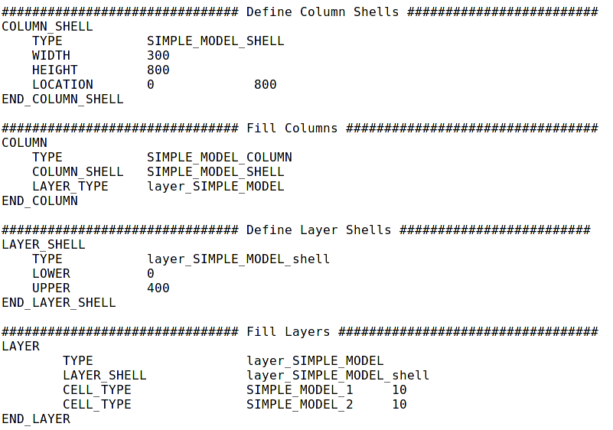
Anatomy

Slide 46
Stimulus
External stimulation (visual, audio…)
Type of signals
  Linear
  Pulse
  Noise
  File-based
Multiple times
Different destinations

Slide 47
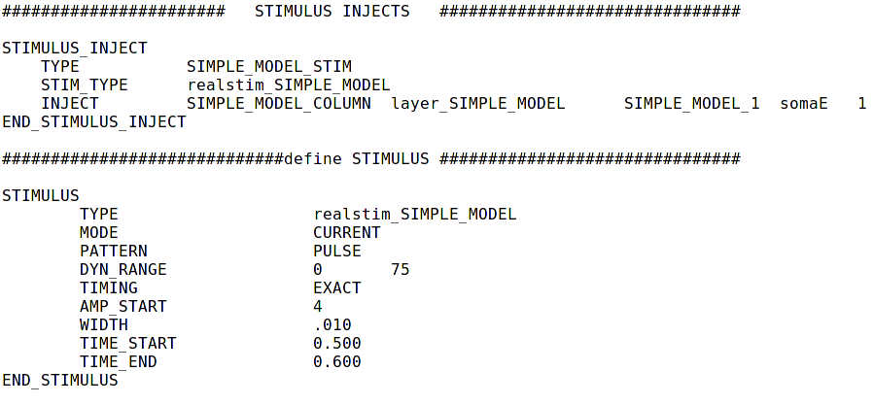
Stimulus

Slide 48
Connections
Extrinsic and intrinsic connections
Synapse connections
From the source to the destination
With or without decaying distance effects
Recurrent connections

Slide 49
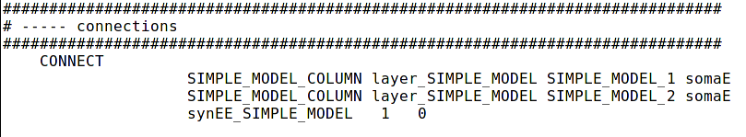
Connections

Slide 50
Synapses
Connections between other cells and their compartments
Excitatory
Inhibitory
Synaptic Waveform
Learning
  Short term synaptic dynamics
    Facilitation
    Depression
  Long term synaptic dynamics (Hebbian Learning)
    STDP rule

Slide 51
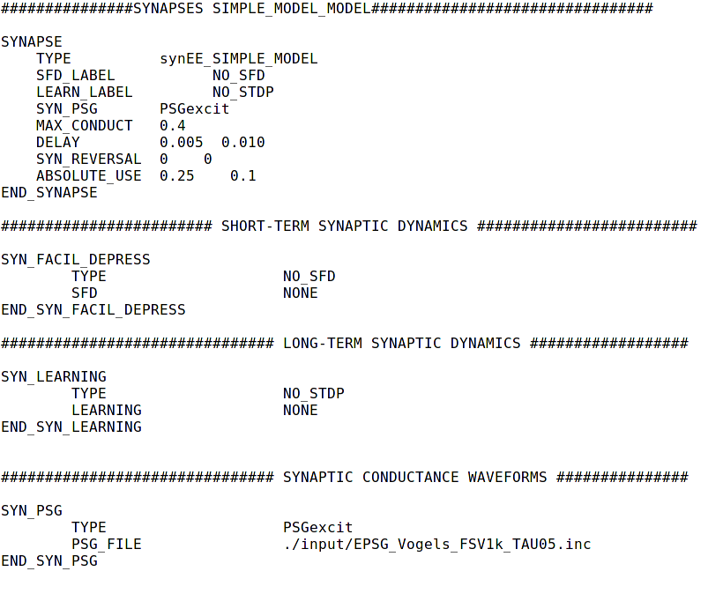
Synapses

Slide 52
Reports
Data about cells
Report files:
  Voltage
  Current
  Firecount
  Channel
  Synaptic strengths
Automatically generated and saved

Slide 53
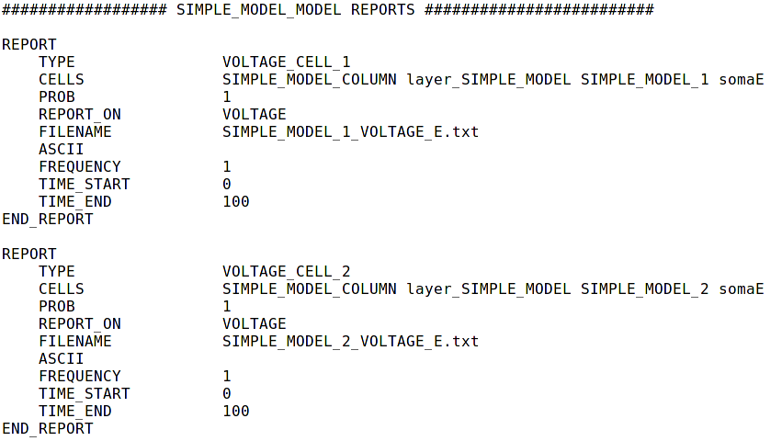
Reports

Slide 54
DEMO

Slide 55
Break

Slide 56
Today’s Outline
First Hour
  Introduction
  Equations and Implementation
  Requirements and Simulation on a Single Machine
  Input Language
Second Hour
  Simple Model
  Parameters Presentation and Testing
  Output Analysis
Third Hour
  Simulation on Multiple Machines
  Software Tools
  Robotic System Configuration
  Larger Networks and Complete Loop Execution
  Future Directions and Summary

Slide 57
Simple Model

Slide 58
Architecture
Column
Compartment
Layer
Stimulus
Group Cell 1
Group Cell 2

Slide 59
Brain

Slide 60
Brain

Slide 61
Brain

Slide 62
Brain

Slide 63
Brain

Slide 64
Brain

Slide 65
Brain

Slide 66
Brain

Slide 67
Brain

Slide 68
Brain

Slide 69
Anatomy

Slide 70
Anatomy

Slide 71
Anatomy

Slide 72
Anatomy

Slide 73
Anatomy

Slide 74
Anatomy

Slide 75
Anatomy

Slide 76
Anatomy

Slide 77
Anatomy

Slide 78
Anatomy

Slide 79
Anatomy

Slide 80
Anatomy

Slide 81
Anatomy

Slide 82
Anatomy

Slide 83
Anatomy

Slide 84
Anatomy

Slide 85
Anatomy

Slide 86
Anatomy

Slide 87
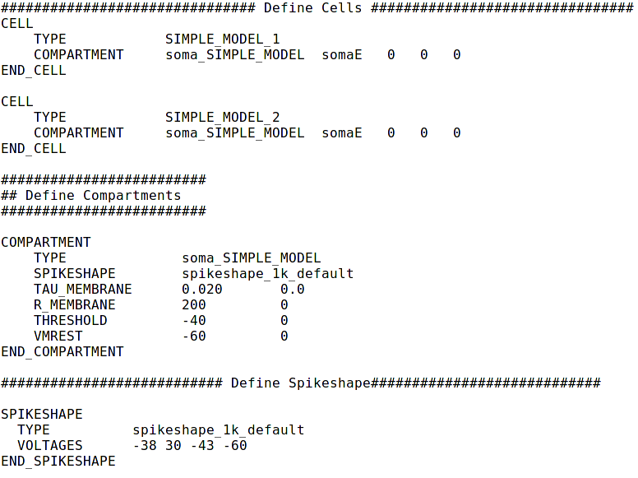
Anatomy

Slide 88
Anatomy

Slide 89
Anatomy

Slide 90
Anatomy

Slide 91
Anatomy

Slide 92
Anatomy

Slide 93
Anatomy

Slide 94
Anatomy

Slide 95
Anatomy

Slide 96
Anatomy

Slide 97
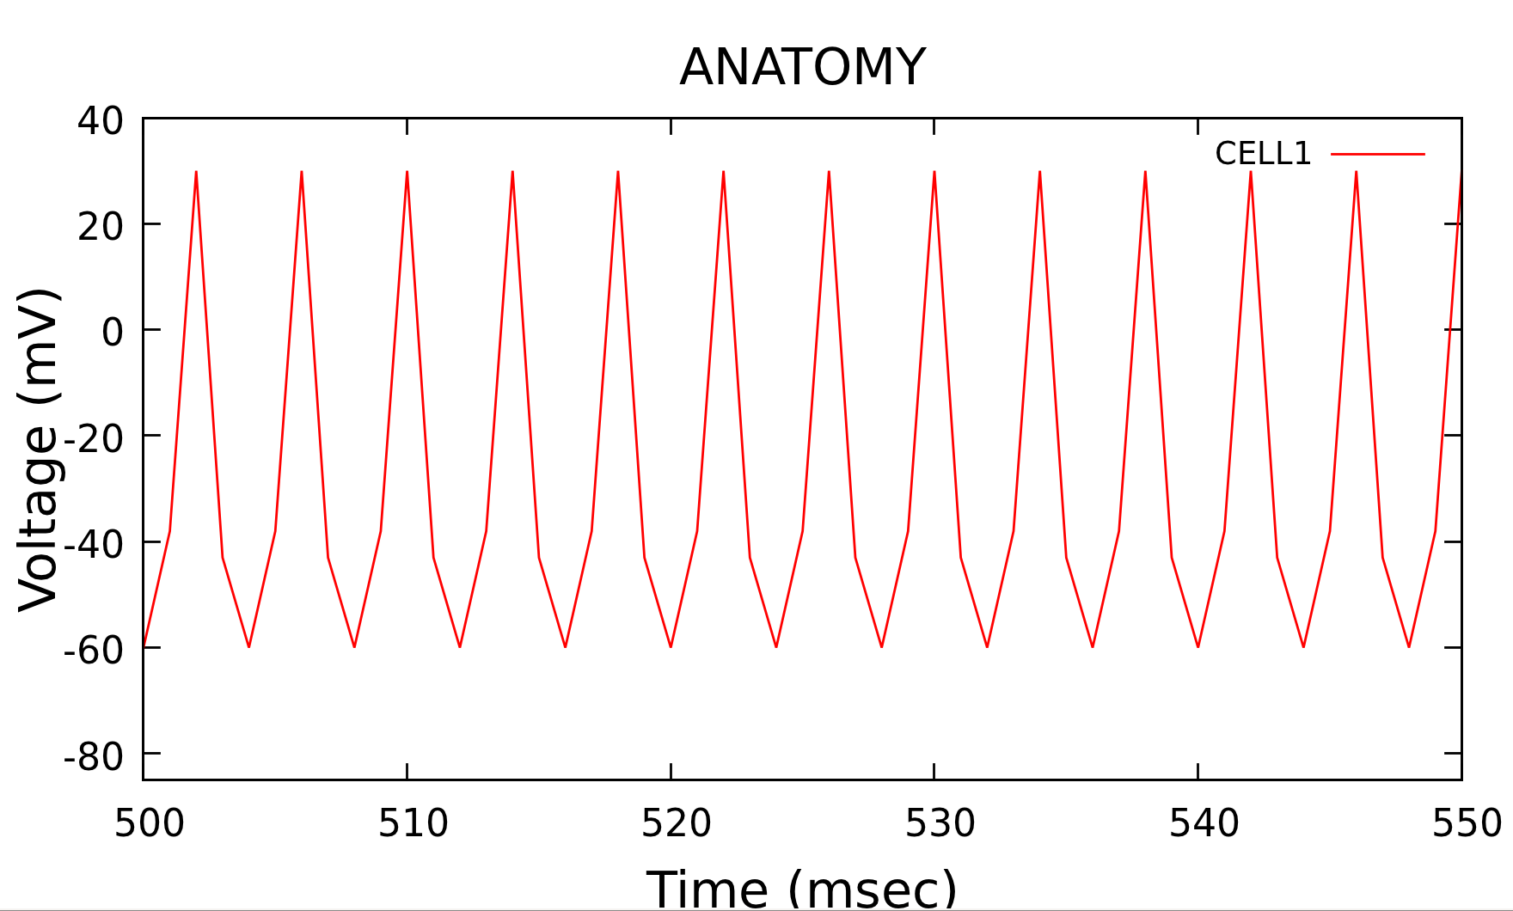
Spike shape

Slide 98
Anatomy

Slide 99
Anatomy

Slide 100
Anatomy

Slide 101
Anatomy

Slide 102
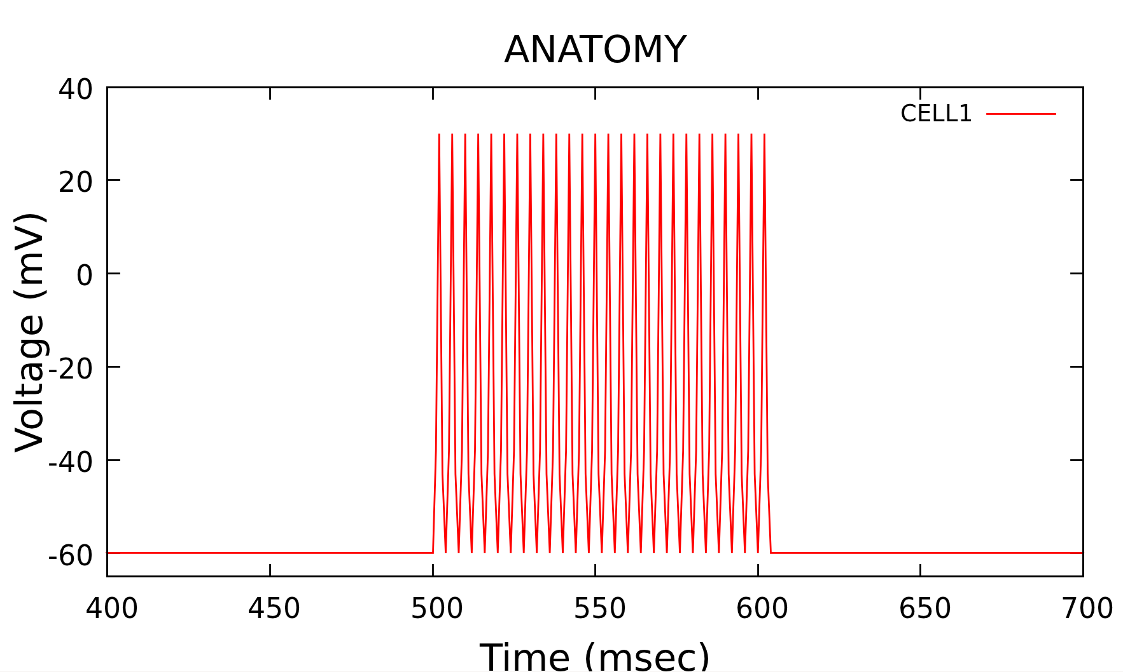
Membrane Potential

Slide 103
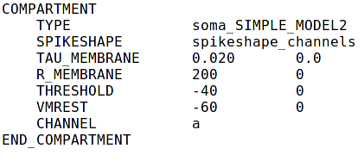
Channel a

Slide 104
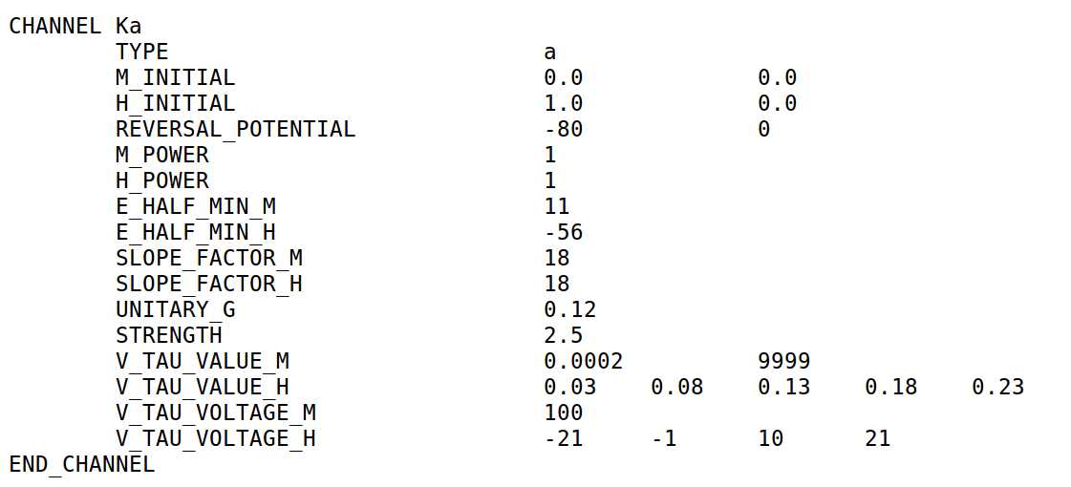
Channel a

Slide 105
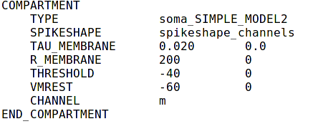
Channel m

Slide 106
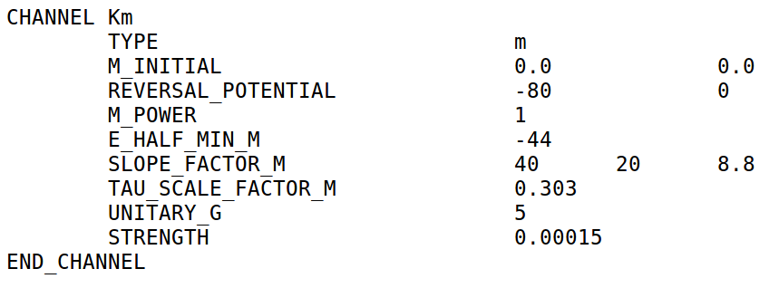
Channel m

Slide 107
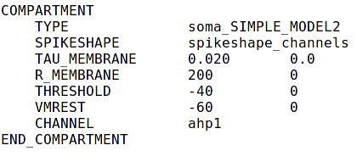
Channel ahp

Slide 108
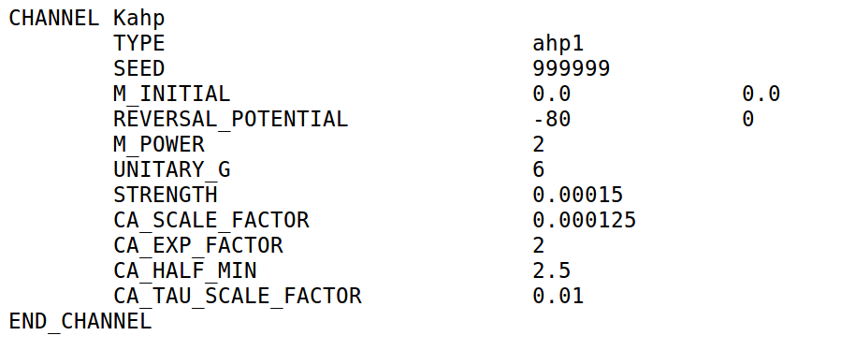
Channel ahp

Slide 109
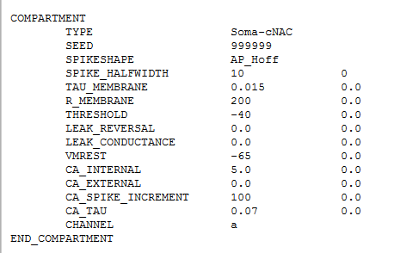
Anatomy

Slide 110
Anatomy

Slide 111
Anatomy

Slide 112
Anatomy

Slide 113
Anatomy

Slide 114
Anatomy

Slide 115
Stimulus

Slide 116
Stimulus

Slide 117
Stimulus

Slide 118
Stimulus

Slide 119
Stimulus

Slide 120
Stimulus

Slide 121
Stimulus

Slide 122
Stimulus

Slide 123
Stimulus

Slide 124
Stimulus

Slide 125
Stimulus

Slide 126
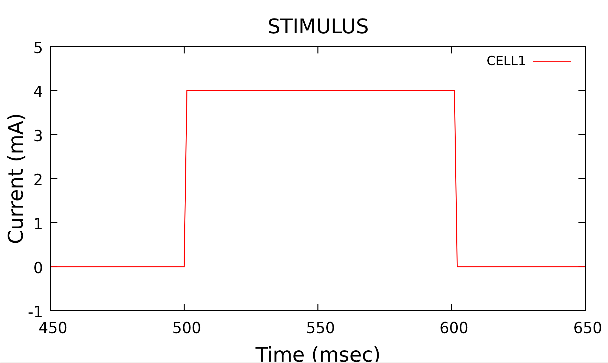
Amplitude

Slide 127
Stimulus

Slide 128
Stimulus

Slide 129
Stimulus

Slide 130
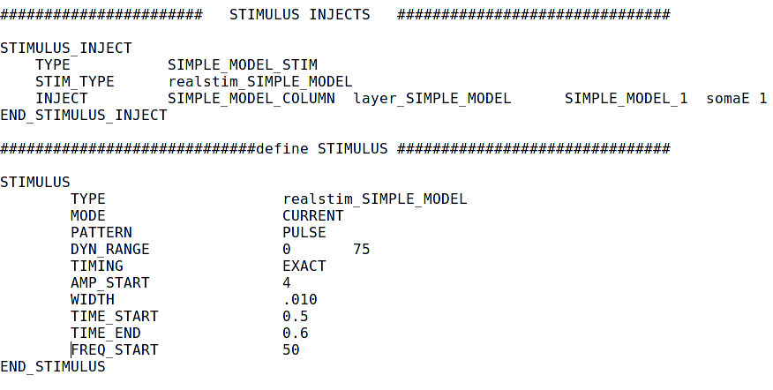
Stimulus

Slide 131
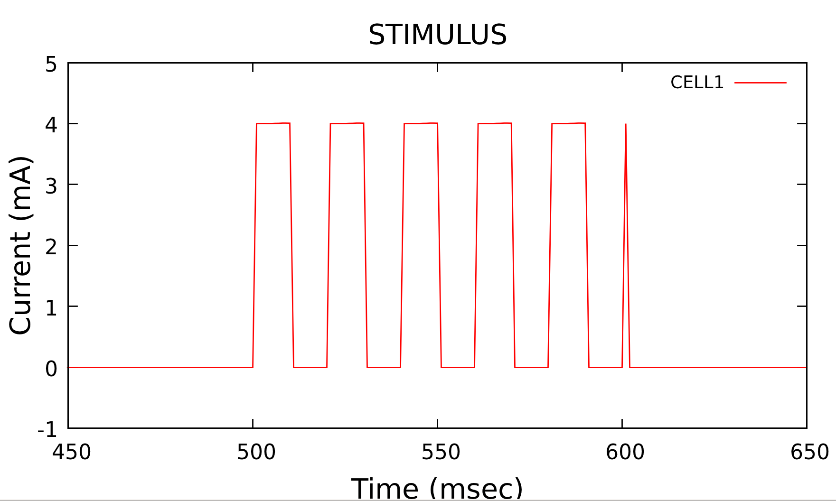
Width / Frequency

Slide 132
Connections

Slide 133
Connections

Slide 134
Connections

Slide 135
Connections

Slide 136
Connections

Slide 137
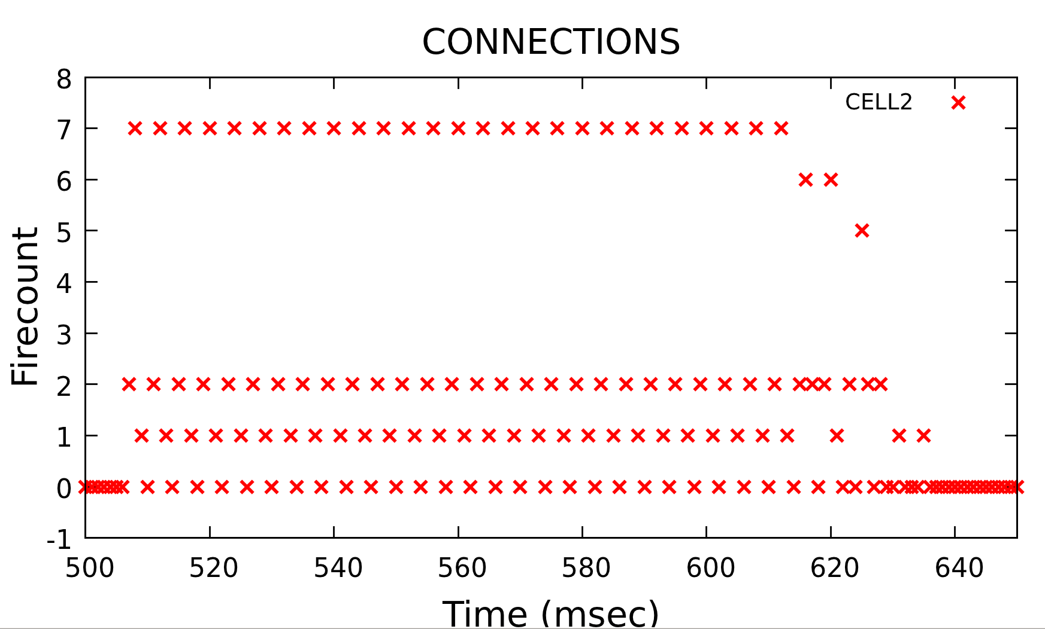
Probability of Connections

Slide 138
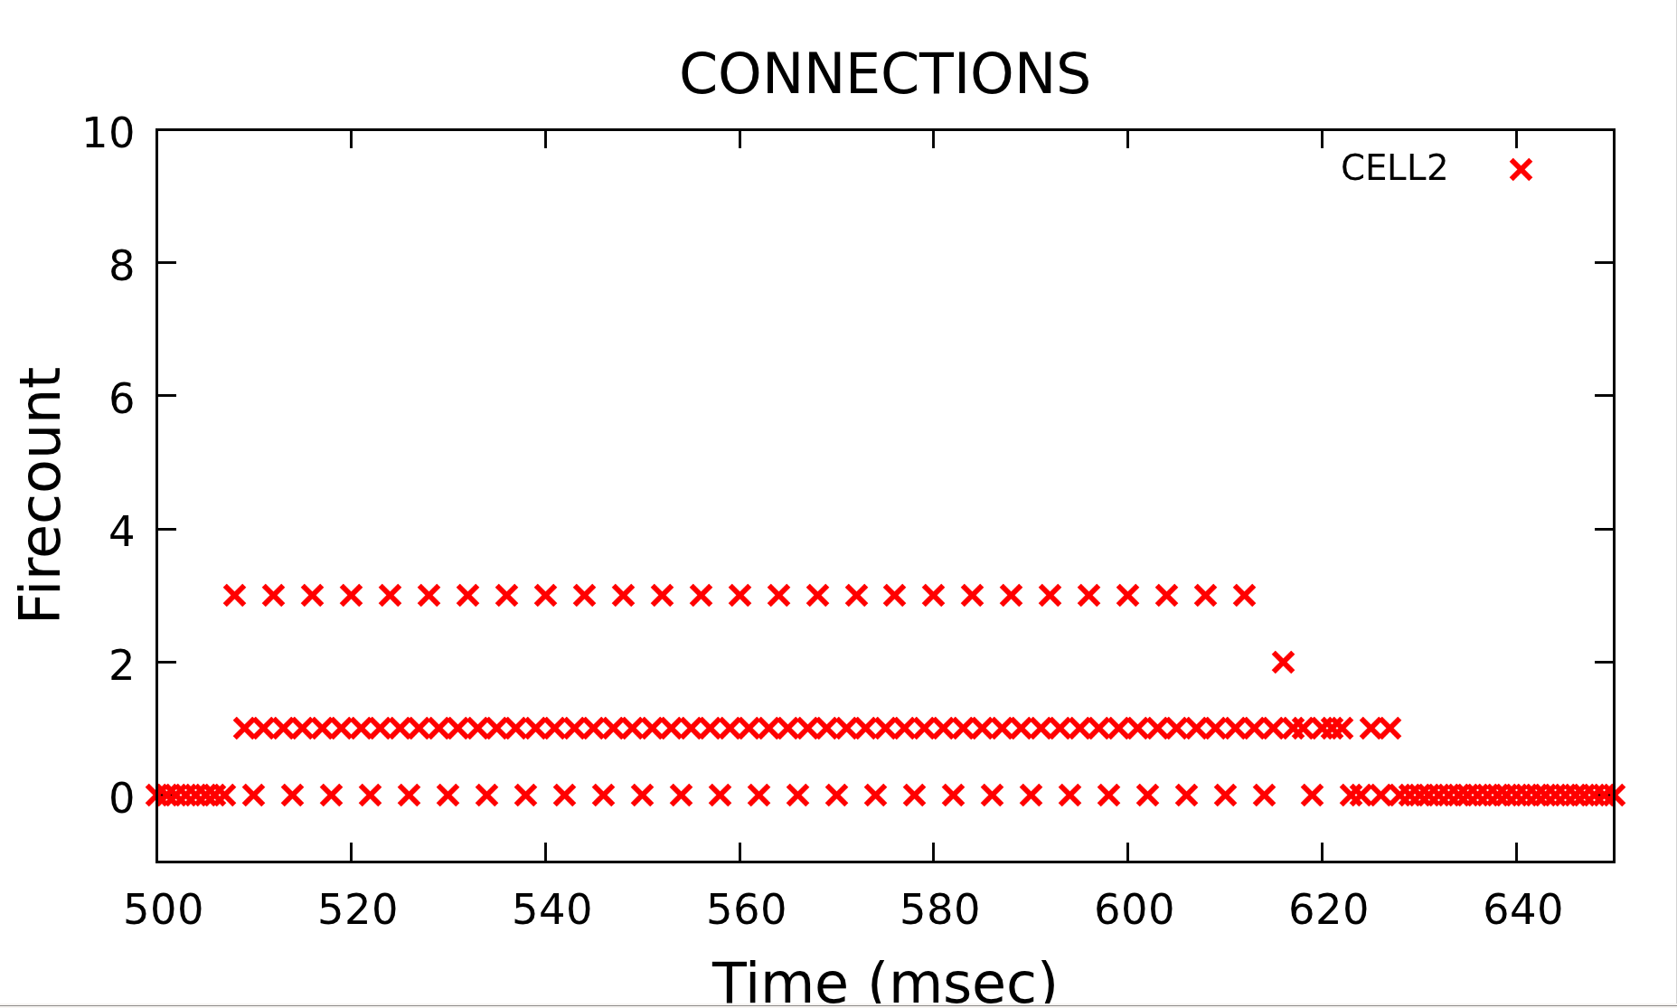
Probability of Connections

Slide 139
Synapses

Slide 140
Synapses

Slide 141
Synapses

Slide 142
Synapses

Slide 143
Synapses

Slide 144
Synapses

Slide 145
Synapses

Slide 146
Synapses

Slide 147
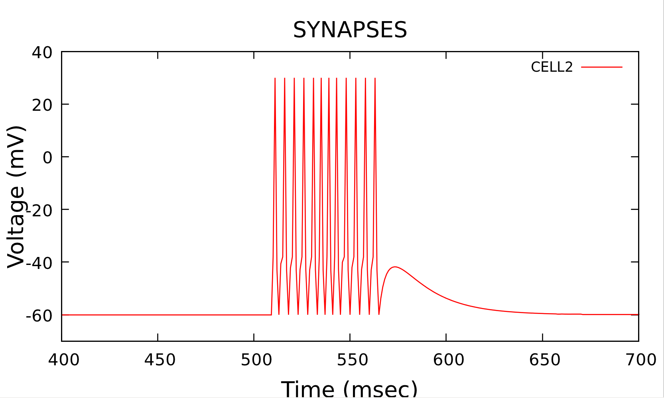
Conductance Strength

Slide 148
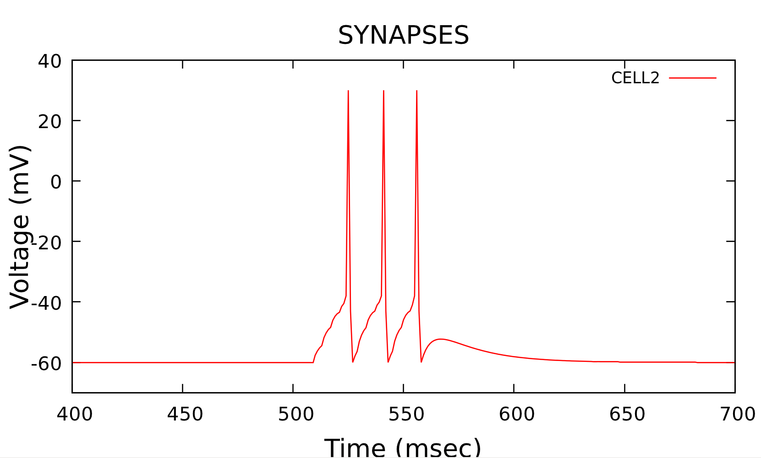
Conductance Strength

Slide 149
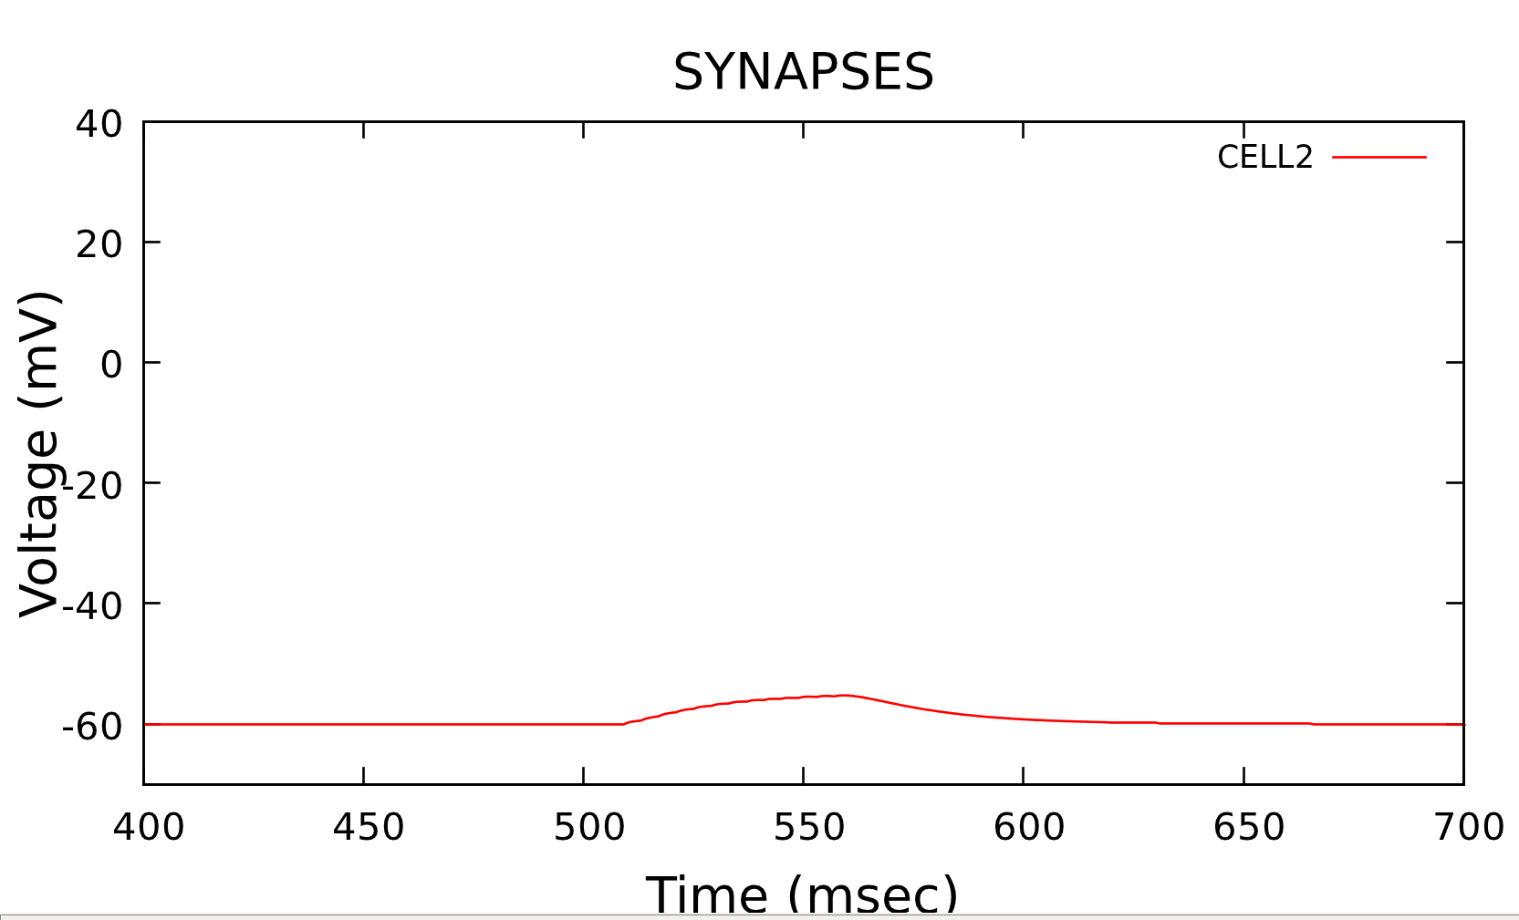
Conductance Strength

Slide 150
Synapses

Slide 151
Synapses

Slide 152
Synapses

Slide 153
Learning

Slide 154
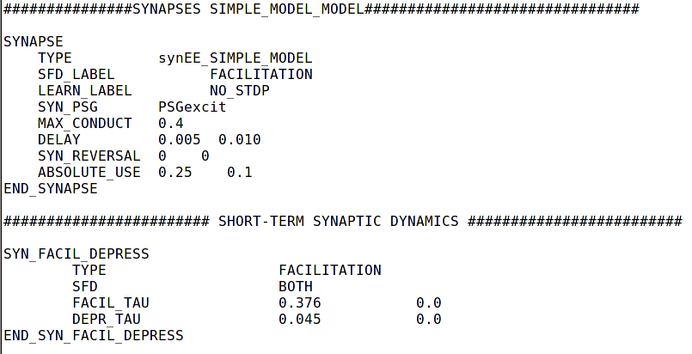
Learning

Slide 155
Learning

Slide 156
Learning

Slide 157
Learning

Slide 158
Learning

Slide 159
Learning

Slide 160
Learning

Slide 161

Learning

Slide 162
Learning

Slide 163
Learning

Slide 164
Learning

Slide 165
Learning

Slide 166
Learning

Slide 167
Learning

Slide 168
Learning

Slide 169
Learning

Slide 170
Learning

Slide 171
Learning

Slide 172
Reports

Slide 173
Reports

Slide 174
Reports

Slide 175
Reports

Slide 176
Reports

Slide 177
Reports

Slide 178
Reports

Slide 179
Reports

Slide 180
Reports

Slide 181
Reports

Slide 182
Reports

Slide 183
Reports

Slide 184
Output Analysis

Slide 185
Graphing
Tools:
  Matlab
  GNUplot
Types of plots
  Dot and Line graphs
  Raster plots
  Spectrogram

Slide 186
Types of Plots

Slide 187

Types of Plots

Slide 188

Types of Plots

Slide 189
DEMO

Slide 190
Break

Slide 191
Today’s Outline
First Hour
  Introduction
  Equations and Implementation
  Requirements and Simulation on a Single Machine
  Input Language
Second Hour
  Simple Model
  Parameters Presentation and Testing
  Output Analysis
Third Hour
  Simulation on Multiple Machines
  Software Tools
  Robotic System Configuration
  Larger Networks and Complete Loop Execution
  Future Directions and Summary

Slide 192
CPU
A single unit of execution (Core)
  Often times sold with multiple cores
A single instruction executed once per cycle per core
  i.e. add X and Y
Most of the silicon in the chip devoted to:
  Branch Handling
  Cache and Memory controllers
  Out of order execution
  etc.
Design optimized for general preformance

Slide 193

CPU Layout

Slide 194
GPU
Groupings of 32 simple cores
Single instruction executed 32 times per cycle
  i.e. add Xi Yi
Most of the silicon is devoted to ALUs(Arithmetic Logic Units)
Design optimized for parallelism and floating point math performance

Slide 195

GPU Layout

Slide 196
CPU vs GPU
Access to Memory
  CPU much closer to RAM and other memory
  GPU has onboard memory, but
Programming model
  GPU much more suited to data parallel problems
    typically image processing, graphics, matrix multiplication
    Very array centric
    Avoids pointer manipulation and branching
  CPU much more suited to general computing problems
Raw floating point performance
  CPU - 100 GFLOPS (i7 980 XE)
  GPU - 1300 GFLOPS (GTX 480)
  Both from 2010

Slide 197
MPI
Message Passing Interface
Handles the dirty details of networking
  Endianness
  Managing sockets
  Grouping Nodes
Provides many methods for sending data out
  Single Node to Single Node (Send Receive)
  Single Node to Many Nodes (Scatter)
  Many Nodes to Single Node (Gather)
Designed for use in high performance networks

Slide 198
Simulation on multiple machines

Slide 199
One-Time Step
SSH keys allow password free access to all computers.
  ssh <computerName>
  ssh-keygen -t rsa
  accept default options
  cd ~/.ssh
  cp id_rsa.pub authorized_keys

Slide 200
One-Time Step
cd /home/userName/NCS6/NCS6/build
Create a file with .mpi extension. This file specifies the number of devices available on each computer in the cluster. For example, we have marbles.mpi file that contains the following information:
Brain1 slots=2
Brain2 slots=2
After creating a file with .mpi extension, run these commands:
  mpirun --hostfile marbles.mpi <space> applications/clusterSpecifier/clusterSpecifier <space> marbles.cluster
  applications/clusterInfo/clusterInfo marbles.cluster

Slide 201
Steps
To compile code:
applications/ncsDistributor/ncsDistributor <space> ../files/NCS6/ marbles.cluster ncsout
To run code:
mpirun -np numberOfDevices –hostfile <space> marbles.mpi <space> applications/simulator/simulator ncsout/

Slide 202
DEMO

Slide 203
Software Tools

Slide 204

NeuroTranslate
NeuroTranslate
  Software tool that translates input files between NCS and NeuroML
N. Jordan, K. Perry, N. Narala, L. C. Jayet Bray, and F. C. Harris, Jr. Design and implementation of an NCS-NeuroML translator. In Proceedings of the International Conference on Software Engineering and Data Engineering (SEDE). Los Angeles, CA, June 2012.

Slide 205


Slide 206


Slide 207
Robotic System Configuration

Slide 208

Virtual NeuroRobotic (VNR)
Goodman P.H., Buntha S., Zou Q., Dascalu S.M., "Virtual Neurorobotics (VNR) to Accelerate Development of Plausible Neuromorphic Brain Architectures", Front Neurorobotics, vol. 1, no. 1, 11/2007.
Goodman P.H., Zou Q., Dascalu S.M., "Framework and Implications of Virtual Neurorobotics", Front Neurosci., vol. 2, no. 1, pp. 123-128, 07/2008.

Slide 209

Overview
Filter

Slide 210
NCS
Models integrate-and-fire neurons with conductance-based synapses
First simulator to support real-time neurorobotics applications
Experiments demonstrate biologically realistic behavior in real time

Slide 211
Server
Brain Communication Server (BCS)
Monitors the robotic avatar and creates the appropriate stimulus for proprioceptive feedback and premotor movement to replicate the role of a biological brainstem

Slide 212

NCSTools
NCSTools
  Software package that simplifies interaction and communication between NCS and remote agents
C. M. Thibeault, J. Hegie, L. Jayet Bray, and F. C. Harris, Jr. Simplifying neurorobotic development with ncstools. In Proceedings of the 2012 Conference on Computers and Their Applications. Las Vegas, NV, March 2012.

Slide 213
Visual / Audio
Computer vision / audio
Machine vision / audio
Image / sound processing
Filtering mechanisms (e.g. Gabor)
Applications:
  external input
  reward-based learning

Slide 214


Robotic Interface
Constructed using
Webots 5
Motions were programmed in C++ using the provided interfaces and the communication was accomplished using the NCSTools C++ client

Slide 215
Large Networks

Slide 216



Technical Approach
Neuro-science
Modeling
Software and Hardware
Virtual Neuro-robotics

Slide 217

Brain Model

Slide 218
Trust
Behavior between a humanoid neurorobot and human actor
  Oxytocin release
    Social reinforcement
    Reduction of inhibition
Experiment has two conceptual phases:
  Learning
    Neurorobot initiates a sequence of motions
    Human performs concordant or discordant actions
    Neurorobot learns to trust the human
  Challenge
    Human reaches for another object
    Depending on whether or not the neurorobot trusts the human the robot will hand over the object or retract the object
L. C. Jayet Bray, S. R. Anumandla, C. M. Thibeault, R. V. Hoang, P. H. Goodman, S.-M. Dascalu, B. D. Bryant, and F. C. Harris, Jr. Real-time human-robot interaction underlying neurorobotic trust and intent recognition. Neural Networks, 32:130-137, 2012.

Slide 219




Trust and Affiliation
Time spent facing
Willingness to exchange token for food
Notes:
Briefly describe the motivation and objective of the overall project.
What is the significance and potential scientific impact of the project?
What makes this effort original and exciting?

Slide 220







Paradigm
LEARNING
CHALLENGE (at any time)
Robot Initiates Action
Human Responds
Human Acts
Robot Reacts
Robot brain initiates arbitrary sequence of motions
Human moves object in either a similar (“match”), or different (“mismatch”) pattern
Human slowly reaches for an object on the table
Robot either “trusts”, (assists/offers the object), or “distrusts”, (retract the object).
Match: robot learns to trust
Mismatch: don’t trust
trusted
distrusted
Notes:
Briefly describe the motivation and objective of the overall project.
What is the significance and potential scientific impact of the project?
What makes this effort original and exciting?

Slide 221

Microcircuitry
Notes:
Briefly describe the motivation and objective of the overall project.
What is the significance and potential scientific impact of the project?
What makes this effort original and exciting?

Slide 222



Video Input – Gabor Filtering
Images are processed and values are sent to the simulated visual pathways (V1, V2 and V4)
Input closely resembles how visual information is processed in a biologically realistic brain
Notes:
Briefly describe the motivation and objective of the overall project.
What is the significance and potential scientific impact of the project?
What makes this effort original and exciting?

Slide 223

Trust the Intent Recognition
Discordant Motions
Notes:
Briefly describe the motivation and objective of the overall project.
What is the significance and potential scientific impact of the project?
What makes this effort original and exciting?

Slide 224

Trust the Intent Recognition
Concordant Motions
Notes:
Briefly describe the motivation and objective of the overall project.
What is the significance and potential scientific impact of the project?
What makes this effort original and exciting?

Slide 225









Results
Discordant > Distrust
Concordant > Trust
Notes:
Briefly describe the motivation and objective of the overall project.
What is the significance and potential scientific impact of the project?
What makes this effort original and exciting?

Slide 226






Results
Notes:
Briefly describe the motivation and objective of the overall project.
What is the significance and potential scientific impact of the project?
What makes this effort original and exciting?

Slide 227
Emotional Speech
Allows for more natural interaction between humans and robots
  Determine the ideal behavior from a simple reward feedback
Emotional Speech processor
  Successfully distinguished “sad” and “happy” utterances
Integrated into neurorobotic scenario
  The robot received a spoken reward if the correct decision was made
Neurorobot successfully and consistently learned the exercise
Step toward the combination of human emotions and virtual neurorobotics
L. C. Jayet Bray, G. Ferheyhough, E. Barker, C. M. Thibeault, P. H. Goodman, and F. C. Harris, Jr.. Emotional speech processing in neurorobotics. In revision, 2012.

Slide 228

REWARD-BASED LEARNING THROUGH ESP
L. C. Jayet Bray, G. Ferheyhough, E. Barker, C. M. Thibeault, P. H. Goodman, and F. C. Harris, Jr.. Emotional speech processing in neurorobotics. In revision, 2012.

Slide 229

ESP CLASSIFICATION PERFROMANCE

Slide 230

ESP RECOGNITION PERFROMANCE

Slide 231

ESP RECOGNITION PERFROMANCE

Slide 232

Results

Slide 233

Results

Slide 234

Results

Slide 235
Navigation
Navigate to familiar location
  Prefrontal Cortex
  Hippocampus (CA1 and Subiculum)
  Entorhinal cortex
Compuational system representing a navigating rodent
Reward at the end of a sequence of 3 turns
Showed learning performance without biased decisions
Short-term memory
L. C. Jayet Bray, C. M. Thibeault, J. A. Dorrity, B. D. Bryant, F. C. Harris, Jr., and P. H. Goodman. A microcircuitry of hippocampal, entorhinal and prefrontal loop dynamics during sequential learning. Frontiers in Computational Neuroscience, In review, 2011.

Slide 236

Paradigm
L. C. Jayet Bray, M. Quoy, F. C. Harris, Jr., and P. H. Goodman. A circuit-level model of hippocampal place field dynamics modulated by entorhinal grid and suppression-generating cells. Frontiers in Neural Circuits, 4(0), 2010.
Notes:
Briefly describe the motivation and objective of the overall project.
What is the significance and potential scientific impact of the project?
What makes this effort original and exciting?

Slide 237

Microcircuitry
Notes:
Briefly describe the motivation and objective of the overall project.
What is the significance and potential scientific impact of the project?
What makes this effort original and exciting?

Slide 238

Results

Slide 239

Results

Slide 240
Complete Loop
Execution

Slide 241
Requirements
Save
  NCS files (NCS_core)
  Configuration files (Reward_Based_Learning)
  Robotic files (Webots_Neighborhood)
Folders in home directory

Slide 242
Steps
Start voServer on port 20003
  cd /home/username/NCS_core/voServer
  ./server <space> -p <space> 20003
Open voInterpreter
  cd /home/username/NCS_core/ncstools/bin
  ./volnterpreter <space> /home/username/Reward_Based_Learning/input/navigation.cfg
Start NCS
  cd /home/username/Reward_Based_Learning
  ./ncs5e 1 ./input/navigation.in

Slide 243
Steps
Video Capture
  cd /home/username/Reward_Based_Learning/card_color_detection
  ./recognize_card
Start webots and load world
  webots

Slide 244
DEMO

Slide 245
Future Directions

Slide 246
Future Directions
Multi-Scale/Mixed Models:
  Izhikevich and NCS and … all in the same model
Published Interface for New Neuron/Synapse Models
  Allow your own coding of neurons and synapses and use our parallel code.
Speed….
  Always here ☺
More Parameters on NCS Neurons/Synapses
Visualization: 2D and 3D

Slide 247
Future Directions
Research into Memory:
Tools:
  GUI Brain Builder,
  Output Analysis
ModelDB
Input language options
  PyNN (like)

Slide 248
Summary

Slide 249
First Hour
Introduction
NCS history and development
Current enhancements
Equations and Implementation
Software and hardware requirements
How to run a small model on a single machine
Overview of the input language

Slide 250
Second Hour
Detailed description of available parameters
Demos
Output analysis

Slide 251
Third Hour
CPU, GPU, and MPI
How to run on multiple machines
Software tools
Robotic system configuration
Large scale models
Complete loop execution
Future directions

Slide 252
Simulator Comparison
Model Scaling
NCS
NEST
NEURON
GENESIS
Biological Detail

Slide 253
Simulator Comparison
Execution Time
GENESIS
NEST
NEURON
Number of Neurons
NCS

Slide 254



Acknowledgments
Office of Naval Research
DARPA Synapse project and HRL

Slide 255











Brain Computation Laboratory
University of Nevada, Reno
in funded collaboration with
U de Cergy-Pontoise and CNRS, Paris, France
University of Bonn, Germany
Brain Mind Institute (Blue Brain Project), EPFL, Lausanne, Switzerland
  Laurence Jayet Bray Fred Harris, Jr Sergiu Dascalu
  Director
  Mathias Quoy
  René Doursat
  Florian Morman
  Henry Markram
  Jim King

Slide 256
Oral session IV: Navigation
Monday July 23
10:40 - 11:00
Talk: O12
Goal-Related Navigation of a Neuromorphic Virtual Robot
  Laurence Jayet Bray, Emily Barker, Gareth Ferneyhough, Roger Hoang, Bobby Bryant, Sergiu Dascalu, and Frederick C Harris

Slide 257

Workshop 4
Multi-Scale Modeling in Computational Neuroscience II: Challenges and Opportunities
  Wed: 9-6

Slide 258
Brain Computation Lab
http://www.cse.unr.edu/brain/

