Slide 1
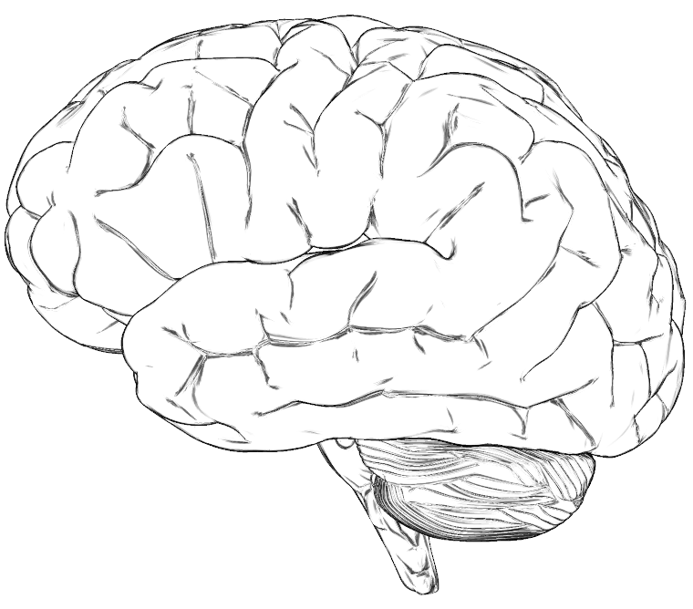
PF
PreFrontal:
sustained decision
EC
Entorhinal Cortex:
navigational memory
PM
PreMotor:
control of movement
HF CA1
CA1: spatial learning
PC
HF SUB
SUBiculum:
working memory
PC
Parietal Cortex:
decision making
PM
PF
AC
EC
HF
AM
AM
AM
AMygdala:
fear response
IT
VC
HYP
HYP
HYPothalamus: paraventricular nucleus: oxytocin neurons
VC
Visual Cortex
IT
InferoTemporal cortex:
face recognition
AC
Auditory Cortex
STDP: learning

Slide 2
PF
PM
PC
EC
HF CA1
DPM
Ventral PreMotor:
sustained activity
HF CA3
CA3: new spatial information
DPM
PM
VPM
Dorsal PreMotor:
planning & deciding
PC
HF DG
Dentate Gyrus:
new memories
VPM
PF
AC
EC
HF
AM
AM
IT
VC
AM
HYP
HYP
BG
IT
VC
Visual Cortex
BG
Basal Ganglia:
decision making
AC
Auditory Cortex
New Theoretical Memory

Slide 3


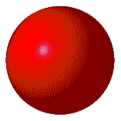



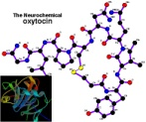
COMING YEAR GOALS
“Trust and Learn” Robotic Project
PF
Prefrontal:
sustained decision
PR
Parietal Reach (LIP):
reach decision making
VPM
BG
Basal Ganglia:
decision making
Ventral PreMotor:
sustained activity
PR
DPM
HPF
Hippocampal
Formation
DPM
Dorsal PreMotor:
planning & deciding
PF
VPM
EC
Entorhinal
Cortex
AC
EC
AM
VC
HPF
IT
HYp
AC
Auditory Cortex
BG
oxytocin
AM
Amygdala [fear response]: inhibited by HYp oxytocin
VC
Visual Cortex
HYp
HYpothalamus paraventricular nucleus [trust]: oxytocin neurons
1,000,000 CELL MODEL
REAL-TIME
IT
InferoTemporal cortex:
responds to faces
HPF

