Slide 1

NCS: A Large-Scale Brain Simulator
Devyani Tanna
Laurence C. Jayet Bray
Bobby D. Bryant
Frederick C. Harris, Jr.

Slide 2
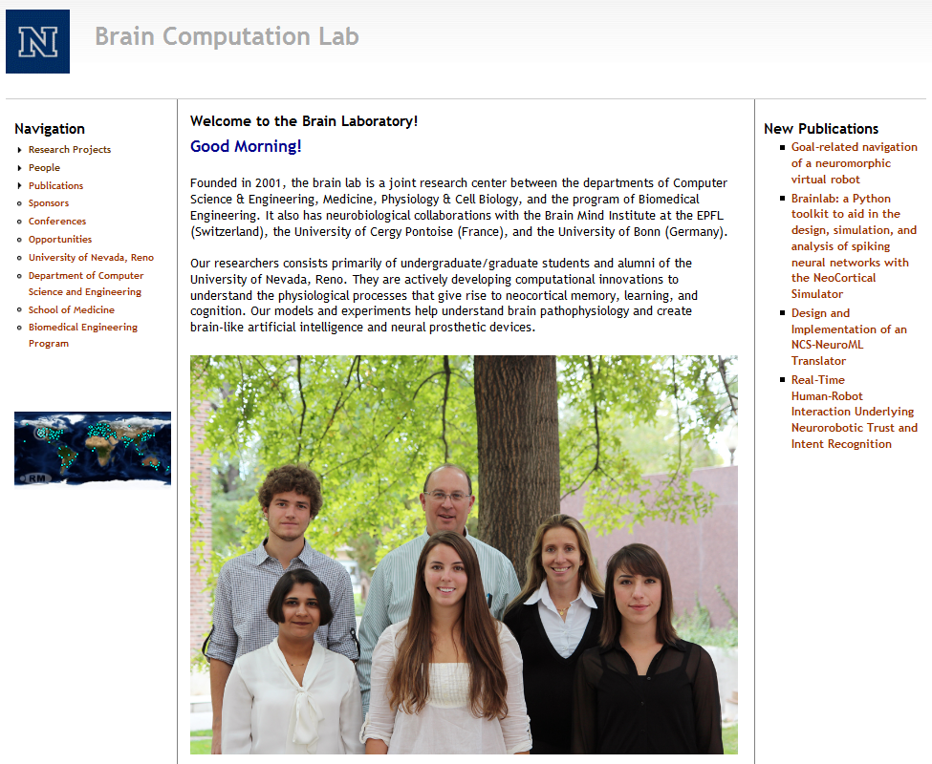
Brain Computation Lab www.cse.unr.edu/brain

Slide 3
What is NCS?
The NeoCortical Simulator (NCS) is designed for modeling large-scale neural networks and systems
One of the first simulators to support neurorobotic applications
Different types of neuron models available:
  Leaky integrate-and-fire / Hodgkin-Huxley
  Izhikevich
Free and open source
Developed and maintained by the UNR Brain Computation Laboratory

Slide 4
Why use NCS?
No programming language experience required
Large-scale brain simulation
Real-time execution
Good for modeling neural systems and networks
Framework for different levels of abstraction
Change/add to what’s on the poster

Slide 5
Current NCS version 6 implementation
GPU/CPU/cluster-based
  Runs on CPUs and CUDA devices simultaneously
Plugin interface for multiple model support
  LIF/HH Neurons
  Izhikevich Neurons
  Ability to design your own
Ability for multi-scale modeling

Slide 6
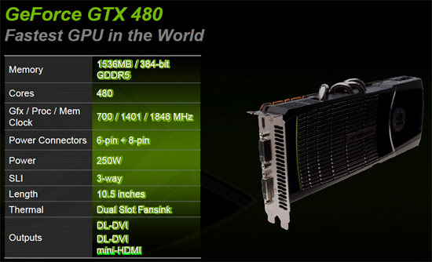
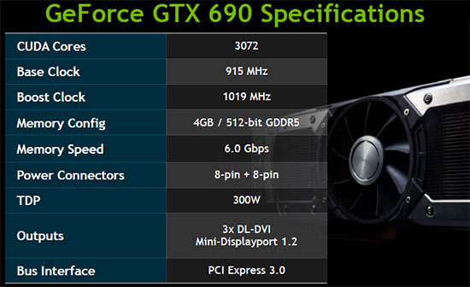
Current Hardware

Slide 7
Current Optimization
C++ 11
Heavily threaded
  Latency hiding
  Increased occupancy
Modular message passing design
GPU usage for parallel computation
Load-balancing across heterogeneous clusters

Slide 8
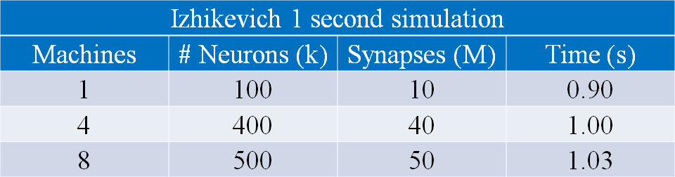
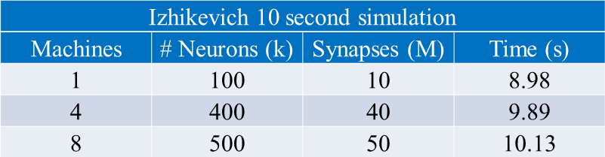
Performance Data
Izhikevich change

Slide 9
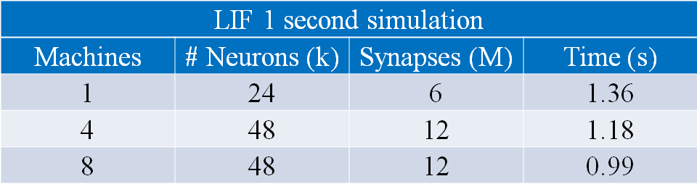
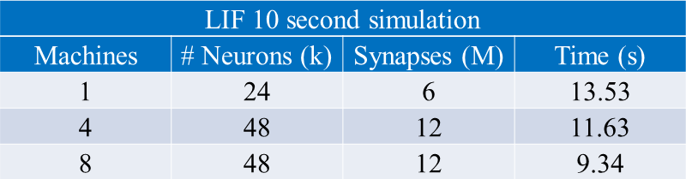
Performance Data
LIF change

Slide 10
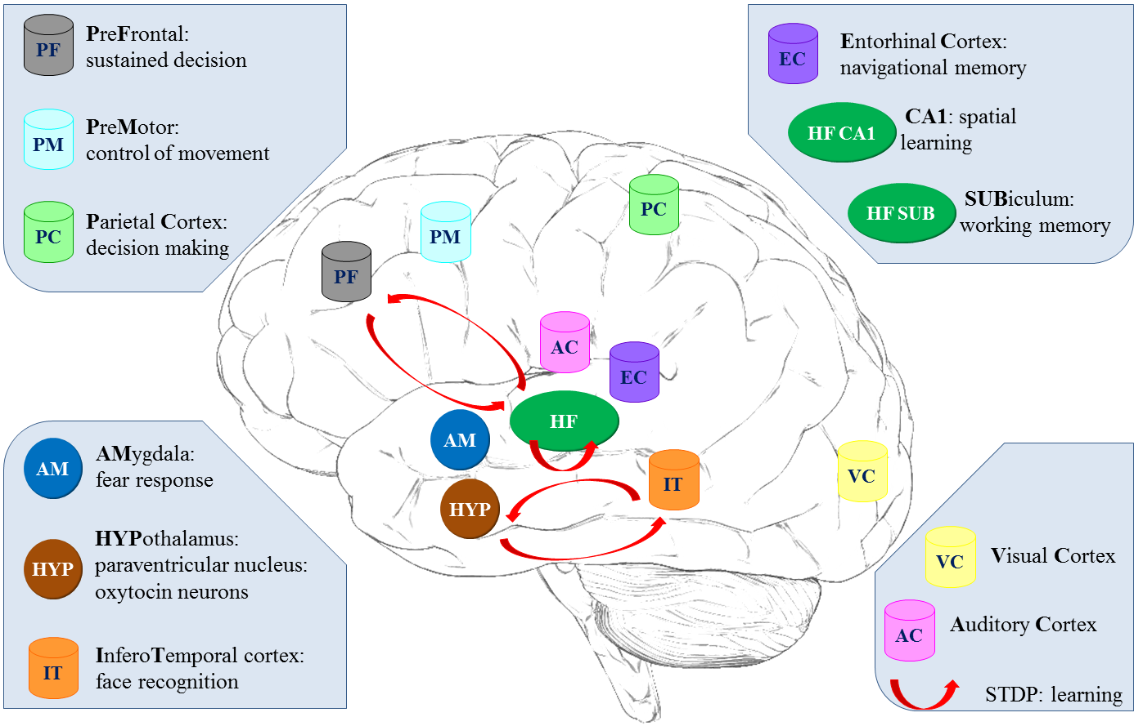
Modeled Brain Regions Using NCS

Slide 11
Two Cell Model

Slide 12
Brain
Define the simulation as a whole
Preliminary outline of other structures
  Anatomy
  Stimuli
  Reports
Extrinsic connections
Include files

Slide 13
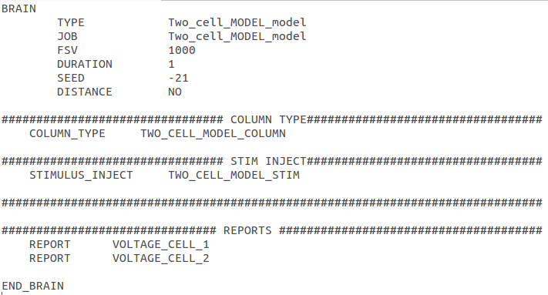
Brain

Slide 14
Anatomy
Columns
Layers
Cells
Compartments
Channels

Slide 15
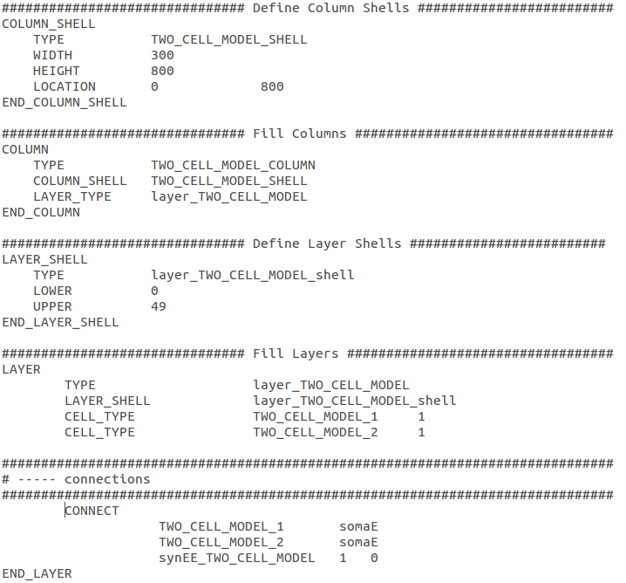
Anatomy

Slide 16
Stimulus
External Stimulation (visual, audio…)
Type of signals
  Linear
  Pulse
  Noise
  File-based
Multiple times
Different Destinations

Slide 17
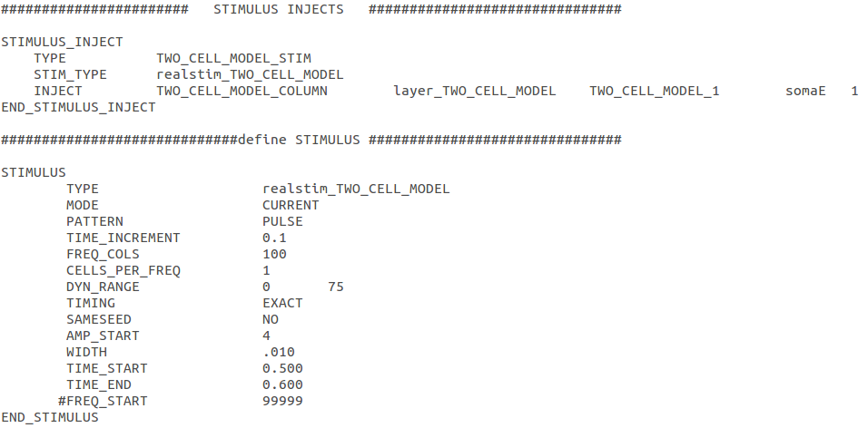
Stimulus

Slide 18
Connections
Extrinsic and intrinsic connections
Synapse connections
From the source to the destination
With or without decaying distance effects
Recurrent connections

Slide 19

Connections

Slide 20
Synapses
Connections between other cells and their compartments
Excitatory
Inhibitory
Synaptic Waveform
Learning
  Short term synaptic dynamics
    Facilitation
    Depression
  Long term synaptic dynamics (Hebbian Learning)
    STDP rule

Slide 21
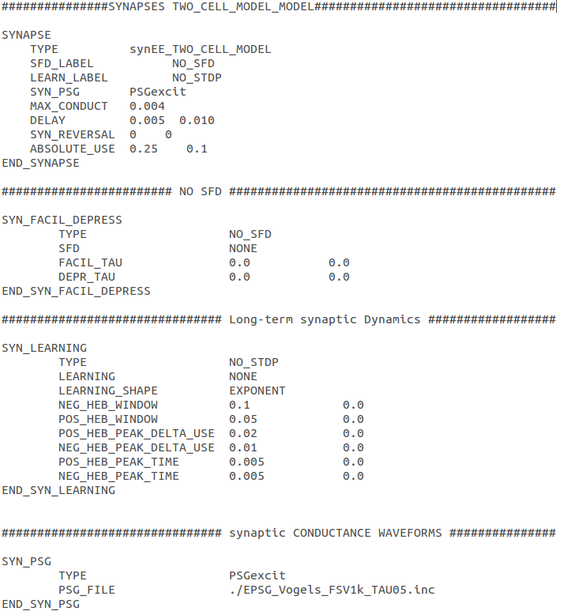
Synapses

Slide 22
Reports
Data about cells
Report files:
  Voltage
  Current
  Firecount
  Channel
  Synaptic strengths
Automatically generated and saved

Slide 23
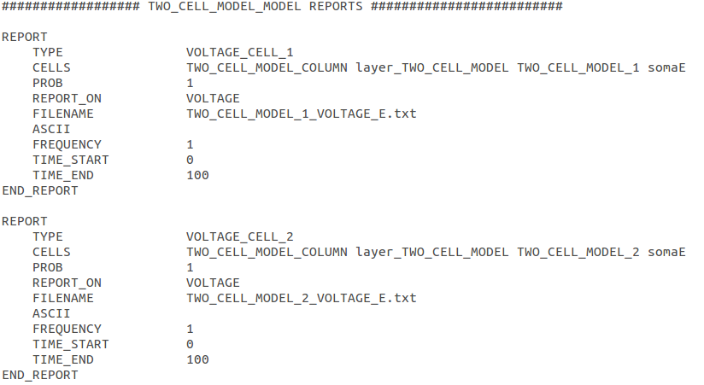
Reports

Slide 24
Robotic Applications with NCS

Slide 25
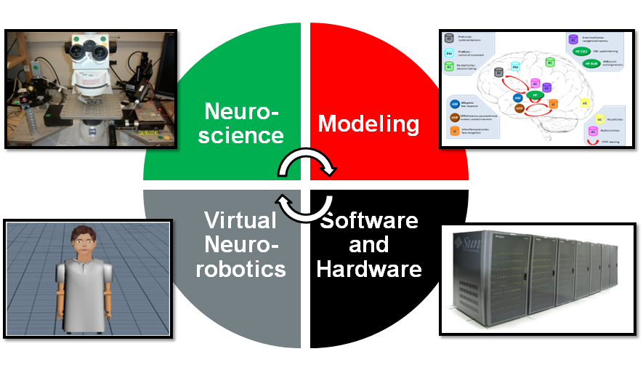
Technical Approach

Slide 26
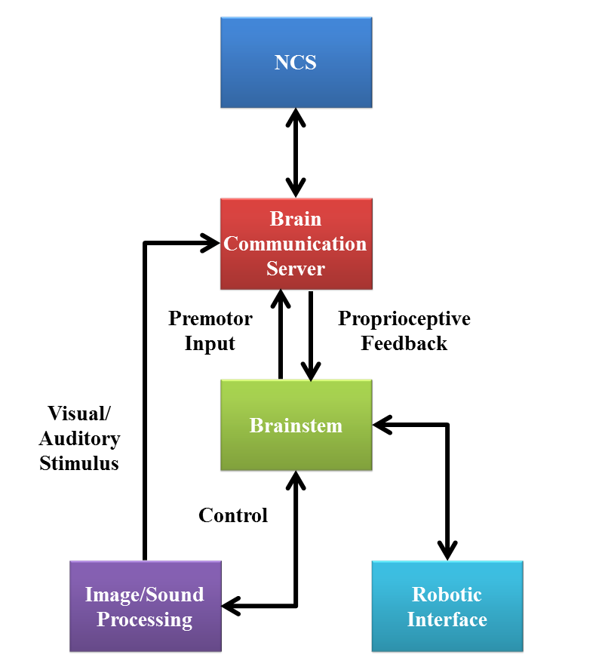
Virtual NeuroRobotic (VNR)

Slide 27
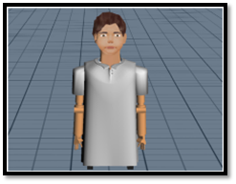
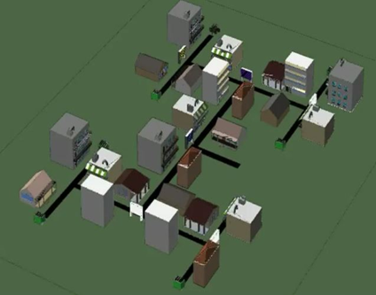
Robotic Interface
Constructed using
Webots 5
Motions were programmed in C++ using the provided interfaces and the communication was accomplished using the NCSTools C++ client

Slide 28
Trust
Behavior between a humanoid neurorobot and human actor
  Oxytocin release
    Social reinforcement
    Reduction of inhibition
Experiment has two conceptual phases:
  Learning
  Challenge

Slide 29




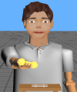


Paradigm
Learning
Challenge (at any time)
Robot Initiates Action
Human Responds
Human Acts
Robot Reacts
Robot brain initiates arbitrary sequence of motions
Human moves object in either a similar (“match”), or different (“mismatch”) pattern
Human slowly reaches for an object on the table
Robot either “trusts”, (assists/offers the object), or “distrusts”, (retract the object).
Match: robot learns to trust
Mismatch: don’t trust
trusted
distrusted

Slide 30

Concordant Motions Video

Slide 31
Discordant Motions Video

Slide 32
Emotional Speech
Allows for more natural interaction between humans and robots
  Determine the ideal behavior from a simple reward feedback
Emotional Speech processor
  Successfully distinguished “sad” and “happy” utterances
Integrated into neurorobotic scenario
  The robot received a spoken reward if the correct decision was made
Step toward the combination of human emotions and virtual neurorobotics

Slide 33
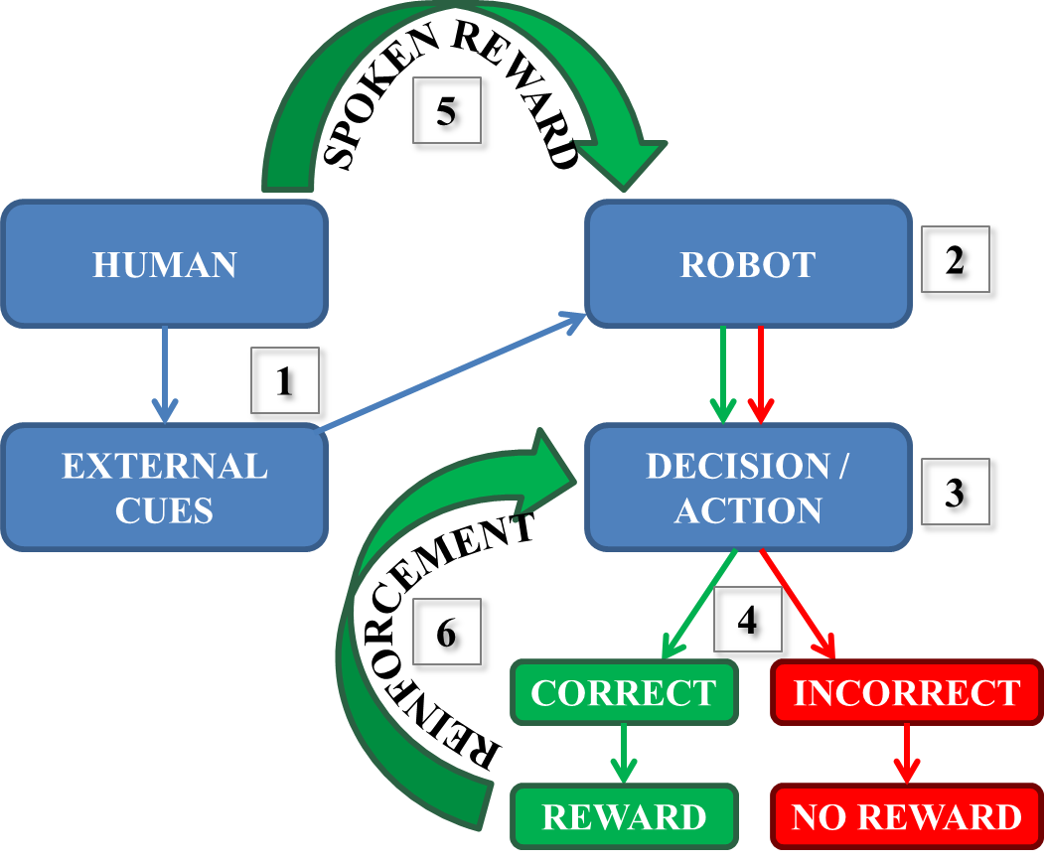
Reward-based Learning Through ESP

Slide 34
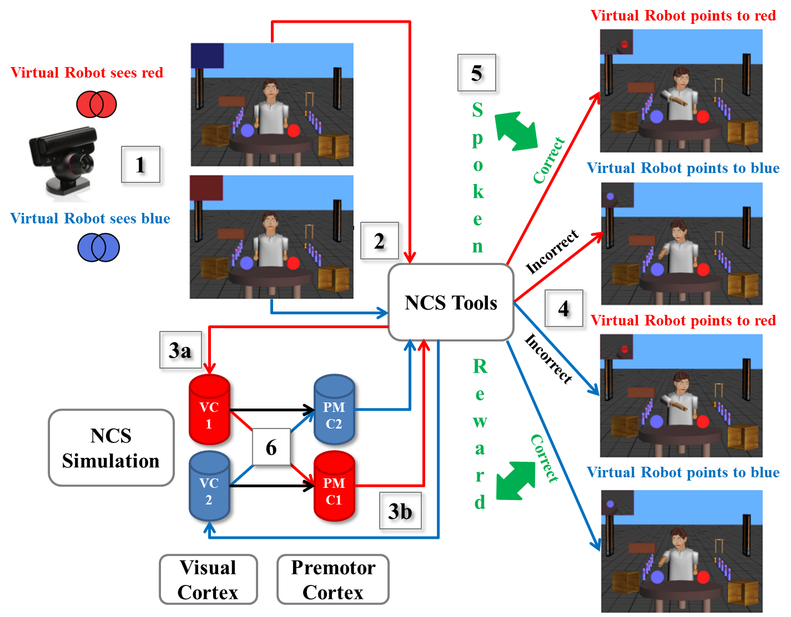
Reward-based Learning Through ESP

Slide 35
Navigation
Navigate to familiar location
  Prefrontal Cortex
  Hippocampus (CA1 and Subiculum)
  Entorhinal cortex
Computational system representing a navigating rodent
Reward at the end of a sequence of 3 turns
Showed learning performance without biased decisions
Short-term memory

Slide 36
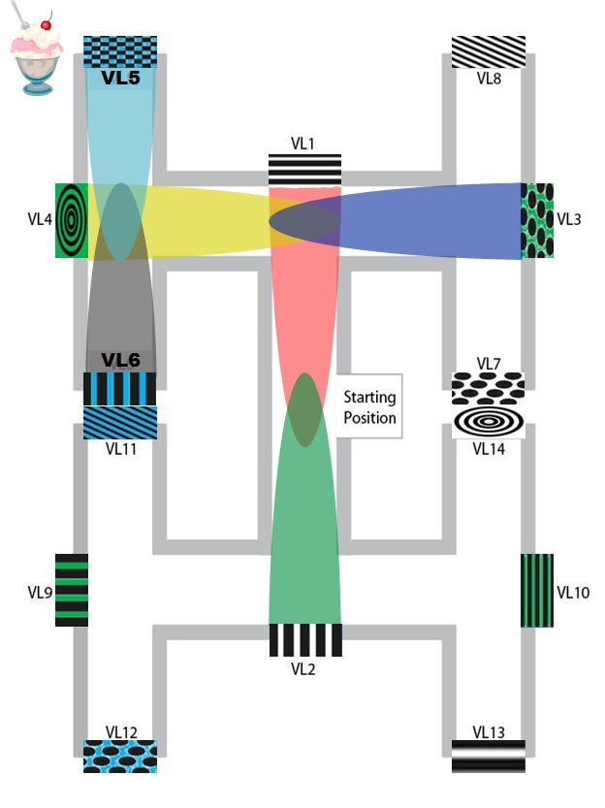
Paradigm

Slide 37
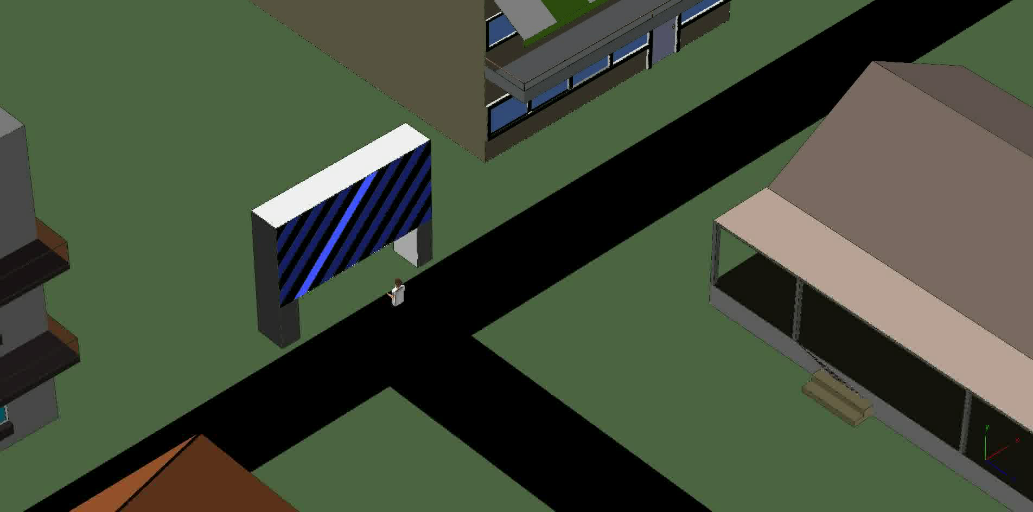
Navigation Video
Incorrect Choice

Slide 38
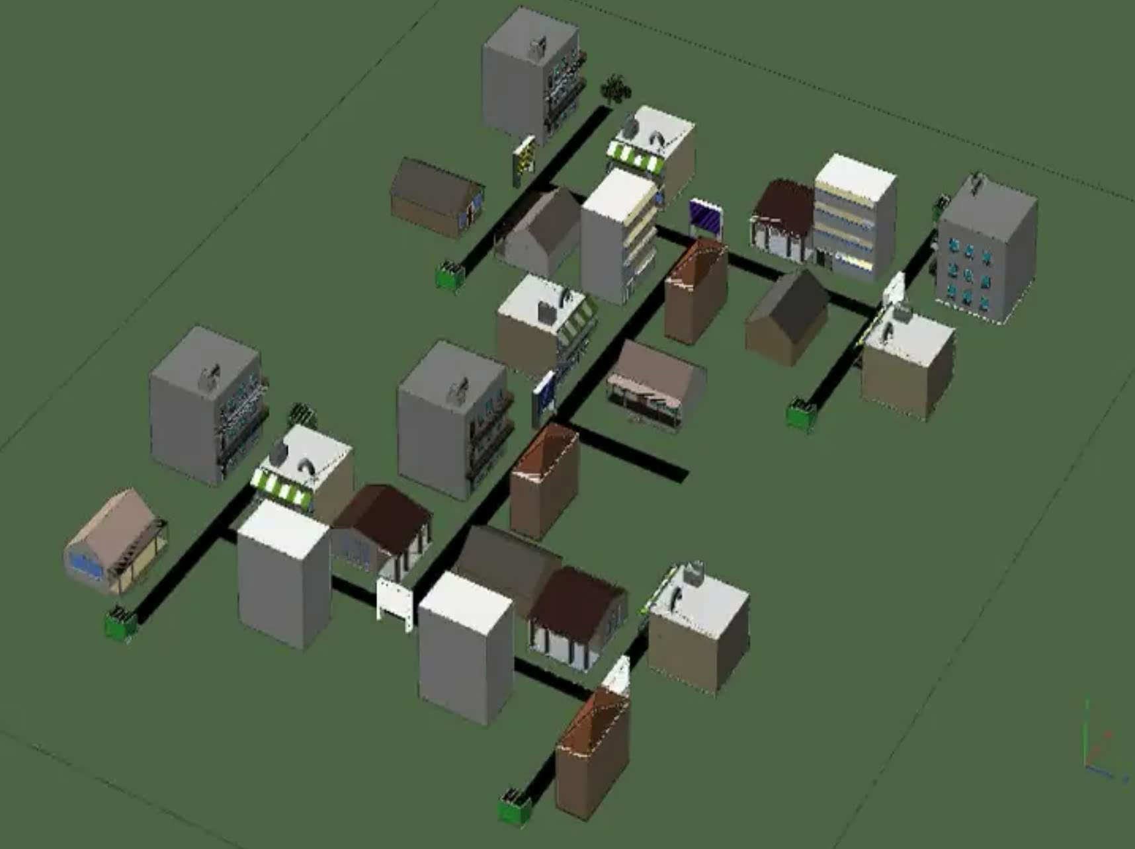
Navigation Video
Correct Choice

Slide 39
Future Directions
Simulator & Tools
Near Term:
  GUI-based brain model builder and visualizer
  Multi-Scale modeling
  Input language options
Long Term:
  Simulated fMRI data

Slide 40
Future Directions
Modeling & Simulation
Near Term:
  Higher-level behavior
  Expanded and more detailed models
Long Term:
  Disorders and interventions
  Drug interaction

Slide 41
Thank you

