Slide 1
The Future of
Computer Science
Frederick C Harris, Jr.
March 23, 2012
Utah State University

Slide 2

Life, the Universe, and Everything
Answer: 42

Slide 3
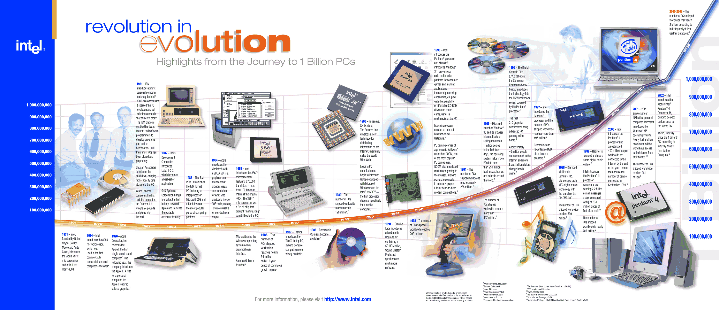
A Short History
According to Intel:

Slide 4
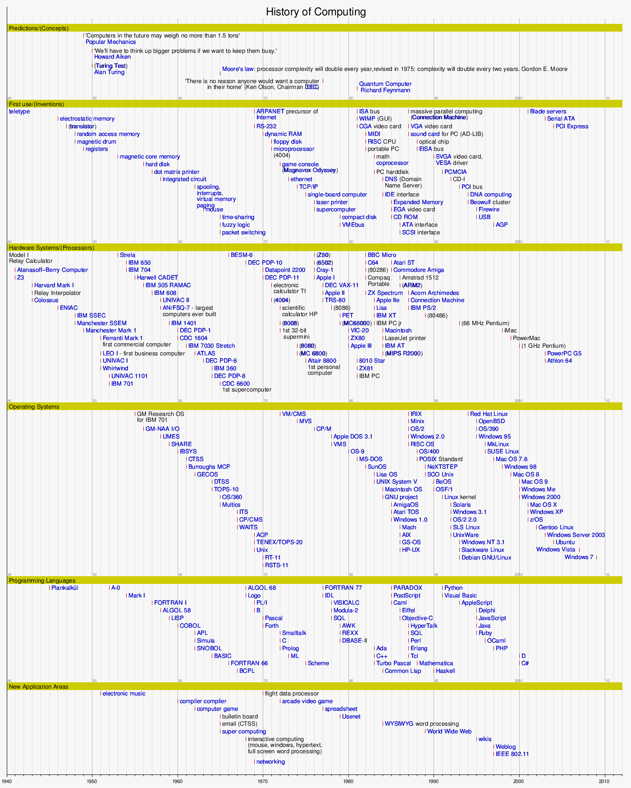

Slide 6
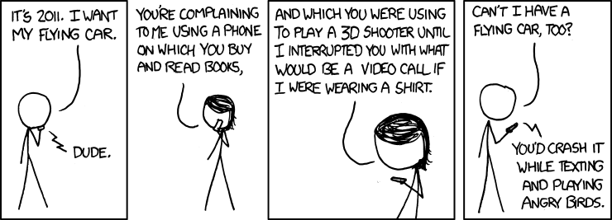
xkcd.com

Slide 7
Grand Challenge Problems
Grand challenge problems refer to really difficult tasks that stretch the limits of cognitive ability.
They are especially popular in high technology fields as working towards a solution often yields many new applications.
      Inside HPC 9-16-2006

Slide 8
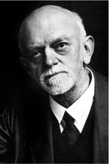
Famous Hard Problems
1900: a 38 year old professor from Göttingen, Germany, David Hilbert, dared to define 23 “mathematical puzzles” which kept contemporary and future colleagues busy for a century

Slide 9
Famous Hard Problems
Fermat’s Last Theorem
  Andrew Wiles proved it … 350 years later
NP ≠ P
  Solution will net you $1million
    (Clay Institute of Mathematics)

Slide 10
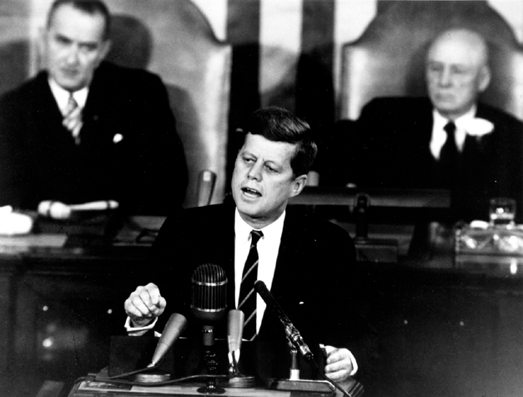
The Decision to go to the Moon
President John F. Kennedy's May 25, 1961 Speech before a Joint Session of Congress

Slide 11

Grand Challenge Problems
“Grand challenge problems” are important problems that require bringing together a community of scientists and researchers to work toward their solution
  Transforming American Education: Learning powered by technology
    US Dept of Education 2011

Slide 12


Slide 13
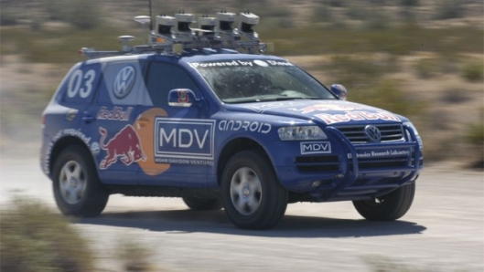
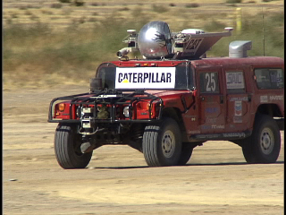
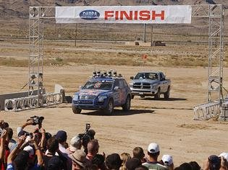
DARPA Grand Challenge
Driverless Vehicles
  2004 – Mojave Desert
    no winner
  2005 – Mojave Desert
    Stanford, Carnegie Melon

Slide 14
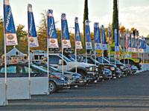
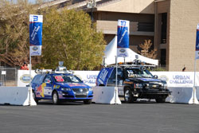
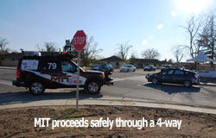

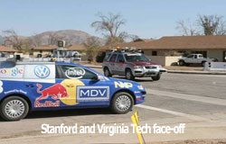

DARPA Grand Challenge
Driverless Vehicles
  2007 – Urban Challenge
    Carnegie Melon, Stanford

Slide 15
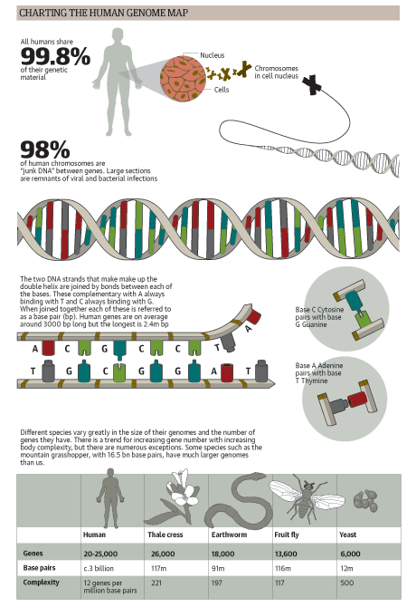
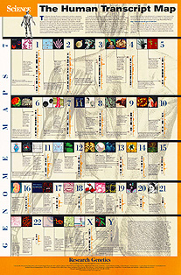
Map the Human Genome
Began in 1990
Working draft in 2000
  Completed in 2003

Slide 16
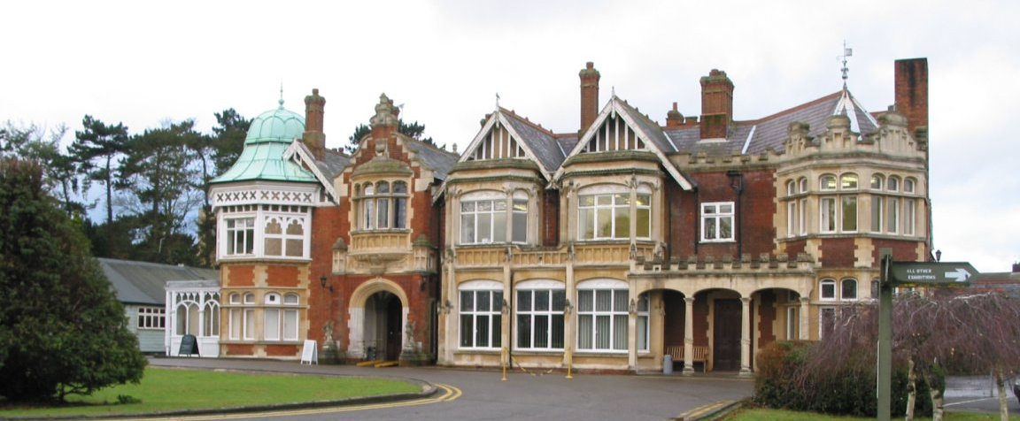
Pass the Turing Test
  The annual Loebner Prize recognizes the best advance towards this goal,
    Though no one has won outright
    May 15, 2012 Bletchley Park, UK

Slide 17
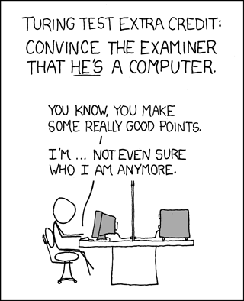
Pass the Turing Test

Slide 18
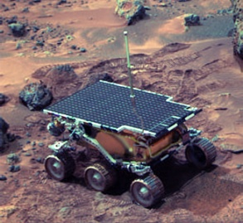
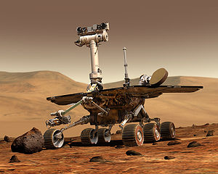
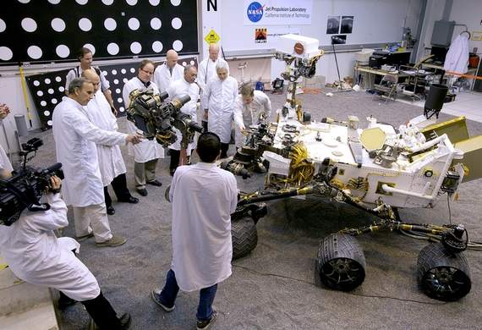
Put Rovers on Mars
Pathfinder – 1997
  Sojourner
Mars Exploration Rover
  Spirit (2004-2010) and
  Opportunity – 2004-
Mars Science Laboratory
  (August 2012 Landing)

Slide 19
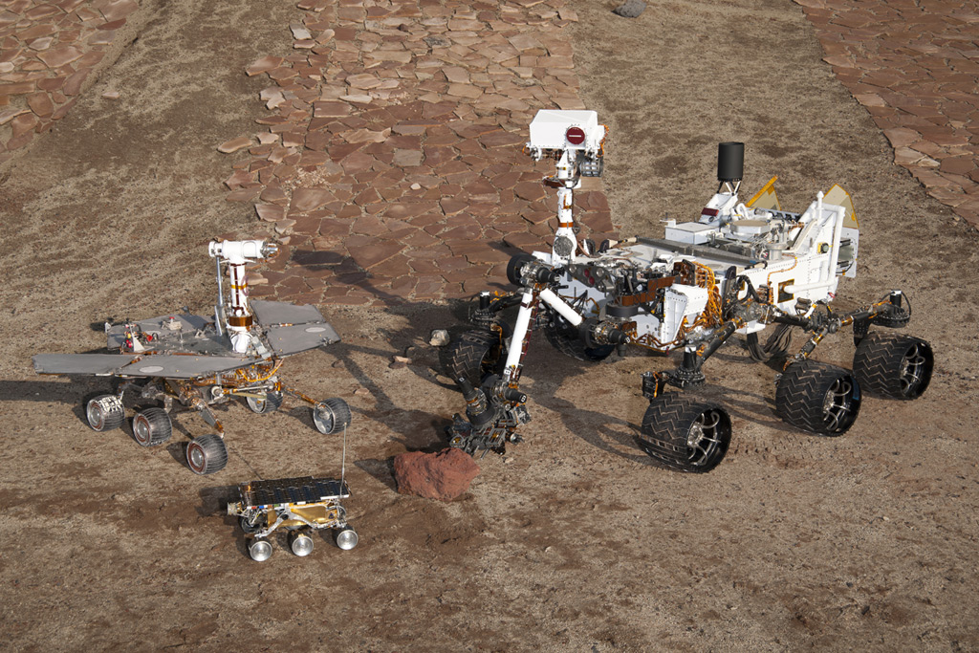
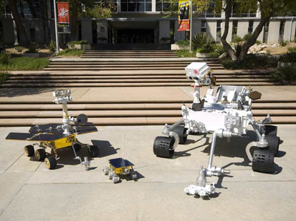
Put Rovers on Mars

Slide 20
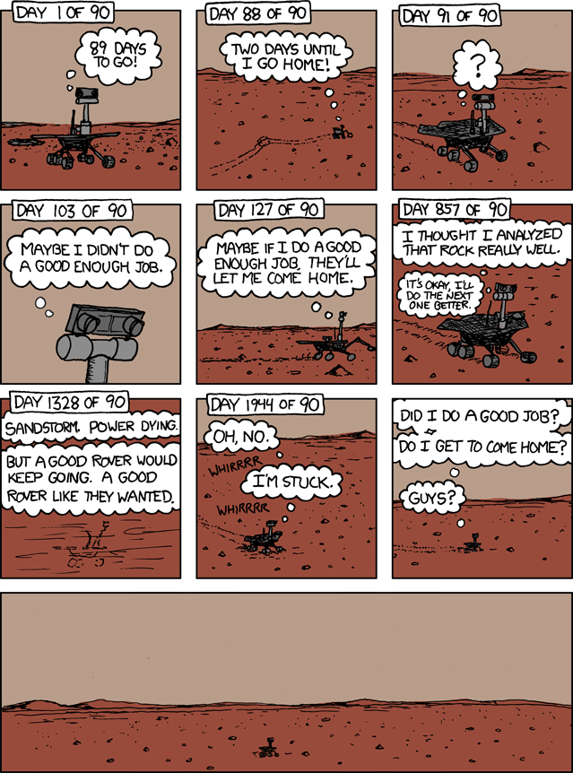
xkcd.com

Slide 21
National Academy for Engineering
Grand Challenges for Engineering
  14 Grand Challenges – several are CS heavy
    Advance health informatics
    Reverse-engineer the brain
    Secure cyberspace
    Enhance virtual reality
    Advance personalized learning
Notes:
http://www.engineeringchallenges.org/cms/8996.aspx

Slide 22

National Science Foundation
The “Grand Challenges” were US policy terms set in the 1980’s
They require extraordinary breakthroughs in computational models, algorithms, data and visualization technologies, software, and collaborative organizations uniting diverse disciplines

Slide 23
Common Themes to the
NSF Grand Challenges (1/5)
All Grand Challenges face barriers in the areas of software, data management, and visualization, and the coordination of the work of diverse communities that combine efforts and resources to develop models and algorithms to evaluate outputs.

Slide 24
Common Themes to the
NSF Grand Challenges (2/5)
All Grand Challenges require transformative discovery and innovation, which in turn demand capabilities approaching or exceeding exascale computing.
Computing at this scale requires dramatic changes in processor architecture and power management

Slide 25
Common Themes to the
NSF Grand Challenges (3/5)
All Grand Challenges need advanced computational models and algorithms, including methods that are informed by observational data in a way that can cope with uncertainty in the data and that can quantify uncertainties in predictions.
New methods are necessary to facilitate multi-scale modeling, enhanced sampling, and vast simulations while integrating high data volume outputs of the simulations along with new methods to encourage the publication of code and data to facilitate verification of computational results.

Slide 26
Common Themes to the
NSF Grand Challenges (4/5)
All Grand Challenges must have the ability to acquire relevant data for calibration and validation of large scale computational models and to characterize and quantify uncertainties.
The transition of conventional deterministic methods and models of complex physical events to those accounting for uncertainties and stochasticity will increase by several orders of magnitude the size, complexity, and computational work needed for predictive simulations.

Slide 27
Common Themes to the
NSF Grand Challenges (5/5)
All Grand Challenge problems call for the development – in some combination – of computational models based on scientific and engineering principles, on the principles and methods of computer science, and on computing technology and the use of core computational and applied mathematics.

Slide 28
Findings and Recommendations to confront GC Problems
1) Computational Models, Methods, and Algorithms
  Recommendation: NSF should support multidisciplinary and interdisciplinary teams that bring together applied mathematicians, computer scientists, and computational scientists and engineers

Slide 29
Findings and Recommendations to confront GC Problems
2) High Performance Computing
  Recommendation: NSF should continue to give high priority to funding a sustained and diverse set of HPC and innovative equipment resources to support the wide ranges of needs.

Slide 30
Findings and Recommendations to confront GC Problems
3) Software
  Recommendation: Support the creation of reliable, robust science and engineering applications and data analysis and visualization applications for Grand Challenges as well as the software development environment needed to create these applications.

Slide 31
Findings and Recommendations to confront GC Problems
4) Data and Visualization
  Recommendation: NSF should support research infrastructure to empower data-driven science and data-intensive computing for discovery, innovation, and solution of society’s pressing problems in health, energy, environment, and food.

Slide 32
Findings and Recommendations to confront GC Problems
5) Education, Training, and Workforce Development
  Recommendation: NSF should support education, training, and workforce development through a variety of programs.

Slide 33
Findings and Recommendations to confront GC Problems
6) Grand Challenge Communities and Virtual Organizations.
  Recommendation: NSF should initiate a thorough study outlining best practices, barriers, success stories, and failures, on how collaborative interdisciplinary research is done among diverse groups involved in Grand Challenge projects.

Slide 34
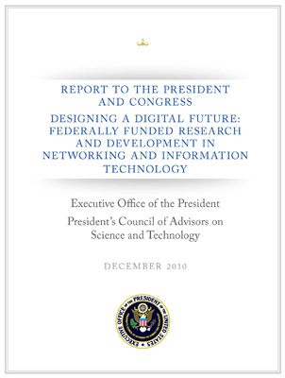
President’s Council of Advisors
December 2010 report by the President's Council of Advisers on Science and Technology
Notes:
http://www.cs.washington.edu/homes/lazowska/nitrd/
http://www.whitehouse.gov/administration/eop/ostp/pcast

Slide 35
President’s Council of Advisors
Findings:
  Advances in Networking and Information Technology (NIT) are a key driver of economic competitiveness
  Advances in NIT are crucial to achieving our major national and global priorities in energy, transportation, education, healthcare, and national security
  Advances in NIT accelerate the pace of discovery in nearly all other fields
  Advances in NIT are essential to achieving the goals of open government

Slide 36
President’s Council of Advisors
Recommendations
  The Federal Government should invest in a national, long-term, multi-agency initiative on NIT for:
    health that goes well beyond the current program to adopt electronic health records
    energy and transportation
    that assures both the security and the robustness of cyberinfrastructure

Slide 37
President’s Council of Advisors
Recommendations
  The Federal Government must increase investment in those fundamental NIT research frontiers that will accelerate progress across a broad range of priorities
    (NSF, DARPA, HHS,…)

Slide 38
President’s Council of Advisors
Crosscutting Themes
  Data Volumes are growing exponentially
  Engineering large software systems to ensure that they are secure and trustworthy is a daunting challenge.
  Privacy is a critical issue
  Interoperable interfaces
    smart grid, health records,..
  The NIT supply chain is vulnerable

Slide 39
John Hopcroft
The Future of Computer Science
  Int J Software Informatics, Volume 5, Issue 4 (2011), pp. 549-565 International Journal of Software and Informatics, ISSN 1673-7288
  John E. Hopcroft, Sucheta Soundarajan, and Liaoruo Wang
  Computer science is undergoing a fundamental change and is reshaping our understanding of the world. An important aspect of this change is the theory and applications dealing with the gathering and analyzing of large real-world data sets.

Slide 40
John Hopcroft
The early years primarily concerned with the size, efficiency and reliability of computers.
  They attempted to increase the computational speed as well as reduce the physical size of computers, to make them more practical and useful.
  The research mainly dealt with hardware, programming languages, compilers, operating systems, and data bases.
Future computer science research and applications will be less concerned with how to make computers work and more focused on the processing and analysis of such large amounts of data.

Slide 41
Big Data
In Industry Big Data is the next frontier for innovation, competition, and productivity
  The amount of data in our world has been exploding, and analyzing large data sets—so-called big data—will become a key basis of competition, underpinning new waves of productivity growth, innovation, and consumer surplus.
  Leaders in every sector will have to grapple with the implications of big data, not just a few data-oriented managers. The increasing volume and detail of information captured by enterprises, the rise of multimedia, social media, and the Internet of Things will fuel exponential growth in data for the foreseeable future.
Notes:
http://www.mckinsey.com/Insights/MGI/Research/Technology_and_Innovation/Big_data_The_next_frontier_for_innovation

Slide 42
Where do I see this area going?
Ubiquitous Computing
Multi/Many core computing
  Parallel should be a very high priority.
Sensor Networks
  Mobile phones (GPS, status [walking sitting running,], heart rate, …)
Large Data

Slide 44
http://www.youtube.com/watch_popup?v=6Cf7IL_eZ38&vq=medium

