Slide 1


Computer Science and Engineering
University of Nevada, Reno
Department Chair
Candidate Presentation
February 26, 2013
Dr. Frederick C Harris, Jr.

Slide 2
A Little Background
California (18 years)
  Born in and grew up in San Jose.
  I have a younger brother who still lives there
  Both parents were high school math/science teachers
  Graduated from high school – 1982
    Played a lot of sports
      13 varsity letters, 3 state championships
    Salutatorian of my HS class
    Also received the Bank of America Achievement Award in Science and Mathematics

Slide 3
A Little Background
South Carolina (12 years)
  BS Major: Mathematics, Minor: Physics (1986)
  MS Educational Administration (1988)
  Married Cindy (1988)
  MS Computer Science (1991)
    Software Reliability: Mars Pathfinder
  Birth of our son Jordan (1994)
  PhD Computer Science (1994)
    Parallel Computation and Graph Algorithms

Slide 4
A Little Background
Nevada (19 years)
  Assistant Professor: 1994-2000
  Birth of our daughter Emily (1995)
  Associate Professor: 2000-2007
  Professor: 2007-present
  Research Center Director @ DRI (2007-2008)
    Advanced Visualization, Computation, and Modeling

Slide 5
Teaching
Undergraduate Courses Taught
  CS I (3 times)
  CS II (10 times)
  Data Structures (11 times)
  Programming Languages (3 times)
  Compiler Construction (10 times)
  Parallel Computation (7 times)
  Computer System Administration (1 time)
  Computer Graphics (11 times)
  Programming Contest Course (4 times)
  Computational Neuroscience (2 times)

Slide 6
Teaching
Graduate Courses Taught
  Advanced Compilers (1 time)
  Parallel and Distributed Computing (4 times)
  Advanced Graphics (5 times)
  Virtual Reality (3 times)
  GPU Computing (3 times)
F. Donald Tibbitts Distinguished Teacher Award
  Recipient 2005, Runner-up 1999 and 2004

Slide 7
Graduate Students
9 PhD students finished
52 MS students finished
4 Post Doctoral students supervised

Slide 8
Publications
34 journal publications
128 refereed conference publications
3 book chapters
4 edited proceedings, 2 co-edited
234 co-authors
  68 undergraduate students
  25 international collaborators
5 Best Paper Awards

Slide 9
Research Funding
PI, Co-PI, and Senior Personnel
  $41.9 million in total
  $1.5 million in hardware support
  More than 50 RA years supported
  Agencies:
    DARPA/HRL, ONR, NSF, NASA, DOD
I also have several proposal under review

Slide 10
Service
Off Campus (selected)
  ABET program evaluator
  Journal editor-in-chief
  Organized 4 conferences
  Special Issue guest editor (2)
  Program committee member for annual conferences (IEEE-VR, SC, IWSSA, CAINE, ITNG, CATA, SEDE, ACHI)

Slide 11
Service
On Campus (selected)
  Departmental
    Undergrad Committee – chair for 12 years
    Search Committees – chaired 8
  College
    Personnel Committee – (6 years, 3 as chair)
    Curriculum Committee (8 years)
    Search Committees – chaired 2
  University
    Faculty Senate (3 years)

Slide 13
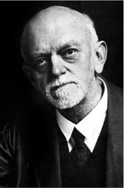
Famous Hard Problems
1900: a 38 year old professor from Göttingen, Germany, David Hilbert, dared to define 23 “mathematical puzzles” which kept contemporary and future colleagues busy for a century

Slide 14
Famous Hard Problems
Fermat’s Last Theorem
  Andrew Wiles proved it … 350 years later
NP ≠ P
  Solution will net you $1million
    (Clay Institute of Mathematics)

Slide 15
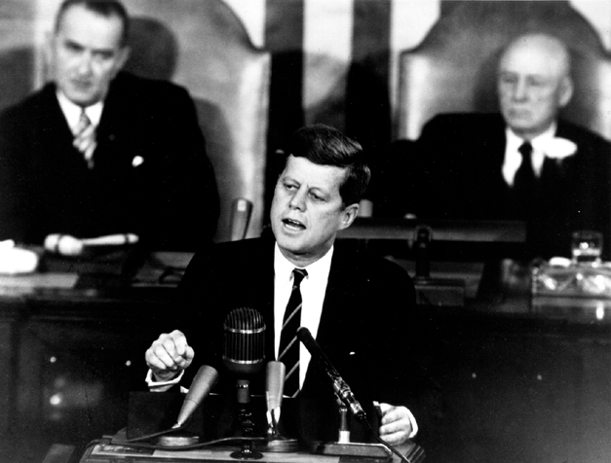
The Decision to Go to the Moon
President John F. Kennedy's May 25, 1961 speech before a Joint Session of Congress

Slide 16
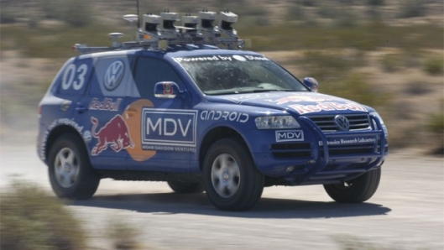
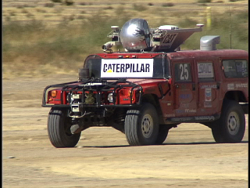
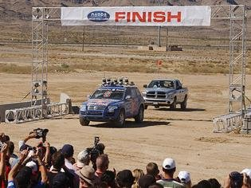
DARPA Grand Challenge
Driverless vehicles
  2004 – Mojave Desert
    no winner
  2005 – Mojave Desert
    Stanford, Carnegie Melon

Slide 17
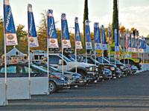
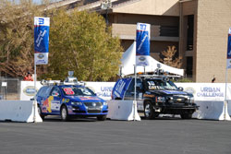
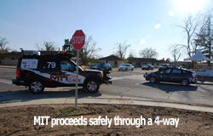

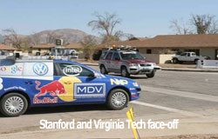

DARPA Grand Challenge
Driverless Vehicles
  2007 – Urban Challenge
    Carnegie Melon, Stanford

Slide 18
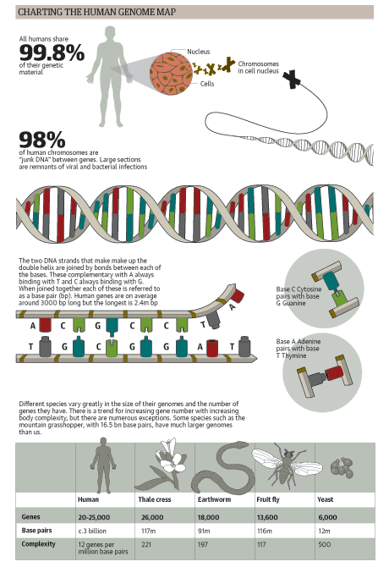
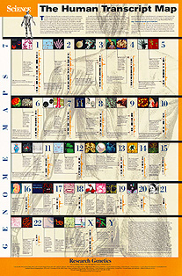
Map the Human Genome
Began in 1990
Working draft in 2000
  Completed in 2003

Slide 19
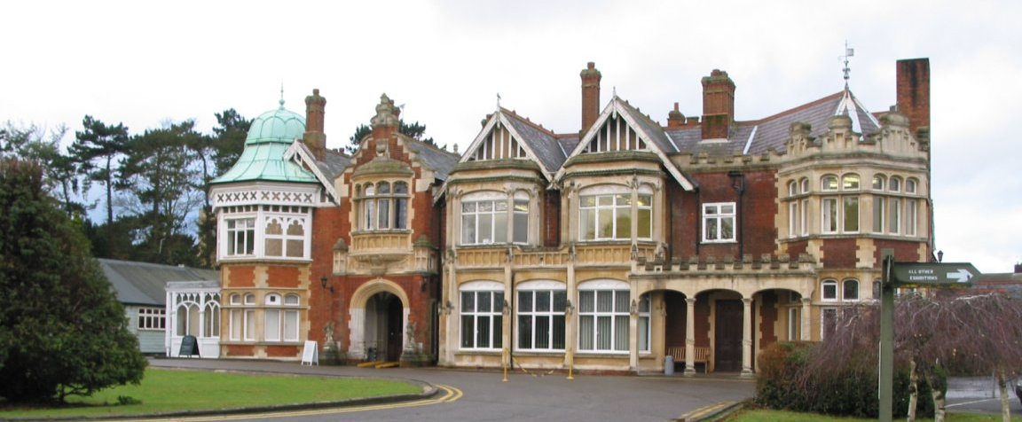
Pass the Turing Test
  The annual Loebner Prize recognizes the best advance towards this goal
    No one has won outright
    May 15, 2012 Bletchley Park, UK

Slide 20
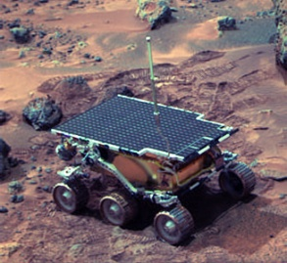
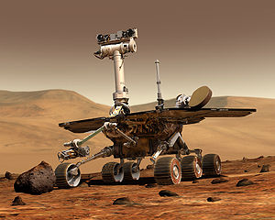
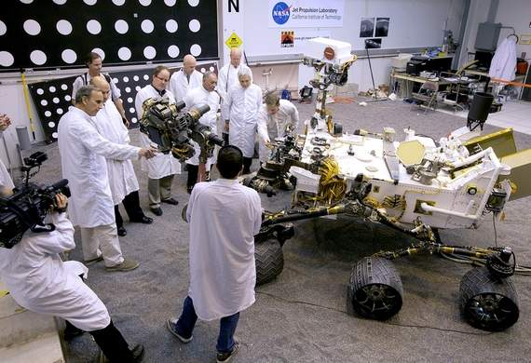
Put Rovers on Mars
Pathfinder – 1997
  Sojourner
Mars Exploration Rover
  Spirit (2004-2010) and
  Opportunity – 2004-
Mars Science Laboratory
  Curiosity - August 2012

Slide 21
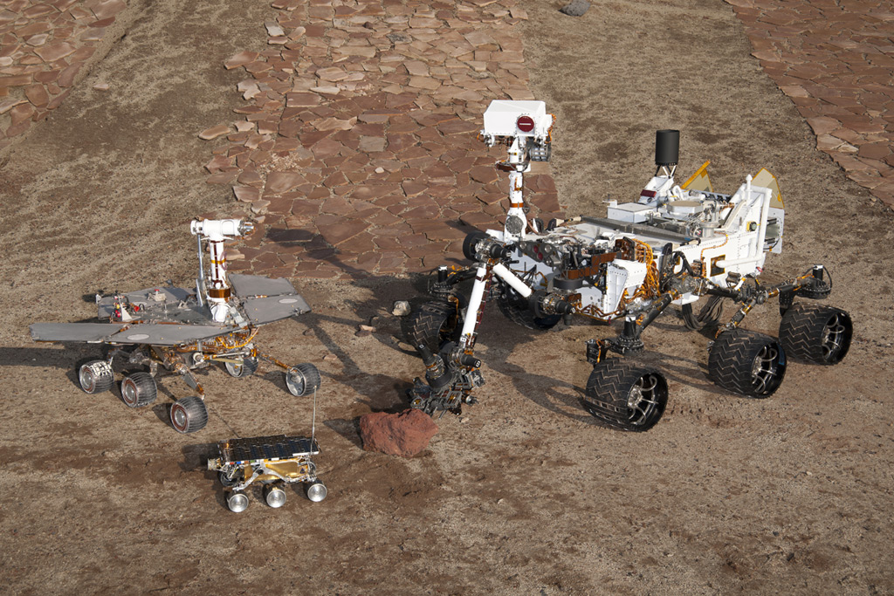
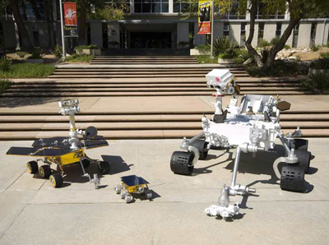
Put Rovers on Mars

Slide 22
National Academy for Engineering
Grand Challenges for Engineering
  14 Grand Challenges – several are CS heavy
    Advance health informatics
    Reverse-engineer the brain
    Secure cyberspace
    Enhance virtual reality
    Advance personalized learning

Slide 23
John Hopcroft
The Future of Computer Science
  Int J Software Informatics, Volume 5, Issue 4 (2011), pp. 549-565 International Journal of Software and Informatics, ISSN 1673-7288
  John E. Hopcroft, Sucheta Soundarajan, and Liaoruo Wang
  Computer science is undergoing a fundamental change and is reshaping our understanding of the world. An important aspect of this change is the theory and applications dealing with the gathering and analyzing of large real-world data sets.

Slide 24
John Hopcroft
The early years primarily concerned with the size, efficiency and reliability of computers.
  They attempted to increase the computational speed as well as reduce the physical size of computers, to make them more practical and useful.
  The research mainly dealt with hardware, programming languages, compilers, operating systems, and data bases.
Future computer science research and applications will be less concerned with how to make computers work and more focused on the processing and analysis of such large amounts of data.

Slide 25
Department
1994:
  Faculty: 5 faculty lines and1 lecturer
    Ed Wishart, Carl Looney, Sushil Louis, Fred Harris, ½ Bob Hooper, ½ Larry LaForge, Rob Langsner
  Research funding - $0

Slide 26
Department
2012
  Faculty: 14 faculty lines, 2 Lecturers, Research Assistant Professor, and Post Docs.
  Research funding:
    36 proposals submitted
    Awards: $1,453,125
    Expenditures: $2,029,819

Slide 27
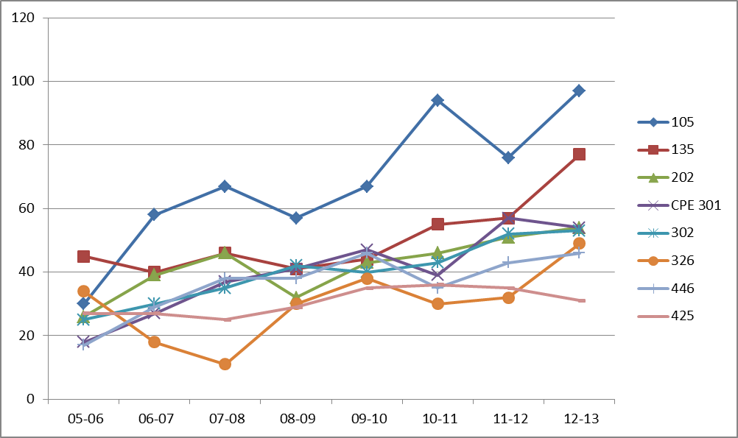
Undergraduate Enrollment

Slide 28
Departmental Vision Statement
We envision that in the next five years, the Department of Computer Science and Engineering at UNR will be recognized in the state and the region as a leader in select focal areas, and for the excellence of its research, education, and outreach, and will continue to gain prominence at a rate to ensure it a place within the second quartile in the National Research Council Rankings before the end of the decade.
CSE Strategic Plan 2010

Slide 29
Vision
Maintain our strengths
  Great departmental atmosphere and interaction, quality teaching, growing research
Improve our department
  Move our program closer to ranked status
  Increase our graduate enrollment, corporate involvement, collaborative research, alumni interaction, faculty
  Move research active faculty to a 2-1 teaching load

Slide 30
Increase Graduate Enrollment
Increase our retention of our good BS students into the MS program
  Encourage them to enroll in the integrated BS/MS program
  Hire them as assistants for 300/400 level courses,
    Pay them out of differential fees.
    Conduct help sessions and grade
Then we will have the enrollment for a variety of graduate courses necessary for our PhD program.

Slide 31
Increase Research
Publications
  Journals:
    It has been increasing: 12, 13, 15 (last 3 years)
    We should shoot for 2 per research active faculty per year (on average).
    Every PhD student should have 1 accepted before their defense.
  Refereed conferences:
    It has been 63, 47, 40 (last 3 years)
    We should shoot for 1 per MS graduate, and 1 per PhD student per year.

Slide 32
Increase Research
Proposals
  Submitted: (2012) 36
Undergraduate involvement in labs
Group/Collaborative proposals
  Target large proposals – possibly a Center
    Knowledge Fund Proposal
Increasing infrastructure support within the department.

Slide 33
Increasing Corporate Involvement
Continue
  GE Bently, Bally, IGT,
Increase
  3G, SNC, …
Assisting/Cultivating start-ups
  Colloquia April 12
    Colin Loretz

Slide 34
Increasing Alumni Interaction
We have a good start with the Hats Off presentations.
Things to add:
  Business card gallery
  Lifetime accounts
    Email forwarding
    Web profiles (with CV link)
  Donations

Slide 35
Increasing Faculty
Hopefully we can leverage differential fees for a second position in this search
Also need targeted hiring in the future
  Big Data
    Several of us have written a position for this into an NSF proposal under review, and the University has agreed to pick up this position.
  Computer Engineering:
    Hardware/Embedded Systems, …

Slide 36
Needs:
Department technician
  A systems administrator was promised to Dr. Varol when he came here 17 years ago.
  This need is impacting our research productivity
Office personnel
More TA-positions

Slide 37
Needs:
Space
  Every faculty should have at least a 400 ft² lab
    This lack has hampered research growth
  Offices
    For new faculty, visiting faculty, Post Docs, …
  Incubator center
  This (and more) could fit in a new CSE building.

Slide 38
Departmental Vision Statement
We envision that in the next five years, the Department of Computer Science and Engineering at UNR will be recognized in the state and the region as a leader in select focal areas, and for the excellence of its research, education, and outreach, and will continue to gain prominence at a rate to ensure it a place within the second quartile in the National Research Council Rankings before the end of the decade.
CSE Strategic Plan 2010

Slide 40
http://www.youtube.com/watch_popup?v=6Cf7IL_eZ38&vq=medium

Slide 41
National Research Council
Research Activity:
  Average Number of Publications per Faculty
    Average 1.67, Stdev 0.78 (UNR CSE 15/14)
  Percent of Faculty with Grants
    Average 73, Stdev 17
  Awards per faculty member
    Average 0.43, Stdev 0.86

Slide 42
National Research Council
Student Support & Outcomes:
  % first year students with support
    Average 84, Stdev 22
  6 year completion %
    Average 29, Stdev 14
  Median time to degree
    Average 5.5, Stdev 0.88
  % Academic plans
    Average 47, Stdev 16
  Dept collects data about post-graduation employment.

Slide 43
National Research Council
Diversity:
  Non-Asian Minority faculty %
  Female faculty %
  Non-Asian minority student %
  Female student %
  International student %

Slide 44
National Research Council
Other Measures:
  Average number PhDs graduated
    Average 7.17, Stdev 6.79, Range [1,37]
  % interdisciplinary faculty
    Average 20, Stdev 18
  Average GRE scores (Q)
    Average 771.89, Stdev 27.84
  % first year students w/ external fellowships
    Average 8. Stdev 16
  Is student space provided? 63%
  Is Health insurance provided?
  Number of student activities
    Orientation, language screening, writing instruction, proposal training, teaching/research prizes…

