Slide 1
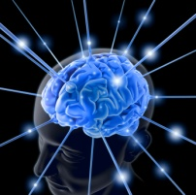

NCS: A Large-Scale Brain Simulator

Slide 2
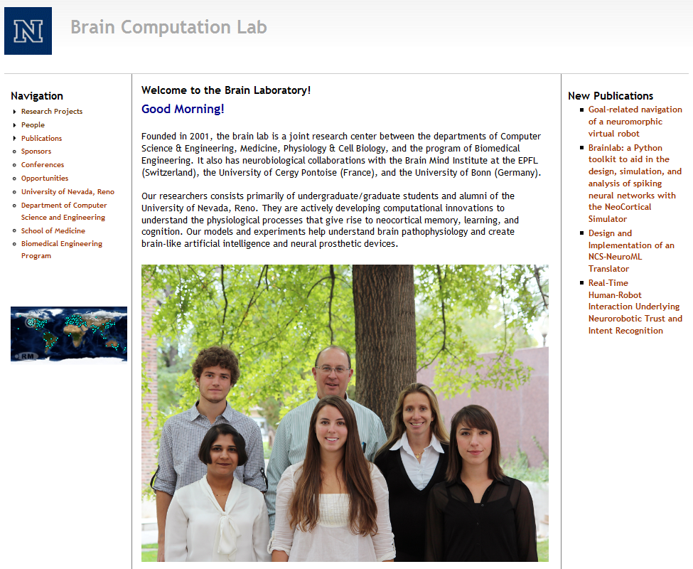
Brain Computation Lab www.cse.unr.edu/brain

Slide 3




Reno, Nevada

Slide 4


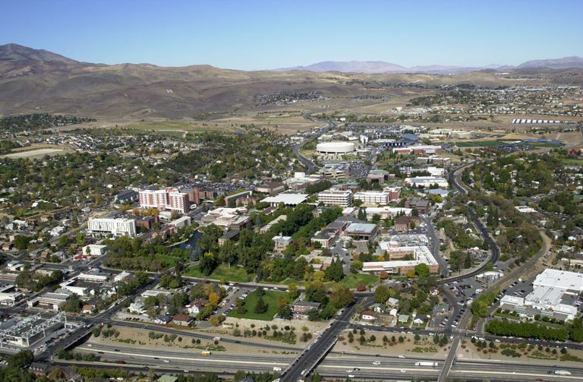

University of Nevada, Reno

Slide 5
What is NCS?
The NeoCortical Simulator (NCS) is designed for modeling large-scale neural networks and systems
One of the first simulators to support neurorobotic applications
Different types of neuron models available:
  Leaky integrate-and-fire / Hodgkin-Huxley
  Izhikevich
Free and open source
Developed and maintained by the UNR Brain Computation Laboratory

Slide 6
Why use NCS?
Biological brain models
Real-time Simulation
Different levels of abstraction
Several neuron models
GPU computation
No programming language experience required
Good for modeling neural systems and networks
Up to 1M neurons and 100M synapses in quasi real-time

Slide 7
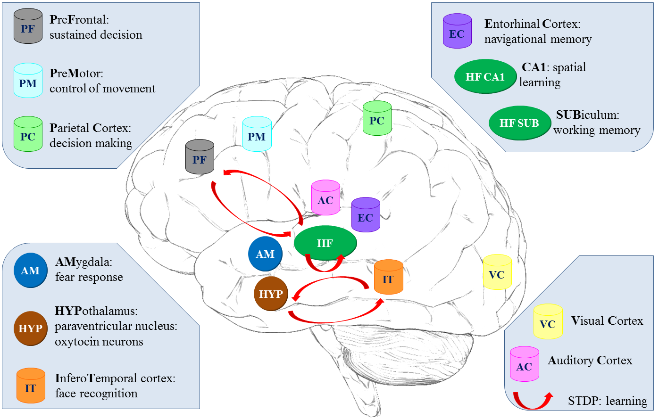
Modeled Brain Regions Using NCS

Slide 8
History of NCS
Version 1:1999
  Matlab – Goodman, Markram, and McKenna
  160-cell, 2-column architecture
    Each cell was modeled as a single integrative compartment (point neuron) with a spike mechanism,
      calcium-dependent (AHP) channels, and
      voltage-sensitive A and M (muscarinic) potassium channels
  M.M. Kellog, H.R. Wills, and P.H. Goodman. “A biologically realistic computer model of neocortical associative learning for the study of aging and dementia.” J. Investig. Med., 47(2), February 1999.

Slide 9
History of NCS
Version 1b: 1999
  Direct translation to C from Matlab
  24 times faster.
  tested on mixed excitatory-inhibitory networks of up to 1,000 cells
  M.M. Kellog, H.R. Wills, and P.H. Goodman. “A biologically realistic computer model of neocortical associative learning for the study of aging and dementia.” J. Investig. Med., 47(2), February 1999.

Slide 10
History of NCS
Version 2: 1999
  code was then redesigned and rewritten for distributed processing on an existing 20-cpu cluster (Pentium II).
  Initial trials of this code were performed on cortical networks of 2 to 1,000 cells
  M.M. Kellog, H.R. Wills, and P.H. Goodman. “A biologically realistic computer model of neocortical associative learning for the study of aging and dementia.” J. Investig. Med., 47(2), February 1999.

Slide 11
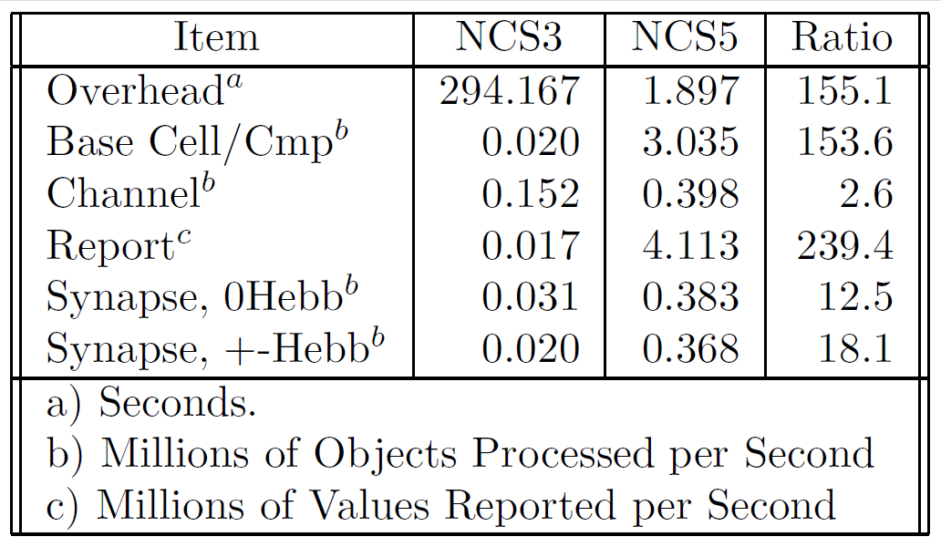
History of NCS

Slide 12
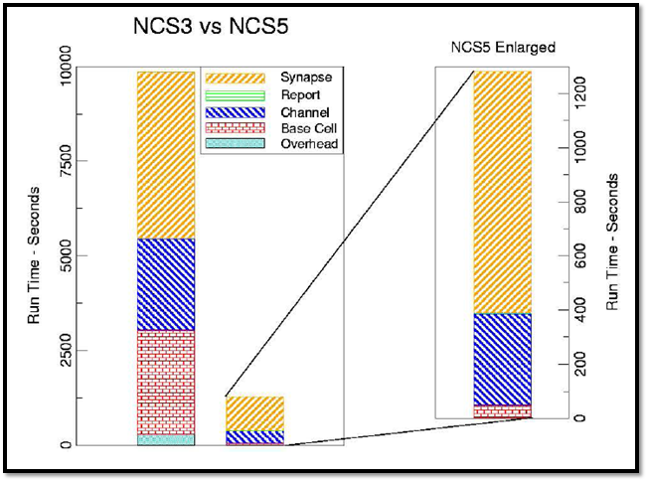
History of NCS
James Frye, James G. King, Christine J. Wilson, and Frederick C. Harris, Jr. “QQ: Nanoscale timing and profiling” In Proceedings of PMEO-PDS, Denver, CO, April 3-8 2005.

Slide 13
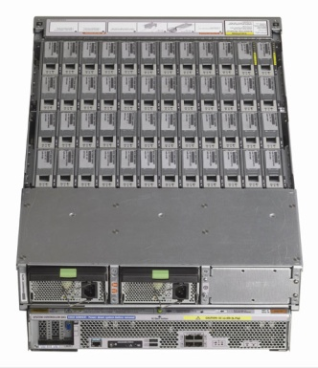
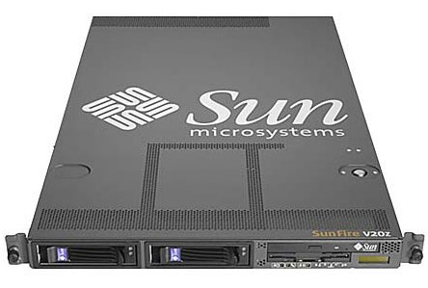
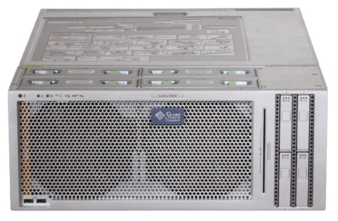
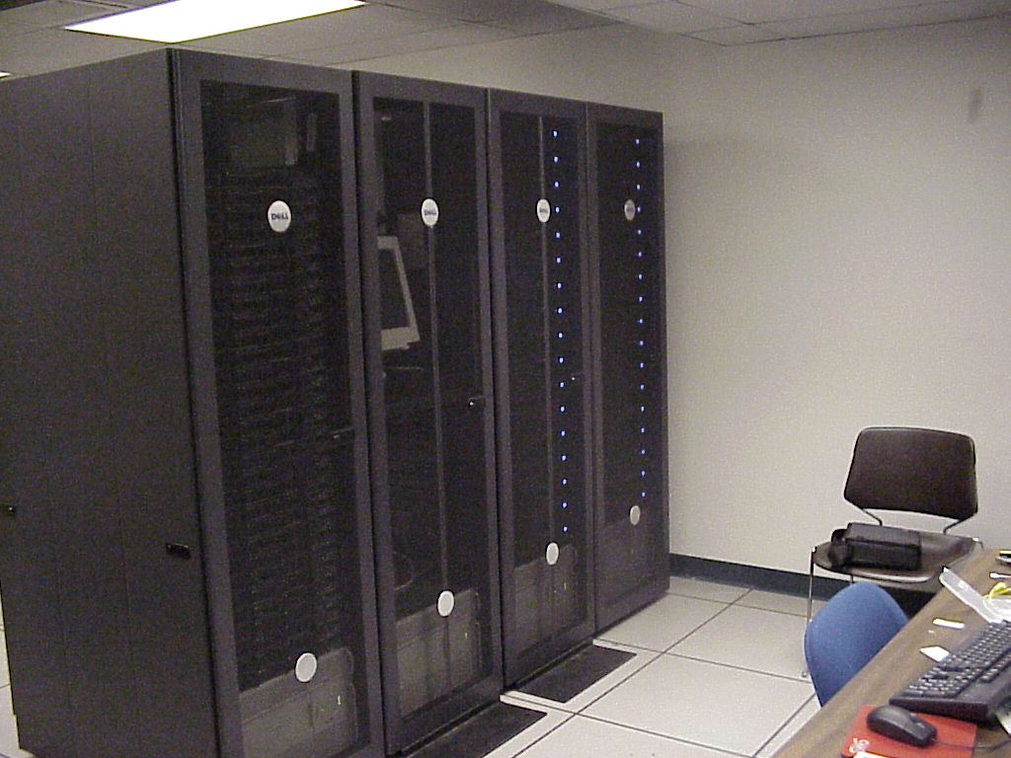
NCS5 Hardware
2007
2008
Sun 4600s and 4500s
16 core boxes with 200GB of RAM
connected by Infiniband
And several 24TB disk arrays
Sun v20z Opteron
(60 CPUs)
ONR DURIP 2007:
ONR DURIP 2008:

Slide 14
Current NCS version 6 implementation
GPU/CPU/cluster-based
  Runs on CPUs and CUDA devices simultaneously
Plugin interface for multiple model support
  LIF/HH Neurons
  Izhikevich Neurons
  Ability to design your own
Ability for multi-scale modeling

Slide 15
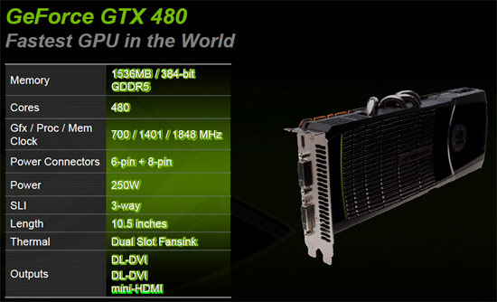
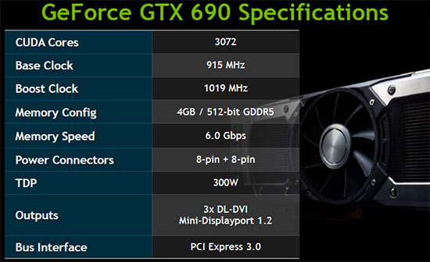
NCS 6 Software / Hardware
Linux based operating system
NVIDIA GPU (GeForce GTX 400 series or higher)

Slide 16
Current Optimization
C++ 11
Heavily threaded
  Latency hiding
  Increased occupancy
Modular message passing design
GPU usage for parallel computation
Load-balancing across heterogeneous clusters

Slide 17
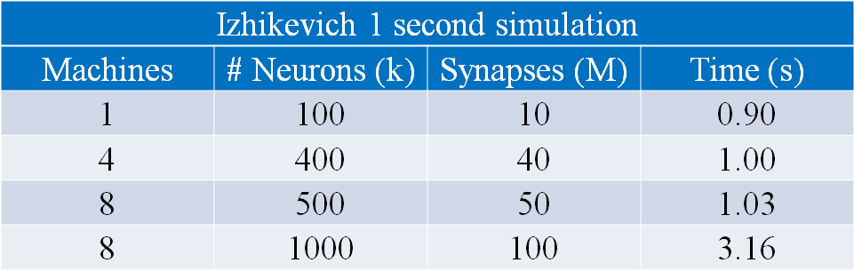
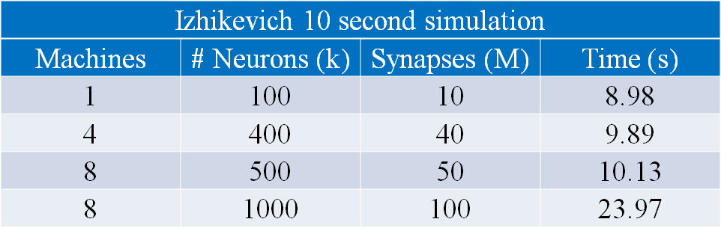
Performance Data
Izhikevich

Slide 18
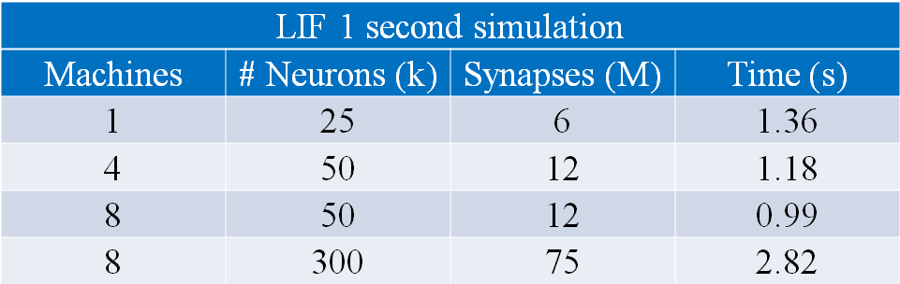
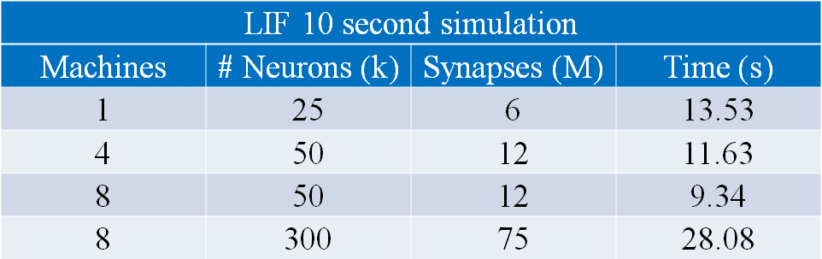
Performance Data
LIF

Slide 19
Leaky Integrate-and-Fire Model

Slide 20
Brain
Define the simulation as a whole
Preliminary outline of other structures
  Anatomy
  Stimuli
  Reports
Extrinsic connections
Include files

Slide 21
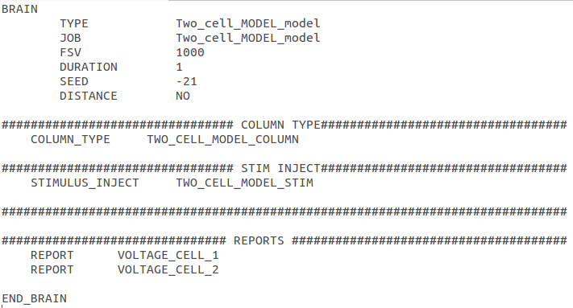
Brain

Slide 22
Anatomy
Columns
Layers
Cells
Compartments
Channels

Slide 23
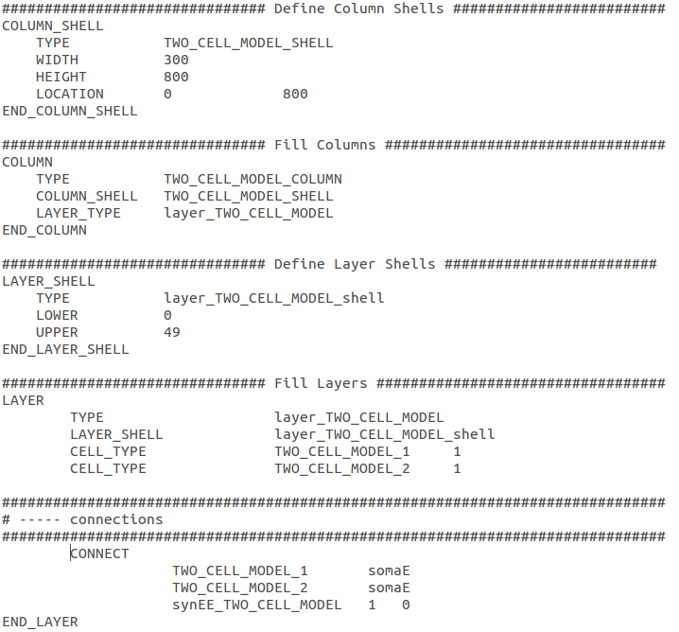
Anatomy

Slide 24
Channels
Km
  Only has one activation particle (m). Inhibits its parent cell from reaching threshold
Kahp
  After Hyper Polarization Channels (Kahp) are voltage independent but Calcium dependent
Ka
  Helps the cell deal with background noise. It has both an activation (m) and inactivation (h) particle

Slide 25
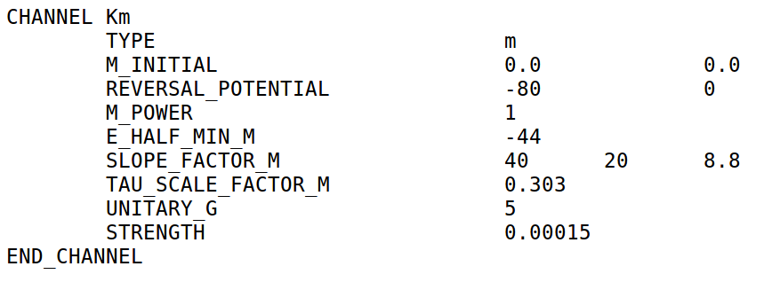
Channel Km

Slide 26
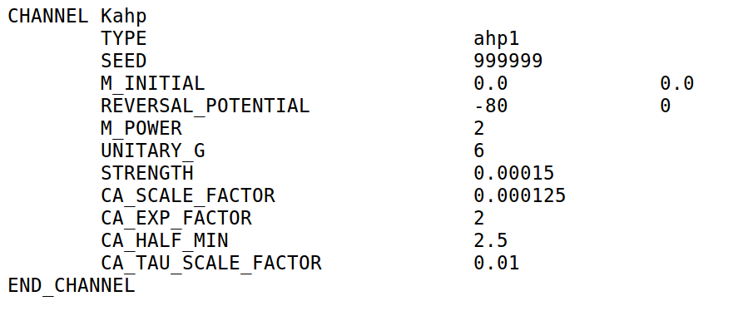
Channel Kahp

Slide 27
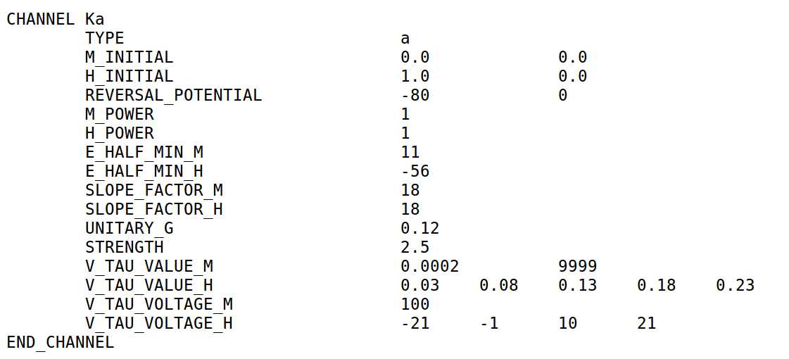
Channel Ka

Slide 28
Stimulus
External Stimulation (visual, audio…)
Type of signals
  Linear
  Pulse
  Noise
  File-based
Multiple times
Different Destinations

Slide 29
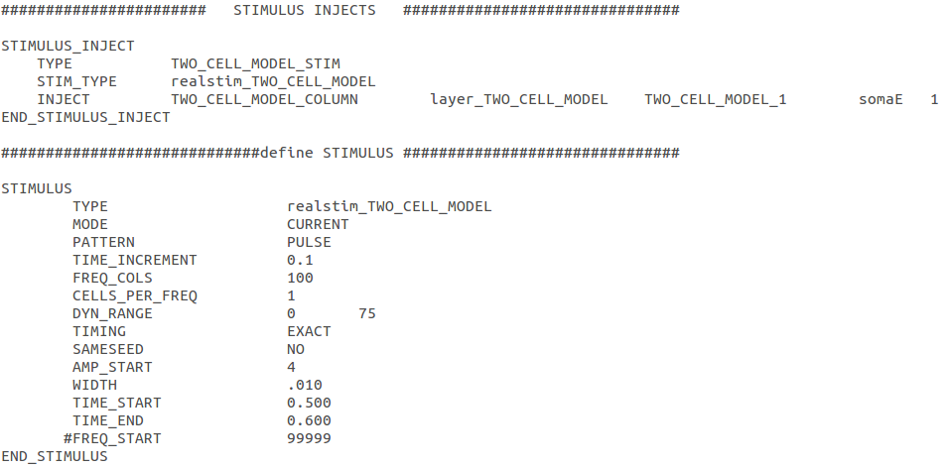
Stimulus

Slide 30
Connections
Extrinsic and intrinsic connections
Synapse connections
From the source to the destination
With or without decaying distance effects
Recurrent connections

Slide 31

Connections

Slide 32
Synapses
Connections between other cells and their compartments
Excitatory
Inhibitory
Synaptic Waveform
Learning
  Short term synaptic dynamics
    Facilitation
    Depression
  Long term synaptic dynamics (Hebbian Learning)
    STDP rule

Slide 33
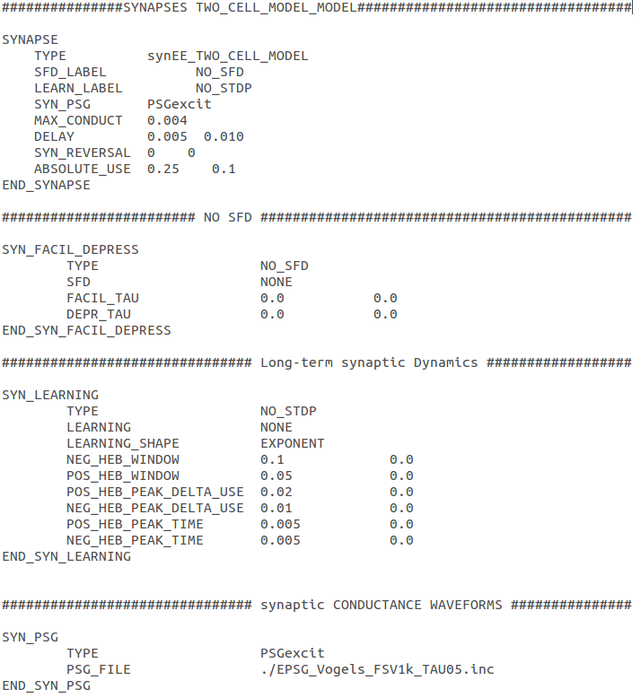
Synapses

Slide 34
Reports
Data about cells
Report files:
  Voltage
  Current
  Firecount
  Channel
  Synaptic strengths
Automatically generated and saved

Slide 35
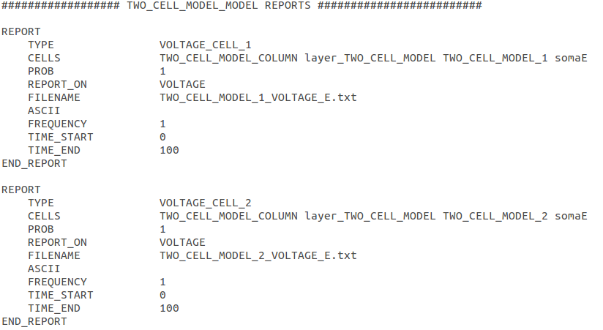
Reports

Slide 36
Izhikevich Model

Slide 37
Files
Neuron file
Synapse file
Current file

Slide 38

Neuron File
Parameters
  NeuronID
  a
  b
  c
  d
  u
  v
Regular Spiking

Slide 39
Synapse File
Parameters
  PreNeuron
  PostNeuron
  Delay
  Weight
  APlus
  AMinus
  TauPlus
  TauMinus

Slide 40

Current File
Parameters
  Neuron ID
  Time start
  Time end
  Amp
  Width
  Frequency
Regular Spiking

Slide 41
Robotic Applications with NCS

Slide 42
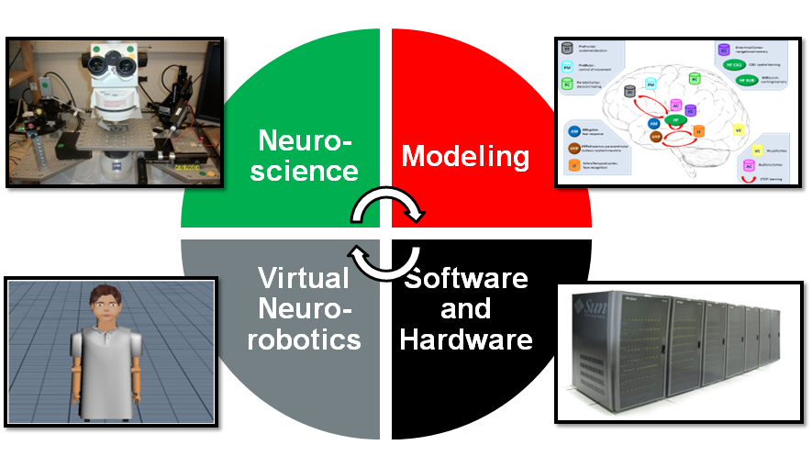
Technical Approach

Slide 43
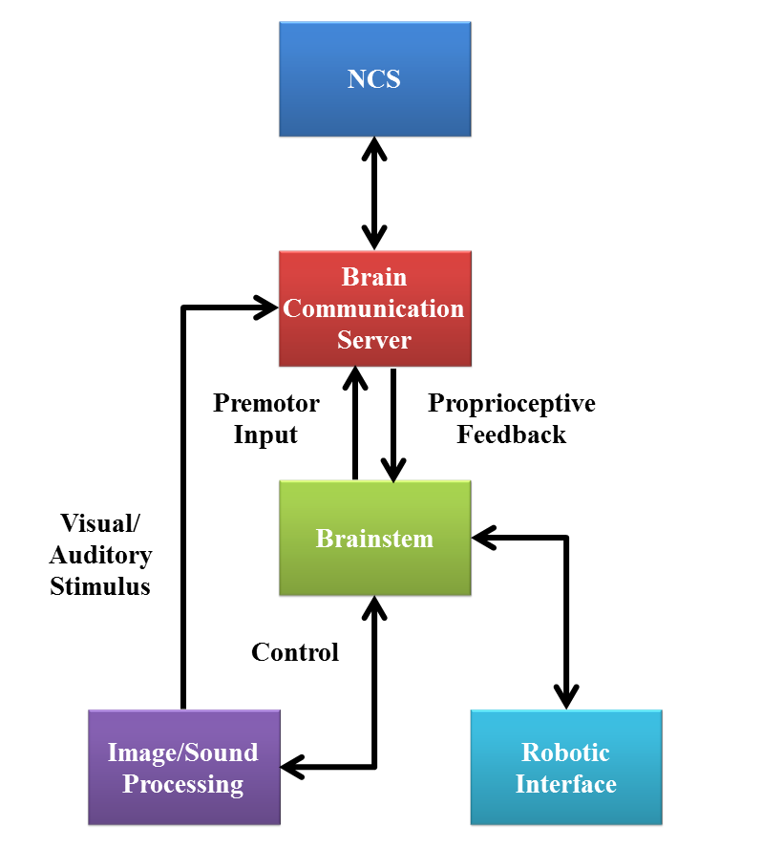
Virtual NeuroRobotic (VNR)
Laurence C. Jayet Bray, Sridhar R. Anumandla, Corey M. Thibeault, Roger V. Hoang, Philip H. Goodman, Sergiu M. Dascalu, Bobby D. Bryant, and Frederick C. Harris, Jr. “Real-time human-robot interaction underlying neurorobotic trust and intent recognition” Neural Networks, 32:130-137, 2012.

Slide 44
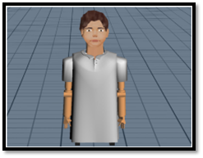
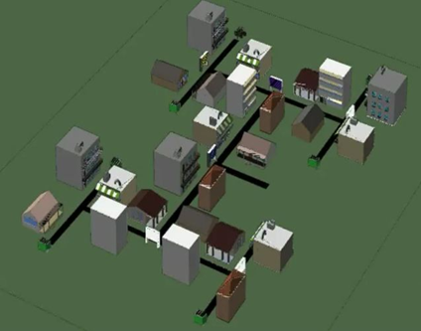
Robotic Interface
Constructed using Webots 5
Motions were programmed in C++ using the provided interfaces and the communication was accomplished using the NCSTools C++ client

Slide 45
Trust
Behavior between a humanoid neurorobot and human actor
  Oxytocin release
    Social reinforcement
    Reduction of inhibition
Experiment has two conceptual phases:
  Learning
  Challenge

Slide 46




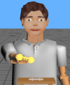


Paradigm
Learning
Challenge (at any time)
Robot Initiates Action
Human Responds
Human Acts
Robot Reacts
Robot brain initiates arbitrary sequence of motions
Human moves object in either a similar (“match”), or different (“mismatch”) pattern
Human slowly reaches for an object on the table
Robot either “trusts”, (assists/offers the object), or “distrusts”, (retract the object).
Match: robot learns to trust
Mismatch: don’t trust
trusted
distrusted
Sridhar R. Anumadla, Laurence C. Jayet Bray, Corey M. Thibeault, Roger V. Hoang, Sergiu M. Dascalu, Frederick C Harris, Jr., and Philip H. Goodman “Modeling Oxytocin Induced Neurorobotic Trust and Intent Recognition in Human Robot Interaction” In Proceedings of the IJCNN (2011) July 31-Aug 5, 2011, San Jose, CA.

Slide 47

Concordant Motions Video

Slide 48
Discordant Motions Video

Slide 49
Emotional Speech
Allows for more natural interaction between humans and robots
  Determine the ideal behavior from a simple reward feedback
Emotional Speech processor
  Successfully distinguished “sad” and “happy” utterances
Integrated into neurorobotic scenario
  The robot received a spoken reward if the correct decision was made
Step toward the combination of human emotions and virtual neurorobotics

Slide 50
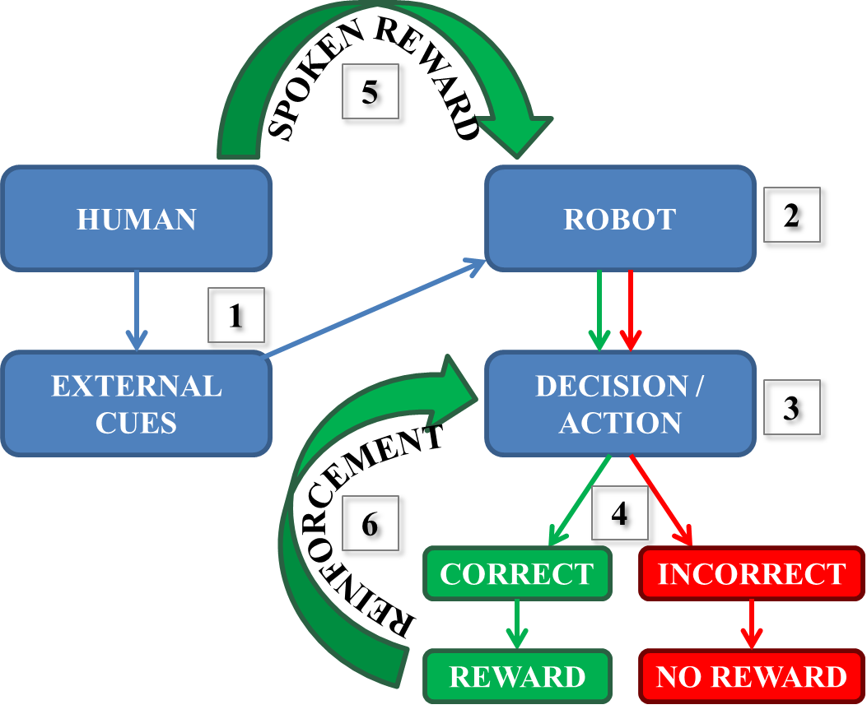
Reward-based Learning Through ESP

Slide 51
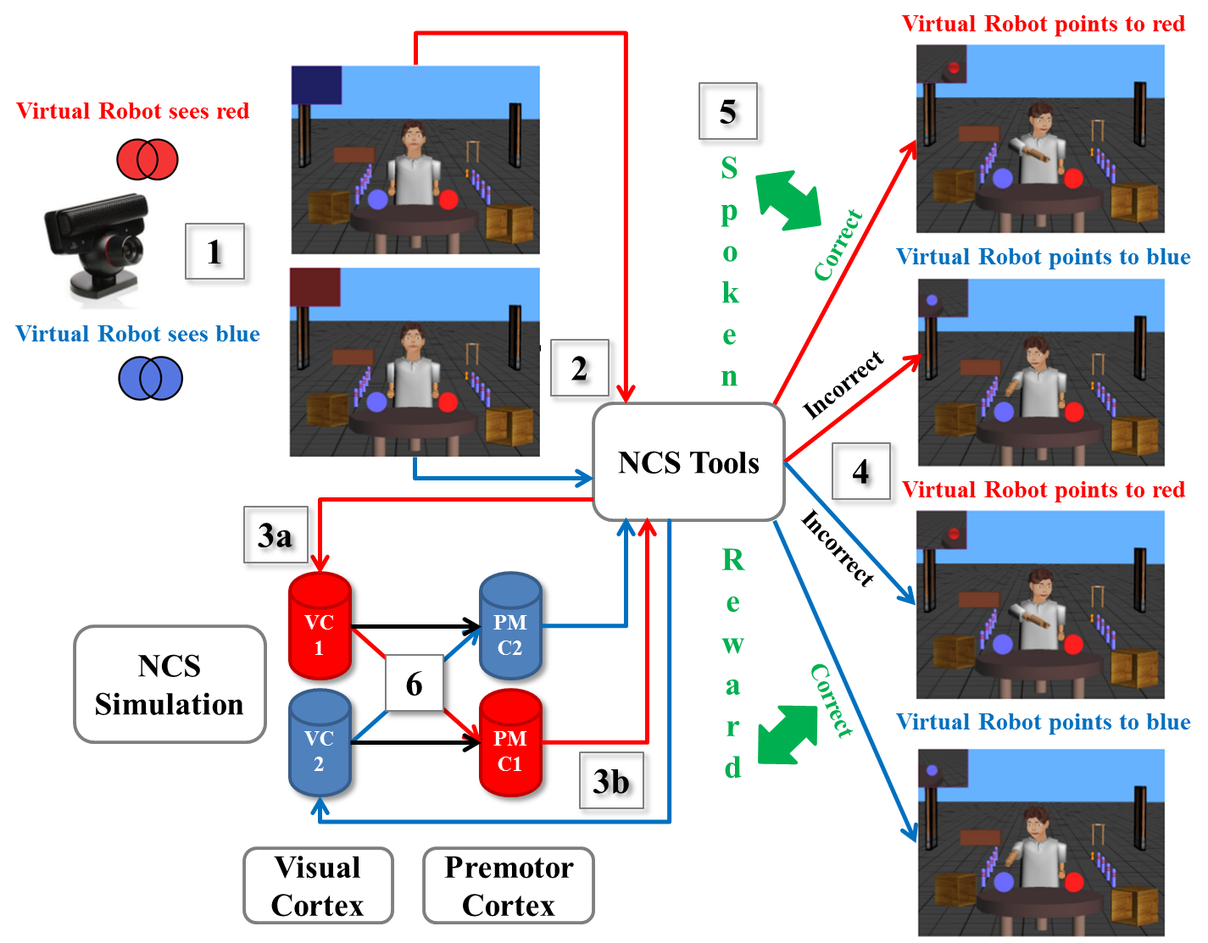
Reward-based Learning Through ESP

Slide 52
Navigation
Navigate to familiar location
  Prefrontal Cortex
  Hippocampus (CA1 and Subiculum)
  Entorhinal cortex
Computational system representing a navigating rodent
Reward at the end of a sequence of 3 turns
Showed learning performance without biased decisions
Short-term memory

Slide 53
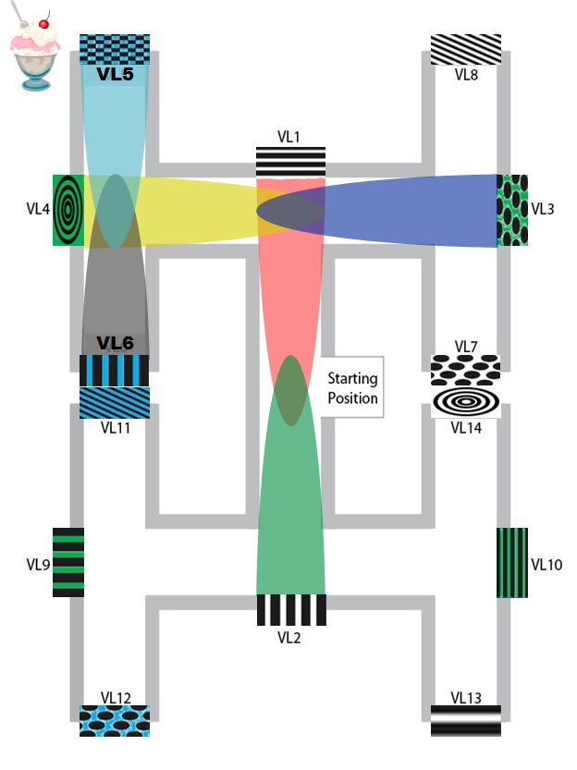
Paradigm
Jayet Bray L. A Circuit-Level Model of Hippocampal, Entorhinal and Prefrontal Dynamics Underlying Rodent Maze Navigational Learning. Ph.D. Dissertation. University of Nevada, Reno, 2010.

Slide 54
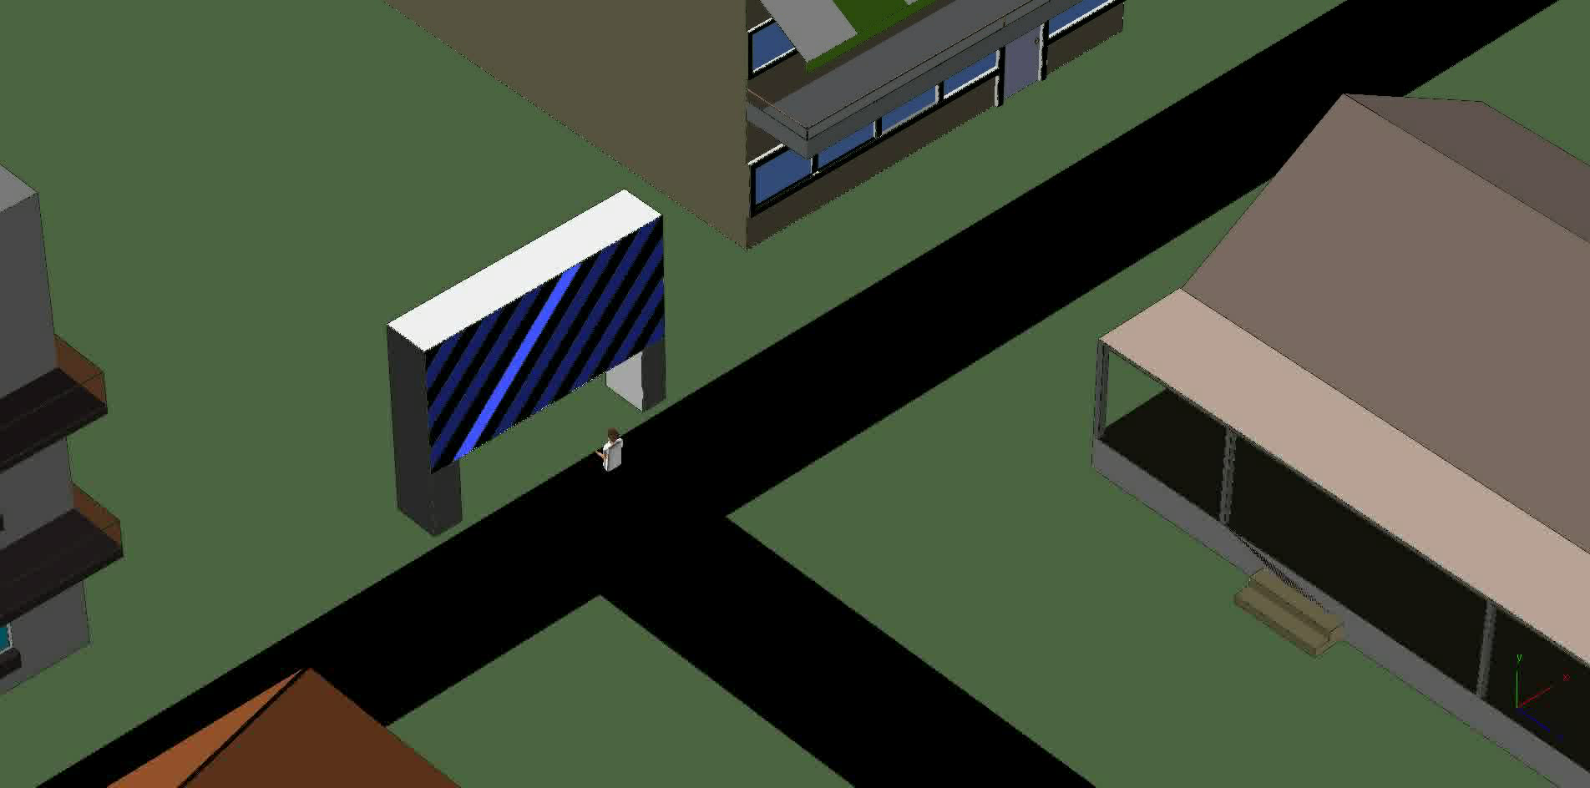
Navigation Video
Incorrect Choice

Slide 55
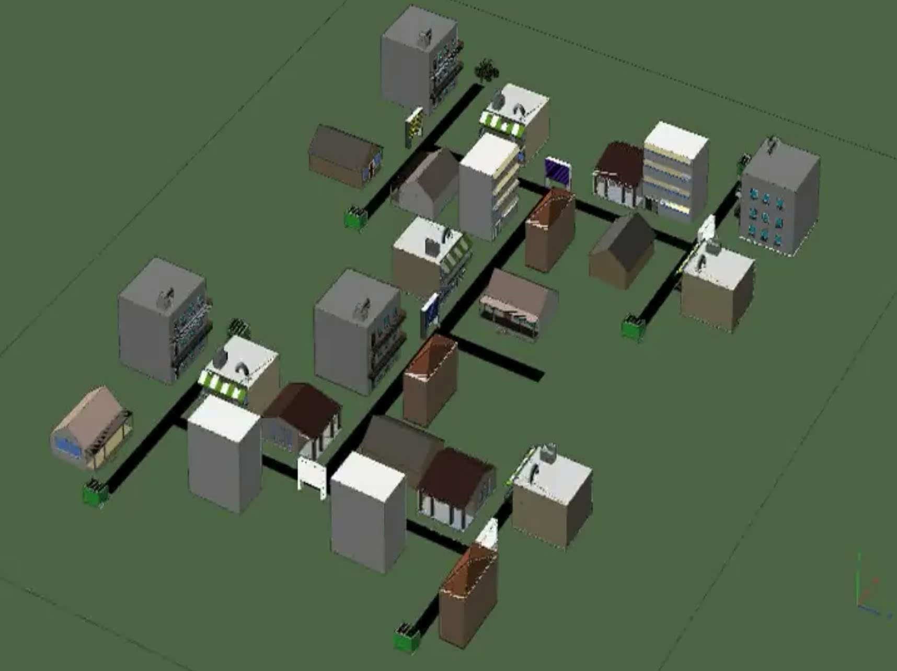
Navigation Video
Correct Choice

Slide 56
Future Directions
Simulator & Tools
Near Term:
  GUI-based brain model builder and visualizer
  Multi-Scale modeling
  Input language options
Long Term:
  Simulated fMRI data

Slide 57



Acknowledgments
Office of Naval Research
DARPA Synapse project and HRL

