Slide 1

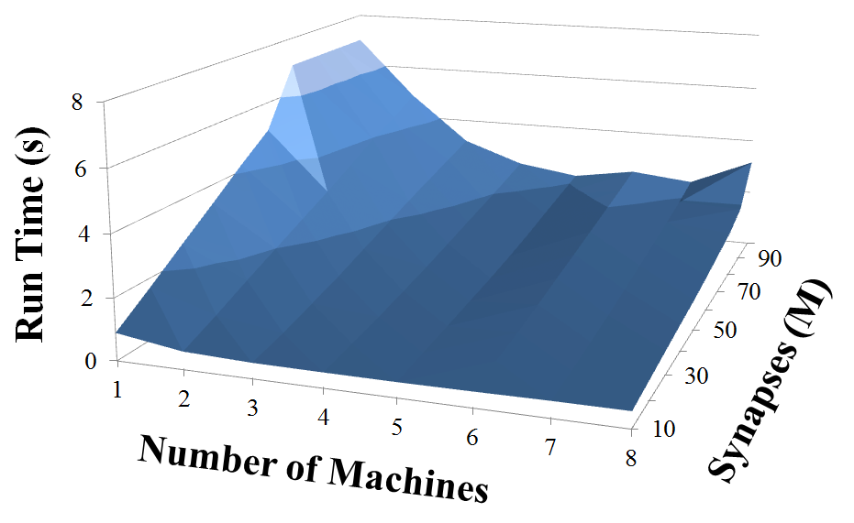
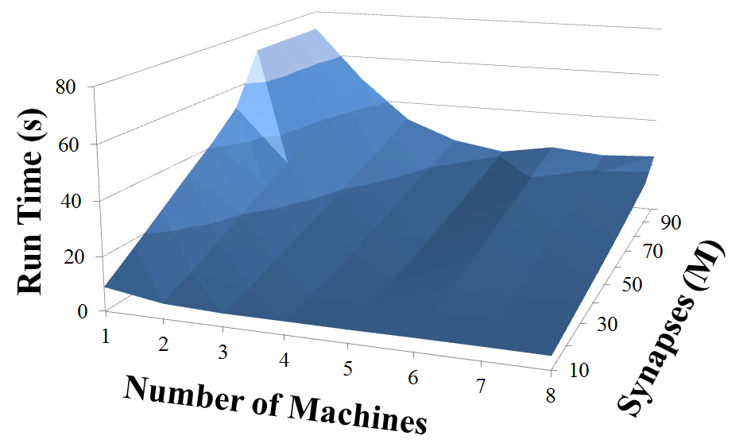
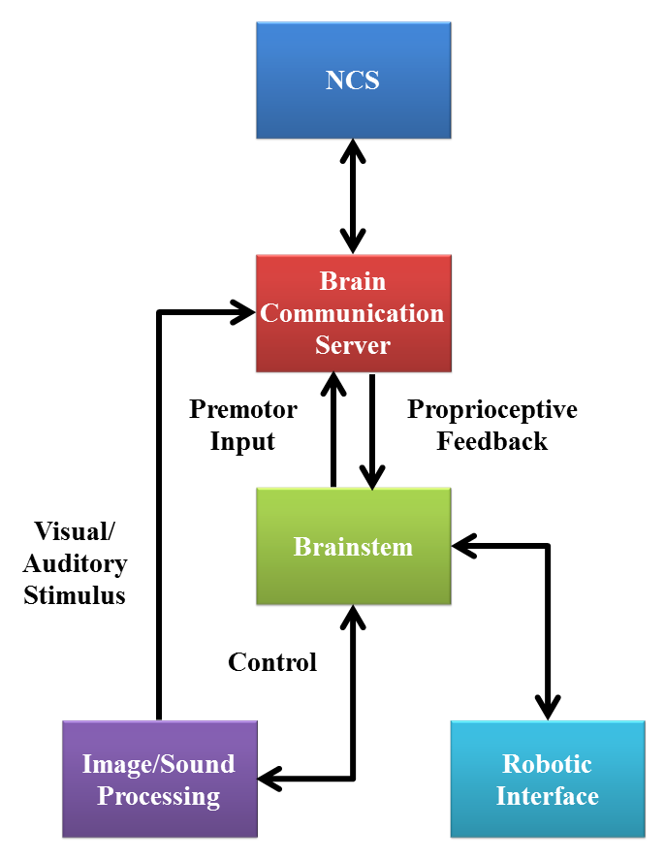
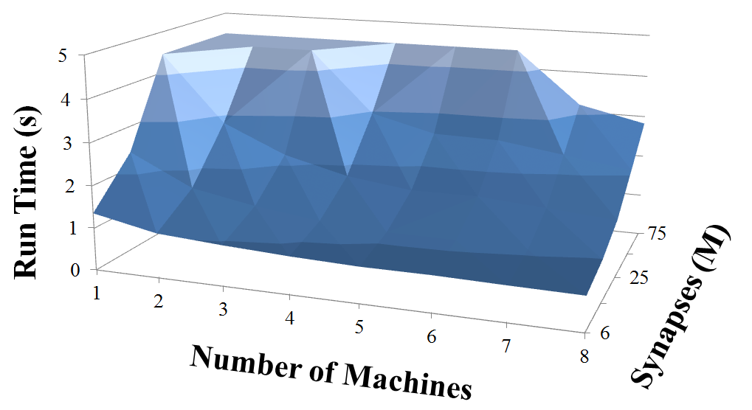
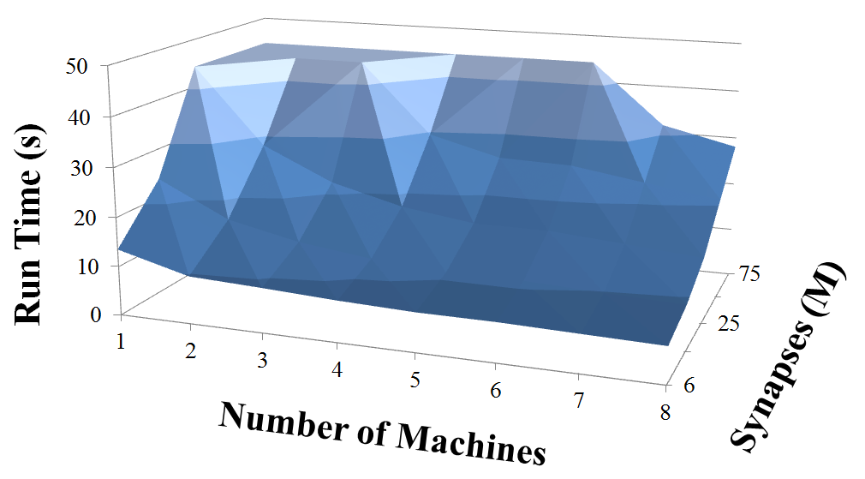
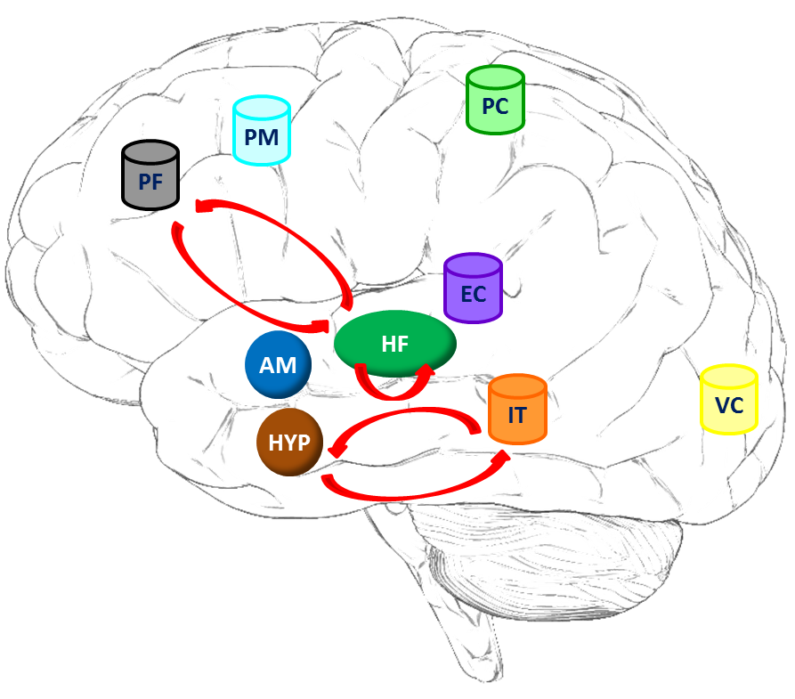

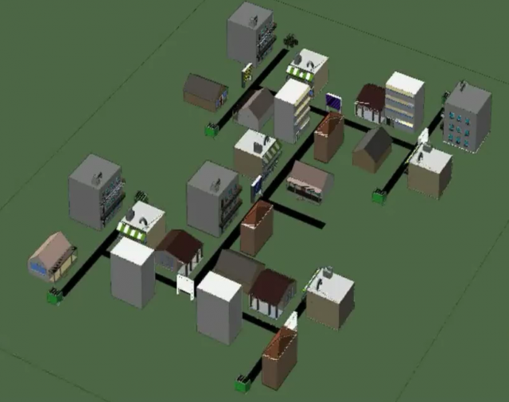
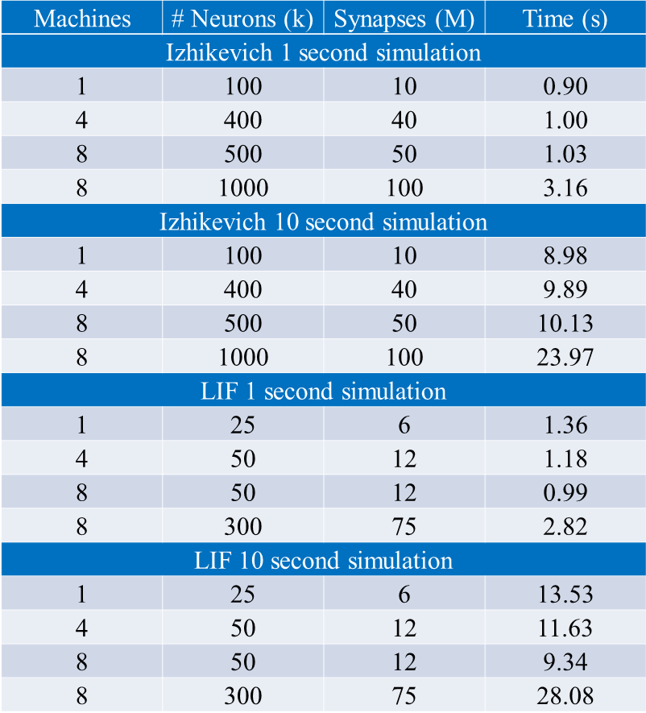
NCS: A Large-Scale Brain Simulator
Devyani Tanna, BS, Laurence C. Jayet Bray, PhD, Bobby D. Bryant, PhD, Frederick C. Harris Jr., PhD
Brain Computation Laboratory, University of Nevada, Reno
www.cse.unr.edu/brain
WHAT IS NCS?
PERFORMANCE
ROBOTICS
MODELS
The NeoCortical Simulator (NCS) is a free, open source, scalable, parallelizable, distributable, real-time simulator for large-scale neural networks and systems, developed and maintained by the UNR Brain Computation Laboratory. It is also the one of the first simulators to support real-time neurorobotics applications. The current version of NCS, NCS6, uses GPUs for parallel computation. NCS6 is designed to create different types of neuron models: leaky integrate-and-fire (LIF) spiking neurons using a reordered form of the Hodgkin-Huxley (HH) equations and Izhikevich neurons using a dynamical system and Izhikevich (IZH) equations. Users also have an ability to design their own plug-in interface for different neuron types.
Our virtual neurorobotic (VNR) system aims to develop combinations of biological neural simula-tions with robotic agents and human participants in closed-loop configurations. VNR is defined as a computer-facilitated loop to study high-level beha-vioral systems. As shown in Figure 2, VNR is composed of supporting tools that include the Brain Communication Server, which manages real-time input/output for a running
As shown in Figure 5, key interacting brain regions have been modeled (PF-PreFrontal,, PM-PreMotor, PC-Parietal Cortex, AM-Amygdala, HF-Hippocampal Formation, EC-Entorhinal Cortex, HYP-Hypothalamus, IT-Infero-Temporal, VC-Visual Cortex, Red Arrows-Learning: STDP rule)
Figure 1: Performance Data (Top left: IZH 1s; top right: IZH 10s; bottom left: LIF 1s; bottom right: LIF 10s)
NCS6 is capable of running large-scale neural models (100,000 - 1,000,000 neurons) faster than any other simulators by distributing data across multiple GPUs. Considering a synapse to neuron ratio of 100 (e.g. 500,000 neurons and 50 million synapses), NCS runs any models up to 1 million neurons in quasi real-time, for 1s and 10s simulations, as presented in Figures 1 and Table 1 for the LIF/HH and IZH neurons, respectively. In the NCS performance figures, up to eight machines were used with each having two video cards (mostly NVIDIA GTX 480). From one to hundred-second simulations, NCS has shown minimal loss of performance over time.
Figure 2: VNR
simulation; Brainstem, which serves as a preprocessor for digital audio, visual, and tactile inputs and an interpreter of motor-control outputs, as required by our neurorobotics applications; and a robotic interface, which represents behavioral scenarios and higher-level behavioral outcomes.
WHY USE NCS?
Figure 5: Modeled Brain Regions
Interests/Reasons
Biological brain models
Real-time simulation
Different levels of abstraction
Several neuron models
GPU computation
Advantages
No programming language experience required
Good for modeling networks and systems
Real-time simulation for 500k neurons and 50M synapses
Quasi real-time simulation for 1M neurons and 100M synapses
Disadvantages
Lack of biophysical details
No graphical user interface (GUI)
No visualization
System Requirements
Linux operating system
NVIDIA graphical cards
FUTURE
DIRECTIONS
Simulator & Tools
Near Term:
Input language options
GUI-based Brain Model Builder and Visualizer
Multi-Scale Modeling
Long Term:
Simulated fMRI data
Modeling & Simulation
Near Term:
Higher-level behavior
Expanded and more detailed models
Long Term:
Disorders and interventions
Drug interactions
Figure 3: Virtual Robot
Figure 4: Virtual Environment
Our existing models and robotic applications consist of replicating trust and intent recognition and spatial navigation. In the first project, we offer a model of a mechanism for trust-building between our virtual neurorobot (Figure 3) and a human participant where imitation of behavior can result in an increase in trust. In this model, we try to replicate the trusting role of hypothalamic oxytocin cells and the suppressing functions of the amygdala. In the second project, we use a virtual city-like maze (Figure 4) to examine the formation of short-term memory, decision making, and reward-based learning during the exploration of a three-binary-decision maze to reach a goal. In this model, we try to replicate the dynamics of mammalian hippocampal-prefrontal loop circuitry during sequential learning.
Table 1: Performance Data
Supported by a grant from the U.S. Office of Naval Research (N000140110014)

