Slide 1

NCS: A Large-Scale Brain Simulator
Devyani Tanna
Laurence C. Jayet Bray
Bobby D. Bryant
Frederick C. Harris, Jr.

Slide 2
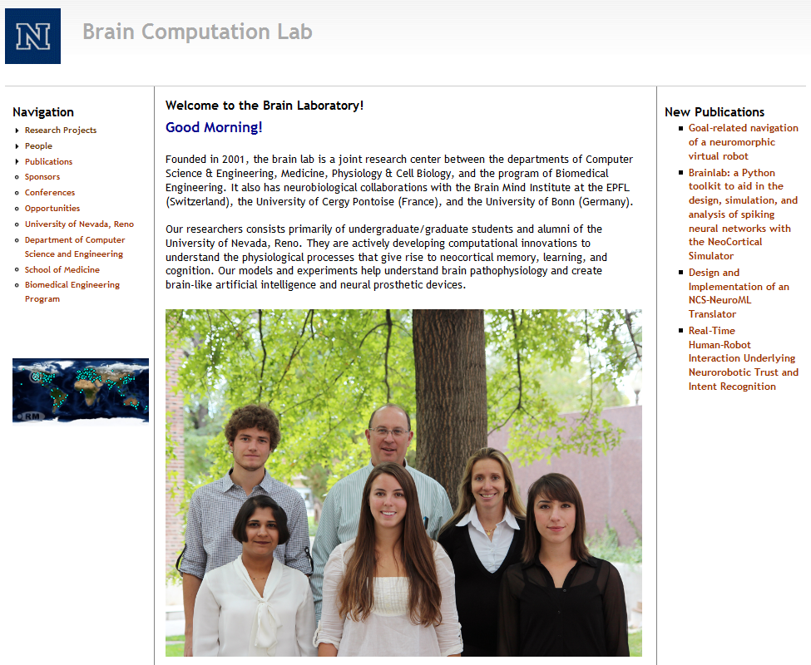
Brain Computation Lab www.cse.unr.edu/brain

Slide 3
What is NCS?
The NeoCortical Simulator (NCS) is designed for modeling large-scale neural networks and systems
One of the first simulators to support neurorobotic applications
Different types of neuron models available:
  Leaky integrate-and-fire / Hodgkin-Huxley
  Izhikevich
Free and open source
Developed and maintained by the UNR Brain Computation Laboratory

Slide 4
Why use NCS?
Biological brain models
Real-time Simulation
Different levels of abstraction
Several neuron models
GPU computation
Python Interface
Good for modeling neural systems and networks
Up to 1M neurons and 100M synapses in quasi real-time

Slide 5
Current NCS version 6 implementation
GPU/CPU/cluster-based
  Runs on CPUs and CUDA devices simultaneously
Plugin interface for multiple model support
  LIF/HH Neurons
  Izhikevich Neurons
  Ability to design your own
Ability for multi-scale modeling

Slide 6
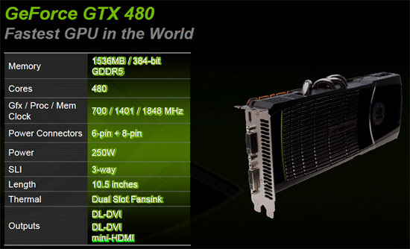
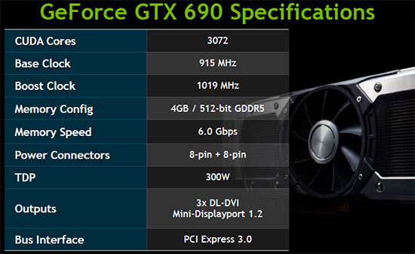
Current Hardware

Slide 7
Current Optimization
C++ 11
Heavily threaded
  Latency hiding
  Increased occupancy
Modular message passing design
GPU usage for parallel computation
Load-balancing across heterogeneous clusters

Slide 8
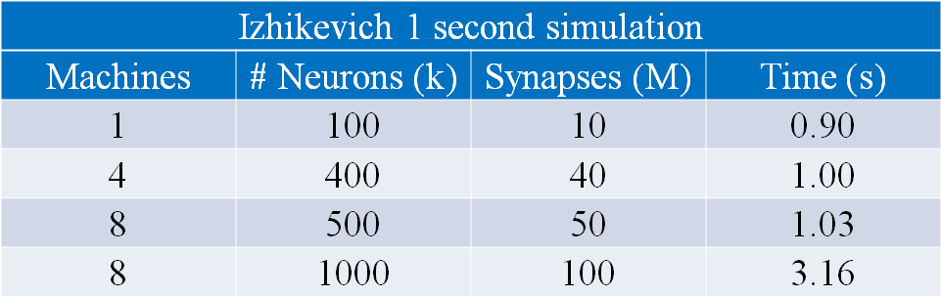
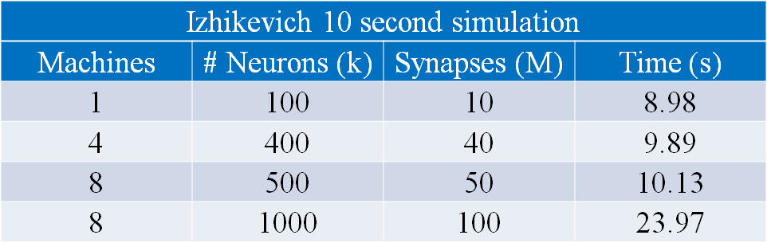
Performance Data
Izhikevich

Slide 9
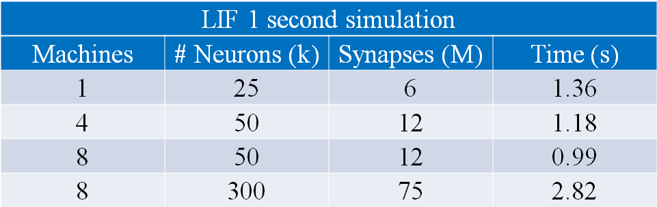
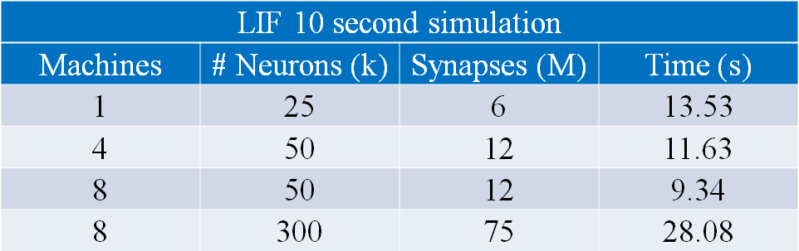
Performance Data
LIF

Slide 10
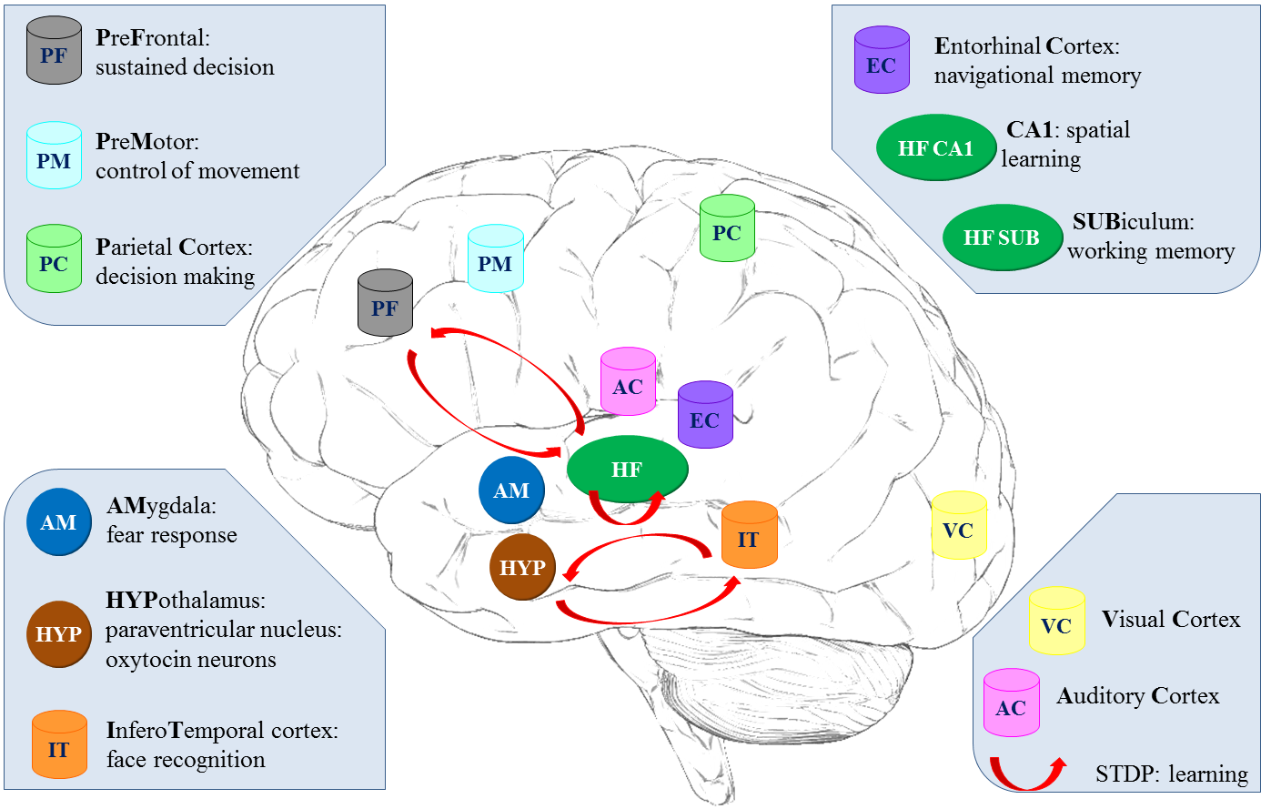
Modeled Brain Regions Using NCS

Slide 11
Simple Model

Slide 12
Simulation Building Blocks
Model Parameters
Cell Group
Cell Alias
Connection Group
Connection Alias
Stimulus
Report
Simulation Parameters

Slide 13
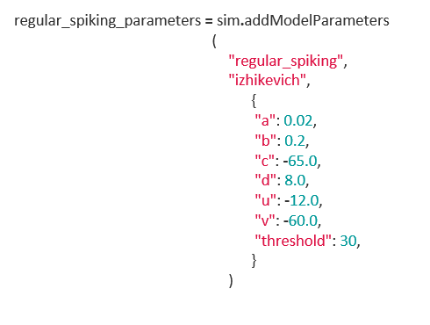
Model Parameters
A model name
A model type
  Izhikevich, LIF, etc.
A map from parameter names to their values

Slide 14
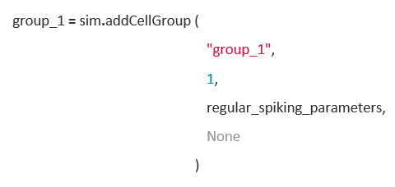
Cell Group
A group name
A number of cells
Model Parameters
Geometry

Slide 15
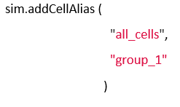
Cell Alias
A set of other cell groups and cell aliases

Slide 16
Types of Synapses
Connections between other cells and their compartments
Excitatory
Inhibitory
Synaptic Waveform
Learning
  Short term synaptic dynamics
    Facilitation
    Depression
  Long term synaptic dynamics (Hebbian Learning)
    STDP rule

Slide 17
Types of Connections
Extrinsic and intrinsic connections
Synapse connections
From the source to the destination
With or without decaying distance effects
Recurrent connections

Slide 18
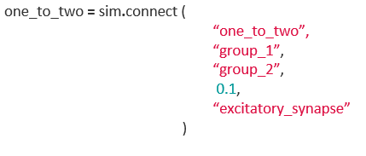
Connection Group
Connection Name
Presynaptic Cell Alias
Postsynaptic Cell Alias
Probability of Connection
Model Parameter

Slide 19
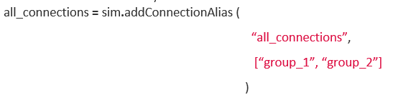
Connection Alias
A set of other connection groups and connection aliases

Slide 20
Types of Stimulus
External Stimulation (visual, audio…)
Type of signals
  Linear
  Pulse
  Sine
  Noise
Multiple times
Different Destinations

Slide 21
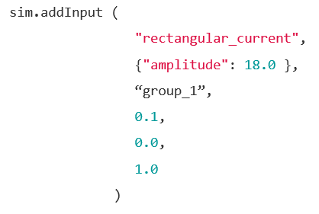
Stimulus
A model type
A map from parameter names to their values
A set of target cell groups
Probability of cell receiving input
Start time
End time

Slide 22
Types of Reports
Data about cells
Report files:
  Voltage
  Current
  Firecount
  Channel
  Synaptic strengths
Automatically generated and saved

Slide 23
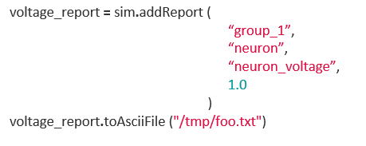
Report
A set of neurons or a set of synapses to report on
A target type: “neuron” or “synapses”
The target attribute
The percentage of elements to report on

Slide 24
Robotic Applications with NCS

Slide 25
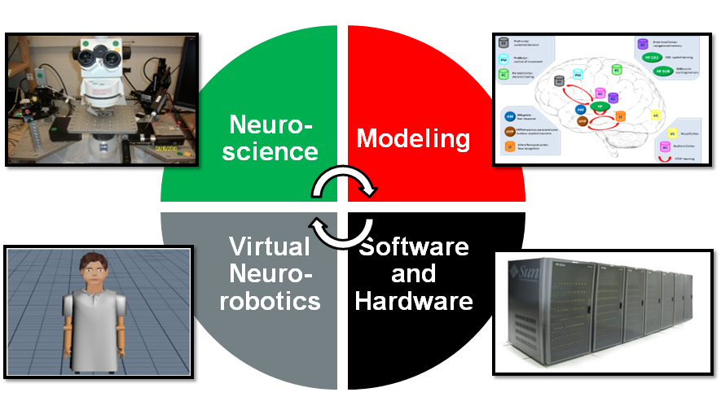
Technical Approach

Slide 26
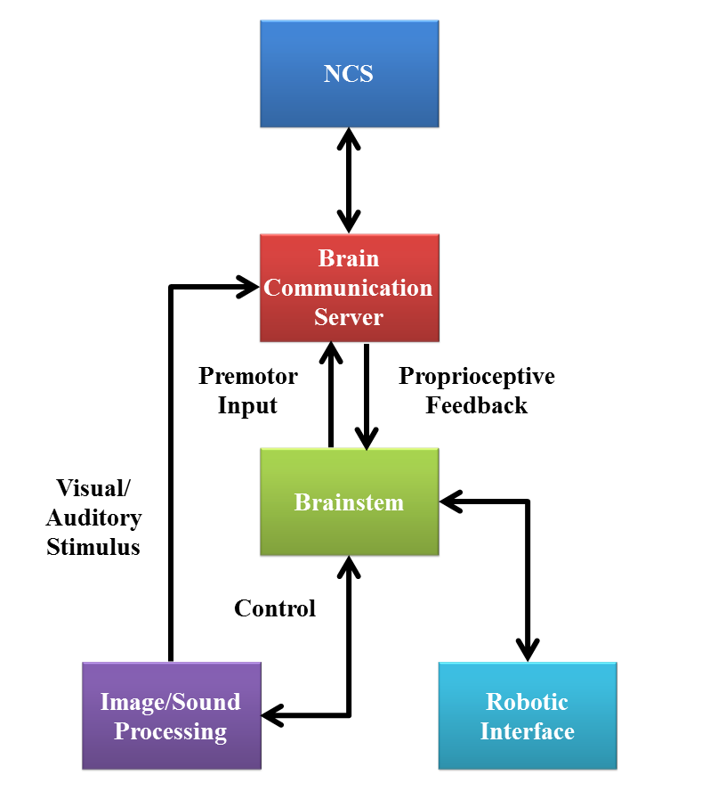
Virtual NeuroRobotic (VNR)

Slide 27
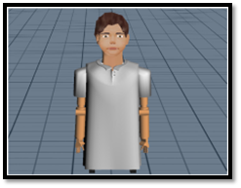
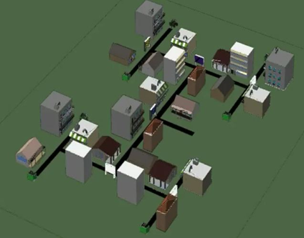
Robotic Interface
Constructed using Webots 5
Motions were programmed in C++ using the provided interfaces and the communication was accomplished using the NCSTools C++ client

Slide 28
Trust
Behavior between a humanoid neurorobot and human actor
  Oxytocin release
    Social reinforcement
    Reduction of inhibition
Experiment has two conceptual phases:
  Learning
  Challenge

Slide 29







Paradigm
Learning
Challenge (at any time)
Robot Initiates Action
Human Responds
Human Acts
Robot Reacts
Robot brain initiates arbitrary sequence of motions
Human moves object in either a similar (“match”), or different (“mismatch”) pattern
Human slowly reaches for an object on the table
Robot either “trusts”, (assists/offers the object), or “distrusts”, (retract the object).
Match: robot learns to trust
Mismatch: don’t trust
trusted
distrusted

Slide 30

Concordant Motions Video

Slide 31
Discordant Motions Video

Slide 32
Emotional Speech
Allows for more natural interaction between humans and robots
  Determine the ideal behavior from a simple reward feedback
Emotional Speech processor
  Successfully distinguished “sad” and “happy” utterances
Integrated into neurorobotic scenario
  The robot received a spoken reward if the correct decision was made
Step toward the combination of human emotions and virtual neurorobotics

Slide 33
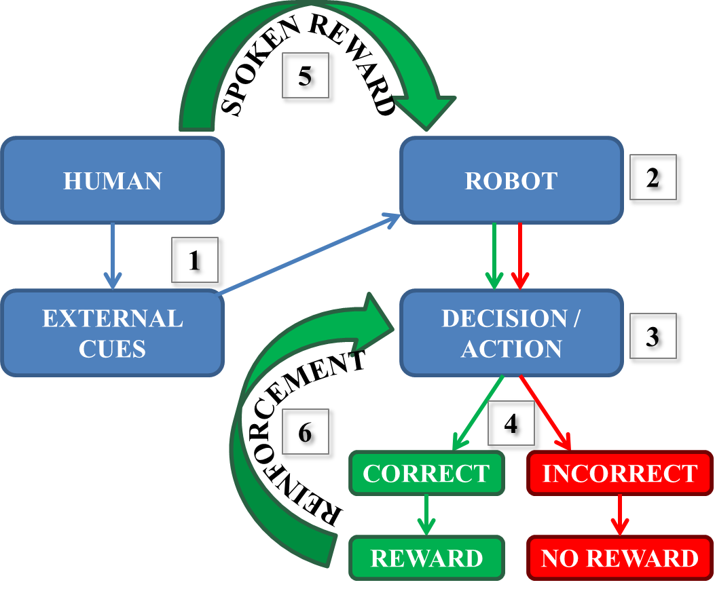
Reward-based Learning Through ESP

Slide 34
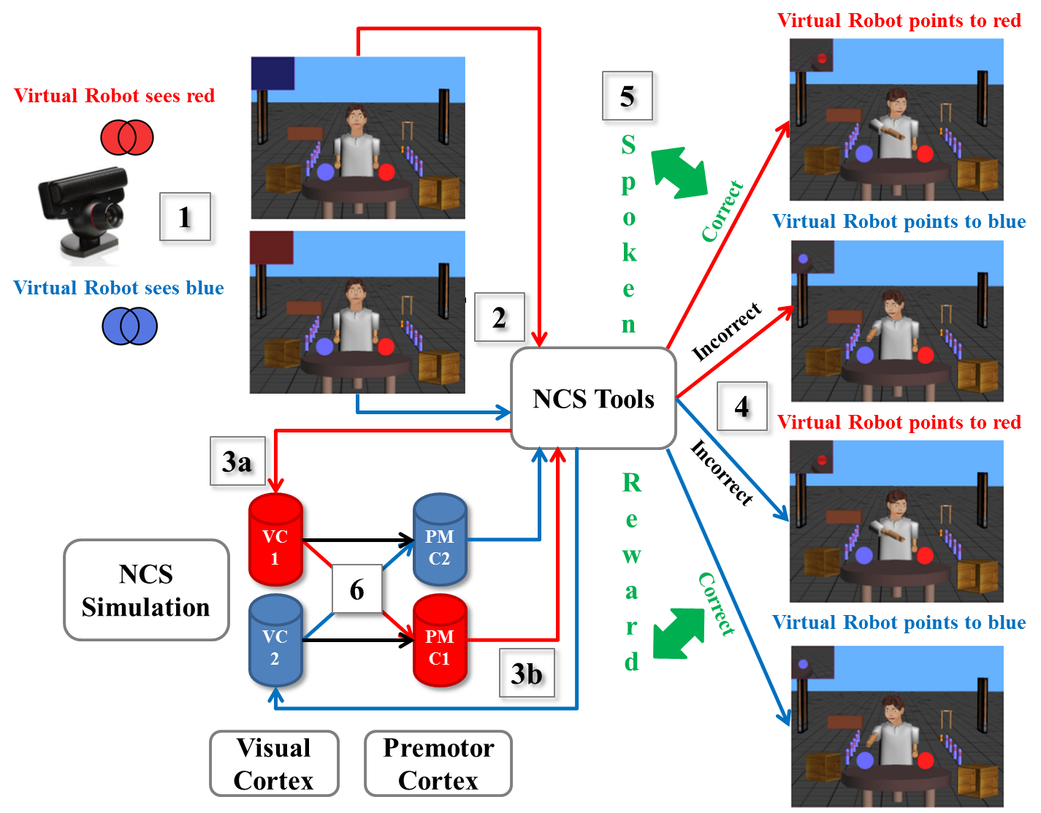
Reward-based Learning Through ESP

Slide 35
Navigation
Navigate to familiar location
  Prefrontal Cortex
  Hippocampus (CA1 and Subiculum)
  Entorhinal cortex
Computational system representing a navigating rodent
Reward at the end of a sequence of 3 turns
Showed learning performance without biased decisions
Short-term memory

Slide 36
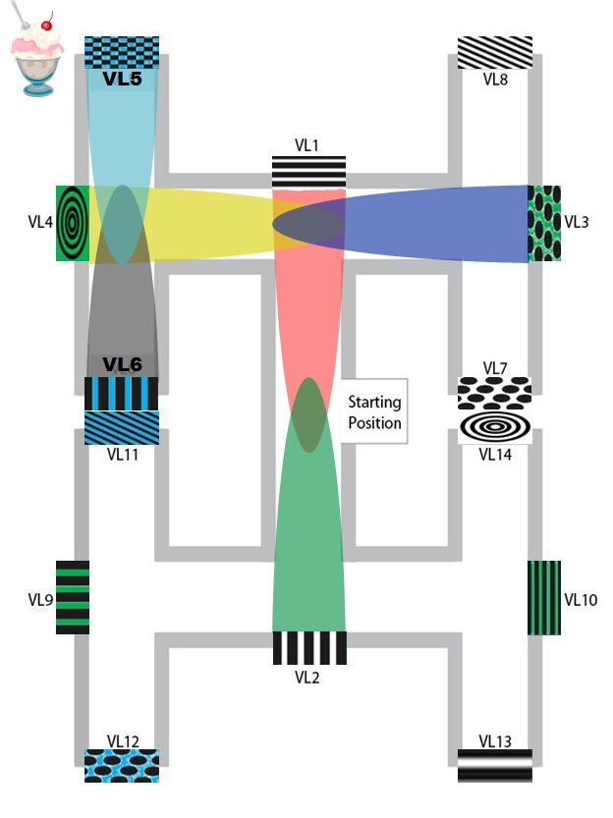
Paradigm

Slide 37
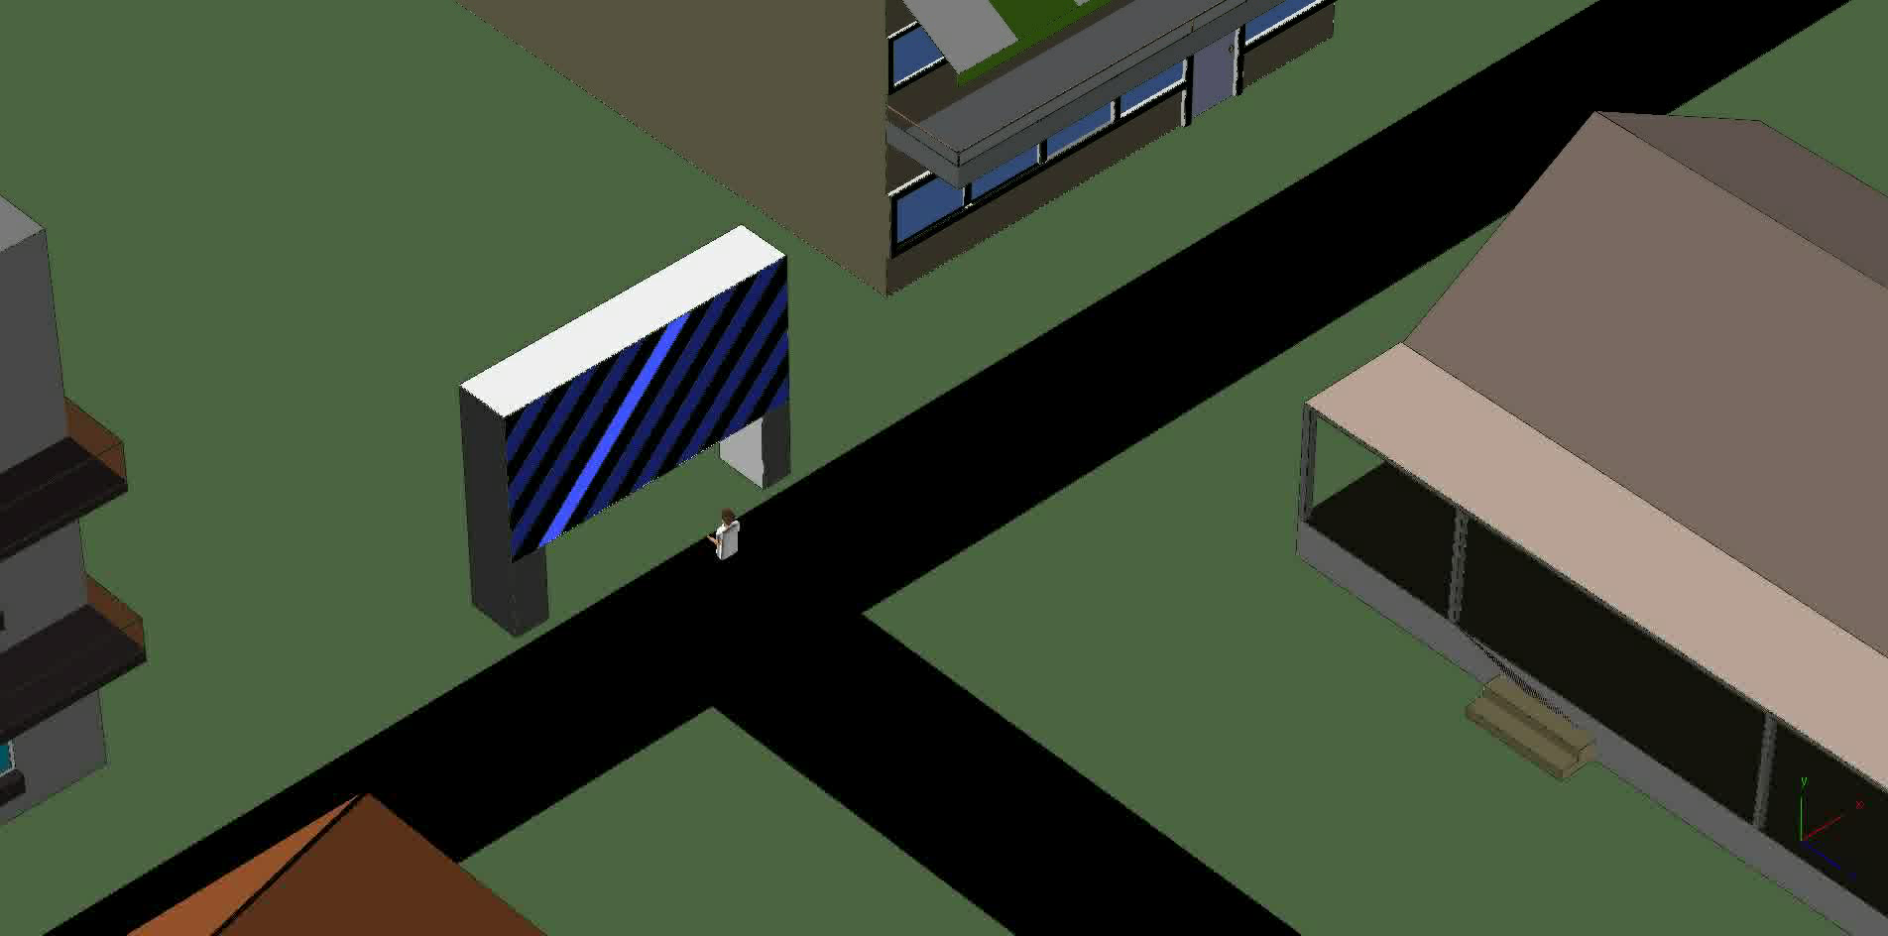
Navigation Video
Incorrect Choice

Slide 38
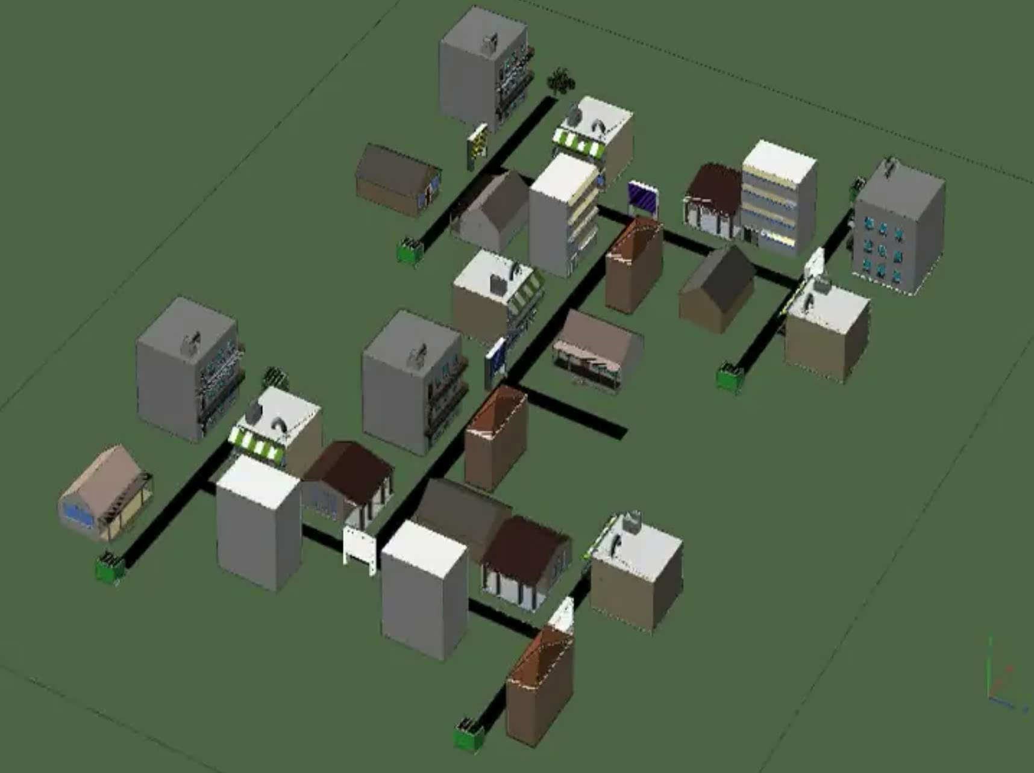
Navigation Video
Correct Choice

Slide 39
Future Directions
Simulator & Tools
Near Term:
  GUI-based brain model builder and visualizer
  Multi-Scale modeling
  Input language options
Long Term:
  Simulated fMRI data

Slide 40
Future Directions
Modeling & Simulation
Near Term:
  Higher-level behavior
  Expanded and more detailed models
Long Term:
  Disorders and interventions
  Drug interaction

Slide 41
Thank you

