Slide 1
Research Overview
Frederick C Harris, Jr.
Professor, Computer Science & Engineering
University of Nevada, Reno

Slide 2
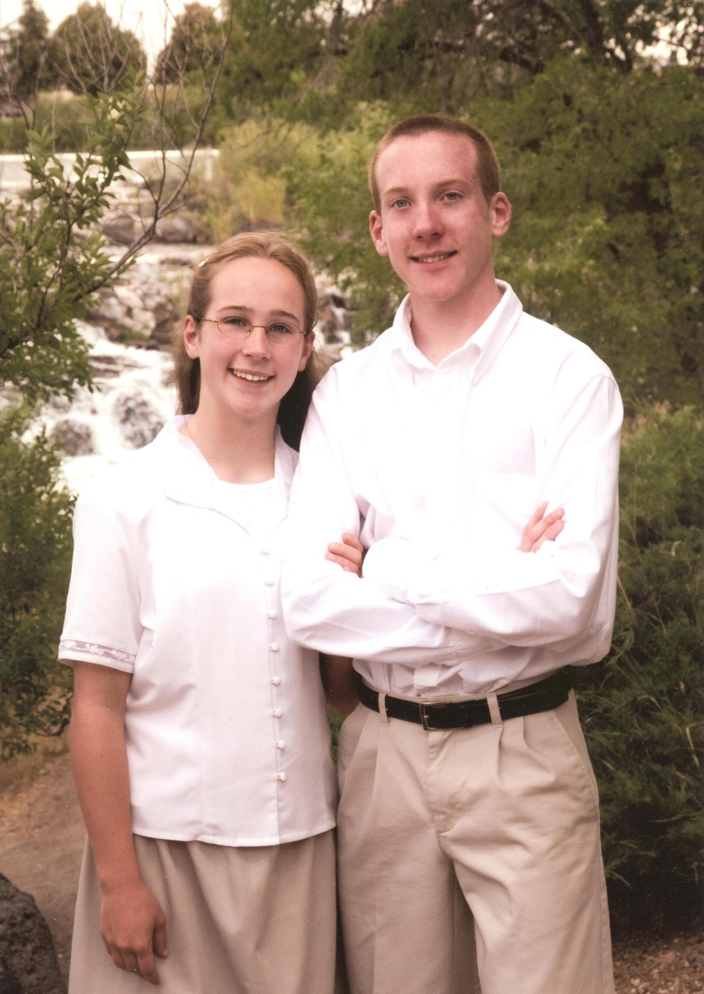
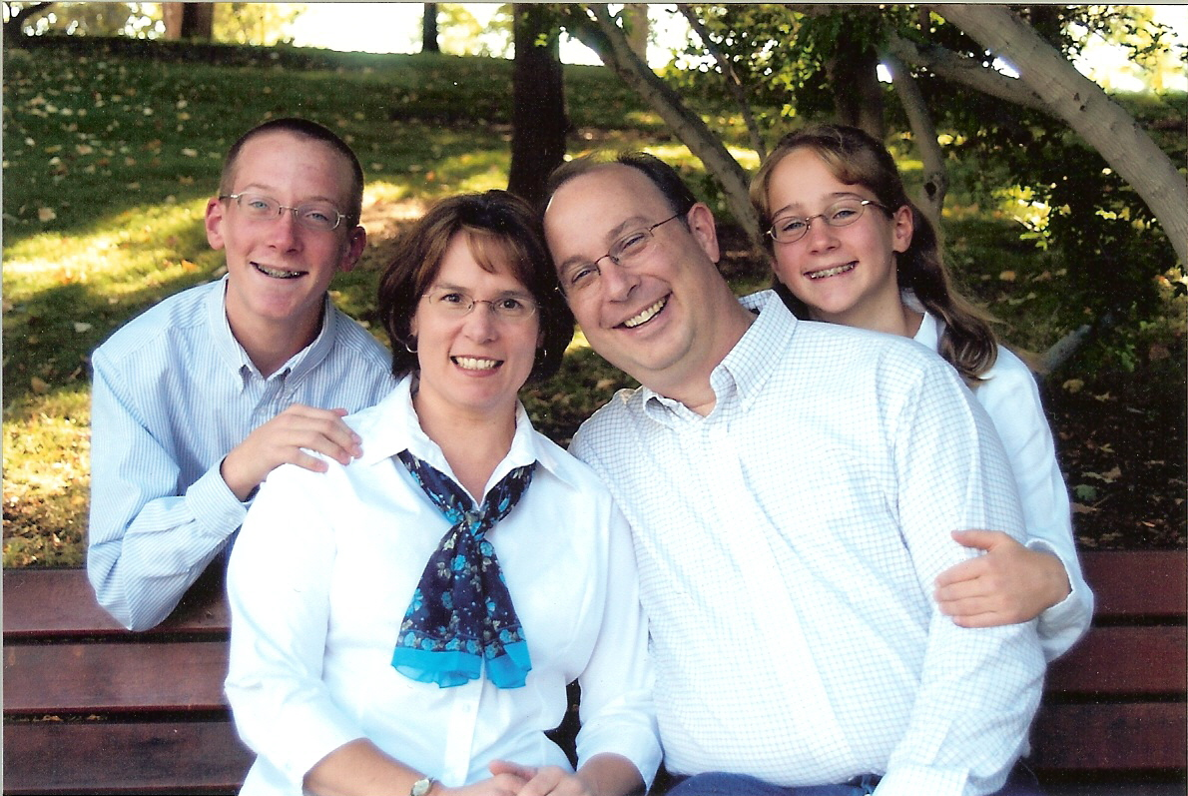
Family

Slide 3

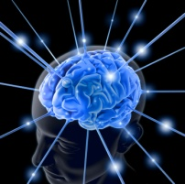
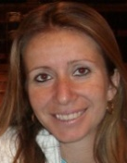

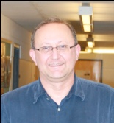
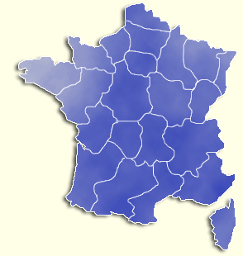


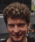

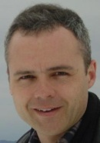

UNR Brain Computation Lab
Brain Computation Laboratory
University of Nevada, Reno
in funded collaboration with
U de Cergy-Pontoise and CNRS, Paris, France
Brain Mind Institute (Blue Brain Project), EPFL, Lausanne, Switzerland
  Laurence Jayet Fred Harris, Jr Sergiu Dascalu
  Director
  Mathias Quoy
  René Doursat
  Henry Markram
  Jim King

Slide 4


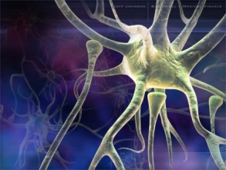
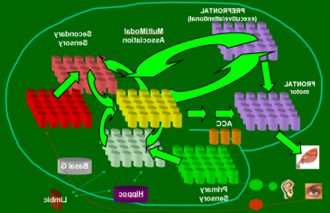
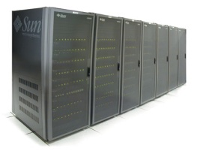

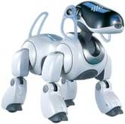
Scope of Work
Neuroscience
Modeling &
Neural Engineering
Robotic/Human Loops
ONR N000140710018: “Large-Scale Biologically Realistic Models of Cortical & Subcortical Dynamics with Social Robotic Applications”
DURIP N000140510525: “Robotic Platform for Security and Service Applications”
DURIP N000140710704: “Parallel Robotic Brains”
HRL0011-09-C-001: “Project Synapse”

Slide 5
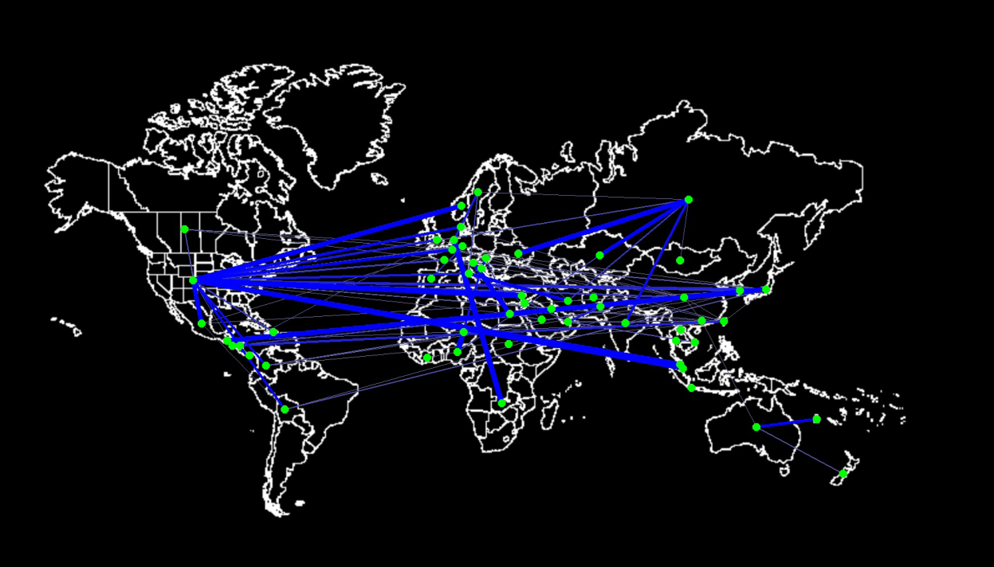
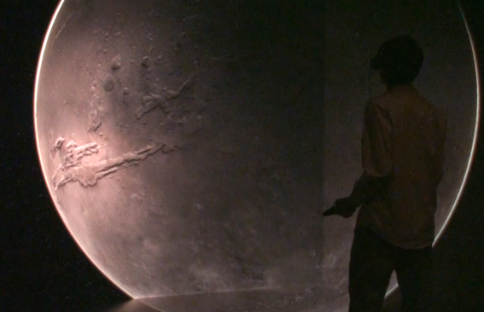
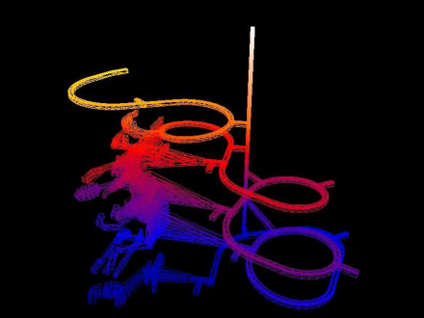
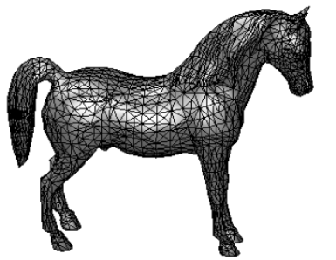
High Performance Computation and Visualization Lab (HPCVIS)
Bioinformatics Research
Scientific Visualization
Cluster/GPU Computation
Watermarking of 3D Models
NASA EPSCoR, grant # NSHE 08-51 : Exploring Planetary Surfaces: Earth, Moon, and Mars
NSF EPSCoR: Cyberinfrastructure Development for the Western Consortium of Idaho, Nevada, and New Mexico
NSF EPSCoR:Nevada Infrastructure for Climate Change Science, Education, and Outreach

Slide 6
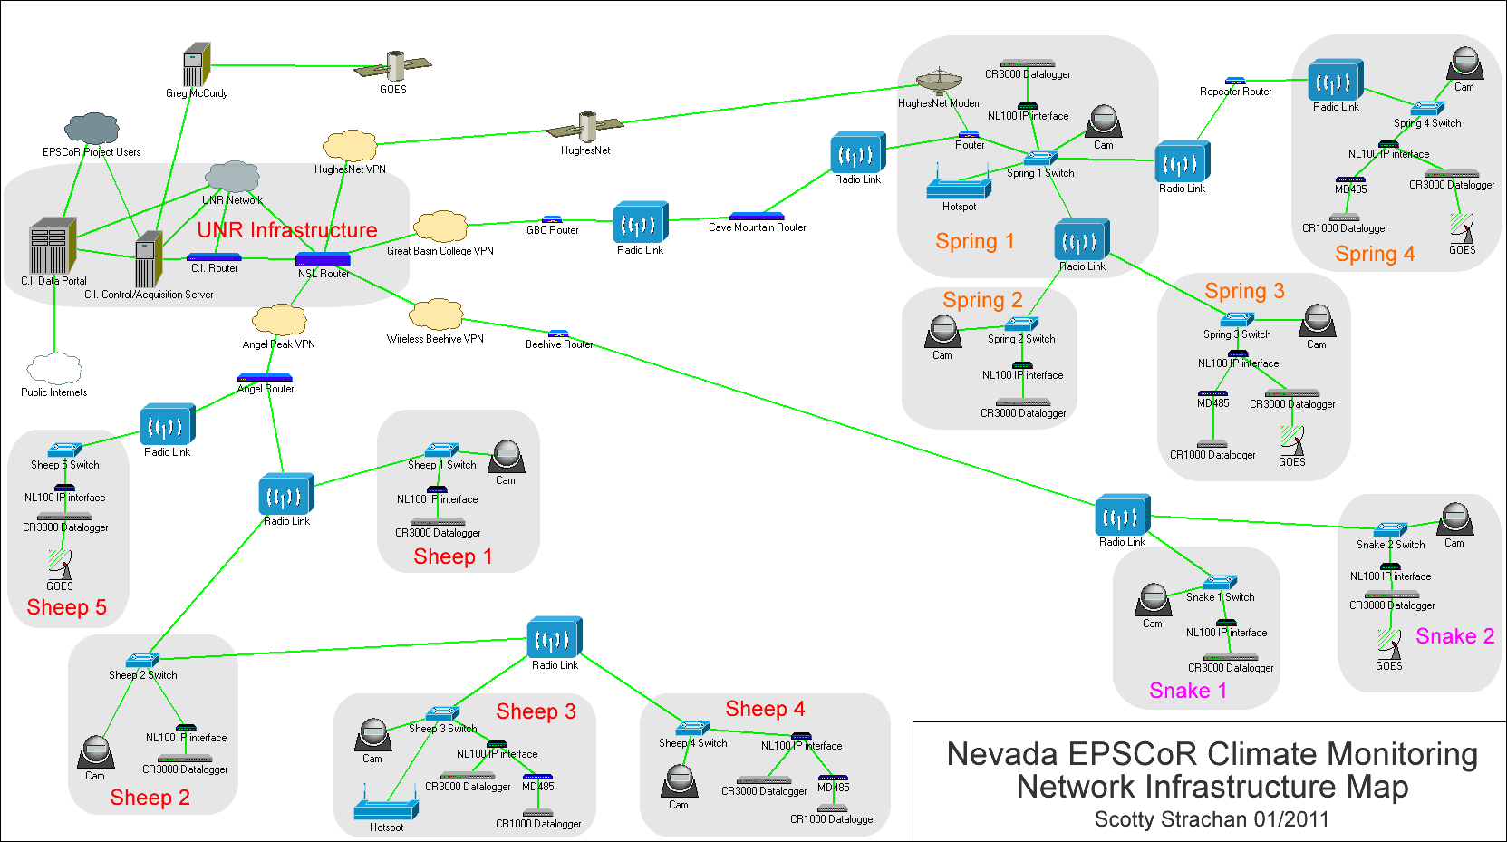
NSF EPSCoR

Slide 7
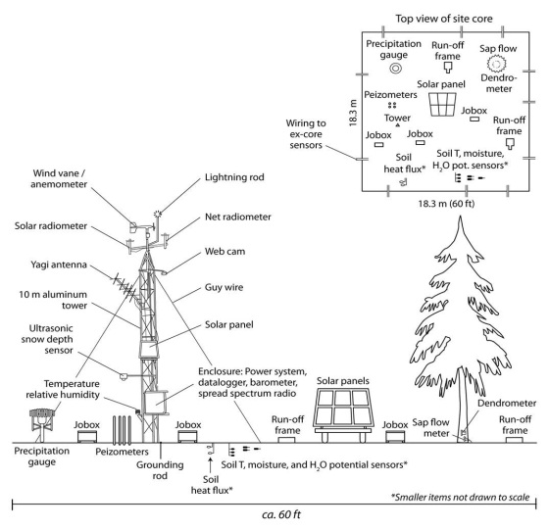
Sensors

