Slide 1
Immersive Visualization and Analysis of
Ground Penetrating Radar Data
By
Matthew Sgambati

Slide 2


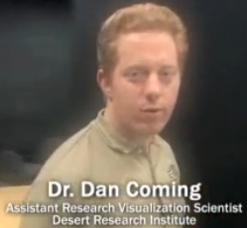
Committee
2 of 84
Dr. Daniel Coming
Dr. Frederick C. Harris, Jr.
Dr. Nicholas Lancaster

Slide 3
Overview
Background
The Project
Software Specification and Design Process
Implementation
Results
Conclusion
Future Work

Slide 4
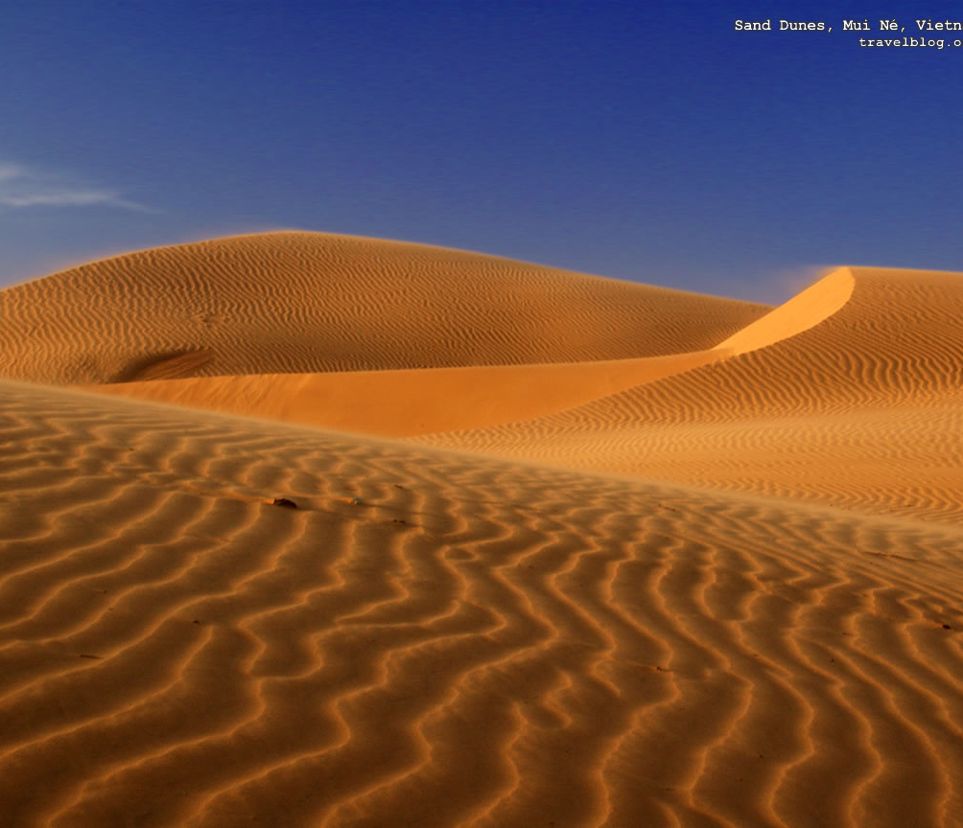
Background
Sand Dunes
Background
  Sand Dunes
  Ground Penetrating Radar and Brunton Compass
  Volume Rendering
  Virtual Reality
  Toirt-Samhlaigh
The Project
Software Specification
and Design Process
Implementation
Results
Conclusion
Future Work

Slide 5
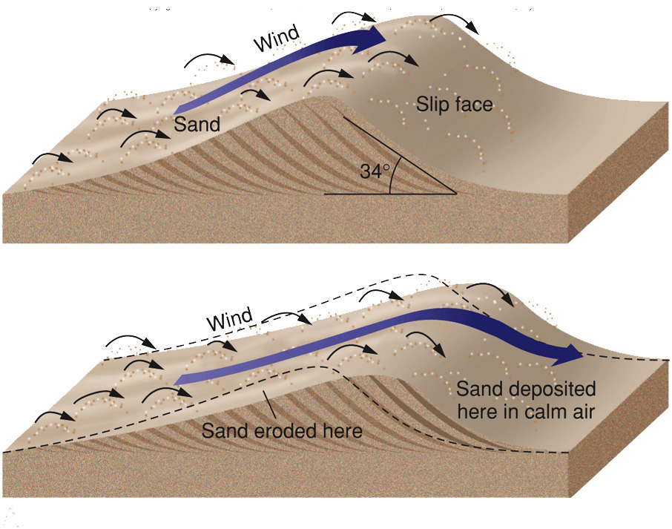
Background
Sand Dunes
Background
  Sand Dunes
  Ground Penetrating Radar and Brunton Compass
  Volume Rendering
  Virtual Reality
  Toirt-Samhlaigh
The Project
Software Specification
and Design Process
Implementation
Results
Conclusion
Future Work

Slide 6
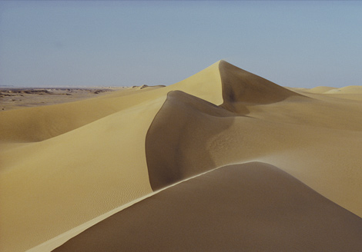
Background
Sand Dunes
Background
  Sand Dunes
  Ground Penetrating Radar and Brunton Compass
  Volume Rendering
  Virtual Reality
  Toirt-Samhlaigh
The Project
Software Specification
and Design Process
Implementation
Results
Conclusion
Future Work

Slide 7
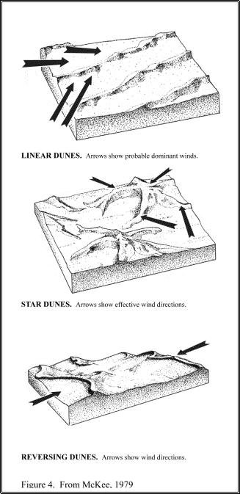
Background
Sand Dunes
Shapes
  Crescentic
  Linear
  Star
  Dome
  Parabolic
  Transverse
  Reversing
Background
  Sand Dunes
  Ground Penetrating Radar and Brunton Compass
  Volume Rendering
  Virtual Reality
  Toirt-Samhlaigh
The Project
Software Specification
and Design Process
Implementation
Results
Conclusion
Future Work

Slide 8
Background
Sand Dunes
Types
  Sub-aqueous
  Lithified
  Coastal
  Desert
Background
  Sand Dunes
  Ground Penetrating Radar and Brunton Compass
  Volume Rendering
  Virtual Reality
  Toirt-Samhlaigh
The Project
Software Specification
and Design Process
Implementation
Results
Conclusion
Future Work

Slide 9
Background
Sand Dunes
Forms
  Simple
  Compound
  Complex
Background
  Sand Dunes
  Ground Penetrating Radar and Brunton Compass
  Volume Rendering
  Virtual Reality
  Toirt-Samhlaigh
The Project
Software Specification
and Design Process
Implementation
Results
Conclusion
Future Work

Slide 10
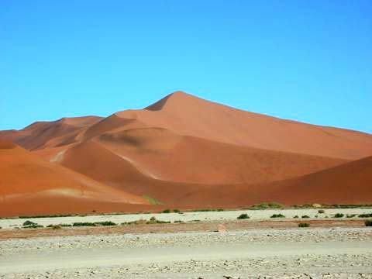
Background
Sand Dunes
Background
  Sand Dunes
  Ground Penetrating Radar and Brunton Compass
  Volume Rendering
  Virtual Reality
  Toirt-Samhlaigh
The Project
Software Specification
and Design Process
Implementation
Results
Conclusion
Future Work
Dune 7 in the Namib desert

Slide 11
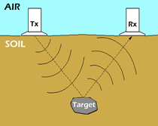
Background
Ground Penetrating Radar
Background
  Sand Dunes
  Ground Penetrating Radar and Brunton Compass
  Volume Rendering
  Virtual Reality
  Toirt-Samhlaigh
The Project
Software Specification
and Design Process
Implementation
Results
Conclusion
Future Work

Slide 12
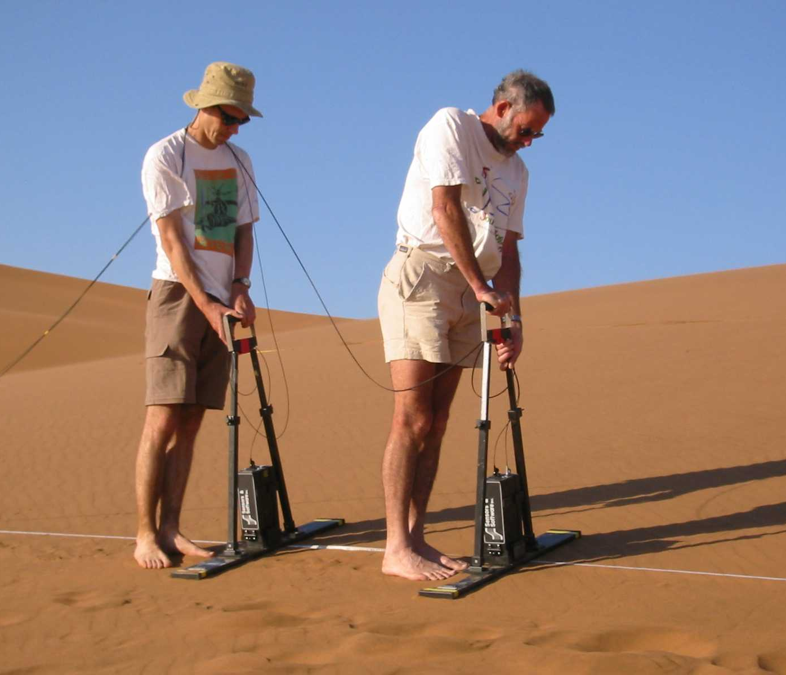
Background
Ground Penetrating Radar
Background
  Sand Dunes
  Ground Penetrating Radar and Brunton Compass
  Volume Rendering
  Virtual Reality
  Toirt-Samhlaigh
The Project
Software Specification
and Design Process
Implementation
Results
Conclusion
Future Work

Slide 13
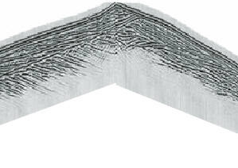
Background
Ground Penetrating Radar
Background
  Sand Dunes
  Ground Penetrating Radar and Brunton Compass
  Volume Rendering
  Virtual Reality
  Toirt-Samhlaigh
The Project
Software Specification
and Design Process
Implementation
Results
Conclusion
Future Work

Slide 14
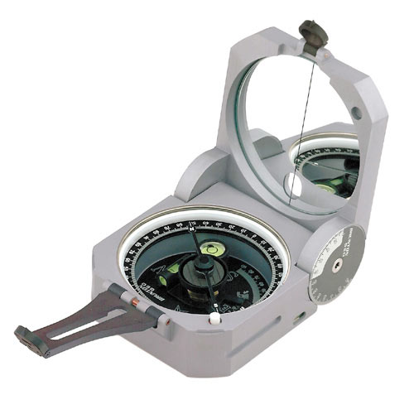
Background
Brunton Compass
Background
  Sand Dunes
  Ground Penetrating Radar and Brunton Compass
  Volume Rendering
  Virtual Reality
  Toirt-Samhlaigh
The Project
Software Specification
and Design Process
Implementation
Results
Conclusion
Future Work

Slide 15
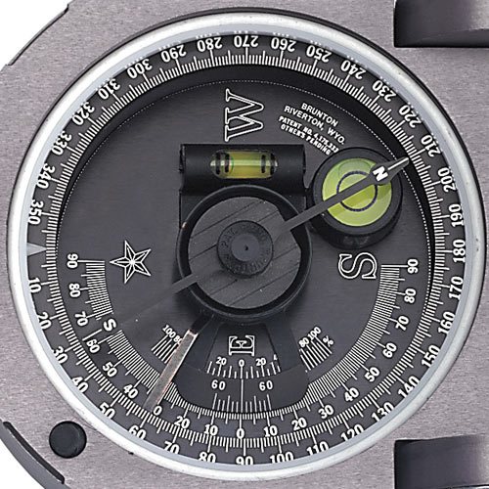
Background
Brunton Compass
Background
  Sand Dunes
  Ground Penetrating Radar and Brunton Compass
  Volume Rendering
  Virtual Reality
  Toirt-Samhlaigh
The Project
Software Specification
and Design Process
Implementation
Results
Conclusion
Future Work

Slide 16
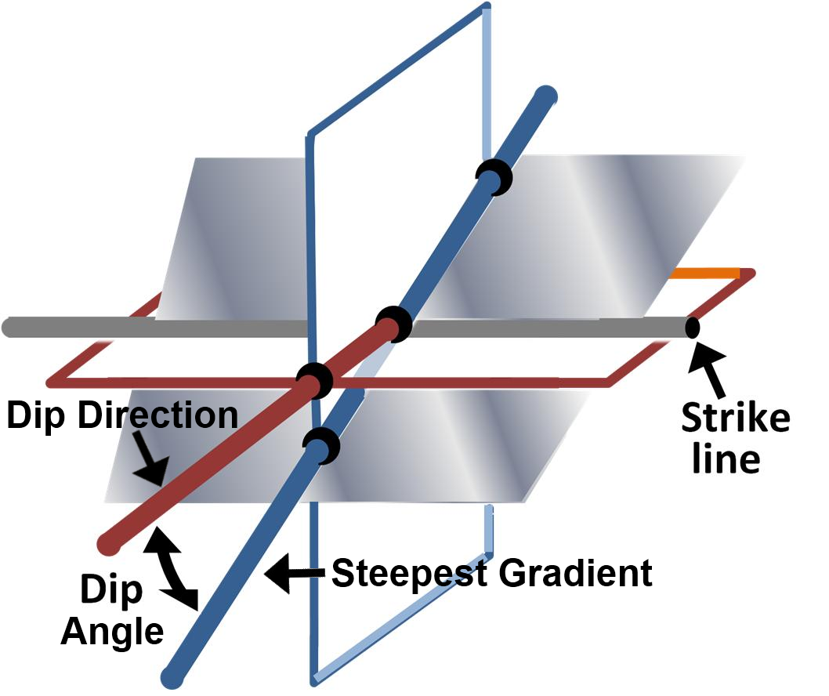
Background
Brunton Compass
Background
  Sand Dunes
  Ground Penetrating Radar and Brunton Compass
  Volume Rendering
  Virtual Reality
  Toirt-Samhlaigh
The Project
Software Specification
and Design Process
Implementation
Results
Conclusion
Future Work

Slide 17
Background
Volume Rendering
Display of data sampled in three dimensions
Background
  Sand Dunes
  Ground Penetrating Radar and Brunton Compass
  Volume Rendering
  Virtual Reality
  Toirt-Samhlaigh
The Project
Software Specification
and Design Process
Implementation
Results
Conclusion
Future Work

Slide 18
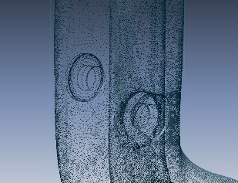
Background
Volume Rendering
Background
  Sand Dunes
  Ground Penetrating Radar and Brunton Compass
  Volume Rendering
  Virtual Reality
  Toirt-Samhlaigh
The Project
Software Specification
and Design Process
Implementation
Results
Conclusion
Future Work

Slide 19
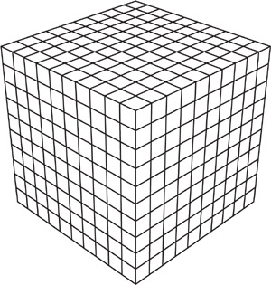
Background
Volume Rendering
Background
  Sand Dunes
  Ground Penetrating Radar and Brunton Compass
  Volume Rendering
  Virtual Reality
  Toirt-Samhlaigh
The Project
Software Specification
and Design Process
Implementation
Results
Conclusion
Future Work

Slide 20
Background
Volume Rendering
Methodologies
  Indirect
  Direct
Algorithm categories
  Object-order
  Image-order
  Hybrid
Background
  Sand Dunes
  Ground Penetrating Radar and Brunton Compass
  Volume Rendering
  Virtual Reality
  Toirt-Samhlaigh
The Project
Software Specification
and Design Process
Implementation
Results
Conclusion
Future Work

Slide 21
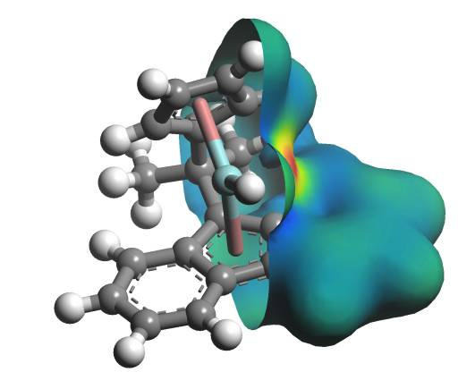
Background
Indirect
Iso-surfaces
Background
  Sand Dunes
  Ground Penetrating Radar and Brunton Compass
  Volume Rendering
  Virtual Reality
  Toirt-Samhlaigh
The Project
Software Specification
and Design Process
Implementation
Results
Conclusion
Future Work

Slide 22
Background
Indirect
Assumptions
  Iso-surfaces exist
  Rendered within a reasonable degree of accuracy
Complexity is an issue
Background
  Sand Dunes
  Ground Penetrating Radar and Brunton Compass
  Volume Rendering
  Virtual Reality
  Toirt-Samhlaigh
The Project
Software Specification
and Design Process
Implementation
Results
Conclusion
Future Work

Slide 23
Background
Direct
Requirement
  Every sample point is mapped to an opacity and color
Techniques
  Ray Casting
  Splatting
  Shear-Warp
  Texture Mapping
  Hardware Accelerated
Background
  Sand Dunes
  Ground Penetrating Radar and Brunton Compass
  Volume Rendering
  Virtual Reality
  Toirt-Samhlaigh
The Project
Software Specification
and Design Process
Implementation
Results
Conclusion
Future Work

Slide 24
Background
Ray Casting
Image-order algorithm
Produces some of the
highest quality images
Very computationally expensive
Background
  Sand Dunes
  Ground Penetrating Radar and Brunton Compass
  Volume Rendering
  Virtual Reality
  Toirt-Samhlaigh
The Project
Software Specification
and Design Process
Implementation
Results
Conclusion
Future Work

Slide 25
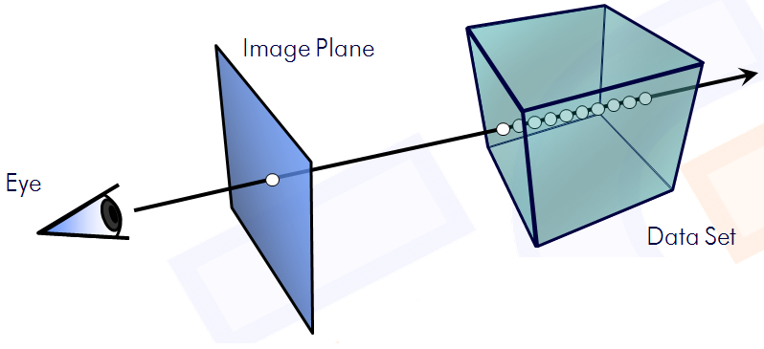
Background
Ray Casting
Background
  Sand Dunes
  Ground Penetrating Radar and Brunton Compass
  Volume Rendering
  Virtual Reality
  Toirt-Samhlaigh
The Project
Software Specification
and Design Process
Implementation
Results
Conclusion
Future Work

Slide 26
Background
Splatting
Object-order algorithm
Less computationally expensive than Ray Casting
Throw paint balls onto a surface to obtain an image
Background
  Sand Dunes
  Ground Penetrating Radar and Brunton Compass
  Volume Rendering
  Virtual Reality
  Toirt-Samhlaigh
The Project
Software Specification
and Design Process
Implementation
Results
Conclusion
Future Work

Slide 27
Background
Splatting
Maps every voxel to the viewing plane
Footprint
  Reconstruction Kernel
Speed
  Precompute footprints
Issue
  Reconstruction Kernel selection
    Too larger results in a blurry image
    Too small results in gaps in the image
Background
  Sand Dunes
  Ground Penetrating Radar and Brunton Compass
  Volume Rendering
  Virtual Reality
  Toirt-Samhlaigh
The Project
Software Specification
and Design Process
Implementation
Results
Conclusion
Future Work

Slide 28
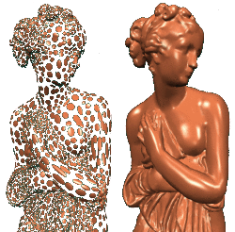
Background
Splatting
Background
  Sand Dunes
  Ground Penetrating Radar and Brunton Compass
  Volume Rendering
  Virtual Reality
  Toirt-Samhlaigh
The Project
Software Specification
and Design Process
Implementation
Results
Conclusion
Future Work

Slide 29
Background
Shear-Warp
Hybrid algorithm
Fastest purely
software-based algorithm
Background
  Sand Dunes
  Ground Penetrating Radar and Brunton Compass
  Volume Rendering
  Virtual Reality
  Toirt-Samhlaigh
The Project
Software Specification
and Design Process
Implementation
Results
Conclusion
Future Work

Slide 30
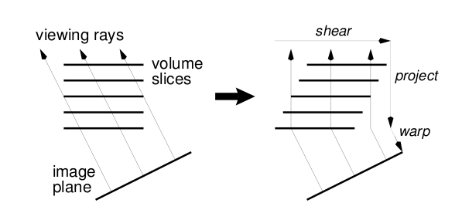
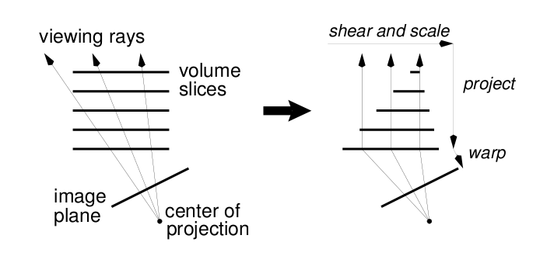
Background
Shear-Warp
Sheared object space
Background
  Sand Dunes
  Ground Penetrating Radar and Brunton Compass
  Volume Rendering
  Virtual Reality
  Toirt-Samhlaigh
The Project
Software Specification
and Design Process
Implementation
Results
Conclusion
Future Work

Slide 31
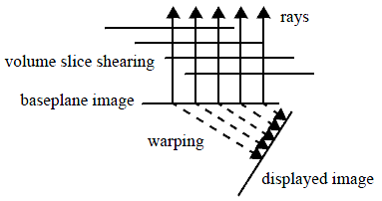
Background
Shear-Warp
Background
  Sand Dunes
  Ground Penetrating Radar and Brunton Compass
  Volume Rendering
  Virtual Reality
  Toirt-Samhlaigh
The Project
Software Specification
and Design Process
Implementation
Results
Conclusion
Future Work

Slide 32
Background
Shear-Warp
Speed
  Run-length encoding
Issues
  Run-length encoding
    One for each axis, 3 x memory consumption
  Interpolation is per slice
    Aliasing
    Staircasing
Background
  Sand Dunes
  Ground Penetrating Radar and Brunton Compass
  Volume Rendering
  Virtual Reality
  Toirt-Samhlaigh
The Project
Software Specification
and Design Process
Implementation
Results
Conclusion
Future Work

Slide 33
Background
Texture Mapping
Uses Graphics Hardware
  Texture Mapping
  Interpolation
Types
  2D-texture mapping
  3D-texture mapping
Background
  Sand Dunes
  Ground Penetrating Radar and Brunton Compass
  Volume Rendering
  Virtual Reality
  Toirt-Samhlaigh
The Project
Software Specification
and Design Process
Implementation
Results
Conclusion
Future Work

Slide 34
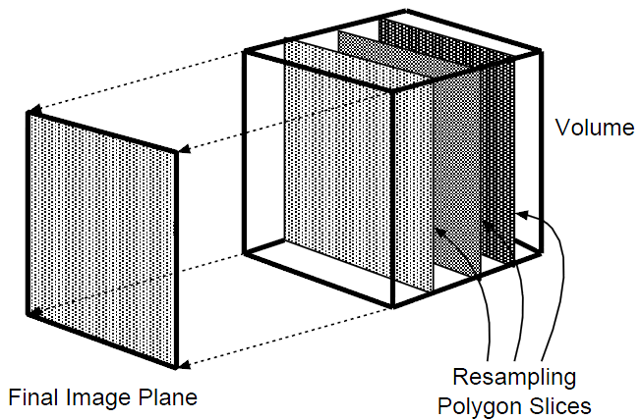
Background
2D-Texture Mapping
Splits data into axis-aligned slices
Composited in back-to-front order
Background
  Sand Dunes
  Ground Penetrating Radar and Brunton Compass
  Volume Rendering
  Virtual Reality
  Toirt-Samhlaigh
The Project
Software Specification
and Design Process
Implementation
Results
Conclusion
Future Work

Slide 35
Background
2D-Texture Mapping
Advantages
  Simplicity
  Takes advantage of graphics hardware (Bilinear interpolation)
Disadvantages
  Slices created for each axis, 3 x memory consumption
  Flickering
  Aliasing occurs when magnified
Background
  Sand Dunes
  Ground Penetrating Radar and Brunton Compass
  Volume Rendering
  Virtual Reality
  Toirt-Samhlaigh
The Project
Software Specification
and Design Process
Implementation
Results
Conclusion
Future Work

Slide 36
Background
3D-Texture Mapping
Stores data as a 3D-texture
Creates viewport aligned slices
Background
  Sand Dunes
  Ground Penetrating Radar and Brunton Compass
  Volume Rendering
  Virtual Reality
  Toirt-Samhlaigh
The Project
Software Specification
and Design Process
Implementation
Results
Conclusion
Future Work

Slide 37
Background
3D-Texture Mapping
Advantages
  Overcomes disadvantages of
  2D-texture mapping
  Takes advantage of graphics hardware (Trilinear interpolation)
Background
  Sand Dunes
  Ground Penetrating Radar and Brunton Compass
  Volume Rendering
  Virtual Reality
  Toirt-Samhlaigh
The Project
Software Specification
and Design Process
Implementation
Results
Conclusion
Future Work

Slide 38
Background
3D-Texture Mapping
Disadvantages
  Bricking mechanism required for large data sets
    Limited by bandwidth between system memory and graphics hardware
    Brick size
      Too large wont fit into graphics hardware’s memory cache
      Too small increases memory footprint and number of intersection tests
Background
  Sand Dunes
  Ground Penetrating Radar and Brunton Compass
  Volume Rendering
  Virtual Reality
  Toirt-Samhlaigh
The Project
Software Specification
and Design Process
Implementation
Results
Conclusion
Future Work

Slide 39
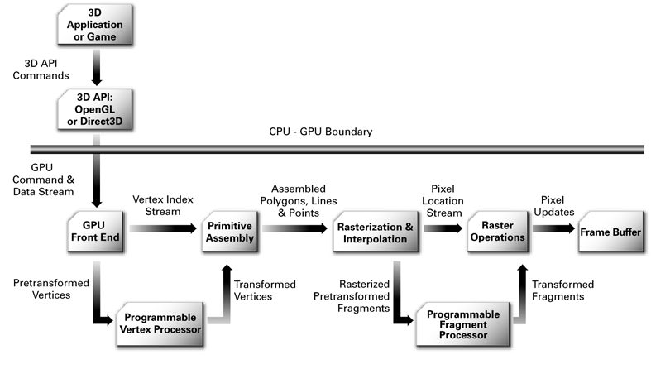
Background
Hardware Accelerated
Uses Programmable Pipeline instead of the Fixed Functionality Pipeline
Background
  Sand Dunes
  Ground Penetrating Radar and Brunton Compass
  Volume Rendering
  Virtual Reality
  Toirt-Samhlaigh
The Project
Software Specification
and Design Process
Implementation
Results
Conclusion
Future Work

Slide 40
Background
Virtual Reality
Notion of mental immersion through feedback
  Visual
  Haptic
  Olfactory
  Auditory
Depth Cues
  Monoscopic
  Stereoscopic
  Motion
Background
  Sand Dunes
  Ground Penetrating Radar and Brunton Compass
  Volume Rendering
  Virtual Reality
  Toirt-Samhlaigh
The Project
Software Specification
and Design Process
Implementation
Results
Conclusion
Future Work

Slide 41
Background
Virtual Reality
Stereo Vision
  Active
  Passive
Stereoscopic Displays
  Fishtank
  Head Mounted Display
  Projection-based
Input Devices
Toolkits
Background
  Sand Dunes
  Ground Penetrating Radar and Brunton Compass
  Volume Rendering
  Virtual Reality
  Toirt-Samhlaigh
The Project
Software Specification
and Design Process
Implementation
Results
Conclusion
Future Work

Slide 42
Background
Depth Cues
Monoscopic
  Provide information from only one eye
  Information
    Interposition
    Size
    Linear perspective
    Motion parallax
Background
  Sand Dunes
  Ground Penetrating Radar and Brunton Compass
  Volume Rendering
  Virtual Reality
  Toirt-Samhlaigh
The Project
Software Specification
and Design Process
Implementation
Results
Conclusion
Future Work

Slide 43
Background
Depth Cues
Stereoscopic
  Provide information from two eyes
  Images are different perspectives of the same location
    Provides spatial information
      Obtained from the parallax between objects in the image
Motion
  Same as motion parallax
  Not always present
Background
  Sand Dunes
  Ground Penetrating Radar and Brunton Compass
  Volume Rendering
  Virtual Reality
  Toirt-Samhlaigh
The Project
Software Specification
and Design Process
Implementation
Results
Conclusion
Future Work

Slide 44
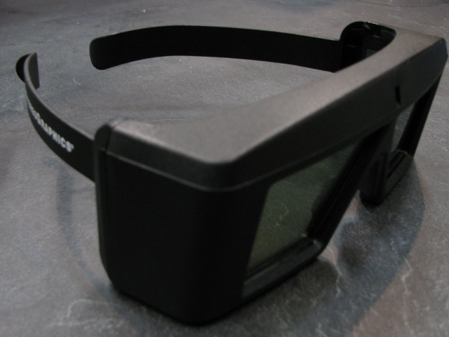
Background
Stereo Vision
Active
  1 Projector with 120Hz refresh rate (60Hz each eye)
  Synchronized signals between projector and glasses
Background
  Sand Dunes
  Ground Penetrating Radar and Brunton Compass
  Volume Rendering
  Virtual Reality
  Toirt-Samhlaigh
The Project
Software Specification
and Design Process
Implementation
Results
Conclusion
Future Work

Slide 45
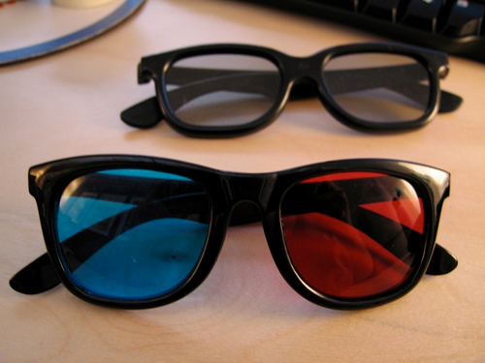
Background
Stereo Vision
Passive
  2 Projectors (60Hz refresh rate)
  Polarized filters
Background
  Sand Dunes
  Ground Penetrating Radar and Brunton Compass
  Volume Rendering
  Virtual Reality
  Toirt-Samhlaigh
The Project
Software Specification
and Design Process
Implementation
Results
Conclusion
Future Work

Slide 46
Background
Stereoscopic Displays
Types
  Fishtank
  Head Mounted Display
  Projection-based
Background
  Sand Dunes
  Ground Penetrating Radar and Brunton Compass
  Volume Rendering
  Virtual Reality
  Toirt-Samhlaigh
The Project
Software Specification
and Design Process
Implementation
Results
Conclusion
Future Work

Slide 47
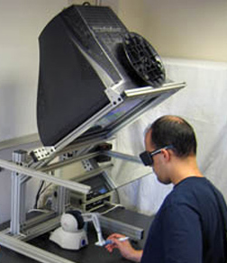
Background
Stereoscopic Displays
Background
  Sand Dunes
  Ground Penetrating Radar and Brunton Compass
  Volume Rendering
  Virtual Reality
  Toirt-Samhlaigh
The Project
Software Specification
and Design Process
Implementation
Results
Conclusion
Future Work

Slide 48
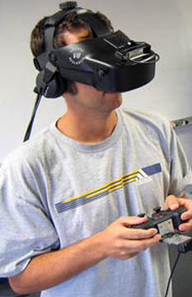
Background
Stereoscopic Displays
Background
  Sand Dunes
  Ground Penetrating Radar and Brunton Compass
  Volume Rendering
  Virtual Reality
  Toirt-Samhlaigh
The Project
Software Specification
and Design Process
Implementation
Results
Conclusion
Future Work

Slide 49
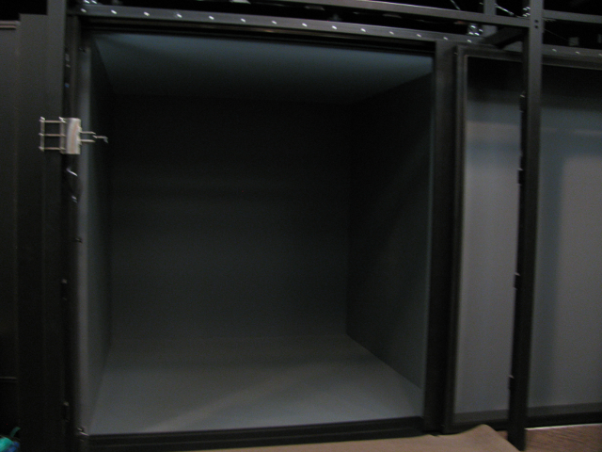
Background
Stereoscopic Displays
Background
  Sand Dunes
  Ground Penetrating Radar and Brunton Compass
  Volume Rendering
  Virtual Reality
  Toirt-Samhlaigh
The Project
Software Specification
and Design Process
Implementation
Results
Conclusion
Future Work

Slide 50
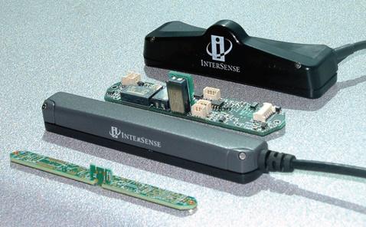
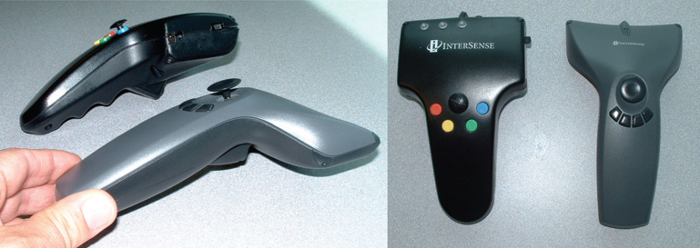
Background
Input Devices
Background
  Sand Dunes
  Ground Penetrating Radar and Brunton Compass
  Volume Rendering
  Virtual Reality
  Toirt-Samhlaigh
The Project
Software Specification
and Design Process
Implementation
Results
Conclusion
Future Work

Slide 51
Background
Toolkits
Designed to help users deal with VR systems
  Specialized hardware
  Specialized devices
  Unique environments
Examples
  FreeVR
  VR Juggler
  Virtual reality user interface (Vrui)
  Hydra
Background
  Sand Dunes
  Ground Penetrating Radar and Brunton Compass
  Volume Rendering
  Virtual Reality
  Toirt-Samhlaigh
The Project
Software Specification
and Design Process
Implementation
Results
Conclusion
Future Work

Slide 52
Background
Vrui
VR development toolkit written by Oliver Kreylos
Goal is to shield developer from a particular configuration of a VR environment
  Display abstraction
  Distribution abstraction
  Input abstraction
Background
  Sand Dunes
  Ground Penetrating Radar and Brunton Compass
  Volume Rendering
  Virtual Reality
  Toirt-Samhlaigh
The Project
Software Specification
and Design Process
Implementation
Results
Conclusion
Future Work

Slide 53
Background
Toirt-Samhlaigh
Volume rendering library
  Patrick O’Leary
3D-texture mapping, hardware accelerated DVR type of algorithm
  Slice-based rendering
Heavily integrated with Vrui
Background
  Sand Dunes
  Ground Penetrating Radar and Brunton Compass
  Volume Rendering
  Virtual Reality
  Toirt-Samhlaigh
The Project
Software Specification
and Design Process
Implementation
Results
Conclusion
Future Work

Slide 54
Background
Toirt-Samhlaigh
Provides many features
  Transfer functions
  Directional lighting
  Volume manipulation
  Color maps
  Tools, such as clipping plane tool
  Modifiable slice factor
  Load several data types
Background
  Sand Dunes
  Ground Penetrating Radar and Brunton Compass
  Volume Rendering
  Virtual Reality
  Toirt-Samhlaigh
The Project
Software Specification
and Design Process
Implementation
Results
Conclusion
Future Work

Slide 55
The Project
Create a program capable of visualizing GPR data in an IVE and create tools to assist in the analysis of the GPR data
This was done by taking Toirt-Samhlaigh and performing enhancements and expansions to the library
Background
The Project
Software Specification
and Design Process
Implementation
Results
Conclusion
Future Work

Slide 56
Software Specification and Design Process
Software Specification
Requirements
  Functional
  Nonfunctional
Background
The Project
Software Specification
and Design Process
  Requirements
  Use Cases
  System Overview
  Iterative Design Process
Implementation
Results
Conclusion
Future Work

Slide 57
Software Specification and Design Process
Requirements
Functional
  The program shall be able to load GPR data in SEG Y revision 1 format.
  The program shall allow the user to turn the data visualization on and off.
  The program shall allow the user to change the orientation and position of the data.
  The program shall allow the user to take dip and strike measurements.
  The program shall allow the user to take distance and angle measurements.
Background
The Project
Software Specification
and Design Process
  Requirements
  Use Cases
  System Overview
  Iterative Design Process
Implementation
Results
Conclusion
Future Work

Slide 58
Software Specification and Design Process
Requirements
Nonfunctional
  The program shall maintain interactive frame rates.
  The program shall written in C/C++.
  The program shall use a hardware accelerated, texture mapping DVR algorithm for its rendering.
  The program shall use VRUI and Toirt- Samhlaigh for its prototype application.
  The program's rendering algorithm shall use OpenGL.
  The program shall be implemented on the Linux platform.
Background
The Project
Software Specification
and Design Process
  Requirements
  Use Cases
  System Overview
  Iterative Design Process
Implementation
Results
Conclusion
Future Work

Slide 59
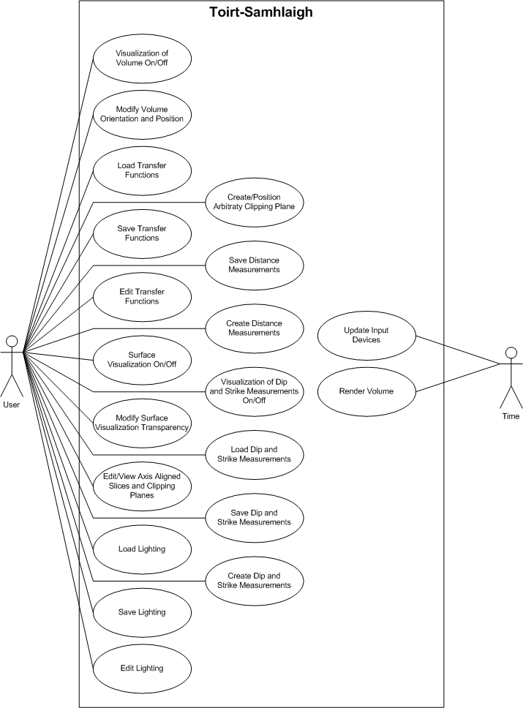
Software Specification and Design Process
Use Cases
Background
The Project
Software Specification
and Design Process
  Requirements
  Use Cases
  System Overview
  Iterative Design Process
Implementation
Results
Conclusion
Future Work

Slide 60

Software Specification and Design Process
System Overview
Background
The Project
Software Specification
and Design Process
  Requirements
  Use Cases
  System Overview
  Iterative Design Process
Implementation
Results
Conclusion
Future Work

Slide 61
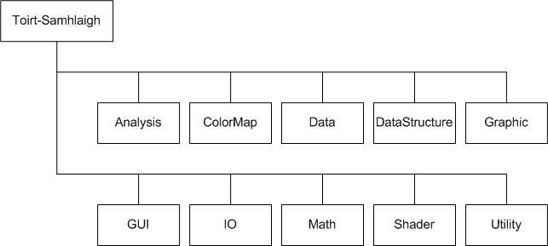
Software Specification and Design Process
Toirt-Samhlaigh
Background
The Project
Software Specification
and Design Process
  Requirements
  Use Cases
  System Overview
  Iterative Design Process
Implementation
Results
Conclusion
Future Work

Slide 62
Software Specification and Design Process
Iterative Design Process
Conducted with a researcher at DRI
  Valuable feedback
  Valuable learning experience
Background
The Project
Software Specification
and Design Process
  Requirements
  Use Cases
  System Overview
  Iterative Design Process
Implementation
Results
Conclusion
Future Work

Slide 63
Implementation
SEG Y file loader
Toirt-Samhlaigh tools tested
Modified Slicing Tool
  Handle scaling of GPR data
  Double as a clipping tool
Added Topographic correction to SEG Y file loader
Surface Visualization
  Transparency modifiable
Background
The Project
Software Specification
and Design Process
Implementation
Results
Conclusion
Future Work

Slide 64
Implementation
Two tools created
  Distance Measurement Tool
  Brunton Compass Tool
GUIs were created as needed
Save/Load Functionality
Background
The Project
Software Specification
and Design Process
Implementation
Results
Conclusion
Future Work

Slide 65
Implementation
Topographic Correction
Store values read in from a file into a 2D grid structure
  x-coordinate, y-coordinate, elevation
  Samples taken at regular intervals, plus at the peaks
Performed linear interpolation
Background
The Project
Software Specification
and Design Process
Implementation
Results
Conclusion
Future Work

Slide 66
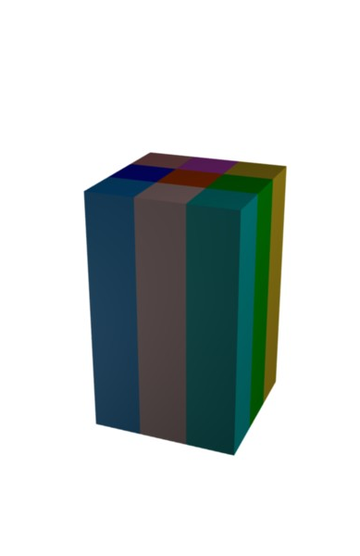
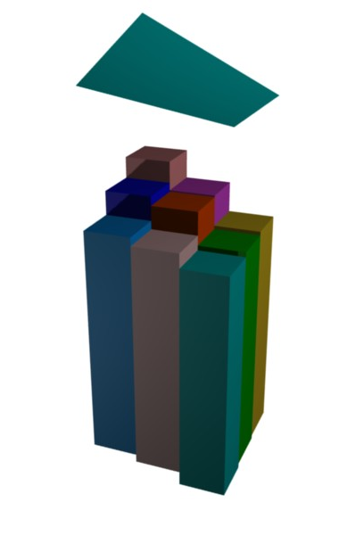
Implementation
Topographic Correction
Background
The Project
Software Specification
and Design Process
Implementation
Results
Conclusion
Future Work

Slide 67
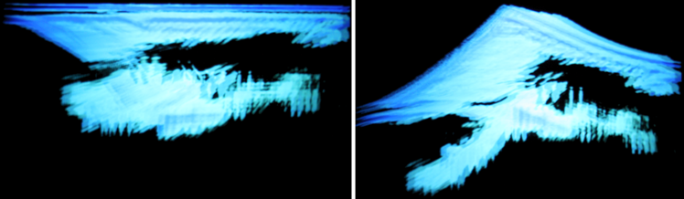
Implementation
Topographic Correction
Background
The Project
Software Specification
and Design Process
Implementation
Results
Conclusion
Future Work

Slide 68
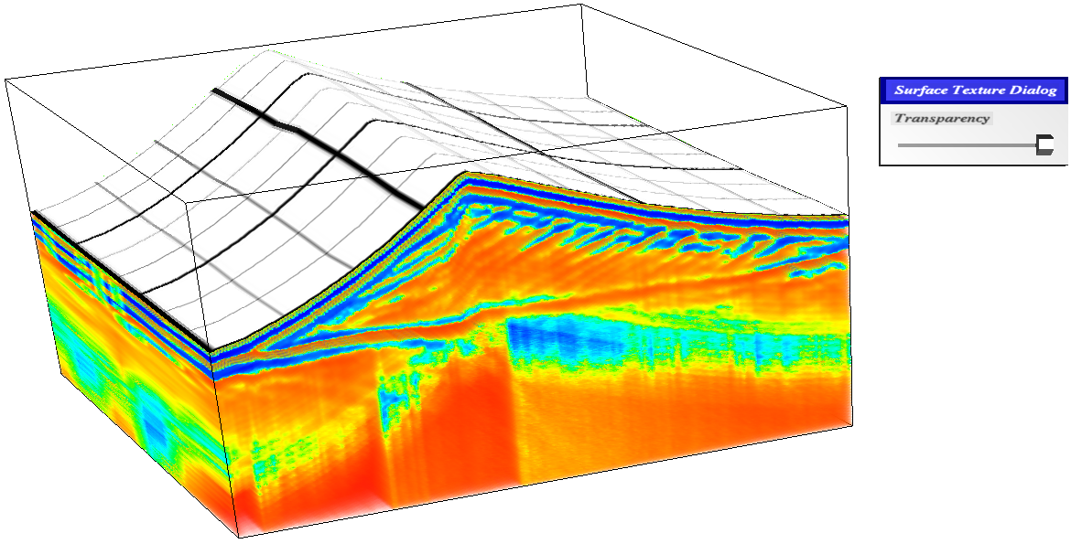
Implementation
Surface Visualization
Background
The Project
Software Specification
and Design Process
Implementation
Results
Conclusion
Future Work

Slide 69
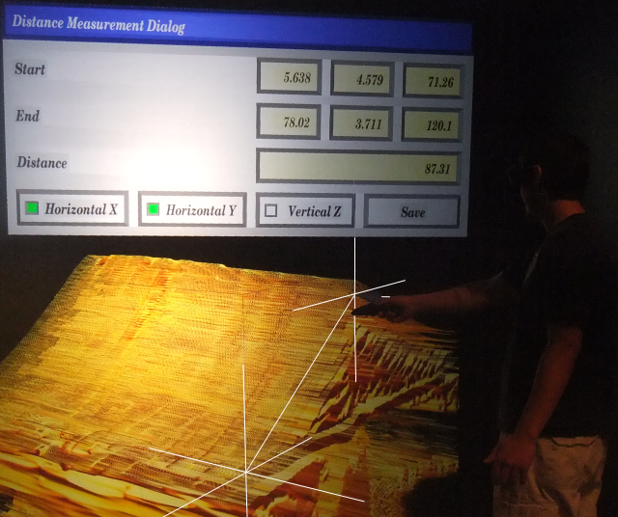
Implementation
Distance Measurement Tool
Background
The Project
Software Specification
and Design Process
Implementation
Results
Conclusion
Future Work

Slide 70
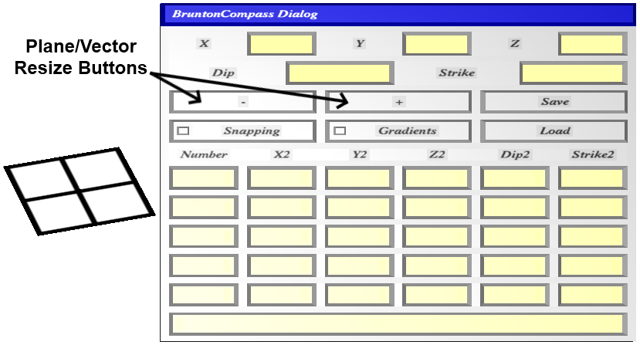
Implementation
Brunton Compass Tool
Background
The Project
Software Specification
and Design Process
Implementation
Results
Conclusion
Future Work

Slide 71
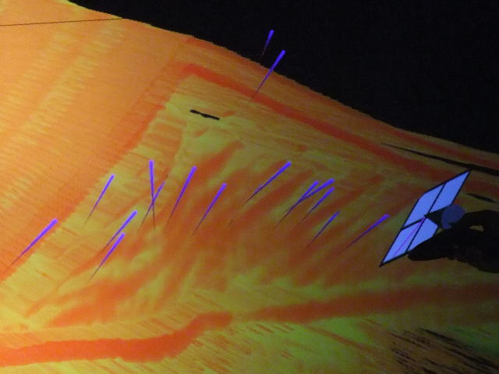
Implementation
Brunton Compass Tool
Background
The Project
Software Specification
and Design Process
Implementation
Results
Conclusion
Future Work

Slide 72
Results
Videos
  Volume orientation and position
  Directional lighting
  Color Maps
  Slice Tool
  1D Transfer Function
  Surface Visualization
  Distance Measurement Tool
  Brunton Compass Tool
Background
The Project
Software Specification
and Design Process
Implementation
Results
Conclusion
Future Work

Slide 73

Results
Volume Orientation and Position
Background
The Project
Software Specification
and Design Process
Implementation
Results
Conclusion
Future Work

Slide 74
Results
Directional Lighting
Background
The Project
Software Specification
and Design Process
Implementation
Results
Conclusion
Future Work

Slide 75
Results
Color Maps
Background
The Project
Software Specification
and Design Process
Implementation
Results
Conclusion
Future Work

Slide 76
Results
Slice Tool
Background
The Project
Software Specification
and Design Process
Implementation
Results
Conclusion
Future Work

Slide 77
Results
1D Transfer Function
Background
The Project
Software Specification
and Design Process
Implementation
Results
Conclusion
Future Work

Slide 78
Results
Surface Visualization
Background
The Project
Software Specification
and Design Process
Implementation
Results
Conclusion
Future Work

Slide 79
Results
Distance Measurement Tool
Background
The Project
Software Specification
and Design Process
Implementation
Results
Conclusion
Future Work

Slide 80
Results
Brunton Compass Tool
Background
The Project
Software Specification
and Design Process
Implementation
Results
Conclusion
Future Work

Slide 81
Conclusion
Background
The Project
Software Specification
and Design Process
Implementation
Results
Conclusion
Future Work
Background
The Project
Software Specification and Design Process
Implementation
Results
Conclusion
Future Work

Slide 82
Future Work
Improve User Friendliness
  File selection menu
Change the scale of the data
Change the loaded data set
Tools
  Custom shaped viewing tool
  Layer peeling tool
  Auto subsurface generating tool
Load more GPR file formats and different types of data
Background
The Project
Software Specification
and Design Process
Implementation
Results
Conclusion
Future Work

Slide 83
Future Work
Have more than one volume loaded at a time
Perform automatic or semi- automatic segmentation of the data into layers
Clipping Plane issue
Replace Toirt-Samhlaigh
  Implements newer DVR algorithms
  Takes better advantage of graphics hardware
  Not integrated with a VR toolkit
Background
The Project
Software Specification
and Design Process
Implementation
Results
Conclusion
Future Work

Slide 84
Questions
84 of 84
Thank you for coming
Demo at 2:00 p.m.

