Slide 1

Out-of-Core Data Management for Planetary Terrain
Cody White
Department of Computer Science and Engineering
University of Nevada, Reno

Slide 2
Special Thanks
Dr. Frederick C. Harris, Jr.
Dr. Sergiu Dascalu
Dr. Scott Bassett
Joe Mahsman

Slide 3
Overview
Introduction
Background Work
Our Solution
Implementation
Results
Conclusions and Future Work

Slide 4
Introduction
Department of Computer Science and Engineering
University of Nevada, Reno

Slide 5
What is Terrain Rendering?
Approximation of real terrain in a computer simulation
  Realistic
  Fictional

Slide 6
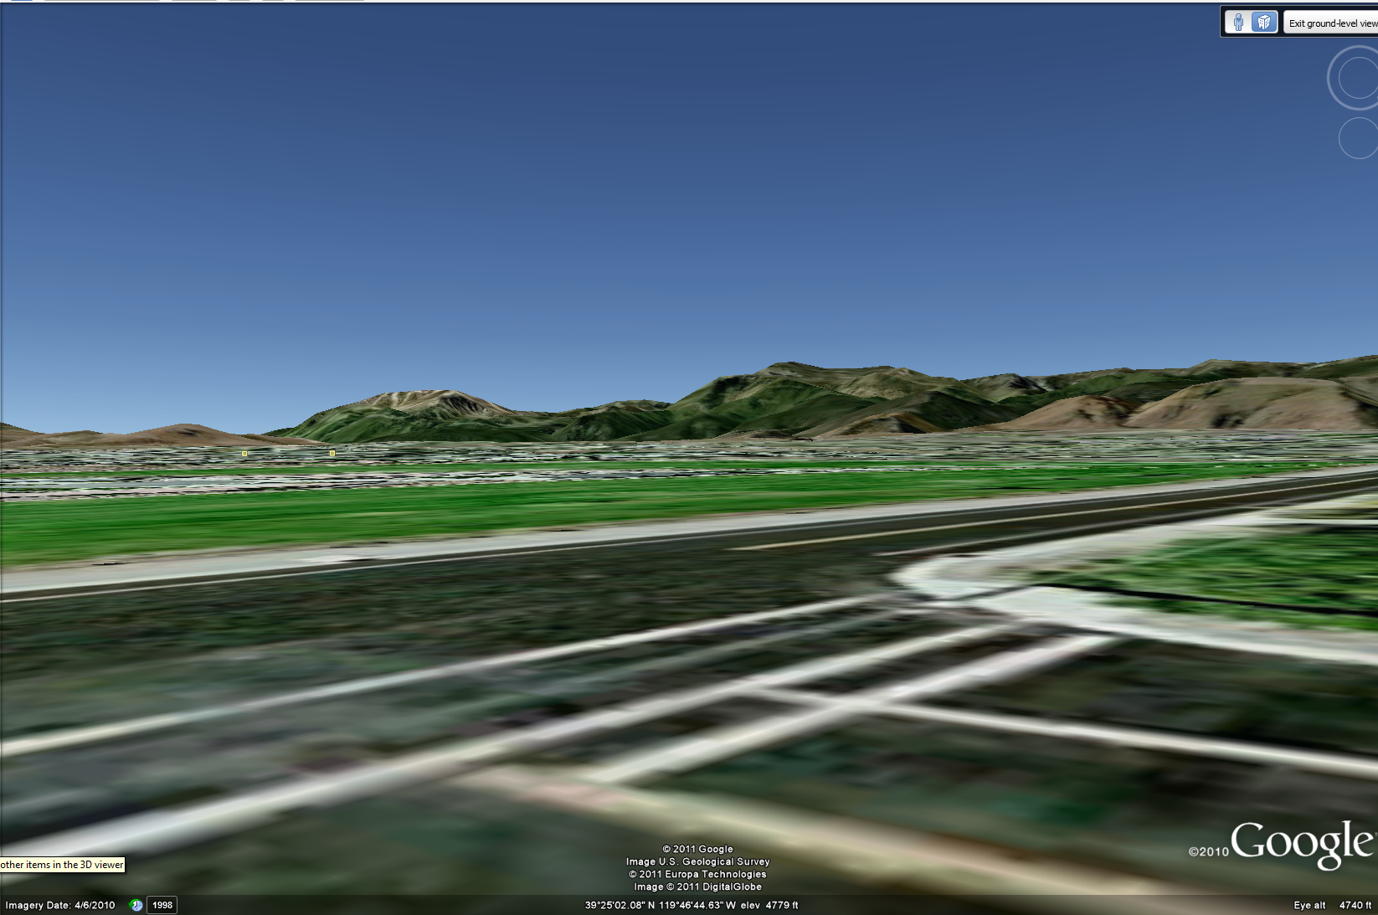
What is Terrain Rendering?

Slide 7
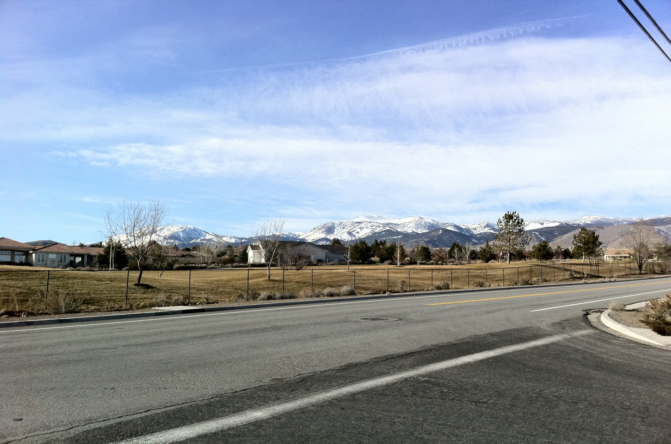
What Do We Want Terrain Rendering to Be?

Slide 8
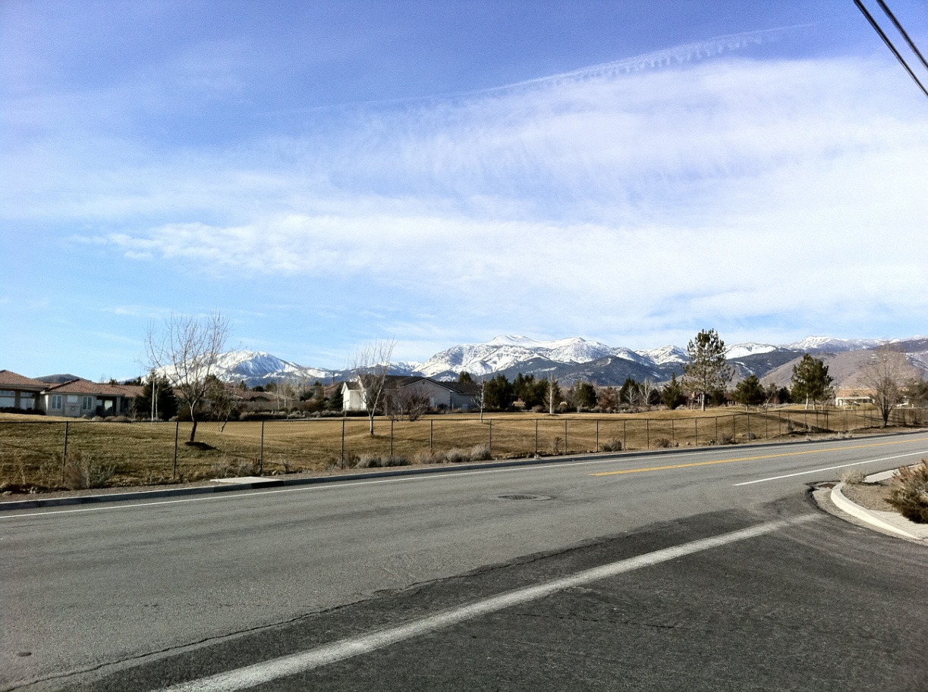
What Do We Want Terrain Rendering to Be?
Photorealistic
  Terrain gradients
  Coloring
  Lighting

Slide 9
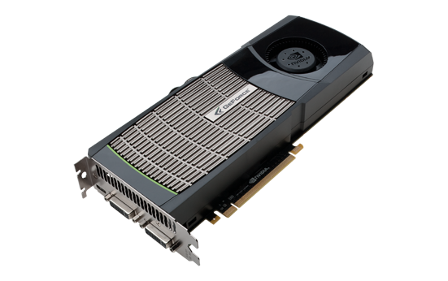
How Do We Do This?
Large amount of data
  Gigabytes or more
  Too big for modern graphics cards
    1.5GB of RAM (nVidia GTX 580)

Slide 10

What About Whole Planets?
Much more data than just Mt. Rose
Multiple types of data projections

Slide 11
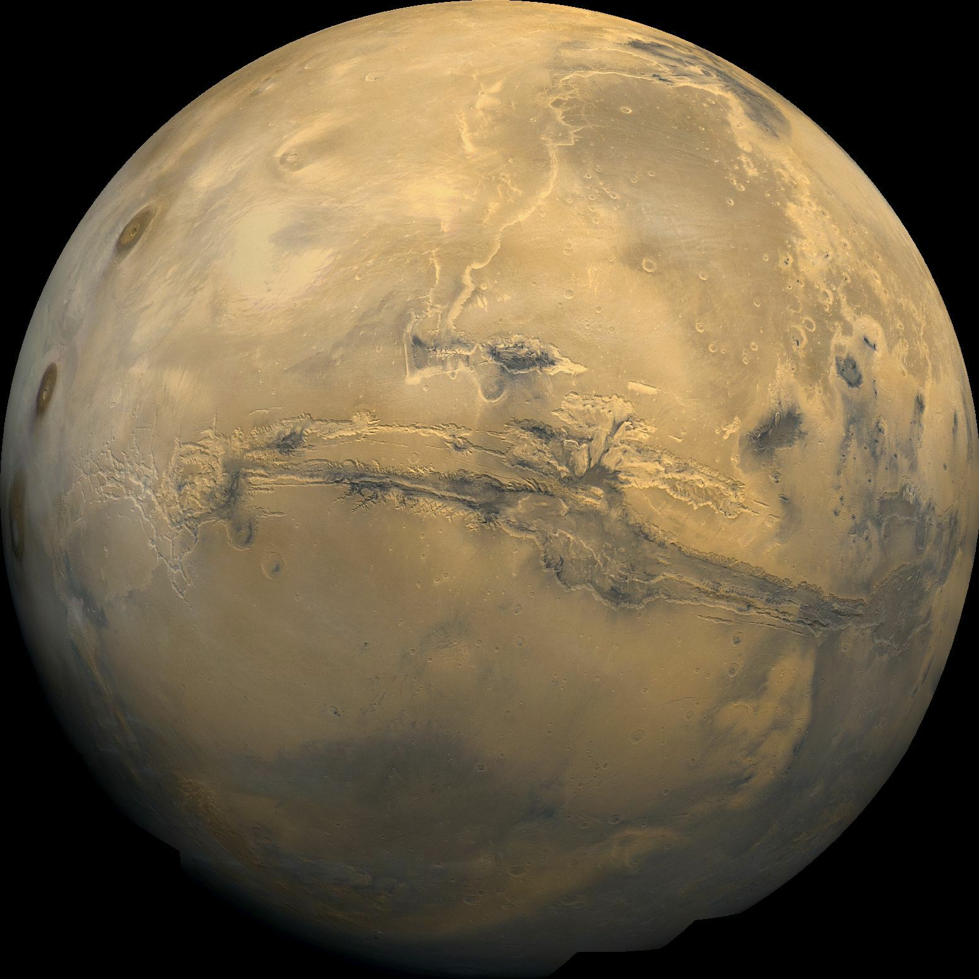
What About Whole Planets?
Many datasets
  Some large
  Some small

Slide 12
What Do We Need?
Data streaming
Visibility testing
Level-of-detail (LOD) selection

Slide 13
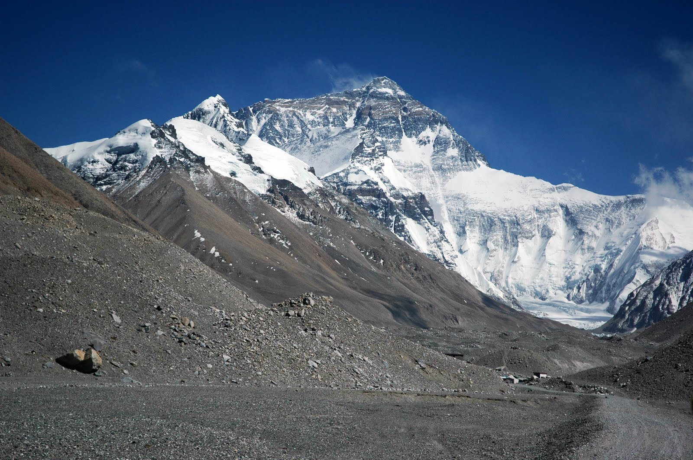
Level-of-Detail (LOD)
Objects farther away have less detail
Helps:
  Realism
  Efficiency

Slide 14
Today
Adapt planar data-caching techniques to a planetary scale
Adapt a LOD scheme for planetary datasets
Utilize the GPU for data composition
Datasets can be added at runtime

Slide 15
Background
Department of Computer Science and Engineering
University of Nevada, Reno

Slide 16
Heightmaps
Texture containing information about the terrain
  Heights
  Easy to use with the GPU

Slide 17
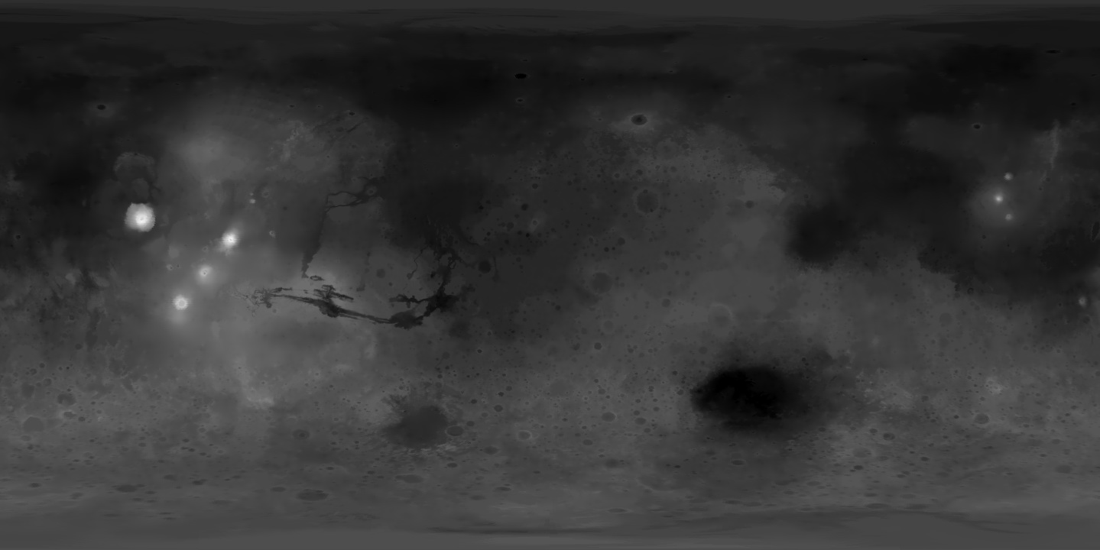
Heightmaps

Slide 18
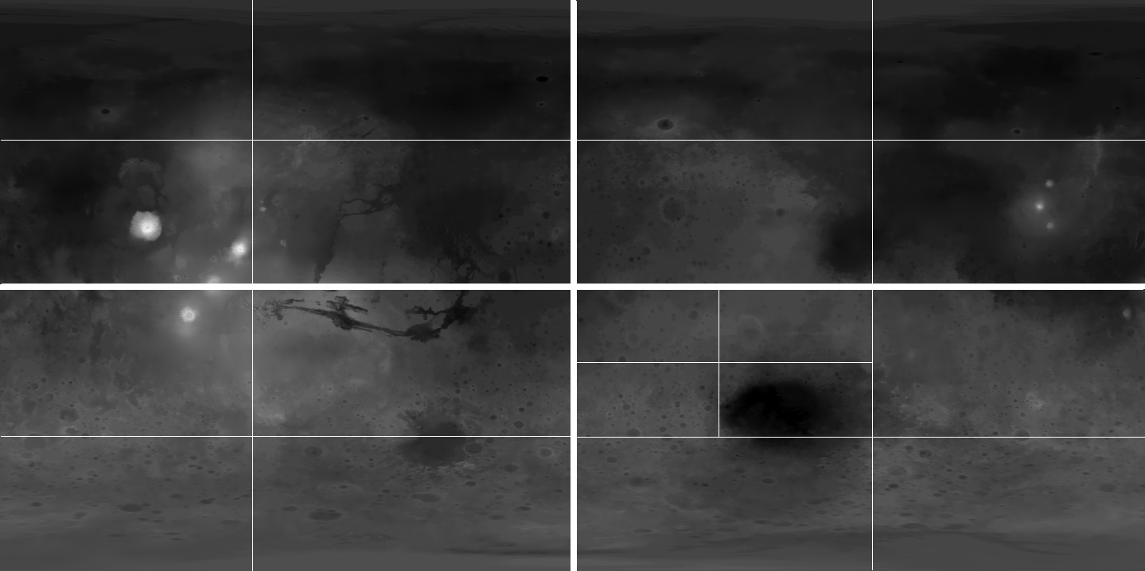
Partitioning the Heightmap
W. De Boer. Fast Terrain Rendering Using Geometrical Mipmapping. October 2000.

Slide 19
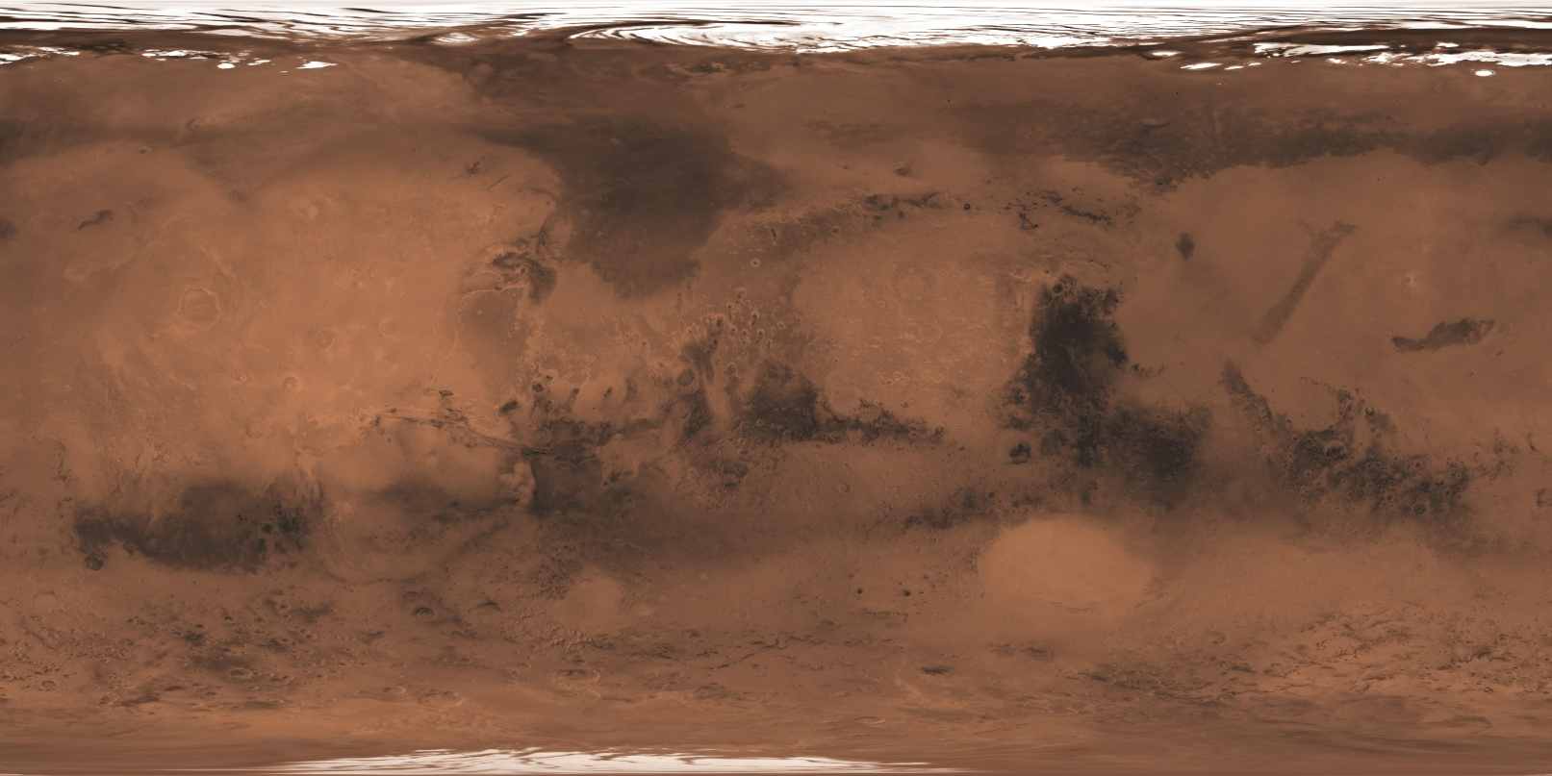
Coloring
Same as heightmap
Contains data about color

Slide 20
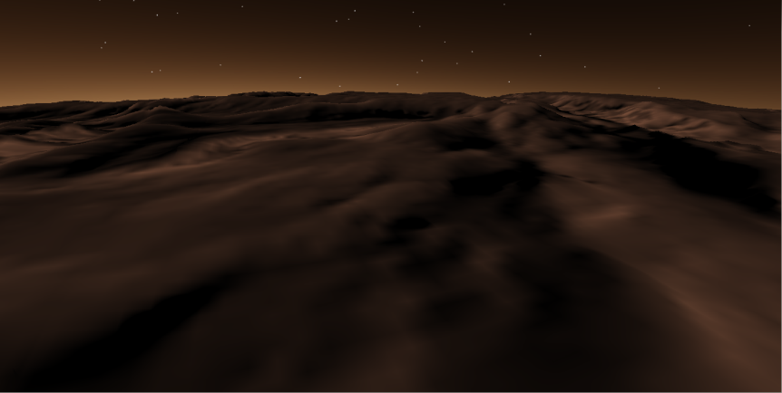
Terrain
+

Slide 21
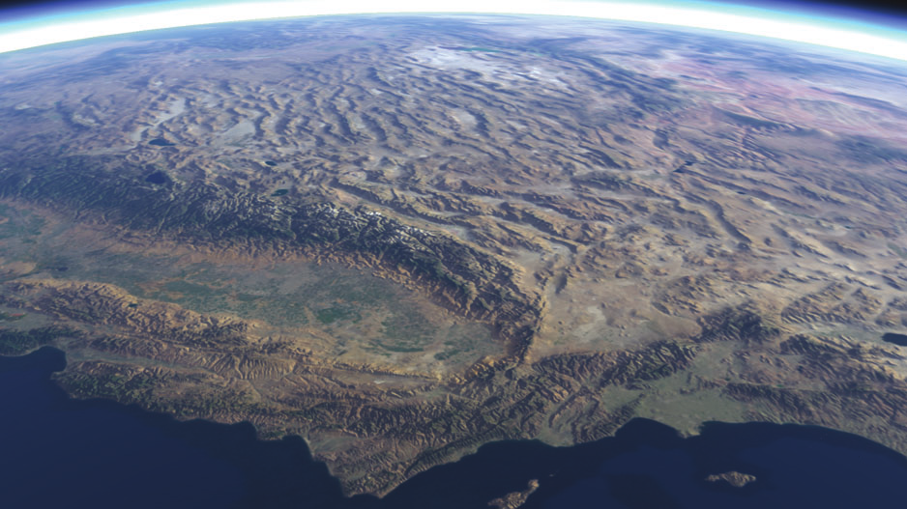
GPU
Speedup existing algorithms
  Mesh generation¹
  Data composition
¹R. Kooima, J. Leigh, A. Johnson, D. Roberts, M.SubbaRao, and T. DeFanti. Planetary-Scale Terrain Composition. IEEE
Transactions on Visualization and Computer Graphics. 2009.

Slide 22
Out-of-Core
Hard-drive to system memory
  Based on view
GPU
  Store datasets as part of a texture¹
  Atlas
¹R. Kooima, J. Leigh, A. Johnson, D. Roberts, M.SubbaRao, and T. DeFanti. Planetary-Scale Terrain Composition. IEEE
Transactions on Visualization and Computer Graphics. 2009.

Slide 23
Texture Atlas
Dataset 4
Dataset 5
Dataset 6
Dataset 1
Dataset 2
Dataset 3
Texture containing datasets

Slide 24
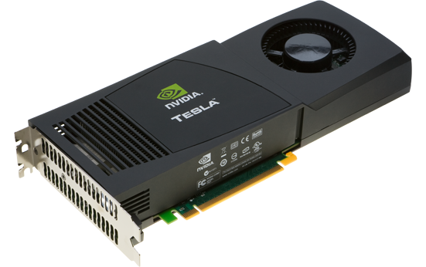
Texture Atlas
Why?
  Easy data composition
  Efficiency
  Stays in GPU memory

Slide 25
Out-of-Core Data Caching for Planetary Terrain
Department of Computer Science and Engineering
University of Nevada, Reno

Slide 26
Algorithm Overview
Preprocessing
Runtime
Read data using GDAL
Render Interface
Partition data into quadtrees
Upload patches to GPU
Create BVH
Start thread for searching
Populate runtime BVH
Search BVH for data

Slide 27
Preprocessing
Read data using GDAL
Partition data into quadtrees
Create BVH
Large amounts of data
  Need to be processed before runtime
Only happens once
Different instances of the program

Slide 28
Preprocessing - Steps
Read data using GDAL
Partition data into quadtrees
Create BVH
Partition datasets into smaller pieces using GDAL¹
Place partitioned datasets into a quadtree hierarchy
  Perform mipmapping operations
Order datasets into a bounding volume hierarchy (BVH)
¹Geospatial Data Abstraction Library. http://www.gdal.org

Slide 29
GDAL
Read data using GDAL
Partition data into quadtrees
Create BVH
Extract
  Projection coordinates of dataset
  Projection information of dataset
P1
P4
P5
P2
P3

Slide 30
GDAL
Read data using GDAL
Partition data into quadtrees
Create BVH
Store
  Lower left coordinate in projection coordinates
  Width and height in projection coordinates
Height
L
Width

Slide 31
Quadtree Creation
Read data using GDAL
Partition data into quadtrees
Create BVH
Spatial subdivision hierarchy where all nodes have either zero or four children
Four equal-sized children
Easy mipmapping

Slide 32
Quadtree Creation
Read data using GDAL
Partition data into quadtrees
Create BVH
Bottom-up approach
  High-resolution data in the leaves
  Lower detail nodes up the tree
Serialize to the hard drive

Slide 33
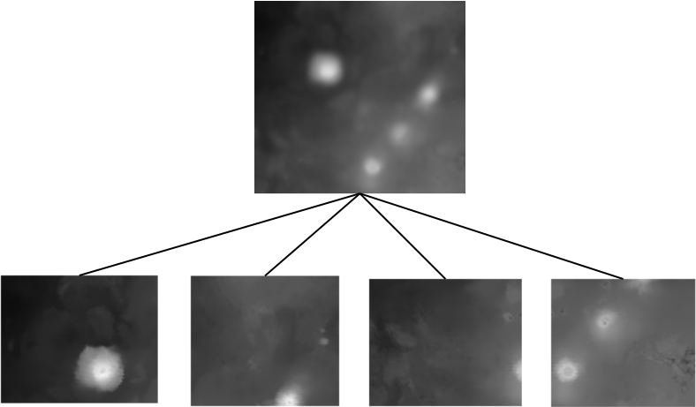
Mipmapping
Read data using GDAL
Partition data into quadtrees
Create BVH

Slide 34
BVH
Read data using GDAL
Partition data into quadtrees
Create BVH
Ordered based on geographic location

Slide 35
Runtime
Search
Composite
LOD
Maintenance
Upload
Insertion
Search the BVH for data
Determine the LOD
Upload data to the GPU
  Composite the data
Perform maintenance
Allow for the insertion of new data

Slide 36
Searching
Search
Composite
LOD
Maintenance
Upload
Insertion
Frustum-box collision
Test quadtrees iff:
  Frustum collides
  Dot product of dataset normal and inverse view > zero
Determine level of tree based on LOD
Preformed by a background thread

Slide 37

LOD Selection
Search
Composite
LOD
Maintenance
Upload
Insertion
Error-based metric
Mipmaps introduce error (δ_{m})
As data gets coarser, error should get higher

Slide 38

LOD Selection
Search
Composite
LOD
Maintenance
Upload
Insertion
Need to calculate the error depending on the screen resolution and field of view
S = screen resolution
τ = user-defined threshold
fov = field of view of the camera
T. Lauritsen and S. Nielsen. Rendering Very Large, Very Detailed Terrains. 2005

Slide 39
Searching
Search
Composite
LOD
Maintenance
Upload
Insertion
Data uploaded to atlas when available

Slide 40
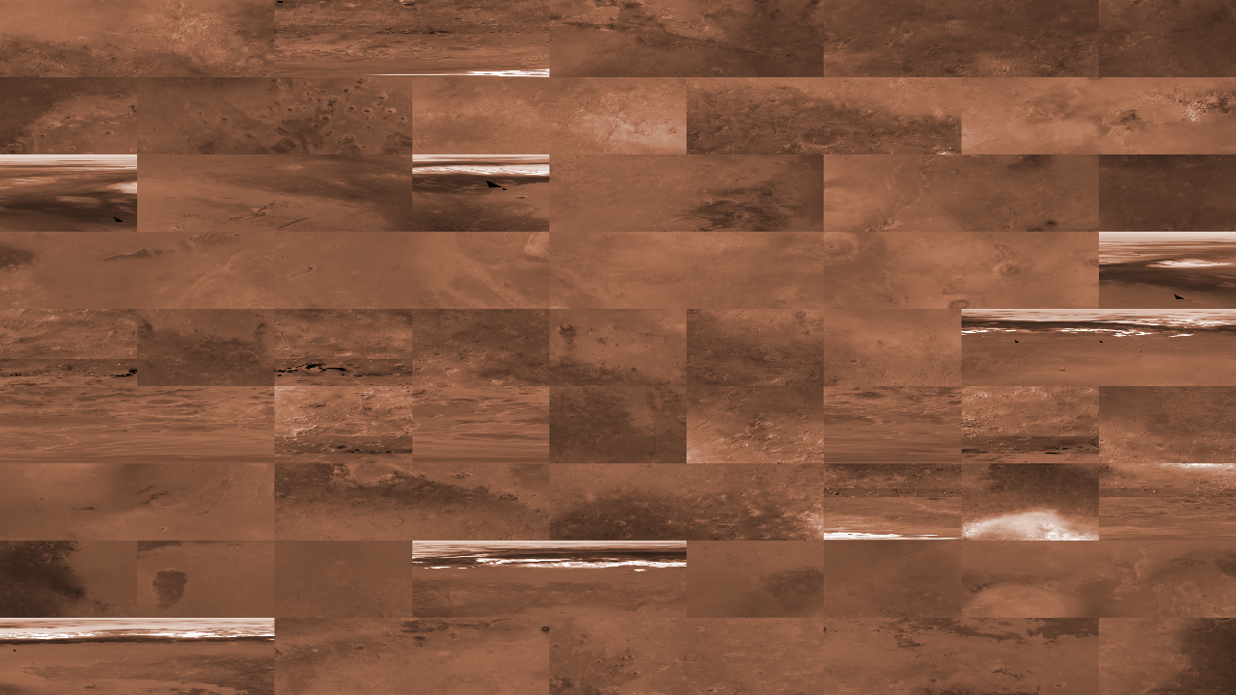
Texture Atlas
Search
Composite
LOD
Maintenance
Upload
Insertion

Slide 41
GPU
Search
Composite
LOD
Maintenance
Upload
Insertion
Datasets composited on the GPU
For each dataset:
  Render center
  Screen-aligned quad
  Composite into framebuffer object

Slide 42
GPU
Search
Composite
LOD
Maintenance
Upload
Insertion
Screen-aligned quad

Slide 43
GPU
Search
Composite
LOD
Maintenance
Upload
Insertion
D = P – L
S = (width, height)
(u,v) = D / S
Height
P
D
L
Width

Slide 44

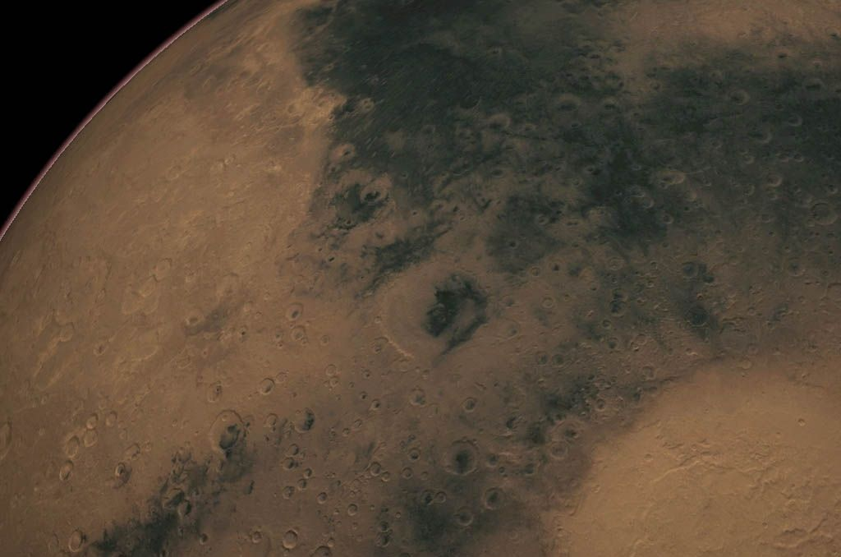
GPU
Search
Composite
LOD
Maintenance
Upload
Insertion
P

Slide 45
Maintenance
Search
Composite
LOD
Maintenance
Upload
Insertion
Too large for GPU memory to handle
  Maintain a list of distances from viewer to each patch
  Remove farthest patches
  Replace with new, closer patches
Performed by a separate thread

Slide 46
Insertion of New Data
Search
Composite
LOD
Maintenance
Upload
Insertion
User may want to add new data
Move through same preprocessing step with new data
  Fit into existing tree
  Ready for rendering
  Background thread

Slide 47
Data Types
Three types of data:
  Height
  Color
  Normal
Handled by multiple threads

Slide 48
Implementation
Department of Computer Science and Engineering
University of Nevada, Reno

Slide 49
Implementation
Extends Hesperian
  Mars
Written in C++
VR and desktop environment

Slide 50

Video

Slide 51
Results
Department of Computer Science and Engineering
University of Nevada, Reno

Slide 52
Test Machine
Intel Core i7 at 2.8GHz
8 GB of RAM
nVidia GeForce GTX 480
  480 cores
  1.4MHz per core
  1536MB of graphics memory

Slide 53
Test Setup
GPU set to have a maximum atlas of 8192x8192 per data type
Averaged over 10,000 frames
Hesperian as a base

Slide 54
Data
Select Dataset Information
Name | Scale (m/px) | Width | Height | Size (MB)
MOC Tile 1 | 2604.699 | 4096 | 4096 | 191.84
MOLA Height | 1853.000 | 11520 | 11520 | 126.56
Victoria Height | 1.011 | 1279 | 1694 | 8.27
5335.39MB of data

Slide 55
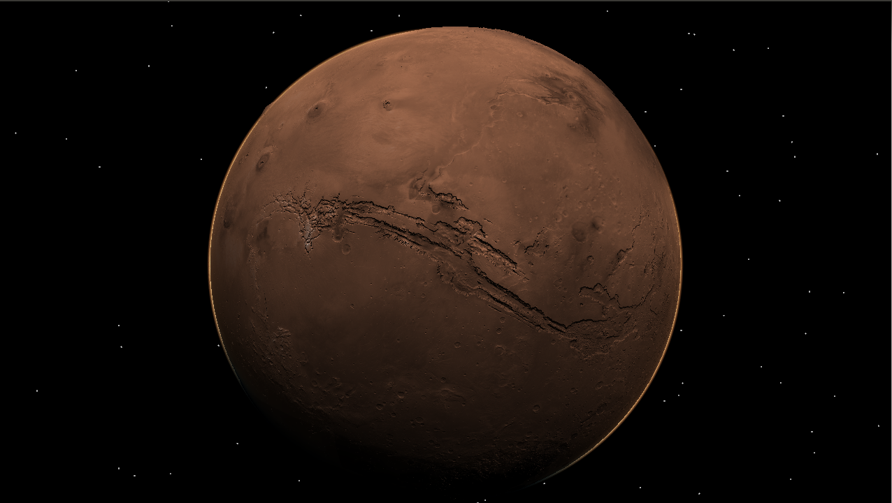
Planetary View

Slide 56
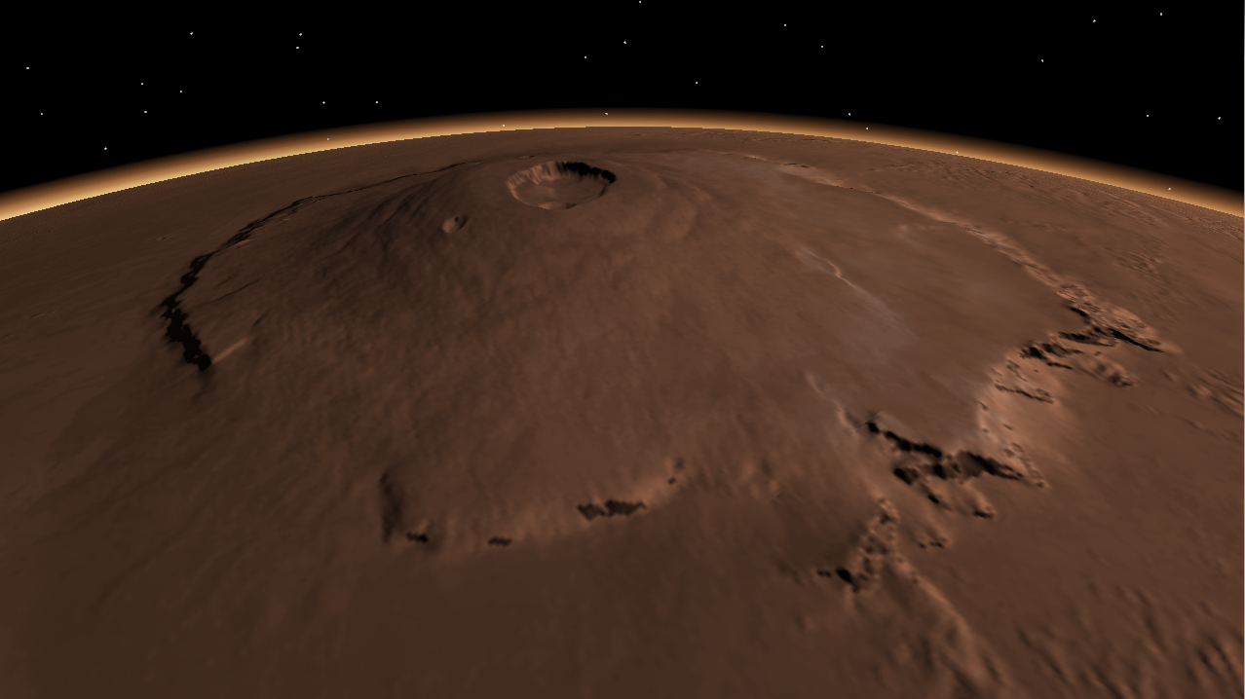
Olympus Mons

Slide 57
Flyby
Flyby from south to north pole

Slide 58
Results
Average Frames Per Second (FPS)
Scene | Data Cacher | Hesperian | Percent Different
Planetary View | 127.15 | 118.04 | +7.7%
Olympus Mons | 127.36 | 115.52 | +10.2%
Flyby | 107.20 | 111.54 | -3.89%

Slide 59
Timing
Flyby scene
  Worst case
4.82% of total runtime
Rest in Hesperian
Average Timing of Algorithm Steps
Process | Time (ms) | Percent of Runtime
Uploading | 0.064 | .68%
Compositing | 0.360 | 3.28%

Slide 60
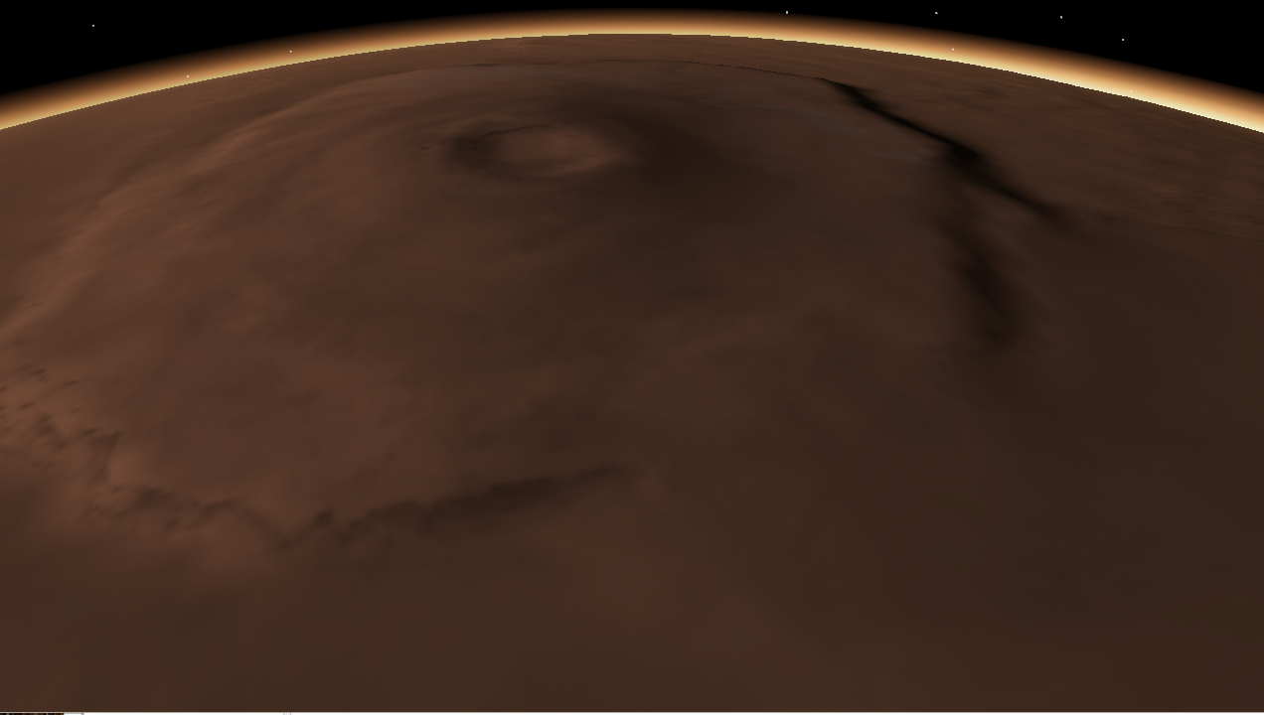
Visual Results

Slide 61

Visual Results

Slide 62
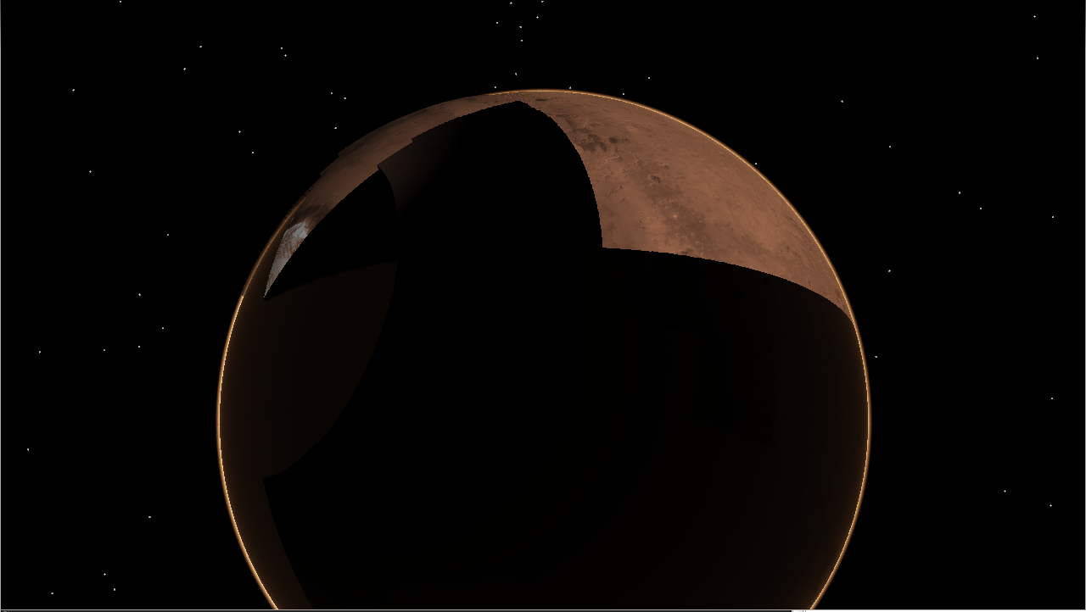
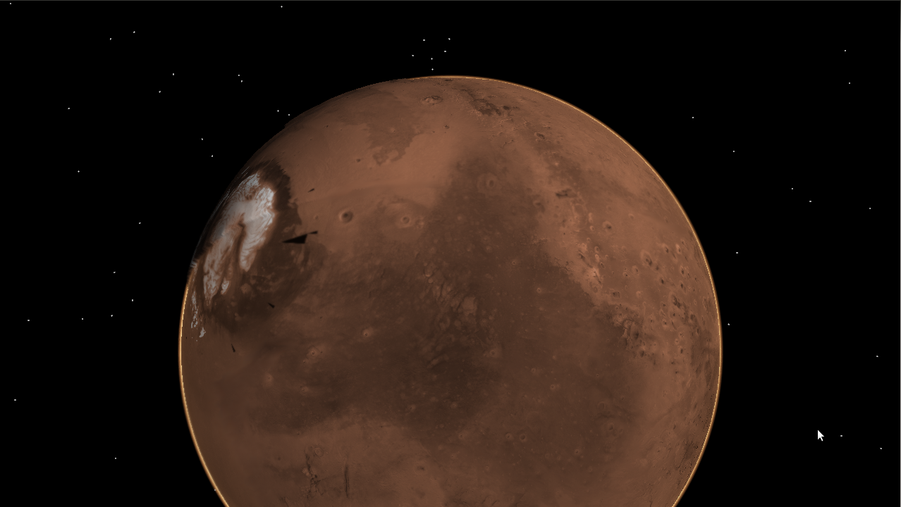
Visual Caveat

Slide 63
Conclusions and Future Work
Department of Computer Science and Engineering
University of Nevada, Reno

Slide 64
Conclusions
Presented a data-caching mechanism
  Planetary terrain
  Hybrid CPU/GPU approach
  Insertion of new data
  Decoupled from the renderer

Slide 65
Future Work
Data compression
Laid out differently on hard drive
Global color dataset

Slide 66
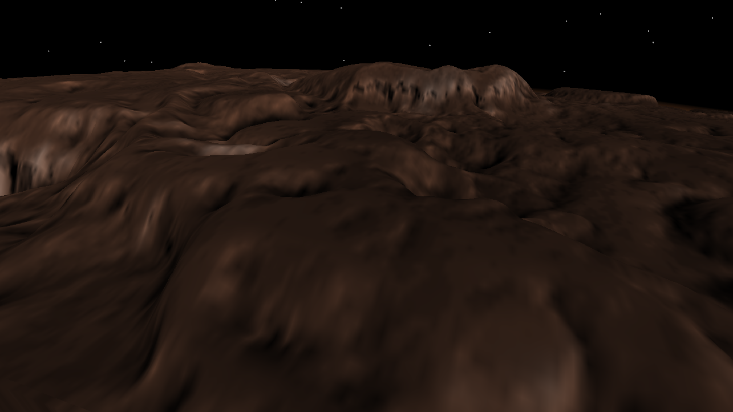
Questions

