Slide 1
Beyond Monitoring:
Proactive Server Preservation in an HPC Environment
Chad Feller
University of Nevada, Reno
8 May 2012
Thesis Defense

Slide 2
Acknowledgements
My wife, Veronica
My kids
My good friend, Derek Eiler
My committee, Dr. Harris, Dr. Dascalu, Dr. Schlauch

Slide 3
Background
Monitoring systems
  Increasingly sophisticated
  Still large holes in capabilities

Slide 4
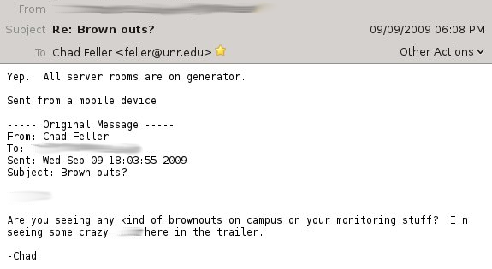
9/9/9

Slide 5
9/9/9
Power failure sequence kicks in
  UPS caught outage
  Generator started up
Temperature rising
  UPS only powers servers
Power switches to generators
Temperature still rising

Slide 6
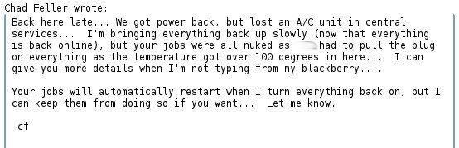
9/9/9

Slide 7
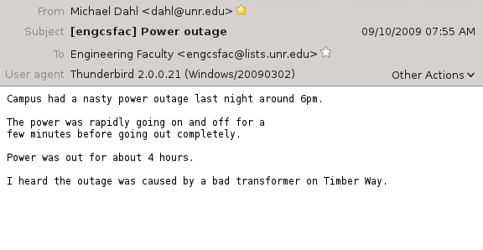
9/10/9

Slide 8
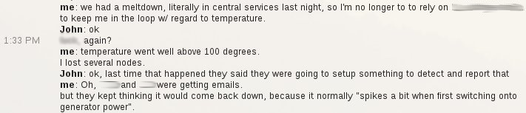
9/10/9

Slide 9
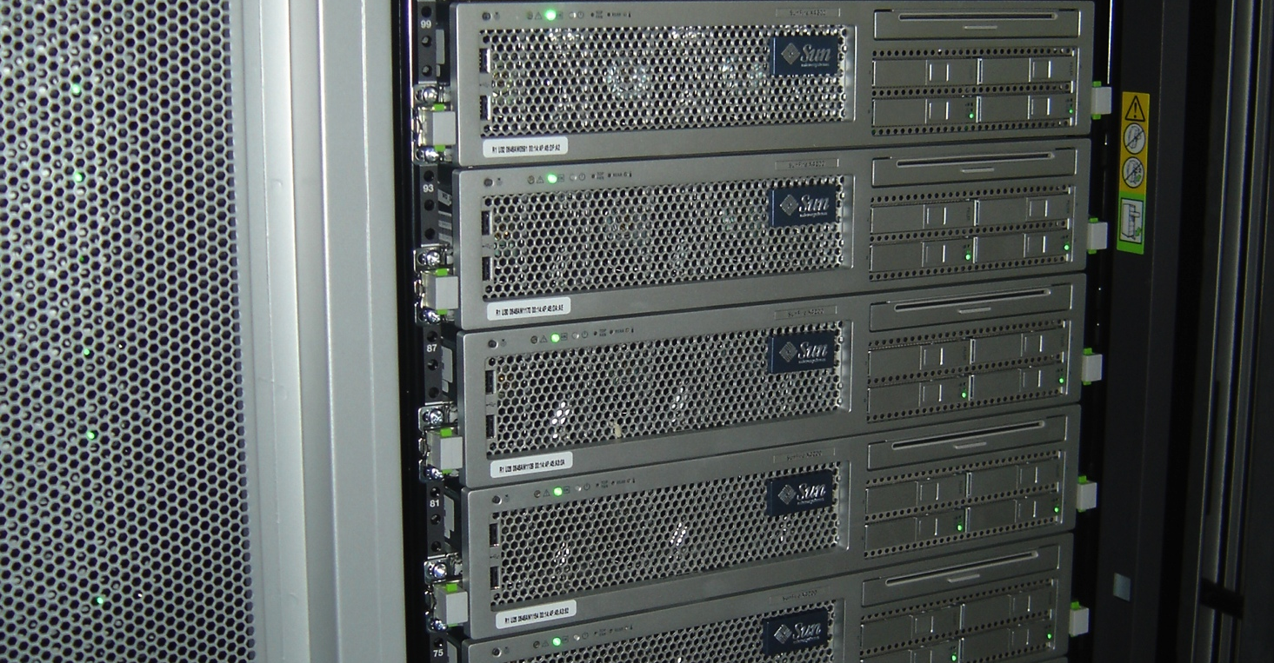
HPC

Slide 10
Computing Density

Slide 11


Slide 12
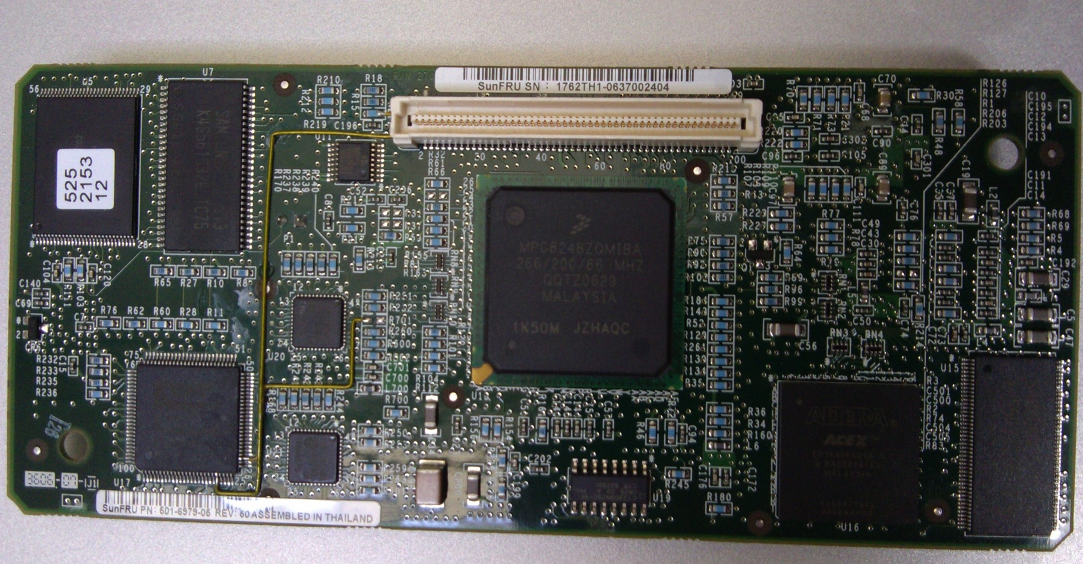
ILOM

Slide 13
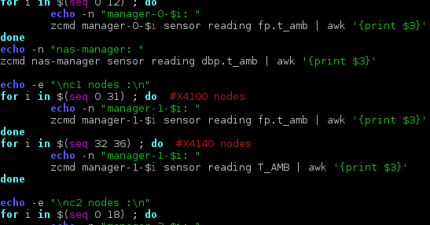
9/10/9

Slide 14
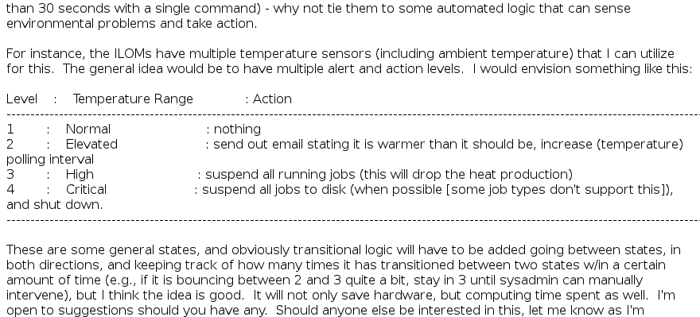
9/10/9

Slide 15
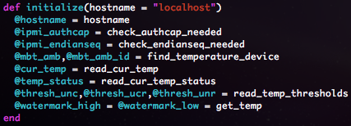
7/20/11

Slide 16
Environmental Considerations
ILOM/IPMI
Sun Grid Engine
Linux

Slide 17
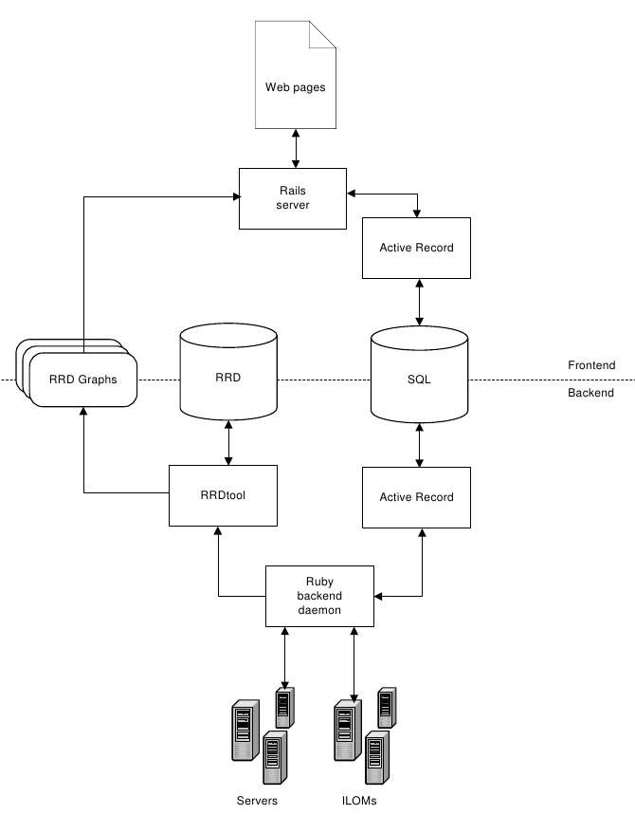
Architecture

Slide 18
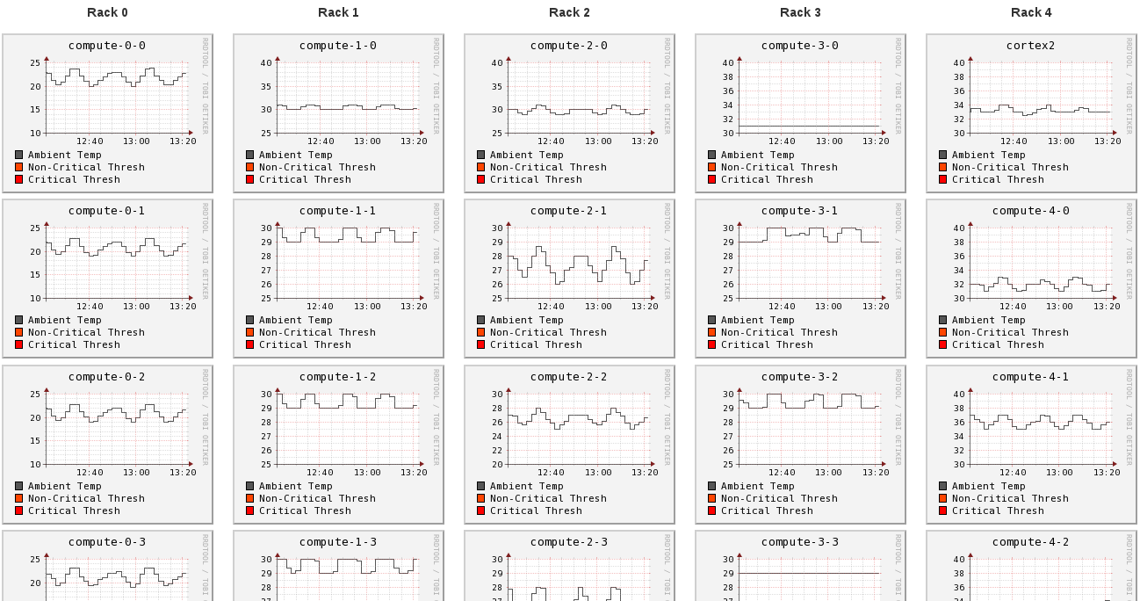
Frontend

Slide 19
Ma
I n Loop

Slide 20
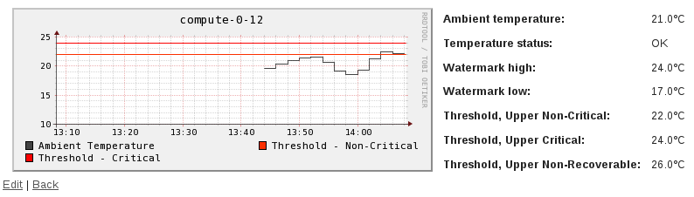
Local Testing

Slide 21
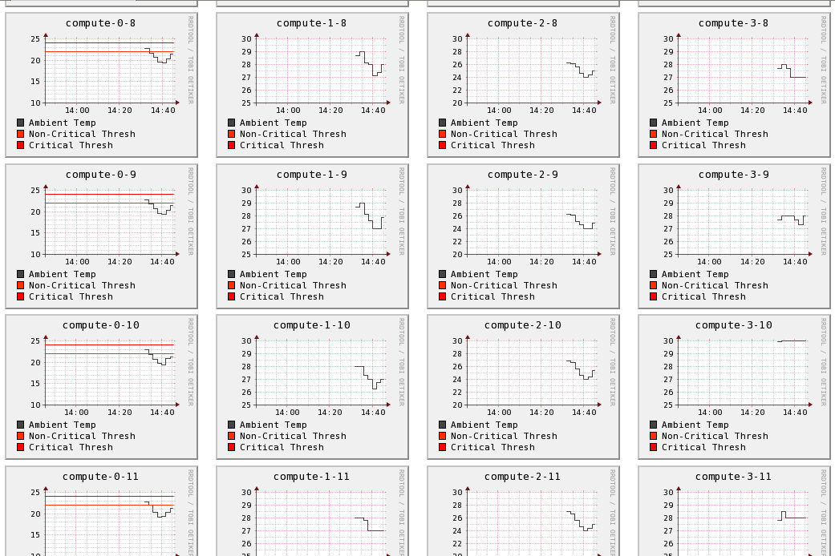
Global Testing

Slide 22
Global Testing

Slide 23
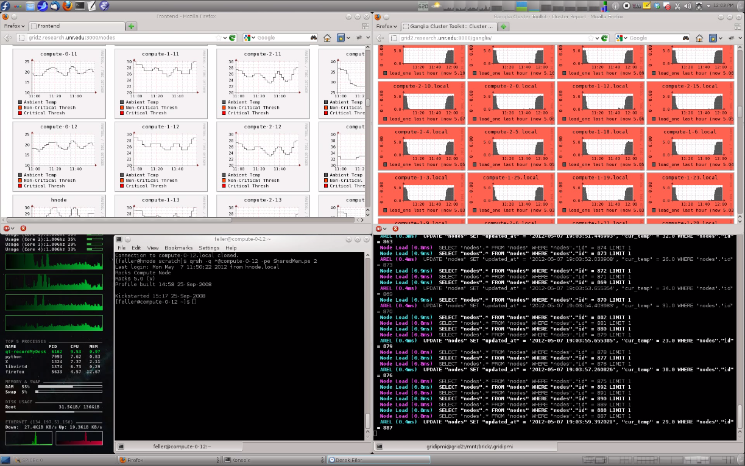
Demo

Slide 24
Conclusion
Developed a temperature monitoring system
  Local Perspective
  Global Perspective
  Intelligent Response
  Designed for HPC & Enterprise servers
Modular Implementation
  Can be easily adapted to other hardware
  Software can be leveraged to other environments
Tested

Slide 25


