Slide 1

Master's Thesis Defense:
A Python Library for Ion Channel Modeling
Gareth Ferneyhough
Department of Computer Science and Engineering
University of Nevada, Reno
Dr. Frederick C. Harris, Jr. / Thesis Advisor
May, 2013

Slide 2
Acknowledgements
Thanks to committee members:
Dr. Frederick C. Harris, Jr.
Dr. Sergiu Dascalu
Dr. Normand Leblanc
This work was partially supported by the U.S. Office of Naval Research (N000140110014).

Slide 3
Outline
Introduction
Biology background
Mathematical background
Software design
Software demonstration
Discussion
Questions

Slide 4
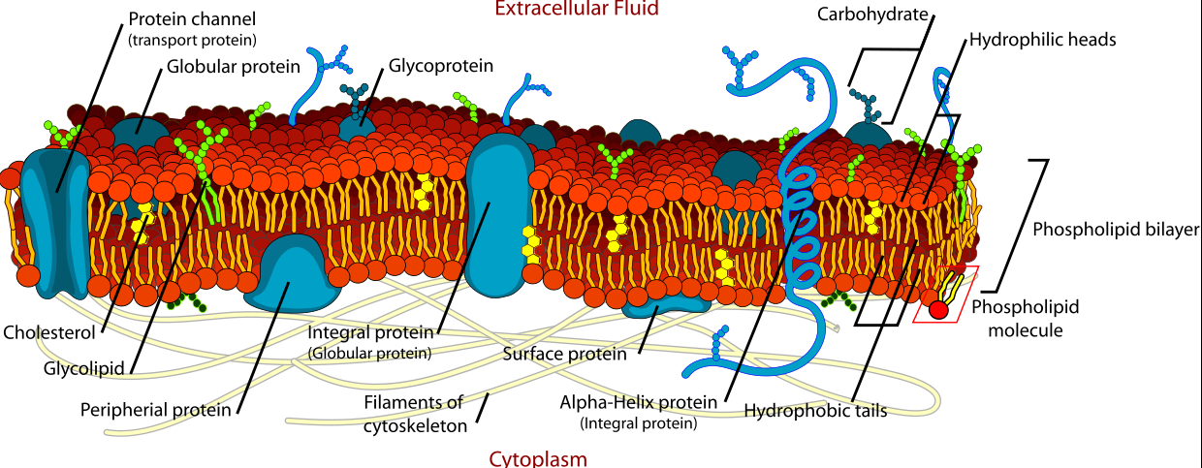
Introduction
Cell membrane [4].

Slide 5
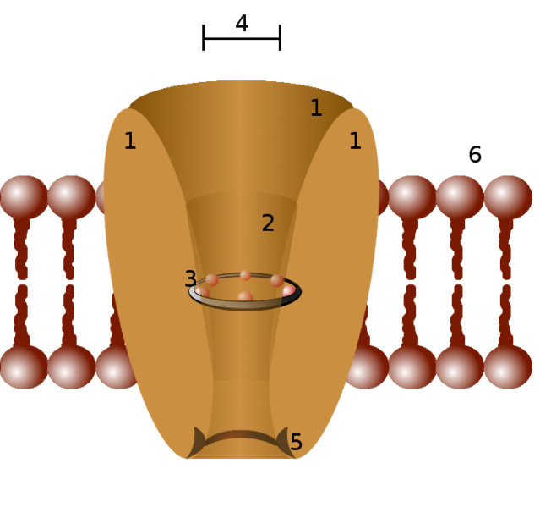
Introduction
What are ion channels?
  Family of proteins embedded in cell membrane
  Passive transport
  Selectively permeable
  Diverse
Used for:
  shaping cell voltage
  sensing
  communication
  regulation of volume
[1].

Slide 6
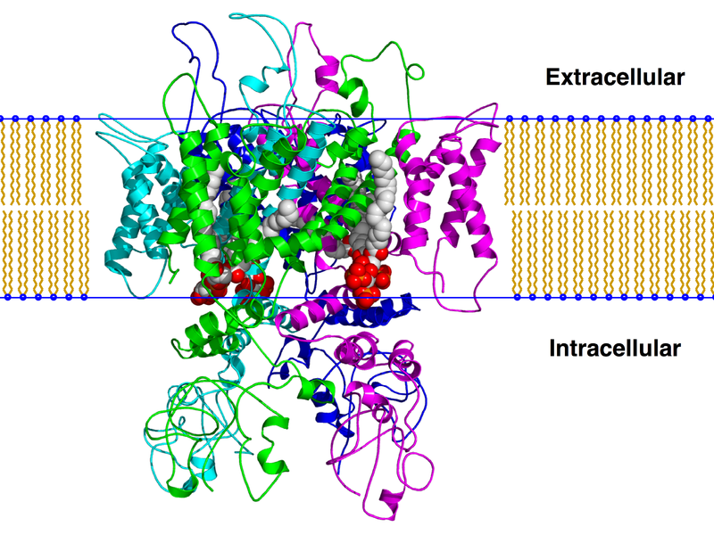
Introduction
Trpv1 (capsaicin receptor) ion channel [2].

Slide 7
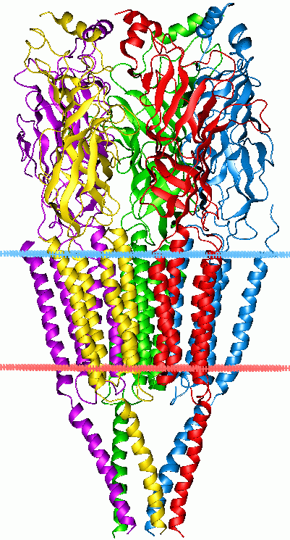
Introduction
Types of ion channels
  Voltage-gated
    (Na+ channel)
  Ligand-gated
    (Calcium-activated chloride channel)
  Stretch-gated
    (blood pressure regulation)
Nicotinic acetylcholine receptor [3].

Slide 8
Introduction
Why study ion channels?
  Diseases:
    Familial hemiplegic migraine
    Cystic fibrosis
    Others
  Poisons / toxins
    Snakes, scorpions, spiders, bees
  Understanding function can lead to new treatments / drugs

Slide 9
Background: Electrochemical gradient

Slide 10
Background: Electrochemical gradient
What provides the work to drive ions through their channels?

Slide 11
Background: Electrochemical gradient
What provides the work to drive ions through their channels?
  The electrochemical gradient
What is that?
  Combination of diffusion and electrical forces

Slide 12
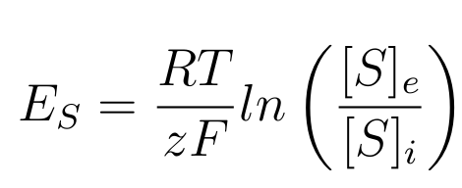
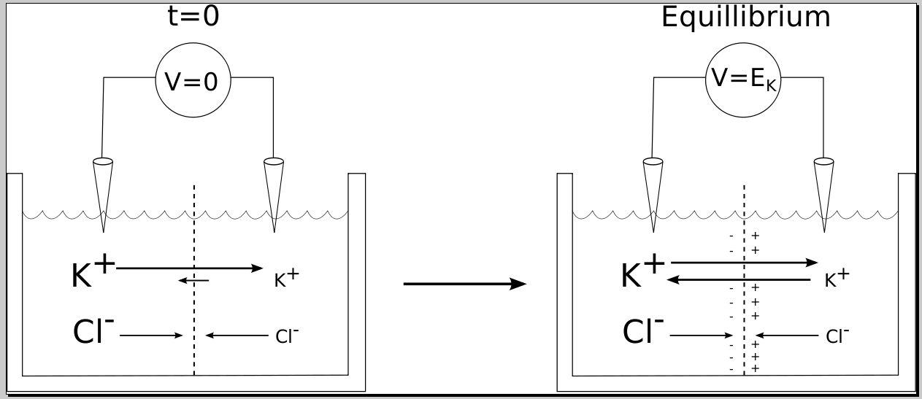
Background: Electrochemical gradient
Nernst equation:

Slide 13
Background:
Membrane potential
How do ion channels contribute to the cell's membrane potential?
  channel state affects membrane permeability to ions
  permeability ≈ conductivity

Slide 14
Background:
Membrane potential
How do ion channels contribute to the cell's membrane potential?
  channel state affects membrane permeability to ions
  permeability ≈ conductivity
Ohm's law:
  V=IR
  V=I/G

Slide 15
Background:
Membrane potential
How do ion channels contribute to the cell's membrane potential?
  channel state affects membrane permeability to ions
  permeability ≈ conductivity
Ohm's law:
  V=IR
  V=I/G
  I=GV

Slide 16
Background:
Membrane potential
Formally,
  I_{s} = G_{s} * (DrivingForce_{s} ),
  where DrivingForce_{s} = (V_{m} - E_{s}).
  Substituting:
  I_{s} = G_{s} * (V_{m} - E_{s}).

Slide 17
Background:
Membrane potential
Formally,
  I_{s} = G_{s} * (DrivingForce_{s} ),
  where DrivingForce_{s} = (V_{m} - E_{s}).
  Substituting:
  I_{s} = G_{s} * (V_{m} - E_{s}).
How do we calculate G_{s}?
  Proportion of open channels

Slide 18
Background:
Channel modeling
How do we model the kinetics, or gating of ion channels?

Slide 19
Background:
Channel modeling
How do we model the kinetics, or gating of ion channels?
  Represent channel as a continuous time Markov process

Slide 20

Background:
Channel modeling
How do we model the kinetics, or gating of ion channels?
  Represent channel as a continuous time Markov process
    States ≈ channel's functional shape
      i.e. open, closed, deactivated, inactivated
    States are connected using various rates

Slide 21
Background:
Channel modeling
Continuous time Markov process:
  used to simulate stochasticity
  maintain "memoryless" Markov property
  transitions between states can occur at any time
    with exponentially distributed probability

Slide 22
Background:
Channel modeling
Continuous time Markov process:
  used to simulate stochasticity
  maintain "memoryless" Markov property
  transitions between states can occur at any time
    with exponentially distributed probability
  can give us the model's probability distribution
    i.e. what is the probability that our ion channel is in the open state?

Slide 23
Background:
Channel modeling
Continuous time Markov process:
  used to simulate stochasticity
  maintain "memoryless" Markov property
  transitions between states can occur at any time
    with exponentially distributed probability
  can give us the model's probability distribution
    i.e. what is the probability that our ion channel is in the open state?
    or - out of many ion channels, how many are open?

Slide 24

Background:
Channel modeling
Continuous time Markov process:
  evolution of probability distribution:
where P is the vector of state probabilities, and A is the transition matrix

Slide 25

Background:
Channel modeling
Continuous time Markov process:
  evolution of probability distribution:
where P is the vector of state probabilities, and A is the transition matrix

Slide 26
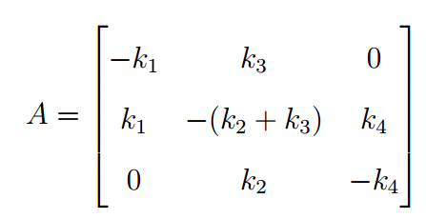
Background:
Channel modeling

Slide 27
Background:
Channel modeling
In summary:
  Ion channels change state in response to environmental factors

Slide 28
Background:
Channel modeling
In summary:
  Ion channels change state in response to environmental factors
  The state of ion channels affects the cell membrane's permeability (conductance)

Slide 29
Background:
Channel modeling
In summary:
  Ion channels change state in response to environmental factors
  The state of ion channels affects the cell membrane's permeability (conductance)
  We can model the conductance over time of an ion channel using continuous time Markov processes

Slide 30
Background:
Channel modeling
In summary:
  Ion channels change state in response to environmental factors
  The state of ion channels affects the cell membrane's permeability (conductance)
  We can model the conductance over time of an ion channel using continuous time Markov processes
    states - channel's physical state
    rates - transitions between states
      dependent on voltage, binding of ligands, etc.

Slide 31
Existing simulators
Several ion channel simulators exist that use CTMM

Slide 32
Existing simulators
Several ion channel simulators exist that use CTMM
  many rely on GUI
    IonChannelLab
    QUB

Slide 33
Existing simulators
Several ion channel simulators exist that use CTMM
  many rely on GUI
    IonChannelLab
    QUB
Some authors use MATLAB

Slide 34
Existing simulators
Several ion channel simulators exist that use CTMM
  many rely on GUI
    IonChannelLab
    QUB
Some authors use MATLAB
  slow

Slide 35
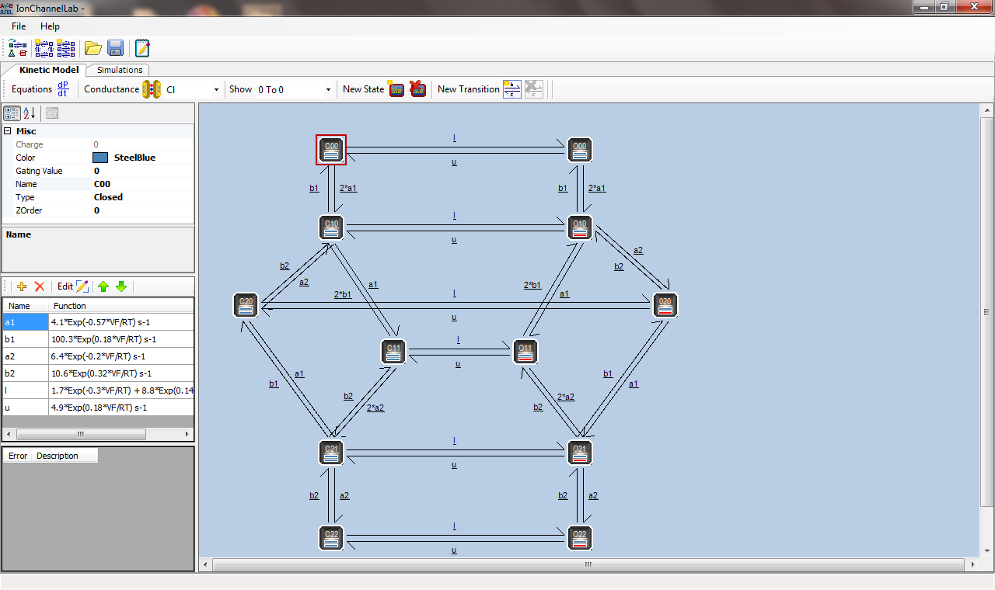
Existing simulators

Slide 36
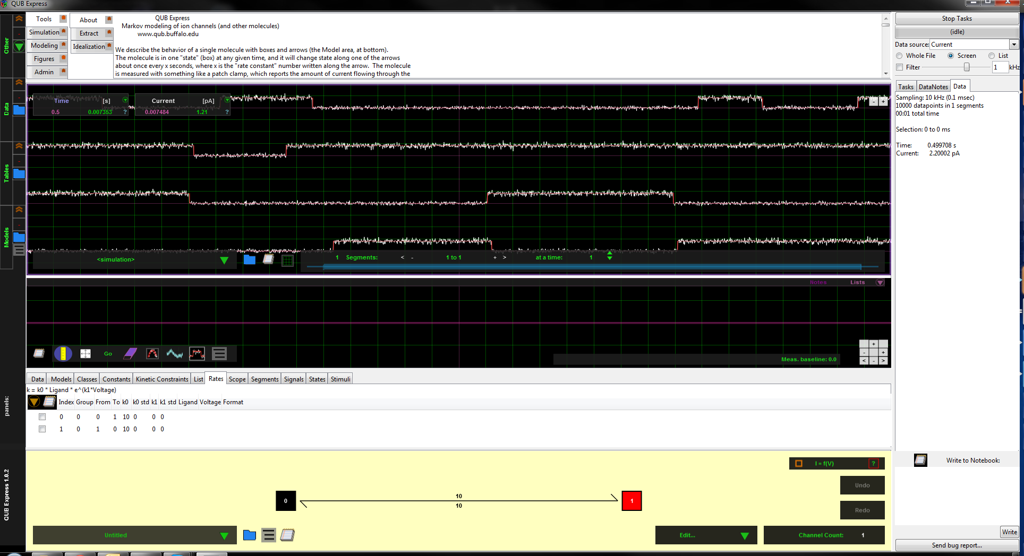
Existing simulators

Slide 37
Existing simulators
Several ion channel simulators exist that use CTMM
  many rely on GUI
    IonChannelLab
    QUB
Some authors use MATLAB
  slow
What about a Python library for ion channel modeling?

Slide 38
Our software:
ModFossa
ModFossa:
  CTMM ion channel simulator written in C++
    fast ODE solving
      17 times faster than MATLAB implementation
  available as Python library
    easy model creation
    attractive plotting
    scriptable

Slide 39
Our software:
ModFossa
Rate constant types:
  constant
  exponential voltage-gated
  sigmoidal voltage-gated
  ligand-gated
Experiment definition:
  voltage protocol
  concentration protocol

Slide 40
Our software:
ModFossa
Plots:
  all plots are vector graphics
  currents
  conductance vs. voltage
  conductance vs. concentration
  IV curves at specified time

Slide 41
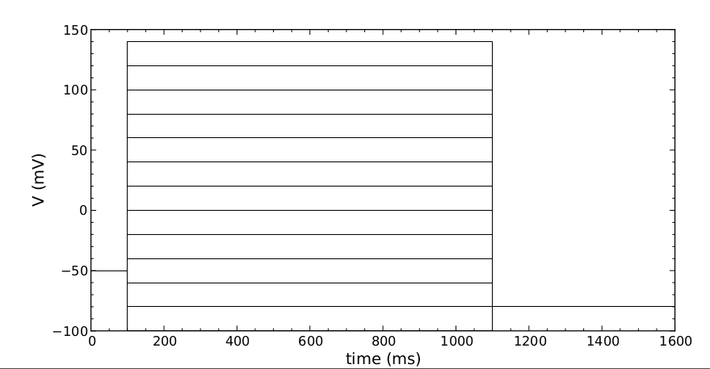
ModFossa plot:
voltage protocol

Slide 42
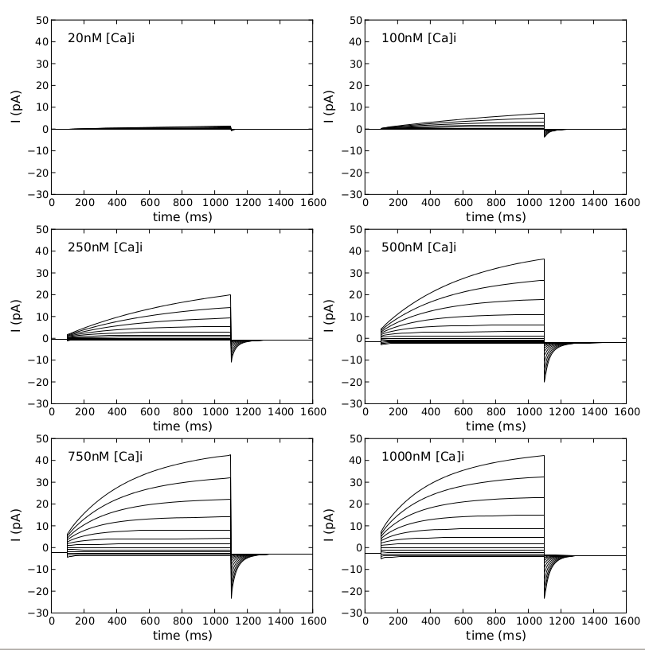
ModFossa plot:
currents

Slide 43
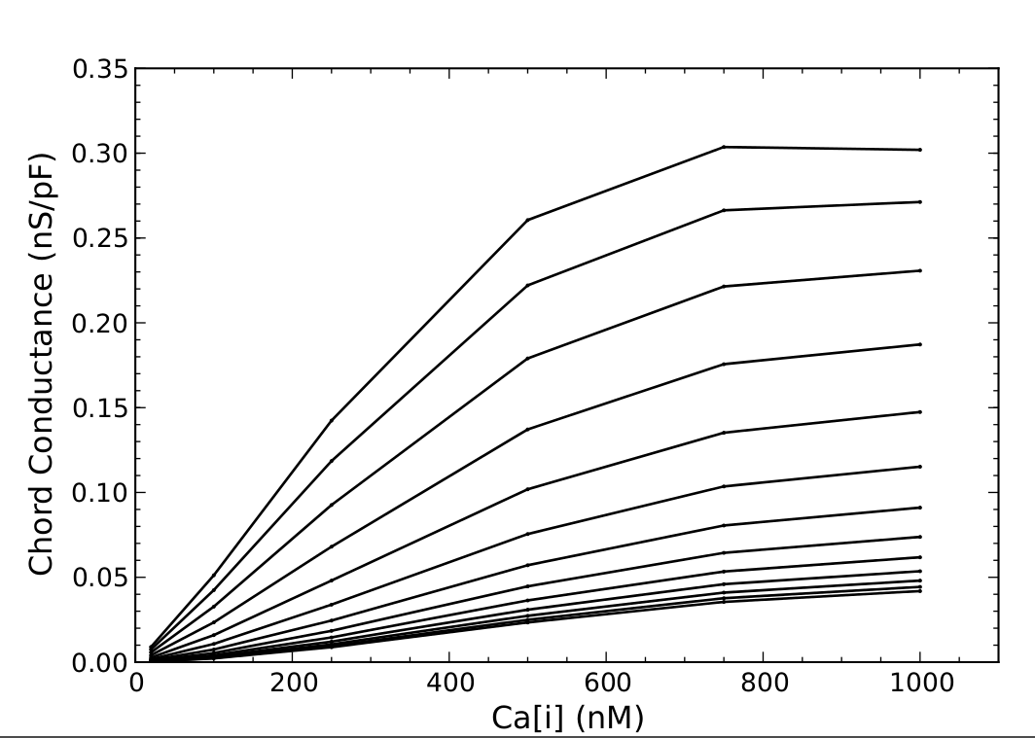
ModFossa plot:
G vs Concentration

Slide 44
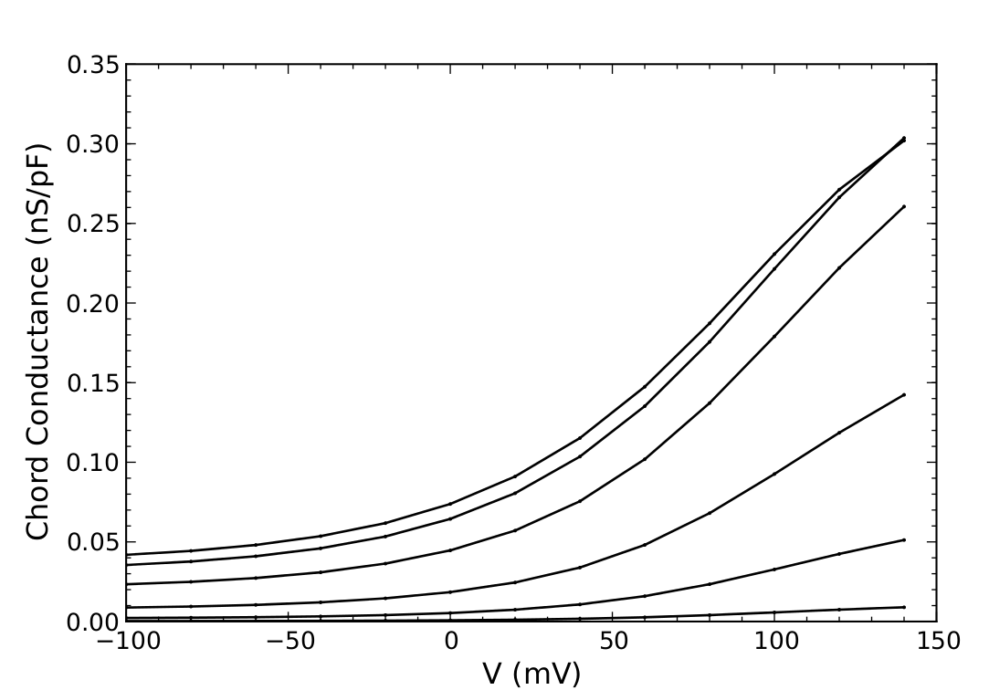
ModFossa plot:
G vs Voltage

Slide 45
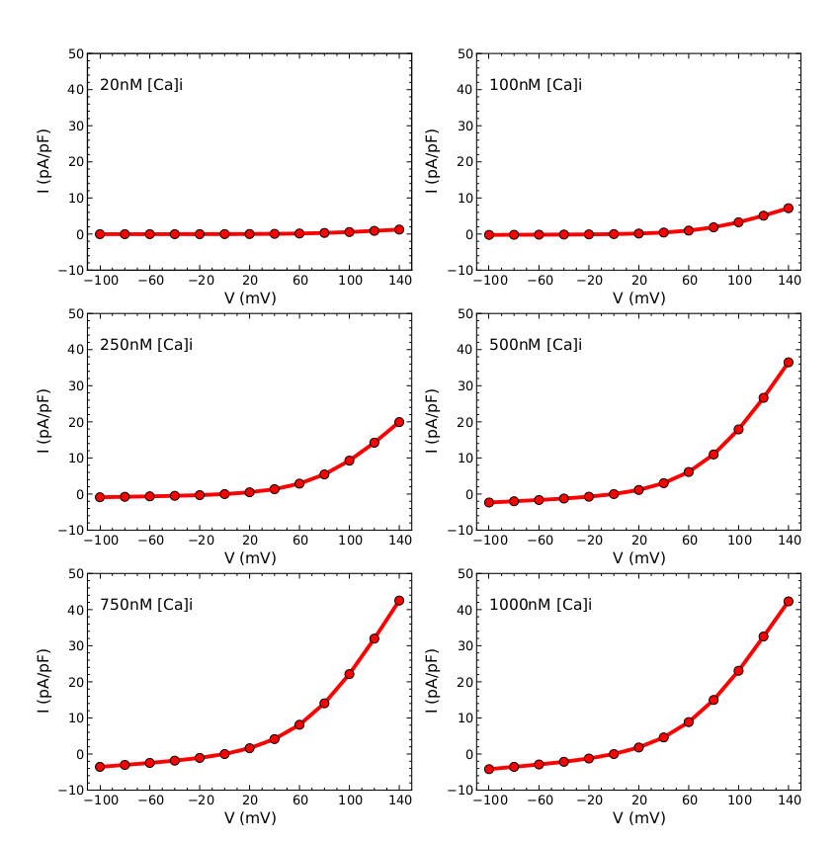
ModFossa plot:
IV curves

Slide 46
Our software:
ModFossa
Software development:
  Ubuntu Linux with Eclipse CDT
  C++ 11
  SUNDIALS ODE solver
  Boost.Python
  Python 2.7

Slide 47
Our software:
ModFossa
Software development:
  Ubuntu Linux with Eclipse CDT
  C++ 11
  SUNDIALS ODE solver
  Boost.Python
  Python 2.7
Building, testing, documentation:
  CMake
  Doxygen, Sphinx
  GTest

Slide 48
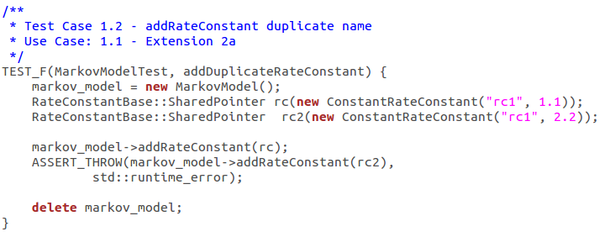
GTest example

Slide 49
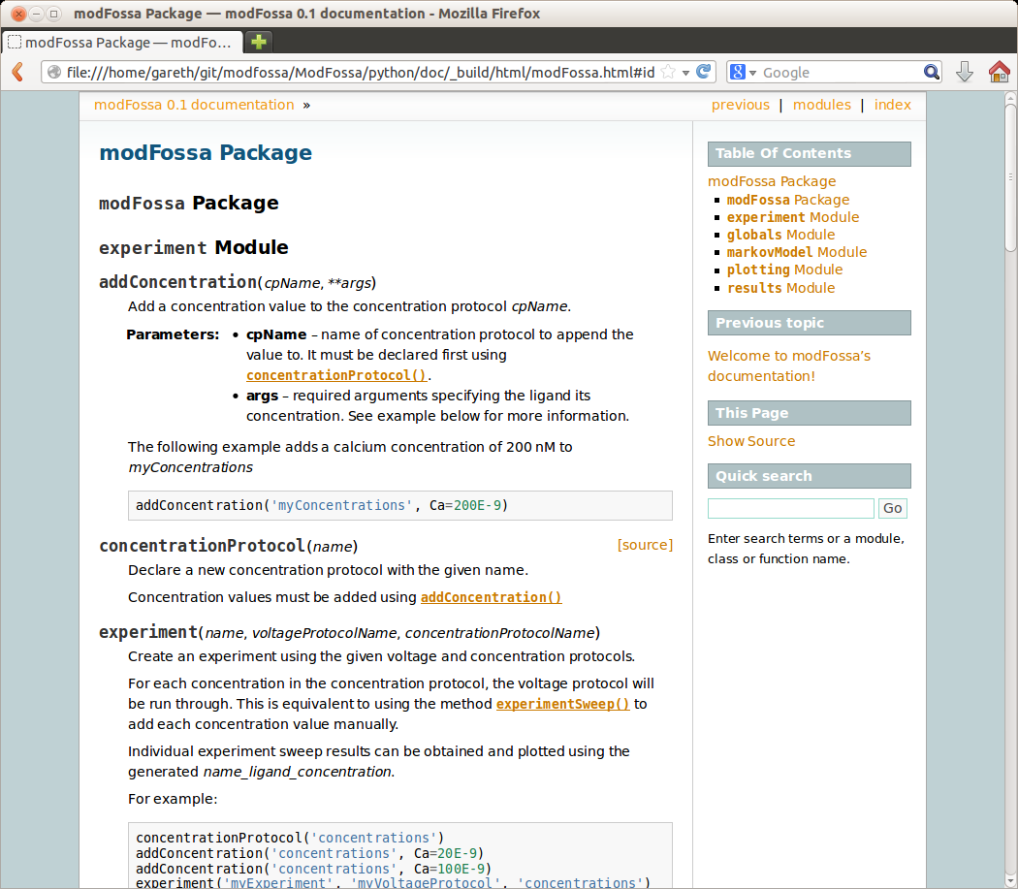
Sphinx example

Slide 50
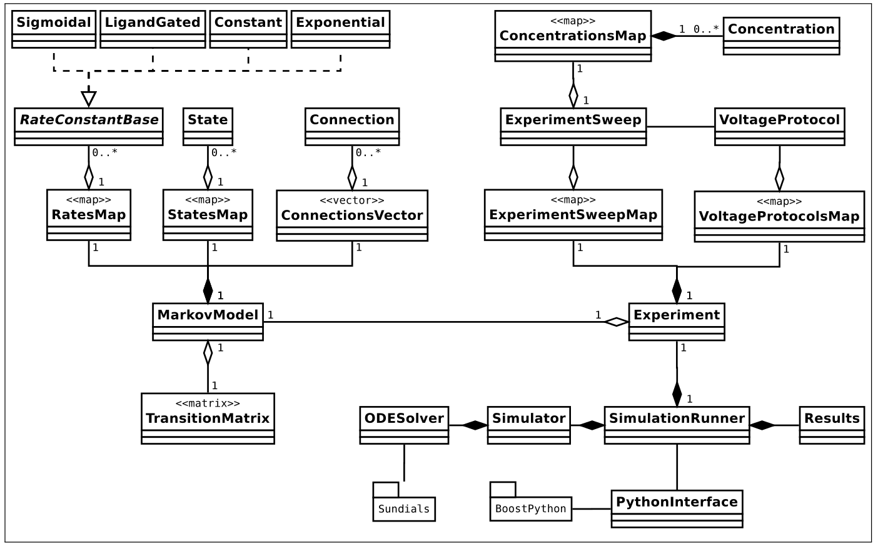
Our software:
ModFossa

Slide 51
Our software:
ModFossa
ModFossa demonstration:
  Two-state model
  Angermann calcium-activated chloride channel model

Slide 52
Discussion
ModFossa:
  fast, easy-to-use
  Python library
  nice plotting

Slide 53
Discussion
ModFossa:
  fast, easy-to-use
  Python library
  nice plotting
Applications:
  rapid model development
  parameter searching

Slide 54
Discussion
ModFossa:
  fast, easy-to-use
  Python library
  nice plotting
Applications:
  rapid model development
  parameter searching
Future work:
  user-defined rates
  curve fitting, parameter searching
  model visualization

Slide 55
Questions?

Slide 56
References
[1] http://en.wikipedia.org/wiki/File:Ion_channel.png
[2] http://en.wikipedia.org/wiki/File:Trpv1_pip2_bilayer.png
[3] http://en.wikipedia.org/wiki/File:2bg9_opm.gif
[4] http://en.wikipedia.org/wiki/File:Cell_membrane_detailed_diagram_en.svg

