Slide 1
Massively Parallel
Programming Models
How to train your GPU
Notes:
Good afternoon my name is Torbjorn Loken
The first thing I would like to do is thank all of you for attending this defense of my masters thesis

Slide 2
Acknowledgements
Thank you to my committee: Dr. Frederick C. Harris, Jr., Dr. Sergiu M. Dascalu and Dr. Yantao Shen
Thank you to Dr. Lee Barford and John Sien for the support.

Slide 3
Outline
Background
Sound Simulation - CUDA
Jitter Measurement - Thrust
Comparing Thrust and CUDA

Slide 4
Coprocessors

Slide 5
Step back in time

Slide 6
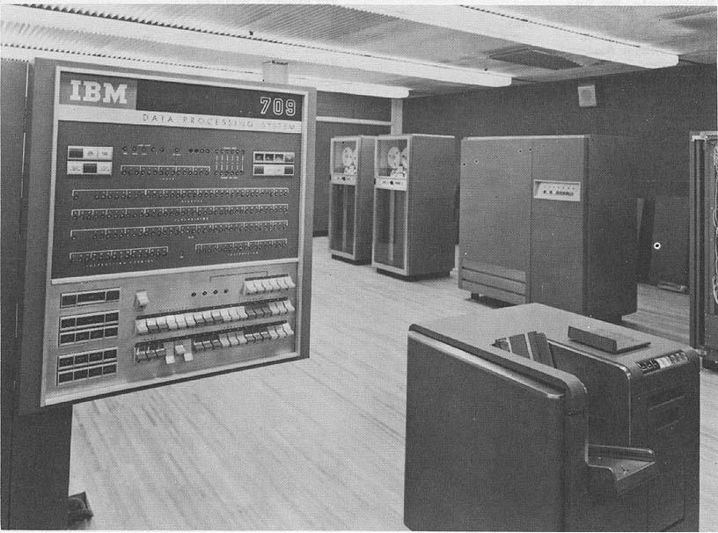
Notes:
http://www.columbia.edu/cu/computinghistory/ibm709.html
Thank you Columbia for the picture
IBM introduced the first coprocessor to offload processor intensive tasks

Slide 7
Channel IO
IO processing was taking a significant amount for processor time
  Just renting an IBM 709 could cost upwards of $55,000 a month
Notes:
Computer time very expensive

Slide 8
Channel IO
IO channels hooked into data synchronizer units
  Central Processor free to continue
Similar to the modern Southbridge chip found on motherboards

Slide 9
Floating Point Units
Notes:
Floating Point Units were probably the most well known coprocessors until recently
They were often the difference between a scientific computer and a computer

Slide 10
Floating Point Math
Before 1985 and the IEEE 754 standard the implementation of floating point math varied greatly
  Word sizes varied, accuracy varied
Notes:
No common interface for dealing with floating point numbers
Some machine had many different floating point types
Most serious machines had some form of coprocessor or hardware acceleration if they supported floating point types
Dark times for portability and programmer sanity

Slide 11
Floating Point Math
IEEE Standard 754 and a consensus about word sizes (32-bits) helped greatly
Hardware implementations almost required
  complex
  slow
  valuable
Notes:
Floating point math is a real bear.
Lead into the next slide with that

Slide 12
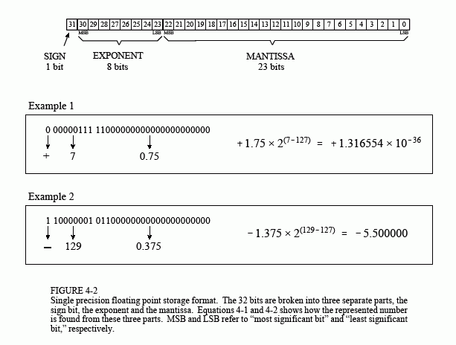
Floating Point Numbers
Notes:
As you can see the format of the float can be complicated
Addition and subtraction can be done if the numbers share a exponent
Multiplacation - multiply significant and add the exponents
Image Credit:
http://www.dspguide.com/ch4/3.htm

Slide 13
Floating Point units
Initially off chip
  One of the most popular coprocessors
Moore’s Law made room for them on chip

Slide 14
SSE and AVX
New instruction sets
Compute using 128-512 bit wide registers
  Multiple floating point numbers per register
Non-blocking, CPU free to continue while computations run.
Modern, widely available.

Slide 15
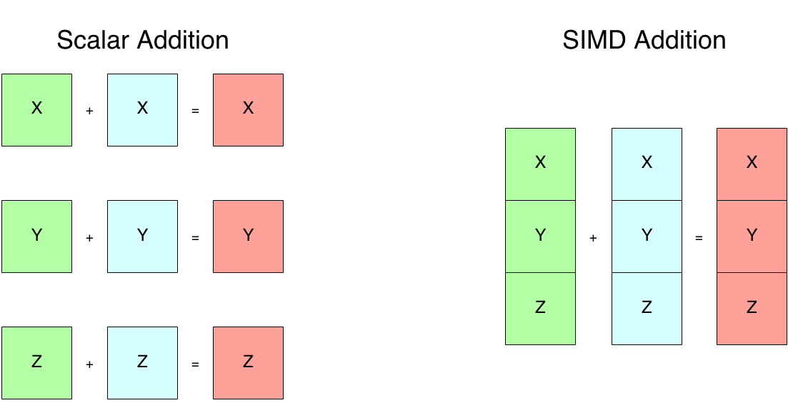

Slide 16
Graphics Processing Units

Slide 17
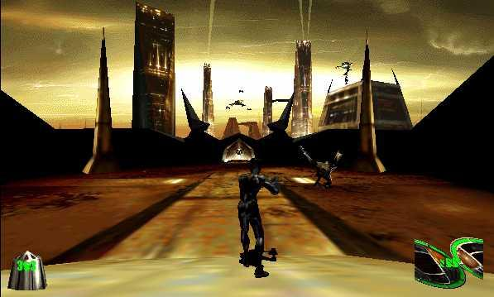
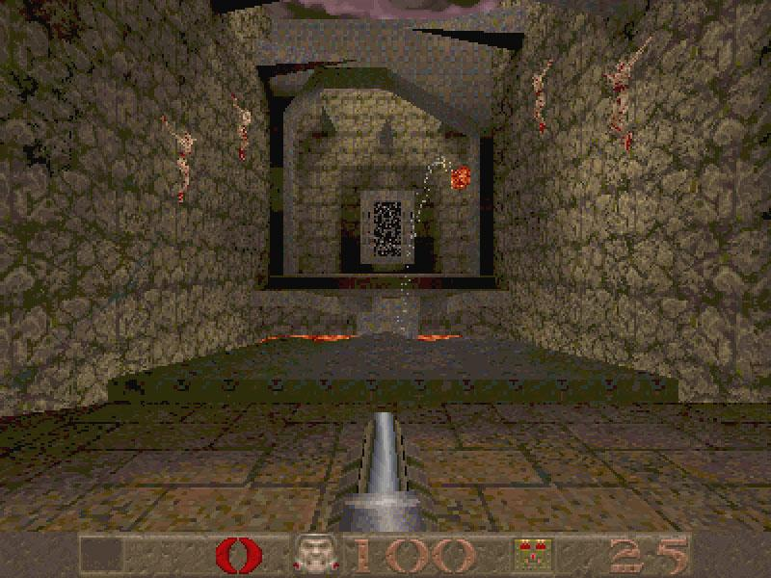
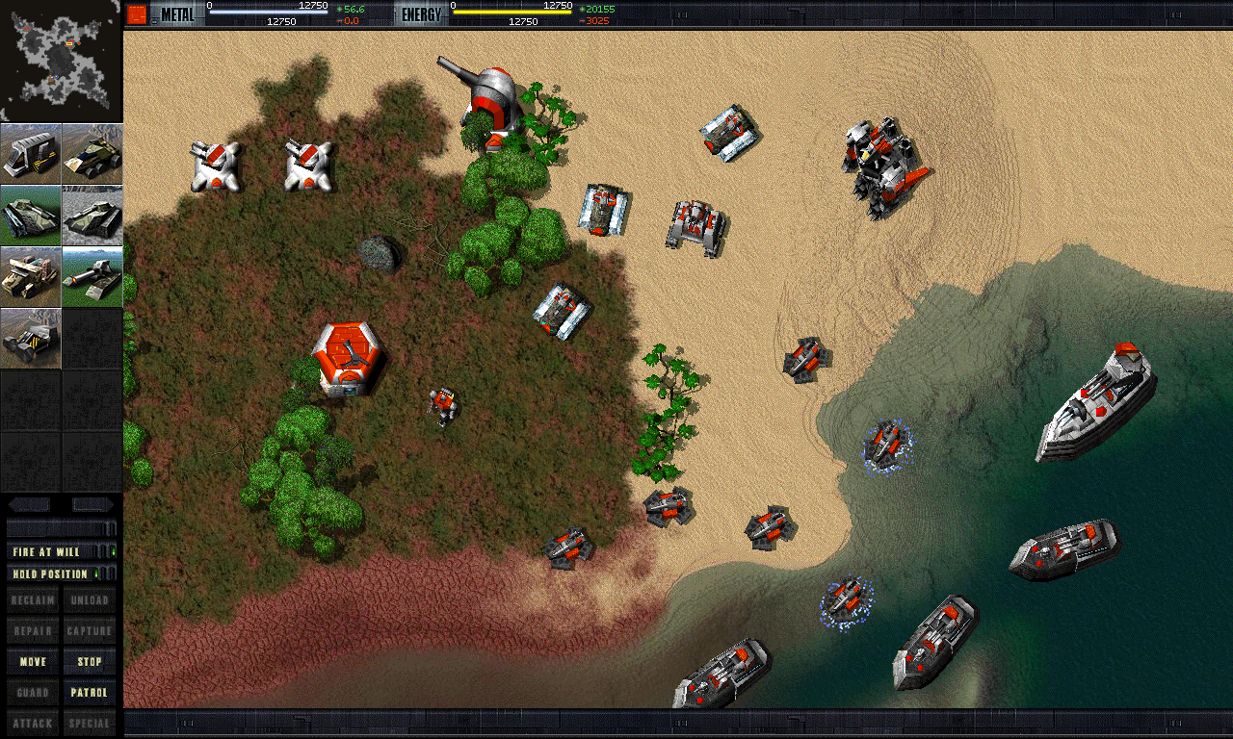
FPU Powered
Notes:
Some graphical programs begin to show up which require more power than the FPU can throw out, in particular games
right 2 images are from 1997
Image credits:
http://mrserincmartin.com/quake-is-the-best-ms-dos-game-ever/
http://www.desura.com/games/mdk/images/mdk1-screenshot
http://www.impulsedriven.com/

Slide 18
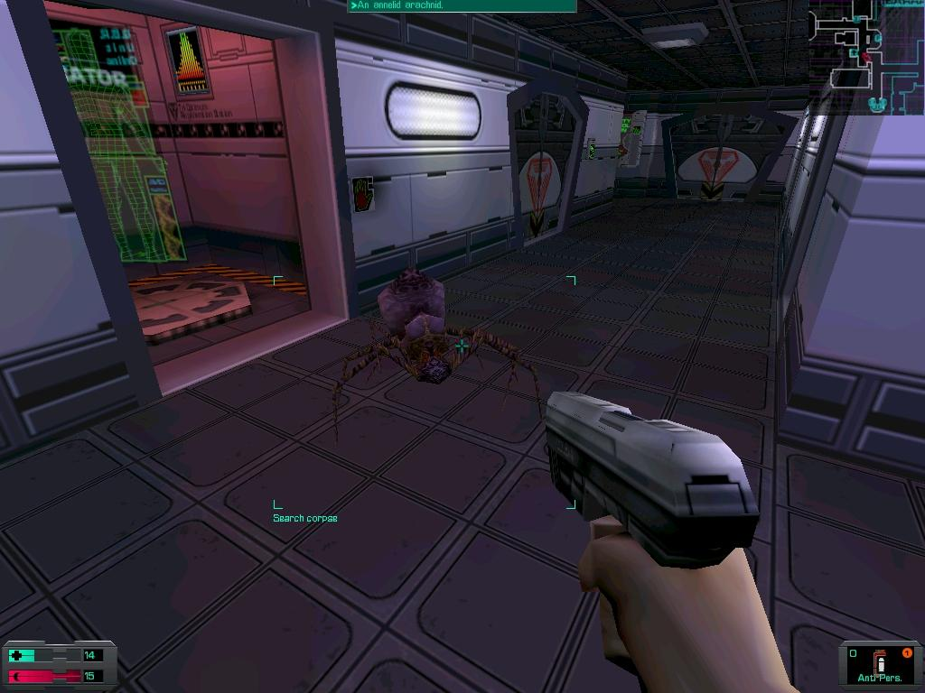
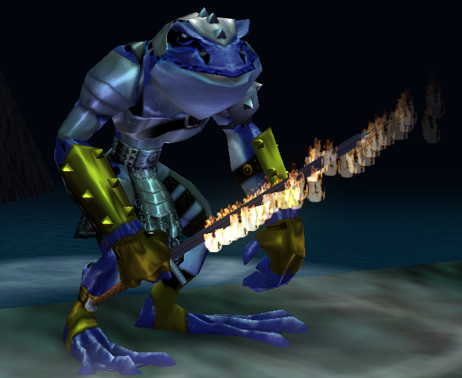
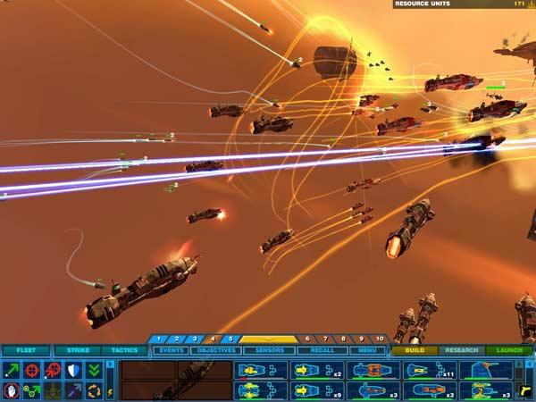
GPU Powered
Notes:
Fully pipelined transformation and lighting allowed for higher polygon counts
All these games came out in 1999 the same year that SSE instructions first started seeing some use
Image Credits:
http://everquest.allakhazam.com/Im/image/203661
http://www.pcgamer.com/2011/03/13/reinstall-system-shock-2/
http://springfiles.com/games/strategy/real-time-strategy/homeworld

Slide 19
Design
Floating Point Throughput
SIMD to the core
Hardware Accelerate common operations
  Initially Transformation and Lighting calculations
  Later Transcendentals, Texture sampling, etc...

Slide 20
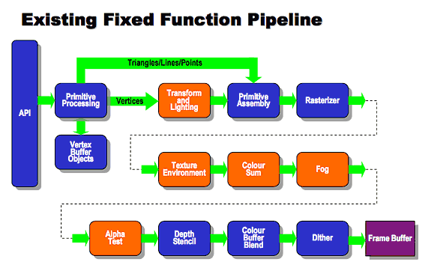
Notes:
Graphics pipeline:
The basic steps things that a graphics card does, ignoring lighting
Image credits:
http://www.khronos.org/opengles/2_X/

Slide 21
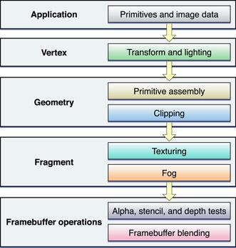
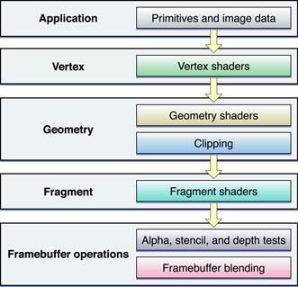
Notes:
The evolution of the pipeline
A move towards generality and programmability
Image Credits:
https://developer.apple.com/library/mac/documentation/graphicsimaging/conceptual/opengl-macprogguide/opengl_shaders/opengl_shaders.html

Slide 22
Increasing Programmability
Shaders
  Intended for graphical use
  Used also to accelerate applications with a large amount of floating point math
    Image processing, simulations, etc
      VFire

Slide 23
Enter CUDA

Slide 24
Changes
Unified Processor Architecture
  No more vertex or fragment processors
Threading emphasized
  Many cores running many many threads

Slide 25
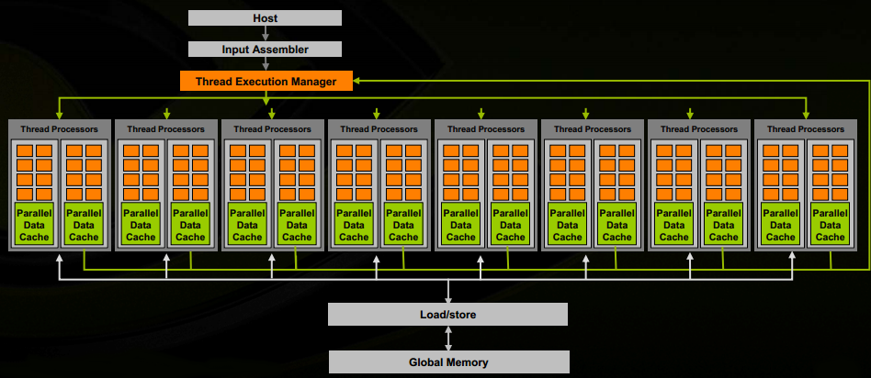

Slide 26
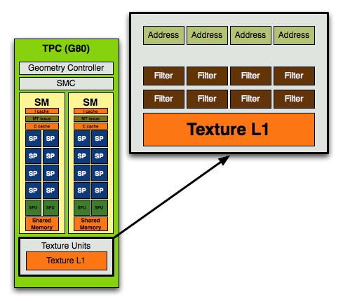
Notes:
Image Credit:
http://www.anandtech.com/show/2549/3

Slide 27
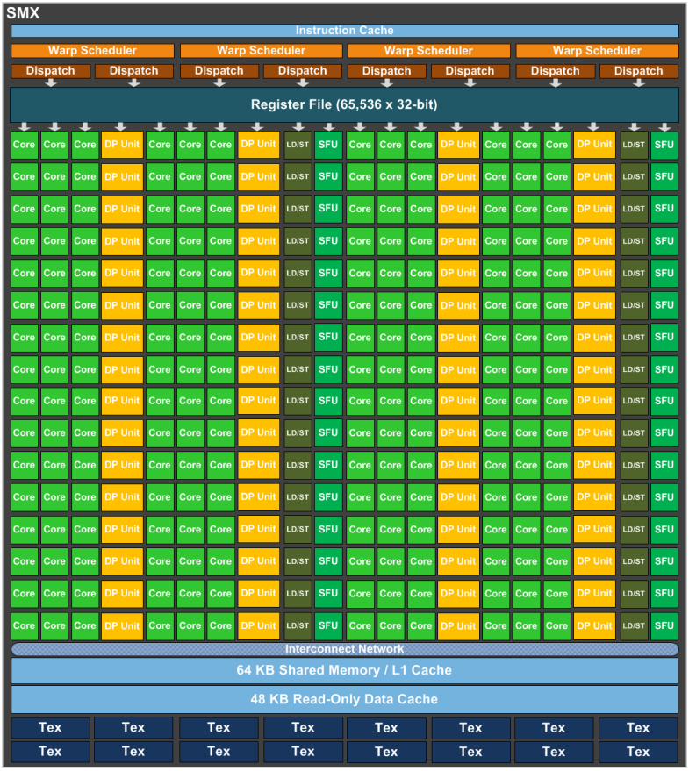

Slide 28
CUDA
A subset of C with some extensions
  Thread identifiers
  Launching kernels
  Some data types
    Mainly used for organizing thread numbering

Slide 29
Example Kernel
__global__ void kernel(float* a, int N) {
int idx = threadIdx.x;
if(idx < N) {
a[idx] = a[idx] * a[idx];
}
}
Notes:
Simply squares the array a

Slide 30
Thrust
The Standard Template Library for the GPU
Provides abstractions from:
  Moving data between the host and device
  Managing allocations
  Determining thread counts

Slide 31
Thrust features
An extremely fast sort
Scans
Transformations and reductions
  Think MapReduce
Compatible with CUDA

Slide 32
Applications
Notes:
We will be exploring 2 different applications
Using CUDA to simulate and visualize sound
and
Using Thrust to analyze digital signals

Slide 33
Sound Simulation
What are the acoustic properties of a room?
What acoustic phenomena will be produced in a room?

Slide 34
Wave Simulation Techniques
Geometric
  Ray tracing
Numeric
  Finite Element Methods(FEM)
    Breaks domain into many smaller domains
  Finite Difference Time Domain(FDTD)
    Grid based
Notes:
FEM is like imagining a room as a series of Smaller rooms with boundries
FEM is more complicated and requires some precomputation
FDTD is like a specialized FEM where the domains are axis aligned on a grid
We choose FDTD because its simplicity
Numeric methods solve the entire space and frequency range

Slide 35
FDTD
Decomposes the space in a rectilinear grid
Visualization easy.
Naturally very data parallel
  Easy to fit to SIMD
Computationally expensive
  Increased frequency range -> Increased resolution of grid and decreased timestep size
Notes:
Used commonly to simulate EM waves to help design antennas
As the frequency of sampling increases the resolution of the grid must also increase, a doubling of the sampling frequency leads to a doubling of the resolution of the grid and number of time steps

Slide 36
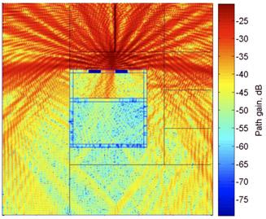
Radio Wave Propagation
Notes:
Blue is very weak signal to Red being very strong.
Simulating cellular telephone in an elevator

Slide 37
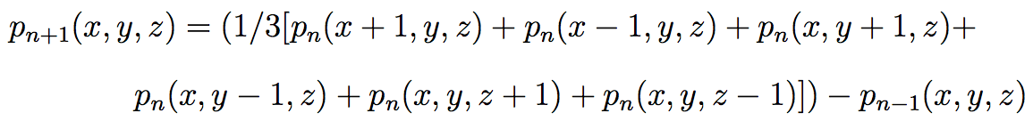
FDTD Sound Simulation
Solve for the acoustic pressure across the each point in the grid every time step
4 Different cases based on the boundaries at a grid point
Notes:
The equation is the solution for an air node

Slide 38
Implementation
1 array which encodes the boundaries for each point on the grid
A series of arrays for holding the current simulation state
Notes:
The boundary array is constant for the entire simulation
The resolution for these arrays

Slide 39
0110
0111
0101
1110
1111
1101
1010
1011
1001
Notes:
y+ y- x+ x-
3 2 1 0

Slide 40
System architecture
3 Components
  Simulation Manager
  Memory Manager
  Renderer
Notes:
Simulation manager handles all the simulation state
Memory manager handles getting simulation data off of the card and preparing it for visualization
The Visualizer handles all visualization tasks

Slide 41
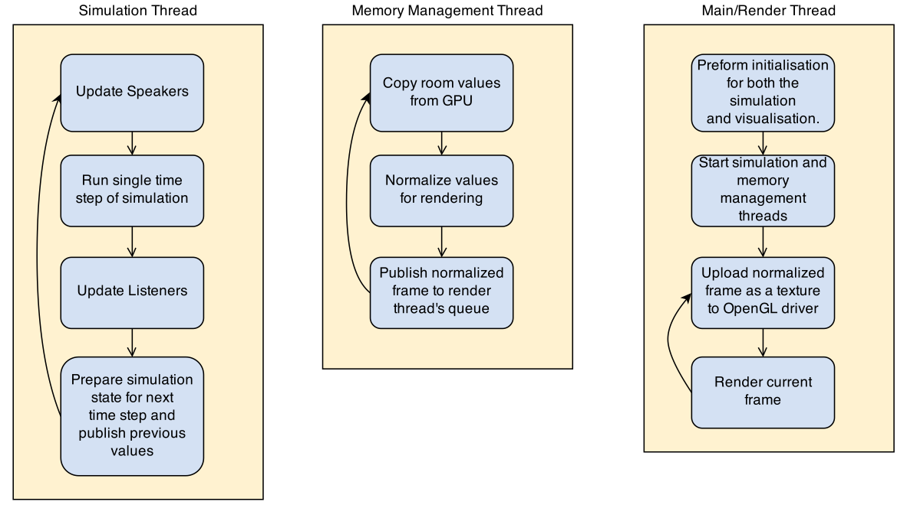

Slide 42
System Architecture
Each component runs on its own thread
Inter-thread communication done with thread-safe queues

Slide 43
GPU
Simulation Manager
Renderer
OpenGL Data
Simulation Data
Memory Manager
CPU
Frame Data

Slide 44
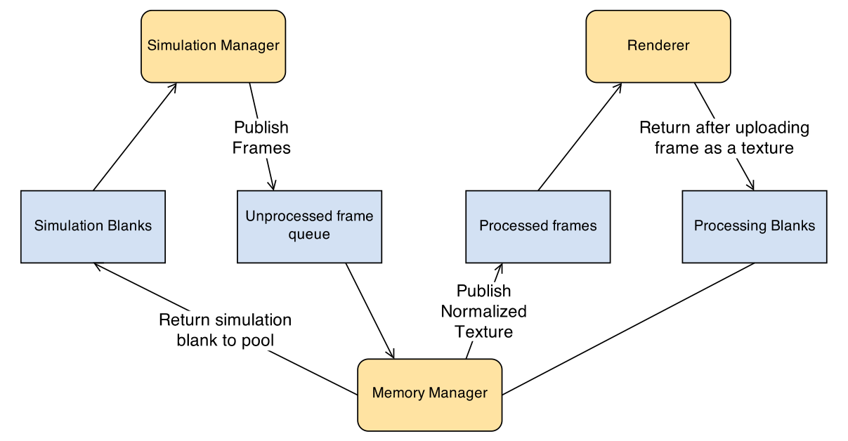

Slide 45
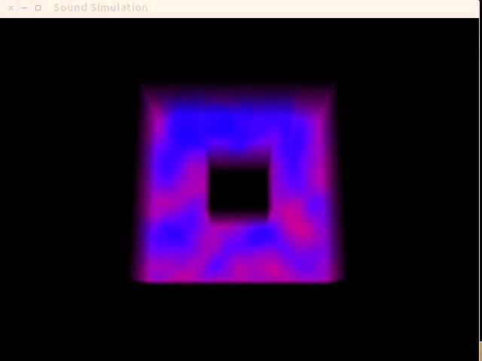

Slide 46
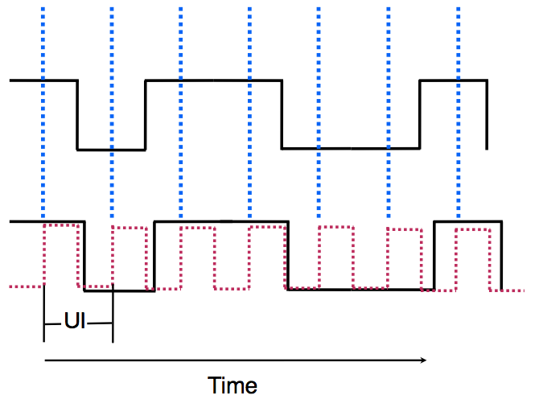

Jitter Measurement
Notes:
Measured signal bottom, we would like to recover the virtual signal on top
Quantifying the skew between the two is the goal.
The measured signal is made at each uptick of the clock (Unit Interval (UI))

Slide 47
Jitter Measurement
The Time Interval Error (TIE) is the difference between the virtual signal and the measured signal.
Jitter is a summary statistic from many TIE

Slide 48
Jitter Measurement
Computation time limits measurement
  This “Dead Time” extremely undesirable

Slide 49
Proposed Method
Determine Voltage Thresholds
Locate Transition Points
Estimate UI length (Samples per UI)
Refine that estimate
Find the phase offset and get final UI length
Recalculate TIE and build jitter representations
Notes:
Determine Voltage Thresholds
Locate Transition Points
Estimate UI length (Samples per UI)
Refine that estimate
Find the phase offset and get final UI length
Recalculate TIE and build jitter representations

Slide 50
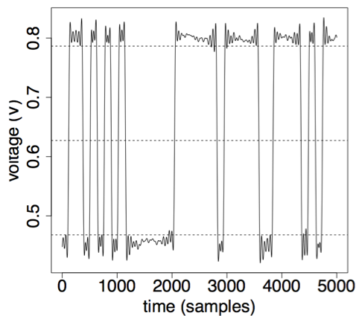
1. Voltage Thresholds
1st (low) and 99th (high) of the measured voltages
Move 10% toward the middle to set the thresholds

Slide 51
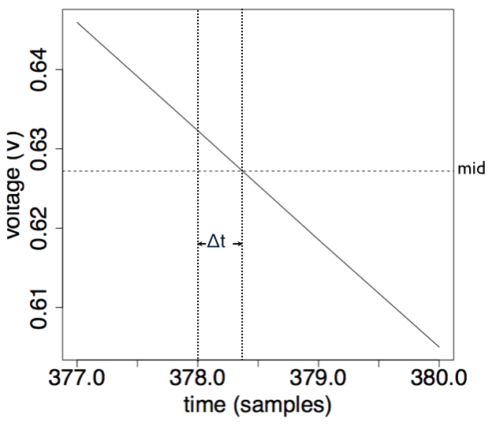
2. Locate Transition Points
Must be found with subsample accuracy as we would like our measurement to have subsample accuracy

Slide 52
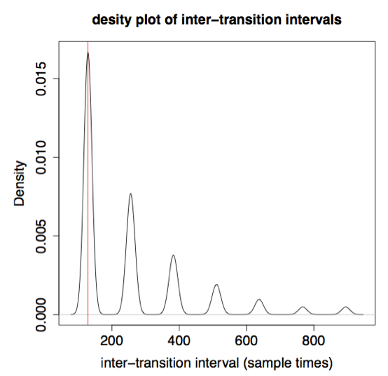
3. Estimate UI length
Use adjacent difference to find the inter-transition intervals
The 25th percentile gives the first estimate of UI length (r)
Notes:
This first estimate accurate to 3 digits, far from the required 8-9 required to handle the large number of transitions
Estimate shown in red.

Slide 53
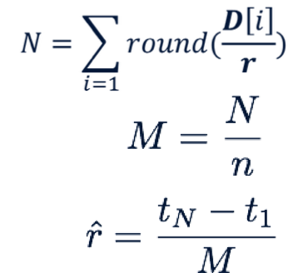
4. Refine UI length estimate
Use estimate to count the number of UIs in signal
Divide the total number of samples from the first transition to the last by the UI count.
Notes:
5-6 digits of accuracy, nearly there

Slide 54
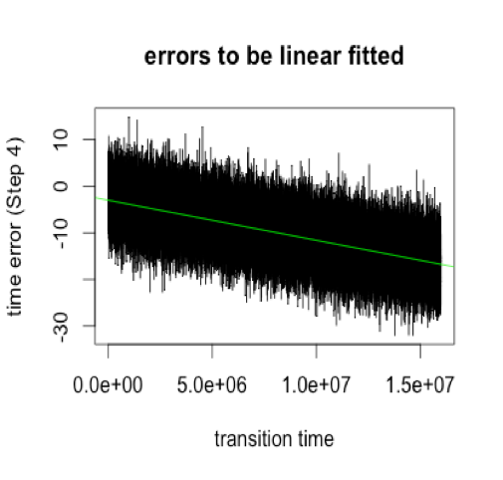
5. Find the phase offset and final UI length
Correct error in last step
Linear regression to get the error around 0

Slide 55

5. Find the phase offset and final UI length
Linear Regression gives 2 coefficients
  m and c
m used to correct UI length
c is the phase offset
Notes:
UI length now accurate to 8-9 digits giving us the accuracy to use it with the number of transitions that will be measured

Slide 56
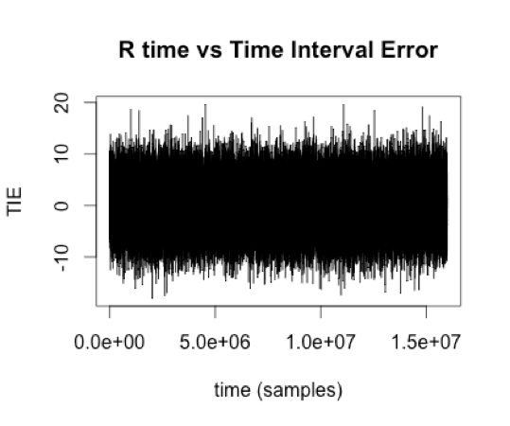
6. Recalculate TIE
Use the final UI length (r) and the phase offset to recalculate TIE

Slide 57
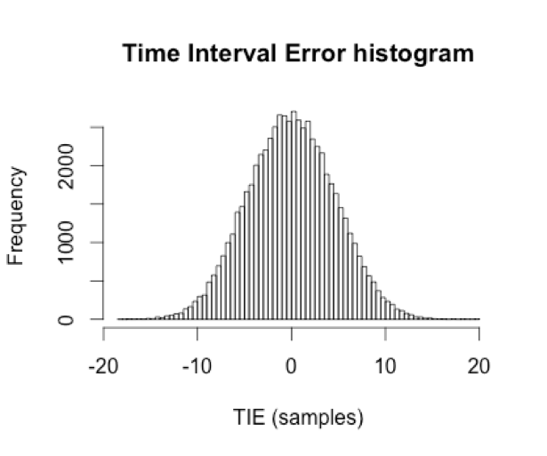
6. Build jitter representations
Final TIE can be used to create to build
  Histograms
  Density estimates
  Etc...

Slide 58
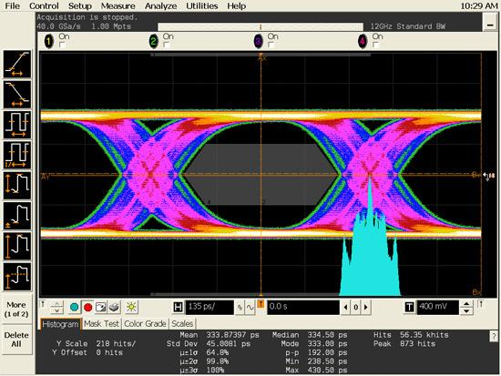

Slide 59
Programming Models

Slide 60
Strengths
CUDA
Extremely performant
High level of control
Large feature set
Thrust
Quickly add acceleration
Code reuse
“Plug and play”

Slide 61
Weaknesses
CUDA
High knowledge of target hardware required
  Thread counts
  Features available
  Cache issues
Low level
Kernel Scheduling affects performance

Slide 62
Weaknesses
Thrust
Very little tuning allowed
  You get what you get
Non-concurrent kernel launches
Lower hardware utilization

Slide 63
What to use?
What are the needs of the project?
How far along is the project?
Does the project need specialized memory features
Does the project need concurrency?
How good are the programmers?

Slide 64
What to use?
Prototype in thrust
Rewrite slow bits in CUDA if needed
  Profile to determine
Notes:
Stress that unless you performance in unusable Thurst is fine.
Thrust is able to deliver a great speed 14-100x
CUDA is able to go just a bit further.
In addition the mixing allows hot bits of code to be rewritten.

Slide 65
Questions?

