Slide 1
HTTP-based Solutions to The Extension of the NCS Brain Simulator
Nathan Jordan

Slide 2
Overview
Introduction
Background
Design & Implementation
Conclusion
Future Work
Questions

Slide 3
Introduction
Traditional neuroscience experiments were performed using in vivo and in vitro methods
These methods are physically-invasive and can be costly
These methods also don’t scale well to larger experiments across networks of neurons

Slide 4
Introduction
To address this issue, neuroscientists turned to in-silico approaches
Computer simulation allows for experimentation of large-scale neural networks, which is impractical with traditional approaches

Slide 5
Introduction
In-silico approaches to brain simulation is known as computational neuroscience
To create these neural models in a computer environment, neural simulators were created

Slide 6
Introduction
Neural simulators use equations formulated from physical experiments to mimic the biological characteristics of neurons
There are several neural simulators available, each with a different set of features and limitations
While their goals remain the same, an appropriate simulator must be chosen by researchers for their experiments

Slide 7
Introduction
NCS is a neural simulator created at the University of Nevada, Reno
Focuses on large-scale simulations
Designed to be very fast and scalable (multiple machines, multiple cores, and GPUs)

Slide 8
Introduction
The NCS simulator is a minimalistic brain simulator
It’s designed to be very efficient and low-level for performance reasons
Only essential features are contained within the simulators code

Slide 9
Introduction
There are many more tasks needed to be performed other than the simulations
Researchers need to be able to build the models and analyze the results
Since these tools are not present in NCS neuroscientists would have to perform these actions themselves

Slide 10
Introduction
A suite of tools were created to allow for a more convenient way for neuroscientists to perform these tasks
Web-based interface
Python library
Server that manages the NCS simulations and data

Slide 11
Introduction
This presentation will discuss the development and implementation of these tools

Slide 12
Overview
Introduction
Background
Design & Implementation
Conclusion
Future Work
Questions

Slide 13
Background - Other Simulators
NEURON tends to focus on smaller simulations
Written in C/C++/Fortran
Uses scripting language called Hoc and a GUI
Has a python interface, but its basically a wrapper for Hoc

Slide 14
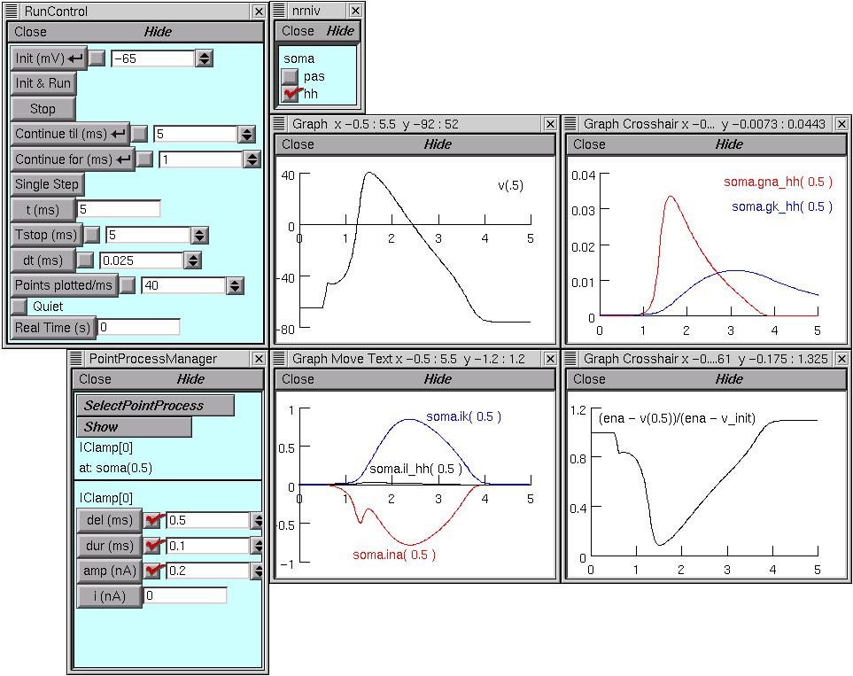
Background - Other Simulators

Slide 15
Background - Other Simulators
create soma, dend, dendx, axon
connect dend(0), soma(1)
connect dendx(0), soma(1)
connect axon(0), soma(0)
access soma
pt3dclear()
pt3dadd(0, 0, 0, 8)
pt3dadd(6, 0, 0, 18)
pt3dadd(10, 0, 0, 20)
pt3dadd(14, 0, 0, 18)
pt3dadd(20, 0, 0, 10)
insert hh
Ra = ra

Slide 16
Background - Other Simulators
GENESIS is another simulator that focuses on smaller simulations including intraneural interactions
Written in C
Command-line interface known as G-Shell
GUI is called XODUS

Slide 17
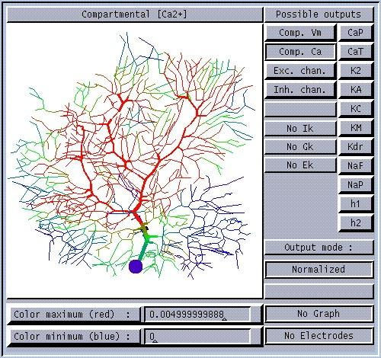
Background - Other Simulators

Slide 18
Background - Other Simulators
create cell /n
create segment /n/soma
model_parameter_add /n/soma Vm_init -0.068
model_parameter_add /n/soma CM 0.0164
model_parameter_add /n/soma RM 1.500
model_parameter_add /n/soma RA 2.500
model_parameter_add /n/soma ELEAK -0.080
model_parameter_add /n/soma LENGTH 4.47e-5
model_parameter_add /n/soma DIA 2e-5
runtime_parameter_add /n/soma INJECT 2e-9
output_add /n/soma Vm
run /n 0.05

Slide 19
Background - Other Simulators
NEST tends to focus on larger networks
NEST uses a CLI, and a Python wrapper
Lacks an out-of-the-box user interface component

Slide 20
Background - Other Simulators
/iaf_neuron Create /n1 Set
/iaf_neuron Create /n2 Set
/iaf_neuron Create /n3 Set
n1 n2 Connect
n1 n3 Connect

Slide 21
Background - Other Simulators
BRIAN is a simulator created exclusively in Python
It uses scipy and numpy to speed computations
Unlike the previously-mentioned simuators, it cannot be parallelized across multiple machines
Lacks a built-in GUI

Slide 22
Background - Other Simulators
from brian import *
eqs = '''
dv/dt = (ge+gi-(v+49*mV))/(20*ms) : volt
dge/dt = -ge/(5*ms) : volt
dgi/dt = -gi/(10*ms) : volt
'''
P = NeuronGroup(4000, eqs, threshold=-50*mV, reset=-60*mV)
P.v = -60*mV
Pe = P.subgroup(3200)
Pi = P.subgroup(800)
Ce = Connection(Pe, P, 'ge', weight=1.62*mV, sparseness=0.02)
Ci = Connection(Pi, P, 'gi', weight=-9*mV, sparseness=0.02)
M = SpikeMonitor(P)
run(1*second)
raster_plot(M)
show()

Slide 23
Background - NCS
NCS is the brain simulator created at the University of Nevada
It is designed to handle very large-scale simulations
Written in C++/CUDA/MPI (ZeroMQ planned)

Slide 24
Background - NCS
On top of NCS is a very thin Python layer for basic interaction with the simulator
Allows access to basic functions like adding neuron groups and connecting them
At large-scales, it would be easy to become lost in your own model

Slide 25
Background - NCS
Creating larger models would also be repetitive
Lots of duplication would lead to confusion
This is not enough functionality for a brain simulator by itself
A better method is needed to accomplish these tasks

Slide 26
Background - Client Server Model
A computational model with many clients asking for resources from a single server
In this model, NCS acts as a service that many different clients with different technologies can use
The server runs on the master node of a cluster
Provides a single point of access

Slide 27
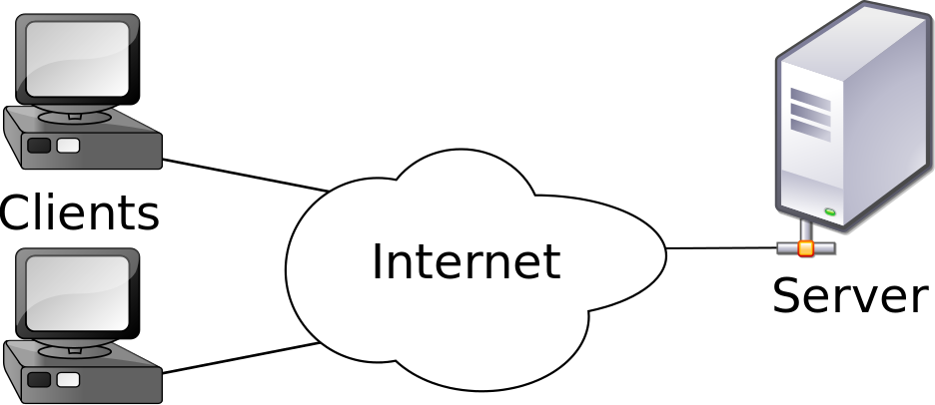
Background - Client Server Model

Slide 28
Background - Client Server Model
Doesn’t require shell access
Provides a uniform way of accessing simulation resources
Allows a myriad of technologies to be used with it, not just SSH

Slide 29
Background - HTTP
A method is needed to transport data between the clients and the server
HTTP is a client-server-based protocol that is used to transport binary or textual data over computer networks
Time-tested and ubiquitous

Slide 30
Background - HTTP
An HTTP transaction begins with a request from client to server
Request methods: Get, Post, Put, Delete
Request path: UNIX filesystem format
Host: what server the request should go to

Slide 31
Background - HTTP
GET / HTTP/1.1
Host: localhost
-----------------------------------------------------
GET /blog HTTP/1.1
Host: localhost
-----------------------------------------------------
POST /blog HTTP/1.1
Host: localhost
title=A new blog post
content=some stuff about this new blog post
author=Me

Slide 32
Background - HTTP
Typically, browsers expect HTML to be returned from the server so they can render the web page
HTML is not the only data that can be returned
XML, JSON, Images, and more can be transported via HTTP
This makes it useful for more than just web browsers

Slide 33
Background - HTTP
Additionally, HTML can perform all the CRUD methods
Create, Read, Update, Delete
Allow for persistent storage
These methods form the basis for REST

Slide 34
Background - REST
REST (REpresentational State Transfer) is an architectural pattern
Usually used in API design
Based around the concept of a resource
In HTTP, a REST resource is specified using a URI

Slide 35
Background - REST
An example URI for a student resource might be
http://example.com/student/1043
This URI uniquely identifies the resource on the server and on the computer network

Slide 36
Background - REST
The URI provides a way to uniquely identify the resource
We still need a way to provide a representation of it
Typically done with the formats discussed earlier, including HTML, JSON, and XML
Creates consistent interaction with the server

Slide 37
Background - REST
Client sends GET request to http://example.com/student/1033
Server responds with
<student>
<name>Bob Jones</name>
<grade>Sophomore</grade>
<age>24</name>
<phone>1+(775)555-5555</phone>
</student>

Slide 38
Background - REST
Client sends POST request to http://example.com/student/1055
Body:
<student>
<name>Martha Stewart</name>
<grade>Freshman</grade>
<age>56</name>
<phone>1+(775)555-5555</phone>
</student>

Slide 39
Background - REST
Client sends PUT request to http://example.com/student/1055
Body:
<student>
<name>Martha Stewart</name>
<grade>Sophomore</grade>
<age>57</name>
<phone>1+(775)555-5555</phone>
</student>

Slide 40
Background - REST
Client sends DELETE request to http://example.com/student/1055

Slide 41
Background - JSON
In the previous REST examples, XML is used as the representation format
JSON (JavaScript Object Notation) is another representation format based on Javascript objects
JSON doesn’t use opening and closing tags like XML, which make its file size smaller

Slide 42
Background - JSON
JSON also has several data types available, which are unavailable in XML (XML only can represent lists and strings)
JSON also usually requires a single function call to turn the JSON document into a language-native object
There are six data types available for use in JSON: number, string, boolean, array, object and null

Slide 43
Background - JSON
{
"company_name": "Planetary Express",
"phone": "1+(800)555-5555",
"manager": "Hubert Farnsworth",
"company_net_worth": 0.0,
"personnel": [
"Phillip J. Fry",
"Turanga Leela"
],
"total_deliveries": 100,
"website": null,
"is_profitable": false
}

Slide 44
Background - WebSockets
HTTP doesn’t provide a way to stream data
It is exclusively a request-response protocol
We cannot send data in a full-duplex fashion like TCP
This makes building realtime web applications difficult to accomplish

Slide 45
Background - WebSockets
The WebSocket protocol was created to address these concerns
It allows full-duplex communication via HTTP
Javascript running client-side sends and receives information to websockets asynchronously
Prevents network overhead of polling the server

Slide 46
Background - MongoDB
Most databases today are implemented as relational databases, which use SQL as their database language
Recently, databases have been developed that do not rely on the relational model
Colloquially known as NoSQL databases

Slide 47
Background - MongoDB
MongoDB is a type of NoSQL database that uses JSON documents as a storage format
Rows are documents and tables are collections
Queries are performed using JavaScript instead of SQL
MapReduce used for advanced queries

Slide 48
Background - MongoDB
Mongo is helpful when you have a non-traditional schema or no schema at all
Also, when you’re working with JSON anyway
Language bindings for Mongo exist in many languages
ORM’s provide a way to use Mongo without JavaScript

Slide 49
Background - Bootstrap
Bootstrap is a client-side library for building websites
It provides a number of user interface components that aid in building web applications
Forms, buttons, headers, tables, navigation, alerts, panels
Makes it much faster to create websites

Slide 50
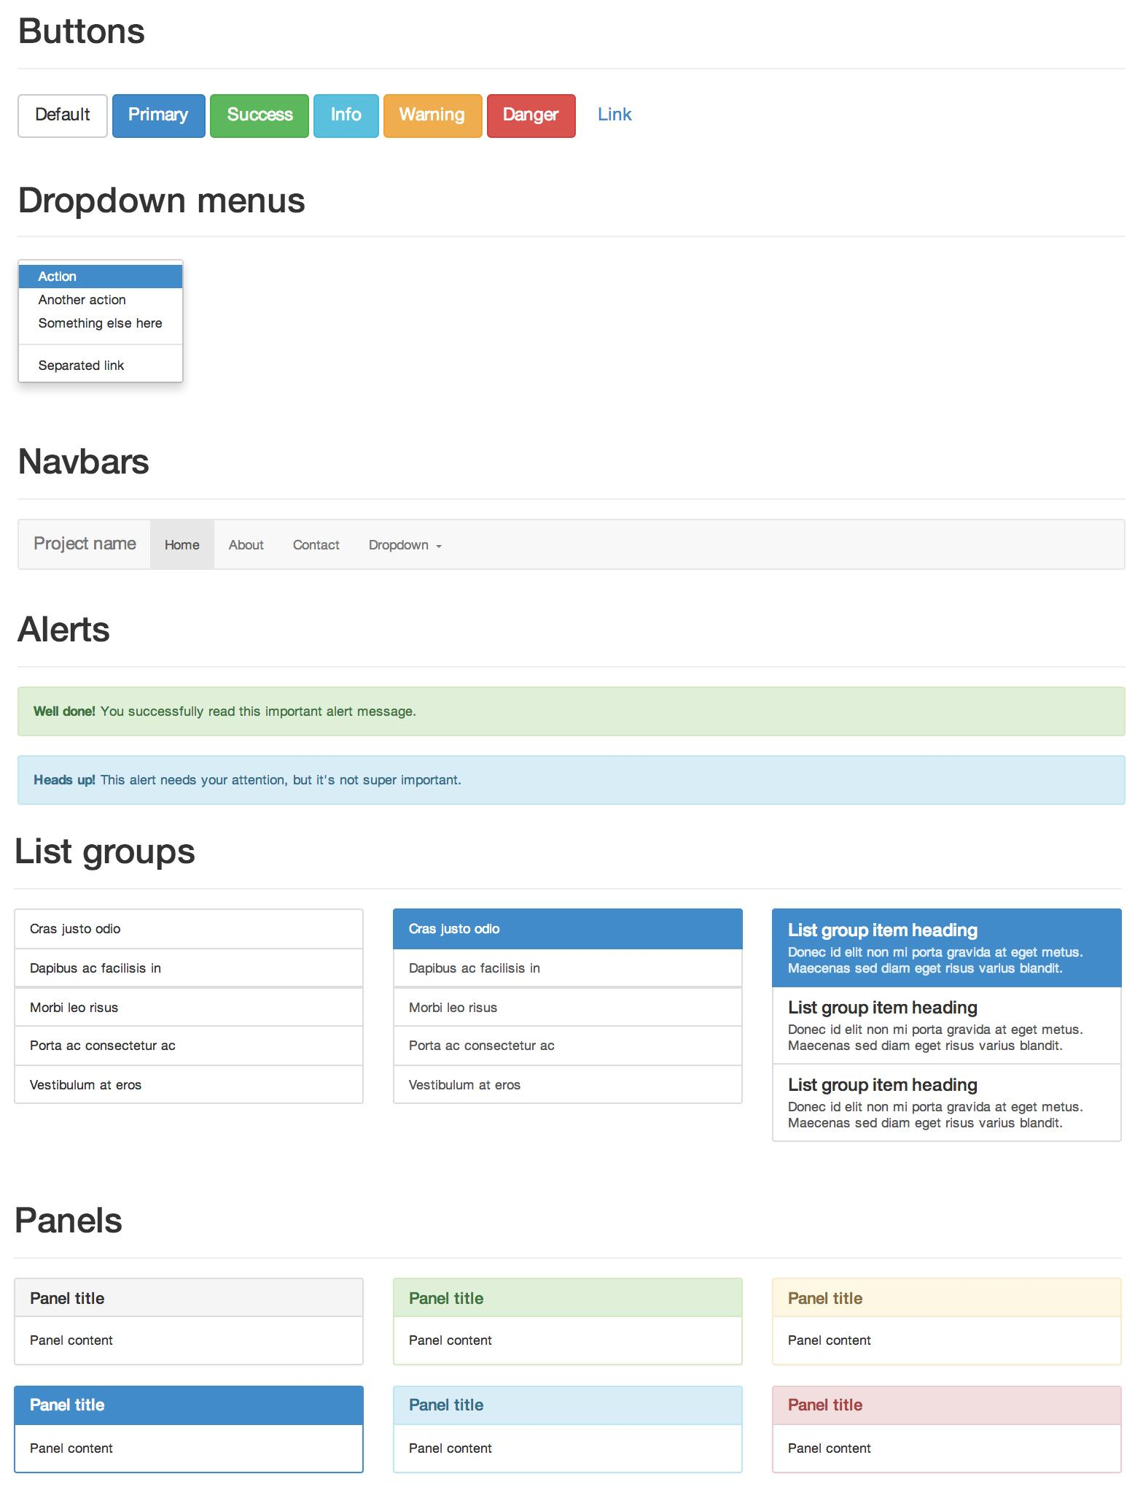
Background - Bootstrap

Slide 51
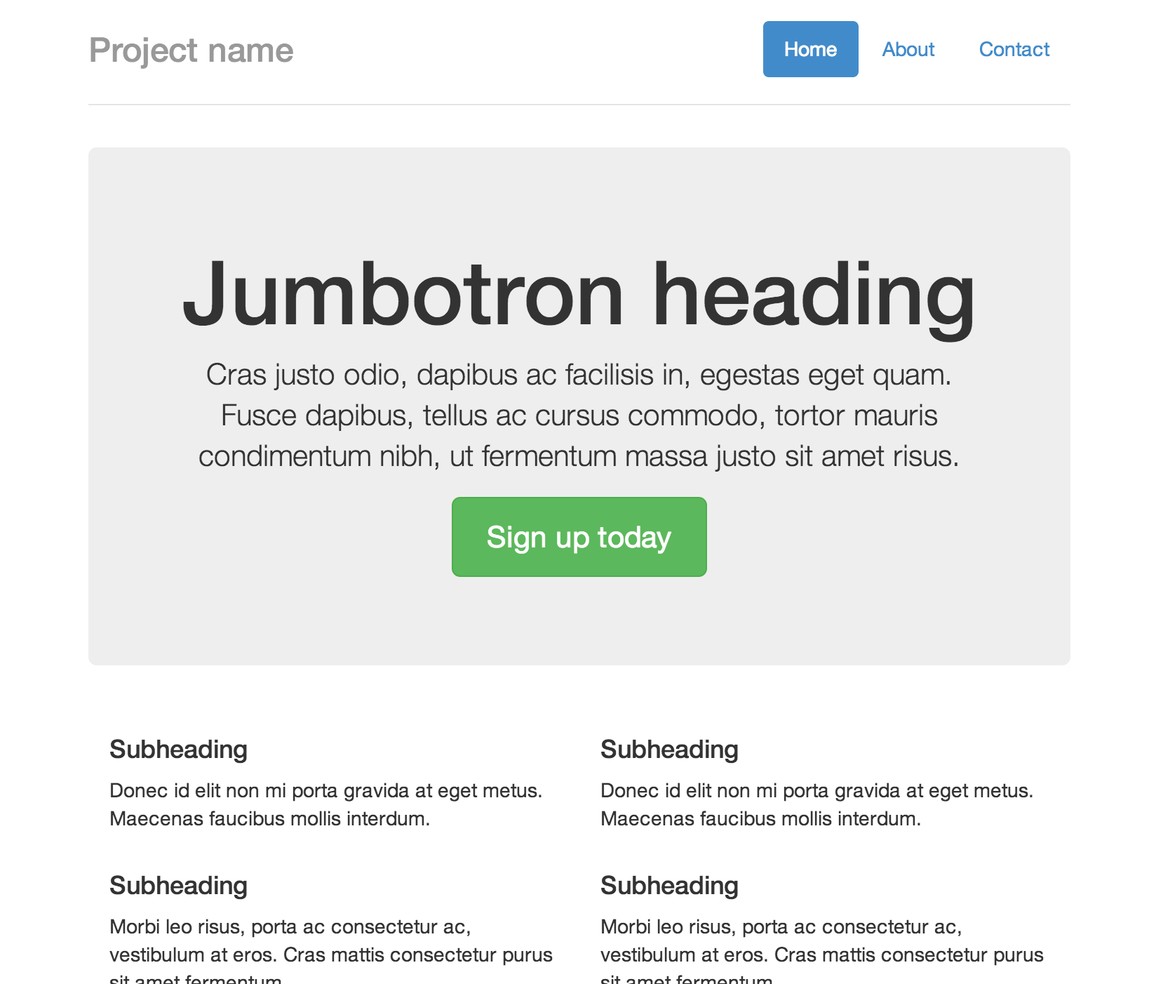
Background - Bootstrap

Slide 52
Background - Angular
Bootstrap creates a UI framework for websites, Angular creates a JavaScript framework for websites
Dramatically reduces development time over traditional Javascript programming
It removes the need for developers to write code that directly manipulates the DOM, which encompases a large portion of the coding in traditional development

Slide 53
Background - Angular
It creates a two-way data binding between the HTML and back-end model
Changed data is immediately updated in the view
Provides declarative-style interface in HTML

Slide 54
Overview
Introduction
Background
Design & Implementation
Conclusion
Future Work
Questions

Slide 55
Design & Implementation - NCS Software
Goals include building the simulation, running the simulation, storing sim data, and analyzing results
We designed a system around NCS to achieve these goals
A sim management system, a high-level Python interface, and a web interface

Slide 56
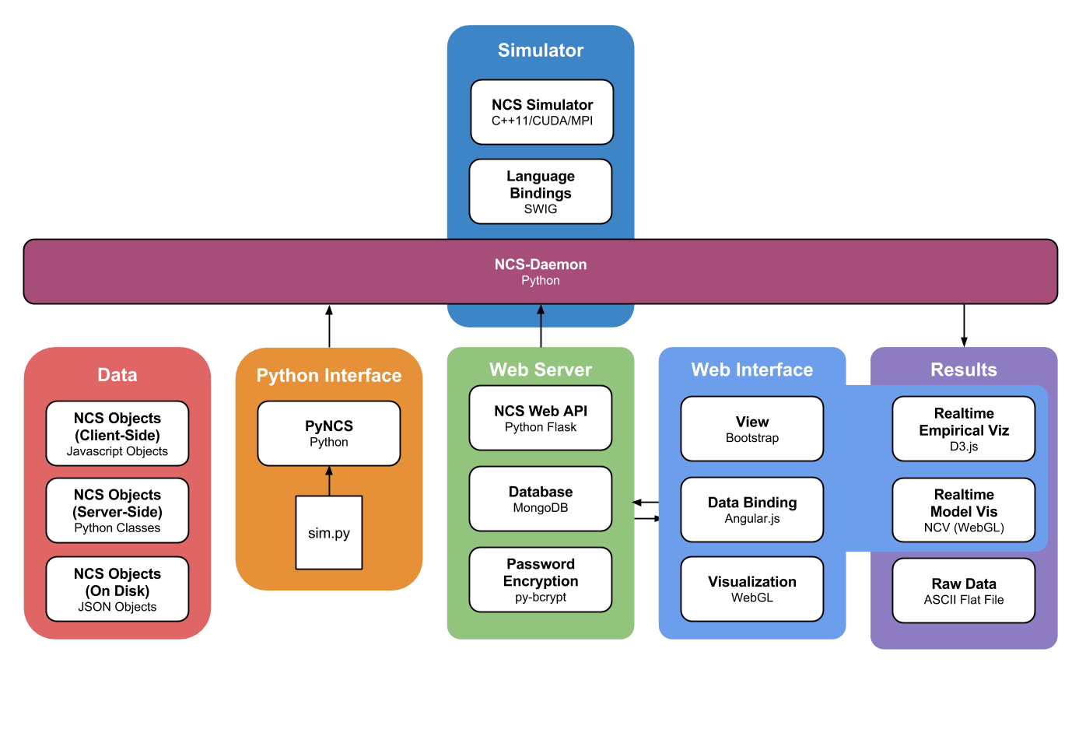
Design & Implementation - NCS Software

Slide 57
Design & Implementation - NCS Software

Slide 58
Design & Implementation - NCS-Demon
Primary goal is to provide NCS as a service for multiple clients, rather than a command line tool
A daemon running on the master node acts as a server
We chose to implement the server as an HTTP server
Tons of libraries exist for HTTP servers and clients

Slide 59
Design & Implementation - NCS-Demon
There are many different HTTP frameworks to choose from
Since NCS is exposed as a Python module, Python would be a good language choice to implement the server
Django has a lot of features that would go unused, we chose Flask as the HTTP framework instead

Slide 60
Design & Implementation - NCS-Demon
Flask takes a minimalistic approach to an HTTP server
Additional functionality can be plugged in as necessary, such as MongoKit or WebSockets

Slide 61
Design & Implementation - NCS-Demon
Basic Flask Hello World Example
from flask import Flask
app = Flask(__name__)
@app.route("/")
def hello():
return "Hello World!"
if __name__ == "__main__":
app.run("localhost", 8000)

Slide 62
Design & Implementation - NCS-Demon
A major consideration when implementing any network service is security
NCS provides a login system for clients to interact with that is required before any other transactions are made
The client sends a username and password to the server and the server provides an access token

Slide 63
Design & Implementation - NCS-Demon
The access token must be provided for every transaction the client makes with the server
This doesn’t by itself provide encrypted access to the server
It prevents attackers from using a user’s credentials on other accounts like banks, email or online retailers

Slide 64
Design & Implementation - NCS-Demon
In order to provide encrypted access, they must create a connection over an SSL or TLS secured socket
This is relatively easy to do using Flask, but could be expensive when using trusted certificates

Slide 65
Design & Implementation - NCS-Demon
NCS-Daemon is implemented as a RESTful service
It exposes a number of routes that clients interact with via requests
It also maintains two WebSocket routes that handle streaming data

Slide 66
Design & Implementation - NCS-Demon
NCS-Daemon is implemented as a RESTful service
It exposes a number of routes that clients interact with via requests
It also maintains two WebSocket routes that handle streaming data

Slide 67
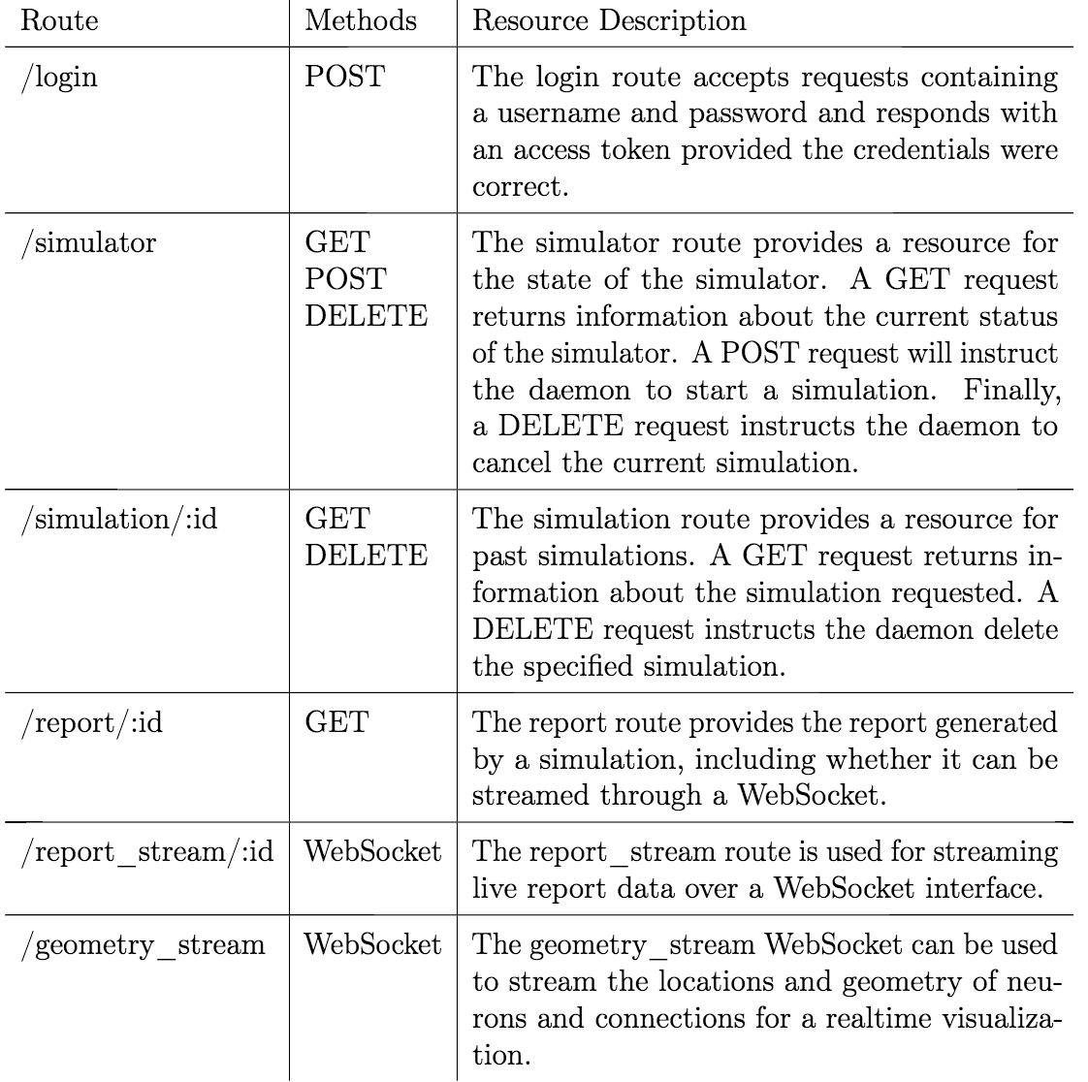
Design & Implementation - NCS-Demon

Slide 68
Design & Implementation - NCS Software

Slide 69
Design & Implementation - Sim Concepts
Sims are defined as a hierarchical structure of groups. neuron groups, and other entities
Entities include neurons, synapses, stimuli, reports, neuron aliases, and synapse aliases

Slide 70
Design & Implementation - Sim Concepts
Neuron entities describe a computational model of a neuron
This model determines based on inputs whether or not a neuron should fire
Leaky-Integrate-and-Fire, Hodgkin-Huxley, and Izhikevich neurons are supported

Slide 71
Design & Implementation - Sim Concepts
Synapses define the properties of connections
Maintain plasticity and learning information
Manipulates inputs and outputs between neurons

Slide 72
Design & Implementation - Sim Concepts
Stimuli bring the model to life
They specify when and where current should be applied to particular cells in the simulation
Starts the model
Inputs can come from a number of sources

Slide 73
Design & Implementation - Sim Concepts
Reports get data out of a simulation
They specify which properties of which neurons/synapses should be collected
Can be written to disk for later use or streamed over a WebSocket

Slide 74
Design & Implementation - Sim Concepts
Aliases provide a way to refer to many groups of objects under one name
Three groups could be referred to as a single label when creating the model
Saves users time when implementing a model

Slide 75
Design & Implementation - Sim Concepts
Since there isn’t native support for organization in NCS, a method to organize models was created
Groups are an organizational construct created exclusively to help users build larger models
Groups form a hierarchical tree structure

Slide 76
Design & Implementation - Sim Concepts
Groups contain subgroups, neuron groups, connections and aliases
Subgroups are instances of other groups with a location
Neuron groups are collections of neurons of the same type

Slide 77
Design & Implementation - Sim Concepts
Connections create synaptic connections with different neuron groups
Aliases simplify referring to collections of neuron groups

Slide 78
Design & Implementation - Sim Concepts
Connections create synaptic connections with different neuron groups
Aliases simplify refer to collections of neuron groups or synapses within neuron groups

Slide 79
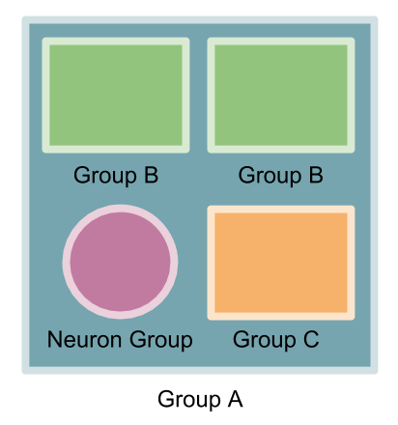
Design & Implementation - Sim Concepts

Slide 80
Design & Implementation - Sim Concepts
To store and transfer this structure of groups and entities, a textual representation for the model must be defined
For most entities, this is relatively straightforward

Slide 81
Design & Implementation - Sim Concepts
{
"_id": "c4f5ea85f4c5ae86c4ebc4a854",
"entity_type": "neuron",
"entity_name": "neuron_izh_1",
"description": "This is a description of the entity",
"author": "Nathan Jordan",
"author_email": "njordan@cse.unr.edu",
"specification": {
"type": "izhikevich",
"a": 0.02,
"b": 0.2,
"c": -65.0,
"d": 8.0,
"u": -12.0,
"v": -65.0,
"threshold": 30
}
}

Slide 82
Design & Implementation - Sim Concepts
The hierarchical nature of the groups posed a more of a problem
If we expand the objects into JSON, the file would expand at an exponential rate
Duplication of data would also take up a lot of space

Slide 83
Design & Implementation - Sim Concepts
To solve this, we normalized the tree structure into a relational structure
Similar to a database
Groups are referred to by a unique identifier instead of expanding their contents

Slide 84
Design & Implementation - Sim Concepts
{
"_id": "df90sahf0sd9ha8sdhf8dhsa",
"entity_type": "group",
"geometry": {
"width": 100.0,
"height": 200.7,
"depth": 300.3
},
"subgroups": [
{
"group": "adfh8a4ddf80ha30d89fh0a19dbf",
"label": "striatum",
"location": {"x": 123.5, "y": 456.5, "z": 789.5}
},

Slide 85
Design & Implementation - Sim Concepts
{
"top_group": "5728ec1d381bad25744bc54c42ba425",
"neurons": [],
"synapses": [],
"stimuli": [],
"reports": [],
"groups": [],
"neuron_aliases": [],
"synapse_aliases": []
}

Slide 86
Design & Implementation - Sim Concepts
In addition to specification parameters the entities also have metadata
The metadata specifies the entity type, its name, description, author, institution, and authors email
This metadata can be used for searching or filtering when combined with MongoDB, or the web interface

Slide 87
Design & Implementation - NCS Software

Slide 88
Design & Implementation - PyNCS
There needs to be a method to interact with the server without dealing with HTTP or JSON
We created a Python library called PyNCS that addresses this

Slide 89
Design & Implementation - PyNCS
PyNCS is a native Python library that allows you to build models
It provides an intuitive way to build entities using classes in an object-oriented fashion
No dictionaries or lower-level Python structures

Slide 90
Design & Implementation - PyNCS
# Correct
server = Simulator(
host='ncscluster.example.edu',
port=8081,
username='my_username',
password='my_password'
)

Slide 91
Design & Implementation - PyNCS
# Throws ConnectionError
server = Simulator(
host='no_ncsdaemon_here.example.edu',
port=8081,
username='my_username',
password='my_password'
)

Slide 92
Design & Implementation - PyNCS
# Throws AuthenticationError
server = Simulator(
host='ncscluster.example.edu',
port=8081,
username='my_username',
password='not_my_password'
)

Slide 93
Design & Implementation - PyNCS
Entity classes enforce which parameters are allowed and whether they are required or optional

Slide 94
Design & Implementation - PyNCS
# This successfully defines an Izhikevich neuron
izh = IzhNeuron(
a=0.5,
b=0.5,
c=0.5,
d=8.0,
u=-12.0,
v=Normal(-65.0, 0.5),
threshold=30.0
)

Slide 95
Design & Implementation - PyNCS
# This throws an EntityError because we tried to specify x
izh = IzhNeuron(
a=0.5,
b=0.5,
c=0.5,
d=8.0,
u=-12.0,
x=10.0,
threshold=30.0
)

Slide 96
Design & Implementation - PyNCS
Once the models are created, the user must create a simulation object
The simulation object encapsulates a single instance of a simulation
It maintains references to the reports generated, including providing a WebSocket client

Slide 97
Design & Implementation - PyNCS
Simulation objects also contain logging information and details about the simulation
The simulation object can only be used once per simulation run
New simulations require a new simulation object

Slide 98
Design & Implementation - PyNCS
# Create the simulation, my_top_group, stim, and rpt have been defined above
sim = Simulation(
top_group=my_top_group,
stimuli=[stim],
reports=[rpt]
)
# Connect to the simulator
server = Simulator(
host='ncscluster.example.edu',
port=8081,
username='my_username',
password='my_password'
)

Slide 99
Design & Implementation - PyNCS
# Gets the status of the simulator
if server.get_status() == Simulator.IDLE:
# Run the simulation if it's not busy
server.run(sim)

Slide 100
Design & Implementation - NCS Software

Slide 101
Design & Implementation - Web Interface
PyNCS provides a programmatic interface
A more user-friendly interface for non-programmers is needed
Other simulators use antiquated interfaces developed in the early 1990’s
A more effective interface are needed

Slide 102
Design & Implementation - Web Interface
We created a web interface for neuroscientists to interact with the simulator
Web interfaces are cross platform
More easily updatable than other user interfaces

Slide 103
Design & Implementation - Web Interface
We used Bootstrap to create the interface and style the page elements
Angular was used at the Javascript framework to save a bunch of development time making the application
There are currently five tabs in the web interface: model builder, sim builder, reports, model database, and robot simulator

Slide 104
Design & Implementation - Web Interface
The model builder is a graphical way to create brain models
The hierarchical structure of the groups posed a particular UI development challenge
We took inspiration from file explorers like those in Microsoft Windows and OSX to navigate the model

Slide 105
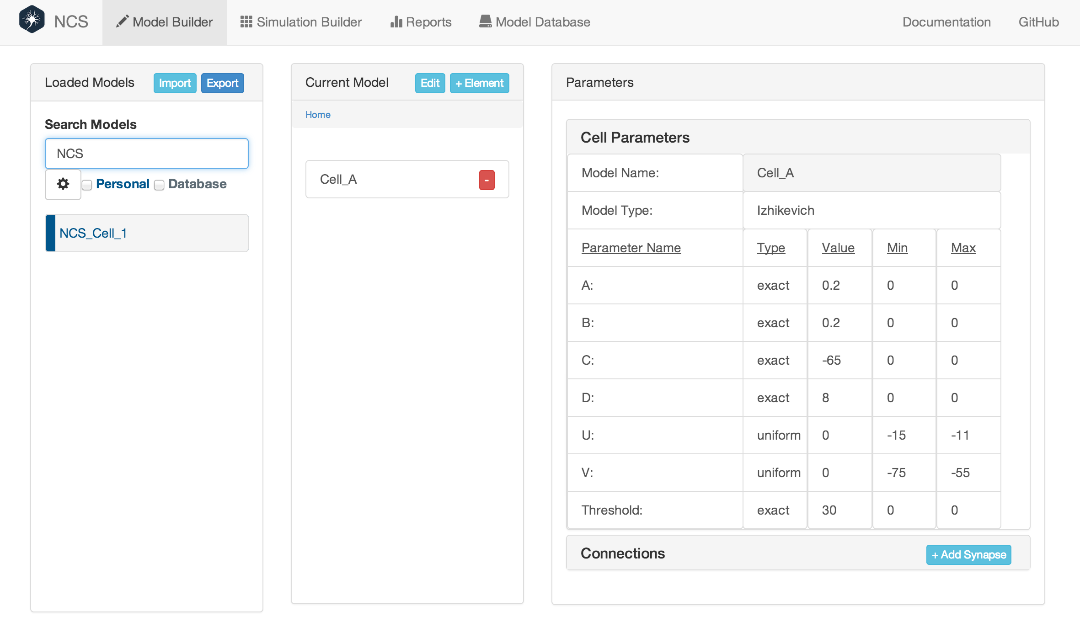
Design & Implementation - Web Interface

Slide 106
Design & Implementation - Web Interface
The sim builder allows users to take their model and bring it to life
Stimuli and reports are added
Send the model to the simulator and start the simulation

Slide 107
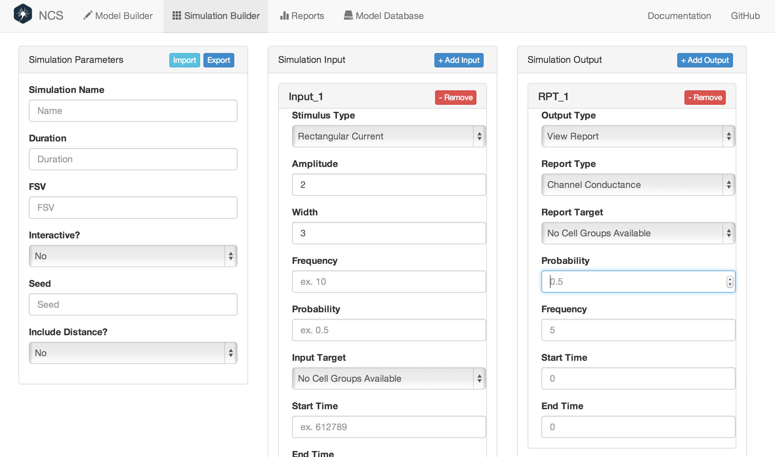
Design & Implementation - Web Interface

Slide 108
Design & Implementation - Web Interface
The reports tab lets you visualize your results
Currently the tab supports raster plots and line graphs
The graphs can be downloaded as animations or high-quality SVGs for use in publications or presentations

Slide 109
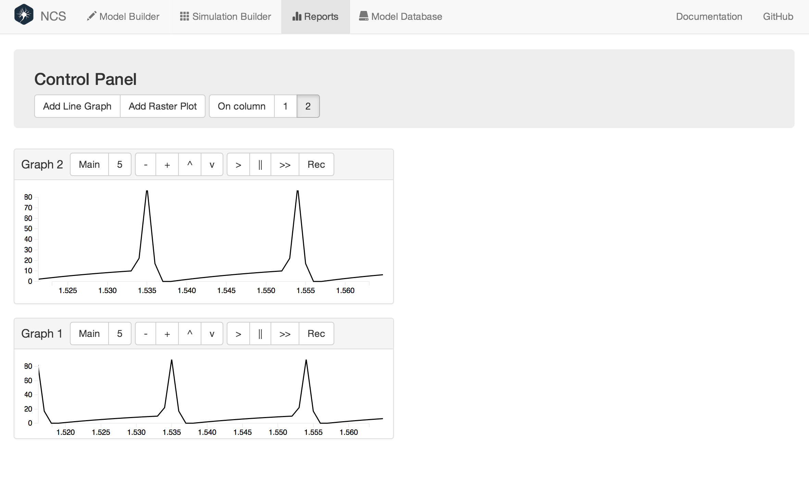
Design & Implementation - Web Interface

Slide 110
Overview
Introduction
Background
Design & Implementation
Conclusion
Future Work
Questions

Slide 111
Conclusion
To extend the NCS brain simulator a number of tools have been developed
These tools help users interact with the simulator in a variety of ways
NCS-Daemon interacts with the low-level interface of the simulator, organizes simulations, and provides an HTTP interface for clients to use

Slide 112
Conclusion
PyNCS allows researchers to use the Python language to create models and interact with the simulator
It provides a high-level interface to simulation constructs and helps prevent problems with parameter checking
The web interface provides an easy-to-use simulator interface without knowledge of programming

Slide 113
Conclusion
This tool lets researchers build models, run them, analyze and visualize the results
This tool, as well as PyNCS and NCS-Daemon bring new technologies to the neural simulator landscape which is plagued with aging technologies
This provides researchers more effective ways of performing experiments and creating scientific breakthroughs

Slide 114
Overview
Introduction
Background
Design & Implementation
Conclusion
Future Work
Questions

Slide 115
Future Work
Job queue for simulations
External robotics interface with ROS
Web-based realtime visualization
Improved UI design and additional features
Additional language bindings

Slide 116
Acknowledgements

Slide 117
Questions?

