Slide 1


NCS: Neuron Models, User Interface, and Modeling
A thesis submitted in partial fulfillment of the requirements for the degree of Master of Science in Computer Science and Engineering
Devyani Tanna
Notes:
Introduce myself and say topic

Slide 2
Acknowledgement
Committee
  Dr. Frederick C. Harris, Jr., Advisor
  Dr. Sergiu M. Dascalu
  Dr. Yantao Shen
Colleagues
  Dr. Laurence Jayet Bray
  Dr. Roger Hong
  Torbjorn Loken
  Nathan Jordan
  Everyone at Brainlab and HPCVIS
Friends and Family

Slide 3
Outline
Background
Neuron Models
User Interface
  GUI
  Python
Modeling
Database
Result
Documentation

Slide 4
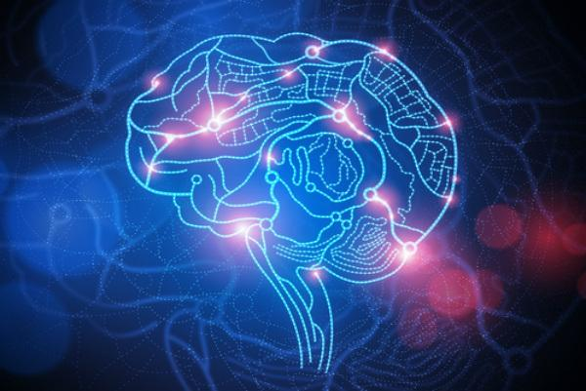
Human Brain
Neurons : ~ 8.6 x 10^10 (86 Billion)
Synapses: ~ 1x 10^14 (100 Trillion)
Image Source: http://voxxi.com/2014/01/21/cool-facts-about-human-brain/
Notes:
The human brain, 3 pound jelly which you can hold in your hands, is able to contemplate vastness of space, meaning of infinity, and is also self-aware. Brain is a very interesting organ and Neuroscientists are interested in learning it’s structures and functions. The human brain has 86 billion neurons and 100 trillion synapses meaning connections between those neurons. Then the question comes, why do we need to simulate a brain in computer? When neuroscientists do experiments in vivo (meaning in living organisms) or in vitro (in artificial experiment), and they can only measure 12 to 15 neurons max at once. Additionally, as sean Hill from Human brain project said “When we talk about human brains, there are lots of them around, but not many of them are accessible” so simulation would be helpful to see how brain functions at a large scale. Moreover, computer models can help find new patterns.
Why do we need to simulate human brain? As Before we talk about simulation and modeling, let’s go over some background information.

Slide 5
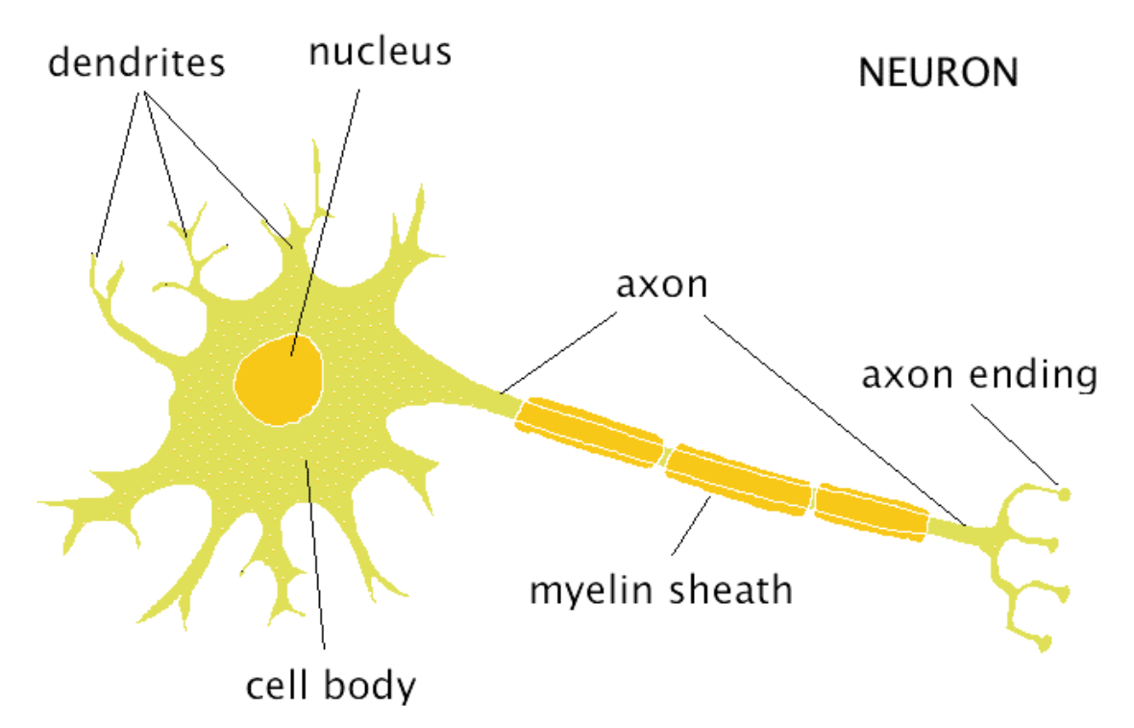
Neurons
Fun Fact - Longest axons in human body run from base of the spinal cord to the big toe of each foot!
Image Source: http://webspace.ship.edu/cgboer/theneuron.html
Notes:
Neurons are specialized cells in the nervous system. What makes neurons interesting is that we do not get many more neurons after we are born. So, what you are born with is what you get to keep. This also means that if you injure brain or spinal cord, most of the time, damage is permanent. Neurons are similar to other cells in the body. For example, they have soma (cell body), nucleus, mitochondria, ribosomes, and so on. However, they have 3 additional properties that differentiate them from regular cells. They are dendrites, axon, and electrochemical process. Dendrites receive inputs from other neuron’s axon or dendrites. Then signal goes to cell body and then out to axon.Axons have myelin sheath that helps to send the signal down to axon without degeneration and that’s very important. When we think about cells, we think of them as being microscopic and cell body and soma are. However, axons can be very long. The longes axon in human body is from base of the spinal cord to the big toe of each foot! When the signal travels down the axon, it goes in one direction because potassium and sodium channels open and let the ions through. Now, lets talk about channels.

Slide 6
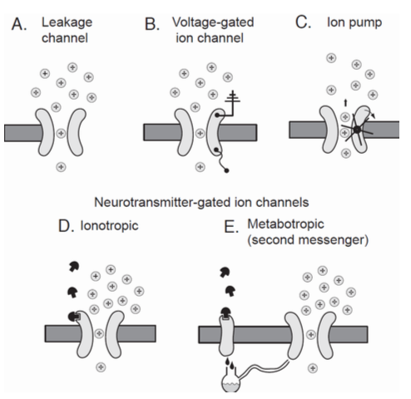
Channels
Image Source: Fundamentals of Computational Neuroscience by Thomas P. Trappenberg, second edition, pg-25
Notes:
- Leakage channels are always open. They allow potassium and sodium ions to leak down their concentration gradient.
- Voltage-gated ion channel: The opening of the voltage-gated ion channel depends on the membrane potential. This is indicated by little wire inside the neuron and ground wire outside the neuron.
- Ion pumps are ion channels that transport ions against their concentration gradient.
- Ionotropic neurotransmitter-gated ion channels allow neurotransmitter to bind to the channel protein, which in turn changes the shape of the channel protein, and allows ion to pass through.
- A metabotropic synapse influences ion channels only through second messengers.
Now, we know about channels. So, lets talk about channels in Neuron’s axon and how they help with the connection or synapse between two neurons.

Slide 7
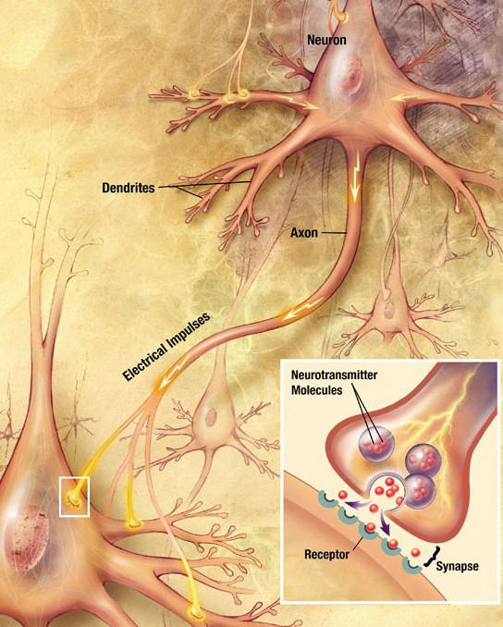
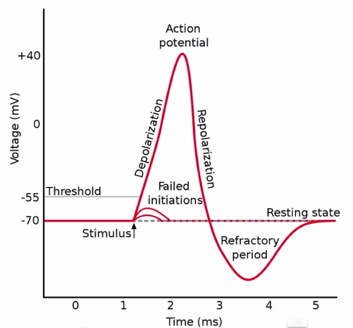
Signal Propagation
Image Source:
(left) http://en.wikipedia.org/wiki/Neuron
(right) https://www.youtube.com/watch?v=HnKMB11ih2o
Notes:
Synapse is a connection between two neurons. Neuron that sends a signal is called presynaptic neuron and the neuron that receives a signal is called a postsynaptic neuron. When the signal travels down the axon, it is an electrical signal. Then signal gets converted to chemical signal during synapse. During synapse, neurotransmitters get released from presynaptic neuron and bind with receptors on postsynaptic neurons. This causes postsynaptic neuron to open channels. Then signal gets converted back to electrical. If you think in terms of computers, signal is digital then analog then digital again. Presynaptic to Postsynaptic (Chemical Synapse and Electrical Synapse), Excitatory and Inhibitory.
Action Potential: Sodium channels open and sodium starts rushing in. That tries to make the voltage go up to equilibrium potential for Na+ which is about 58 mv. It quite doesn’t get there. Once we reach about 40mV or so, voltage-gated potassium channel have enough voltage to open. Positives repel positive so K+ starts rushing out and it wants to reach equilibrium potential for K+ which is -93 so voltage goes below the resting state. During refractory period (a.k.a. Hyperpolarization), ion pump pumps three Na+ out and lets two K+ ions in. This information is important to know if you want to create biologically accurate models so lets talk about different levels of models.

Slide 8
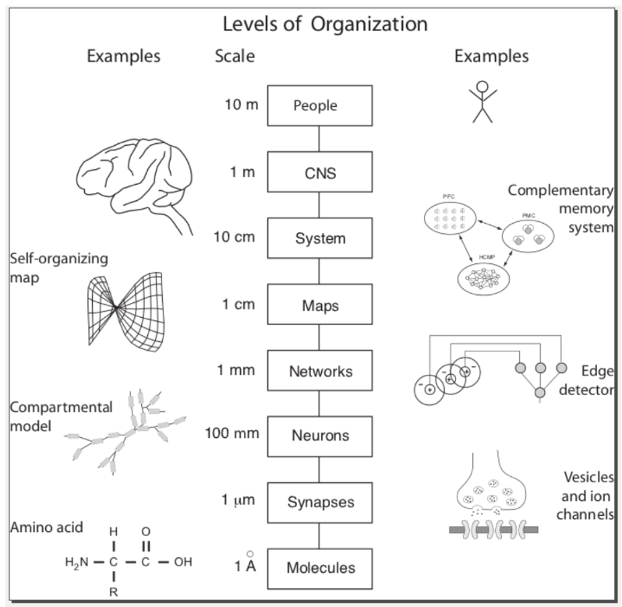
Levels of Organization of Modeling
Image Source: Fundamentals of Computational Neuroscience by Thomas P. Trappenberg, second edition, pg 4
Notes:
Different researchers are interested in creating models at different level. There is a simulator called GENESIS, that focuses at neuron and synapse level. Another simulator called NEURON focuses at neurons, networks, and map level. Researchers at brainlab are interested in networks, maps, and system.
Networks of neurons have information processing capabilities that are no present in the single neuron. System-level models are important in understanding higher order brain functions such as learning and memory.
We wanted to model and simulate Networks, Maps, and System so NCS was created. Let’s talk about what is NCS. (ADD MORE INFO)

Slide 9
What is NCS?
Developed and maintained by the UNR Brain Computation Laboratory
The NeoCortical Simulator is designed for modeling large-scale neural networks and systems
Open source
Runs on a heterogeneous cluster of CPUs and NVIDIA GPUs
First simulator to support real-time neurorobotics application
Notes:
History: First version was in Matlab, then C and now in C++11 and CUDA. Currently, we are on version 7. In this presentation,we will talk about both NCS 6 and NCS 7.
Now, that we knowwhat NCS is lets, talk about neuron models that are provided with NCS.

Slide 10
Outline
Background
Neuron Models
User Interface
  GUI
  Python
Modeling
Database
Result
Documentation

Slide 11
Neuron Models
Hodgkin-Huxley
Leaky Integrate-and-Fire
Izhikevich

Slide 12
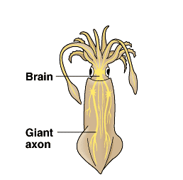
Hodgkin-Huxley (Added in NCS 7.0)
Biologically accurate
Developed in 1952 by Alan Hodgkin and Andrew Huxley from their experiments on the giant axon of a squid
Set of four differential equations
Three variables n, m, h
Notes:
Since it is computationally intensive due to differential equations, it was not implemented until now.
n - potassium channel (unknown at that time)
m - Activation of sodium channel
h - Inactivation of sodium channel
Axon of a squid is usually around 0.5mm and can be up to 1mm in diameter. Alan Hodgkin and Andrew Huxley were able to use intracellular electrode.

Slide 13
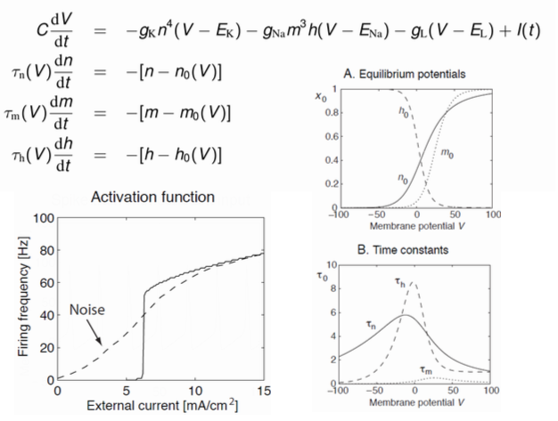
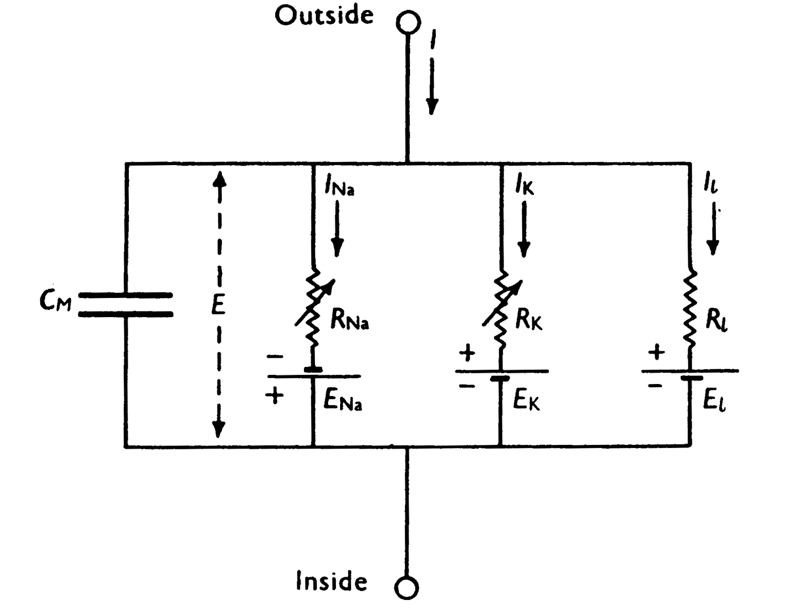
Hodgkin-Huxley
Image Source: http://www.ebi.ac.uk/biomodels-main/static-pages.do?page=ModelMonth%2F2006-09
Notes:
A circuit representation of the Hodgkin-Huxley model. This circuit includes a capacitor on which the membrane potential can be measured and three resistors with their own batteries, modeling ion channels; two are voltage dependant and one is static.
Resistors: resistance of ion channels
E_ion = reversal potential of ion channels
L = Leakage
I(t) is this external current from neurotransmitter-gated channels. Neurotransmitter-gated channel is were ion binds to the channel protein and changes the shape of the protein so ions can flow through.
Since this model is complicated and would take a long time to simulate, this wasn’t added in the simulator till NCS version 7. 0 even though it has been around for a while. Now, let’s talk about a model that has been part of NCS since the beginning.

Slide 14
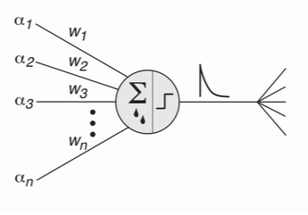
Leaky Integrate-and-Fire
Comprised of
  Sub-threshold leaky-integrator dynamic
  Firing threshold
  Reset mechanism
Leakage Channels
Drive the neuron to higher voltage
Let the voltage decay to its resting potential
Image Source: Fundamentals of Computational Neuroscience by Thomas P. Trappenberg, second edition, pg 55
Notes:
The model that has been part of the NCS since beginning is Leaky Integrate and fire. Since this was the only built-in model at first.
This neuron model integrates (sums) the external input, with each channel weighted with corresponding synaptic weighting factors w_i, and produces an output spike if the membrane potential reaches a firing threshold.
Traditionally, LIF is HH without the fast sodium or slow rectifying potassium channels. It only has leakage channels. In NCS, we added add other channels with sub-threshold dynamics that follow the HH formalism (they treat the channels as two-state processes). Also, we reordered some of the channels so computation would be faster. So we refer to LIF model in NCS as NCS neuron model. All the equations for the ncs neuron model are in the appendix of the journal paper for NCS 6 if you are interested.
Now that we have talked about LIF and HH, there is a neuron model that reproduces spiking and bursting bevior as fast as HH and it is also computationally efficient as LIF and that is Izhikevich model.

Slide 15
Izhikevich
Created by Eugene M. Izhikevich
Published in 2003
Most Simplistic
Computationally efficient and captures large variety of response properties of real neurons.
Only 6 variables!
Notes:
Fundamentals of Computational Neuroscience. 2nd Edition. Thomas P. Trappenberg
Biologically plausible as hodgkin-Huxley neuron and computationally efficient as LIF. Let’s look at the equations and spiking patterns that are produced by Izhikevich neuron model.

Slide 16
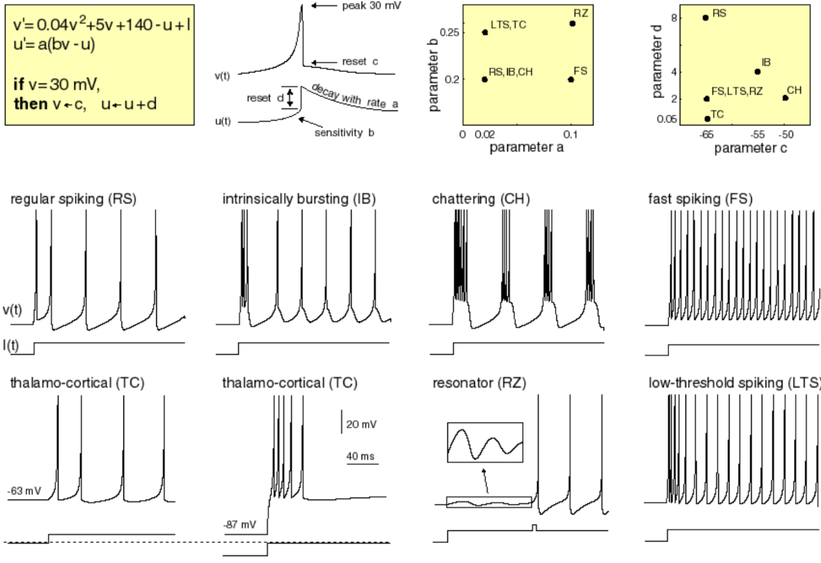
Izhikevich (Added in NCS 6.0)
Image Source: http://www.izhikevich.org/publications/spikes.htm
Notes:
Since this is easy to model and simulate, it was added in NCS 6.0.
There is a yellow box at the top left corner that has equations for Izhikevich neuron models. The six variables that are used are a,b,c,d,u, and v. As shown in the second figure in the top row,
variable v represents the membrane potential of the neuron variable and u represents recovery.
a - time scale of the recovery variable u
b - sensitivity of the recovery variable u
c - after spike reset value of the membrane potential variable v
d - after spike reset of the recovery variable u
Last two yellow figure shows what values of a,b,c, and d to choose to get different spiking patterns. V is membrane potential usually -65 and for u- good place to start testing is v*b
So now we have talked about three neuron models that are built-in NCS as of NCS 7.0. These neuron models are plug in based so users have an ability to write their own plug-in to include different neuron model type if they choose. Now, let’s take a look at spike patterns generated by LIF and IZH and comapre them.

Slide 17
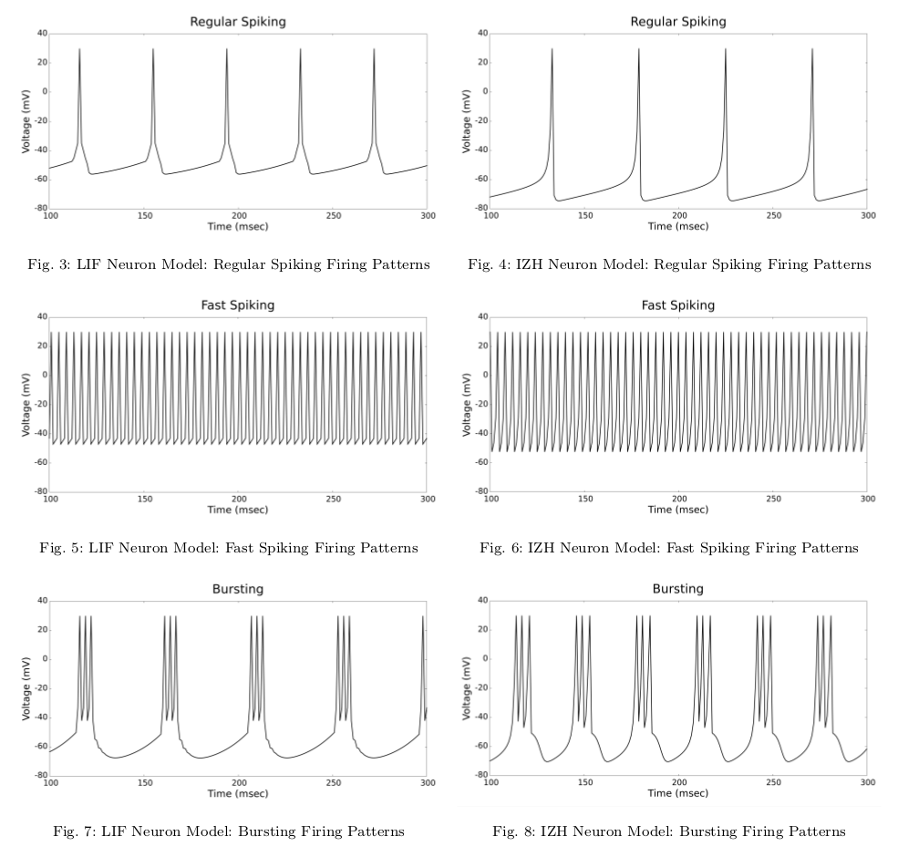
R. V. Hoang, D. Tanna, L. C. Jayet Bray, S. M. Dascalu, and F.C. Harris, Jr. “A Novel CPU/GPU Simulation Environment for Large-Scale Neural Modeling.” Frontiers in Neuroinformatics, 7 (19), 2013.
Notes:
So, on the left are the spiking patterns generated by LIF model and on the right are patterns generated by IZH. It is easy to notice that they are similar. However, IZH has smoother spikes as noticeable in regular spiking and bursting firing patterns. Our goal was three things. 1) Get data from electrophysiology paper and generate LIF patterns by using biologically accurate parameters. 2) Show that we can generate similar spiking patterns using Izhikevich model which is much faster and uses significantly less variables. 3) Izhikevich has provided his models in matlab. So for the third thing, take the parameter values that were used to generate Izhikevich pattern on the right and put them in matlab program and double check that we get the same pattern. We achieved all three of this.
Now, you have seen three neuron models and spiking patterns using Izhikevich and Leaky-Integrate-and-fire from NCS6. Now let’s talk about how to model this?

Slide 18
How do you model these?

Slide 19
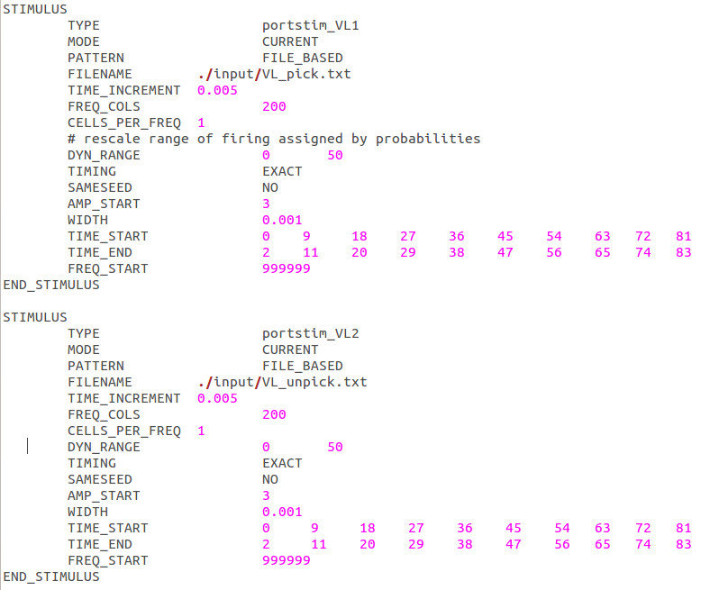
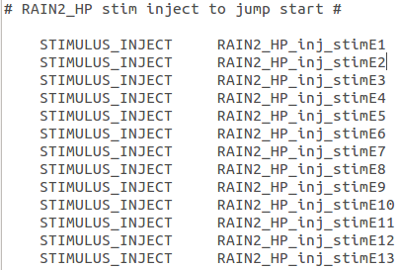
.in file (Good old days)
Notes:
In good old days, prior to NCS7, we used text input files as an input to the simulator. Input files did not allow loops, lots of it was copy paste of the code with minor change in parameter values, and change in one place required change in lots of different places. For example, if you have 13 different stimulus input, you have to write out each one. In C++ or python, loop would be used instead. In second figure on the right, if time start and time end was incorrect, you would have to change it in lots of different places. The bottom figure shows the same thing. Copy paste the code and change stimE1 to stimE2. Even though it was easy to understand the input files, it became inconvinient to write, debug, and maintain code so it was decided that we needed a better option for user interface. Now, let’s talk about user interface.

Slide 20
Outline
Background
Neuron Models
User Interface
  GUI
  Python
Modeling
Database
Result
Documentation

Slide 21
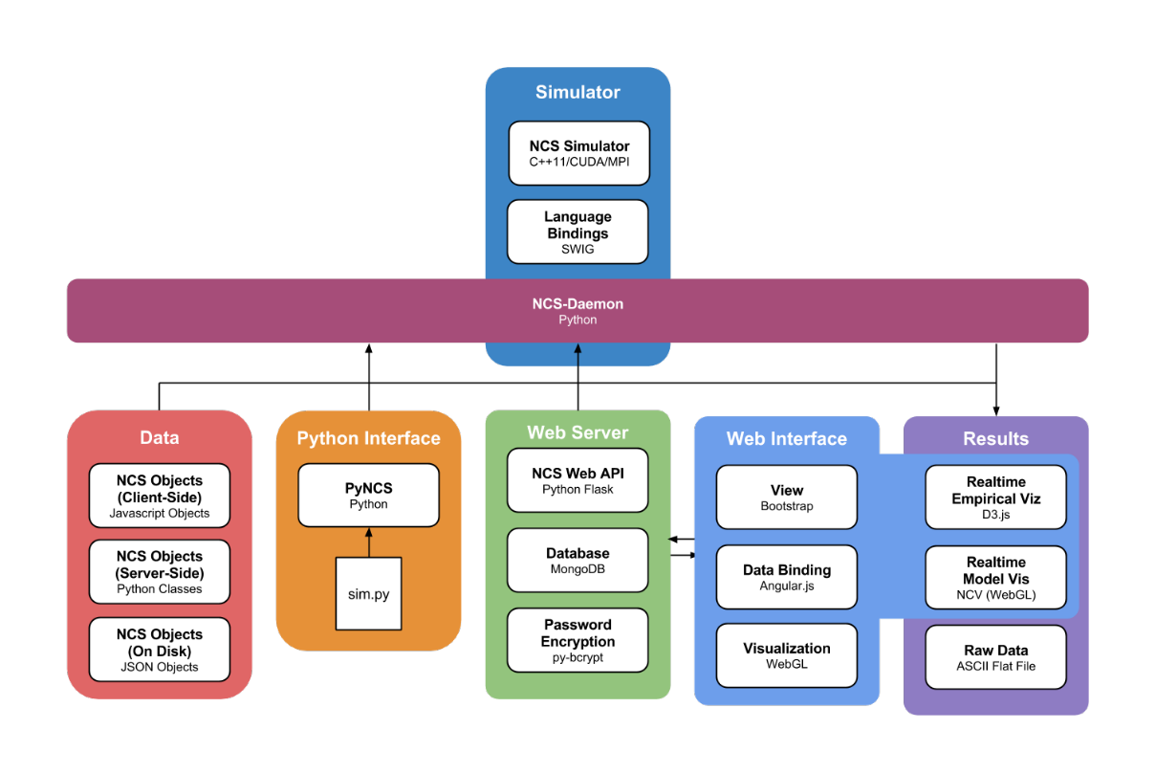
Big Picture
Image Source: www.cse.unr.edu/~fredh/papers/thesis/056-jordan/thesis.pdf
Notes:
Before we go into lots of detail, let’s talk about the big picture. For user interface, we wanted both Graphical User Interface and Python Interface so if a researcher wants to program, he/she can use python, if not GUI can be used.
The backend or the core of the simulator is written using C++11 and CUDA. Then we have SWIG which stands for simplified wrapper and Interface generator. SWIG connects programs written in c/c++ with high-level programming languages such as python, perl, and ruby. After swig comes ncs-daemon. The python code goes through the ncs-daemon to swig and then to simulator. Then reports come back from ncs-daemon and you can get raw data in ASCII file if that’s what you prefer or it can go to report interface and report interface would provide graphs of the reports to you. We will talk more about report interface later. In addition to the report interface or raw data, data can also go to WebGL application that provides neuron and synapse visualization in real time. The WebGL application is work in progress.
Now that we know the big picture, let’s look at simulation building blocks and then GUI.

Slide 22
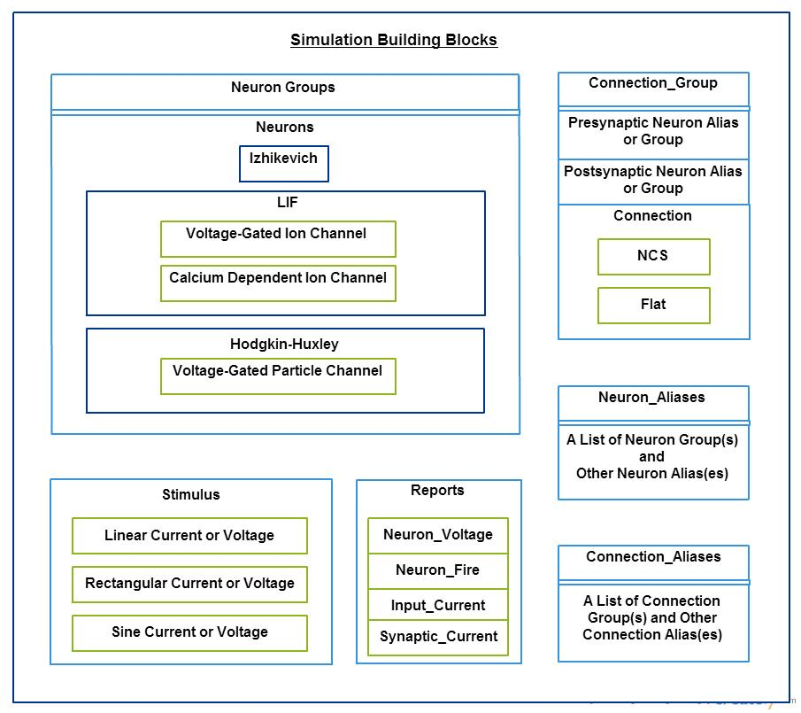
Simulation Building Blocks
Notes:
Here is a diagram of simulation building blocks. Smallest units are the channels. There are three-in built channels for NCS. Two of the channels are for LIF and one is for HH.
voltage-gated ion channel - generic voltage gated channel
Calcium dependent ion channel - after hyperpolarization channel. Voltage-independant, calcium -dependant (K+ channel)
Voltage-gated particle channel - generic voltage-gated channel. Parameters are completely different than voltage-gated ion channel for LIF. The term particle is used instead of ion because n,m,h particles for hodgkin-huxley model. It is possible to model leakage channel, sodium, and potassium with it.
Channels are part of neurons and neurons go inside a neuron group. we should note that one neuron group can only have one type of neuron. If you would like more neurons in one group, use neuron alias.
There are two types of in-built synapse or connection types in NCS. They are flat and NCS (LIF). Connection is from one neuron group to another so specify presynaptic group and postsynaptic group. If you want to combine multiple connections, use connection alias.
Then we have two seprate components. Stimulus and reports. Stimulus is input and report is output. Stimulus goes to neuron group and report comes from neuron group and connection_group.

Slide 23
Outline
Background
Neuron Models
User Interface
  GUI
  Python
Modeling
Database
Result
Documentation

Slide 24
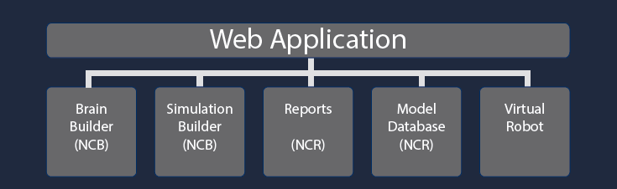
Web Application
J. Berlinski, C. Rowe, D. M. Chavez, N. M. Jordan, D. Tanna, R. V. Hoang, S. M. Dascalu, L. C. Jayet Bray, and F. C. Harris, Jr. “NeoCortical Builder: A Web Based Front End for NCS”. In Proceedings of the 27th International Conference on Computer Applications in Industry and Engineering (CAINE-2014), 2014. Submitted.
Notes:
Virtual robot tab is being developed by Thomas Kelley for his master’s work.

Slide 25
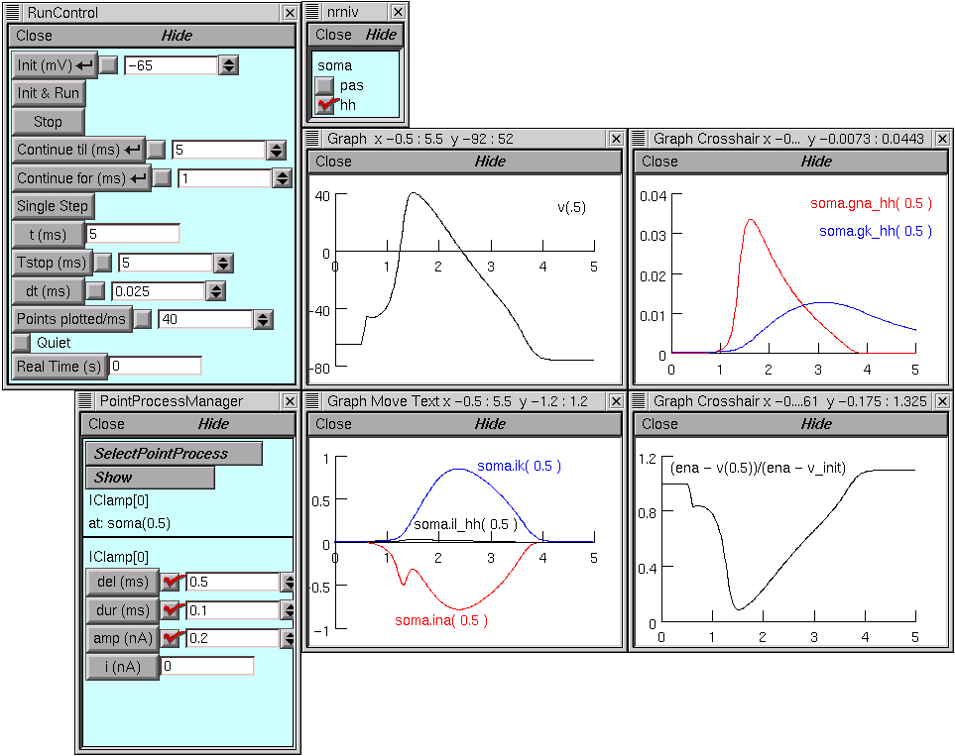
NEURON Simulator GUI
Image Source: http://www.neuron.yale.edu/neuron/static/docs/grafex/mygui.htm

Slide 26
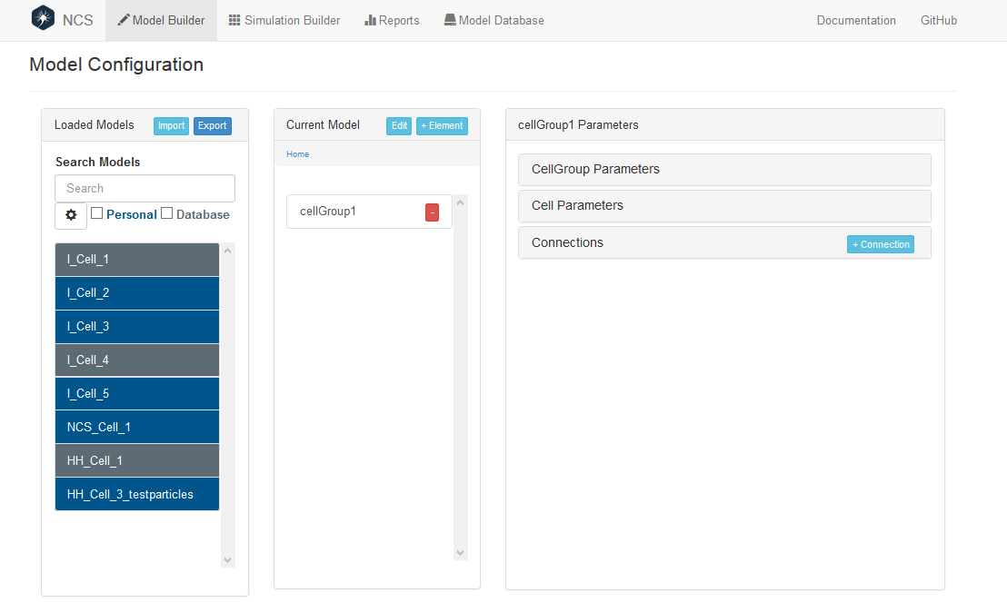
Brain Builder
J. Berlinski, C. Rowe, D. M. Chavez, N. M. Jordan, D. Tanna, R. V. Hoang, S. M. Dascalu, L. C. Jayet Bray, and F. C. Harris, Jr. “NeoCortical Builder: A Web Based Front End for NCS”. In Proceedings of the 27th International Conference on Computer Applications in Industry and Engineering (CAINE-2014), 2014. Submitted.

Slide 27
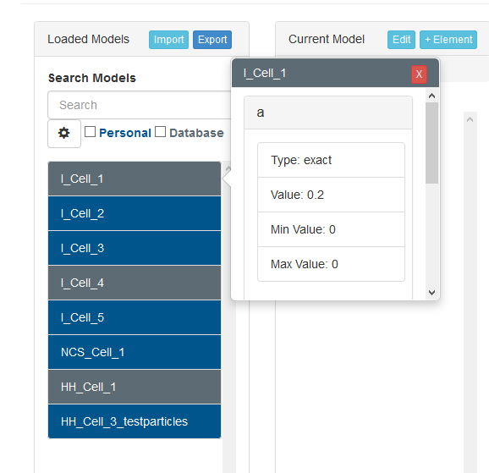
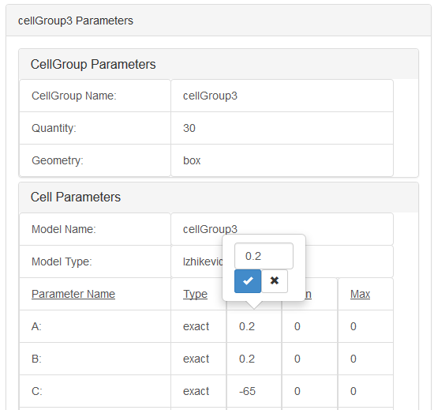
Brain Builder
J. Berlinski, C. Rowe, D. M. Chavez, N. M. Jordan, D. Tanna, R. V. Hoang, S. M. Dascalu, L. C. Jayet Bray, and F. C. Harris, Jr. “NeoCortical Builder: A Web Based Front End for NCS”. In Proceedings of the 27th International Conference on Computer Applications in Industry and Engineering (CAINE-2014), 2014. Submitted.

Slide 28
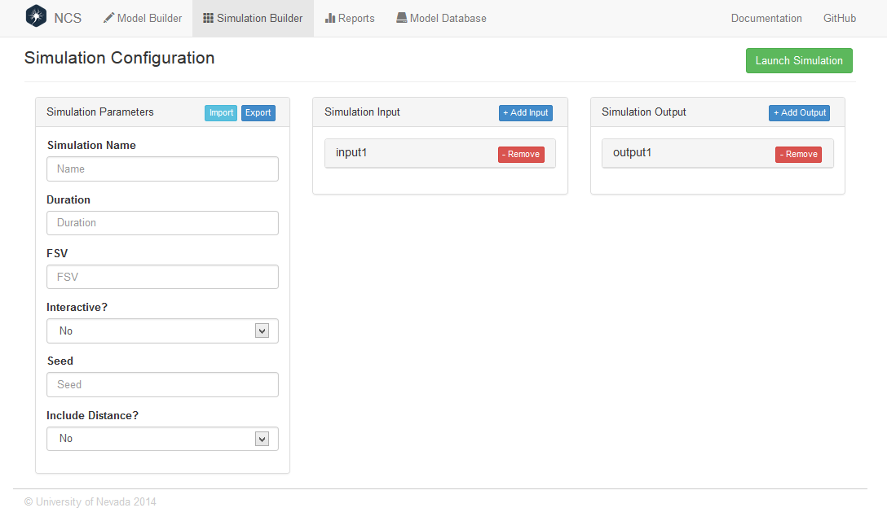
Sim Builder
J. Berlinski, C. Rowe, D. M. Chavez, N. M. Jordan, D. Tanna, R. V. Hoang, S. M. Dascalu, L. C. Jayet Bray, and F. C. Harris, Jr. “NeoCortical Builder: A Web Based Front End for NCS”. In Proceedings of the 27th International Conference on Computer Applications in Industry and Engineering (CAINE-2014), 2014. Submitted.

Slide 29
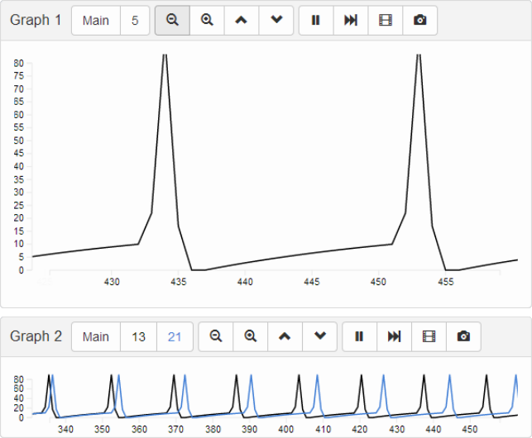
Report Interface
E. Almachar, A. Falconi, K. Gilgen, D.Tanna, N. M. Jordan, R. V. Hoang, S. M. Dascalu, L. C. Jayet Bray, and F. C. Harris, Jr. “NeoCortical Repository and Reports: Database and Repository for NCS.” In Proceedings of the International Conference on Software Engineering and Data Engineering (SEDE-2014), 2014. Submitted.

Slide 30
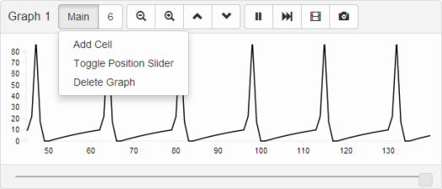
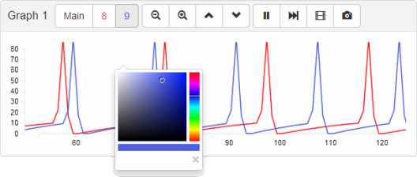
Report Interface
E. Almachar, A. Falconi, K. Gilgen, D.Tanna, N. M. Jordan, R. V. Hoang, S. M. Dascalu, L. C. Jayet Bray, and F. C. Harris, Jr. “NeoCortical Repository and Reports: Database and Repository for NCS.” In Proceedings of the International Conference on Software Engineering and Data Engineering (SEDE-2014), 2014. Submitted.

Slide 31
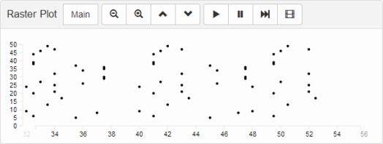
Report Interface
E. Almachar, A. Falconi, K. Gilgen, D.Tanna, N. M. Jordan, R. V. Hoang, S. M. Dascalu, L. C. Jayet Bray, and F. C. Harris, Jr. “NeoCortical Repository and Reports: Database and Repository for NCS.” In Proceedings of the International Conference on Software Engineering and Data Engineering (SEDE-2014), 2014. Submitted.

Slide 32
Outline
Background
Neuron Models
User Interface
  GUI
  Python
Modeling
Database
Result
Documentation

Slide 33
Python Interface - pyNCS
addNeuron
addNeuronGroup
addNeuronAlias
addSynapse
addSynapseGroup
addSynapseAlias
addStimulus
addReport
init
run

Slide 34
Outline
Background
Neuron Models
User Interface
  GUI
  Python
Modeling
Database
Result
Documentation

Slide 35
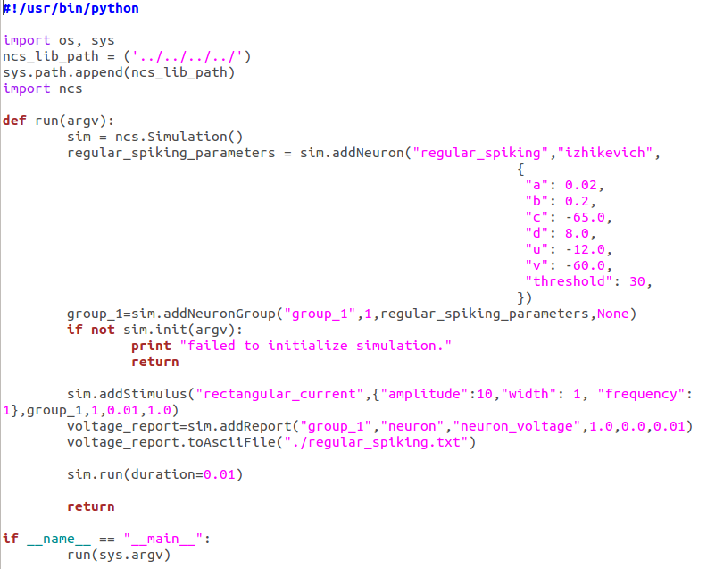
Izhikevich - Regular Spiking

Slide 36
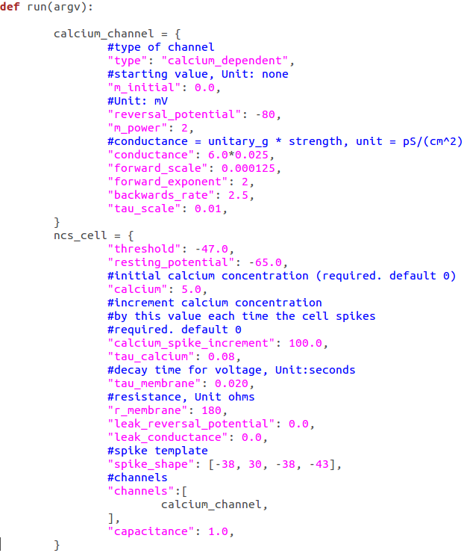
LIF - Regular Spiking

Slide 37
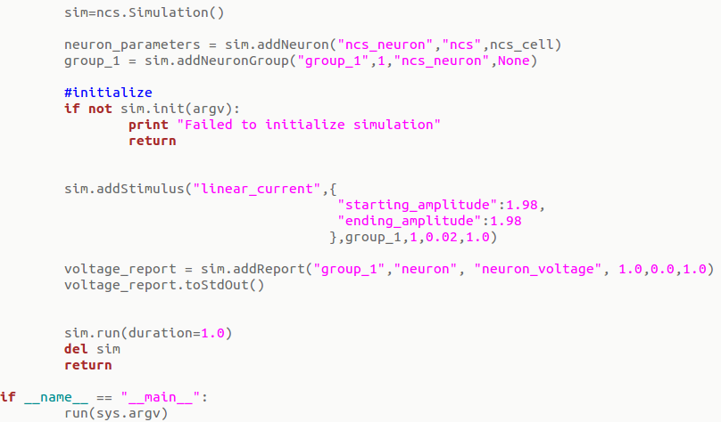
LIF - Regular Spiking (Continue)

Slide 38
Outline
Background
Neuron Models
User Interface
  GUI
  Python
Modeling
Database
Result
Documentation

Slide 39
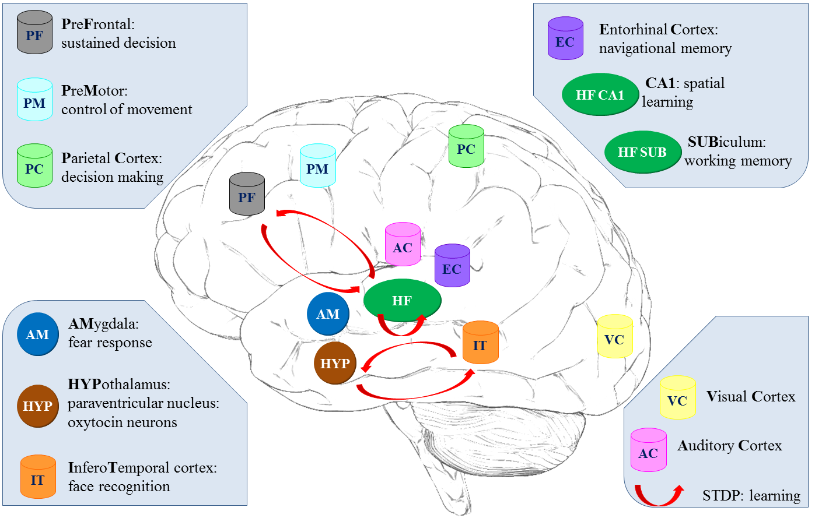
Demonstration: L. C. Jayet Bray, D. Tanna, F. C. Harris, Jr. “NCS: A Large-Scale Brain Simulator”, December 2012 Neural Information Processing Systems (NIPS 2012), Lake Tahoe, NV

Slide 40
MongoDB (from "humongous") is a scalable, high-performance, open source, schema-free, document-oriented database.
-mongodb.org

Slide 41
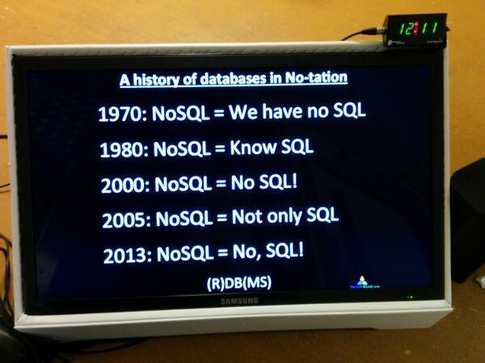
MongoDB
NoSQL database
JSON Style documents
Missing:
  No Joins
    They are too expensive!
  No Complex Transactions
  No Constraint Support
    Not at database level. Added at application level.
Extra:
  Document based queries
  Fast Performance
  Horizontal Scalability
Image Source: pic.twitter.com/XHXMJsXHjV
Notes:
So now we know what MongoDB is and know that it is uses JSON-Schema, let’s a look at a JSON document.
Note: Put diagram of already created models.

Slide 42
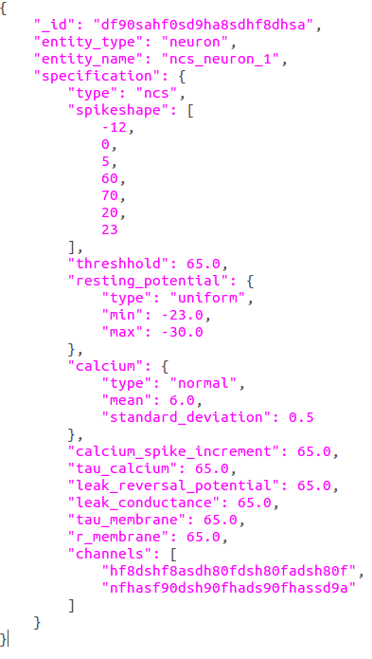
JSON Schema
Notes:
put a diagram of c++-> swig -> ncs-dameon (GUI - json to python) , python (python to json) and then store in MongoDB

Slide 43
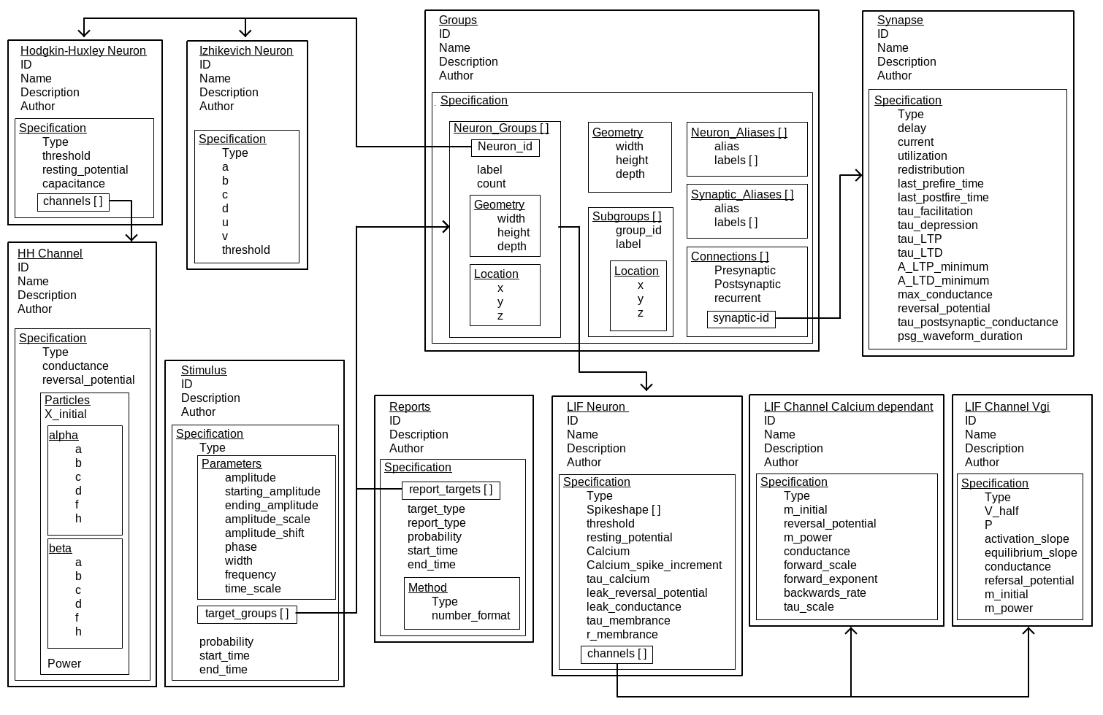
MongoDB Database Design

Slide 44
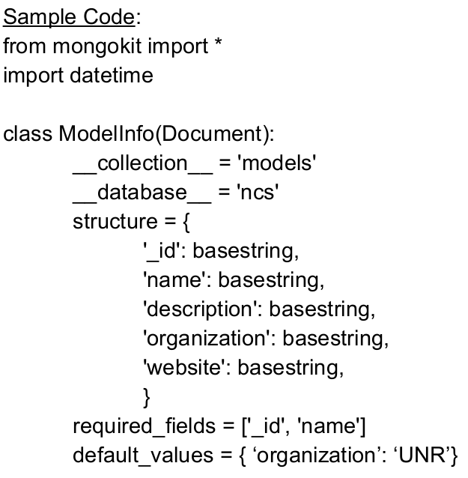
Mongokit

Slide 45
Outline
Background
Neuron Models
User Interface
  GUI
  Python
Modeling
Database
Result
Documentation

Slide 46
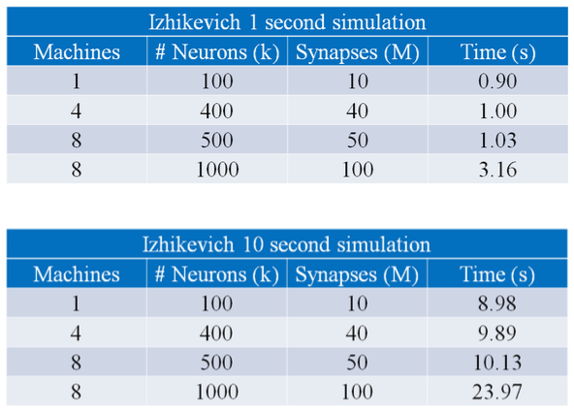
Performance - Izhikevich
Demonstration: R. Hoang, D. Tanna, L. C. Jayet Bray, S. M. Dascalu, F. C. Harris, Jr. “NCS: A Novel CPU/GPU Simulation Environment for Large-Scale Biologically-Realistic Neural Modeling”, December 2013 Neural Information Processing Systems (NIPS 2013), Lake Tahoe, NV

Slide 47
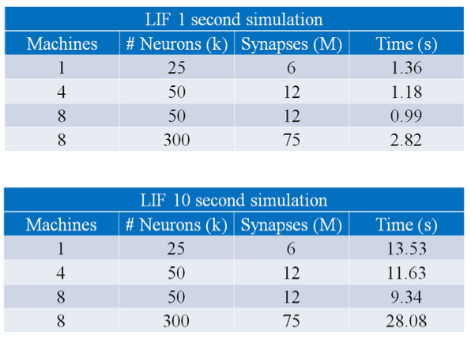
Performance - LIF
Demonstration: R. Hoang, D. Tanna, L. C. Jayet Bray, S. M. Dascalu, F. C. Harris, Jr. “NCS: A Novel CPU/GPU Simulation Environment for Large-Scale Biologically-Realistic Neural Modeling”, December 2013 Neural Information Processing Systems (NIPS 2013), Lake Tahoe, NV

Slide 48
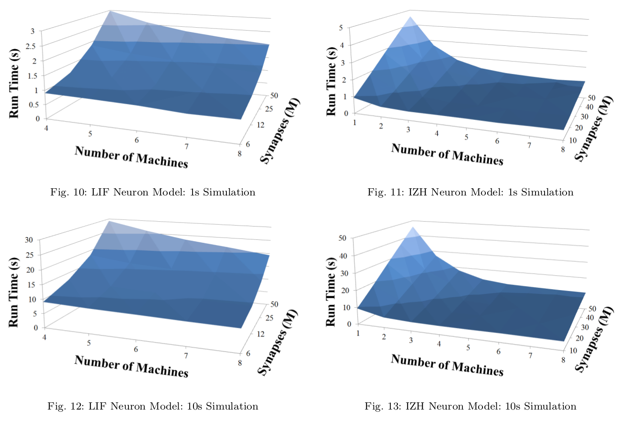
Performance - IZH vs. LIF
R. V. Hoang, D. Tanna, L. C. Jayet Bray, S. M. Dascalu, and F.C. Harris, Jr. “A Novel CPU/GPU Simulation Environment for Large-Scale Neural Modeling.” Frontiers in Neuroinformatics, 7 (19), 2013.

Slide 49
Outline
Background
Neuron Models
User Interface
  GUI
  Python
Modeling
Database
Result
Documentation

Slide 50
Documentation
http://ncs.io/

Slide 51
Outline
Background
Neuron Models
User Interface
  GUI
  Python
Modeling
Database
Result
Documentation

Slide 52
Future Work
WebGL based robotic environment
3D geometry information for each neuron model

Slide 53
Questions?
Notes:
Thank the audience and ask for questions.

Slide 54
Publications
Justin E. Cardoza, Alexander K. Jones, Denver J. Liu, Roger V. Hoang, Devyani Tanna, Laurence C. Jayet Bray, Sergiu M. Dascalu, and Frederick C. Harris, Jr. Design and Implementation of a Graphical Visualization Tool for NCS, in Proceedings of The 2013 International Conference on Software Engineering and Data Engineering (SEDE 2013), pp 37-43, September 25-27, 2013, Los Angeles, CA.
Roger V. Hoang, Devyani Tanna, Laurence C. Jayet Bray, Sergiu M. Dascalu, and Frederick C. Harris, Jr. A Novel CPU/GPU Simulation Environment for Large-Scale Biologically Realistic Neural Modeling, Frontiers in Neuroinformatics, Vol 7, Article 19, October 2013.
Jakub Berlinski, Cameron Rowe, Daniel M. Chavez, Nathan M. Jordan, Devyani Tanna, Roger V. Hoang, Sergiu M. Dascalu, Laurence C. Jayet Bray, and Frederick C. Harris, Jr. NeoCortical Builder: A Web Based Front End for NCS. In Proceedings of the 27th International Conference on Computer Applications in Industry and Engineering (CAINE-2014), 2014. Submitted.
Edson Almachar, Alexander Falconi, Katie Gilgen, Devyani Tanna, Nathan M. Jordan, Roger V. Hoang, Sergiu M. Dascalu, Laurence C. Jayet Bray, and Frederick C. Harris, Jr. NeoCortical Repository and Reports: Database and Repository for NCS. In Proceedings of the International Conference on Software Engineering and Data Engineering (SEDE-2014), 2014. Submitted.

Slide 55
Demonstrations
NCS: A Large-Scale Brain Simulator, December 2012, Neural Information Processing Systems (NIPS 2012), Lake Tahoe, NV
NCS: A Novel CPU/GPU Simulation Environment for Large-Scale Biologically-Realistic Neural Modeling, December 2013 Neural Information Processing Systems (NIPS 2013), Lake Tahoe, NV

Slide 56
NCS: Neuron Models, User Interface, and Modeling
A thesis submitted in partial fulfillment of the requirements for the degree of Master of Science in Computer Science and Engineering
Devyani Tanna

