Slide 1
Autonomous Mobile Robots
CpE 470/670(X)
Lecture 1
Instructor: Monica Nicolescu

Slide 2
General Information
Instructor: Dr. Monica Nicolescu
  E-mail: monica@cse.unr.edu
  Office hours: Tuesday 11:00am-noon, 1-3pm
  Room: SEM 239
Class webpage:
  http://www.cse.unr.edu/~monica/Courses/CPE470-670/

Slide 3
Time and Place
Lectures
  Monday: 9:30-10:45pm, SEM 344
Labs
  Wednesday: 9:30-10:45pm LME 321
  The use of the lab equipment requires a $50 deposit paid at the cashier’s office
  Deposit is returned at the end of the semester

Slide 4
Class Policy
Grading
  Homeworks: 20%
  Midterm: 20%
  Final: 20%
  Laboratory sessions: 20%
  Final project: 20%
Late submissions
  No late submissions will be accepted
Attendance
  Exams, laboratory sessions and final competition are mandatory
  If you cannot attend you must discuss with the instructor in advance

Slide 5

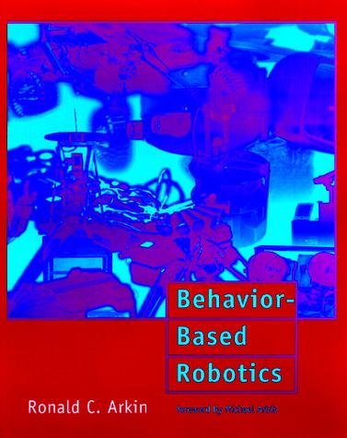
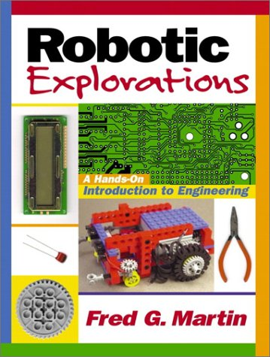
Textbooks
Lectures
  The Robotics Primer, 2007.
  Author: Maja Mataric‘ (required)
  Behavior-Based Robotics, 2001.
  Author: Ron Arkin (recommended)
Labs
  Robotic Explorations: An Introduction to Engineering Through Design, 2001. Author: Fred G. Martin (recommended)

Slide 6
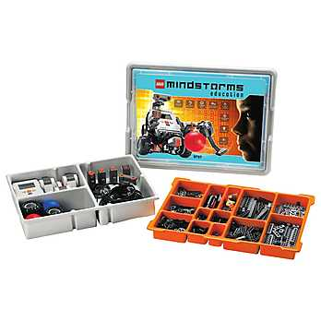
What will we Learn?
Fundamental aspects of robotics
  What is a robot?
  What are robots composed of?
  How do we control/program robots?
  Learning, multi-robot systems
Hands-on experience
  Build robots using LEGO parts
  Control NXT robots using NXC
  Contests during the semester, final competition

Slide 7
The term “robot”
Karel Capek’s 1921 play RUR (Rossum’s Universal Robots)
  It is (most likely) a combination of “rabota” (obligatory work) and “robotnik” (serf)
Most real-world robots today do perform such “obligatory work” in highly controlled environments
  Factory automation (car assembly)
But that is not what robotics research about; the trends and the future look much more interesting

Slide 8
What is a Robot?
In the past
  A clever mechanical device – automaton
Robotics Industry Association, 1985
  “A re-programmable, multi-functional manipulator designed to move material, parts, tools, or specialized devices […] for the performance of various tasks”
What does this definition miss?
  Notions of thought, reasoning, problem solving, emotion, consciousness

Slide 9
A Robot is…
… a machine able to extract information from its environment and use knowledge about its world to act safely in a meaningful and purposeful manner (Ron Arkin, 1998)
… an autonomous system which exists in the physical world, can sense its environment and can act on it to achieve some goals

Slide 10
What is Robotics?
Robotics is the study of robots, autonomous embodied systems interacting with the physical world
Robotics addresses perception, interaction and action, in the physical world

Slide 11
Key Concepts
Situatedness
  Agents are strongly affected by the environment and deal with its immediate demands (not its abstract models) directly
Embodiment
  Agents have bodies, are strongly constrained by those bodies, and experience the world through those bodies, which have a dynamic with the environment

Slide 12
Key Concepts (cont.)
Situated intelligence
  is an observed property, not necessarily internal to the agent or to a reasoning engine; instead it results from the dynamics of interaction of the agent and environment
  and behavior are the result of many interactions within the system and w/ the environment, no central source or attribution is possible

Slide 13
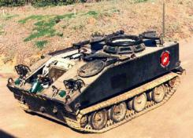
Robots: Alternative Terms
UAV
  unmanned aerial vehicle
UGV (rover)
  unmanned ground vehicle
UUV
  unmanned undersea vehicle

Slide 14

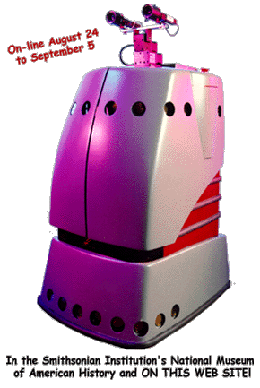
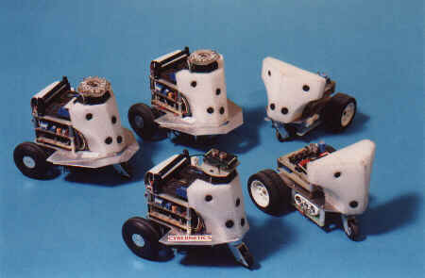
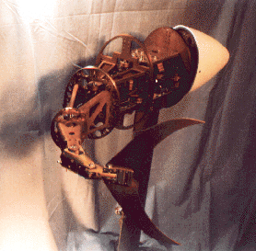
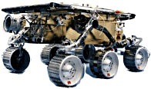
An assortment of robots…

Slide 15
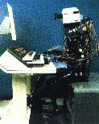
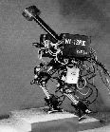

Anthropomorphic Robots

Slide 16
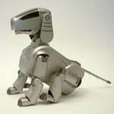
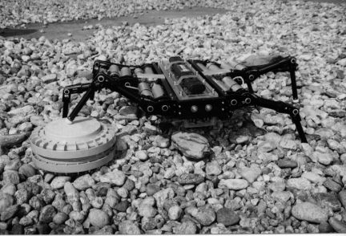
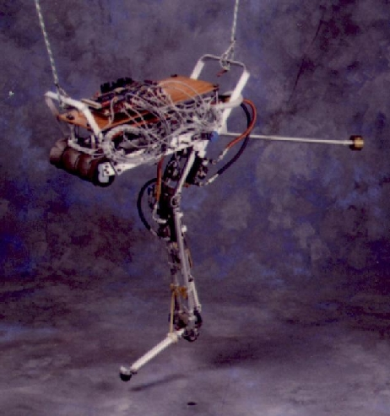
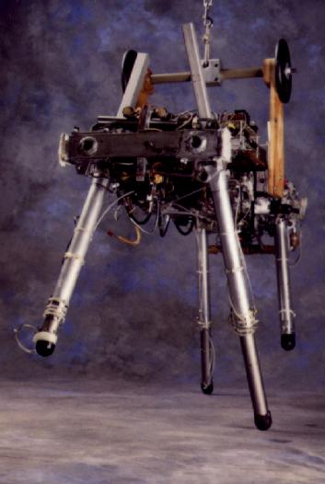
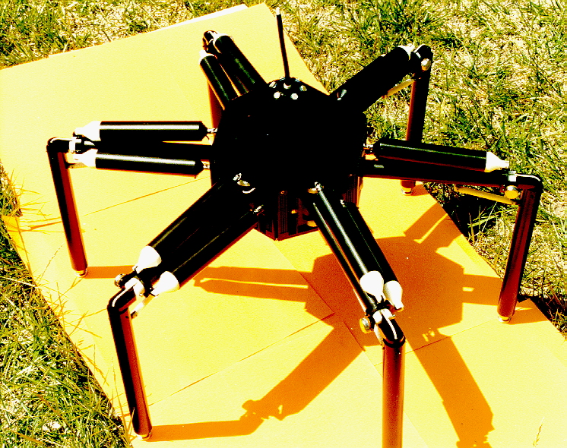
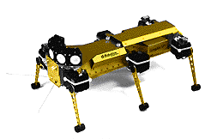
Animal-like Robots

Slide 17
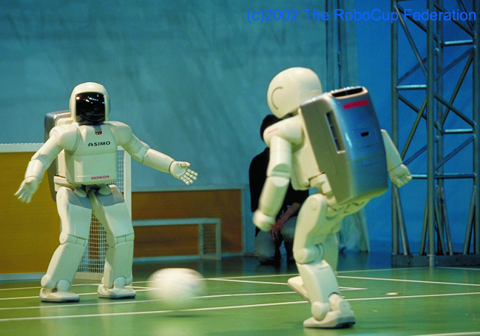
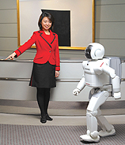
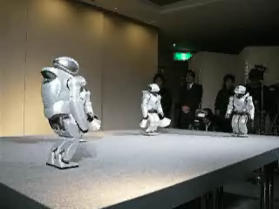
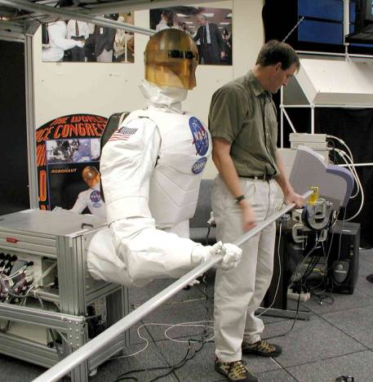
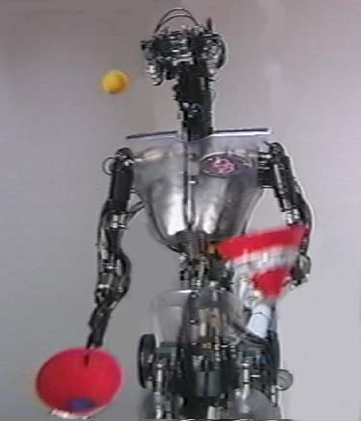
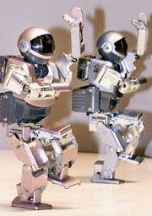
Humanoid Robots
Asimo (Honda)
QRIO
Robonaut (NASA)
DB (ATR)
Sony Dream Robot

Slide 18
What is in a Robot?
Sensors
Effectors and actuators
  Used for locomotion and manipulation
Controllers for the above systems
  Coordinating information from sensors with commands for the robot’s actuators

Slide 19
Uncertainty
Uncertainty is a key property of existence in the physical world
Physical sensors provide limited, noisy, and inaccurate information
Physical effectors produce limited, noisy, and inaccurate action
The uncertainty of physical sensors and effectors is not well characterized, so robots have no available a priori models

Slide 20
Uncertainty (cont.)
A robot cannot accurately know the answers to the following:
  Where am I?
  Where are my body parts, are they working, what are they doing?
  What did I just do?
  What will happen if I do X?
  Who/what are you, where are you, what are you doing, etc.?...

Slide 21
Sensors
Sensor = physical device that provides information about the world
  Process is called sensing or perception
What does a robot need to sense?
  Depends on the task it has to do
Sensor (perceptual) space
  All possible values of sensor readings
  One needs to “see” the world through the robot’s “eyes”
  Grows quickly as you add more sensors

Slide 22
State
State: A description of the robot (of a system in general)
For a robot state can be:
  Observable: the robot knows its state entirely
  Partially observable: the robot only knows a part of its state
  Hidden (unobservable): the robot does not have any access to its state
  Discrete: up, down, blue, red
  Continuous: 2.34 mph

Slide 23
Types of State
External
  The state of the world as perceived by the robot
  Perceived through sensors
  E.g.: sunny, cold
Internal
  The state of the robot as it can perceive it
  Perceived through internal sensors, monitoring (stored, remembered state)
  E.g.: Low battery, velocity
The robot’s state is the combination of its internal and external state

Slide 24
State Space
All possible states a robot could be in
  E.g.: light switch has two states, ON, OFF; light switch with dimmer has continuous state (possibly infinitely many states)
In this case the state space is the same with the perceptual space

Slide 25
State Space
In general, the state space is different than the sensor/perceptual space!!
  Internal state may be used to store information about the world (maps, location of “food”, etc.)
How intelligent a robot appears is strongly dependent on how much and how fast it can sense its environment and about itself

Slide 26
Representation
Internal state that stores information about the world is called a representation or internal model
  Self: stored proprioception, goals, intentions, plans
  Environment: maps
  Objects, people, other robots
  Task: what needs to be done, when, in what order
Representations and models influence determine the complexity of a robot’s “brain”

Slide 27
Action
Effectors: devices of the robot that have impact on the environment (legs, wings ⇔ robotic legs, propeller)
Actuators: mechanisms that allow the effectors to do their work (muscles ⇔ motors)
Robotic effectors and actuators are used for
  locomotion (moving around, going places)
  manipulation (handling objects)
Classical activity decomposition
  Mobile robotics
  Manipulator robotics

Slide 28
Autonomy
Autonomy is the ability to make one’s own decisions and act on them.
  For robots: take the appropriate action on a given situation
Autonomy can be complete (R2D2) or partial (teleoperated robots)
Controllers enable robots to be autonomous
  Play the role of the “brain” and nervous system in animals
  Typically more than one controller, each process information from sensors and decide what actions to take
  Challenge in robotics: how do all these controllers coordinate with each other?

Slide 29
Control Architectures
Robot control is the means by which the sensing and action of a robot are coordinated
Control architecture
  Guiding principles and constraints for organizing a robot’s control system
Robot control may be implemented:
  In hardware: programmable logic arrays
  In software
Should control modules be centralized?
  Controllers need not (should not) be a single program

Slide 30
Languages for Programming Robots
What is the best robot programming language?
  There is no “best” language
In general, use the language that
  Is best suited for the task
  Comes with the hardware
  You are used to
General purpose:
  JAVA, C
Specially designed:
  the Behavior Language, the Subsumption Language

Slide 31
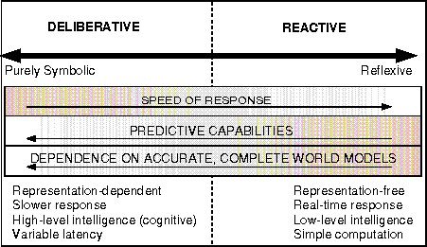
Spectrum of robot control
From “Behavior-Based Robotics” by R. Arkin, MIT Press, 1998

Slide 32
Robot control approaches
Reactive Control
  Don’t think, (re)act.
Deliberative (Planner-based) Control
  Think hard, act later.
Hybrid Control
  Think and act separately & concurrently.
Behavior-Based Control (BBC)
  Think the way you act.

Slide 33
Readings
F. Martin: Sections 1.1, 1.2.3
M. Matarić: Chapters 1, 3

