Slide 1
Autonomous Mobile Robots
CPE 470/670
Lecture 10
Instructor: Monica Nicolescu

Slide 2
What Is a Behavior?
Behavior-achieving modules
Rules of implementation
Behaviors achieve or maintain particular goals (homing, wall-following)
Behaviors are time-extended processes
Behaviors take inputs from sensors and from other behaviors and send outputs to actuators and other behaviors
Behaviors are more complex than actions (stop, turn-right vs. follow-target, hide-from-light, find-mate etc.)

Slide 3
Principles of BBC Design
Behaviors are executed in parallel, concurrently
  Ability to react in real-time
Networks of behaviors can store state (history), construct world models/representation and look into the future
  Use representations to generate efficient behavior
Behaviors operate on compatible time-scales
  Ability to use a uniform structure and representation throughout the system

Slide 4
Continuous Behavioral Encoding
Continuous response provides a robot an infinite space of potential reactions to the world
A mathematical function transforms the sensory input into a behavioral reaction
Potential fields
  Law of universal gravitation: potential force drops off with the square of the distance between objects
  Goals are attractors and obstacles are repulsors
  Separate fields are used for each object
  Fields are combined (superposition) ⇒ unique global field

Slide 5


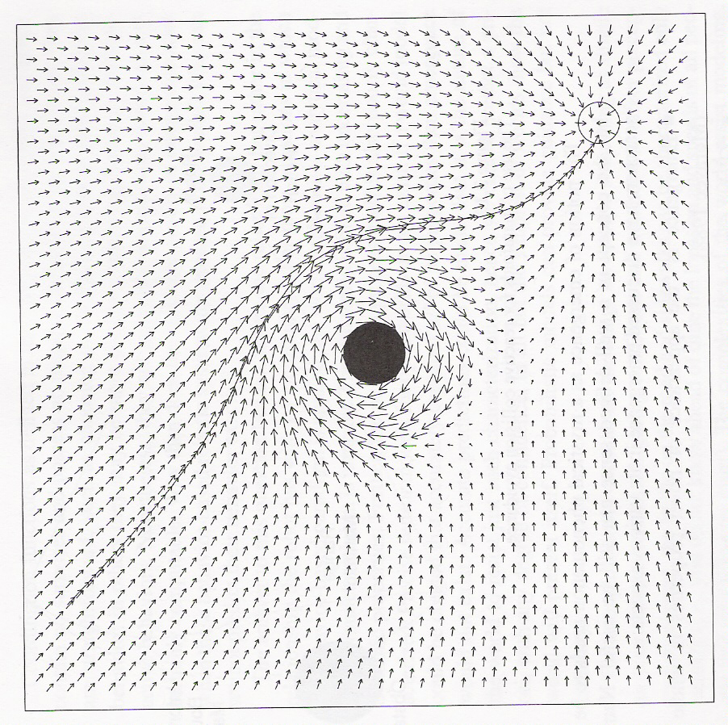
Potential Fields
Ballistic goal
attraction field
Superposition of
two fields

Slide 6
Potential Fields
Advantages
  Provide an infinite set of possibilities of reaction
  Highly parallelizable
Disadvantages
  Local minima, cyclic-oscillatory behavior
  Apparently, large amount of time required to compute the entire field: reaction is computed only at the robot’s position!

Slide 7
Motor Schemas
Motor schemas are a type of behavior encoding
  Based on neuroscience and cognitive science
They are based on schema theory (Arbib)
  Explains motor behavior in terms of the concurrent control of many different activities
  Schemas store how to react and the way the reaction can be realized: basic units of activity
  Schema theory provides a formal language for connecting action and perception
  Activation levels are associated with schemas, and determine their applicability for acting

Slide 8
Visually Guided Behaviors
Michael Arbib & colleagues constructed computer models of visually guided behaviors in frogs and toads
Toads & frogs respond visually to
  Small moving objects ⇒ feeding behavior
  Large moving objects ⇒ fleeing behavior
Behaviors implemented as a vector field (schemas)
  Attractive force (vector) along the direction of the fly
What happens when presented with two files simultaneously?
  The frog sums up the two vectors and snaps between the two files, missing both of them

Slide 9
Motor Schemas
Provide large grain modularity
Schemas act concurrently, in a cooperative but competing manner
Schemas are primitives from which more complex behaviors (assemblages can be constructed)
Represented as vector fields

Slide 10
Examples of Schemas
Obstacle avoid and stay on corridor schemas

Slide 11
Schema Representation
Responses represented in uniform vector format
Combination through cooperative coordination via vector summation
No predefined schema hierarchy
Arbitration is not used
  each behavior has its contribution to the robot’s overall response
  gain values control behavioral strengths
Here is how:

Slide 12
The Role of Gains in Schemas
Low gain
High gain

Slide 13
Foraging Example

Slide 14
Schema-Based Robots
At Georgia Tech (Ron Arkin)
Exploration
Hall following
Wall following
Impatient waiting
Navigation
Docking
Escape
Forage

Slide 15
Behavior Coordination
Behavior-based systems require consistent coordination between the component behaviors for conflict resolution
Coordination of behaviors can be:
  Competitive: one behavior’s output is selected from multiple candidates
  Cooperative: blend the output of multiple behaviors
  Combination of the above two

Slide 16
Competitive Coordination
Arbitration: winner-take-all strategy ⇒ only one response chosen
Behavioral prioritization
  Subsumption Architecture
Action selection/activation spreading (Pattie Maes)
  Behaviors actively compete with each other
  Each behavior has an activation level driven by the robot’s goals and sensory information
Voting strategies
  Behaviors cast votes on potential responses

Slide 17
Cooperative Coordination
Fusion: concurrently use the output of multiple behaviors
Major difficulty in finding a uniform command representation amenable to fusion
Fuzzy methods
Formal methods
  Potential fields
  Motor schemas
  Dynamical systems

Slide 18
The DAMN Architecture
Distributed Architecture for Mobile Navigation (Rosenblatt 1995)
Multi-valued behaviors (at all levels) propose multiple action preferences
Each behavior votes for or against sets of actions
Arbiter selects max weighted vote sum
Practically demonstrated on real-world long-distance navigation
Disadvantage: highly heuristic

Slide 19
Emergent Behavior
The resulting robot behavior may sometimes be surprising or unexpected
⇒ emergent behavior

Slide 20
Wall Following
A simple wall following controller:
  If too close on left-back, turn left
  If too close on left-front, turn right
  Similarly for right
  Otherwise, keep straight
If the robot is placed close to a wall it will follow
Is this emergent?
  The robot has no explicit representations of walls
  The controller does not specify anything explicit about following

Slide 21
Emergence
A “holistic” property, where the behavior of the robot is greater than the sum of its parts
A property of a collection of interacting components
  A robot’s interaction with the environment
  The interaction of behaviors
Often occurs in reactive and behavior-based systems (BBS)
Typically exploited in reactive and BBS design

Slide 22

Flocking
How would you design a flocking behavior for a group of robots?
Each robot can be programmed with the same behaviors:
  Don’t get too close to other robots
  Don’t get too far from other robots
  Keep moving if you can
When run in parallel these rules will result in the group of robots flocking

Slide 23
Emergent Behavior
Emergent behavior is structured behavior that is apparent at one level of the system (the observer’s point of view) and not apparent at another (the controller’s point of view)
The robot generates interesting and useful behavior without explicitly being programmed to do so!!
E.g.: Wall following can emerge from the interaction of the avoidance rules and the structure of the environment

Slide 24
Components of Emergence
The notion of emergence depends on two components
  The existence of an external observer, to observe the emergent behavior and describe it
  Access to the internals of the controller, to verify that the behavior is not explicitly specified in the system
The combination of the two is, by many researchers, the definition of emergent behavior

Slide 25
Unexpected & Emergent Behavior
Some argue that the description above is not emergent behavior and that it is only a particular style of robot programming
  Use of the environment and side-effects leads to the novel behavior
Their view is that emergent behavior must be truly unexpected, and must come to a surprise to the external observer

Slide 26
Expectation and Emergence
The problem with unexpected surprise as property of behavior is that:
  it entirely depends on the expectations of the observer which are completely subjective
  it depends on the observer’s knowledge of the system (informed vs. naïve observer)
  once observed, the behavior is no longer unexpected

Slide 27
Emergent Behavior and Execution
Emergent behavior cannot always be designed in advance and is indeed unexpected
This happens as the system runs, and only at run-time can emergent behavior manifest itself
The exact behavior of the system cannot be predicted
  Would have to consider all possible sequences and combinations of actions in all possible environments
  The real world is filled with uncertainty and dynamic properties
  Perception is affected by noise
If we could sense the world perfectly, accurate predictions could be made and emergence would not exist!

Slide 28
Desirable/Undesirable
Emergent Behavior
New, unexpected behaviors will always occur in any complex systems interacting with the real world
Not all behaviors (patterns, or structures) that emerge from the system's dynamics are desirable!
Example: a robot with simple obstacle avoidance rules can oscillate and get stuck in a corner
This is also emergent behavior, but regarded as a bug rather than a feature

Slide 29
Sequential and Parallel Execution
Emergent behavior can arise from interactions of the robot and the environment over time and/or over space
Time-extended execution of behaviors and interaction with the environment (wall following)
Parallel execution of multiple behaviors (flocking)
Given the necessary structure in the environment and enough space and time, numerous emergent behaviors can arise

Slide 30
Architectures and Emergence
Different architectures have different methods for dealing with emergent behaviors: modularity directly affects emergence
Reactive systems and behavior-based systems exploit emergent behavior by design
  Use parallel rules and behaviors which interact with each other and the environment
Deliberative systems and hybrid systems aim to minimize emergence
  Sequential, no interactions between components, attempt to produce a uniform output of the system

Slide 31
Readings
M. Matarić: Chapter 11, 12, 14

