Slide 1
Autonomous Mobile Robots CPE 470/670
Lecture 11
Instructor: Monica Nicolescu

Slide 2
Deliberative Systems
Deliberative control refers to systems that take a lot of thinking to decide what actions to perform
Deliberative control grew out of the field of AI
AI, deliberative systems were used in non-physical domains, such as playing chess
This type of reasoning was considered similar to human intelligence, and thus deliberative control was applied to robotics as well

Slide 3
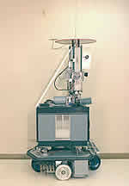
Shakey (1960)
Early AI-based robots used computer vision techniques to process visual information from cameras
Interpreting the structure of the environment from visual input involved complex processing and required a lot of deliberation
Shakey used state-of-the-art computer vision techniques to provide input to a planner and decide what to do next (how to move)

Slide 4
Planning
Planning:
Looking ahead at the outcomes of possible actions, searching for a sequence that would reach the goal
The world is represented as a set of states
A path is searched that takes the robot from the current state to the goal state
Searching can go from the goal backwards, or from the current state to the goal, or both ways
To select an optimal path we have to consider all possible paths and choose the best one

Slide 5
SPA Architectures
Deliberative, planner-based architectures involve the sequential execution of three functional steps:
Sensing (S)
Planning (P)
Acting (A), executing the plan
SPA has serious drawbacks for robotics

Slide 6
Drawback 1: Time-Scale
It takes a very long time to search in large state spaces
The combined inputs from a robot’s sensors:
Digital sensors: switches, IRs
Complex sensors: cameras, sonars, lasers
Analog sensors: encoders, gauges
+ representations ⇒ constitutes a large state space
Potential solutions:
Plan as rarely as possible
Use hierarchies of states

Slide 7
Drawback 2: Space
It may take a large amount of memory to represent and manipulate the robot’s state space representation
The representation must be as complete as possible to ensure a correct plan:
Distances, angles, landmarks, etc.
How do you know when to stop collecting information?
Generating a plan that uses this amount of information requires additional memory
Space is a lesser problem than time

Slide 8
Drawback 3: Information
The planner assumes that the representation of the state space is accurate and up-to-date
The representation must be updated and checked continuously
The more information, the better
Updating the world model also requires time

Slide 9
Drawback 4: Use of Plans
Any plan is useful only if:
The representation on which the plan was based is accurate
The environment does not change during the execution of the plan in a way that affects the plan
The robot’s effectors are accurate enough to perfectly execute the plan, in order to make the next step possible

Slide 10
Departure from SPA
Alternatives were proposed in the early 1980 as a reaction to these drawbacks: reactive, hybrid, behavior-based control
What happened to purely deliberative systems?
No longer used for physical mobile robots, because the combination of real-world sensors, effectors and time-scales makes them impractical
Still used effectively for problems where the environment is static, there is plenty of time to plan and the plan remains accurate: robot surgery, chess

Slide 11
SPA in Robotics
SPA has not been completely abandoned in robotics, but it was expanded
The following improvements can be made:
Search/planning is slow
⇒ saved/cache important and/or urgent decisions
Open-loop execution is bad
⇒ use closed-loop feedback and be ready to re-plan when the plan fails

Slide 12
Summary of Deliberative Control
Decompose control into functional modules: sense-world, generate-plan, translate-plan-to-actions
Modules are executed sequentially
Require extensive and slow reasoning computation
Encourage open-loop execution of generated plans

Slide 13
Hybrid Control
Idea: get the best of both worlds
Combine the speed of reactive control and the brains of deliberative control
Fundamentally different controllers must be made to work together
Time scales: short (reactive), long (deliberative)
Representations: none (reactive), elaborate world models (deliberative)
This combination is what makes these systems hybrid

Slide 14
Biological Evidence
Psychological experiments indicate the existence of two modes of behavior: willed and automatic
Norman and Shallice (1986) have designed a system consisting of two such modules:
Automatic behavior: action execution without awareness or attention, multiple independent parallel activity threads
Willed behavior: an interface between deliberate conscious control and the automatic system
Willed behavior:
Planning or decision making, troubleshooting, novel or poorly learned actions, dangerous/difficult actions, overcoming habit or temptation

Slide 15
Hybrid System Components
Typically, a hybrid system is organized in three layers:
A reactive layer
A planner
A layer that puts the two together
They are also called three-layer architectures or three-layer systems

Slide 16
The Middle Layer
The middle layer has a difficult job:
compensate for the limitations of both the planner and the reactive system
reconcile their different time-scales
deal with their different representations
reconcile any contradictory commands between the two
The main challenge of hybrid systems is to achieve the right compromise between the two layers

Slide 17
An Example
A robot that has to deliver medication to a patient in a hospital
Requirements:
Reactive: avoid unexpected obstacles, people, objects
Deliberative: use a map and plan short paths to destination
What happens if:
The robot needs to deliver medication to a patient, but does not have a plan to his room?
The shortest path to its destination becomes blocked?
The patient was moved to another room?
The robot always goes to the same room?

Slide 18
Bottom-up Communication
Dynamic Re-Planning
If the reactive layer cannot do its job
⇒ It can inform the deliberative layer
The information about the world is updated
The deliberative layer will generate a new plan
The deliberative layer cannot continuously generate new plans and update world information
⇒ the input from the reactive layer is a good indication of when to perform such an update

Slide 19
Top-Down Communication
The deliberative layer provides information to the reactive layer
Path to the goal
Directions to follow, turns to take
The deliberative layer may interrupt the reactive layer if better plans have been discovered
Partial plans can also be used when there is no time to wait for the complete solution
Go roughly in the correct direction, plan for the details when getting close to destination

Slide 20
Reusing Plans
Frequently planned decisions could be reused to avoid re-planning
These can be stored in an intermediate layer and can be looked up when needed
Useful when fast reaction is needed
These mini-plans can be stored as contingency tables
intermediate-level actions
macro operators: plans compiled into more general operators for future use

Slide 21
Universal Plans
Assume that we could pre-plan in advance for all possible situations that might come up
Thus, we could generate and store all possible plans ahead of time
For each situation a robot will have a pre-existing optimal plan, and will react optimally
It has a universal plan:
A set of all possible plans for all initial states and all goals within the robot’s state space
The system is a reactive controller!!

Slide 22
Applicability of Universal Plans
Examples have been developed as situated automata
Universal plans are not useful for the majority of real-world domains because:
The state space is too large for most realistic problems
The world must not change
The goals must not change
Disadvantages of pre-compiled systems
Are not flexible in the presence of changing environments, tasks or goals
It is prohibitively large to enumerate the state space of a real robot, and thus pre-compiling generally does not scale up to complex systems

Slide 23
Reaction – Deliberation Coordination
Selection:
Planning is viewed as configuration
Advising:
Planning is viewed as advice giving
Adaptation:
Planning is viewed as adaptation
Postponing:
Planning is viewed as a least commitment process

Slide 24
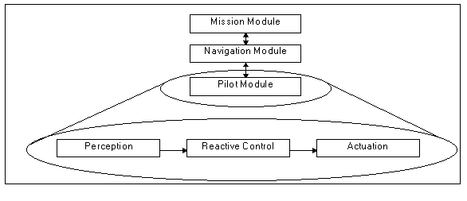
Selection Example: AuRA
Autonomous Robot Architecture (R. Arkin, ’86)
A deliberative hierarchical planner and a reactive controller based on schema theory
Mission planner
Interface to human
Spatial reasoner
A* planner
Plan sequencer
Rule-based system

Slide 25
Advising Example: Atlantis
E. Gat, Jet Propulsion Laboratory (1991)
Three layers:
Deliberator: planning and world
modeling
Sequencer: initiation and termination
of low-level activities
Controller: collection of primitive activities
Asynchronous, heterogeneous architecture
Controller implemented in ALFA (A Language for Action)
Introduces the notion of cognizant failure
Planning results view as advice, not decree
Tested on NASA rovers

Slide 26
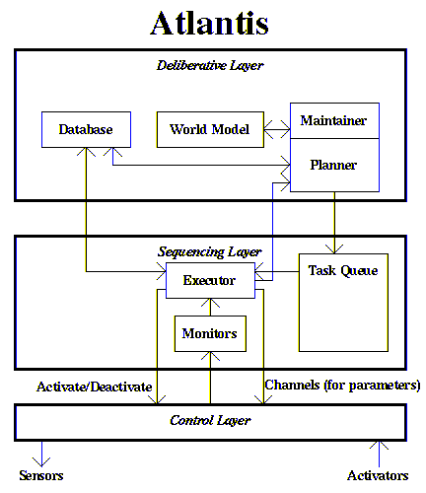
Atlantis Schematic

Slide 27
Adaptation Example: Planner-Reactor
D. Lyons (1992)
The planner continuously
modifies of the reactive control system
Planning is a form of reactor adaptation
Monitor execution, adapts control system based on environment changes and changes of the robot’s goals
Adaptation is on-line rather than off-line deliberation
Planning is used to remove performance errors when they occur and improve plan quality
Tested in assembly and grasp planning

Slide 28
Postponing Example: PRS
Procedural Reasoning System,
Georgeff and A. Lansky (1987)
Reactivity refers to
postponement of planning
until it is necessary
Information necessary to make a decision is assumed to become available later in the process
Plans are determined in reaction to current situation
Previous plans can be interrupted and abandoned at any time
Tested on SRI Flakey

Slide 29
TJ Robot at IBM
Hybrid Architecture for Robot Navigation & Mapping
http://www.youtube.com/watch?v=fQAnvfH3nZ8

Slide 30
BBS vs. Hybrid Control
Both BBS and Hybrid control have the same expressive and computational capabilities
Both can store representations and look ahead
BBS and Hybrid Control have different niches in the set of application domains
BBS: multi-robot domains, hybrid systems: single-robot domain
Hybrid systems:
Environments and tasks where internal models and planning can be employed, and real-time demands are few
Behavior-based systems:
Environments with significant dynamic changes, where looking ahead would be required

Slide 31
Readings
M. Matarić: Chapter 11, 12, 14

