Slide 1
Autonomous Mobile Robots
CPE 470/670
Lecture 12
Instructor: Monica Nicolescu

Slide 2
Learning & Adaptive Behavior
Learning produces changes within an agent that over time enable it to perform more effectively within its environment
Adaptation refers to an agent’s learning by making adjustments in order to be more attuned to its environment
  Phenotypic (within an individual agent) or genotypic (evolutionary)
  Acclimatization (slow) or homeostasis (rapid)

Slide 3
Learning
Learning can improve performance in additional ways:
Introduce new knowledge (facts, behaviors, rules)
Generalize concepts
Specialize concepts for specific situations
Reorganize information
Create or discover new concepts
Create explanations
Reuse past experiences

Slide 4
Learning Methods
Reinforcement learning
Neural network (connectionist) learning
Evolutionary learning
Learning from experience
  Memory-based
  Case-based
Learning from demonstration
Inductive learning
Explanation-based learning
Multistrategy learning

Slide 5
Reinforcement Learning (RL)
Motivated by psychology (the Law of Effect, Thorndike 1991):
Applying a reward immediately after the occurrence of a response increases its probability of reoccurring, while providing punishment after the response will decrease the probability
One of the most widely used methods for adaptation in robotics

Slide 6
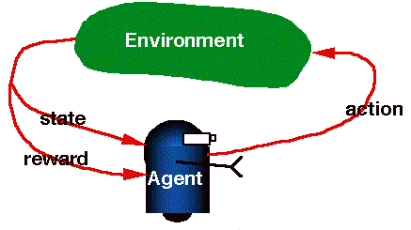
Reinforcement Learning
Goal: learn an optimal policy that chooses the
best action for every set of possible inputs
Policy: state/action mapping that determines
which actions to take
Desirable outcomes are strengthened and undesirable outcomes are weakened
Critic: evaluates the system’s response and applies reinforcement
  external: the user provides the reinforcement
  internal: the system itself provides the reinforcement (reward function)

Slide 7
Unsupervised Learning
RL is an unsupervised learning method:
  No target goal state
Feedback only provides information on the quality of the system’s response
  Simple: binary fail/pass
  Complex: numerical evaluation
Through RL a robot learns on its own, using its own experiences and the feedback received
The robot is never told what to do

Slide 8
Challenges of RL
Credit assignment problem:
  When something good or bad happens, what exact state/condition-action/behavior should be rewarded or punished?
Learning from delayed rewards:
  It may take a long sequence of actions that receive insignificant reinforcement to finally arrive at a state with high reinforcement
  How can the robot learn from reward received at some time in the future?

Slide 9
Challenges of RL
Exploration vs. exploitation:
  Explore unknown states/actions or exploit states/actions already known to yield high rewards
Partially observable states
  In practice, sensors provide only partial information about the state
  Choose actions that improve observability of environment
Life-long learning
  In many situations it may be required that robots learn several tasks within the same environment

Slide 10
Learning to Walk
Maes, Brooks (1990)
Genghis: hexapod robot
Learned stable tripod
stance and tripod gait
Rule-based subsumption
controller
Two sensor modalities for feedback:
  Two touch sensors to detect hitting the floor: - feedback
  Trailing wheel to measure progress: + feedback

Slide 11
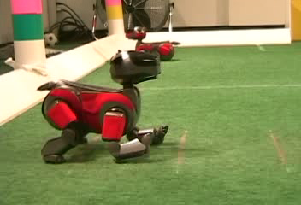
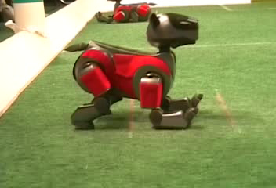
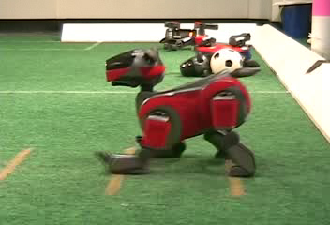
Learning to Walk
Nate Kohl & Peter Stone (2004)

Slide 12
Supervised Learning
Supervised learning requires the user to give the exact solution to the robot in the form of the error direction and magnitude
The user must know the exact desired behavior for each situation
Supervised learning involves training, which can be very slow; the user must supervise the system with numerous examples

Slide 13
Neural Networks
One of the most used supervised learning methods
Used for approximating real-valued and vector-valued target functions
Inspired from biology: learning systems are built from complex networks of interconnecting neurons
The goal is to minimize the error between the network output and the desired output
  This is achieved by adjusting the weights on the network connections

Slide 14
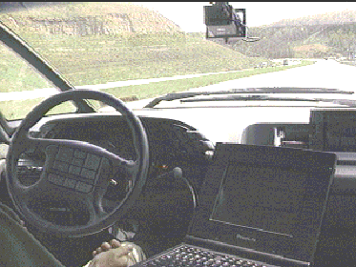
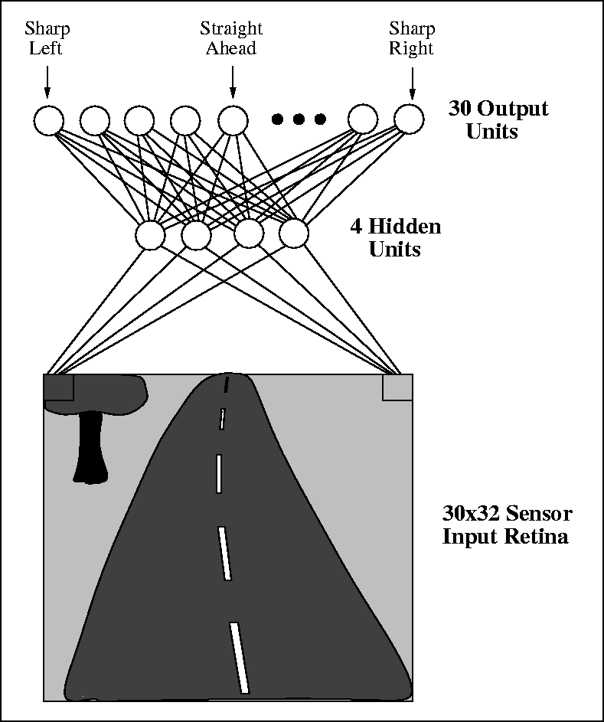

ALVINN
ALVINN (Autonomous Land Vehicle in a Neural Network)
Dean Pomerleau (1991)
Pittsburg to San Diego: 98.2% autonomous

Slide 15
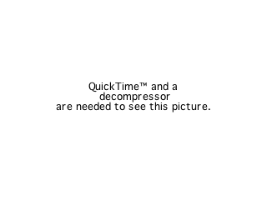
Learning from Demonstration & RL
S. Schaal (’97)
Pole balancing, pendulum-swing-up

Slide 16
Classical Conditioning
Pavlov 1927
Assumes that unconditioned stimuli (e.g. food) automatically generate an unconditioned response (e.g., salivation)
Conditioned stimulus (e.g., ringing a bell) can, over time, become associated with the unconditioned response

Slide 17

Darvin’s Perceptual Categorization
Early training
After the 10th stimulus
Two types of stimulus blocks
  6cm metallic cubes
  Blobs: low conductivity (“bad taste”)
  Stripes: high conductivity (“good taste”)
Instead of hard-wiring stimulus-response rules, develop these associations over time

Slide 18
Genetic Algorithms
Inspired from evolutionary biology
Individuals in a populations have a particular fitness with respect to a task
Individuals with the highest fitness are kept as survivors
Individuals with poor performance are discarded: the process of natural selection
Evolutionary process: search through the space of solutions to find the one with the highest fitness

Slide 19
Genetic Operators
Knowledge is encoded as bit strings: chromozome
  Each bit represents a “gene”
Biologically inspired operators are applied to yield better generations

Slide 20
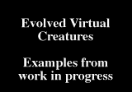
Evolving Structure and Control
Karl Sims 1994
Evolved morphology and control
for virtual creatures performing
swimming, walking, jumping,
and following
Genotypes encoded as directed graphs are used to produce 3D kinematic structures
Genotype encode points of attachment
Sensors used: contact, joint angle and photosensors
Video: http://www.youtube.com/watch?v=JBgG_VSP7f8

Slide 21
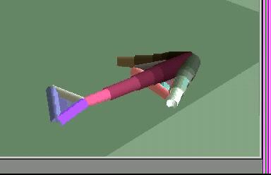
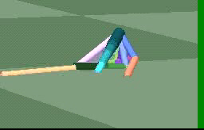
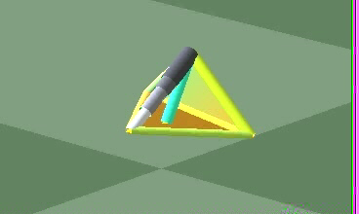
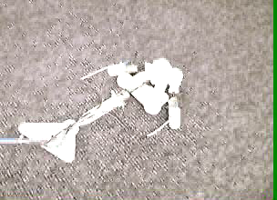
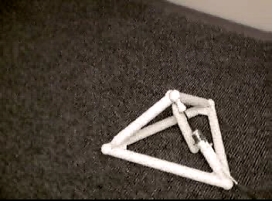
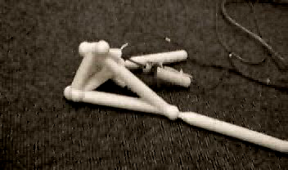
Evolving Structure and Control
Jordan Pollak
  Real structures

Slide 22
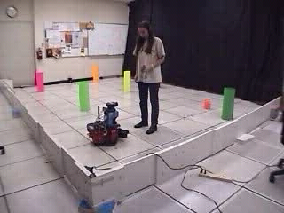
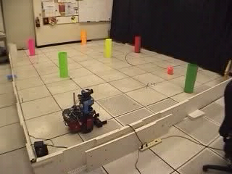
Learning from Demonstration
Inspiration:
Human-like teaching by demonstration
Multiple means for interaction and learning: concurrent use of demonstration, verbal instruction, attentional cues, gestures, etc.
Solution:
Instructive demonstrations, generalization and practice
Demonstration
Robot performance

Slide 23
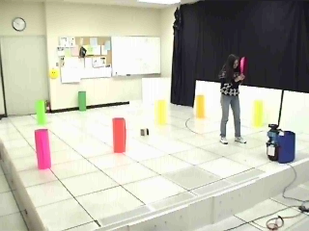
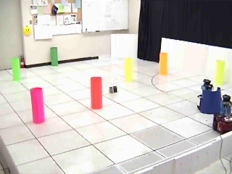
Robot Learning from other Robot Teachers
Transfer of task knowledge from humans to robots, between heterogeneous robots
Human demonstration
Robot performance

Slide 24
Multirobot Systems
Motivation
  the task complexity is too high for a single robot
  the task is inherently distributed
  building several resource-bounded
  robots is much easier than having a
  single powerful robot
  multiple robots can solve problems faster
  the introduction of multiple robots increases robustness through redundancy

Slide 25
Multirobot Systems – Control Approaches
Collective swarms
  robots execute their own tasks with only minimal need for knowledge about other robot team members
  homogeneous teams
  little explicit communication among robots
Intentionally cooperative systems
  have knowledge of the presence of other robots in the environment and act together to accomplish the same goal
  strongly cooperative solutions: robots act in concert to achieve the goal, executing tasks that are not trivially serializable (require some type of communication and synchronization among the robots.
  weakly cooperative solutions: robots have periods of operational independence
  heterogeneous teams

Slide 26
Architectures for Robot Teams
How is group behavior generated from the control architectures of the individual robots in the team?
Several approaches
  centralized: coordinate the entire team from a single point of control
  hierarchical: each robot oversees the actions of a relatively small group of other robots
  decentralized: robots to take actions based only on knowledge local to their situation
  hybrid: combine local control with higher-level control approaches

Slide 27
Communication in Multirobot Systems
Global solutions should be achieved through interaction of robots lacking global information
Implicit communication through the world (stigmergy)
  robots sense the effects of teammate’s actions through their effects on the world
Passive action recognition
  robots use sensors to directly observe the actions of their teammates
Explicit (intentional) communication
  robots directly and intentionally communicate relevant information through some active means, such as radio

Slide 28
Task Allocation
Each task can be worked on by different robots; each robot can work on a variety of different tasks
Taxonomy (Gerkey & Matarić 2004)
  Single robot tasks (SR): require only one robot at a time
  Multirobot tasks (MR): require more than one robot working on the same task at the same time
  Single task robots (ST): work on only one task at a time
  Multitask robots (MT): work on multiple tasks at a time
  Instantaneous Allocation (IA): optimize the instantaneous allocation
  Time-extended Allocation (TA): optimize the assignments into the future

Slide 29
Task Allocation
ST-SR-IA: single-robot tasks are assigned once to single-task robots
ST-SR-IA: the easiest - can be solved in polynomial time as an instance of the optimal assignment problem
ST-MR-IA variant is an instance of the set partitioning problem, which is NP-hard
ST-MR-TA, MT-SR-IA, and MT-SR-TA are also NP-hard
Most approaches to task allocation in multirobot teams generate approximate solutions

Slide 30
Readings
M. Matarić: Chapters 17, 18

