Slide 1
Autonomous Mobile Robots
CpE 470/670
Lecture 2
Instructor: Monica Nicolescu

Slide 2
Review
Definitions
  Robots, robotics
Robot components
  Sensors, actuators, control
State, state space
Representation
Spectrum of robot control
  Reactive, deliberative

Slide 3
Robot Control
Robot control is the means by which the sensing and action of a robot are coordinated
The infinitely many possible robot control programs all fall along a well-defined control spectrum
The spectrum ranges from reacting to deliberating

Slide 4
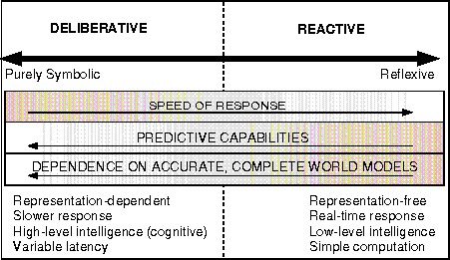
Spectrum of robot control
From “Behavior-Based Robotics” by R. Arkin, MIT Press, 1998

Slide 5
Robot control approaches
Reactive Control
  Don’t think, (re)act.
Deliberative (Planner-based) Control
  Think hard, act later.
Hybrid Control
  Think and act separately & concurrently.
Behavior-Based Control (BBC)
  Think the way you act.

Slide 6
Thinking vs. Acting
Thinking/Deliberating
  involves planning (looking into the future) to avoid bad solutions
  flexible for increasing complexity
  slow, speed decreases with complexity
  thinking too long may be dangerous
  requires (a lot of) accurate information
Acting/Reaction
  fast, regardless of complexity
  innate/built-in or learned (from looking into the past)
  limited flexibility for increasing complexity

Slide 7
How to Choose a Control Architecture?
For any robot, task, or environment consider:
  Is there a lot of sensor noise?
  Does the environment change or is static?
  Can the robot sense all that it needs?
  How quickly should the robot sense or act?
  Should the robot remember the past to get the job done?
  Should the robot look ahead to get the job done?
  Does the robot need to improve its behavior and be able to learn new things?

Slide 8
Reactive Control:
Don’t think, react!
Technique for tightly coupling perception and action to provide fast responses to changing, unstructured environments
Collection of stimulus-response rules
Limitations
  No/minimal state
  No memory
  No internal representations
  of the world
  Unable to plan ahead
  Unable to learn
Advantages
  Very fast and reactive
  Powerful method: animals are largely reactive

Slide 9
Deliberative Control:
Think hard, then act!
In DC the robot uses all the available sensory information and stored internal knowledge to create a plan of action: sense → plan → act (SPA) paradigm
Limitations
  Planning requires search through potentially all possible plans ⇒ these take a long time
  Requires a world model, which may become outdated
  Too slow for real-time response
Advantages
  Capable of learning and prediction
  Finds strategic solutions

Slide 10
Hybrid Control:
Think and act independently & concurrently!
Combination of reactive and deliberative control
  Reactive layer (bottom): deals with immediate reaction
  Deliberative layer (top): creates plans
  Middle layer: connects the two layers
Usually called “three-layer systems”
Major challenge: design of the middle layer
  Reactive and deliberative layers operate on very different time-scales and representations (signals vs. symbols)
  These layers must operate concurrently
Currently one of the two dominant control paradigms in robotics

Slide 11
Behavior-Based Control:
Think the way you act!
An alternative to hybrid control, inspired from biology
Has the same capabilities as hybrid control:
  Act reactively and deliberatively
Also built from layers
  However, there is no intermediate layer
  Components have a uniform representation and time-scale
  Behaviors: concurrent processes that take inputs from sensors and other behaviors and send outputs to a robot’s actuators or other behaviors to achieve some goals

Slide 12
Behavior-Based Control:
Think the way you act!
“Thinking” is performed through a network of behaviors
Utilize distributed representations
Respond in real-time
  are reactive
Are not stateless
  not just reactive
Allow for a variety of behavior coordination mechanisms

Slide 13
Fundamental Differences of Control
Time-scale: How fast do things happen?
  How quickly the robot has to respond to the environment, compared to how quickly it can sense and think
Modularity: What are the components of the control system?
  Refers to the way the control system is broken up into modules and how they interact with each other
Representation: What does the robot keep in its brain?
  The form in which information is stored or encoded in the robot

Slide 14
A Brief History of Robotics
Robotics grew out of the fields of control theory, cybernetics and AI
Robotics, in the modern sense, can be considered to have started around the time of cybernetics (1940s)
Early AI had a strong impact on how it evolved (1950s-1970s), emphasizing reasoning and abstraction, removal from direct situatedness and embodiment
In the 1980s a new set of methods was introduced and robots were put back into the physical world

Slide 15
Control Theory
The mathematical study of the properties of automated control systems
  Helps understand the fundamental concepts governing all mechanical systems (steam engines, aeroplanes, etc.)
Feedback: measure state and take an action based on it
  Idea: continuously feeding back the current state and comparing it to the desired state, then adjusting the current state to minimize the difference (negative feedback).
  The system is said to be self-regulating
E.g.: thermostats
  if too hot, turn down, if too cold, turn up

Slide 16
Control Theory through History
Thought to have originated with the ancient Greeks
  Time measuring devices (water clocks), water systems
Forgotten and rediscovered in Renaissance Europe
  Heat-regulated furnaces (Drebbel, Reaumur, Bonnemain)
  Windmills
James Watt’s steam engine (the governor)

Slide 17
Cybernetics
Pioneered by Norbert Wiener in the 1940s
  Comes from the Greek word “kibernts” – governor, steersman
Combines principles of control theory, information science and biology
Sought principles common to animals and machines, especially with regards to control and communication
Studied the coupling between an organism and its environment

Slide 18
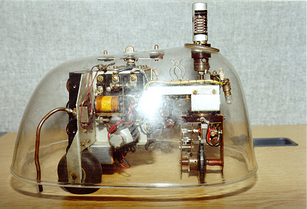
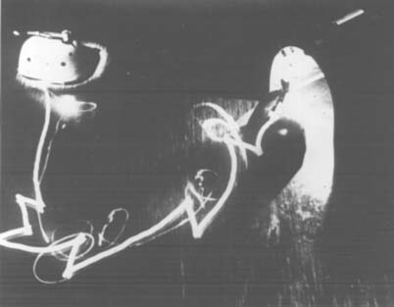
W. Grey Walter’s Tortoise
“Machina Speculatrix” (1953)
  1 photocell, 1 bump sensor, 3 motor, 3 wheels, 1 battery
Behaviors:
  seek light
  head toward moderate light
  back from bright light
  turn and push
  recharge battery
Uses reactive control, with behavior prioritization
http://www.youtube.com/watch?v=lLULRlmXkKo

Slide 19
Principles of Walter’s Tortoise
Parsimony
  Simple is better
Exploration or speculation
  Never stay still, except when feeding (i.e., recharging)
Attraction (positive tropism)
  Motivation to move toward some object (light source)
Aversion (negative tropism)
  Avoidance of negative stimuli (heavy obstacles, slopes)
Discernment
  Distinguish between productive/unproductive behavior (adaptation)

Slide 20
Braitenberg Vehicles
Valentino Braitenberg (1980)
Thought experiments
  Use direct coupling between sensors and motors
  Simple robots (“vehicles”) produce complex behaviors that appear very animal, life-like
Excitatory connection
  The stronger the sensory input, the stronger the motor output
  Light sensor → wheel: photophilic robot (loves the light)
Inhibitory connection
  The stronger the sensory input, the weaker the motor output
  Light sensor → wheel: photophobic robot (afraid of the light)

Slide 21
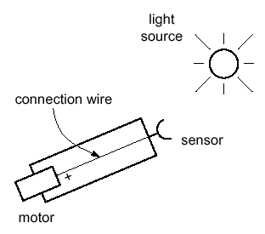
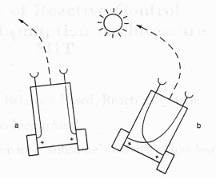
Example Vehicles
Wide range of vehicles can be designed, by changing the connections and their strength
Vehicle 1:
  One motor, one sensor
Vehicle 2:
  Two motors, two sensors
  Excitatory connections
Vehicle 3:
  Two motors, two sensors
  Inhibitory connections
Vehicle 1
Being “ALIVE”
“FEAR” and “AGGRESSION”
Vehicle 2
“LOVE”

Slide 22
Artificial Intelligence
Officially born in 1955 at Dartmouth University
  Marvin Minsky, John McCarthy, Herbert Simon
Intelligence in machines
  Internal models of the world
  Search through possible solutions
  Plan to solve problems
  Symbolic representation of information
  Hierarchical system organization
  Sequential program execution

Slide 23
AI and Robotics
AI influence to robotics:
  Knowledge and knowledge representation are central to intelligence
Perception and action are more central to robotics
New solutions developed: behavior-based systems
  “Planning is just a way of avoiding figuring out what to do next” (Rodney Brooks, 1987)
Distributed AI (DAI)
  Society of Mind (Marvin Minsky, 1986): simple, multiple agents can generate highly complex intelligence
First robots were mostly influenced by AI (deliberative)

Slide 24
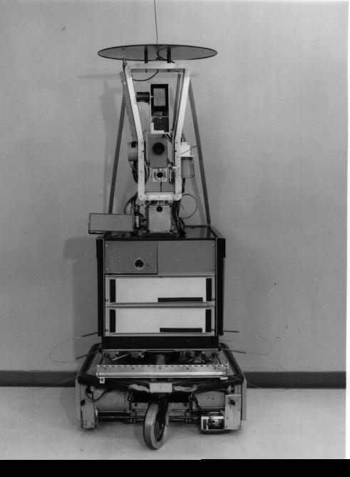
Shakey
At Stanford Research Institute (late 1960s)
A deliberative system
Visual navigation in a very special world
STRIPS planner
Vision and contact sensors
http://www.youtube.com/watch?v=qXdn6ynwpiI

Slide 25
Readings
M. Matarić: Chapters 2, 4, 11

