Slide 1
Autonomous Mobile Robots
CPE 470/670
Lecture 4
Instructor: Monica Nicolescu

Slide 2
Review
DC motors
  inefficiencies, operating voltage and current, stall voltage and current and torque
  current and work of a motor
Gearing
  Up, down, combining gears
Servo motors
Effectors
  DOF
  Locomotion: holonomicity, stability

Slide 3
Stability
Robots need to be stable to get their job done
Stability can be
  Static: the robot can stand still without falling over
  Dynamic: the body must actively balance or move to remain stable
Static stability is achieved through the mechanical design of the robot
Dynamic stability is achieved through control

Slide 4
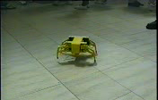
Statically Stable Walking
If the robot can walk while staying balanced at all times it is statically stable walking
There need to be enough legs to keep the robot stable
  Three legged robots are not statically stable
  Four legged robots can only lift one leg at a time
    Slow walking pace, energy inefficient
  Six legs are very popular (both in nature and in robotics) and allow for very stable walking

Slide 5
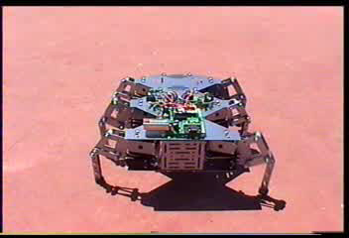
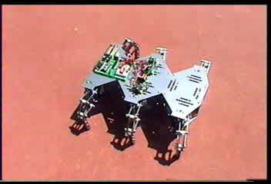
Tripod Gait
Gait: the particular order in which a robot/animal lifts and lowers its legs to move
Tripod gait
  keep 3 legs on the ground while other 3 are moving
The same three legs move at a time ⇒ alternating tripod gait
Wave-like motion
⇒ ripple gait
Tripod Gait
Ripple Gait

Slide 6

Biologically Inspired Walking
Numerous six-legged insects (cockroaches) use the alternating tripod gait
Arthropods (centipedes,
millipedes) use ripple gait
Statically stable walking is
slow and inefficient
Bugs typically use more efficient walking
  Dynamically stable gaits
  They become airborne at times, gaining speed at the expense of stability

Slide 7
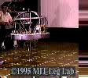

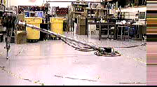
Dynamic Stability
Allows for greater speed and efficiency, but requires more complex control
Enables a robot to stay up while moving, however the robot cannot stop and stay upright
Dynamic stability requires active control
  the inverse pendulum problem

Slide 8
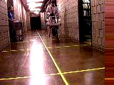
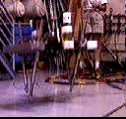
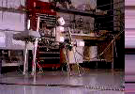
Quadruped Gaits
Trotting gait
  diagonal legs as pairs
Pacing gait
  lateral pairs
Bounding
  front pair and rear pair
MIT Cheetah
https://www.youtube.com/watch?v=XMKQbqnXXhQ

Slide 9
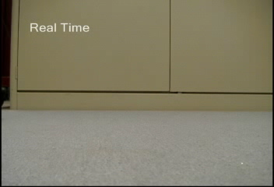
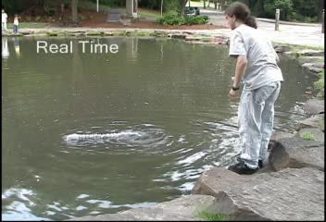
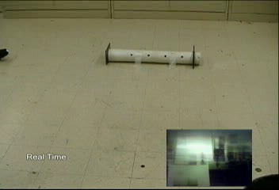
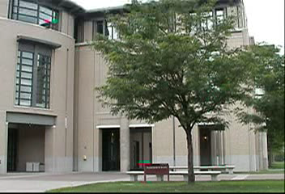
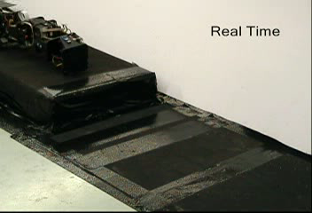
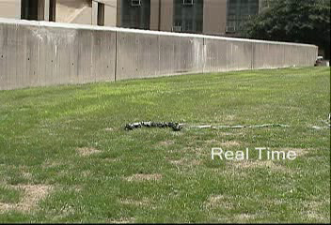
Snake Locomotion
Crawling
Swiming
Pipe
Climbing
Stairs
Rolling

Slide 10
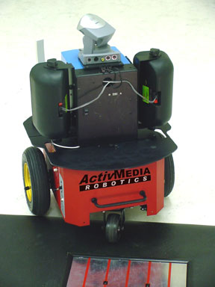
Wheels
Wheels are the locomotion effector of choice in robotics
  Simplicity of control
  Stability
Most robots have four wheels or two
wheels and a passive caster for balance
  Such models are non-holonomic

Slide 11
Differential Drive & Steering
Wheels can be controlled in different ways
Differential drive
  Two or more wheels can be driven separately and differently
Differential steering
  Two or more wheels can be steered separately and differently
Why is this useful?
  Turning in place: drive wheels in different directions
  Following arbitrary trajectories

Slide 12
Getting There
Robot locomotion is necessary for
  Getting the robot to a particular location
  Having the robot follow a particular path
Path following is more difficult than getting to a destination
Some paths are impossible to follow
  This is due to non-holonomicity
Some paths can be followed, but only with discontinuous velocity (stop, turn, go)
  Parallel parking

Slide 13
Why Follow Trajectories?
Autonomous car driving
Surgery
Trajectory (motion) planning
  Searching through all possible trajectories and evaluating them based on some criteria (shortest, safest, most efficient)
  Computationally complex process
  Robot shape (geometry) must be taken into account
Depending on application, robots may not be so concerned with following specific trajectories

Slide 14
Manipulation
Manipulation: moving a part of the robot (manipulator arm) to a desired location and orientation in 3D
The end-effector is the extreme part of the manipulator that affects the world
Manipulation has numerous challenges
  Getting there safely: should not hurt others or hurt yourself
  Getting there effectively
Manipulation started with tele-operation

Slide 15
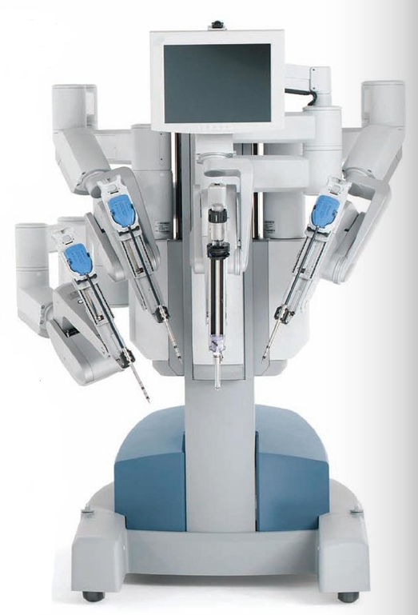
Teleoperation
Requires a great deal of skill from
the human operator
  Manipulator complexity
  Interface constraints (joystick, exoskeleton)
  Sensing limitations
Applications in robot-assisted surgery
da Vinci Robotic Surgical System

Slide 16
Kinematics
Kinematics: correspondence between what the actuator does and the resulting effector motion
  Manipulators are typically composed of several links connected by joints
  Position of each joint is given as angle
  w.r.t adjacent joints
  Kinematics encode the rules describing
  the structure of the manipulator
Find where the end-point is, given the joint angles of a robot arm

Slide 17
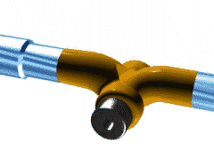
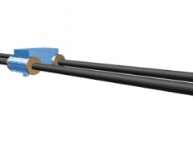
Types of Joints
There are two main types of joints
Rotary
  Rotational movement around a fixed axis
Prismatic
  Linear movement

Slide 18
Inverse Kinematics
To get the end-effector to a desired point one needs to plan a path that moves the entire arm safely to the goal
  The end point is in Cartesian space (x, y, z)
  Joint positions are in joint space (angle Θ)
Inverse Kinematics: converting from Cartesian (x, y, z) position to joint angles of the arm (theta)
Given the goal position, find the joint angles for the robot arm
This is a computationally intensive process

Slide 19
Sensors
Physical devices that provide information about the world
Based on the origin of the received stimuli we have:
  Proprioception: sensing internal state - stimuli arising from within the agent (e.g., muscle tension, limb position)
  Exteroception: sensing external state – external stimuli (e.g., vision, audition, smell, etc.)
The ensemble of proprioceptive
and exteroceptive sensors
constitute the robot’s perceptual
system

Slide 20
Sensor Examples
Physical Property
Sensor
contact
switch
distance
ultrasound, radar, infrared
light level
photocells, cameras
sound level
microphone
rotation
encoders and potentiometers
acceleration
accelerometers, gyroscopes

Slide 21
More Sensor Examples
Physical Property
Sensor
magnetism
compass
smell
chemical
temperature
thermal, infra red
inclination
inclinometers, gyroscopes
pressure
pressure gauges
altitude
altimeters

Slide 22
Knowing what’s Going On
Perceiving environmental state is crucial for the survival or successful achievement of goals
Why is this hard?
  Environment is dynamic
  Only partial information about the world is available
  Sensors are limited and noisy
  There is a lot of information to be perceived
Sensors do not provide state
Sensors are physical devices that measure physical quantities

Slide 23
Types of Sensors
Sensors provide raw measurements that need to be processed
Depending on how much information they provide, sensors can be simple or complex
Simple sensors:
  A switch: provides 1 bit of information (on, off)
Complex sensors:
  A camera: 512x512 pixels
  Human retina: more than a hundred million photosensive elements

Slide 24
Getting Answers From Sensors
Given a sensory reading, what should I do?
  Deals with actions in the world
Given a sensory reading, what was the world like when the reading was taken?
  Deals with reconstruction of the world
Simple sensors can answer the first question
  Their output can be used directly
Complex sensors can answer both questions
  Their information needs to be processed

Slide 25
Signal to Symbol Problem
Sensors produce only signals, not symbolic descriptions of the world
To extract the information necessary for making intelligent decisions a lot of sensor pre-processing is needed
  Symbols are abstract representations of the sensory data
Sensor pre-processing
  Uses methods from electronics, signal processing and computation

Slide 26
Levels of Processing
Finding out if a switch is open or closed
  Measure voltage going through the circuit ⇒ electronics
Using a microphone to recognize voice
  Separate signal from noise, compare with store voices for recognition ⇒ signal processing
Using a surveillance camera
  Find people in the image and recognize intruders, comparing them to a large database ⇒ computation

Slide 27
Perception Designs
Historically perception has been treated in isolation
  perception in isolation
  perception as “king”
  perception as reconstruction
Generally it is not a good idea to separate:
  What the robot senses
  How it senses it
  How it processes it
  How it uses it

Slide 28
A Better Way
Instead it is good to think about it as a single complete design
  The task the robot has to perform
  The best suited sensors for the task
  The best suited mechanical design that would allow the robot to get the necessary sensory information for the task (e.g. body shape, placement of the sensors)

Slide 29
A New Perceptual Paradigm
Perception without the context of actions is meaningless
Action-oriented perception [Demo]
  How can perception provide the information necessary for behavior?
  Perceptual processing is tuned to meet motor activity needs
  World is viewed differently based on the robot’s intentions
  Only the information necessary for the task is extracted
Active perception
  How can motor behaviors support perceptual activity?
  Motor control can enhance perceptual processing
  Intelligent data acquisition, guided by feedback and a priori knowledge

Slide 30
Using A Priori Knowledge of the World
Perceptual processing can benefit if knowledge about the world is available
Expectation-based perception (what to look for)
  Knowledge of the world constraints the interpretation of sensors
Focus of attention methods (where to look for it)
  Knowledge can constrain where things may appear
Perceptual classes (how to look for it)
  Partition the world into categories of interaction

Slide 31
Sensor Fusion
A man with a watch knows what time it is;
a man with two watches isn’t so sure
Combining multiple sensors to get better information about the world
Sensor fusion is a complex process
  Different sensor accuracy
  Different sensor complexity
  Contradictory information
  Asynchronous perception
Cleverness is needed to put this information together

Slide 32
Neuroscientific Evidence
Our brain process information from multiple sensory modalities
  Vision, touch, smell, hearing, sound
Individual sensory modalities use separate regions in the brain (sight, hearing, touch)
Vision itself uses multiple regions
  Two main vision streams: the “what” (object recognition) and the “where” (position information)
  Pattern, color, movement, intensity, orientation

Slide 33
Readings
M. Matarić: Chapters 7, 8

