Slide 1
Autonomous Mobile Robots
CPE 470/670
Lecture 5
Instructor: Monica Nicolescu

Slide 2
Review
Effectors
  Manipulation: direct and inverse kinematics
Sensors
  Simple, complex
  Proprioceptive, exteroceptive
Perception
  Treat the problem in combination with actions

Slide 3
Neuroscientific Evidence
Our brain process information from multiple sensory modalities
  Vision, touch, smell, hearing, sound
Individual sensory modalities use separate regions in the brain (sight, hearing, touch)
Vision itself uses multiple regions
  Two main vision streams: the “what” (object recognition) and the “where” (position information)
  Pattern, color, movement, intensity, orientation

Slide 4
What Can We Learn from Biology?
Sensor function should decide its form
Evolved sensors have specific geometric and mechanical properties
Examples
  Flies: complex facetted eyes
  Birds: polarized light sensors
  Bugs: horizon line sensors
  Humans: complicated auditory systems
Biology uses clever designs to maximize the sensor’s perceptual properties, range and accuracy

Slide 5
Psychological Insights: Affordances
Affordances: refer to the meaning of objects in relation to an organism’s motor intents
Perceptual entities are not semantic abstractions, but opportunities that the environment presents
Perception is biased by the robot’s task
A chair:
  Something to sit in
  Something blocking the way
  Something to throw if attacked

Slide 6
How Would You Detect People?
Use the interaction with the world, keep in mind the task
Camera: great deal of processing
Movement: if everything else is static: movement means people
Color: If you know the particular color people wear
Temperature: can use sensors that detect the range of human body heat
Distance: If any open-range becomes blocked

Slide 7
How Would You Measure Distance?
Ultrasound sensors (sonar) provide distance measurement directly (time of flight)
Infra red sensors provide return signal intensity
Two cameras (i.e., stereo) can be used to compute distance/depth
A laser and a camera: triangulate distance
Laser-based structured light: overly grid patterns on the world, use distortions to compute distance

Slide 8
Sensor Categories
Passive Sensors
  Measure a physical property from the environment
Active Sensors
  Provide their own signal and use the interaction of the signal with the environment
  Consist of an emitter and a detector
Sensor complexity
  Determined by the amount of processing required
Active/passive
  Determined by the sensor mechanism

Slide 9
Classification of Sensors
General classification (typical use) | Sensor System | PC proprioceptive EC exteroceptive | A active P passive
Tactile sensors (physical contact or closeness) | Contact switches Optical barriers Noncontact proximity sensors | EC EC EC | P A A
Wheel/motor sensors (wheel/motor speed and position) | Brush encoders Potentiometers Synchros, resolvers Optical encoders Magnetic encoders Inductive encoders Capacitive encoders | PC PC PC PC PC PC PC | P P A A A A A
Heading sensors (orientation of the robot in relation to a fixed reference frame) | Compass Gyroscopes Inclinometers | EC PC EC | P P A/P

Slide 10
Classification of Sensors
General classification (typical use) | Sensor System | PC proprioceptive EC exteroceptive | A active P passive
Ground-based beacons (localization in a fixed reference frame) | GPS Active optical or RF beacons Active ultrasonic beacons Reflective beacons | EC EC EC EC | A A A A
Active ranging (reflectivity, time-of-flight, geometric triangulation) | Reflectivity sensors Ultrasonic sensor Laser rangefinder Optical triangulation (1D) Structured light (2D) | EC EC EC EC EC | A A A A A
Motion/speed sensors (speed relative to fixed or moving objects) | Doppler radar Doppler sound | EC EC | A A
Vision-based sensors (visual ranging, whole –image analysis, segmentation, object recognition) | CCD/CMOS camera(s) Visual ranging packages Object tracking packages | EC | P

Slide 11


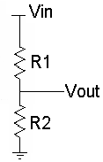
Electronics for Simple Sensors
Ohm’s law
  Explains the relationship between voltage (V), current (I) and resistance (R)
Series resistance
  Resistances in series add up
Voltage divider
  Voltage can be divided by using two resistors in
  series
V = IR
V_{in} = I(R₁ + R₂)
V_{out} = V_{in} R₂/(R₁ + R₂)

Slide 12
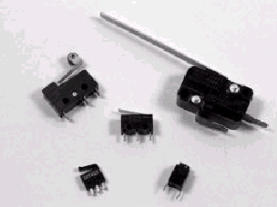

Switch Sensors
Among the simplest sensors of all
Do not require processing, work at “circuit” level
If the switch is open ⇒ there is no current flowing
If the switch is closed ⇒ current will flow
Can be
  Normally open (more common)
  Normally closed

Slide 13
Uses of Switch Sensors
Contact sensors:
  detect contact with another object (e.g., triggers when a robot hits a wall or grabs an object, etc.)
Limit sensors:
  detect when a mechanism has moved to the end of its range (e.g., triggers when a gripper is wide open)
Shaft encoder sensors:
  detect how many times a shaft turns (e.g., a switch clicks at every turn, clicks are counted)

Slide 14
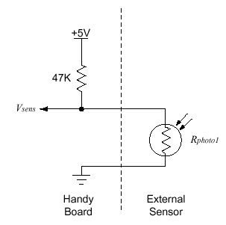
Light Sensors
Light sensors measure the amount of light impacting a photocell
The sensitivity of the photocell to light is reflected in changes in resistance
  Low when illuminated V_{sens}
  High when in the dark: V_{sens}
Light sensors are “dark” sensors
Could invert the output so that low means dark and high means bright
~= 0v
~= +5 v

Slide 15
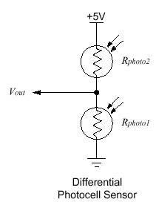
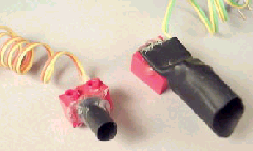
Uses of Light Sensors
Can measure the following properties
  Light intensity: how light/dark it is
  Differential intensity: difference between photocells
  Break-beams: changes in intensity
Photocells can be shielded to improve accuracy and range
  R_{photo2} = R_{photo1}
  V_{out} = 2.5 v
  R_{photo2} << R_{photo1}
  V_{out} ~= +5 v (R2 more light)
  R_{photo2} >> R_{photo1}
  V_{out} ~= gnd

Slide 16
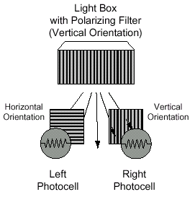
Polarized Light
Waves in normal light travel in all directions
A polarizing filter will only let light in a specified direction ⇒ polarized light
Why is it useful?
  Distinguish between different light sources
  Can tell if the robot is pointed at a light beacon
  One photocell will receive only ambient light, while the other receives both ambient and source light
  In the absence of filters both photocells would receive the same amount of light

Slide 17
Polarized Light Sensors
Filters can be combined to select various directions and amounts of light
Polarized light can be used by placing polarizing filters:
  at the output of a light source (emitter)
  at the input of a photocell (receiver)
Depending on whether the filters add (pass through) or subtract (block) the light, various effects can be achieved

Slide 18
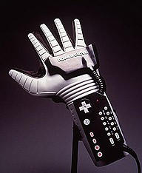
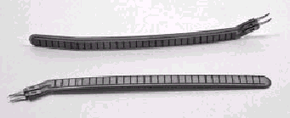
Resistive Position Sensors
Finger flexing in Nintendo PowerGlove
In robotics: useful for contact sensing
and wall-tracking
Electrically, the bend sensor is a
simple resistance
The resistance of a material increases as it is bent
The bend sensor is less robust than a light sensor, and requires strong protection at its base, near the electrical contacts
Unless the sensor is well-protected from direct forces, it will fail over time

Slide 19
Biological Analogs
All of the sensors we have seen so far exist in biological systems
Touch/contact sensors with much more precision and complexity in all species
Polarized light sensors in insects and birds
Bend/resistance receptors in muscles
and many more...

Slide 20
Active Sensors
Active sensors provide their own signal/stimulus (and thus the associated source of energy)
reflectance
break-beam
infra red (IR)
ultrasound (sonar)
others

Slide 21
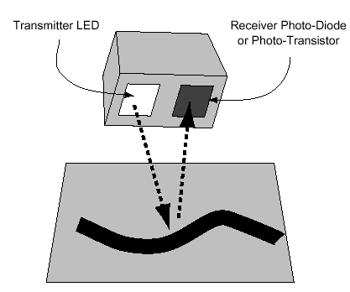
Reflective Optosensors
Include a source of light emitter (light emitting diodes LED) and a light detector (photodiode or phototransistor)
Two arrangements, depending on the positions of the emitter and detector
  Reflectance sensors: Emitter and detector are side by side; Light reflects from the object back into the detector
  Break-beam sensors: The emitter and detector face each other; Object is detected if light between them is interrupted

Slide 22
Photocells vs. Phototransistors
Photocells
  easy to work with, electrically they are just resistors
  their response time is slow
  suitable for low frequency applications (e.g., detecting when an object is between two fingers of a robot gripper)
Reflective optosensors (photodiode or phototransistor)
  rapid response time
  more sensitive to small levels of light, which allows the illumination source to be a simple LED element

Slide 23
Reflectance Sensing
Used in numerous applications
Detect the presence of an object
Detect the distance to an object
Detect some surface feature (wall, line, for following)
Bar code reading
Rotational shaft encoding

Slide 24
Properties of Reflectivity
Reflectivity is dependent on the color, texture of the surface
  Light colored surfaces reflect better
  A matte black surface may not reflect light at all
Lighter objects farther away seem closer than darker objects close by
Another factor that influences reflective light sensors
  Ambient light: how can a robot tell the difference between a stronger reflection and simply an increase in light in the robot’s environment?

Slide 25
Ambient light
Ambient / background light can interfere with the sensor measurement
To correct it we need to subtract the ambient light level from the sensor measurement
This is how:
  take two (or more, for increased accuracy) readings of the detector, one with the emitter on, one with it off,
  then subtract them
The result is the ambient light level

Slide 26
Calibration
The ambient light level should be subtracted to get only the emitter light level
Calibration: the process of adjusting a mechanism so as to maximize its performance
Ambient light can change ⇒ sensors need to be calibrated repeatedly
Detecting ambient light is difficult if the emitter has the same wavelength
  Adjust the wavelength of the emitter

Slide 27
Infra Red (IR) Light
IR light works at a frequency different than ambient light
IR sensors are used in the same ways as the visible light sensors, but more robustly
  Reflectance sensors, break beams
Sensor reports the amount of overall illumination,
  ambient lighting and the light from light source
More powerful way to use infrared sensing
  Modulation/demodulation: rapidly turn on and off the source of light

Slide 28
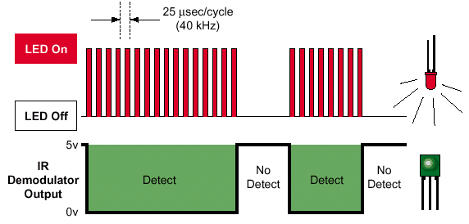
Modulation/Demodulation
Modulated IR is commonly
used for communication
Modulation is done by flashing the light source at a particular frequency
This signal is detected by a demodulator tuned to that particular frequency
Offers great insensitivity to ambient light
  Flashes of light can be detected even if weak

Slide 29
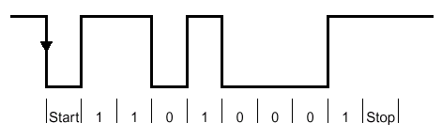
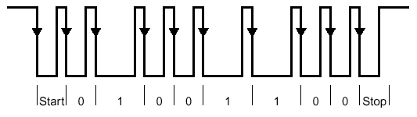
Infrared Communication
Bit frames
  All bits take the same amount of
  time to transmit
  Sample the signal in the middle of the bit frame
  Used for standard computer/modem communication
  Useful when the waveform can be reliably transmitted
Bit intervals
  Sampled at the falling edge
  Duration of interval between sampling determines whether it is a 0 or 1
  Common in commercial use
  Useful when it is difficult to control the exact shape of the waveform

Slide 30
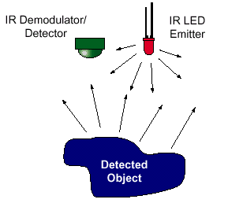
Proximity Sensing
Ideal application for modulated/demodulated IR light sensing
Light from the emitter is reflected back into detector by a nearby object, indicating whether an object is present
  LED emitter and detector are pointed in the same direction
Modulated light is far less susceptible to environmental variables
  amount of ambient light and the reflectivity of different objects

Slide 31
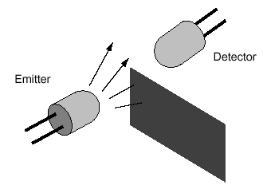
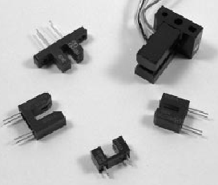
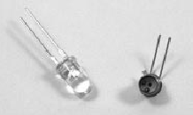
Break Beam Sensors
Any pair of compatible emitter-detector devices can be used to make a break-beam sensor
Examples:
  Incadescent flashlight bulb and photocell
  Red LEDs and visible-light-sensitive photo-transistors
  IR emitters and detectors
Where have you seen these?
  Security systems
  In robotics they are mostly used for keeping track of shaft rotation

Slide 32
Shaft Encoding
Shaft encoders
  Measure the angular rotation of a shaft or an axle
Provide position and velocity information about the shaft
Speedometers: measure how fast the wheels are turning
Odometers: measure the number of rotations of the wheels

Slide 33
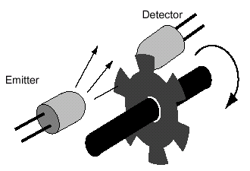
Measuring Rotation
A perforated disk is mounted on the shaft
An emitter–detector pair is placed on both
sides of the disk
As the shaft rotates, the holes in the disk
interrupt the light beam
These light pulses are counted thus monitoring the rotation of the shaft
The more notches, the higher the resolution of the encoder
  One notch, only complete rotations can be counted

Slide 34
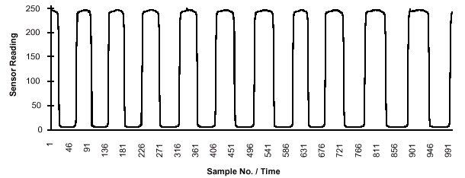
General Encoder Properties
Encoders are active sensors
Produce and measure a wave
function of light intensity
The wave peaks are counted to compute the speed of the shaft
Encoders measure rotational velocity and position

Slide 35
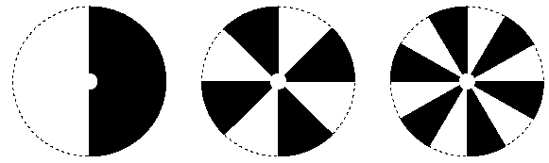
Color-Based Encoders
Use reflectance sensors to count the rotations
Paint the disk wedges in alternating contrasting colors
Black wedges absorb light, white reflect it and only reflections are counted

Slide 36
Uses of Encoders
Velocity can be measured
  at a driven (active) wheel
  at a passive wheel (e.g., dragged behind a legged robot)
By combining position and velocity information, one can:
  move in a straight line
  rotate by a fixed angle
Can be difficult due to wheel and gear slippage and to backlash in geartrains

Slide 37
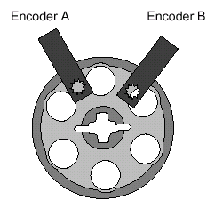
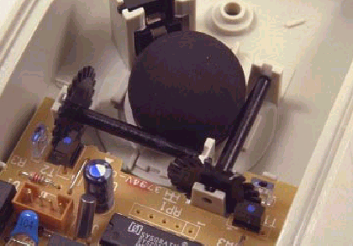
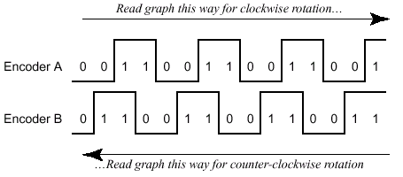
Quadrature Shaft Encoding
How can we measure
direction of rotation?
Idea:
  Use two encoders instead of one
  Align sensors to be 90 degrees out of phase
  Compare the outputs of both sensors at each time step with the previous time step
  Only one sensor changes state (on/off) at each time step, based on the direction of the shaft rotation ⇒ this determines the direction of rotation
  A counter is incremented in the encoder that was on

Slide 38
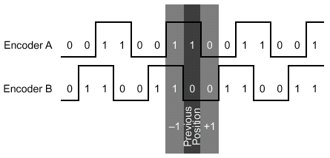
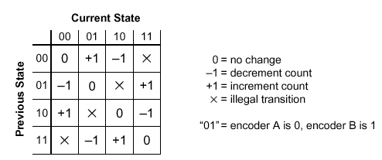
Which Direction is the Shaft Moving?
Encoder A = 1 and Encoder B = 0
  If moving to position AB=00, the position count is incremented
  If moving to the position AB=11, the position count is decremented
State transition table:
Previous state = current state ⇒ no change in position
Single-bit change ⇒ incrementing / decrementing the count
Double-bit change ⇒ illegal transition

Slide 39
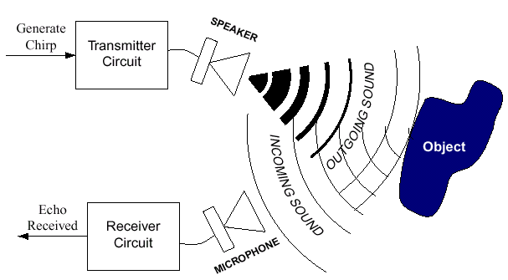
Ultrasonic Distance Sensing
Sonars: so(und) na(vigation) r(anging)
Based on the time-of-flight principle
The emitter sends a “chirp” of sound
If the sound encounters a barrier it reflects back to the sensor
The reflection is detected by a receiver circuit, tuned to the frequency of the emitter
Distance to objects can be computed by measuring the elapsed time between the chirp and the echo
Sound travels about 0.89 milliseconds per foot

Slide 40
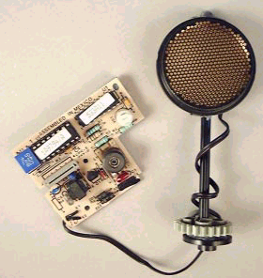
Sonar Sensors
Emitter is a membrane that transforms mechanical energy into a “ping” (inaudible sound wave)
The receiver is a microphone tuned to the frequency of the emitted sound
Polaroid Ultrasound Sensor
  Used in a camera to measure the
  distance from the camera to the subject
  for auto-focus system
  Emits in a 30 degree sound cone
  Has a range of 32 feet
  Operates at 50 KHz

Slide 41
Echolocation
Echolocation = finding location based on sonar
Some animals use echolocation
Bats use sound for:
  finding pray, avoid obstacles, find mates,
  communication with other bats
Dolphins/Whales:
  find small fish, swim through mazes
Natural sensors are much more complex than artificial ones

Slide 42
Specular Reflection
Sound does not reflect directly and come right back
Specular reflection
  The sound wave bounces off multiple sources before returning to the detector
Smoothness
  The smoother the surface the more likely is that the sound would bounce off
Incident angle
  The smaller the incident angle of the sound wave the higher the probability that the sound will bounce off

Slide 43
Improving Accuracy
Use rough surfaces in lab environments
Multiple sensors covering the same area
Multiple readings over time to detect “discontinuities”
Active sensing
In spite of these problems sonars are used successfully in robotics applications
  Navigation
  Mapping

Slide 44
Readings
F. Martin: Chapter 3, Section 6.1
M. Matarić: Chapters 7, 8

