Slide 1
Autonomous Mobile Robots
CPE 470/670
Lecture 6
Instructor: Monica Nicolescu

Slide 2
Review
Sensors
Photocells
Reflective optosensors
Infrared sensors
Break-Beam sensors
Shaft encoders
Sonar sensors

Slide 3
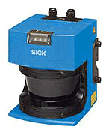

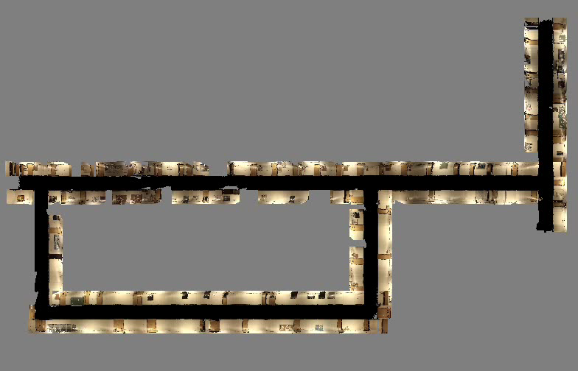
Laser Sensing
High accuracy sensor
Lasers use light time-of-flight
Light is emitted in a beam (3mm) rather than a cone
Provide higher resolution
SICK LMS200
  360 readings over an 180-degrees, 10Hz
Disadvantages:
  cost, weight, power, price
  mostly 2D

Slide 4
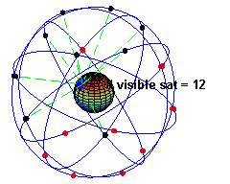
Global Positioning System (GPS)
General information
  At least 24 satellites orbiting the earth
  every 12 hours at a height of 20.190 km
  4 satellites were located in each of 6 orbits with 60 degrees orientation between each other
How does it work?
  Each satellite transmits its location and current time
  GPS receivers use the arrival time and location to infer their current location
  GPS receivers read from at least 4 satellites

Slide 5
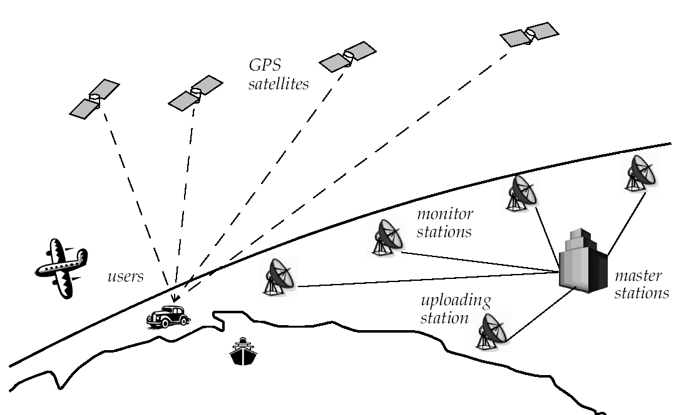
Global Positioning System (GPS)
Challenges
  Time synchronization between satellites and GPS receiver
  Real time update of the location of the satellites
  Precise measurement of time-of flight

Slide 6
Visual Sensing
Cameras try to model biological eyes
Machine vision is a highly difficult research area
  Reconstruction
  What is that? Who is that? Where is that?
Robotics requires answers related to achieving goals
  Not usually necessary to reconstruct the entire world
Applications
  Security, robotics (mapping, navigation)

Slide 7
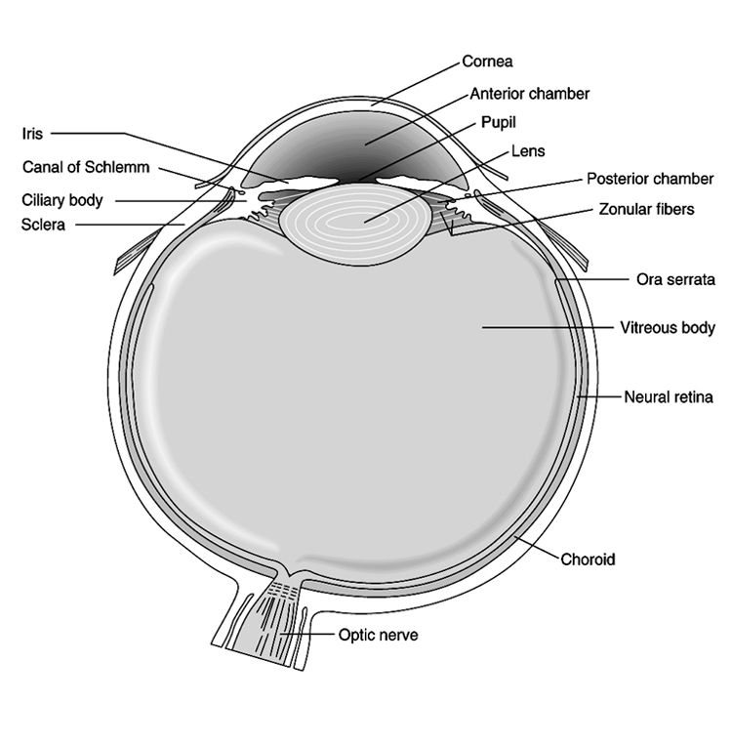
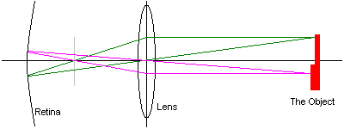
Principles of Cameras
Cameras have many similarities with the human eye
  The light goes through an opening (iris - lens) and hits the image plane (retina)
  The retina is attached to light-sensitive elements (rods, cones – silicon circuits)
  Only objects at a particular range are
  in focus (fovea) – depth of field
  512x512 pixels (cameras),
  120x10⁶ rods and 6x10⁶ cones (eye)
  The brightness is proportional to the
  amount of light reflected from the objects

Slide 8


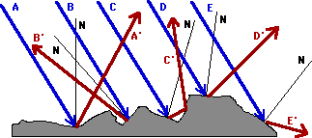
Image Brightness
Brightness depends on
  reflectance of the surface patch
  position and distribution of the light sources in the environment
  amount of light reflected from other objects in the scene onto the surface patch
Two types of reflection
  Specular (smooth surfaces)
  Diffuse (rough sourfaces)
Necessary to account for these properties for correct object reconstruction ⇒ complex computation

Slide 9
Early Vision
The retina is attached to numerous rods and cones which, in turn, are attached to nerve cells (neurons)
The nerves process the information; they perform "early vision", and pass information on throughout the brain to do "higher-level" vision processing
The typical first step ("early vision") is edge detection, i.e., find all the edges in the image
Suppose we have a b&w camera with a 512 x 512 pixel image
Each pixel has an intensity level between white and black
How do we find an object in the image? Do we know if there is one?

Slide 10
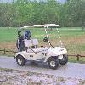
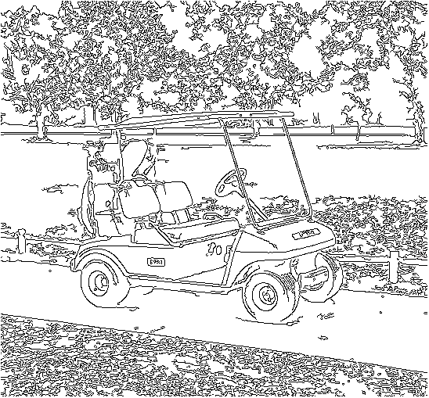
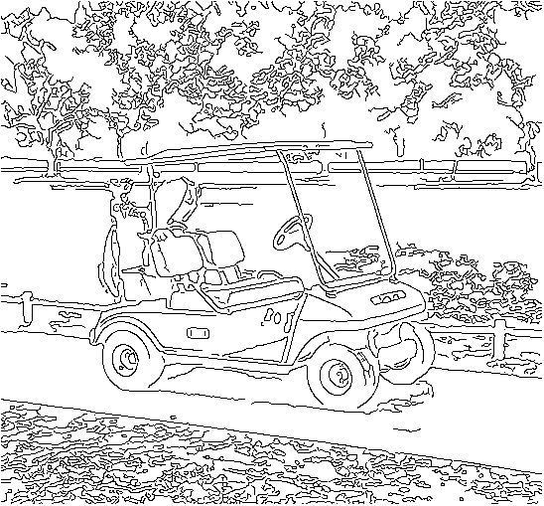
Edge Detection
Edge = a curve in the image across which there is a change in brightness
Finding edges
  Differentiate the image and look for areas where the magnitude of the derivative is large
Difficulties
  Not only edges produce changes in brightness: shadows, noise
Smoothing
  Filter the image using convolution
  Use filters of various orientations
Segmentation: get objects out of the lines

Slide 11
Model-Based Vision
Compare the current image with images of similar objects (models) stored in memory
Models provide prior information about the objects
Storing models
  Line drawings
  Several views of the same object
  Repeatable features (two eyes, a nose, a mouth)
Difficulties
  Translation, orientation and scale
  Not known what is the object in the image
  Occlusion

Slide 12
Vision from Motion
Take advantage of motion to facilitate vision
Static system can detect moving objects
  Subtract two consecutive images from each other ⇒ the movement between frames
Moving system can detect static objects
  At consecutive time steps continuous objects move as one
  Exact movement of the camera should be known
Robots are typically moving themselves
  Need to consider the movement of the robot

Slide 13
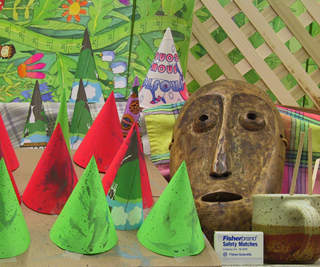
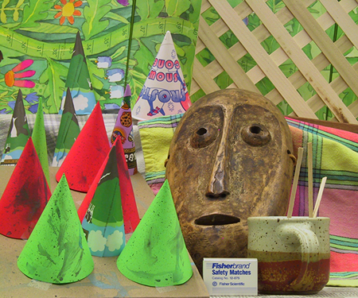
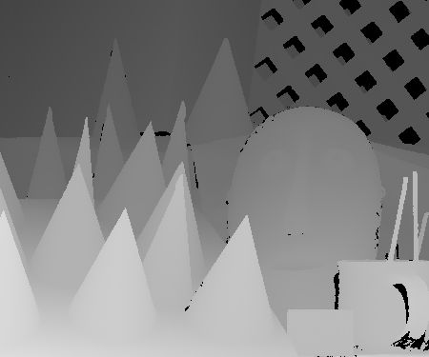
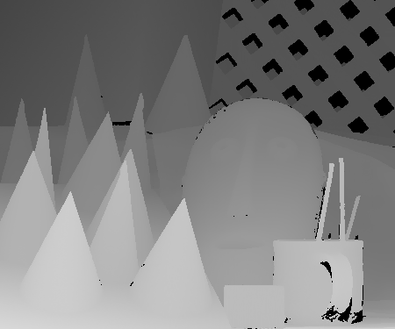
Stereo Vision
3D information can be
computed from two
images
Compute relative
positions of cameras
Compute disparity
  displacement of a point in
  2D between the two images
Disparity is inverse proportional with actual distance in 3D

Slide 14
Biological Vision
Similar visual strategies are used in nature
Model-based vision is essential for object/people recognition
Vestibular occular reflex
  Eyes stay fixed while the head/body is moving to stabilize the image
Stereo vision
  Typical in carnivores
Human vision is particularly good at recognizing shadows, textures, contours, other shapes

Slide 15
Vision for Robots
If complete scene reconstruction is not needed we can simplify the problem based on the task requirements
Use color
Use a combination of color and movement
Use small images
Combine other sensors with vision
Use knowledge about the environment

Slide 16
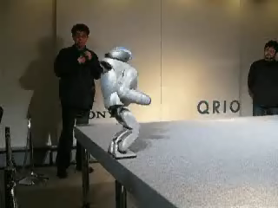
Examples of Vision-Based Navigation
Running QRIO
Sony Aibo – obstacle avoidance

Slide 17
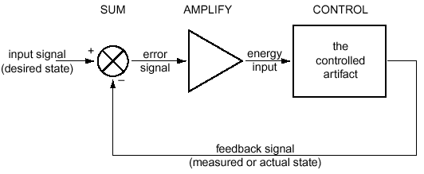
Feedback Control
Feedback control = having a system achieve and maintain a desired state by continuously comparing its current and desired states, then adjusting the current state to minimize the difference
Also called closed loop control

Slide 18
Goal State
Goal driven behavior is used in both control theory and in AI
Goals in AI
  Achievement goals: states that the system is trying to reach
  Maintenance goals: states that need to be maintained
Control theory: mostly focused on maintenance goals
Goal states can be:
  Internal: monitor battery power level
  External: get to a particular location in the environment
  Combinations of both: balance a pole

Slide 19
Error
Error = the difference in the current state and desired state of the system
The controller has to minimize the error at all times
Zero/non-zero error:
  Tells whether there is an error or not
  The least information we could have
Magnitude of error:
  The distance to the goal state
Direction of error:
  Which way to go to minimize the error
Control is much easier if we know both magnitude and direction

Slide 20
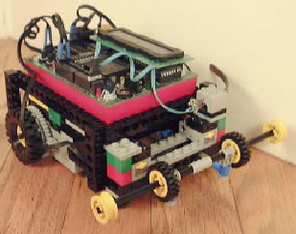
A Robotic Example
Use feedback to design a wall following robot
What sensors to use, what info will they provide?
  Contact: the least information
  IR: information about a possible wall, but not distance
  Sonar, laser: would provide distance
  Bend sensor: would provide distance
Control
  If distance-to-wall is right, then keep going
  If distance-to-wall is larger
  then turn toward the wall
  else turn away from the wall

Slide 21
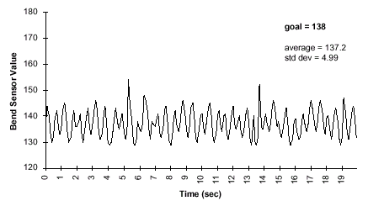
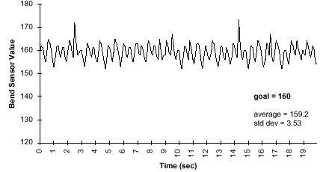
Simple Feedback Control
Sharp turns
void left() {
motor(RIGHT_MOTOR, 100);
motor(LEFT_MOTOR, 0);
}
void right() {
motor(LEFT_MOTOR, 100);
motor(RIGHT_MOTOR, 0);
}
HandyBug oscillates around setpoint goal value
Never goes straight

Slide 22
Readings
M. Matarić: Chapter 10

