Slide 1
Autonomous Mobile Robots CPE 470/670
Lecture 7
Instructor: Monica Nicolescu

Slide 2
Mid-Term
Monday, October 27, in classroom
Tentative exam structure
5 (6) problems with 3-4 small questions each
From lecture and lab material

Slide 3
Review
Complex sensors
Laser
GPS
Vision
Feedback control
General principles

Slide 4
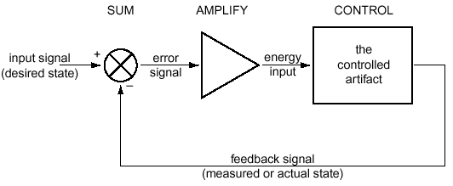
Feedback Control
Feedback control = having a system achieve and maintain a desired state by continuously comparing its current and desired states, then adjusting the current state to minimize the difference
Also called closed loop control

Slide 5
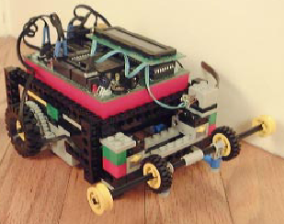
A Robotic Example
Use feedback to design a wall following robot
What sensors to use, what info will they provide?
Contact: the least information
IR: information about a possible wall, but not distance
Sonar, laser: would provide distance
Bend sensor: would provide distance
Control
If distance-to-wall is right, then keep going
If distance-to-wall is larger
then turn toward the wall
else turn away from the wall

Slide 6
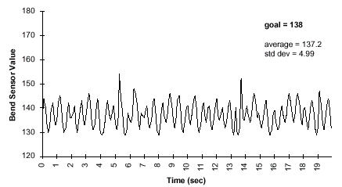
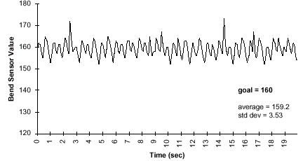
Simple Feedback Control
Sharp turns
void left() {
motor(RIGHT_MOTOR, 100);
motor(LEFT_MOTOR, 0);
}
void right() {
motor(LEFT_MOTOR, 100);
motor(RIGHT_MOTOR, 0);
}
HandyBug oscillates around setpoint goal value
Never goes straight

Slide 7
Overshoot
The system goes beyond its setpoint ⇒ changes direction before stabilizing on it
For this example overshoot is not a critical problem
Other situations are more critical
A robot arm moving to a particular position
Going beyond the goal position ⇒ could have collided with some object just beyond the setpoint position

Slide 8
Oscillations
The robot oscillates around the optimal distance from the wall, getting either too close or too far
In general, the behavior of a feedback system oscillates around the desired state
Decreasing oscillations
Adjust the turning angle
Use a range instead of a fixed distance as the goal state

Slide 9
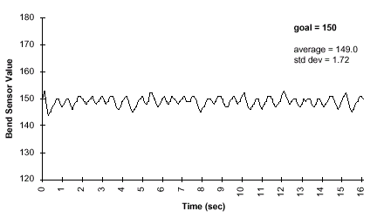
Simple Feedback Control
Gentle Turns
void left() {
motor(RIGHT_MOTOR, 100);
motor(LEFT_MOTOR, 50);
}
void right() {
motor(LEFT_MOTOR, 100);
motor(RIGHT_MOTOR, 50);
}
Gentle Turning Algorithm:
Swings less abrupt
HandyBug completes run in 16 sec (vs. 19 sec in hard turn version) for same length course
Minimize both overshoot and oscillation, but provide adequate system response to changes in setpoints

Slide 10
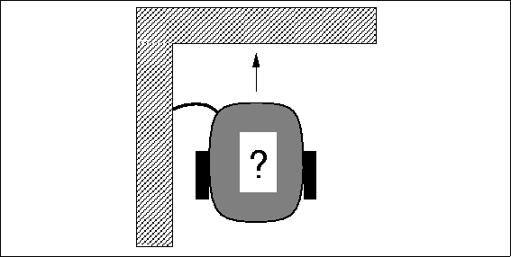
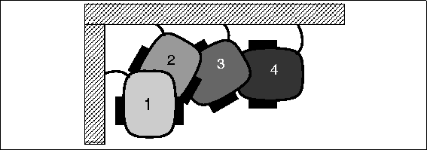
Wall Following
Negotiating a corner
Make little turns, drive straight
ahead, hit the wall, back up, repeat
Disadvantage: time consuming,
jerky movements
Alternative
Execute a turn command that was timed to accomplish a ninety degree rotation robot_spin_clockwise(); sleep(1.5);
Works reliably only when the robot is very predictable (battery strength, traction on the surface, and friction in the geartrain may influence the outcomes)
⇒ Open loop control

Slide 11
Open Loop Control
Does not use sensory feedback, and state is not fed back into the system
Feed-forward control
The command signal is a function of some parameters measured in advance
E.g.: battery strength measurement could be used to "predict" how much time is needed for the turn
Still open loop control, but a computation is made to make the control more accurate
Feed-forward systems are effective only if
They are well calibrated
The environment is predictable & does not change such as to affect their performance

Slide 12
Uses of Open Loop Control
Repetitive, state independent tasks
Switch microwave on to defrost for 2 minutes
Program a toy robot to walk in a certain direction
Switch a sprinkler system on to water the garden at set times
Conveyor belt machines

Slide 13
Types of Feedback Control
There are three types of basic feedback controllers
P: proportional control
PD: proportional derivative control
PID: proportional integral derivative control

Slide 14
Proportional Control
The response of the system is proportional to the amount of the error
The output o is proportional to the input i:
o = K_{p} ∗ i
K_{p} is a proportionality constant (gain)
Control generates a stronger response the farther away the system is from the goal state
Turn sharply toward the wall sharply if far from it,
Turn gently toward the wall if slightly farther from it

Slide 15
Determining Gains
How do we determine the gains?
Empirically (trial and error):
require that the system be tested extensively
Analytically (mathematics):
require that the system be well understood and characterized mathematically
Automatically
by trying different values at run-time

Slide 16
Gains
The gains (K_{p}) are specific to the particular control system
The physical properties of the system directly affect the gain values
E.g.: the velocity profile of a motor (how fast it can accelerate and decelerate), the backlash and friction in the gears, the friction on the surface, in the air, etc.
All of these influence what the system actually does in response to a command

Slide 17
Gains and Oscillations
Incorrect gains will cause the system to undershoot or overshoot the desired state ⇒ oscillations
Gain values determine if:
The system will keep oscillating (possibly increasing oscillations)
The system will stabilize
Damping: process of systematically decreasing oscillations
A system is properly damped if it does not oscillate out of control (decreasing oscillations, or no oscillations at all)

Slide 18
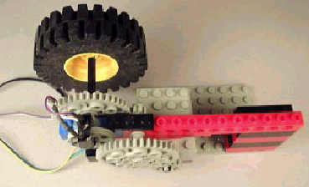
Proportional Control for Rotation Position of Wheel
Test system:
Control rotational position of
LEGO wheel
Desired position: 100
Will vary power to motor
Large LEGO wheel gives the system momentum (load on the system)
Quadrature-based shaft encoder keeps track of the shaft position

Slide 19
Proportional Control for Rotation Position of Wheel
Simple P controller:
Command = 100 – encoder-counts
Initially, the error is 100
The motor turns on full speed
As it starts going, the error becomes
progressively smaller
Halfway, at position 50, the error is only 50
at that point the motor goes at 50% of full power
When it arrives at the intended position of 100, the error is zero
the motor is off

Slide 20
Proportional Control for Rotation Position of Wheel
Proportional gain:
Command = 5∗(100 – encoder-counts)
Response should feel much “snappier”
The wheel reaches the setpoint position faster
More aggressive resistance to being turned away from the setpoint

Slide 21
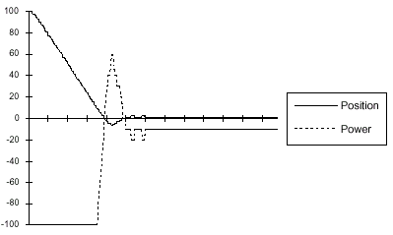
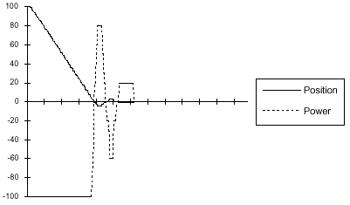
Proportional Control
P_{gain}=10:
System overshot the zero point, and had to turn around
Offset Error: System did not stabilize at the goal
Power command too small to activate the motor
P_{gain}=20: should ameliorate the offset problem
Offset error is solved
Oscillation: the system overshoots three times—twice beyond the setpoint and once before it
power= P_{gain} * (0 - counts)
P_{gain} = 10
P_{gain} = 20

Slide 22
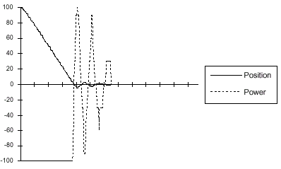
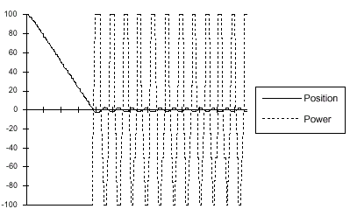
Proportional Control
P_{gain}=30:
Oscillation problem is more pronounced; there are a total of five oscillatory swings
P_{gain}=50: Oscillation behavior has taken over
System cannot stabilize at the setpoint
A small error generates a power command that moves the system across the setpoint
power= P_{gain} * (0 - counts)
P_{gain} = 30
P_{gain} = 50

Slide 23
Derivative Control
Setting gains is difficult, and simply changing the gains does not remove oscillations
The system needs to be controlled differently when it is close to the desired state and when it is far from it
The momentum of the correction carries the system beyond the desired state, and causes oscillations
Momentum = mass ∗ velocity
Solution: correct the momentum as the system approaches the desired state

Slide 24
Controlling Velocity
Momentum and velocity are directly proportional ⇒ we can control the momentum by controlling velocity
As the system nears the desired state, we subtract an amount proportional to the velocity:
- (gain ∗ velocity)
Derivative term (velocity is the derivative of position)
A controller that has a derivative term is called a derivative (D) controller

Slide 25
Derivative Control
A derivative controller has an output o proportional to the derivative of its input i:
o = K_{d} ∗ di/dt
K_{d} is a proportionality constant
The intuition behind derivative control:
Controller corrects for the momentum as it approaches the desired state
Slow down a robot and decrease the turning angle while getting closer to the desired state
Decrease the motor power while getting closer to the desired state

Slide 26
PD Control
Proportional-derivative control
Combination (sum) of proportional and derivative terms
o = K_{p} ∗ i + K_{d} ∗ di/dt
PD Control is used extensively in industrial process control
Combination of varying the power input when the system is far away from the setpoint, and correcting for the momentum of the system as it approaches the setpoint is quite effective

Slide 27
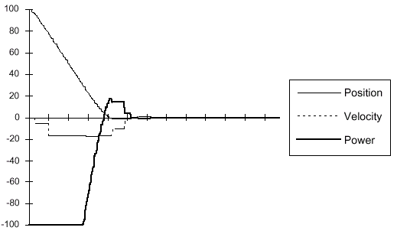
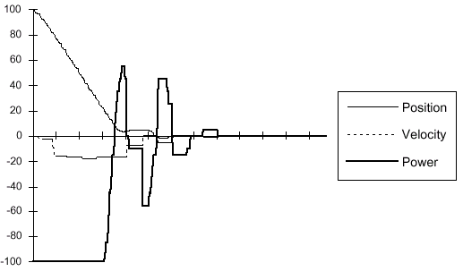
Proportional-Derivative Control
P_{gain}=4, D_{gain}=1:
Overshoot is minimized, no oscillatory behavior at all
P_{gain}=10, D_{gain}=5:
Unstable; D_{gain} is too large
Position graph: controller “puts on the brakes” too hard and the system stops moving before the destination setpoint (between the 0.8 and 1.0 second mark)
When the velocity hits zero, the proportional gain kicks in again and the system corrects
power= P_{gain} * (0 - counts) - D_{gain} * velocity
pgain=4, dgain=1
pgain=10, dgain=5

Slide 28
Control Example
A lawn mowing robot covers the lawn
From one side of the yard to the other
Turns over each time to cover another “strip”
What problems could occur?
Turning is not perfect
Robot makes a consistent error each time it turns
The errors accumulate as the robot is running a longer time
How can we solve the problem?
Sum up the errors and compensate for them when they become significantly large

Slide 29
Integral Control
Control system can be improved by introducing an integral term
o = K_{f} ∗ ∫ i(t)dt
K_{f} = proportionality constant
Intuition:
System keeps track of its repeatable, steady state errors
These errors are integrated (summed up) over time
When they reach a threshold, the system compensates for them

Slide 30
PID Control
Proportional integral derivative control
Combination (sum) of proportional, derivative and integral terms
o = K_{p} ∗ i + K_{d} ∗ di/dt + K_{f} ∗ ∫ i(t)dt

Slide 31
Feedback Control

Slide 32
Visual Feedback

Slide 33
Control Theory and Robotics
Feedback control plays a key role for low-level control of the actuators
What about achieving higher-level goals?
Navigation, robot coordination, interaction, collaboration
Use other approaches, initially coming from the field of AI
Algorithmic control
a procedural series of steps or phases that a robot’s program moves through in service of accomplishing some task

Slide 34
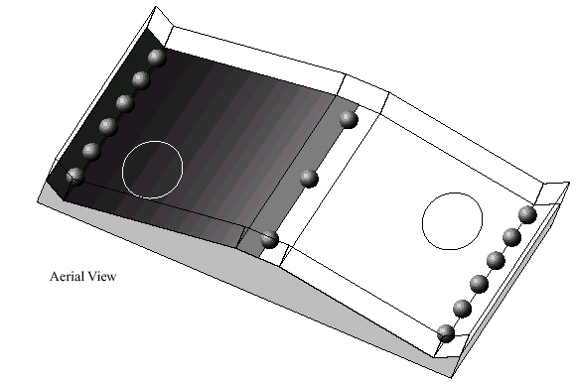
Robo-Pong Contest
Run at MIT January 1991
Involved 2 robots and 15 plastic golf balls
Goal:
have your robot transport balls from its side of table to opponent’s in 60 seconds
Robot with fewer balls on its side is the winner
Table 4x6 feet, inclined surfaces, small plateau area in center
Robots start in circles, balls placed as shown
Robots could use reflectance sensors to determine which side they were on
Plan encouraged diversity in robot strategies

Slide 35
Robo-Pong Contest
Necessary skills:
go uphill and downhill, maneuver in the trough area, and coordinate activities of collecting and delivering balls
Ball-collecting robots
Harvester Robots: scooped the balls into some sort of open arms and then pushed them onto the opponent’s side of the playing field
Eater Robots: collected balls “inside their bodies” (more complex mechanically)
Shooter robots: catapulted balls onto the opponent’s side of the table
If a ball went over the playing field wall on the opponent’s territory, the ball would be permanently scored against the opponent
Sophisticated mechanical design
Lost against aggressor designs

Slide 36
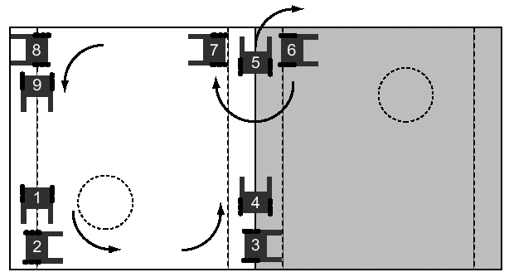
Robo-Pong Contest
Strategy pattern of Groucho, an algorithmic ball-harvester
Linear series of actions, which are performed in a repetitive loop
Sensing may be used in the service of these actions, but it does not change the order in which they will be performed.
Some feedback based on the surrounding environment would be necessary

Slide 37
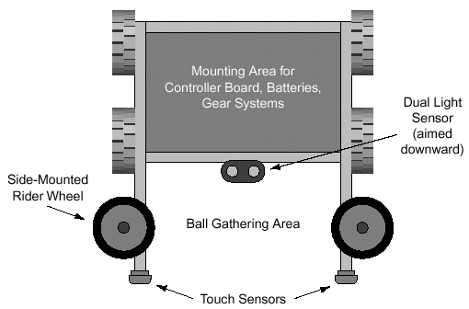
Groucho’s Mechanics
Basic turtle drive system with
pair of driven wheels one each side
Pair of free-spinning rider
wheels mounted parallel to the floor ⇒ driving along a wall with no sensing or feedback required
Two kinds of sensors:
a touch sensor at the end each of of its “arms,”
a pair of light sensors facing downward located near its geometric center

Slide 38
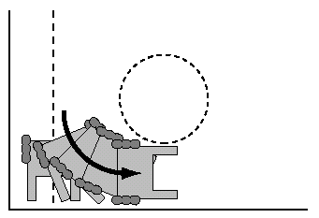
Groucho’s Strategy
Taking corners
From position 1 to position 2:
a repetitive series of little turns and
collisions back into the wall
(four or five iterations)
Reliable turning method
if the wheels slipped a little on one turn, Groucho kept turning until the touch sensor no longer struck the wall—in which case, it would have completed its turn
This method works for a wide range of corners—ones less than and greater than the right angles on the Robo-Pong playing field

Slide 39
Groucho’s Strategy
Ninety degree turns
From position 3 to position 4, a single timed
turn movement
Crossing the center plateau
Use feedback sensing from a dual light sensor, aimed downward at the playing surface
One sensor was kept on the dark side of the table and the other on the light side
Summary:
algorithmic strategy method is relatively simple and can be effective when a straight-forward algorithm can be devised

Slide 40
Strengths and Weaknesses of Algorithmic Control
Strengths:
Simplicity, directness, and predictability when things go according to plan
Weaknesses:
Inability to detect or correct for problems or unexpected circumstances, and the chained-dependencies required for proper functioning
If any one step fails, the whole solution typically fails
Each link-step of an algorithmic solution has a chance of failing, and this chance multiplies throughout the set of steps
E.g., if each step has a 90% chance of functioning properly and there are six such steps in the solution ⇒ the likelihood of overall program working is the likelihood that each steps functions properly: ~53% chance

Slide 41
Bolstering Algorithmic Control
Have separable steps along the way performed by feedback loops
Handling of inside corners: use a series of little turns and bumps
Assumes that Groucho would not hit the wall perpendicularly
Through feedback ⇒ can compensate for variances in the playing field, the performance of the robot, and real-world unpredictability
Crossing the plateau
The rolling rider wheels ensured that the robot is properly oriented
The right-angle turn was immediately followed by a feedback program that tracked the light/dark edge
Embed feedback controls within the algorithmic framework

Slide 42
Exit Conditions
Problem with simple algorithmic approach:
No provision for detecting or correcting for, problem situations
Groucho’s program:
Robot is waiting for a touch sensor to trigger the next phase of action
If something would impede its travel, without striking a touch sensor, Groucho would be unable to take corrective action
While crossing the top plateau the opponent robot gets in the way, and triggers a touch sensor ⇒ Groucho would begin its behavior activated when reaching the opposing wall
Solution: techniques for error detection and recovery within an algorithmic framework
“Knowing” that it had struck the opponent

Slide 43
Exit Conditions
- Timeouts
Going from position 4 to 5:
Traverses light/dark edge across the field
Check for touch sensor to continue
Problem:
Only way to exit is if one of the touch sensors is pressed
Solution:
Allow the subroutine to time out
After a predetermined period of time has elapsed, the subroutine exits even if a touch sensor was not pressed

Slide 44
Exit Conditions - Timeouts
Inform the higher level control program of abnormal exit by returning a value indicating
Normal termination (with a touch sensor press) or abnormal termination (because of a timeout)
Another Problem: routine finishes in too little time
Solution:
Use a “too-long” and a “too-short” timeout
If elapsed time is less than TOO-SHORT ⇒ procedure returns an EARLY error result

Slide 45
Exit Conditions – Premature Exits
Edge-following section
Veer left, go straight, going right
Problem:
Robot shouldn’t stay in any of these modes for very long
Solution: monitor the transitions between the different modes of the feedback loop
Parameters representing longest time that Groucho may spend continuously in any given state
State variables: last_mode and last_time
Return codes to represent the states: stuck veering left/right/straight

Slide 46
Exit Conditions – Taking Action
What action to take after learning that a problem has occurred?
Robot gets stuck following the edge (position 4 to 5)
Robot has run into the opponent robot
Robot has mistracked the median edge
Something else has gone wrong
Solution
After an error condition re-examine all other sensors to try to make sense of the situation (e.g. detecting the opponent robot)
Difficult to design appropriate reactions to any possible situation
A single recovery behavior would suffice for many circumstances
Groucho: heading downhill until hitting the bottom wall and then proceeding with the cornering routine

Slide 47
Readings
M. Matarić: Chapter 10

