Slide 1
Autonomous Mobile Robots CPE 470/670
Lecture 7
Instructor: Monica Nicolescu

Slide 2
Harvesting Contest Results
Team | Small RF | Large RF | Color | Time | Total food | Total time | Total
 | 10 | 5 | 5
3 | 2 | 2 | 2 | 66 | 40 | 50.00 | 90.00
5 | 0 | 0 | 0 | 10 | 0 | 140.32 | 140.32
6 | 0 | 1 | 2 | 4 | 15 | 150.00 | 165.00
7 | 2 | 3 | 1 | 17 | 40 | 129.03 | 169.03
11 | 2 | 2 | 1 | 12 | 35 | 137.10 | 172.10

Slide 3
Mid-Term
Wednesday, October 16, in classroom
Tentative exam structure
5 (6) problems with 3-4 small questions each
From lecture and lab material

Slide 4
Review
Complex sensors
Laser
GPS
Vision
Feedback control
General principles
Proportional control

Slide 5
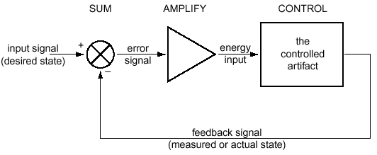
Feedback Control
Feedback control = having a system achieve and maintain a desired state by continuously comparing its current and desired states, then adjusting the current state to minimize the difference
Also called closed loop control

Slide 6
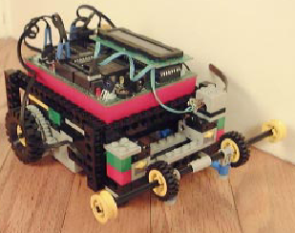
A Robotic Example
Use feedback to design a wall following robot
What sensors to use, what info will they provide?
Contact: the least information
IR: information about a possible wall, but not distance
Sonar, laser: would provide distance
Bend sensor: would provide distance
Control
If distance-to-wall is right, then keep going
If distance-to-wall is larger
then turn toward the wall
else turn away from the wall

Slide 7
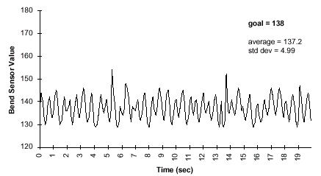
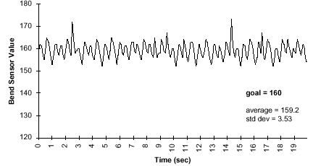
Simple Feedback Control
Sharp turns
void left() {
motor(RIGHT_MOTOR, 100);
motor(LEFT_MOTOR, 0);
}
void right() {
motor(LEFT_MOTOR, 100);
motor(RIGHT_MOTOR, 0);
}
HandyBug oscillates around setpoint goal value
Never goes straight

Slide 8
Overshoot
The system goes beyond its setpoint ⇒ changes direction before stabilizing on it
For this example overshoot is not a critical problem
Other situations are more critical
A robot arm moving to a particular position
Going beyond the goal position ⇒ could have collided with some object just beyond the setpoint position

Slide 9
Oscillations
The robot oscillates around the optimal distance from the wall, getting either too close or too far
In general, the behavior of a feedback system oscillates around the desired state
Decreasing oscillations
Adjust the turning angle
Use a range instead of a fixed distance as the goal state

Slide 10
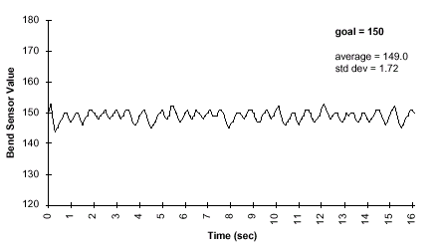
Simple Feedback Control
Gentle Turns
void left() {
motor(RIGHT_MOTOR, 100);
motor(LEFT_MOTOR, 50);
}
void right() {
motor(LEFT_MOTOR, 100);
motor(RIGHT_MOTOR, 50);
}
Gentle Turning Algorithm:
Swings less abrupt
HandyBug completes run in 16 sec (vs. 19 sec in hard turn version) for same length course
Minimize both overshoot and oscillation, but provide adequate system response to changes in setpoints

Slide 11
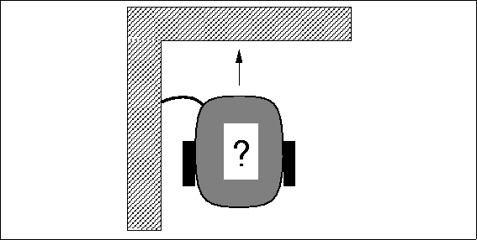
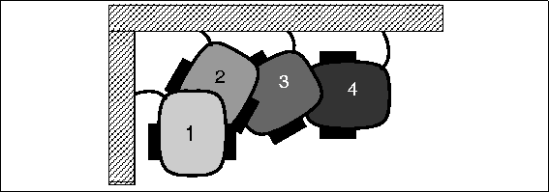
Wall Following
Negotiating a corner
Make little turns, drive straight
ahead, hit the wall, back up, repeat
Disadvantage: time consuming,
jerky movements
Alternative
Execute a turn command that was timed to accomplish a ninety degree rotation robot_spin_clockwise(); sleep(1.5);
Works reliably only when the robot is very predictable (battery strength, traction on the surface, and friction in the geartrain may influence the outcomes)
⇒ Open loop control

Slide 12
Open Loop Control
Does not use sensory feedback, and state is not fed back into the system
Feed-forward control
The command signal is a function of some parameters measured in advance
E.g.: battery strength measurement could be used to "predict" how much time is needed for the turn
Still open loop control, but a computation is made to make the control more accurate
Feed-forward systems are effective only if
They are well calibrated
The environment is predictable & does not change such as to affect their performance

Slide 13
Uses of Open Loop Control
Repetitive, state independent tasks
Switch microwave on to defrost for 2 minutes
Program a toy robot to walk in a certain direction
Switch a sprinkler system on to water the garden at set times
Conveyor belt machines

Slide 14
Types of Feedback Control
There are three types of basic feedback controllers
P: proportional control
PD: proportional derivative control
PID: proportional integral derivative control

Slide 15
Proportional Control
The response of the system is proportional to the amount of the error
The output o is proportional to the input i:
o = K_{p} ∗ i
K_{p} is a proportionality constant (gain)
Control generates a stronger response the farther away the system is from the goal state
Turn sharply toward the wall sharply if far from it,
Turn gently toward the wall if slightly farther from it

Slide 16
Determining Gains
How do we determine the gains?
Empirically (trial and error):
require that the system be tested extensively
Analytically (mathematics):
require that the system be well understood and characterized mathematically
Automatically
by trying different values at run-time

Slide 17
Gains
The gains (K_{p}) are specific to the particular control system
The physical properties of the system directly affect the gain values
E.g.: the velocity profile of a motor (how fast it can accelerate and decelerate), the backlash and friction in the gears, the friction on the surface, in the air, etc.
All of these influence what the system actually does in response to a command

Slide 18
Gains and Oscillations
Incorrect gains will cause the system to undershoot or overshoot the desired state ⇒ oscillations
Gain values determine if:
The system will keep oscillating (possibly increasing oscillations)
The system will stabilize
Damping: process of systematically decreasing oscillations
A system is properly damped if it does not oscillate out of control (decreasing oscillations, or no oscillations at all)

Slide 19
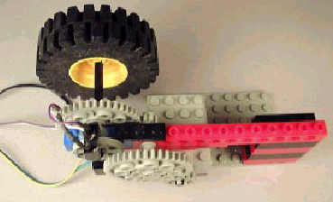
Proportional Control for Rotation Position of Wheel
Test system:
Control rotational position of
LEGO wheel
Desired position: 100
Will vary power to motor
Large LEGO wheel gives the system momentum (load on the system)
Quadrature-based shaft encoder keeps track of the shaft position

Slide 20
Proportional Control for Rotation Position of Wheel
Simple P controller:
Command = 100 – encoder-counts
Initially, the error is 100
The motor turns on full speed
As it starts going, the error becomes
progressively smaller
Halfway, at position 50, the error is only 50
at that point the motor goes at 50% of full power
When it arrives at the intended position of 100, the error is zero
the motor is off

Slide 21
Proportional Control for Rotation Position of Wheel
Proportional gain:
Command = 5∗(100 – encoder-counts)
Response should feel much “snappier”
The wheel reaches the setpoint position faster
More aggressive resistance to being turned away from the setpoint

Slide 22
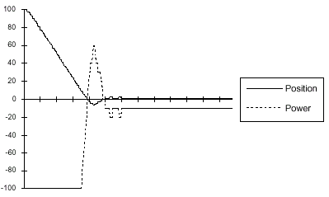
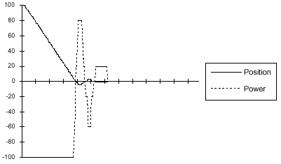
Proportional Control
P_{gain}=10:
System overshot the zero point, and had to turn around
Offset Error: System did not stabilize at the goal
Power command too small to activate the motor
P_{gain}=20: should ameliorate the offset problem
Offset error is solved
Oscillation: the system overshoots three times—twice beyond the setpoint and once before it
power= P_{gain} * (0 - counts)
P_{gain} = 10
P_{gain} = 20

Slide 23
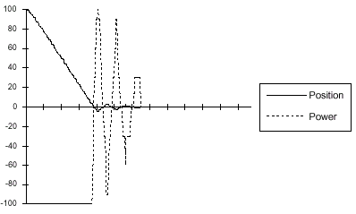
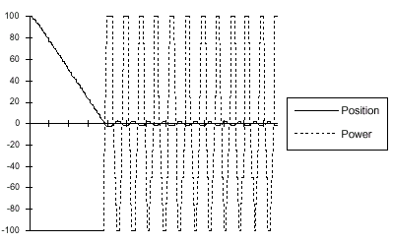
Proportional Control
P_{gain}=30:
Oscillation problem is more pronounced; there are a total of five oscillatory swings
P_{gain}=50: Oscillation behavior has taken over
System cannot stabilize at the setpoint
A small error generates a power command that moves the system across the setpoint
power= P_{gain} * (0 - counts)
P_{gain} = 30
P_{gain} = 50

Slide 24
Derivative Control
Setting gains is difficult, and simply changing the gains does not remove oscillations
The system needs to be controlled differently when it is close to the desired state and when it is far from it
The momentum of the correction carries the system beyond the desired state, and causes oscillations
Momentum = mass ∗ velocity
Solution: correct the momentum as the system approaches the desired state

Slide 25
Controlling Velocity
Momentum and velocity are directly proportional ⇒ we can control the momentum by controlling velocity
As the system nears the desired state, we subtract an amount proportional to the velocity:
- (gain ∗ velocity)
Derivative term (velocity is the derivative of position)
A controller that has a derivative term is called a derivative (D) controller

Slide 26
Derivative Control
A derivative controller has an output o proportional to the derivative of its input i:
o = K_{d} ∗ di/dt
K_{d} is a proportionality constant
The intuition behind derivative control:
Controller corrects for the momentum as it approaches the desired state
Slow down a robot and decrease the turning angle while getting closer to the desired state
Decrease the motor power while getting closer to the desired state

Slide 27
PD Control
Proportional-derivative control
Combination (sum) of proportional and derivative terms
o = K_{p} ∗ i + K_{d} ∗ di/dt
PD Control is used extensively in industrial process control
Combination of varying the power input when the system is far away from the setpoint, and correcting for the momentum of the system as it approaches the setpoint is quite effective

Slide 28
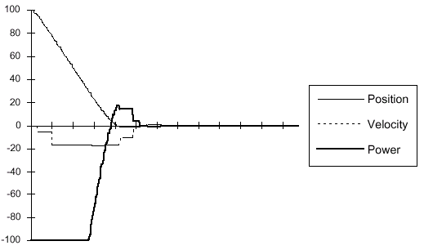
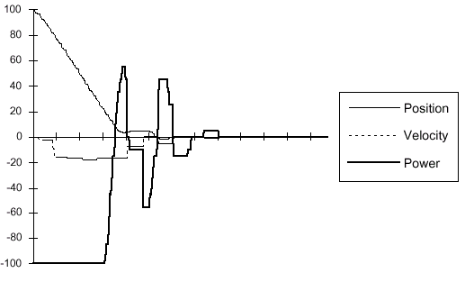
Proportional-Derivative Control
P_{gain}=4, D_{gain}=1:
Overshoot is minimized, no oscillatory behavior at all
P_{gain}=10, D_{gain}=5:
Unstable; D_{gain} is too large
Position graph: controller “puts on the brakes” too hard and the system stops moving before the destination setpoint (between the 0.8 and 1.0 second mark)
When the velocity hits zero, the proportional gain kicks in again and the system corrects
power= P_{gain} * (0 - counts) - D_{gain} * velocity
pgain=4, dgain=1
pgain=10, dgain=5

Slide 29
Control Example
A lawn mowing robot covers the lawn
From one side of the yard to the other
Turns over each time to cover another “strip”
What problems could occur?
Turning is not perfect
Robot makes a consistent error each time it turns
The errors accumulate as the robot is running a longer time
How can we solve the problem?
Sum up the errors and compensate for them when they become significantly large

Slide 30
Integral Control
Control system can be improved by introducing an integral term
o = K_{f} ∗ ∫ i(t)dt
K_{f} = proportionality constant
Intuition:
System keeps track of its repeatable, steady state errors
These errors are integrated (summed up) over time
When they reach a threshold, the system compensates for them

Slide 31
PID Control
Proportional integral derivative control
Combination (sum) of proportional, derivative and integral terms
o = K_{p} ∗ i + K_{d} ∗ di/dt + K_{f} ∗ ∫ i(t)dt

Slide 32
Feedback Control

Slide 33
Visual Feedback

Slide 34
Control Theory and Robotics
Feedback control plays a key role for low-level control of the actuators
What about achieving higher-level goals?
Navigation, robot coordination, interaction, collaboration
Use other approaches, initially coming from the field of AI
Algorithmic control
a procedural series of steps or phases that a robot’s program moves through in service of accomplishing some task

Slide 35
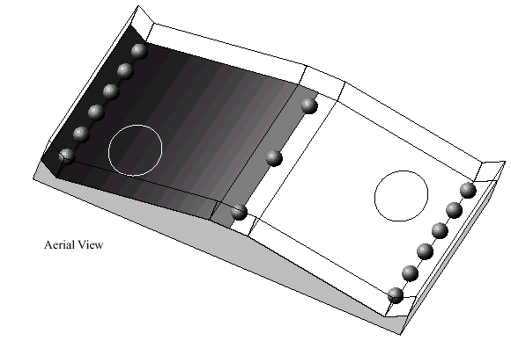
Robo-Pong Contest
Run at MIT January 1991
Involved 2 robots and 15 plastic golf balls
Goal:
have your robot transport balls from its side of table to opponent’s in 60 seconds
Robot with fewer balls on its side is the winner
Table 4x6 feet, inclined surfaces, small plateau area in center
Robots start in circles, balls placed as shown
Robots could use reflectance sensors to determine which side they were on
Plan encouraged diversity in robot strategies

Slide 36
Robo-Pong Contest
Necessary skills:
go uphill and downhill, maneuver in the trough area, and coordinate activities of collecting and delivering balls
Ball-collecting robots
Harvester Robots: scooped the balls into some sort of open arms and then pushed them onto the opponent’s side of the playing field
Eater Robots: collected balls “inside their bodies” (more complex mechanically)
Shooter robots: catapulted balls onto the opponent’s side of the table
If a ball went over the playing field wall on the opponent’s territory, the ball would be permanently scored against the opponent
Sophisticated mechanical design
Lost against aggressor designs

Slide 37
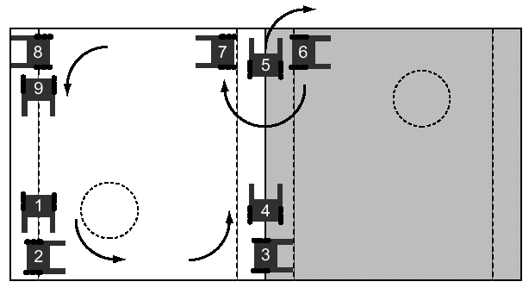
Robo-Pong Contest
Strategy pattern of Groucho, an algorithmic ball-harvester
Linear series of actions, which are performed in a repetitive loop
Sensing may be used in the service of these actions, but it does not change the order in which they will be performed.
Some feedback based on the surrounding environment would be necessary

Slide 38
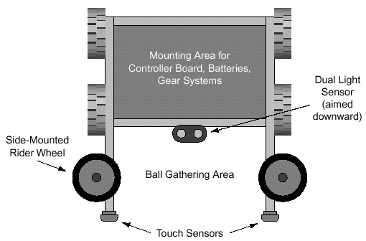
Groucho’s Mechanics
Basic turtle drive system with
pair of driven wheels one each side
Pair of free-spinning rider
wheels mounted parallel to the floor ⇒ driving along a wall with no sensing or feedback required
Two kinds of sensors:
a touch sensor at the end each of of its “arms,”
a pair of light sensors facing downward located near its geometric center

Slide 39
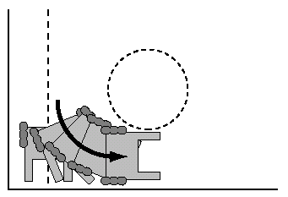
Groucho’s Strategy
Taking corners
From position 1 to position 2:
a repetitive series of little turns and
collisions back into the wall
(four or five iterations)
Reliable turning method
if the wheels slipped a little on one turn, Groucho kept turning until the touch sensor no longer struck the wall—in which case, it would have completed its turn
This method works for a wide range of corners—ones less than and greater than the right angles on the Robo-Pong playing field

Slide 40
Groucho’s Strategy
Ninety degree turns
From position 3 to position 4, a single timed
turn movement
Crossing the center plateau
Use feedback sensing from a dual light sensor, aimed downward at the playing surface
One sensor was kept on the dark side of the table and the other on the light side
Summary:
algorithmic strategy method is relatively simple and can be effective when a straight-forward algorithm can be devised

Slide 41
Strengths and Weaknesses of Algorithmic Control
Strengths:
Simplicity, directness, and predictability when things go according to plan
Weaknesses:
Inability to detect or correct for problems or unexpected circumstances, and the chained-dependencies required for proper functioning
If any one step fails, the whole solution typically fails
Each link-step of an algorithmic solution has a chance of failing, and this chance multiplies throughout the set of steps
E.g., if each step has a 90% chance of functioning properly and there are six such steps in the solution ⇒ the likelihood of overall program working is the likelihood that each steps functions properly: ~53% chance

Slide 42
Bolstering Algorithmic Control
Have separable steps along the way performed by feedback loops
Handling of inside corners: use a series of little turns and bumps
Assumes that Groucho would not hit the wall perpendicularly
Through feedback ⇒ can compensate for variances in the playing field, the performance of the robot, and real-world unpredictability
Crossing the plateau
The rolling rider wheels ensured that the robot is properly oriented
The right-angle turn was immediately followed by a feedback program that tracked the light/dark edge
Embed feedback controls within the algorithmic framework

Slide 43
Exit Conditions
Problem with simple algorithmic approach:
No provision for detecting or correcting for, problem situations
Groucho’s program:
Robot is waiting for a touch sensor to trigger the next phase of action
If something would impede its travel, without striking a touch sensor, Groucho would be unable to take corrective action
While crossing the top plateau the opponent robot gets in the way, and triggers a touch sensor ⇒ Groucho would begin its behavior activated when reaching the opposing wall
Solution: techniques for error detection and recovery within an algorithmic framework
“Knowing” that it had struck the opponent

Slide 44
Exit Conditions
- Timeouts
Going from position 4 to 5:
Traverses light/dark edge across the field
Check for touch sensor to continue
Problem:
Only way to exit is if one of the touch sensors is pressed
Solution:
Allow the subroutine to time out
After a predetermined period of time has elapsed, the subroutine exits even if a touch sensor was not pressed

Slide 45
Exit Conditions - Timeouts
Inform the higher level control program of abnormal exit by returning a value indicating
Normal termination (with a touch sensor press) or abnormal termination (because of a timeout)
Another Problem: routine finishes in too little time
Solution:
Use a “too-long” and a “too-short” timeout
If elapsed time is less than TOO-SHORT ⇒ procedure returns an EARLY error result

Slide 46
Exit Conditions – Premature Exits
Edge-following section
Veer left, go straight, going right
Problem:
Robot shouldn’t stay in any of these modes for very long
Solution: monitor the transitions between the different modes of the feedback loop
Parameters representing longest time that Groucho may spend continuously in any given state
State variables: last_mode and last_time
Return codes to represent the states: stuck veering left/right/straight

Slide 47
Exit Conditions – Taking Action
What action to take after learning that a problem has occurred?
Robot gets stuck following the edge (position 4 to 5)
Robot has run into the opponent robot
Robot has mistracked the median edge
Something else has gone wrong
Solution
After an error condition re-examine all other sensors to try to make sense of the situation (e.g. detecting the opponent robot)
Difficult to design appropriate reactions to any possible situation
A single recovery behavior would suffice for many circumstances
Groucho: heading downhill until hitting the bottom wall and then proceeding with the cornering routine

Slide 48
Control Architectures
Feedback control is very good for doing one thing
Wall following, obstacle avoidance
Most non-trivial tasks require that robots do multiple things at the same time
How can we put multiple feedback controllers together?
Find guiding principles for robot programming

Slide 49
Control Architecture
A robot control architecture provides the guiding principles for organizing a robot’s control system
It allows the designer to produce the desired overall behavior
The term architecture is used similarly as “computer architecture”
Set of principles for designing computers from a collection of well-understood building blocks
The building-blocks in robotics are dependent on the underlying control architecture

Slide 50
Software/Hardware Control
Robot control involves hardware, signal processing and computation
Controllers may be implemented:
In hardware: programmable logic arrays
In software: conventional program running on a processor
The more complex the controller, the more likely it will be implemented in software
In general, robot control refers to software control

Slide 51
Languages for Robot Programming
Control architectures may be implemented in various programming languages
Turing universality: a programming language is Turing universal if it has the following capabilities:
Sequencing: a then b then c
Conditional branching: if a then b else c
Iteration: for a = 1 to 10 do something
With these one can compute the entire class of computable functions
All major programming languages are Turing Universal

Slide 52
Computability
Architectures are all equivalent in computational expressiveness
If an architecture is implemented in a Turing Universal programming language, it is fully expressive
No architecture can compute more than another
The level of abstraction may be different
Architectures, like languages are better suited to a particular domain

Slide 53
Organizing Principles
Architectures are built from components, specific for the particular architecture
The ways in which these building blocks are connected facilitate certain types of robotic design
Architectures do greatly affect and constrain the structure of the robot controller (e.g., behavior representation, granularity, time scale…)
Control architectures do not constrain expressiveness
Any language can compute any computable function ⇒ the architecture on top of it cannot further limit it

Slide 54
Uses of Programming Languages
Programming languages are designed for specific uses
Web programming
Games
Robots
A control architecture may be implemented in any programming language
Some languages are better suited then others
Standard: Lisp, C, C++
Specialized: Behavior-Language, Subsumption Language

Slide 55
Specialized Languages for Robot Control
Why not use always a language that is readily available (C, Java)?
Specialized languages facilitate the implementation of the guiding principles of a control architecture
Coordination between modules
Communication between modules
Prioritization
Etc.

Slide 56
Robot Control Architectures
There are infinitely many ways to program a robot, but there are only few types of robot control:
Deliberative control (no longer in use)
Reactive control
Hybrid control
Behavior-based control
Numerous “architectures” are developed, specifically designed for a particular control problem
However, they all fit into one of the categories above

Slide 57
Comparing Architectures
The previous criteria help us to compare and evaluate different architectures relative to specific robot designs, tasks, and environments
There is no perfect recipe for finding the right control architecture
Architectures can be classified by the way in which they treat:
Time-scale (looking ahead)
Modularity
Representation

Slide 58
Time-Scale and Looking Ahead
How fast does the system react? Does it look into the future?
Deliberative control
Look into the future (plan) then execute ⇒ long time scale
Reactive control
Do not look ahead, simply react ⇒ short time scale
Hybrid control
Look ahead (deliberative layer) but also react quickly (reactive layer)
Behavior-based:
Look ahead while acting

Slide 59
Modularity
Refers to the way the control system is broken into components
Deliberative control
Sensing (perception), planning and acting
Reactive control
Multiple modules running in parallel
Hybrid control
Deliberative, reactive, middle layer
Behavior-based:
Multiple modules running in parallel

Slide 60
Representation
Representation is the form in which the control system internally stores information
Internal state
Internal representations
Internal models
History
What is represented and how it is represented has a major impact on robot control
State refers to the "status" of the system itself, whereas "representation" refers to arbitrary information that the robot stores

Slide 61
An Example
Consider a robot that moves in a maze: what does the robot need to know to navigate and get out?
Store the path taken to the end of the maze
Straight 1m, left 90 degrees, straight 2m, right 45 degrees
Odometric path
Store a sequence of moves it has made at particular landmark in the environment
Left at first junction, right at the second, left at the third
Landmark-based path

Slide 62
Topological Map
Store what to do at each landmark in the maze
Landmark-based map
The map can be stored (represented) in different forms
Store all possible paths and use the shortest one
Topological map: describes the connections among the landmarks
Metric map: global map of the maze with exact lengths of corridors and distances between walls, free and blocked paths: very general!
The robot can use this map to find new paths through the maze
Such a map is a world model, a representation of the environment

Slide 63
World Models
Numerous aspects of the world can be represented
self/ego: stored proprioception, self-limits, goals, intentions, plans
space: metric or topological (maps, navigable spaces, structures)
objects, people, other robots: detectable things in the world
actions: outcomes of specific actions in the environment
tasks: what needs to be done, in what order, by when
Ways of representation
Abstractions of a robot’s state & other information

Slide 64
Model Complexity
Some models are very elaborate
They take a long time to construct
These are kept around for a long time throughout the lifetime of the robot
E.g.: a detailed metric map
Other models are simple
Can be quickly constructed
In general they are transient and can be discarded after use
E.g.: information related to the immediate goals of the robot (avoiding an obstacle, opening of a door, etc.)

Slide 65
Models and Computation
Using models require significant amount of computation
Construction: the more complex the model, the more computation is needed to construct the model
Maintenance: models need to be updated and kept up-to-date, or they become useless
Use of representations: complexity directly affects the type and amount of computation required for using the model
Different architectures have different ways of handling representations

Slide 66
An Example
Consider a metric map
Construction:
Requires exploring and measuring the environment and intense computation
Maintenance:
Continuously update the map if doors are open or closed
Using the map:
Finding a path to a goal involves planning: find free/navigational spaces, search through those to find the shortest, or easiest path

Slide 67
Simultaneous Mapping and Localization

Slide 68
Cooperative Mapping and Localization

Slide 69
Readings
M. Matarić: Chapter 10

