Slide 1
Autonomous Mobile Robots
CPE 470/670
Lecture 9
Instructor: Monica Nicolescu

Slide 2
Reactive Control
Reactive control is based on tight (feedback) loops connecting a robot's sensors with its effectors
Purely reactive systems do not use any internal representations of the environment, and do not look ahead
  They work on a short time-scale and react to the current sensory information
Reactive systems use minimal, if any, state information

Slide 3
Collections of Rules
Reactive systems consist of collections of reactive rules that map specific situations to specific actions
Analog to stimulus-response, reflexes
  Bypassing the “brain” allows reflexes to be very fast
Rules are running concurrently and in parallel
Situations
  Are extracted directly from sensory input
Actions
  Are the responses of the system (behaviors)

Slide 4
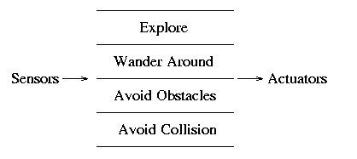
The Subsumption Architecture
Principles of design
  systems are built from
  the bottom up
  components are task-achieving
  actions/behaviors (avoid-obstacles, find-doors, visit-rooms)
  components are organized in layers, from the bottom up
  lowest layers handle most basic tasks
  all rules can be executed in parallel, not in a sequence
  newly added components and layers exploit the existing ones

Slide 5

Communication Through the World
Collecting soda cans: Herbert
Herbert’s capabilities
  Move around without running into obstacles
  Detect soda cans using a camera and a laser
  An arm that could: extend, sense if there is a can in the gripper, close the gripper, tuck the arm in

Slide 6
Herbert
Look for soda cans, when seeing one approach it
When close, extend the arm toward the soda can
If the gripper sensors detect something, close the gripper
If can is heavy, put it down, otherwise pick it up
If gripper was closed, tuck the arm in and head home
The robot did not keep internal state about what it had just done and what it should do next: it just sensed!

Slide 7
More on Herbert
There is no internal wire between the layers that achieve can finding, grabbing, arm tucking, and going home
However, the events are all executed in proper sequence. Why?
Because the relevant parts of the control system interact and activate each other through sensing the world

Slide 8
World as the Best Model
This is a key principle of reactive systems & Subsumption Architecture:
  Use the world as its own best model!
If the world can provide the information directly (through sensing), it is best to get it that way, than to store it internally in a representation (which may be large, slow, expensive, and outdated)

Slide 9
Subsumption System Design
What makes a Subsumption Layer, what should go where?
There is no strict recipe, but some solutions are better than others, and most are derived empirically
How exactly layers are split up depends on the specifics of the robot, the environment, and the task

Slide 10
Designing in Subsumption
Qualitatively specify the overall behavior needed for the task
Decompose that into specific and independent behaviors (layers)
Determine behavior granularity
Ground low-level behaviors in the robot’s sensors and effectors
Incrementally build, test, and add

Slide 11
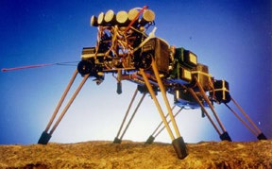
Genghis (MIT)
Walk over rough terrain and follow a human (Brooks ’89)
  Standup
    Control leg’s swing position and lift
  Simple walk
  Force balancing
    Force sensors provide information about the ground profile
  Leg lifting: step over obstacles
  Obstacle avoidance (whiskers)
  Pitch stabilization
  Prowling
  Steered prowling

Slide 12
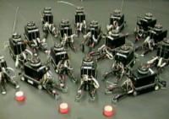
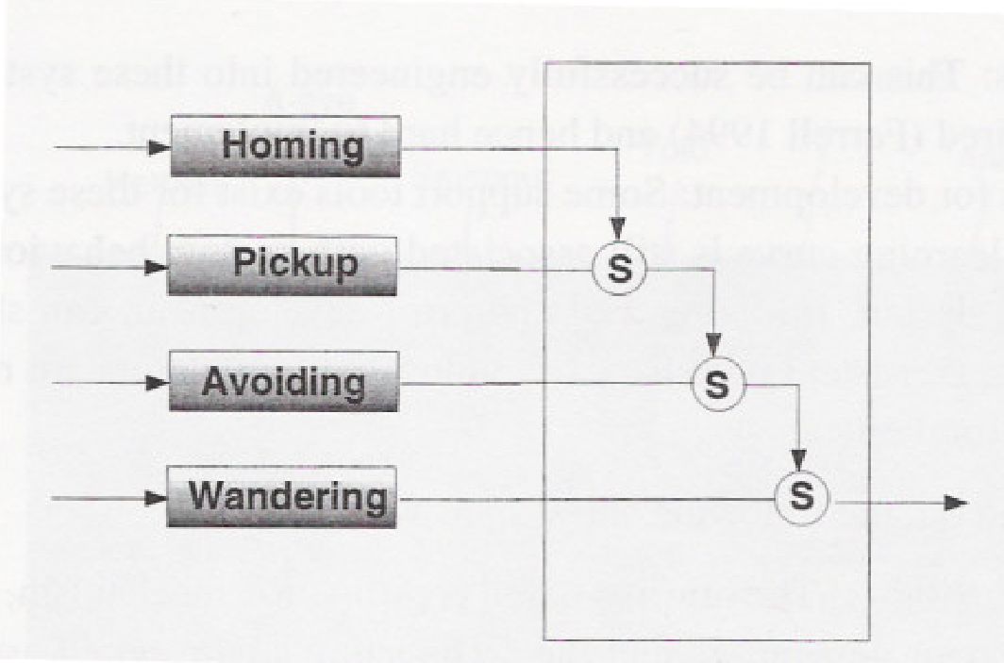
The Nerd Herd (MIT)
Foraging example (Matarić ’93)
  R1 robots (IS robotics)
Behaviors involved:
  Wandering
  Avoiding
  Pickup
  Homing

Slide 13
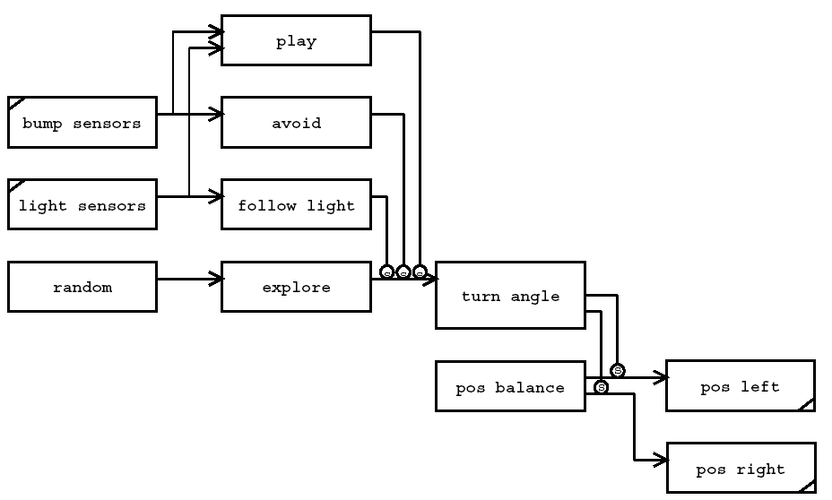
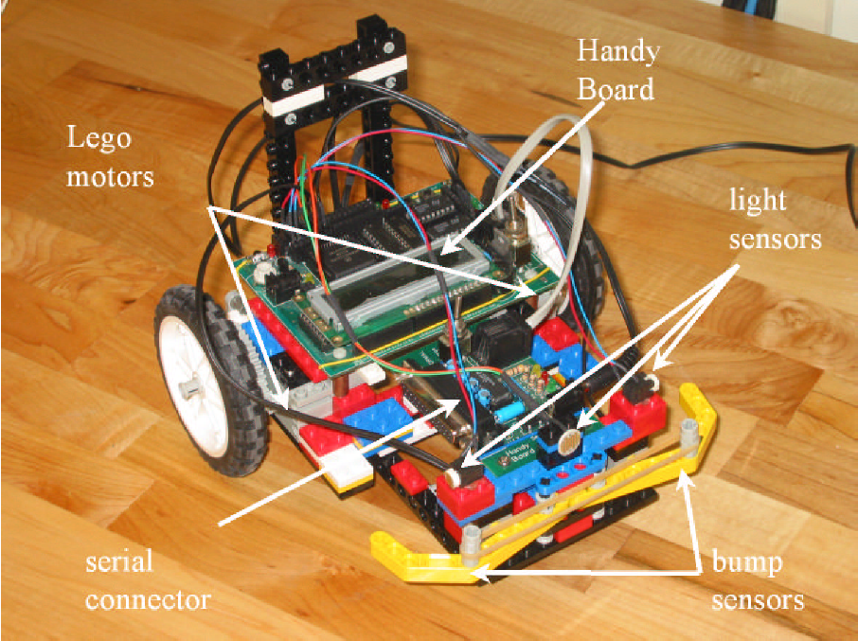
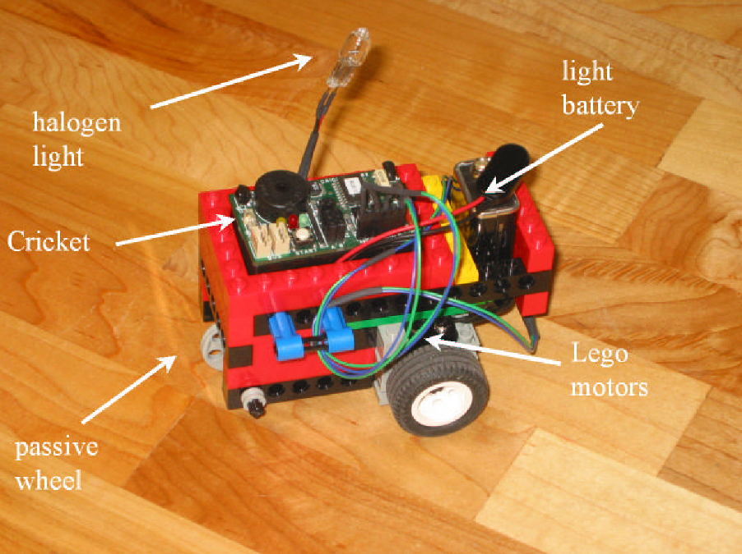
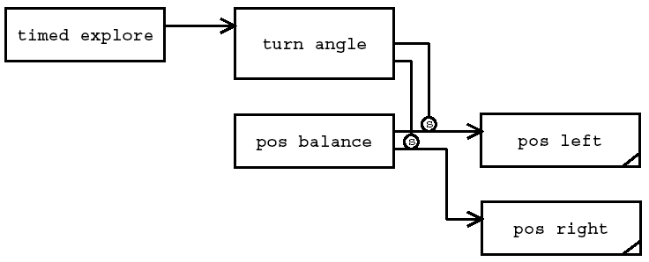
Tom and Jerry (MIT)
fsdf
Tom
Jerry

Slide 14
Pros and Cons
Some critics consider the lack of detail about designing layers to be a weakness of the approach
Others feel it is a strength, allowing for innovation and creativity
Subsumption has been used on a vast variety of effective implemented robotic systems
It was the first architecture to demonstrate many working robots

Slide 15
Benefits of Subsumption
Systems are designed incrementally
  Avoid design problems due to the complexity of the task
  Helps the design and debugging process
Robustness
  If higher levels fail, the lower ones continue unaffected
Modularity
  Each “competency” is included into a separate layer, thus making the system manageable to design and maintain
  Rules and layers can be reused on different robots and for different tasks

Slide 16
Behavior-Based Control
Reactive systems
  Too inflexible, use no representation, no adaptation or learning
Deliberative systems
  Too slow and cumbersome
Hybrid systems
  Complex interactions among the hybrid components
Behavior-based control involves the use of “behaviors” as modules for control

Slide 17
What Is a Behavior?
Behavior-achieving modules
Rules of implementation
Behaviors achieve or maintain particular goals (homing, wall-following)
Behaviors are time-extended processes
Behaviors take inputs from sensors and from other behaviors and send outputs to actuators and other behaviors
Behaviors are more complex than actions (stop, turn-right vs. follow-target, hide-from-light, find-mate etc.)

Slide 18
Principles of BBC Design
Behaviors are executed in parallel, concurrently
  Ability to react in real-time
Networks of behaviors can store state (history), construct world models/representation and look into the future
  Use representations to generate efficient behavior
Behaviors operate on compatible time-scales
  Ability to use a uniform structure and representation throughout the system

Slide 19
An Example Task: Mapping
Design a robot that is capable of:
  Moving around safely
  Make a map of the environment
  Use the map to find the shortest paths to particular places
Navigation & mapping are the most common mobile robot tasks

Slide 20
Map Representation
The map is distributed over different behaviors
We connect parts of the map that are adjacent in the environment by connecting the behaviors that represent them
The network of behaviors represents a network of locations in the environment
Topological map: Toto (Matarić ’90)

Slide 21
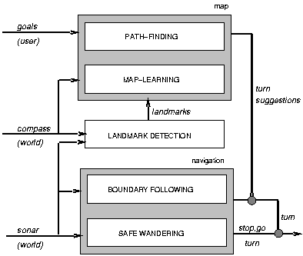

Toto’s Controller

Slide 22
Landmark Detection
Keep track of what was sensed and how it was moving
  meandering ⇒ cluttered area
  constant compass direction, go straight ⇒ left, right walls
  moving straight, both walls ⇒ corridor

Slide 23
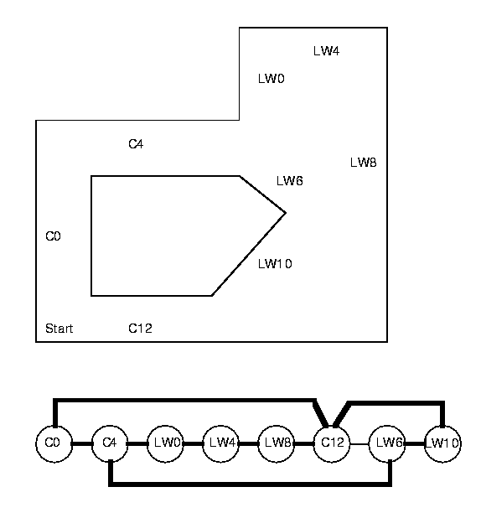
Building a Map
Each landmark was stored in a behavior
Whenever a new landmark was discovered a new behavior was added
Adjacent landmarks are connected by communication wires
This resulted in a topological representation of the environment, i.e., a topological world model

Slide 24
Toto’s Mapping Behaviors
Each landmark was stored in a behavior
Each such landmark behavior stored (remembered) some information
  landmark type (wall, corridor, irregular)
  compass heading
  approximate length/size
  some odometry
my-behavior-type: corridor
my-compass-direction: NV
my-approximate-location: x,y
my-approximate-length: length
whenever received (input)
if input(behavior-type)= my-behavior-type
and input (compass-direction) = my-compass-direction
then
active <- true

Slide 25
Localization
Whenever a landmark is detected, its description (type, compass direction, etc.) is sent to all behaviors in parallel ⇒ the one that matches becomes active
When nothing in the map matches ⇒ a new place/landmark was discovered and added to the map
If an existing behavior was activated, it inhibited any other active behaviors

Slide 26
Getting Around
Toto can use the map to navigate
The behavior that corresponds to the goal sends messages (spreads activation) to all of its neighbors
The neighbors send messages to their neighbors in turn
So on, until the messages reach the currently active behavior
This forms path(s) from the current state to the goal

Slide 27
Path Following
Toto did not keep a sequence of behaviors
Instead, messages were passed continuously
  Useful in changing environments
How does Toto decide where to go if multiple choices are available?
  Rely on the landmark size: behaviors add up their own length as messages are passed from one behavior to another ⇒ give path length
  Choose the shortest path
Thus, one behavior at a time, it reached the goal
Video: http://robotics.usc.edu/interaction/movies/ilab_toto1.mov

Slide 28
Expression of Behaviors
Example:
  Going from a classroom to another
What does it involve?
  Getting to the destination from the current location
  Not bumping into obstacles along the way
  Making your way around students on corridors
  Deferring to elders
  Coping with change in the environment

Slide 29
Stimulus-Response Diagrams
Behaviors are represented as a general response to a particular stimulus
move-to-class
C
O
O
R
D
I
N
A
T
O
R
class location
detected object
avoid-object
detected student
dodge-student
Actions
detected path
stay-right
detected elder
defer-to-elder

Slide 30
Finite State Acceptor Diagrams
Useful for describing aggregations and sequences of behaviors
Finite state acceptor:
  Q: set of allowable behavioral states
  δ: transition function from (input, current state) → new state
  q₀: initial state
  F: set of accepting (final) states
other
not-at-class
all
Start
move
Journey
error
Lost
reached-class
At-class
all

Slide 31
Formal Methods
Have very useful properties for the programmer
  Can be used to verify designer intentions
  Provide a framework for formal analysis of the program, adequacy and completeness
  Facilitate the automatic generation of control systems
  Provide a common language for expressing robot behaviors
  Provide support for high-level programming language design

Slide 32
Situated Automata
Kaelbling & Rosenschein (’91)
Controllers are designed as logic circuits
Capable of reasoning
REX: Lisp-based language
  First language to encode a reactive systems with synchronous digital circuitry
Gapps: goals are specified more directly
  Achievement, maintenance, execution
  Logical boolean operators are used to create higher-level goals ⇒ generate circuits

Slide 33
Situated Automata
(defgoalr (ach in-classroom)
(if (not start-up)
(maint (and (maint move-to-classroom) (maint avoid-objects)
(maint dodge-students)
(maint stay-to-right-on-path)
(maint defer-to-elders)
)
)
)
)

Slide 34
Discrete Behavioral Encoding
The behavior consists of a set finite set of (situation, response) pairs
Rule-based systems
IF antecedent THEN consequent
Condition-action production rules (Nilsson ’94)
  Produce durative actions: “move at 5m/s” vs. “move 5 m”
The Subsumption Architecture
(whenever condition & consequent)
(defbehavior name & inputs outputs declarations processes)

Slide 35
Readings
M. Matarić: Chapter 11, 12, 14

