Slide 1
Analysis of Algorithms
CS 477/677
Instructor: Monica Nicolescu
Lecture 10

Slide 2
A Better Selection Algorithm
Can perform Selection in O(n) Worst Case
Idea: guarantee a good split on partitioning
  Running time is influenced by how “balanced” are the resulting partitions
Use a modified version of PARTITION
  Takes as input the element around which to partition

Slide 3
Selection in O(n) Worst Case
A:
x₁
x₂
x₃
x_{⎡n/5⎤}
x
k – 1 elements
x
n - k elements
Divide the n elements into groups of 5 ⇒⎡n/5⎤ groups
Find the median of each of the ⎡n/5⎤ groups
  Use insertion sort, then pick the median
Use SELECT recursively to find the median x of the ⎡n/5⎤ medians
Partition the input array around x, using the modified version of PARTITION
  There are k-1 elements on the low side of the partition and n-k on the high side
If i = k then return x. Otherwise, use SELECT recursively:
  Find the i-th smallest element on the low side if i < k
  Find the (i-k)-th smallest element on the high side if i > k

Slide 4
Recurrence for the Running Time
Step 1: making groups of 5 elements takes
Step 2: sorting n/5 groups in O(1) time each takes
Step 3: calling SELECT on ⎡n/5⎤ medians takes time
Step 4: partitioning the n-element array around x takes
Step 5: recursion on one partition takes
T(n) = T(⎡n/5⎤) + T(7n/10 + 6) + O(n)
We will show that T(n) = O(n)
O(n)
O(n)
T(⎡n/5⎤)
O(n)
time ≤ T(7n/10 + 6)

Slide 5
Substitution
T(n) = T(⎡n/5⎤) + T(7n/10 + 6) + O(n)
Show that T(n) ≤ cn for some constant c > 0 and all n ≥ n₀
T(n) ≤ c ⎡n/5⎤ + c (7n/10 + 6) + an
≤ cn/5 + c + 7cn/10 + 6c + an
= 9cn/10 + 7c + an
= cn + (-cn/10 + 7c + an)
≤ cn if: -cn/10 + 7c + an ≤ 0
c ≥ 10a(n/(n-70))
  choose n₀ > 70 and obtain the value of c

Slide 6
How Fast Can We Sort?
Insertion sort, Bubble Sort, Selection Sort
Merge sort
Quicksort
What is common to all these algorithms?
  These algorithms sort by making comparisons between the input elements
To sort n elements, comparison sorts must make 𝝮(nlgn) comparisons in the worst case
Θ(n²)
Θ(nlgn)
Θ(nlgn)

Slide 7
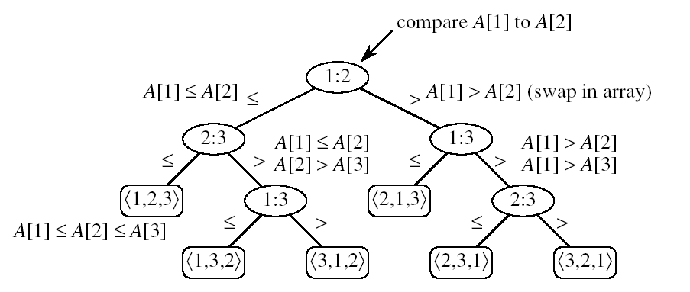
Decision Tree Model
Represents the comparisons made by a sorting algorithm on an input of a given size: models all possible execution traces
Control, data movement, other operations are ignored
Count only the comparisons
Decision tree for insertion sort on three elements:
one execution trace
node
leaf:

Slide 8
Decision Tree Model
All permutations on n elements must appear as one of the leaves in the decision tree
Worst-case number of comparisons
  the length of the longest path from the root to a leaf
  the height of the decision tree
n! permutations

Slide 9
Decision Tree Model
Goal: finding a lower bound on the running time on any comparison sort algorithm
  find a lower bound on the heights of all decision trees for all algorithms

Slide 10
Lemma
Any binary tree of height h has at most
Proof: induction on h
Basis: h = 0 ⇒ tree has one node, which is a leaf
2^{h} = 1
Inductive step: assume true for h-1
  Extend the height of the tree with one more level
  Each leaf becomes parent to two new leaves
  No. of leaves for tree of height h =
  = 2 ×(no. of leaves for tree of height h-1)
  ≤ 2 ×2^{h-1}
  = 2^{h}
2^{h} leaves

Slide 11
Lower Bound for Comparison Sorts
Theorem: Any comparison sort algorithm requires 𝝮(nlgn) comparisons in the worst case.
Proof: How many leaves does the tree have?
  At least n! (each of the n! permutations of the input appears as some leaf) ⇒ n! ≤ l
  At most 2^{h} leaves
⇒ n! ≤ l ≤ 2^{h}
⇒ h ≥ lg(n!) = 𝝮(nlgn)
h
leaves l
We can beat the 𝝮(nlgn) running time if we use other operations than comparisons!

Slide 12
Counting Sort
Assumption:
  The elements to be sorted are integers in the range 0 to k
Idea:
  Determine for each input element x, the number of elements smaller than x
  Place element x into its correct position in the output array
1
2
3
4
5
6
7
8
0
1
2
3
4
5
A
2
5
3
0
2
3
0
3
C
2
2
4
7
7
8
1
2
3
4
5
6
7
8
B
0
0
2
2
3
3
3
5

Slide 13
COUNTING-SORT
1
j
n
A
  Alg.: COUNTING-SORT(A, B, n, k)
  for i ← 0 to k
  do C[ i ] ← 0
  for j ← 1 to n
  do C[A[ j ]] ← C[A[ j ]] + 1
  C[i] contains the number of elements equal to i
  for i ← 1 to k
  do C[ i ] ← C[ i ] + C[i -1]
  C[i] contains the number of elements ≤ i
  for j ← n downto 1
  do B[C[A[ j ]]] ← A[ j ]
  C[A[ j ]] ← C[A[ j ]] - 1
0
k
C
1
n
B

Slide 14
Example
1
2
3
4
5
6
7
8
0
1
2
3
4
5
A
2
5
3
0
2
3
0
3
C
2
2
4
7
7
8
0
1
2
3
4
5
C
2
0
2
3
0
1
1
2
3
4
5
6
7
8
1
2
3
4
5
6
7
8
B
3
B
0
3
0
1
2
3
4
5
0
1
2
3
4
5
C
2
2
4
6
7
8
C
1
2
4
6
7
8
1
2
3
4
5
6
7
8
1
2
3
4
5
6
7
8
B
0
3
3
B
0
2
3
3
0
1
2
3
4
5
0
1
2
3
4
5
C
1
2
4
5
7
8
C
1
2
3
5
7
8

Slide 15
Example (cont.)
1
2
3
4
5
6
7
8
A
2
5
3
0
2
3
0
3
1
2
3
4
5
6
7
8
1
2
3
4
5
6
7
8
B
0
0
2
3
3
B
0
0
2
3
3
3
5
0
1
2
3
4
5
0
1
2
3
4
5
C
0
2
3
5
7
8
C
0
2
3
4
7
7
1
2
3
4
5
6
7
8
1
2
3
4
5
6
7
8
B
0
0
2
3
3
3
B
0
0
2
2
3
3
3
5
0
1
2
3
4
5
C
0
2
3
4
7
8

Slide 16
Analysis of Counting Sort
  Alg.: COUNTING-SORT(A, B, n, k)
  for i ← 0 to k
  do C[ i ] ← 0
  for j ← 1 to n
  do C[A[ j ]] ← C[A[ j ]] + 1
  C[i] contains the number of elements equal to i
  for i ← 1 to k
  do C[ i ] ← C[ i ] + C[i -1]
  C[i] contains the number of elements ≤ i
  for j ← n downto 1
  do B[C[A[ j ]]] ← A[ j ]
  C[A[ j ]] ← C[A[ j ]] - 1
Θ(k)
Θ(n)
Θ(k)
Θ(n)
Overall time: Θ(n + k)

Slide 17
Analysis of Counting Sort
Overall time: Θ(n + k)
In practice we use COUNTING sort when k = O(n)
⇒ running time is Θ(n)
Counting sort is stable
  Numbers with the same value appear in the same order in the output array
  Important when additional data is carried around with the sorted keys

Slide 18

Radix Sort
Considers keys as numbers in a base-k number
  A d-digit number will occupy a field of d columns
Sorting looks at one column at a time
  For a d digit number, sort the least significant digit first
  Continue sorting on the next least significant digit, until all digits have been sorted
  Requires only d passes through the list

Slide 19

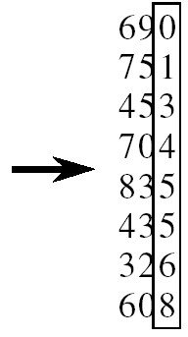
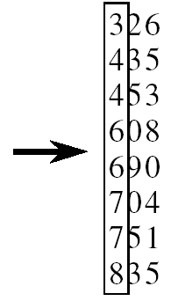
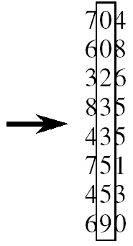
RADIX-SORT
Alg.: RADIX-SORT(A, d)
for i ← 1 to d
do use a stable sort to sort array A on digit i
1 is the lowest order digit, d is the highest-order digit

Slide 20
Analysis of Radix Sort
Given n numbers of d digits each, where each digit may take up to k possible values, RADIX-SORT correctly sorts the numbers in Θ(d(n+k))
  One pass of sorting per digit takes Θ(n+k) assuming that we use counting sort
  There are d passes (for each digit)

Slide 21
Correctness of Radix sort
We use induction on the number d of passes through the digits
Basis: If d = 1, there’s only one digit, trivial
Inductive step: assume digits 1, 2, . . . , d-1 are sorted
  Now sort on the d-th digit
  If a_{d} < b_{d}, sort will put a before b: correct
  a < b regardless of the low-order digits
  If a_{d} > b_{d}, sort will put a after b: correct
  a > b regardless of the low-order digits
  If a_{d} = b_{d}, sort will leave a and b in the
  same order and a and b are already sorted
  on the low-order d-1 digits

Slide 22
Bucket Sort
Assumption:
  the input is generated by a random process that distributes elements uniformly over [0, 1)
Idea:
  Divide [0, 1) into n equal-sized buckets
  Distribute the n input values into the buckets
  Sort each bucket
  Go through the buckets in order, listing elements in each one
Input: A[1 . . n], where 0 ≤ A[i] < 1 for all i
Output: elements in A sorted
Auxiliary array: B[0 . . n - 1] of linked lists, each list initially empty

Slide 23
BUCKET-SORT
Alg.: BUCKET-SORT(A, n)
for i ← 1 to n
do insert A[i] into list B[⎣nA[i]⎦]
for i ← 0 to n - 1
do sort list B[i] with insertion sort
concatenate lists B[0], B[1], . . . , B[n -1] together in order
return the concatenated lists

Slide 24
Example - Bucket Sort
1
.78
.17
.39
.26
.72
.94
.21
.12
.23
.68
0
/
2
1
.17
.12 /
3
2
.26
.21
.23 /
4
3
.39 /
5
4
/
6
5
/
7
6
.68 /
8
7
.78
.72 /
9
8
/
10
9
.94 /

Slide 25
Example - Bucket Sort
.12
.17
.21
.23
.26
.39
.68
.72
.78
.94 /
0
/
1
.12
.17 /
2
.21
.23
.26 /
3
.39 /
4
/
5
/
6
.68 /
7
.72
.78 /
Concatenate the lists from
0 to n – 1 together, in order
8
/
9
.94 /

Slide 26
Correctness of Bucket Sort
Consider two elements A[i], A[ j]
Assume without loss of generality that A[i] ≤ A[j]
Then ⎣nA[i]⎦ ≤ ⎣nA[j]⎦
  A[i] belongs to the same group as A[j] or to a group with a lower index than that of A[j]
If A[i], A[j] belong to the same bucket:
  insertion sort puts them in the proper order
If A[i], A[j] are put in different buckets:
  concatenation of the lists puts them in the proper order

Slide 27
Analysis of Bucket Sort
Alg.: BUCKET-SORT(A, n)
for i ← 1 to n
do insert A[i] into list B[⎣nA[i]⎦]
for i ← 0 to n - 1
do sort list B[i] with insertion sort
concatenate lists B[0], B[1], . . . , B[n -1] together in order
return the concatenated lists
𝝤(n)
Θ(n)
𝝤(n)
Θ(n)

Slide 28
Conclusion
Any comparison sort will take at least nlgn to sort an array of n numbers
We can achieve a better running time for sorting if we can make certain assumptions on the input data:
  Counting sort: each of the n input elements is an integer in the range 0 to k
  Radix sort: the elements in the input are integers represented with d digits
  Bucket sort: the numbers in the input are uniformly distributed over the interval [0, 1)

Slide 29
Readings
Chapter 8

