Slide 1
Analysis of Algorithms
CS 477/677
Instructor: Monica Nicolescu
Lecture 14

Slide 2
Order-Statistic Tree
Def.: Order-statistic tree: a red-black tree with additional information stored in each node
Node representation:
  Usual fields: key[x], color[x], p[x], left[x], right[x]
  Additional field: size[x] that contains the number of (internal) nodes in the subtree rooted at x (including x itself)
For any internal node of the tree:
size[x] =
size[left[x]] + size[right[x]] + 1

Slide 3
Example: Order-Statistic Tree
key
10
7
size
8
15
3
3
4
9
11
19
1
1
1
1

Slide 4
Maintaining Subtree Sizes
We need to maintain the size field during INSERT and DELETE operations
Need to maintain them efficiently
Otherwise, might have to recompute all size fields, at a cost of 𝝮(n)

Slide 5
Maintaining Size for OS-INSERT
Insert in a red-black tree has two stages
  Perform a binary-search tree insert
  Perform rotations and change node colors to restore red-black tree properties

Slide 6
OS-INSERT
Idea for maintaining the size field during insert
Phase 1 (going down):
Increment size[x] for each node x on the traversed path from the root to the leaves
The new node gets a size of 1
Constant work at each node, so still O(lgn)
10
7
8
15
3
3
4
9
11
19
1
1
1
1

Slide 7
OS-INSERT
Idea for maintaining the size field during insert
Phase 2 (going up):
  During RB-INSERT-FIXUP there are:
    O(lgn) changes in node colors
    At most two rotations
Rotations affect the subtree sizes !!
42
x
93
y
size[y] = size[x]
19
19
LEFT-ROTATE(T, x)
6
93
y
42
x
7
12
size[x] = size[left[x]] +
size[right[x]] + 1
11
4
7
6
4
Maintain size in: O(lgn)

Slide 8
Augmenting a Data Structure
Choose an underlying data structure
Determine additional information to maintain
Verify that we can maintain additional information for existing data structure operations
Develop new operations
⇒ Red-black trees
⇒ size[x]
⇒ Shown how to maintain size during modifying operations
⇒ Developed OS-RANK and OS-SELECT

Slide 9
Augmenting Red-Black Trees
Theorem: Let f be a field that augments a red-black tree. If the contents of f for a node can be computed using only the information in x, left[x], right[x] ⇒ we can maintain the values of f in all nodes during insertion and deletion, without affecting their O(lgn) running time.

Slide 10
Examples
Can we augment a RBT with size[x]?
Yes: size[x] = size[left[x]] + size[right[x]] + 1
Can we augment a RBT with height[x]?
Yes: height[x] = 1 + max(height[left[x]], height[right[x]])
Can we augment a RBT with rank[x]?
No, inserting a new minimum will cause all n rank values to change

Slide 11
Interval Trees
Def.: Interval tree = a red-black tree that maintains a dynamic set of elements, each element x having associated an interval int[x].
Operations on interval trees:
  INTERVAL-INSERT(T, x)
  INTERVAL-DELETE(T, x)
  INTERVAL-SEARCH(T, i)

Slide 12
Interval Properties
Intervals i and j overlap iff:
low[i] ≤ high[j] and low[j] ≤ high[i]
Intervals i and j do not overlap iff:
high[i] < low[j] or high[j] < low[i]
i
i
i
i
j
j
j
j
i
j
j
i

Slide 13
Interval Trichotomy
Any two intervals i and j satisfy the interval trichotomy: exactly one of the following three properties holds:
  i and j overlap,
  i is to the left of j (high[i] < low[j])
  i is to the right of j (high[j] < low[i])

Slide 14
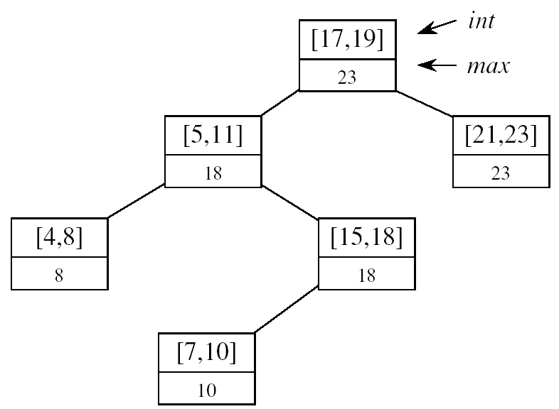
Designing Interval Trees
Underlying data structure
  Red-black trees
  Each node x contains: an interval int[x], and the key: low[int[x]]
  An inorder tree walk will list intervals sorted by their low endpoint
Additional information
  max[x] = maximum endpoint value in subtree rooted at x
Maintaining the information
max[x] =
Constant work at each node, so still O(lgn) time
high[int[x]]
max max[left[x]]
max[right[x]]

Slide 15
Designing Interval Trees
Develop new operations
INTERVAL-SEARCH(T, i):
  Returns a pointer to an element x in the interval tree T, such that int[x] overlaps with i, or NIL otherwise
Idea:
Check if int[x]
overlaps with i
Max[left[x]] ≥ low[i]
  Go left
Otherwise,
go right
low
high
[16, 21]
30
[22, 25]
[8, 9]
23
[25, 30]
30
[5, 8]
10
[15, 23]
23
[17, 19]
20
[26, 26]
26
[0, 3]
3
[6, 10]
10
[19, 20]
20

Slide 16
Example
i = [11, 14]
[16, 21]
30
x
i = [22, 25]
x
[8, 9]
23
[25, 30]
30
x
[5, 8]
10
[15, 23]
23
[17, 19]
20
[26, 26]
26
[0, 3]
3
[6, 10]
10
x = NIL
[19, 20]
20

Slide 17
INTERVAL-SEARCH(T, i)
x ← root[T]
while x ≠ nil[T] and i does not overlap int[x]
do if left[x] ≠ nil[T] and max[left[x]] ≥ low[i]
then x ← left[x]
else x ← right[x]
return x

Slide 18
Readings
Chapters 14, 15

