Slide 1
Analysis of Algorithms
CS 477/677
Instructor: Monica Nicolescu
Lecture 15

Slide 2
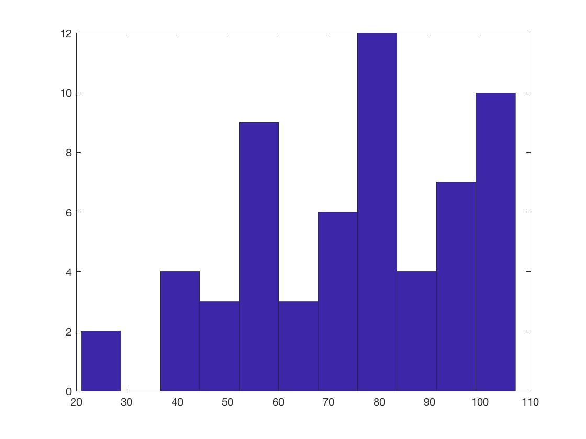
Mid-Term Results CS 477
min = 21 max = 107 average = 74.95

Slide 3
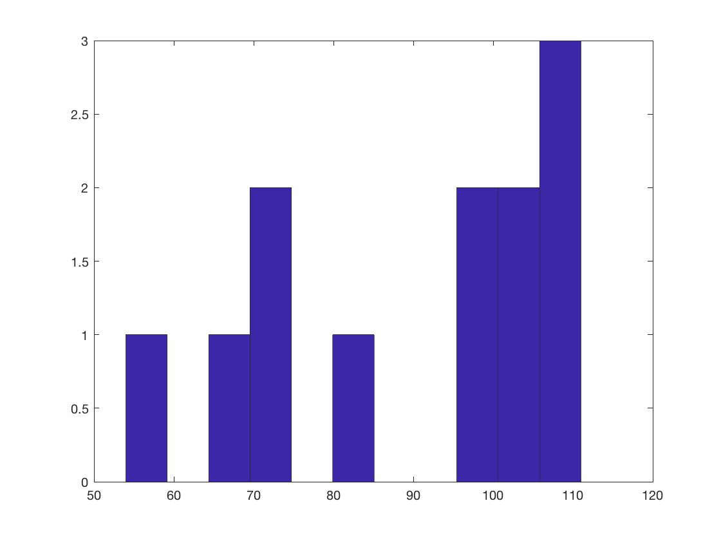
Mid-Term Results CS 677
min = 54 max = 111 average = 90.33

Slide 4
Interval Trees
Def.: Interval tree = a red-black tree that maintains a dynamic set of elements, each element x having associated an interval int[x].
Operations on interval trees:
  INTERVAL-INSERT(T, x)
  INTERVAL-DELETE(T, x)
  INTERVAL-SEARCH(T, i)

Slide 5
Interval Properties
Intervals i and j overlap iff:
low[i] ≤ high[j] and low[j] ≤ high[i]
Intervals i and j do not overlap iff:
high[i] < low[j] or high[j] < low[i]
i
i
i
i
j
j
j
j
i
j
j
i

Slide 6
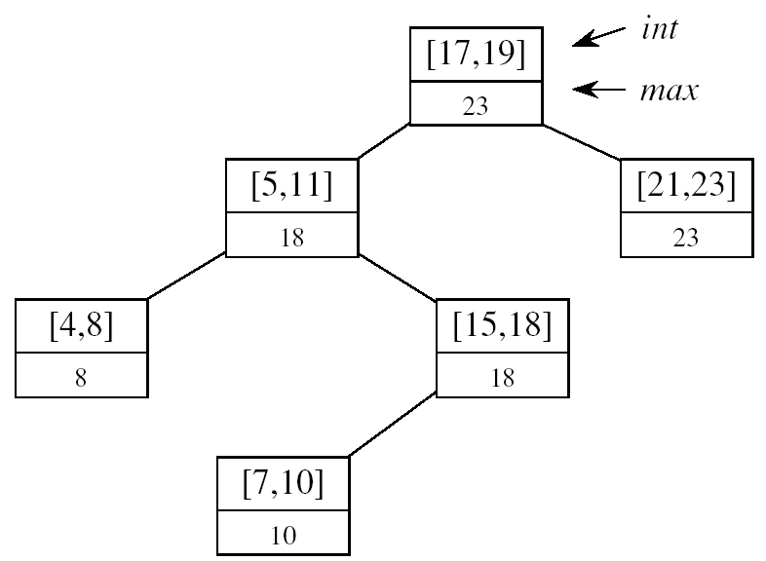
Designing Interval Trees
Underlying data structure
  Red-black trees
  Each node x contains: an interval int[x], and the key: low[int[x]]
  An inorder tree walk will list intervals sorted by their low endpoint
Additional information
  max[x] = maximum endpoint value in subtree rooted at x
Maintaining the information
max[x] =
Constant work at each node, so still O(lgn) time
high[int[x]]
max max[left[x]]
max[right[x]]

Slide 7
Designing Interval Trees
Develop new operations
INTERVAL-SEARCH(T, i):
  Returns a pointer to an element x in the interval tree T, such that int[x] overlaps with i, or NIL otherwise
Idea:
Check if int[x]
overlaps with i
Max[left[x]] ≥ low[i]
  Go left
Otherwise,
go right
low
high
[16, 21]
30
[22, 25]
[8, 9]
23
[25, 30]
30
[5, 8]
10
[15, 23]
23
[17, 19]
20
[26, 26]
26
[0, 3]
3
[6, 10]
10
[19, 20]
20

Slide 8
Theorem
At the execution of interval search: if the search goes right, then either:
  There is an overlap in right subtree, or
  There is no overlap in either subtree
Similar when the search goes left
It is safe to always proceed in only one direction

Slide 9
Theorem
Proof: If search goes right:
  If there is an overlap in right subtree, done
  If there is no overlap in right ⇒ show there is no overlap in left
  Went right because:
left[x] = nil[T] ⇒ no overlap in left, or
max[left[x]] < low[i] ⇒ no overlap in left
i
max[left[x]]
low[x]

Slide 10
Theorem - Proof
If search goes left:
If there is an overlap in left subtree, done
If there is no overlap in left, show there is no overlap in right
Went left because:
low[i] ≤ max[left[x]] = high[j] for some j in left subtree
int[root]
max
max[left]
[low[j], high[j]]
max[j]
[low[k], high[k]]
max[k]
i
j
i
k
No overlap!
high[i] < low[k]
high[i] < low[j]
high[j] < low[i]
low[j] < low[k]

Slide 11
Dynamic Programming
An algorithm design technique for optimization problems (similar to divide and conquer)
Divide and conquer
  Partition the problem into independent subproblems
  Solve the subproblems recursively
  Combine the solutions to solve the original problem

Slide 12
Dynamic Programming
Used for optimization problems
  Find a solution with the optimal value (minimum or maximum)
  A set of choices must be made to get an optimal solution
  There may be many solutions that return the optimal value: we want to find one of them

Slide 13
Dynamic Programming
Applicable when subproblems are not independent
  Subproblems share subsubproblems
E.g.: Fibonacci numbers:
    Recurrence: F(n) = F(n-1) + F(n-2)
    Boundary conditions: F(1) = 0, F(2) = 1
    Compute: F(5) = 3, F(3) = 1, F(4) = 2
  A divide and conquer approach would repeatedly solve the common subproblems
  Dynamic programming solves every subproblem just once and stores the answer in a table

Slide 14
Dynamic Programming Algorithm
Characterize the structure of an optimal solution
Recursively define the value of an optimal solution
Compute the value of an optimal solution in a bottom-up fashion
Construct an optimal solution from computed information

Slide 15
Elements of Dynamic Programming
Optimal Substructure
  An optimal solution to a problem contains within it an optimal solution to subproblems
  Optimal solution to the entire problem is built in a bottom-up manner from optimal solutions to subproblems
Overlapping Subproblems
  If a recursive algorithm revisits the same subproblems again and again ⇒ the problem has overlapping subproblems

Slide 16
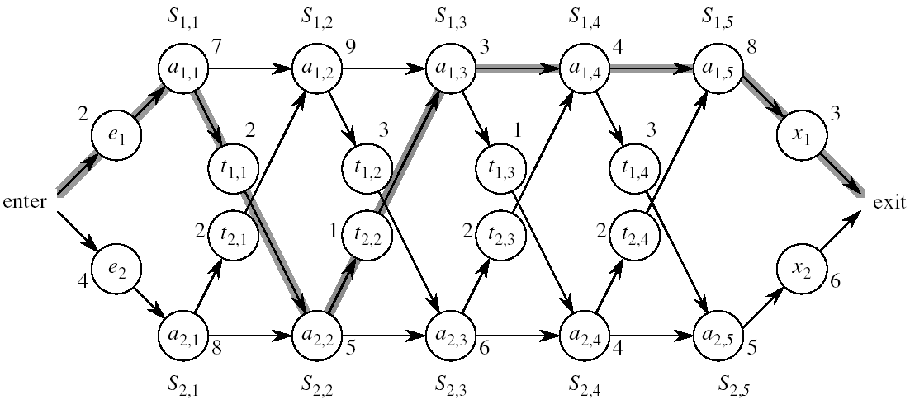
Assembly Line Scheduling
Automobile factory with two assembly lines
  Each line has n stations: S_{1,1}, . . . , S_{1,n} and S_{2,1}, . . . , S_{2,n}
  Corresponding stations S_{1, j} and S_{2, j} perform the same function but can take different amounts of time a_{1, j} and a_{2, j}
  Times to enter are e₁ and e₂ and times to exit are x₁ and x₂

Slide 17
Assembly Line
After going through a station, the car can either:
  stay on same line at no cost, or
  transfer to other line: cost after S_{i,j} is t_{i,j} , i = 1, 2, j = 1, . . . , n-1

Slide 18
Assembly Line Scheduling
Problem:
What stations should be chosen from line 1 and what from line 2 in order to minimize the total time through the factory for one car?

Slide 19
One Solution
Brute force
  Enumerate all possibilities of selecting stations
  Compute how long it takes in each case and choose the best one
  There are 2^{n} possible ways to choose stations
  Infeasible when n is large
1
2
3
4
n
1
0
0
1
1
0 if choosing line 2
at step j (= 3)
1 if choosing line 1
at step j (= n)

Slide 20
1. Structure of the Optimal Solution
How do we compute the minimum time of going through the station?

Slide 21
1. Structure of the Optimal Solution
Let’s consider all possible ways to get from the starting point through station S_{1,j}
  We have two choices of how to get to S_{1, j}:
    Through S_{1, j - 1}, then directly to S_{1, j}
    Through S_{2, j - 1}, then transfer over to S_{1, j}
S_{1,j-1}
S_{1,j}
a_{1,j-1}
a_{1,j}
t_{2,j-1}
a_{2,j-1}
S_{2,j-1}

Slide 22
1. Structure of the Optimal Solution
Suppose that the fastest way through S_{1, j} is through S_{1, j – 1}
  We must have taken the fastest way from entry through S_{1, j – 1}
  If there were a faster way through S_{1, j - 1}, we would use it instead
Similarly for S_{2, j – 1}
S_{1,j-1}
S_{1,j}
a_{1,j-1}
a_{1,j}
t_{2,j-1}
a_{2,j-1}
S_{2,j-1}

Slide 23
Optimal Substructure
Generalization: an optimal solution to the problem find the fastest way through S_{1, j} contains within it an optimal solution to subproblems: find the fastest way through S_{1, j - 1} or S_{2, j - 1}.
This is referred to as the optimal substructure property
We use this property to construct an optimal solution to a problem from optimal solutions to subproblems

Slide 24
2. A Recursive Solution
Define the value of an optimal solution in terms of the optimal solution to subproblems
Assembly line subproblems
  Finding the fastest way through each station j on each line i
  (i = 1,2, j = 1, 2, …, n)

Slide 25
2. A Recursive Solution
f* = the fastest time to get through the entire factory
f_{i}[j] = the fastest time to get from the starting point through station S_{i,j}
  f* = min (f₁[n] + x₁, f₂[n] + x₂)

Slide 26
2. A Recursive Solution
f_{i}[j] = the fastest time to get from the starting point through station S_{i,j}
j = 1 (getting through station 1)
f₁[1] = e₁ + a_{1,1}
f₂[1] = e₂ + a_{2,1}

Slide 27
2. A Recursive Solution
Compute f_{i}[j] for j = 2, 3, …,n, and i = 1, 2
Fastest way through S_{1, j} is either:
  the way through S_{1, j - 1} then directly through S_{1, j}, or
  f₁[j - 1] + a_{1,j}
  the way through S_{2, j - 1}, transfer from line 2 to line 1, then through S_{1, j}
f₂[j -1] + t_{2,j-1} + a_{1,j}
f₁[j] = min(f₁[j - 1] + a_{1,j} ,f₂[j -1] + t_{2,j-1} + a_{1,j})
S_{1,j-1}
S_{1,j}
a_{1,j-1}
a_{1,j}
t_{2,j-1}
a_{2,j-1}
S_{2,j-1}

Slide 28
2. A Recursive Solution
e₁ + a_{1,1} if j = 1
f₁[j] =
min(f₁[j - 1] + a_{1,j} ,f₂[j -1] + t_{2,j-1} + a_{1,j}) if j ≥ 2
e₂ + a_{2,1} if j = 1
f₂[j] =
min(f₂[j - 1] + a_{2,j} ,f₁[j -1] + t_{1,j-1} + a_{2,j}) if j ≥ 2

Slide 29
3. Computing the Optimal Value
  f* = min (f₁[n] + x₁, f₂[n] + x₂)
f₁[j] = min(f₁[j - 1] + a_{1,j} ,f₂[j -1] + t_{2,j-1} + a_{1,j})
Solving top-down would result in exponential running time
1
2
3
4
5
f₁[j]
f₁(1)
f₁(2)
f₁(3)
f₁(4)
f₁(5)
f₂[j]
f₂(1)
f₂(2)
f₂(3)
f₂(4)
f₂(5)
4 times
2 times

Slide 30
3. Computing the Optimal Value
For j ≥ 2, each value f_{i}[j] depends only on the values of f₁[j – 1] and f₂[j - 1]
Compute the values of f_{i}[j]
  in increasing order of j
Bottom-up approach
  First find optimal solutions to subproblems
  Find an optimal solution to the problem from the subproblems
increasing j
1
2
3
4
5
f₁[j]
f₂[j]

Slide 31
Readings
Chapters 14, 15

