Slide 1
Analysis of Algorithms
CS 477/677
Instructor: Monica Nicolescu
Lecture 5

Slide 2
The recursion-tree method
Convert the recurrence into a tree:
  Each node represents the cost incurred at that level of recursion
  Sum up the costs of all levels
Used to “guess” a solution for the recurrence

Slide 3
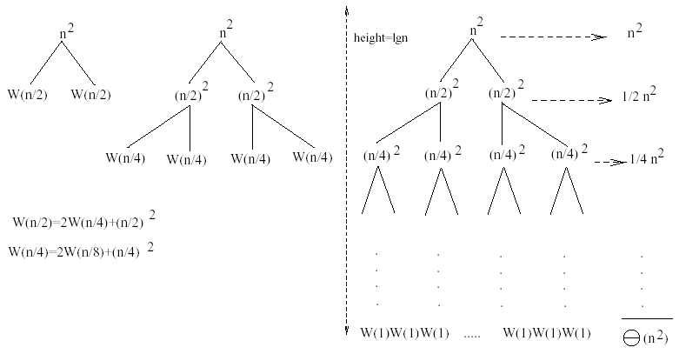
Example 1
W(n) = 2W(n/2) + n²
Subproblem size at level i is: n/2^{i}
Subproblem size hits 1 when 1 = n/2^{i} ⇒i = lgn
Cost of the problem at level i = (n/2^{i})² No. of nodes at level i = 2^{i}
Total cost:
⇒ W(n) = O(n²)

Slide 4
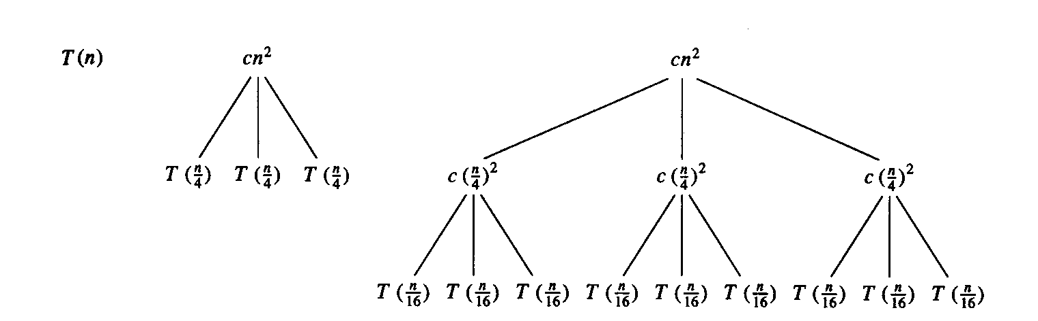
Example 2
E.g.: T(n) = 3T(n/4) + cn²
Subproblem size at level i is: n/4^{i}
Subproblem size hits 1 when 1 = n/4^{i} ⇒i = log₄n
Cost of a node at level i = c(n/4^{i})²
Number of nodes at level i = 3^{i} ⇒last level has 3^{log}₄^{n} = n^{log}₄³ nodes
Total cost:
⇒T(n) = O(n²)

Slide 5
Example 2 - Substitution
T(n) = 3T(n/4) + cn²
Guess: T(n) = O(n²)
  Induction goal: T(n) ≤ dn², for some d and n ≥ n₀
  Induction hypothesis: T(n/4) ≤ d (n/4)²
Proof of induction goal:
T(n) = 3T(n/4) + cn²
≤ 3d (n/4)² + cn²
= (3/16) d n² + cn²
= d n² + cn² + (3/16) d n² - d n²
= d n² + cn² - (13/16) d n²
≤ d n² if: cn² - (13/16) d n² ≤ 0
d ≥ (16/13)c
Therefore: T(n) = O(n²)

Slide 6
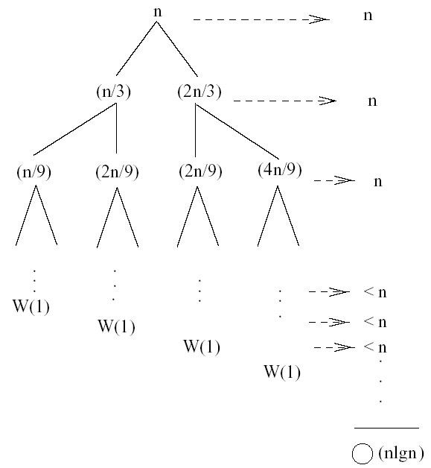
Example 3
W(n) = W(n/3) + W(2n/3) + n
The longest path from the root to a leaf is: n → (2/3)n →(2/3)² n →… →1
Subproblem size hits 1 when 1 = (2/3)^{i}n ⇔ i=log_{3/2}n
Cost of the problem at level i = n
Total cost:
⇒W(n) = O(nlgn)
for all levels

Slide 7
Example 3 - Substitution
W(n) = W(n/3) + W(2n/3) + n
Guess: W(n) = O(nlgn)
  Induction goal: W(n) ≤ dnlgn, for some d and n ≥ n₀
  Induction hypothesis: W(k) ≤ d klgk for any k < n (n/3, 2n/3)
Proof of induction goal:
Try it out as an exercise!!

Slide 8
Readings
Chapter 4

