Slide 1
Analysis of Algorithms
CS 477/677
Instructor: Monica Nicolescu
Lecture 6

Slide 2
Administrative
Note taking
  Assistance needed with note taking for a student in our class
  Let me know either now or at the end of the class
Updates
  Mid-term new date: March 10
  TA office hours updated on website and syllabus:
    Office: Lab C in ECC, SEM
    Office hours: Friday: 10am-noon
  Course website (on CSE server) updated

Slide 3
Master’s method
“Cookbook” for solving recurrences of the form:
where, a ≥ 1, b > 1, and f(n) > 0
Idea: compare f(n) with n^{log}_{b}ª
f(n) is asymptotically smaller or larger than n^{log}_{b}ª by a polynomial factor n^{ℇ}
f(n) is asymptotically equal with n^{log}_{b}ª

Slide 4
Master’s method
“Cookbook” for solving recurrences of the form:
where, a ≥ 1, b > 1, and f(n) > 0
Case 1: if f(n) = O(n^{log}_{b}^{a -ℇ}) for some ℇ > 0, then: T(n) = 𝚹(n^{log}_{b}ª)
Case 2: if f(n) = 𝚹(n^{log}_{b}ª), then: T(n) = 𝚹(n^{log}_{b}ª lgn)
Case 3: if f(n) = 𝛀(n^{log}_{b}^{a + ℇ}) for some ℇ > 0, and if
af(n/b) ≤ cf(n) for some c < 1 and all sufficiently large n, then:
T(n) = 𝚹(f(n))
regularity condition

Slide 5
Why n^{log}_{b}ª?
Case 1:
  If f(n) is dominated by n^{log}_{b}ª:
    T(n) = 𝚹(n^{log}_{b}^{n})
Case 3:
  If f(n) dominates n^{log}_{b}ª:
    T(n) = 𝚹(f(n))
Case 2:
  If f(n) = 𝚹(n^{log}_{b}ª):
    T(n) = 𝚹(n^{log}_{b}ª logn)
Assume n = b^{k} ⇒k = log_{b}n
At the end of iterations, i = k:

Slide 6
Examples
T(n) = 2T(n/2) + n
a = 2, b = 2, log₂2 = 1
Compare n^{log}₂² with f(n) = n
⇒ f(n) = 𝚹(n) ⇒ Case 2
⇒ T(n) = 𝚹(nlgn)

Slide 7
Examples
T(n) = 2T(n/2) + n²
a = 2, b = 2, log₂2 = 1
Compare n with f(n) = n²
⇒ f(n) = 𝛀(n^{1+ℇ})
Case 3 ⇒ verify regularity cond.: a f(n/b) ≤ c f(n)
⇒ 2 n²/4 ≤ c n² ⇒ c = ½ is a solution (c<1)
⇒ T(n) = 𝚹(n²)

Slide 8
Examples (cont.)
T(n) = 2T(n/2) +
a = 2, b = 2, log₂2 = 1
Compare n with f(n) = n^{1/2}
⇒ f(n) = O(n^{1-ℇ}) Case 1
⇒ T(n) = 𝚹(n)

Slide 9
Examples
T(n) = 3T(n/4) + nlgn
a = 3, b = 4, log₄3 = 0.793
Compare n^{0.793} with f(n) = nlgn
f(n) = 𝛀(n^{log}₄^{3+ℇ})
Case 3: check regularity condition:
3(n/4)lg(n/4) ≤ (3/4)nlgn = c f(n), c=3/4
⇒ T(n) = 𝚹(nlgn)

Slide 10
Examples
T(n) = 2T(n/2) + nlgn
a = 2, b = 2, log₂2 = 1
Compare n with f(n) = nlgn
  seems like case 3 should apply
f(n) must be polynomially larger by a factor of n^{ℇ}
In this case it is only larger by a factor of lgn

Slide 11
The Sorting Problem
Input:
  A sequence of n numbers a₁, a₂, . . . , a_{n}
Output:
  A permutation (reordering) a₁’, a₂’, . . . , a_{n}’ of the input sequence such that a₁’ ≤ a₂’ ≤ · · · ≤ a_{n}’

Slide 12
Why Study Sorting Algorithms?
There are a variety of situations that we can encounter
  Do we have randomly ordered keys?
  Are all keys distinct?
  How large is the set of keys to be ordered?
  Need guaranteed performance?
  Does the algorithm sort in place?
  Is the algorithm stable?
Various algorithms are better suited to some of these situations

Slide 13
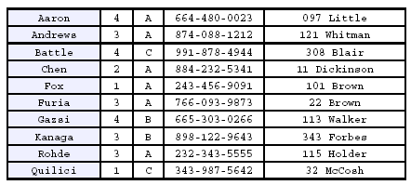
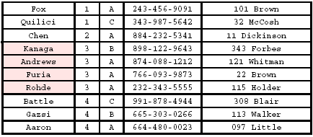
Stability
A STABLE sort preserves relative order of records with equal keys
Sort file on first key:
Sort file on second key:
Records with key value 3 are not in order on first key!!

Slide 14
Insertion Sort
Idea: like sorting a hand of playing cards
  Start with an empty left hand and the cards facing down on the table
  Remove one card at a time from the table, and insert it into the correct position in the left hand
    compare it with each of the cards already in the hand, from right to left
  The cards held in the left hand are sorted
    these cards were originally the top cards of the pile on the table

Slide 15
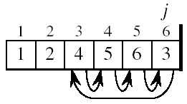
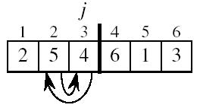
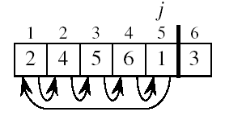
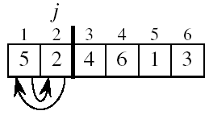

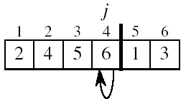
Example

Slide 16
INSERTION-SORT
Alg.: INSERTION-SORT(A)
for j ← 2 to n
do key ← A[ j ]
Insert A[ j ] into the sorted sequence A[1 . . j -1]
i ← j - 1
while i > 0 and A[i] > key
do A[i + 1] ← A[i]
i ← i – 1
A[i + 1] ← key
Insertion sort – sorts the elements in place
1
2
3
4
5
6
7
8
a₁
a₂
a₃
a₄
a₅
a₆
a₇
a₈
key

Slide 17
Loop Invariant for Insertion Sort
Alg.: INSERTION-SORT(A)
for j ← 2 to n
do key ← A[ j ]
Insert A[ j ] into the sorted sequence A[1 . . j -1]
i ← j - 1
while i > 0 and A[i] > key
do A[i + 1] ← A[i]
i ← i – 1
A[i + 1] ← key
Invariant: at the start of each iteration of the for loop, the elements in A[1 . . j-1] are in sorted order

Slide 18
Proving Loop Invariants
Proving loop invariants works like induction
Initialization (base case):
  It is true prior to the first iteration of the loop
Maintenance (inductive step):
  If it is true before an iteration of the loop, it remains true before the next iteration
Termination:
  When the loop terminates, the invariant gives us a useful property that helps show that the algorithm is correct

Slide 19
Loop Invariant for Insertion Sort
Initialization:
  Just before the first iteration, j = 2:
  the subarray A[1 . . j-1] = A[1], (the element originally in A[1]) – is sorted

Slide 20
Loop Invariant for Insertion Sort
Maintenance:
  the while inner loop moves A[j -1], A[j -2], A[j -3], and so on, by one position to the right until the proper position for key (which has the value that started out in A[j]) is found
  At that point, the value of key is placed into this position.

Slide 21
Loop Invariant for Insertion Sort
Termination:
  The outer for loop ends when j = n + 1 ⇒ j-1 = n
  Replace n with j-1 in the loop invariant:
    the subarray A[1 . . n] consists of the elements originally in A[1 . . n], but in sorted order
The entire array is sorted!
j - 1
j

Slide 22
Analysis of Insertion Sort
INSERTION-SORT(A)
for j ← 2 to n
do key ← A[ j ]
Insert A[ j ] into the sorted seq. A[1 . . j -1]
i ← j - 1
while i > 0 and A[i] > key
do A[i + 1] ← A[i]
i ← i – 1
A[i + 1] ← key
cost times
c₁ n
c₂ n-1
0 n-1
c₄ n-1
c₅
c₆
c₇
c₈ n-1
Notes:
₇

Slide 23
Best Case Analysis
The array is already sorted
  A[i] ≤ key upon the first time the while loop test is run (when i = j -1)
  t_{j} = 1
T(n) = c₁n + c₂(n -1) + c₄(n -1) + c₅(n -1) + c₈(n-1) = (c₁ + c₂ + c₄ + c₅ + c₈)n - (c₂ + c₄ + c₅ + c₈)
= an + b = Θ(n)
“while i > 0 and A[i] > key”

Slide 24
Worst Case Analysis
The array is reversely sorted
  Always A[i] > key in while loop test
  Have to compare key with all elements to the left of the j-th position ⇒ compare with j-1 elements ⇒ t_{j} = j
  a quadratic function of n
T(n) = Θ(n²) order of growth in n²
“while i > 0 and A[i] > key”

Slide 25
Comparisons and Exchanges in Insertion Sort
INSERTION-SORT(A)
for j ← 2 to n
do key ← A[ j ]
Insert A[ j ] into the sorted sequence A[1 . . j -1]
i ← j - 1
while i > 0 and A[i] > key
do A[i + 1] ← A[i]
i ← i – 1
A[i + 1] ← key
cost times
c₁ n
c₂ n-1
0 n-1
c₄ n-1
c₅
c₆
c₇
c₈ n-1
≈n²/2 comparisons
≈n²/2 exchanges

Slide 26
Insertion Sort - Summary
Idea: like sorting a hand of playing cards
  Start with an empty left hand and the cards facing down on the table.
  Remove one card at a time from the table, and insert it into the correct position in the left hand
Advantages
  Good running time for “almost sorted” arrays Θ(n)
Disadvantages
  Θ(n²) running time in worst and average case
  ≈n²/2 comparisons and n²/2 exchanges

Slide 27
Bubble Sort
Idea:
  Repeatedly pass through the array
  Swaps adjacent elements that are out of order
Easier to implement, but slower than Insertion sort
i
1
2
3
n
8
4
6
9
2
3
1
j

Slide 28
Example
8
4
6
9
2
3
1
1
8
4
6
9
2
3
i = 1
j
i = 2
j
8
4
6
9
2
1
3
1
2
8
4
6
9
3
i = 1
j
i = 3
j
8
4
6
9
1
2
3
1
2
3
8
4
6
9
i = 1
j
i = 4
j
8
4
6
1
9
2
3
1
2
3
4
8
6
9
i = 1
j
i = 5
j
8
4
1
6
9
2
3
1
2
3
4
6
8
9
i = 1
j
i = 6
j
8
1
4
6
9
2
3
1
2
3
4
6
8
9
i = 1
j
i = 7
1
8
4
6
9
2
3
j
i = 1
j

Slide 29
Bubble Sort
Alg.: BUBBLESORT(A)
for i ← 1 to length[A]
do for j ← length[A] downto i + 1
do if A[j] < A[j -1]
then exchange A[j] ⟺A[j-1]
i
8
4
6
9
2
3
1
i = 1
j

Slide 30
Readings
Chapter 4

