Slide 1
Analysis of Algorithms
CS 477/677
Instructor: Monica Nicolescu
Lecture 7

Slide 2
Bubble Sort
Idea:
  Repeatedly pass through the array
  Swaps adjacent elements that are out of order
Easier to implement, but slower than Insertion sort
i
1
2
3
n
8
4
6
9
2
3
1
j

Slide 3
Bubble Sort
Alg.: BUBBLESORT(A)
for i ← 1 to length[A]
do for j ← length[A] downto i + 1
do if A[j] < A[j -1]
then exchange A[j] ⟺A[j-1]
i
8
4
6
9
2
3
1
i = 1
j

Slide 4
Bubble-Sort Running Time
Alg.: BUBBLESORT(A)
for i ←1 to length[A]
do for j ←length[A] downto i + 1
do if A[j] < A[j -1]
then exchange A[j] ⟺A[j-1]
Comparisons: ≈n²/2
Exchanges: ≈n²/2
T(n) =
c₁(n+1) +
c₂
c₃
c₄
= Θ(n) +
(c₂ + c₃ + c₄)
T(n) = Θ(n²)

Slide 5
Selection Sort
8
4
6
9
2
3
1
Idea:
  Find the smallest element in the array
  Exchange it with the element in the first position
  Find the second smallest element and exchange it with the element in the second position
  Continue until the array is sorted
Invariant:
  All elements to the left of the current index are in sorted order and never changed again
Disadvantage:
  Running time depends only slightly on the amount of order in the file

Slide 6
Example
8
4
6
9
2
3
1
1
2
3
4
9
6
8
1
4
6
9
2
3
8
1
2
3
4
6
9
8
1
2
6
9
4
3
8
1
2
3
4
6
8
9
1
2
3
9
4
6
8
1
2
3
4
6
8
9

Slide 7
Selection Sort
Alg.: SELECTION-SORT(A)
n ← length[A]
for j ← 1 to n - 1
do smallest ← j
for i ← j + 1 to n
do if A[i] < A[smallest]
then smallest ← i
exchange A[j] ⟺ A[smallest]
8
4
6
9
2
3
1

Slide 8
Analysis of Selection Sort
Alg.: SELECTION-SORT(A)
n ← length[A]
for j ← 1 to n - 1
do smallest ← j
for i ← j + 1 to n
do if A[i] < A[smallest]
then smallest ← i
exchange A[j] ⟺ A[smallest]
cost times
c₁ 1
c₂ n
c₃ n-1
c₄
c₅
c₆
c₇ n-1
≈n²/2
comparisons
≈n exchanges
T(n) = Θ(n²)

Slide 9
Divide-and-Conquer
Divide the problem into a number of subproblems
  Similar sub-problems of smaller size
Conquer the sub-problems
  Solve the sub-problems recursively
  Sub-problem size small enough ⇒ solve the problems in straightforward manner
Combine the solutions to the sub-problems
  Obtain the solution for the original problem

Slide 10
Merge Sort Approach
To sort an array A[p . . r]:
Divide
  Divide the n-element sequence to be sorted into two subsequences of n/2 elements each
Conquer
  Sort the subsequences recursively using merge sort
  When the size of the sequences is 1 there is nothing more to do
Combine
  Merge the two sorted subsequences

Slide 11
Merge Sort
p
q
r
1
2
3
4
5
6
7
8
Alg.: MERGE-SORT(A, p, r)
if p < r Check for base case
then q ← ⎣(p + r)/2⎦ Divide
MERGE-SORT(A, p, q) Conquer
MERGE-SORT(A, q + 1, r) Conquer
MERGE(A, p, q, r) Combine
Initial call: MERGE-SORT(A, 1, n)
5
2
4
7
1
3
2
6

Slide 12
Example – n Power of 2
Example
1
2
3
4
5
6
7
8
5
2
4
7
1
3
2
6
q = 4
1
2
3
4
5
6
7
8
5
2
4
7
1
3
2
6
1
2
3
4
5
6
7
8
5
2
4
7
1
3
2
6
1
2
3
4
5
6
7
8
5
2
4
7
1
3
2
6

Slide 13
Example – n Not a Power of 2
1
2
3
4
5
6
7
8
9
10
11
4
7
2
6
1
4
7
3
5
2
6
q = 6
1
2
3
4
5
6
7
8
9
10
11
q = 3
4
7
2
6
1
4
7
3
5
2
6
q = 9
1
2
3
4
5
6
7
8
9
10
11
4
7
2
6
1
4
7
3
5
2
6
1
2
3
4
5
6
7
8
9
10
11
4
7
2
6
1
4
7
3
5
2
6
1
2
4
5
7
8
4
7
6
1
7
3

Slide 14
Example – n Not a Power of 2
1
2
3
4
5
6
7
8
9
10
11
1
2
2
3
4
4
5
6
6
7
7
1
2
3
4
5
6
7
8
9
10
11
1
2
4
4
6
7
2
3
5
6
7
1
2
3
4
5
6
7
8
9
10
11
2
4
7
1
4
6
3
5
7
2
6
1
2
3
4
5
6
7
8
9
10
11
4
7
2
1
6
4
3
7
5
2
6
1
2
4
5
7
8
4
7
6
1
7
3

Slide 15
Merging
p
q
r
1
2
3
4
5
6
7
8
2
4
5
7
1
2
3
6
Input: Array A and indices p, q, r such that p ≤ q < r
  Subarrays A[p . . q] and A[q + 1 . . r] are sorted
Output: One single sorted subarray A[p . . r]

Slide 16
Merging
Idea for merging:
  Two piles of sorted cards
    Choose the smaller of the two top cards
    Remove it and place it in the output pile
  Repeat the process until one pile is empty
  Take the remaining input pile and place it face-down onto the output pile

Slide 17
Merge - Pseudocode
p
q
r
Alg.: MERGE(A, p, q, r)
Compute n₁ and n₂
Copy the first n₁ elements into L[1 . . n₁ + 1] and the next n₂ elements into R[1 . . n₂ + 1]
L[n₁ + 1] ← ∞; R[n₂ + 1] ← ∞
i ← 1; j ← 1
for k ← p to r
do if L[ i ] ≤ R[ j ]
then A[k] ← L[ i ]
i ←i + 1
else A[k] ← R[ j ]
j ← j + 1
1
2
3
4
5
6
7
8
2
4
5
7
1
2
3
6
n₁
n₂
p
q
L
2
4
5
7
∞
q + 1
r
R
1
2
3
6
∞

Slide 18
Running Time of Merge
Initialization (copying into temporary arrays):
  Θ(n₁ + n₂) = Θ(n)
Adding the elements to the final array (the for loop):
  n iterations, each taking constant time ⇒ Θ(n)
Total time for Merge:
  Θ(n)

Slide 19
Analyzing Divide and Conquer Algorithms
The recurrence is based on the three steps of the paradigm:
  T(n) – running time on a problem of size n
  Divide the problem into a subproblems, each of size n/b: takes D(n)
  Conquer (solve) the subproblems: takes aT(n/b)
  Combine the solutions: takes C(n)
Θ(1) if n ≤ c
T(n) = aT(n/b) + D(n) + C(n) otherwise

Slide 20
MERGE – SORT Running Time
Divide:
  compute q as the average of p and r: D(n) = Θ(1)
Conquer:
  recursively solve 2 subproblems, each of size n/2 ⇒ 2T (n/2)
Combine:
  MERGE on an n-element subarray takes Θ(n) time ⇒ C(n) = Θ(n)
Θ(1) if n =1
T(n) = 2T(n/2) + Θ(n) if n > 1

Slide 21
Solve the Recurrence
T(n) = c if n = 1
2T(n/2) + cn if n > 1
Use Master’s Theorem:
Compare n with f(n) = cn
Case 2: T(n) = Θ(nlgn)

Slide 22
Merge Sort - Discussion
Running time insensitive of the input
Advantages:
  Guaranteed to run in Θ(nlgn)
Disadvantage
  Requires extra space ≈N
Applications
  Maintain a large ordered data file
  How would you use Merge sort to do this?

Slide 23
Quicksort
A[p…q]
≤
A[q+1…r]
Sort an array A[p…r]
Divide
  Partition the array A into 2 subarrays A[p..q] and A[q+1..r], such that each element of A[p..q] is smaller than or equal to each element in A[q+1..r]
  The index (pivot) q is computed
Conquer
  Recursively sort A[p..q] and A[q+1..r] using Quicksort
Combine
  Trivial: the arrays are sorted in place ⇒ no work needed to combine them: the entire array is now sorted

Slide 24
QUICKSORT
Alg.: QUICKSORT(A, p, r)
if p < r
then q ← PARTITION(A, p, r)
QUICKSORT (A, p, q)
QUICKSORT (A, q+1, r)

Slide 25
Partitioning the Array
Idea
  Select a pivot element x around which to partition
  Grows two regions
A[p…i] ≤ x
x ≤A[j…r]
  For now, choose the value of the first element as the pivot x
A[p…i] ≤ x
x ≤ A[j…r]
i
j

Slide 26
Example
A[p…r]
5
3
2
6
4
1
3
7
5
3
2
6
4
1
3
7
i
j
i
j
3
3
2
6
4
1
5
7
3
3
2
6
4
1
5
7
i
j
i
j
A[p…q]
A[q+1…r]
3
3
2
1
4
6
5
7
3
3
2
1
4
6
5
7
i
j
j
i

Slide 27
Partitioning the Array
Alg. PARTITION (A, p, r)
x ←A[p]
i ←p – 1
j ←r + 1
while TRUE
do repeat j ←j – 1
until A[j] ≤ x
repeat i ←i + 1
until A[i] ≥ x
if i < j
then exchange A[i] ⟺A[j]
else return j
p
r
A:
5
3
2
6
4
1
3
7
i
j
A[p…q]
≤
A[q+1…r]
A:
a_{p}
a_{r}
j=q
i
Running time: Θ(n)
n = r – p + 1

Slide 28
Performance of Quicksort
Worst-case partitioning
  One region has 1 element and one has n – 1 elements
  Maximally unbalanced
Recurrence
  T(n) = T(n – 1) + T(1) + Θ(n)
  =
n
n
1
n - 1
n
1
n - 2
n - 1
n
1
n - 3
n - 2
1
2
3
1
1
2
Θ(n²)

Slide 29
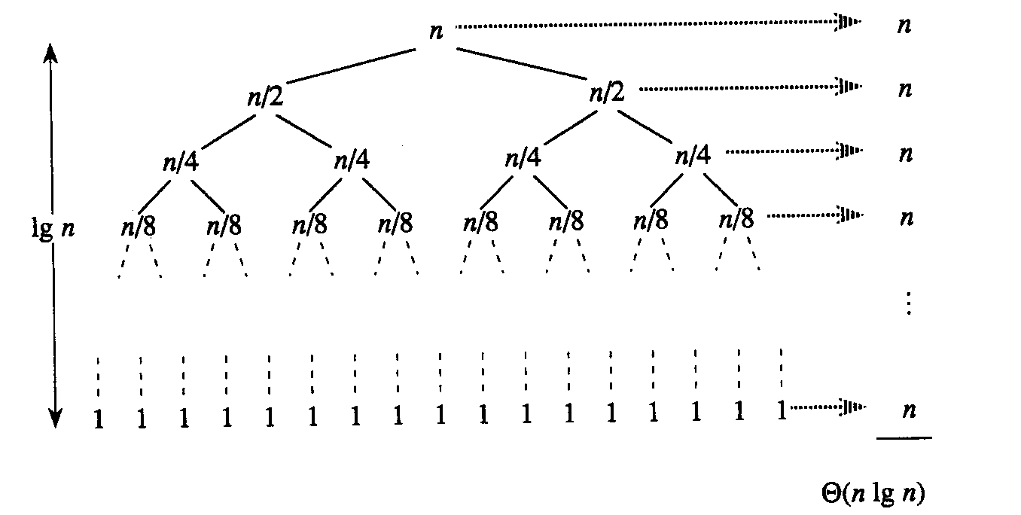
Performance of Quicksort
Best-case partitioning
  Partitioning produces two regions of size n/2
Recurrence
  T(n) = 2T(n/2) + Θ(n)
  T(n) = Θ(nlgn) (Master theorem)

Slide 30
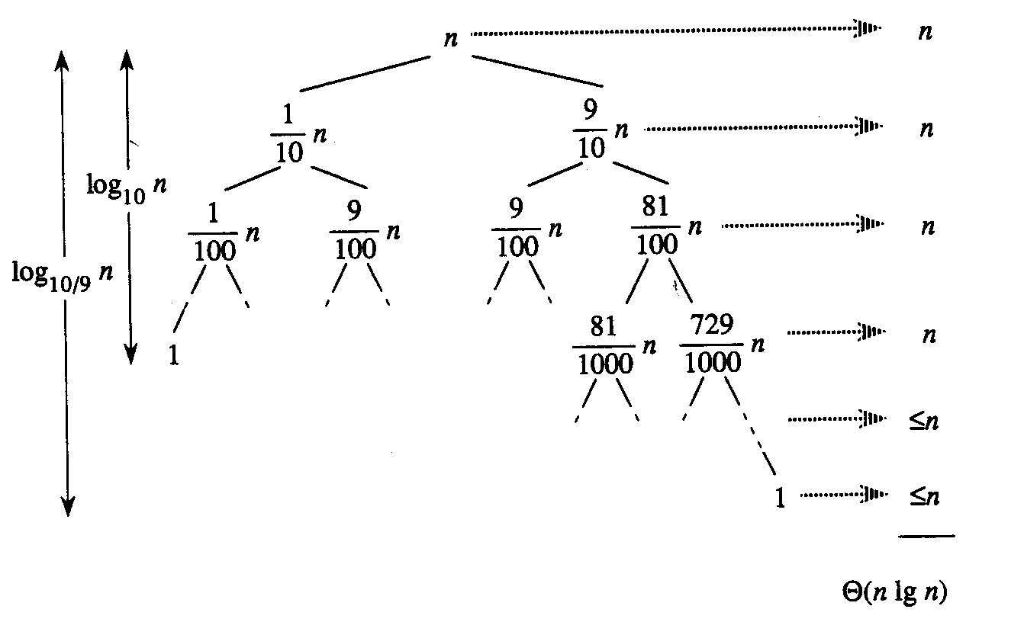
Performance of Quicksort
Balanced partitioning
  Average case is closer to best case than to worst case
  (if partitioning always produces a constant split)
E.g.: 9-to-1 proportional split
T(n) = T(9n/10) + T(n/10) + n

Slide 31
Performance of Quicksort
Average case
  All permutations of the input numbers are equally likely
  On a random input array, we will have a mix of well balanced and unbalanced splits
  Good and bad splits are randomly distributed throughout the tree
n
combined cost:
2n-1 = Θ(n)
n
combined cost:
n = Θ(n)
1
n - 1
(n – 1)/2 + 1
(n – 1)/2
(n – 1)/2
(n – 1)/2
Alternation of a bad
and a good split
Nearly well
balanced split
Running time of Quicksort when levels alternate between good and bad splits is O(nlgn)

Slide 32
Readings
Chapter 7

