Slide 1
Plane Spotting Or how to put yourself on no-fly lists.
Predicting Air Delays at SeaTac airport.
A CS 773C Project by Sam Delaney

Slide 2
Abstract
Predict flight delays out of a major airport.
Predict the amount of time the delay will take.

Slide 3
Current Projects
FlightCaster
Six hour prediction window
DelayCast
Currently updating algorithm…
University of Boston
CS Project - 2008

Slide 4
DATA! Where are we getting it?
www.transtats.bts.gov
www.flightstats.com
www.flightaware.com

Slide 5
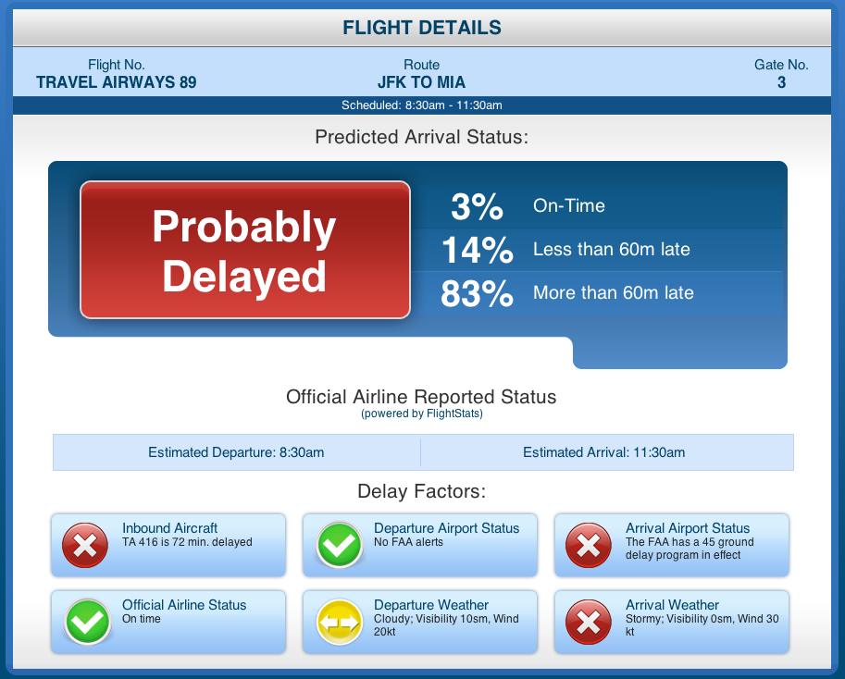
Data! Current Examples

Slide 6
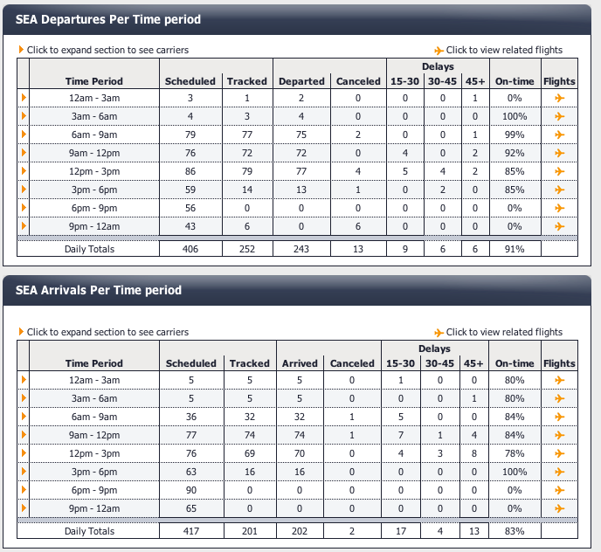
DATA! What does it look like?

Slide 7
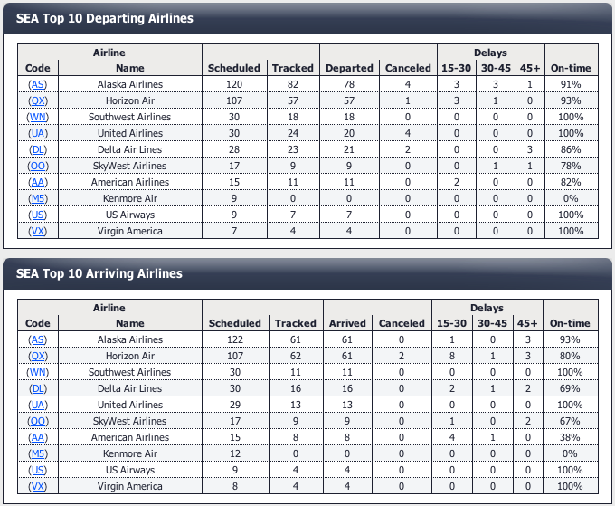
DATA! What does it look like?

Slide 8
DATA! A closer look

Slide 9
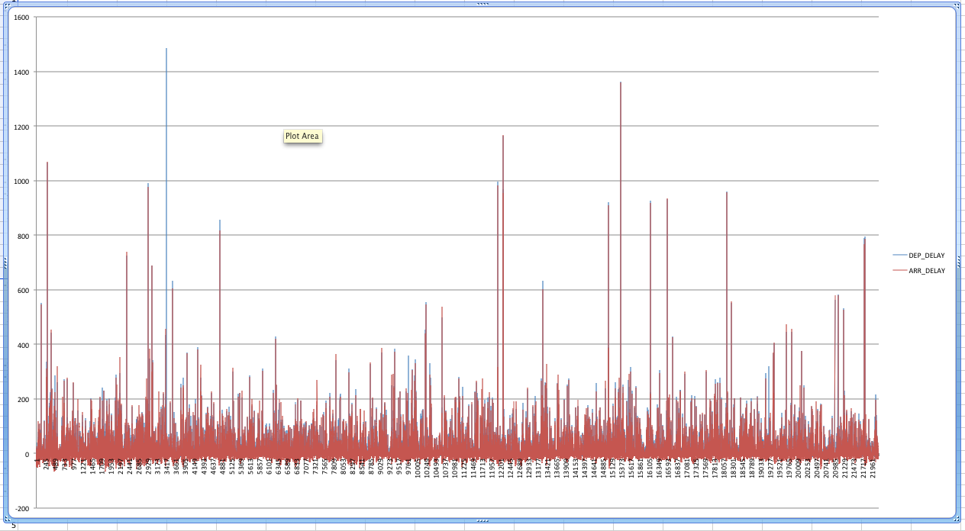
GRAPHS!

Slide 10
Fun Facts!
Airport with the most Delays: Newark
Airport with the least Delays: Honolulu
Airline with most Delays: Alaska Airlines
Airline with least Delays: Southwest

Slide 11
Questions?

