Slide 1
Plane Spotting 2 Or how to get more free peanuts.
Predicting Air Delays at SeaTac airport.
A CS 773C Project by Sam Delaney

Slide 2
The Problem!

Slide 3
The Problem
Air travel is one of the most popular forms of travel. One of its drawbacks however is when flights are delayed and people are stranded for anywhere from 5 minutes to 10+ hours. My goal is to allow users the ability to know in advance whether a flight is doomed to Tarmac Purgatory.

Slide 4
Delay Projections Delay Causes
14% of delayed flights had carrier cause
15% of delayed flights had weather cause
15% of delayed flights are due to NAS
12 % of delayed flights are due to security
For the year of 2012 so far. Give the holidays time to bring the hurt.

Slide 5
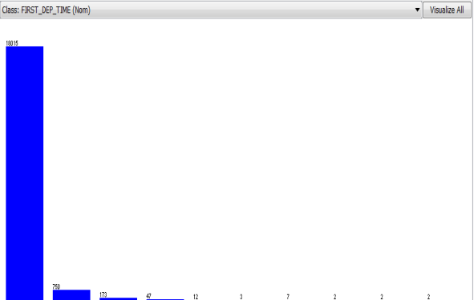
Delay Times. In Bins!

Slide 6
A plane by any other name
Feature Extraction!

Slide 7
Features
Features to flights
Day of Week
Distance of flight
Tail Number
Destination airport
Origin airport
Flight time
Carrier
Arrival Delay
Number of flights
+others

Slide 8
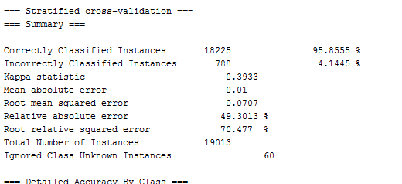
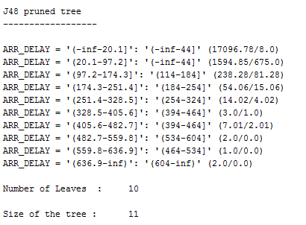
Early Results
95%! Stick a fork in it. We’re done here!
☹

Slide 9
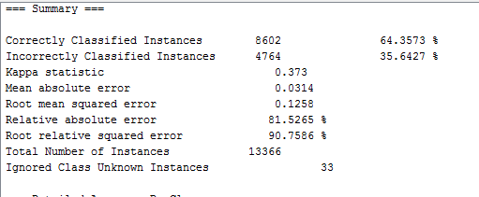
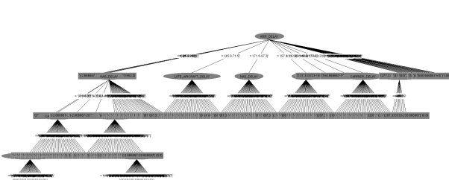
Early Results

Slide 10
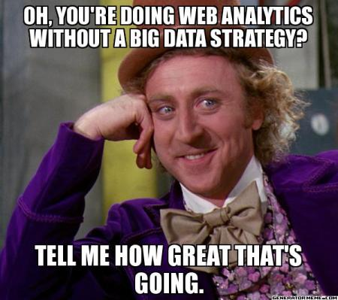

Slide 11
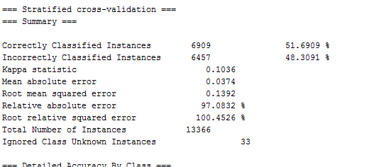
Early Results
Things learned
Arrival delay is HUGE
Without arrival delay, it’s not as easy to predict…
But what stood out?

Slide 12
Interesting Features!
Tail Number
Never bet on old bessy
Flight time
Day of week
So, now that arrival delay is off the board, what else was of any relevance?

Slide 13
Ok, that’s cool but what else?

Slide 14
Real World Application
Sometimes we are so happy with the data we have we forget to look at it in perspective
How much do you really know much about your flight when you buy a ticket?

Slide 15
A star to sail by
What we know when we buy a ticket
Date and time
Airline
Rough weather estimate for time of year (more on this later)
Destination airport
Previous airport if flight is not the first flight of the day

Slide 16
Future Work
Weka improvement for larger data sets
More research into better predictors, i.e. incorporate weather predictions
And I shall call this second learner Mini… learn..er

Slide 17
Questions?

