Slide 1
Comparing Heuristic Search Methods for Finding Effective Group Behaviors in RTS Game
Authors: Siming Liu, Sushil Louis and Monica Nicolascu
simingl@cse.unr.edu, sushil@cse.unr.edu, monica@cse.unr.edu http://www.cse.unr.edu/~simingl
Notes:
Thank you all for being here
My name is Siming Liu, I am from the Evolutionary Computing Systems Lab at University of Nevada, Reno.
Today, I’m going to present part of my ongoing research – Comparing Heuristic Search Methods for Finding Effective Group Behaviors in RTS Game.

Slide 2
Outline
RTS Games
Prior Work
Methodology
Representation
Influence Map
Potential Field
Performance Metrics
Techniques
Hill-Climbers
Genetic Algorithm
Results
Conclusions and Future Work
Notes:
Here is the outline of today’s presentation.
Our overall goal is to create an AI player that finds good group behaviors to win a skirmish in a RTS game.
The first step is selecting a method that can find effective group behaviors. In our research, we compare GA to HCs for finding effective group behaviors in a predefined skirmish scenario.
Before I explain our research in detail, let’s talk about what is RTS game, and why we are interested in RTS AI research.
1.5 minutes

Slide 3
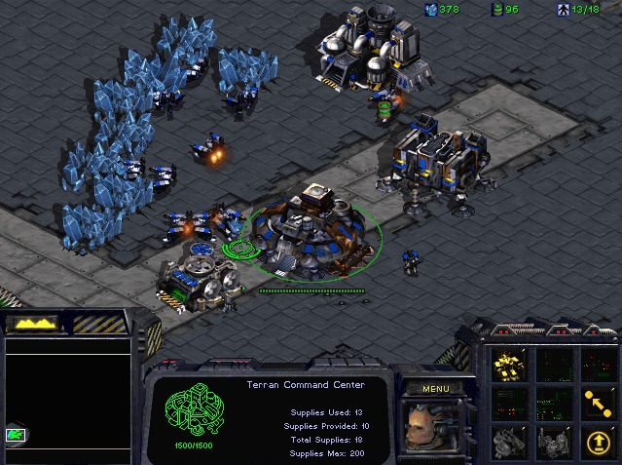
Real-Time Strategy Game
Real-Time
Strategy
Economy
Technology
Army
Player
Macro
Micro
StarCraft
Released in 1998
Sold over 11 million copies
Challenges in AI research
Decision making under uncertainty
Opponent modeling
Spatial and temporal reasoning
…
Notes:
RTS game stands for Real-Time Strategy game. It composed of two parts: Real Time, and Strategy.
Unlike Chess and Poker, in RTS games, players simultaneously take actions.
It’s also a strategy game. Players need to build up their economy to get the technology and the army in order to defeat their opponent.
When a player is playing a RTS game, there are several levels of tasks. We usually call it Macro and Micro.
Macro is long term planning, and Micro focuses on short term operations.
This paper covers only the Micro part.
Starcraft is a popular RTS game, which was released in 1998, and sold over 11 million copies. We used Starcraft as our testbed. This is a snapshot of Starcraft’s game play.
AI research in RTS game is different with classic board games, like Chess.
The challenges in RTS AI research includes “decision making under uncertainty”, “opponent modeling”, “spatial and temporal reasoning”, etc.
A large number of works have been done in this domain.

Slide 4
Previous Work
Co-evolving team tactics (Avery, 2010)
Flocking (Preuss, 2010)
MAPF (Hagelback, 2008)
Other techniques
Case based planning (David Aha 2005, Ontanon 2007, )
Case injected GA(Miles 2005)
What we do
Skirmish
Spatial Reasoning
Micro
Compare GA to HCs
Notes:
Phillipa Avery worked on co-evolving team tactics using a combination of influence maps, guiding a group of units to move and attack based on opponent’s position.
Mike Preuss used a flocking based and influence map based path finding algorithm to enhance team movement.
Johan Hagelbäck presented a Multi-Agent Potential Field based bot architecture in ORTS . It applied potential field at the tactical and unit operation level of the player.
Researchers also work on other techniques like case based planning, case injected GA, etc.
Our research focuses on comparing heuristic search algorithms on a micromanagement problem. Specifically, we compare a GA to two types of HCs to find effective group behaviors for winning a skirmish scenario.
Let me describe our scenario in detail.

Slide 5
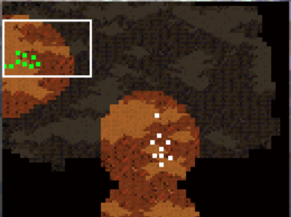
Scenario
Same units
8 Marines
1 Tank
Plain
No high land
No choke point
No obstacles
Starcraft units
No fog of war
Notes:
Our scenario is a customized Starcraft map with size of 64*64 unit grid, with the same number and types of units on each side.
The enemy units are located in the middle of the map, and controlled by the default Starcraft AI.
Our units are located on the left side of the map, and controlled by our AI player.
To simplify the problem in this preliminary work, this map does not contain any obstacles, no high land, and without any choke points.
We used some of the default Starcraft units without changing their properties, because they are well balanced.
And there is no fog of war. Because we are assuming the enemy position information is already known before the skirmish.
As many other researchers have done, we represent our AI player with two commonly used methods: influence map and potential field.

Slide 6
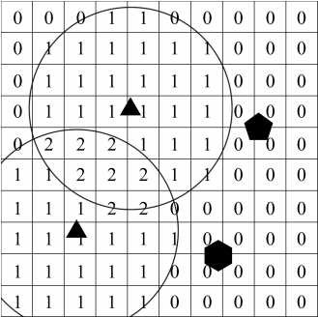
Representation - Influence Map
IMFunction
Linear
Non-linear
Parameters
Weight
Range
Combined IM
Marine IM
Tank IM
Sum IM
Notes:
An influence map is a grid placed over the game world, with values assigned to each square by an IMFunction. The IMFunction could be linear or non-linear.
Each influence map is specified by two parameters, the weight, and the range.
Here is an example of an IM. The triangles represent units in the game. This is the “range”. The “weight” determines the cell value inside the range. If two influence range overlap, we sum them up, we can see the cell values in the overlapped part are 2.
IMs could also be combined together. We have Marine IM, Tank IM, and the sum IM of the two. The sum IM is derived from the previous two.
In our representation, influence maps tell our units where to move. All our units will move to the cell with the highest value on the map until each unit occupies one cell.

Slide 7
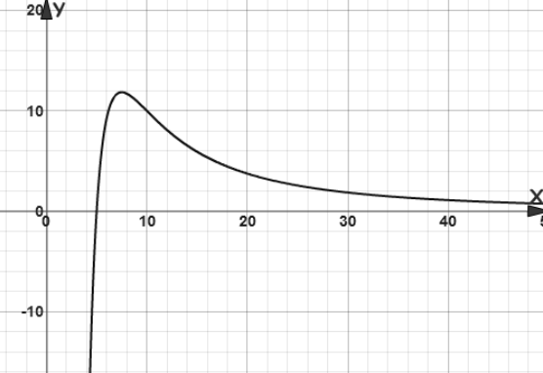
Representation - Potential Field
$F=cd^{e}$
Parameters
c - coefficient
e – exponent
3 potential fields
Attractor
Friend Repulsor
Enemy Repulsor
$F=\frac{2000}{d2}−\frac{10000}{d3}$ (1)
Notes:
We use potential fields to produce good group movement, avoiding collision, and remaining outside the enemy’s weapon range.
A PF is a vector force calculated by a potential function. Each potential field is specified by two parameters. “coefficient” and “exponent”.
Equation 1 is an example of PF. This equation contains 2 PFs, the parameters of the first part are “c=2000 and e = -2” . The parameters of the second PF are “c=-10000 and e=-3”.
The X axis is the distance. The Y axis is the potential force.
We can see the force is repulsive at a small distance. The force is attractive and strong at a medium distance, and the force is attractive and weak at a large distance.
We use 3 PFs representing Attractor, Friend Repulsor, and Enemy Repulsor.

Slide 8
Representation - Encoding
Parameters | bits
W_{M} | 5
R_{M} | 4
W_{T} | 5
R_{T} | 4
c_{A} | 6
c_{FR} | 6
c_{ER} | 6
e_{A} | 4
e_{FR} | 4
e_{ER} | 4
Influence Maps
2 IMs, 4 parameters
Potential Fields
3 PFs, 6 parameters
Bitstring / Chromosome
Total: 48 bits
IMs
PFs
W_{M}
R_{M}
c_{A}
e_{A}
……
1 | 0 | 1 | 0 | 1 | 0 | 1 | 0 | 1 | 0 | 1 | 0 | 1 | 0 | … | … | 1 | 0 | 1 | 1 | 0 | 0 | 1 | 0 | 1 | 0 | 1 | 0 | 1 | 0
48 bits
Notes:
We compactly represent our group behaviors as a combination of two IMs and three PFs, by encoding them into a 48 bit string, since GA and HCs work well with binary encodings.
Each bitstring represents a specific group behavior.
The table lists all our parameters, W represents weight, R represents range, M represents Marine, T represents Tank, c represents coefficient, e represents exponent, A is the attraction, FR represents friend repulsion, ER represents enemy repulsion.
Once we have decoded our bitstring, it tells our units where to move by the decoded IMs, and controls our group to move by the decoded PFs. After positioning, our units will attack the enemy units and evaluate the fitness of this AI player at the end of the game.

Slide 9
Metric - Fitness
Parameters | Description | Default
S_{M} | Marine | 100
S_{T} | Tank | 700
S_{time} | Time Weight | 100
S_{dist} | Distance Weight | 100
When engaged, fitness rewards
More surviving units
More expensive units
Short game
(1)
Without engagement, fitness rewards
Movements in the right direction
(2)
Notes:
When our units engage the enemy units, our fitness function rewards 3 aspects.
The more units remaining alive, (N_{FM}, N_{EM}, N_{FT}, N_{ET} are the number of units remaining alive at the end of the game.)
the higher the cost of the remaining units, (S_{M}, S_{T}, S_{time} are scores listed in the table.)
and the shorter the game lasts will increase fitness.
But if there is no engagement at all until the end of the game, the previous fitness function will always be 0. Then we came up with the second fitness function which evaluates the average distance between our units with enemy units. Small average distance means our units move toward right direction, and it will get higher fitness.
With the representation of our group behaviors and the evaluation with fitness functions, we use a GA and HCs to search the effective group behaviors and compare their performance.

Slide 10
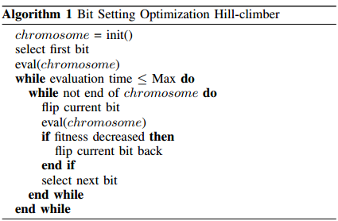
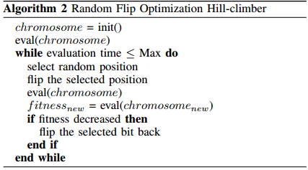
Methodology – Hillclimbers
Bit-Setting Optimization (BSO)
Sequentially flip
4000 evaluations
Random Flip Optimization (RFO)
Random flip
4000 evaluations
Notes:
We used two types of HCs in our experiments. BSO and RFO.
The BSO sequentially flips a bit in the 48 bit string, evaluates the fitness, and accept the better solution. Repeat this until the end of the bit string, and start over from the beginning. It runs 4000 evaluations and then terminate.
The RFO randomly selects a position and flip the bit, evaluates the fitness, and accept the better solution. Also run 4000 evaluations.

Slide 11
Methodology - GA
Pop. Size 80, 60 generations
CHC selection (Eshelman)
0.88 probability of crossover
0.01 probability of mutation
Notes:
We then apply a GA to find effective group behaviors.
Our GA used population size 80 and ran for 60 generations.
We used CHC selection which is a cross generation elitist selection.
The probability of crossover is 0.88 (point eight eight), and the probability of mutation is 0.01(point zero one).

Slide 12
Results - Quality
10 runs with different random seeds
Highest average fitness of GA, RFO, and BSO
GA – 1566
RFO – 1106
BSO – 887
Notes:
All our results are the average of 10 runs with different random seeds.
From the quality point of view, the GA found the highest average fitness of 1566 in all 3 techniques, the BSO had the lowest average fitness of 887.

Slide 13
Results - Reliability
GA – 100% RFO – 70% BSO – 50%
Notes:
For reliablity, we can see the figure, this is the all ten runs of 2 HCs and the GA. The Green is GA, the red is RFO, and the blue is BSO.
Our GA found high quality solutions 100% of the time. Our RFO found high quality solutions 70% percent of the time. While our BSO found high quality solutions half of the time.

Slide 14
Results - Speed
GA – 1000 evaluations (3 hours)
RFO – 400 evaluations (1 hour)
BSO – 200 evaluations (35 min)
Notes:
From the speed point of view, our GA used around 1000 evaluations to find high quality solutions, which needs approximately 3 hours in our simulation environment. The RFO needs approximately 1 hours, and the BSO needs only 35 minutes to converge.
Therefore, Our HCs could find quick solutions but not reliably. Our GA reliably found high quality solutions, but it takes much longer than HCs.
We also interested in the robustness of our AI players. If we found high quality solutions in one scenario, how do they perform in other scenarios.

Slide 15
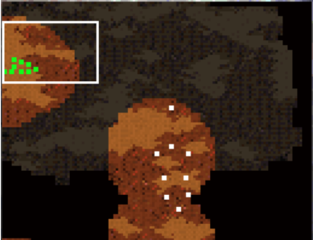
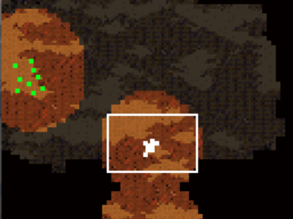
Results - Robustness
2 more scenarios
Intermediate
Dispersed
Concentrated
Train
Notes:
We designed 2 more scenarios. By including the previous scenario, we have 3 scenarios in total. We call these scenarios Intermediate, Dispersed and Concentrated.
We trained all our players in the Intermediate scenario, and applied the best solution to all three scenarios. We run the solution 500 times on each scenario and take the average.
Our solution performed well in the Intermediate scenario because we trained on this scenario, and the average fitness is 1380.
It surprisingly works better in the Dispersed scenario. However, it works poorly in the Concentrated scenario.
The reason behind this is because the concentrated enemy units have more concentrated fire power, and they do more damage compare to the dispersed units.
Dispersed enemy units have weaker fire power, but it has more map control, and more spatial information. However, our setting does not contain fog of war, map control and spatial information is useless in this scenario. Then the units were eliminated one by one sequentially without doing much damage.

Slide 16
Best Solution in Intermediate
Notes:
I have a movie to show the best solution trained on intermediate scenario.
The IMs tell our units where to move.
Start to attack after the units are in the correct position, and evaluate the fitness at the end of the game. We can see we don’t lose a single unit in this fight.
You can watch movies of the other scenarios on my website.

Slide 17
Conclusions and Future Work
Conclusions
HCs can produce quality solutions quickly
GA can reliably produce high-quality solutions
Future work
Investigate Case-Injection
Find high quality solutions faster
Investigate more complicated scenarios
Notes:
Our conclusions in this research is:
HCs can produce quality solutions quickly, but not reliably.
GA can reliably produce high-quality solutions, but much slower than HCs.
In the future, we will investigate Case-Injection GA to speed up our GA, and we will also investigate scenarios where we consider complicated terrain, hitpoints, fire range, and other elements.
Thank you.

Slide 18
Acknowledgements
This research is supported by ONR grants
N000014-12-I-0860
N00014-12-C-0522
More information (papers, movies)
simingl@cse.unr.edu (http://www.cse.unr.edu/~simingl)
sushil@cse.unr.edu (http://www.cse.unr.edu/~sushil)
monica@cse.unr.edu (http://www.cse.unr.edu/~monica)

