Slide 1
Using CIGAR for Finding Effective Group Behaviors in RTS Game
Authors: Siming Liu, Sushil Louis and Monica Nicolascu
simingl@cse.unr.edu, sushil@cse.unr.edu, monica@cse.unr.edu http://www.cse.unr.edu/~simingl
Notes:
Thank you all for being here
My name is Siming Liu, I am from the Evolutionary Computing Systems Lab at University of Nevada, Reno.
Today, I’m going to present part of my ongoing research – Using CIGAR for Finding Effective Group Behaviors in RTS Game.

Slide 2
Outline
RTS Games
Prior Work
Methodology
  Representation
    Influence Map
    Potential Field
  Performance Metrics
  Techniques
    Genetic Algorithm
    Case-injected GA
Results
Conclusions and Future Work
Notes:
Here is the outline of today’s presentation.
Our overall goal is to create an AI player that finds good group behaviors to win a skirmish in a RTS game.
In our research, we compare CIGAR to GA for finding effective group behaviors to defeat the default Starcraft AI, our baseline.
Early results showed that our hill-climbers were quick but unreliable while the genetic algorithm was slow but reliably found quality solutions a hundred percent of the time.
CIGAR, on the other hand, finds high quality results as reliable as GA but up to twice as quickly.
Before I explain our research in detail, let’s talk about what is RTS game, and why we are interested in RTS AI research.

Slide 3
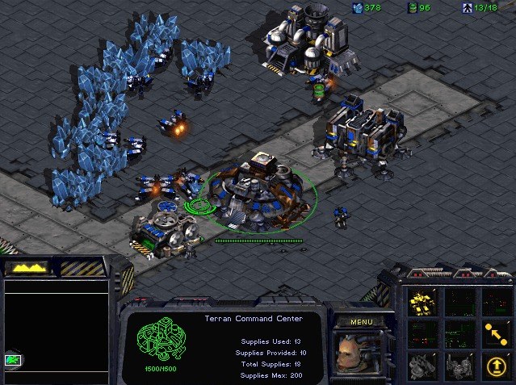
Real-Time Strategy Game
Real-Time
Strategy
  Economy
  Technology
  Army
Player
  Macro
  Micro
StarCraft
  Released in 1998
  Sold over 11 million copies
Challenges in AI research
  Decision making under uncertainty
  Opponent modeling
  Spatial and temporal reasoning
  …
Notes:
RTS game stands for Real-Time Strategy game. It composed of two parts: Real Time, and Strategy.
Unlike Chess and Poker, in RTS games, players simultaneously take actions.
It’s also a strategy game. Players need to build up their economy to get the technology and the army in order to defeat their opponent.
When a player is playing a RTS game, there are several levels of tasks. We usually call it Macro and Micro.
Macro is long term planning, and Micro focuses on short term operations.
This paper covers only the Micro part.
Starcraft is a popular RTS game, which was released in 1998, and sold over 11 million copies until 2009. We used Starcraft as our testbed. This is a snapshot of Starcraft’s game play.
AI research in RTS game is different with classic board games, like Chess.
The challenges in RTS AI research includes “decision making under uncertainty”, “opponent modeling”, “spatial and temporal reasoning”, etc.
A large number of works have been done in this domain.

Slide 4
Previous Work
  Case based planning (David Aha 2005, Ontanon 2007, )
Case injected GA(Louis, Miles 2005)
Flocking (Preuss, 2010)
MAPF (Hagelback, 2008)
What we do
  Skirmish
  Spatial Reasoning
  Micro
  Compare CIGAR to GA
Notes:
David Aha worked on a case-based plan selection method that learns to retrieve and adapt a suitable strategy for each specific situation during the game.
Sushil Louis and Chris Miles applied CIGAR in a strike force asset allocation game. They used the cases from both human’s and system’s game-playing experiences to bias CIGAR toward producing plans that contain previous important strategic elements.
Mike Preuss used a flocking based and influence map based path finding algorithm to enhance team movement.
Johan Hagelbäck presented a Multi-Agent Potential Field based bot architecture in ORTS . It applied potential field at the tactical and unit operation level of the player.
Our research focuses on comparing heuristic search algorithms on a micromanagement problem. Specifically, we compare a CIGAR to GA to find effective group behaviors for winning skirmish scenarios.
Let me describe our scenarios in detail.

Slide 5
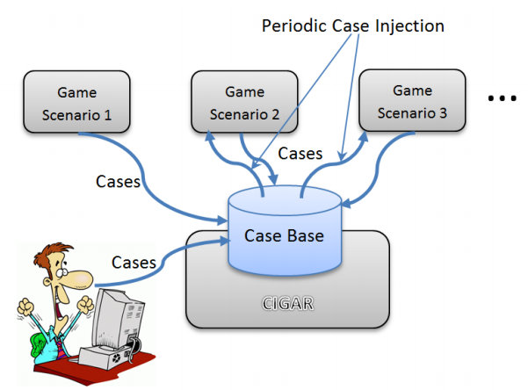
CIGAR
Case-Injected Genetic AlgoRithm
  Case-based reasoning
  Problem similarity to solution similarity
Notes:
CIGAR was first introduced by Louis and McDonnell, they borrowed ideas from case-based reasoning (CBR) in which experience from solving previous problems helps solve new similar problems.

Slide 6
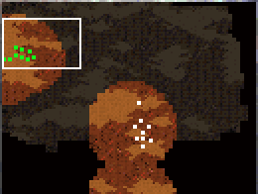
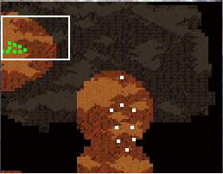
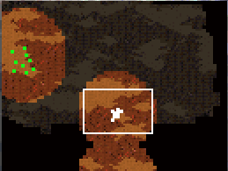
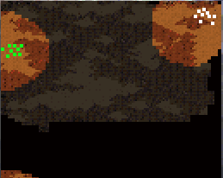
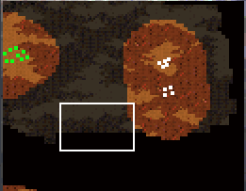
Scenarios
Same units
  8 Marines, 1 Tank
Plain
  No high land, No choke point, No obstacles
Position of enemy units
  5 scenarios
1. Intermediate
2. Dispersed
3. Concentrated
4. Corner
5. Split
Notes:
Our scenarios are customized Starcraft maps with size of 64*64 unit grid, with the same number and types of units on each side.
The enemy units are controlled by the default Starcraft AI as our baseline.
To simplify the problem in this preliminary work, these maps do not contain any obstacles, no high land, and without any choke points.
To evaluate the performance of GA with or without case injection, we designed five different but similar scenarios. The difference between scenarios is the initial position of enemy units’.
These five types of scenario can usually be found in human player matches. Dispersed units have less concentrated fire power but more map control and information gain. On the other hand, concentrated units have less map control but are harder to destroy. Since our experiments do not have fog of war, the advantage of dispersed enemy units do not apply in this case resulting in making the more concentrated enemy units harder to destroy. Therefore, the first two scenarios and the last one are relatively easy for GAs to find high quality solutions, while the scenario three and four are harder.
As many other researchers have done, we represent our AI player with two commonly used methods: influence map and potential field.

Slide 7
Representation – IM & PF
Influence Map
  Marine IM
  Tank IM
  Sum IM
Potential Field
  Attractor
  Friend Repulsor
  Enemy Repulsor
Notes:
In our representation, influence maps tell our units where to move. All our units will move to the cell with the highest value on the map until each unit occupies one cell.
We have Marine IM, Tank IM, and the sum IM of the two. The sum IM is derived from the previous two.
We use potential fields to produce good group movement, avoiding collision, and remaining outside the enemy’s weapon range.
We use 3 PFs representing Attractor, Friend Repulsor, and Enemy Repulsor.

Slide 8
Representation - Encoding
Parameters | bits
W_{M} | 5
R_{M} | 4
W_{T} | 5
R_{T} | 4
c_{A} | 6
c_{FR} | 6
c_{ER} | 6
e_{A} | 4
e_{FR} | 4
e_{ER} | 4
Influence Maps
  2 IMs, 4 parameters
Potential Fields
  3 PFs, 6 parameters
Bitstring / Chromosome
  Total: 48 bits
IMs
PFs
W_{M}
R_{M}
c_{A}
e_{A}
……
1 | 0 | 1 | 0 | 1 | 0 | 1 | 0 | 1 | 0 | 1 | 0 | 1 | 0 | … | … | 1 | 0 | 1 | 1 | 0 | 0 | 1 | 0 | 1 | 0 | 1 | 0 | 1 | 0
48 bits
Notes:
We compactly represent our group behaviors as a combination of two IMs and three PFs, by encoding them into a 48 bit string, since GA and HCs work well with binary encodings.
Each bitstring represents a specific group behavior.
The table lists all our parameters, W represents weight, R represents range, M represents Marine, T represents Tank, c represents coefficient, e represents exponent, A is the attraction, FR represents friend repulsion, ER represents enemy repulsion.
Once we have decoded our bitstring, it tells our units where to move by the decoded IMs, and controls our group to move by the decoded PFs. After positioning, our units will attack the enemy units and evaluate the fitness of this AI player at the end of the game.

Slide 9
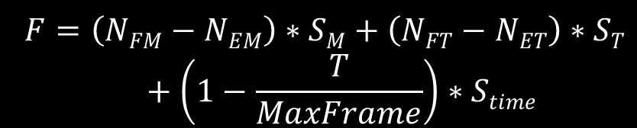
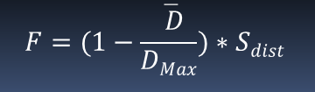
Metric - Fitness
Parameters | Description | Default
S_{M} | Marine | 100
S_{T} | Tank | 700
S_{time} | Time Weight | 100
S_{dist} | Distance Weight | 100
When engaged, fitness rewards
  More surviving units
  More expensive units
  Short game
(1)
Without engagement, fitness rewards
  Movements in the right direction
(2)
Notes:
When our units engage the enemy units, our fitness function rewards 3 aspects.
The more units remaining alive, (N_{FM}, N_{EM}, N_{FT}, N_{ET} are the number of units remaining alive at the end of the game.)
the higher the cost of the remaining units, (S_{M}, S_{T}, S_{time} are scores listed in the table.)
and the shorter the game lasts will increase fitness.
But if there is no engagement at all until the end of the game, the previous fitness function will always be 0. Then we came up with the second fitness function which evaluates the average distance between our units with enemy units. Small average distance means our units move toward right direction, and it will get higher fitness.
With the representation of our group behaviors and the evaluation with fitness functions, we use a GA and HCs to search the effective group behaviors and compare their performance.

Slide 10
Methodology - GA
Pop. Size 40, 60 generations
CHC selection (Eshelman)
0.88 probability of crossover
0.01 probability of mutation
Notes:
We apply our GA to find effective group behaviors on the five predefined scenarios sequentially.
Our GA used population size 80 and ran for 60 generations.
We used CHC selection which is a cross generation elitist selection.
The probability of crossover is 0.88 (point eight eight), and the probability of mutation is 0.01(point zero one).

Slide 11
Methodology – CIGAR
Case-Injected Genetic Algorithm (CIGAR)
  GA parameters are the same
  Extract the best individual in each generation
  Solution similarity
    Hamming distance
  Injection strategy
    Closest to best
    Replace 10% worst
    Every 6 generations
Notes:
Then we apply CIGAR on the 5 scenarios with the same order.
The GA parameters are the same with the previous one.
We use Hamming distance to measure our solution similarity, and use a “Closest to best” injection strategy to choose individuals from case-base to be injected into CIGAR’s population.
In our case, we inject four cases retrieved from case-base every 6 generation.

Slide 12
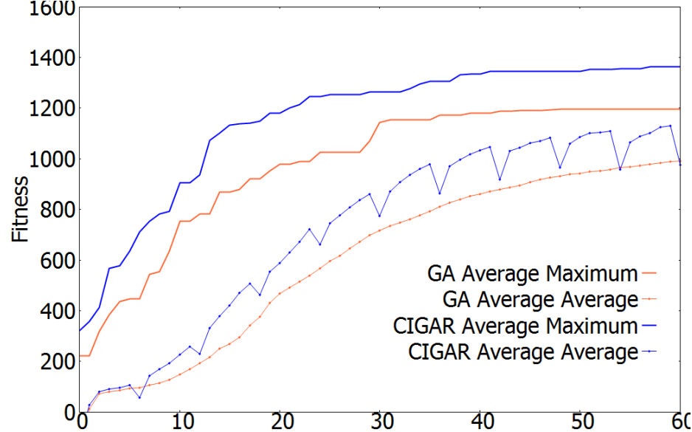
Results – GA vs CIGAR
On Concentrated scenario.
The third scenario: Intermediate, Dispersed
Notes:
All our results are the average of 10 runs with different random seeds.
This is the results of GA and CIGAR on Concentrated scenario. This scenario is the third one after Intermediate and Dispersed scenario. Therefore, there are already 7.9 cases in the case-base.
We can see the CIGAR with the case injection performed better than GA.

Slide 13
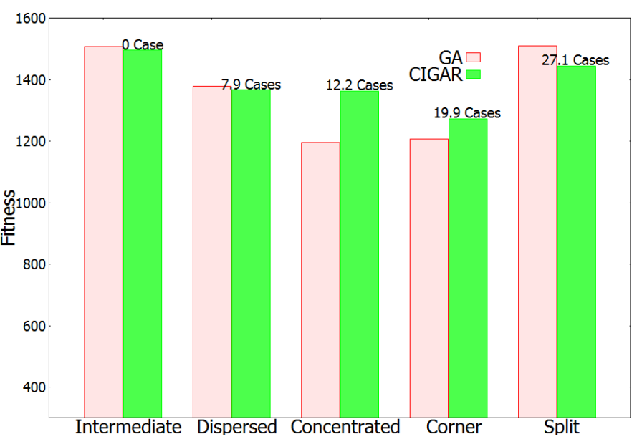
Results - Quality
Notes:
From the quality point of view, we can see the figure, CIGAR and GA performed close on the first scenario, Intermediate, because our case-base is empty. Without case-injection, CIGAR is a GA.
On the second and the last scenario, the enemy is relatively easy to defeat as I describe before, GA performed the same with CIGAR, on the last one it is even outperformed than CIGAR.
However, on hard problems, like Concentrated and Corner, CIGAR took advantage of cases in case-base and outperformed GA.

Slide 14
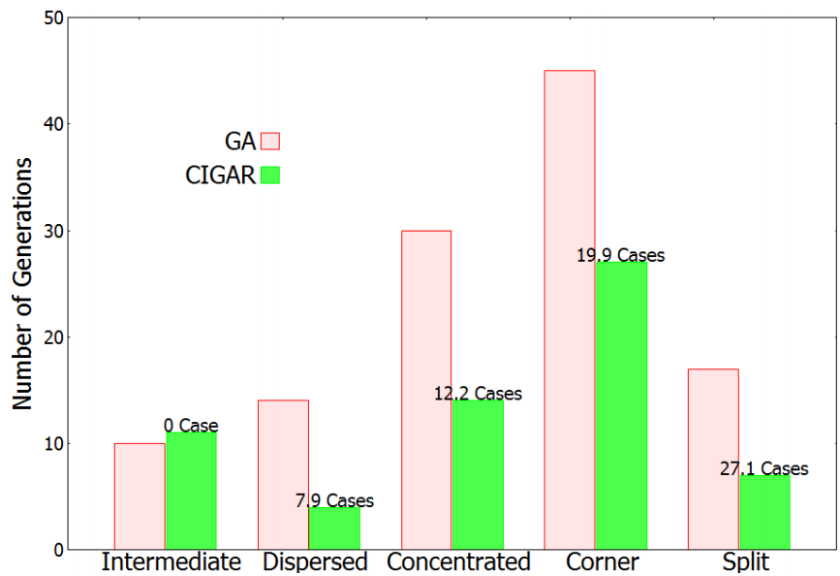
Results - Speed
Notes:
One of our goal of this research is finding a faster method and as reliable as GA. This figure shows the number of generations needed to find quality solutions above “1100” from our GA and CIGAR.
The GA ran on each scenario without any bias, so GA performance could reflect the difficulty of each scenario.
We can see CIGAR and GA performed the same on Intermediate scenario, however, it used much less generations on rest of the scenarios.

Slide 15
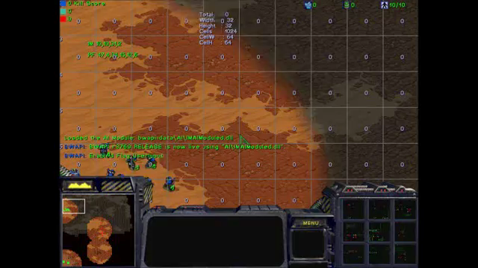
Best Solution in Intermediate
Notes:
I have a movie to show the best solution trained on intermediate scenario.
The IMs tell our units where to move.
Start to attack after the units are in the correct position, and evaluate the fitness at the end of the game. We can see we don’t lose a single unit in this fight.
You can watch movies of the other scenarios on my website.

Slide 16
Conclusions and Future Work
Conclusions
  CIGARs find high quality results as reliable as genetic algorithms but up to twice as quickly.
Future work
  Investigate more complicated scenarios
  Evaluate our AI player against state-of-the-art bots

Slide 17
Acknowledgements
This research is supported by ONR grants
  N000014-12-I-0860
  N00014-12-C-0522
More information (papers, movies)
  simingl@cse.unr.edu (http://www.cse.unr.edu/~simingl)
  sushil@cse.unr.edu (http://www.cse.unr.edu/~sushil)
  monica@cse.unr.edu (http://www.cse.unr.edu/~monica)

