Slide 1

Kalman Filters
Cameron Rowe

Slide 2
Overview
Introduction
Purpose
Implementation
Simple Example Problem
Extended Kalman Filters
Conclusion
Real World Examples

Slide 3
Introduction
Optimal Estimator
Recursive Computation
Good when noise follows Gaussian distribution

Slide 4
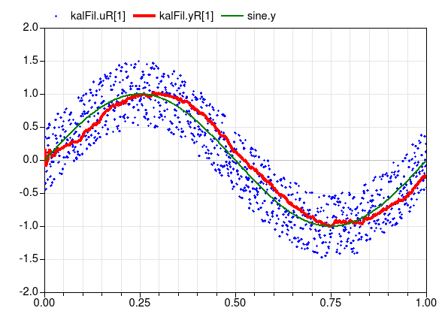
Purpose
“Filter” noisy data

Slide 5
Implementation
Important Variables
  x_{k} : current signal value
  x_hat_{k}: estimated signal value
  z_{k}: linear combination signal value and measurement noise
  A : matrix that describes state transition
  B : matrix that describes how control signal effects state
  H : matrix that describes how measured value is mapped to signal value
  Q : process noise
  R : measurement noise
  K_{k} : Kalman gain
  P_{k} : Previous error covariance

Slide 6
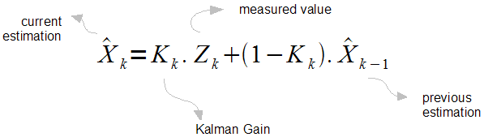
Implementation
Notes:
http://bilgin.esme.org/BitsBytes/KalmanFilterforDummies.aspx

Slide 7


Implementation
x_{k} = Ax_{k-1} + Bu_{k} + w_{k}
z_{k} = Hx_{k} + v_{k}
For Simple 1D problem

Slide 8
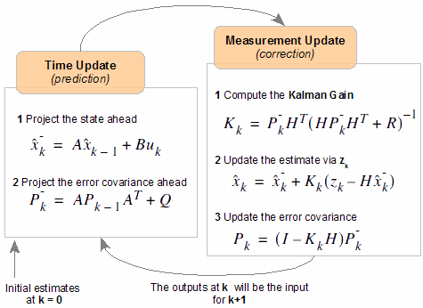
Implementation
Notes:
http://bilgin.esme.org/BitsBytes/KalmanFilterforDummies.aspx

Slide 9
Simple Example Problem
http://bilgin.esme.org/BitsBytes/KalmanFilterforDummies.aspx

Slide 10
Extended Kalman Filters
Similar to regular Kalman Filter but works on non-linear system (ex. GPS)
Uses differentiable functions for state transition and observation
x_{k} = f(x_{k-1} , u_{k-1}) + w_{k-1}
z_{k} = h(x_{k}) + v_{k}

Slide 11
Conclusion
Good real time processing for events with Gaussian noise distribution
Difficult to set up but efficient and effective with good values
Multi-dimensionality is complicated

Slide 12
Real World Examples
https://www.youtube.com/watch?v=095IOfqF4nY
https://www.youtube.com/watch?v=MELYZ5r5V1c

