Slide 1
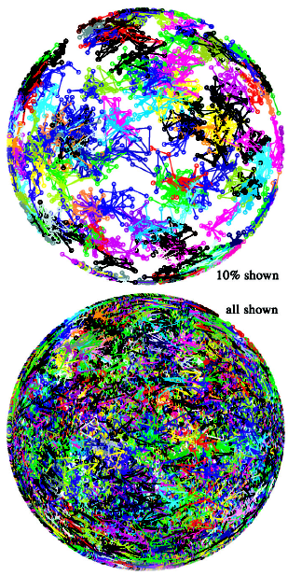
Spiking Neural Networks
Banafsheh Rekabdar

Slide 2
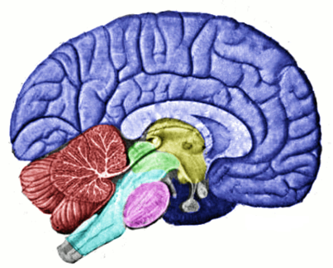
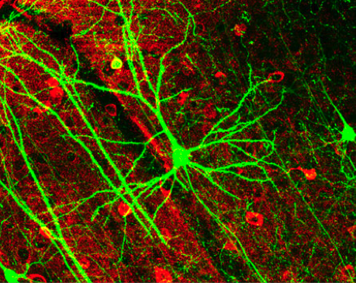
Biological Neuron:
The Elementary Processing Unit of the Brain

Slide 3
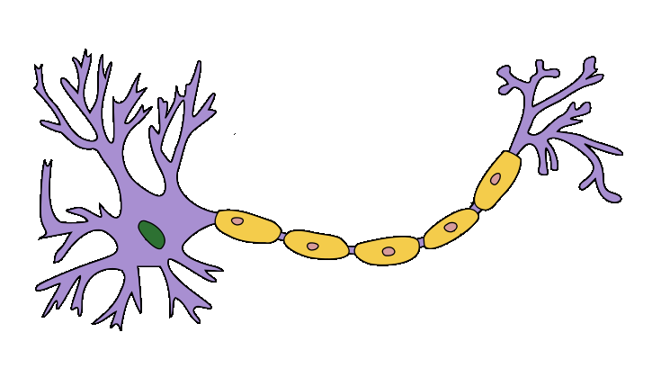
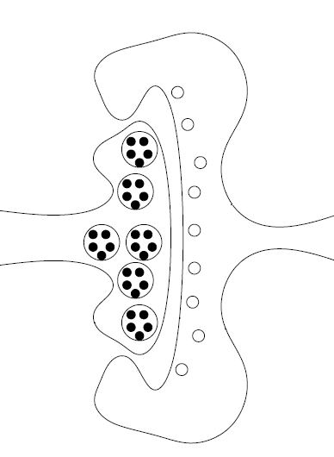
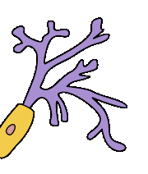
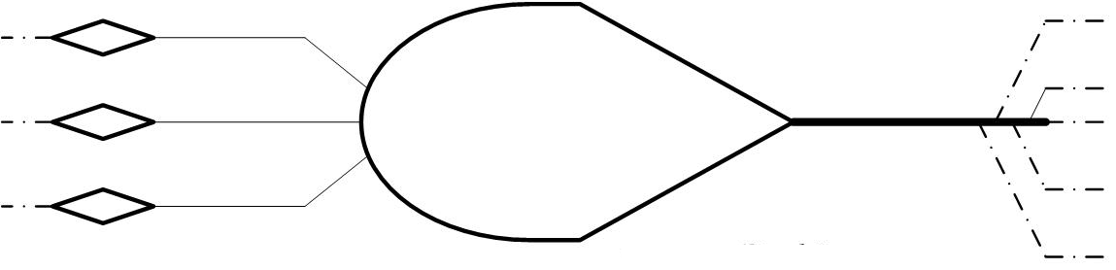
Biological Neuron:
A Generic Structure
Synapse
Axon
Axon Terminal
Dendrite
Soma

Slide 4
Biological Neuron – Computational Intelligence Approach:
The First Generation
The first artificial neuron was proposed by W. McCulloch & W. Pitts in 1943

Slide 5
Biological Neuron – Computational Intelligence Approach:
The Second Generation
Multilayered Perception is a universal approximator

Slide 6
Biological Neuron – Computational Intelligence Approach:
The Third Generation
Spiking neuron model was introduced by J. Hopfield in 1995
Spiking neural networks are
- biologically more plausible,
- computationally more powerful,
- considerably faster
than networks of the second generation

Slide 7
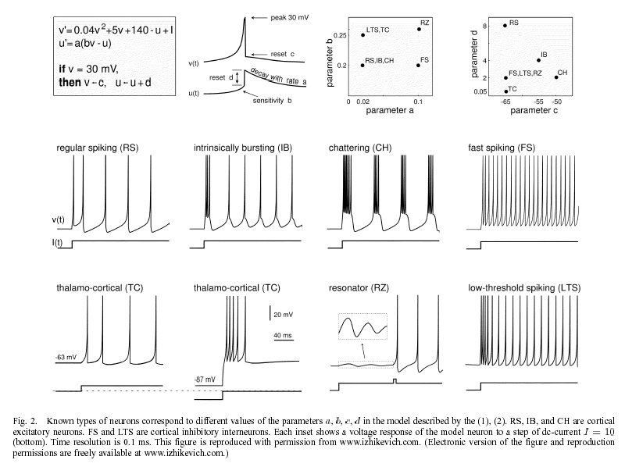
Spiking Neuron Model
Notes:
It is computational simple and efficient to implement in large-scale simulations

Slide 8
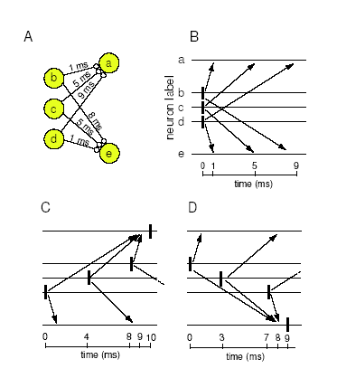
Polychronization

Slide 9
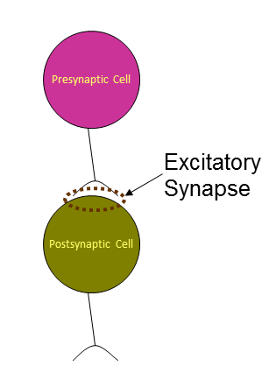
STDP rule (spike-timing-dependent plasticity)
Initially, all synaptic connections have equal weights.
The magnitude of change of synaptic weight
  depends on the timing of spikes.

Slide 10
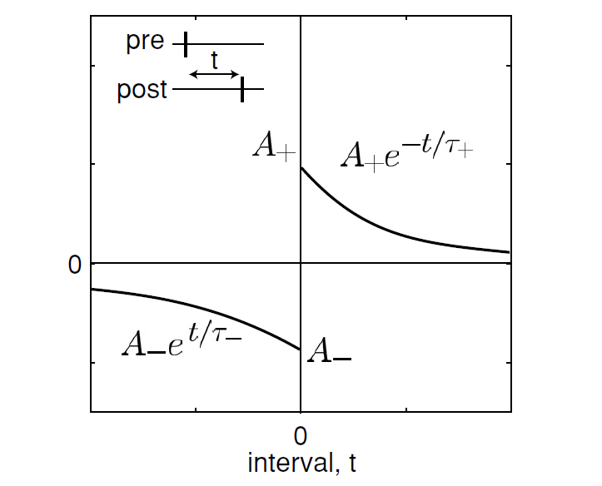
STDP rule (spike-timing-dependent plasticity)
If the presynaptic spike arrives at the postsynaptic neuron before the postsynaptic neuron fires—for example, it causes the firing—the synapse is potentiated.

Slide 11
STDP rule (spike-timing-dependent plasticity)
If the presynaptic spike arrives at the postsynaptic neuron after it fired, that is, it brings the news late, the synapse is depressed.

Slide 12
Spiking neural network
The network consists of cortical spiking neurons with axonal conduction delays and spike timing-dependent plasticity (STDP).
The network is sparse with 0.1 probability of connection between any two neurons.
Neurons are connected to each other randomly

Slide 13
Spiking neural network
Synaptic connections among neurons have fixed conduction delays, which are random integers between 1 ms and 20 ms.

Slide 14
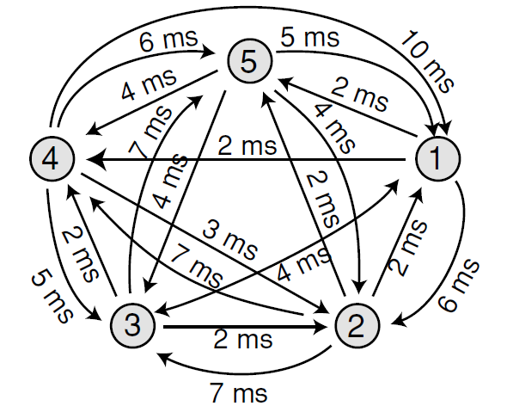
Spiking neural network

Slide 15
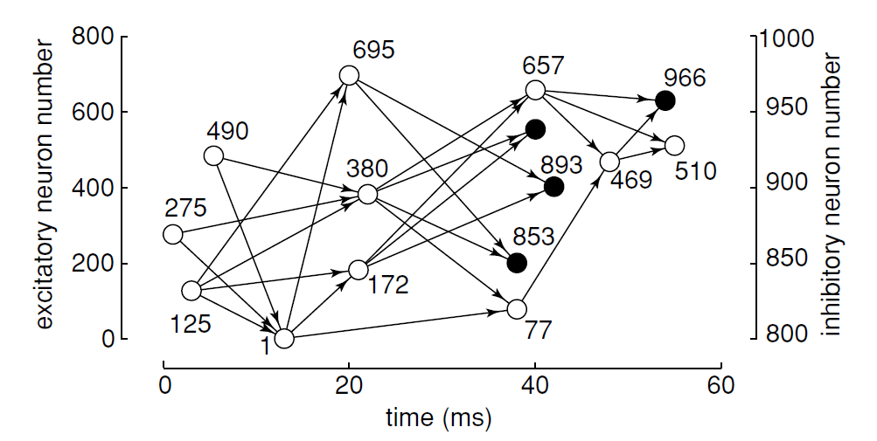
Polychronous Neural Group (PNG)
Notes:
Whenever the neurons in the figure do fire with the spike-timing pattern determined by the connectivity and delays, we say that the group is activated and the corresponding neurons polychronize. Typically, firing of the first few neurons with the righ

Slide 16
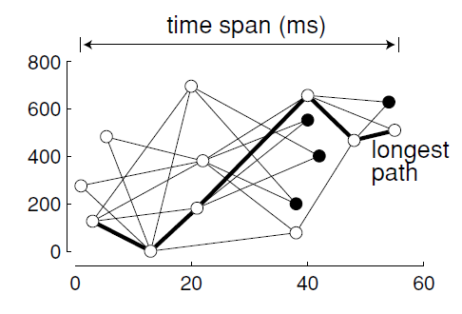
Characteristics of polychronous groups
The groups have different
  Sizes
  Lengths
  Time spans

Slide 17
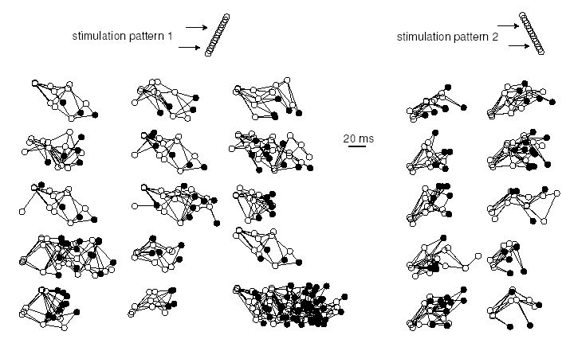
Representations of
Memories and Experience
Persistent stimulation of the network with two spatio-temporal patterns result in emergence of polychronous groups that represent the patterns. the groups activate whenever the patterns are present.

Slide 18
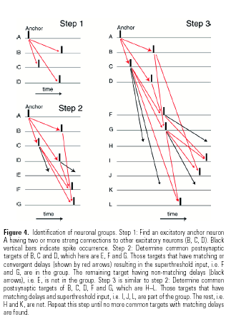
Time-locked spiking patterns

Slide 19
What useful for?
Its useful for classifying temporal patterns

Slide 20
Available software
There is diverse range of application software to simulate spiking neural networks.
EDLUT
GENESIS
NEST

