Slide 1
Decision Trees
ID | Hair | Height | Weight | Lotion | Result
Sarah | Blonde | Average | Light | No | Sunburn
Dana | Blonde | Tall | Average | Yes | none
Alex | Brown | Tall | Average | Yes | None
Annie | Blonde | Short | Average | No | Sunburn
Emily | Red | Average | Heavy | No | Sunburn
Pete | Brown | Tall | Heavy | No | None
John | Brown | Average | Heavy | No | None
Katie | Blonde | Short | Light | Yes | None

Slide 2
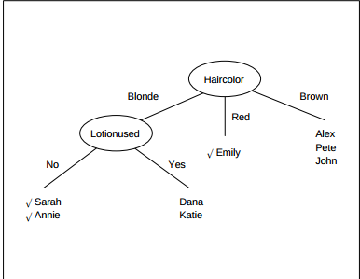
Example

Slide 3
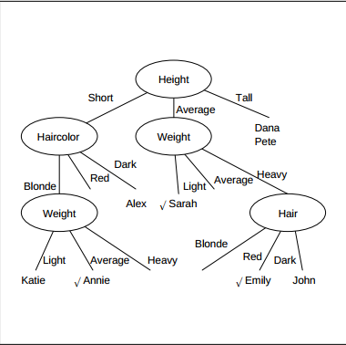
Example 2

Slide 4
Examples, which one is better?

Slide 5
Good when
Samples are attribute-value pairs
Target function has discrete output values
Disjunctions required
Missing, noisy training data

Slide 6
Construction
Top down construction
  Which attribute should be tested to form the root of a tree?
  Create branches for each attribute value and sort samples into these branches
  At each branch node, repeat 1

Slide 7
So how do we choose attribute?
Prefer smaller trees
  Occam's razor for DTs
  The world is inherently simple. Therefore the smallest decision tree that is consistent with the samples is once that is most likely to identify unknown objects correctly

Slide 8
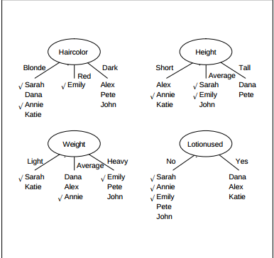
How can you construct smallest
Maximize homogeneity in each branch

Slide 9
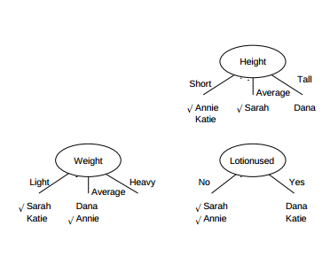
After choosing hair color

Slide 10
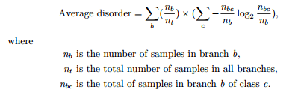
Formally
Maximize homogeneity = Minimize Disorder
Disorder formula can be taken from information theory

Slide 11

Entropy

Slide 12
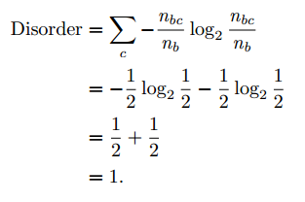
Entropy intuition
An attribute can have two values. If equal numbers of both values then

Slide 13
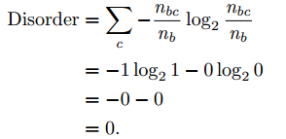
Entropy intuition (2)
An attribute can have two values. If ONLY one value present

Slide 14
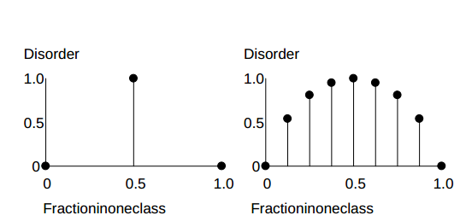
Entropy intuition (3)

Slide 15

Entropy intuition (4)

Slide 16
Decision Trees
ID | Hair | Height | Weight | Lotion | Result
Sarah | Blonde | Average | Light | No | Sunburn
Dana | Blonde | Tall | Average | Yes | none
Alex | Brown | Tall | Average | Yes | None
Annie | Blonde | Short | Average | No | Sunburn
Emily | Red | Average | Heavy | No | Sunburn
Pete | Brown | Tall | Heavy | No | None
John | Brown | Average | Heavy | No | None
Katie | Blonde | Short | Light | Yes | None

Slide 17
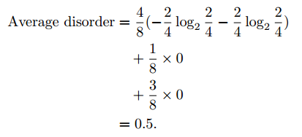
Worked Example, hair color

Slide 18
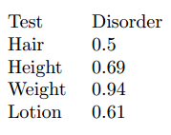
Other tests

Slide 19
Issues in DT learning
Over fitting the data
  Given a learned tree t with error e, if there is an alternate tree t' with error e' that fits the data and e' > e on the training set, but t' has smaller error over the entire distribution of samples

Slide 20
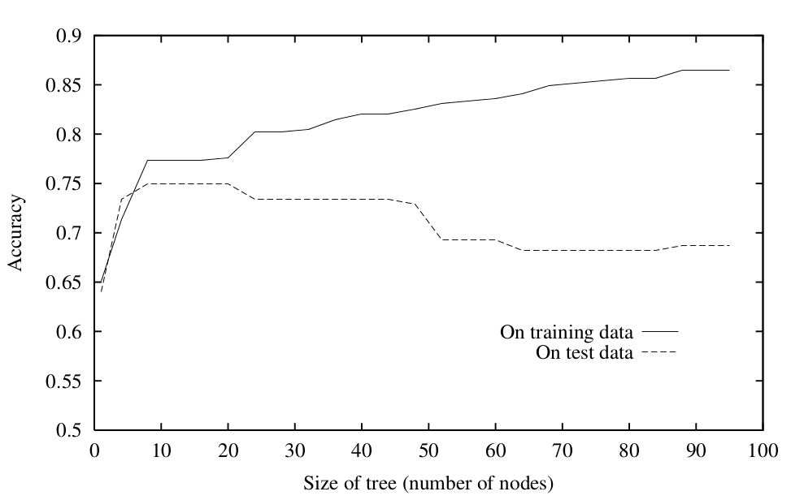
Overfitting

Slide 21
Dealing with overfitting
Stop growing the tree
Post prune the tree after overfitting
How do we determine correct final tree (size)
  Validation set (1/3rd)
  Statistical (chi-square) test to determine whether to grow the tree
  Minimize MDL (measure of complexity)
    size(tree) + size(misclassifications)

Slide 22
Reduced error pruning
Remove subtree at node and replace with leaf
Assign most common class at node to leaf
Only select node for removal if error <= error of original tree on validation set

Slide 23
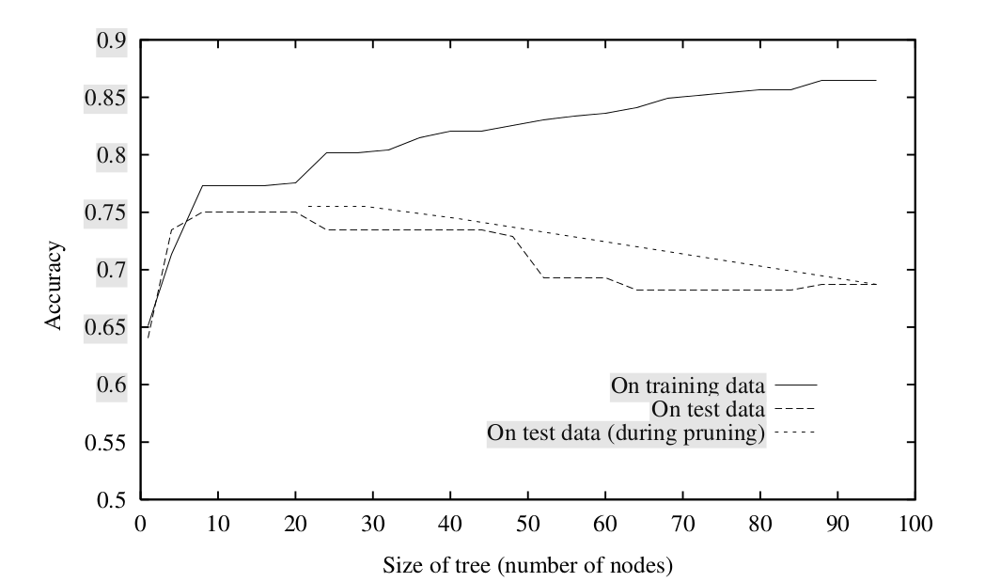
Effect of Reduced-Error Pruning

Slide 24
Rule post pruning
Convert tree to equivalent set of rules
Prune each rule independently of others
  Remove precondition and test
Sort final rules into sequence by estimated accuracy and consider them in this sequence

Slide 25
Why rules then pruning?
Each path through a node produces a different rule so you have many rules per node that can be pruned versus removing one node (and subtree)
In rules, tests near the root do not mean more than tests near leaves
Rules are often easier to read and understand

Slide 26
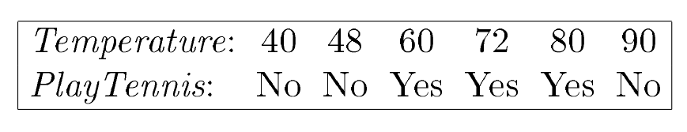
Continuous valued attributes

Slide 27
Continuous to discrete
We want a threshold (binary attribute) that produces the greatest information gain.
  Sort attribute
  Identify adjacent examples that differ in class
  Candidate thresholds are midway between attribute value on these examples
  Check candidate thresholds for information gain and choose the one that maximizes gain (or equivalently minimizes entropy)

Slide 28
Continuous attributes are favored
ID3 prefers many valued attributes
Consider Name: Perfect classification
Also include how well (broadly and uniformly) an attribute helps to split data
Name not broad at all
Lotion used: much better

Slide 29
Attributes with Costs
We want lower cost attributes tested earlier
Multiply by cost?

