Slide 1
Neural Networks
A neural network is a network of simulated neurons that can be used to recognize instances of patterns. NNs learn by searching through a space of network weights
https://www.cse.unr.edu/~sushil/class/ai/old/classnotes/glickman/1.pgm.txt

Slide 2
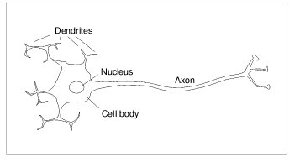
Neural network nodes simulate some properties of real neurons
A neuron fires when the sum of its collective inputs reaches a threshold
A real neuron is an all-or-none device
There are about 10^11 neurons per person
Each neuron may be connected with up to 10^5 other neurons
There are about 10^16 synapses (300 X characters in library of congress)

Slide 3
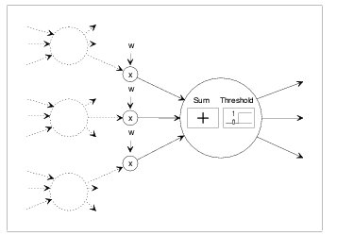
Simulated neurons use a weighted sum of inputs
A simulated nn node is connected to other nodes via links
Each link has an associated weight that determines the strength and nature (+/-) of one nodes influence on another
Influence = weight * output
Activation function can be a threshold function. Node output is then a 0 or 1
Real neurons do a lot more computation. Spikes, frequency, output…

Slide 4
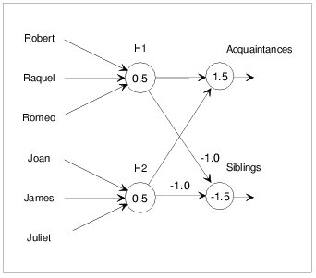
Feed-forward NNs can model siblings and acquaintances
We present the input nodes with a pair of 1’s for the people whose relationship we want to know.
All other inputs are 0.
Assume that the top group of three are siblings
Assume that the bottom group of three are siblings
Any pair not siblings are aquaintances
H1 and H2 are hidden nodes – their outputs are not observable
The network is not fully connected
The number inside node is node threshold
1.0
1.0

Slide 5
Search provides a method for finding correct weights
In general, link and node roles are obscure because the recognition capability is diffused over a number of nodes and links
We can use a simple hill climbing search method to learn NN weights
The quality metric is to minimize error

Slide 6
Training a NN with a hill-climber
Repeat
  Present a training example to the network
  Compute the values at the output nodes
  Error = difference between observed and NN-computed values
  Make small changes to weights to reduce the error
Until (there are no more training examples);

Slide 7
Back-propagation is well-known hill-climber for NN weight adjustment
Back-propagation propagates weight changes in output layer backwards towards input layer. Theoretical guarantee of convergence for smooth error surfaces with one optimum.
We need two modifications to neural nets

Slide 8
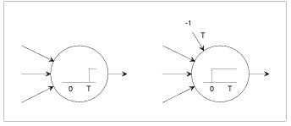
Nonzero thresholds can be eliminated
A node with a non-zero threshold is equivalent to a node with zero threshold and an extra link connected from an output held at -1.0

Slide 9
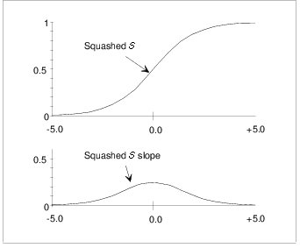
Hill-climbing benefits from smooth threshold function
All-or-none nature produces flat plains and abrupt cliffs in the space of weights – making it difficult to search
We use a sigmoid function – squashed S shaped function.
Note how the slope changes

Slide 10
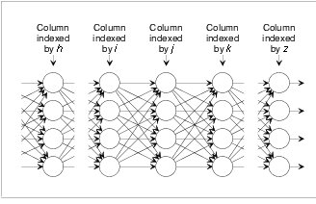
A trainable neural net

Slide 11
Intuition for BP
Make change in weight proportional to reduction in error at the output nodes
  For each sample input-combination, consider each output’s desired value (d), its actual computed value (o) and the influence of a particular weight (w) on the error (d – o).
  Make a large change to w if it leads to a large reduction in error
  Make a small change to w if it does not significantly reduce a large error

Slide 12
More intuition for BP
Consider how we might change the weights of links connecting nodes in layer (i) to layer (j)
  First: A change in node (j)’s input results in a change in node (j)’s output that depends on the slope of the threshold function
    Let us therefore make the change in (w_{i→j}) proportional to slope of sigmoid function. Slope = o (1 – o)

Slide 13
Weight change
The change in the input to node, given a change in weight, (w_{i→j}), depends on the output of node i.
Also we need to consider how beneficial it is to change the output of node j,
Benefit → β

Slide 14
How beneficial is it to change the output (o) of node j? (o_{j})
  Depends on how it effects the outputs at layer k.
How do we analyze the effect?
  Suppose node j is connected to only one node (k) in layer k.
  Benefit at layer j depends on changes at node k
  Applying the same reasoning

Slide 15
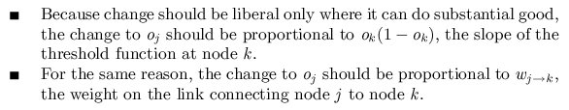

BP propagates changes back
Summing over all nodes in layer k

Slide 16
Stopping the recursion
Remember
And we now know the benefit at layer j
So now: Where does the recursion stop?
  At the output layer where the benefit is given by the error at the output node!

Slide 17
Putting it all together
Benefit at output layer (z) , β_{z} = d_{z} – o_{z}
Let us also introduce a rate parameter, r, to give us external control of the learning rate (the size of changes to weights). So
Change in w_{i→j} is proportional to r

Slide 18
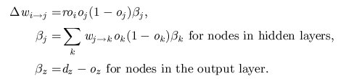
Back Propagation weights

Slide 19
Other issues
When do you make the changes
  After every examplar?
  After all exemplars?
After all exemplars is consistent with the mathematics of BP
If an output node’s output is close to 1, consider it as 1. Thus, usually we consider that an output node’s output is 1 when it is > 0.9 (or 0.8)

Slide 20
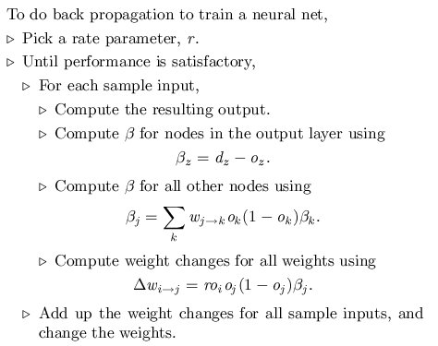
Training NNs with BP

Slide 21
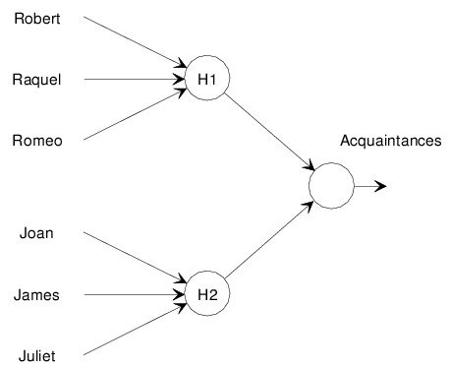
How do we train an NN?
Assume exactly two of the inputs are on
If the output node value > 0.9, then the people represented by the two on-inputs are acquaintances
If the output node value < 0.1, then they are siblings

Slide 22
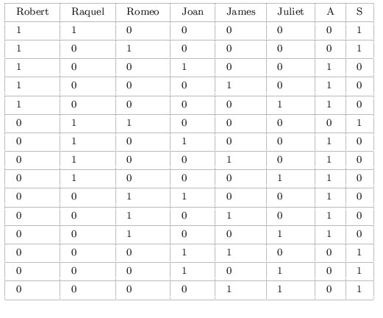
We need training examples to tell us correct outputs (o) so we can calculate output error for BP
Training examples

Slide 23
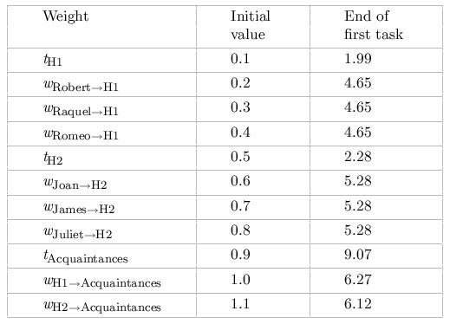
Initial Weights usually chosen randomly
We initialize the weights as on the right for simplicity
For this simple problem randomly choosing the initial weights gives the same performance

Slide 24
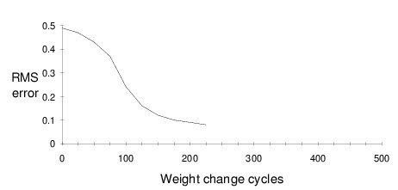
Training takes many cycles
225 weight changes
Each weight change comes after all sample inputs are presented
225 * 15 = 3375 inputs presented !

Slide 25
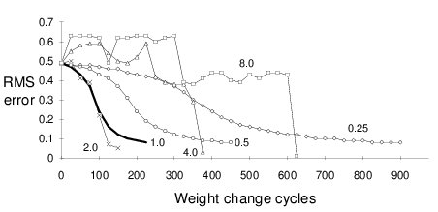
Learning rate: r
Best value for r depends on the problem being solved

Slide 26
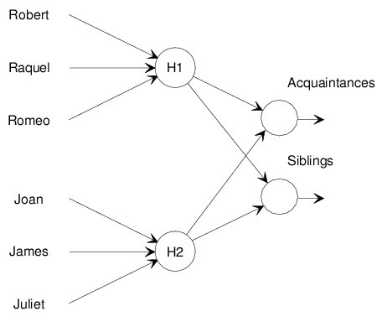
BP can be done in stages

Slide 27
Exemplars in the form of a table

Slide 28
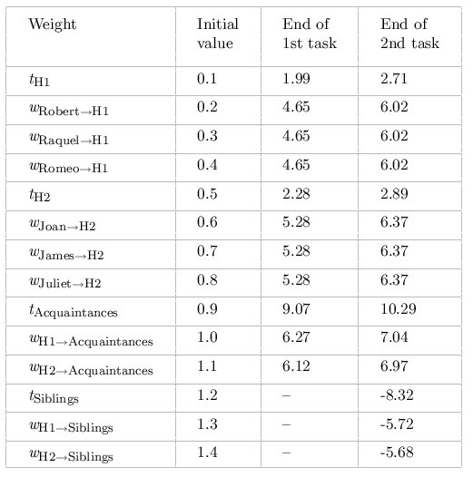
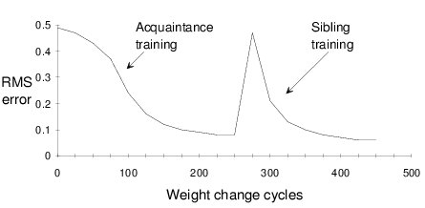
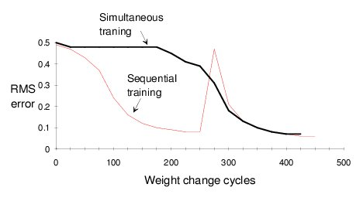
Sequential and parallel learning of multiple concepts

Slide 29
NNs can make predictions
Testing and training sets

Slide 30
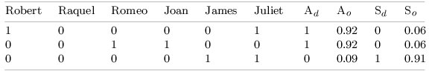
Training set versus Test set
We have divided our sample into a training set and a test set
20% of the data is our test set
The NN is trained on the training set only (80% of the data) – it never sees the exemplars in the test set
The NN deals successfully on the test set

Slide 31
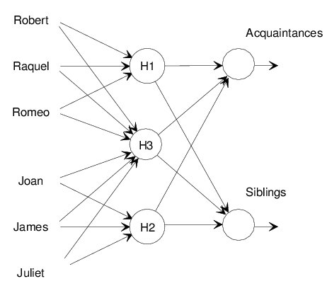
Excess weights can lead to overfitting
How many nodes in the hidden layer ?
  Too many and you might over-train
  Too few and you may not get good accuracy
How many hidden layers ?

Slide 32
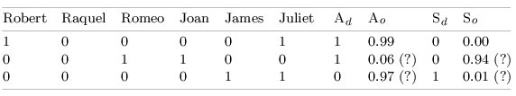
Over-fitting
BP requires fewer weight changes (300) versus about 450.
However we get poorer performance on test set

Slide 33
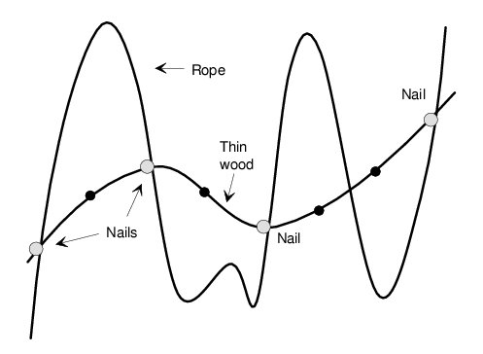
Over-fitting
To avoid over-fitting: Be sure that the number of trainable weights influencing any particular output is smaller than the number of training samples
First net with two hidden nodes: 11 training, 12 weights → ok
Second net with three hidden notes: 11 training, 19 weights → overfitting

Slide 34
Like GAs: Using NNs is an art
How can you represent information for a neural network?
How many neurons? Inputs, outputs, hidden
What rate parameter should be used?
Sequential or parallel training?

