Slide 1
Rule Based Systems
If <condition> then <consequence>
Rules to solve problems
What is forward chaining?
What is backward chaining?
Expert systems

Slide 2
RB Deduction Systems
Rule looks like
  If
    Cond1
    Cond2
    …
  Then
    Then1
    Then2
    …

Slide 3
Vocabulary/Terminology
Assertion: A statement about a fact
If-patterns match assertions in a collection of assertions called a
Working Memory
Deduction system: then-patterns specify assertions to be placed in working memory
Reaction systems: then-patterns specify actions

Slide 4
More terminology
In deduction systems
  Antecedent: if-pattern
  Consequent: then-pattern
Forward chaining: process of moving from if-patterns to then-patterns, using the if-pattern to identify appropriate situations for the deduction of a new assertion or the performance of an action

Slide 5
Deduction systems
Satisfying an assertion: When an if-pattern matches an assertion
Rule Triggering: When all if-patterns of a rule are satisfied
Rule Firing: When a triggered rule establishes a new assertion or performs an action

Slide 6
Zookeeper
Identifies animals in a small zoo
Robbie the robot can perceive
  Color, size, hair, gives milk, …
Can tell that an object is an animal, but cannot tell what animal it is
Would be nice to write Robbie an animal identification system

Slide 7
Zookeeper Designs
One if-then rule for each animal in the zoo
  Similar to the “giant table” approach to ttt
If-then rules produce intermediate assertions
  Only a few antecedents each. Easier
  Forward chaining through intermediate assertions to identity of animal

Slide 8
Rules
Small zoo
  Tiger, cheetah, giraffe, zebra, ostrich, penguin, albatross
  Zookeeper is simpler
Z1:
  If
    ?x has hair
  Then
    ?x is a mammal

Slide 9
Variables and bindings
Antecedents and consequents contain variables (?x)
Variables acquire values during the matching process

Slide 10
Variables and bindings 2
Assertion in WM: Stretch has hair
?x has hair matches when ?x becomes stretch
  Stretch has hair
  ?x has hair
?x is bound to Stretch or
Stretch’s is ?x’s binding

Slide 11
Bindings
Once a variable is bound, that variable is replaced by its binding wherever it appears in the same or subsequently processed patterns
Whenever the variables in a pattern are replaced by their bindings, the pattern is said to be instantiated

Slide 12
Instantiation
Stretch has hair
If ?x has hair
then ?x is-a mammal
?x bound to Stretch, then instantiated rule is
If Stretch has hair
Then Stretch is-a mammal

Slide 13
More Zookeeper rules
Z2
  If ?x gives milk
  Then ?x is-a mammal
Z3
  If ?x has feathers
  Then ?x is a bird

Slide 14
Zookeeper cont’d
Z4:
  If ?x flies
  ?x lays eggs
  Then ?x is a bird
Need some rules to disambiguate carnivores

Slide 15
More Zookeeper rules
Z5:
  If ?x is-a mammal
  ?x eats meat
  Then ?x is-a carnivore
Z6:
  If ?x is-a mammal
  ?x has pointed teeth
  ?x has claws
  ?x has forward-pointing eyes
  Then ?x is-a carnivore

Slide 16
Ungulate rules
Z7:
  If ?x is-a mammal
  ?x has hooves
  Then ?x is-an ungulate
Z8, Z9, … Z15

Slide 17
How does it work?
Note more than one animal has the same color, stripes, ….
Let’s see how it works through forward chaining

Slide 18
Working Memory
Stretch has hair
Stretch chews cud
Stretch has long legs
Stretch has tawny color
Stretch has dark spots
Stretch has a long neck

Slide 19
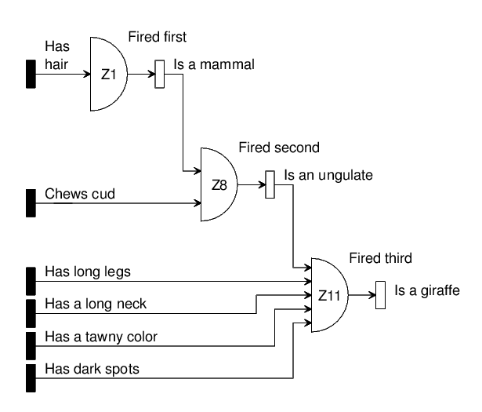
Rule firing sequence
?

Slide 20
Zookeeper (FC)
Until no rule produces an assertion or the animal is identified
  For each rule
    Try to support each of the rule’s antecedents by matching it to known assertions
    If all the rule’s antecedents are supported, assert the consequent unless there is an identical assertion already
    Repeat for all matching and instantiation alternatives

Slide 21
Backward Chaining
Form a hypothesis – rule consequent
Work to find supporting assertions in rule antecedents
  Swifty has tawny color
  Swifty has dark spots
  Swifty has hair
  Swifty has forward pointing eyes
  Swifty has claws
  Swifty has teeth

Slide 22
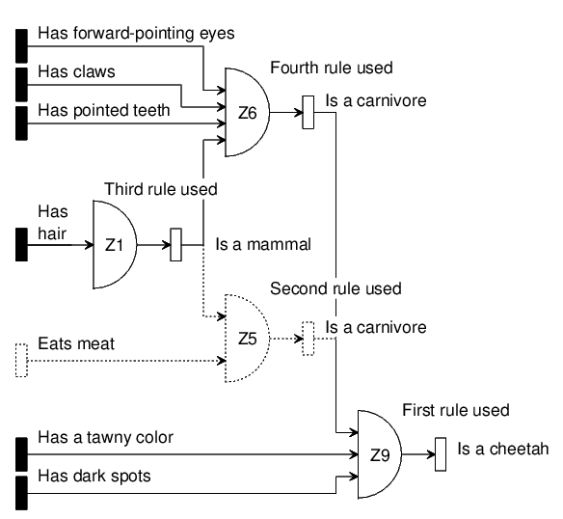
Rule Chaining Backward

Slide 23
Backward chaining code
Until all hypothesis have been tried and none have been supported or until the animal has been identified
  For each hypothesis
    For each rule whose consequent matches the current hypothesis
      Try to support each of the rule’s antecedents by matching it to assertions in WM or by backward chaining through another rule, creating new hypotheses. Be sure to check all matching and instantiating alternatives
      If all the rule’s antecedents are supported, announce success and conclude that the hypothesis is true

Slide 24
Forward or backward
Depends on the problem!
Fan-out versus Fan-in
If the facts can lead to a large number of conclusions, but the number of ways to reach the particular conclusion we are interested in is small, then there is more fan-out than fan-in. Use backward chaining

Slide 25
Backward or Forward?
If the number of ways of reaching the particular conclusion in which you are interested is large, but the number of conclusions you are likely to reach using the assertions is small, you have more fan-in.
Use forward chaining

Slide 26
Forward or Backward
If fan-in an fan-out are about the same
If you have not yet gathered any facts, and if you are only interested in whether one of many possible conclusions is true, use backward chaining
If you are only interested in whether an animal is a carnivore, only look at antecedents of carnivore rule to focus fact finding

Slide 27
Get all the facts
If you have all the facts that you will ever get, and are interested in everything that you can conclude from those facts, use Forward chaining
If you catch a fleeting glimpse of an animal, gathered a set of facts. No more facts possible because animal is gone: Forward chain

Slide 28
Mycin

Slide 29
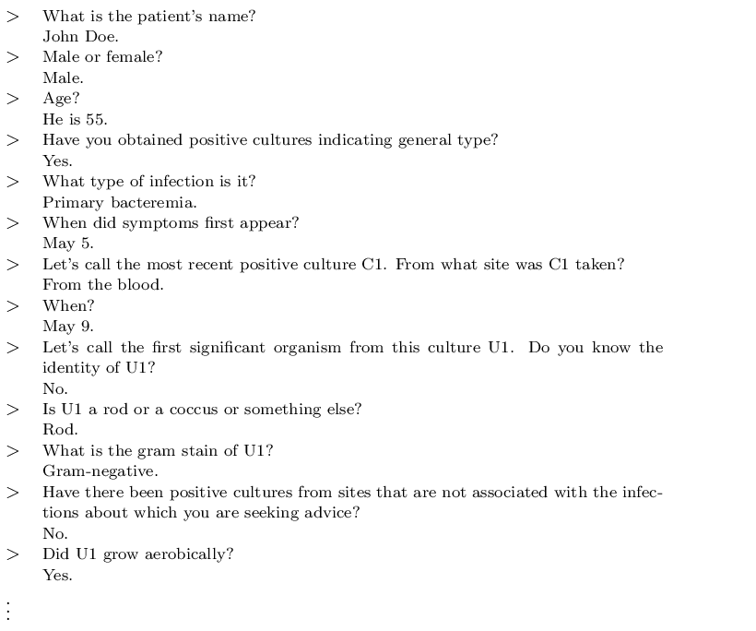
Mycin

Slide 30
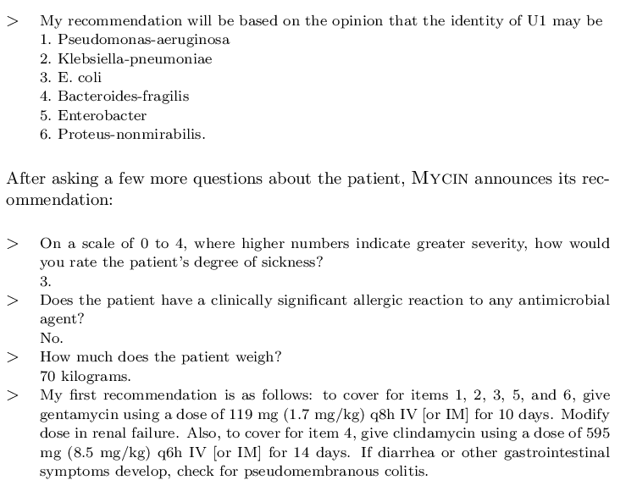

Slide 31
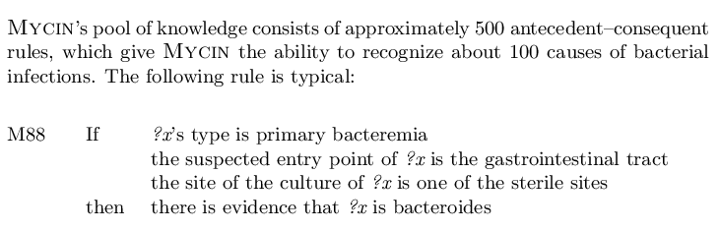
Mycin Rule

Slide 32
Reaction Systems
In reaction systems, the if-parts specify the conditions that have to be satisfied and the then-parts specify actions that need to be undertaken
Actions
  Add an assertion
  Delete an assertion
  Execute some procedure that has nothing to do with working memory or rule base

Slide 33
Grocery bagging
Robbie needs to know how to bag groceries
Plan A: For each item in store, design a rule?
Plan B: Four grocery bagging steps, differing sets of rules active within each of these four steps

Slide 34
Four steps
Check order
  Check if something is missing
Bag large items
  Put bottles in first
Bag medium items
  Frozen items in freezer bags
Bag small items

Slide 35
Working memory
Item | Container type | Size | Frozen
Bread | Plastic bag | Medium | no
Glop | Jar | Small | No
Granola | Cardboard box | Large | No
Ice cream | Cardboard carton | Medium | Yes
Potato chips | Plastic bag | Medium | No
Pepsi | Bottle | Large | no

Slide 36
Bagger assertions
Now that we have knowledge of items to be bagged in WM, we need to know current state. To start things off:
  Step is check-order
  Bag1 is-a bag
  Bread is to be bagged
  Glop is to be bagged
  Granola is to be bagged
  Ice Cream is to be bagged
  Potato-chips is to be bagged

Slide 37
Bagger rules
Note that WM contains assertion identifying the current step
Rules contains antecedent specifying which step they belong to
B1
  If step is check-order
  potato chips is to be bagged
  there is no pepsi to be bagged
  Then ask the customer whether he would like a Pepsi

Slide 38
B1 explanation
The purpose is to ask the customer if he/she would like something to drink with potato chips that are known to be dry and salty
Note “there is no Pepsi to be bagged” checks that a particular assertion is NOT in WM
Need a rule to move to bag-large-items step

Slide 39
Rule B2
B2
  If step is check-order
  Then step is no longer check-order
  step is bag-large-items
First then part Deletes an assertion from WM
Deduction systems cannot deal with inconsistencies. Static worlds where something true can never become false

Slide 40
Reactions systems are dynamic
Reactions systems are allowed more freedom
Then-parts are made up of add and delete parts
B2:
  If step is check-order
  Delete step is check-order
  Add step is bag-large-items

Slide 41
Conflict Resolution
B2 could prevent B1 from firing?
We need to find a way to choose one rule to fire from among many triggered rules
Bagger uses rule-ordering. B1 will fire before B2 because B1 comes before B2
There are other conflict resolution strategies

Slide 42
Escape mechanism in B3
If step is bag-large-items
a large item is to be bagged
the large item is a bottle
the current bag contains<6 large items
Delete the large item is to be bagged
Add the large item is in the current bag

Slide 43
Escape to Lisp
The condition “current bag contains < 6 large items” calculates something that has nothing to do with matching or binding
Most RBSs provide such an escape mechanism to a general purpose programming language
Useful when you need to do more than match

Slide 44
Bagger example
Code on web page

Slide 45
Conflict Resolution
Rule ordering
Context limiting
Specificity ordering
Data ordering
  Prioritize assertions. Trigger rule that matches highest priority assertions
Size ordering
  Longest list of conditions
Recency ordering
  LRU

