Slide 1
Artificial Intelligence
CS482, CS682, MW 1 – 2:15, SEM 201, MS 227
Prerequisites: 302, 365
Instructor: Sushil Louis, sushil@cse.unr.edu, http://www.cse.unr.edu/~sushil

Slide 2
Syllabus
Webpage: http://www.cse.unr.edu/~sushil/class/ai/
Textbook: Russell and Norvig’s Artificial Intelligence a Modern Approach, Third edition
40 % Assignments
40% Exams
20% Final Project
Pairs encouraged
Read the syllabus
First assignment due Sept 11

Slide 3
Outline
What is AI?
A Brief History of AI
What is the state of the Art

Slide 4
What is AI?
AI seeks to understand and build intelligent entities
AI is new
AI coined in 1956 at Workshop at Dartmouth
AI is hard
But what is it?

Slide 5
Definitions
Thinking Humanly The automation of activities that we associate with human thinking… (Haugeland) | Thinking Rationally The study of the computations that make it possible to perceive, reason, and act (Wilson)
Acting Humanly The study of how to make computers do things at which, at the moment, people are better (Rich and Knight) | Acting Rationally AI is concerned with intelligent behavior in artifacts (Nilsson)
Human performance metric
Ideal or rational performance metric

Slide 6
Acting humanly – Turing
Turing Test is an operational test for intelligent behavior (Turing, 1950)
Turing predicted that by 2000, a machine might have a 30% chance of fooling a lay person for 5 minutes
Language, knowledge, reasoning, learning
Natural language processing
Knowledge representation
Automatic reasoning
Machine learning
Total Turing test:
Computer vision
Robotics

Slide 7
Thinking humanly
How do we answer how do we think?
Introspection
Experimentation – observing a person in action
Brain imaging
Once we know sufficiently precisely how we think , we can write a computer program to do this
This is Cognitive Science
Distinct from AI but cross fertilization

Slide 8
Thinking rationally
Socrates is a man, All men are mortal, Therefore Socrates is mortal
Logic and derivation rules
Once you have Facts, and a set of rules for manipulating facts, you can (automatically) derive conclusions (prove theorems)
We will study logic and the limits of theorem proving

Slide 9
Acting Rationally
Rational behavior: doing the right thing
Maximize goal achievement given the available information
An agent is just something that acts
Doesn’t necessarily involve “thinking rationally”
Hot stove reflex is not the effect of a logical sequence of rule applications that deduce the optimal action is to move hand away from stove

Slide 10
Rational Agents
An agent is an entity that perceives and acts
F(P*) → Action
For any given class of environments and tasks, we seek the agent (or class of agents) with the best performance
Perfect rationality is computationally intractable
So we design the best program for given machine resources

Slide 11
Foundations and History
Philosophy
Logic, methods of reasoning, foundations of learning, language, rationality
Mathematics
Formal representations and proof. Algorithms, computation, decidability, tractability, probability
Economics
Rational agents maximize profits (payoff), OR
Psychology
Adaptation, learning, Experimental techniques
Neuroscience
Neural nets, when will computers reach human level computing capacity
Control Theory
Homeostatic systems, agents maximize an objective function, agents minimize error between goals state and current state

Slide 12
History
1942: Boolean circuit model of the brain
1950: Turing
1950s:
Samuel: Checkers
Newell and Simon: Logic Theorist
Gelernter: Geometry engine
1956: Dartmouth Meeting. The term: Artificial Intelligence coined
50s-60s: Everyone: Cannot do X. AI: Here’s a program for X. Lisp invented
Mid 60s: Computational Complexity kills scaling up in AI
70s: Expert systems
80s+: Industrial Expert systems
90s: AI winter + Neural Nets, GAs, NNs, Fuzzy logic
90s: Agents
2003+: Human level competitiveness with very large data sets

Slide 13
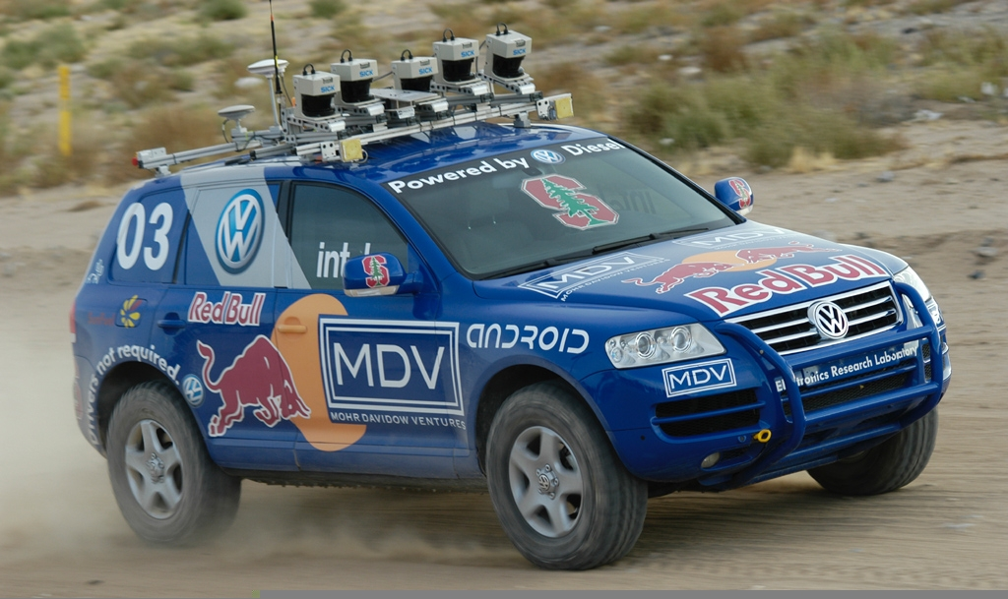
State of the Art: Stanley

Slide 14
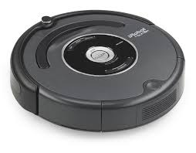
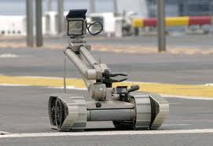
State of the Art: Robotics

Slide 15
State of the art
Speech recognition
United Airlines’ speech recognition system for support, booking
Siri,
Planning and Scheduling
Spacecraft ops (Nasa’s rovers)
Games
Deep blue and chess. Humans are no longer competitive
Spam fighting
80 – 90 % filtered out
Logistics
DART generated plans in hours that would have taken weeks
DARPA stated that this single application paid back DARPA’s 30 year investment in AI
Machine Translation: Google translate?

