Slide 1
Artificial Intelligence
CS482, CS682, MW 1 – 2:15, SEM 201, MS 227
Prerequisites: 302, 365
Instructor: Sushil Louis, sushil@cse.unr.edu, http://www.cse.unr.edu/~sushil
Logic

Slide 2
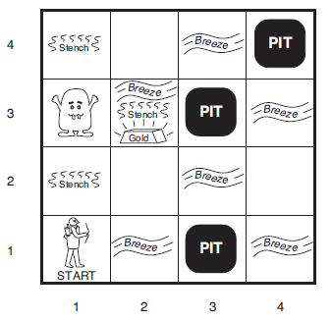
Logical Agents

Slide 3
Truth tables you know
E1 | E2 | E1&E2 | E1V E2 | E1➔E2 | !E1 V E2
T | T | T | T | T | T
T | F | F | T | F | F
F | T | F | T | T | T
F | F | F | F | T | T

Slide 4
Logical agents
Logical agents reason on internal representations of knowledge
Knowledge-based agent (KBA)
Previously states were represented as
Black boxes – is state a goal or not?
A set of variables and their assignments – Do these variable assignments satisfy problem’s constraints?
Now
Logic is a general class of representations to support KBAs
Combine and recombine information, old and new
Logic is old and the rules are well developed. If a problem permits a logic representation → we can use well understood tools to solve it
Many problems do not permit logic representations

Slide 5
Initial Vocabulary
Logic is old and has thus developed an extensive vocabulary
Knowledge base (KB)
Is a set of sentences expressed in a knowledge representation language
Some sentences are axioms
Tell adds a sentence to the KB
Ask queries the KB
Both operations may require inference → deriving new sentences from old
Not allowed to make up stuff when deriving new sentences from old

Slide 6
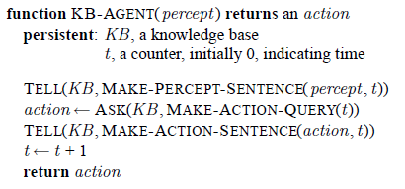
KBA
Tell an agent what it needs to know
Tell an agent goals to achieve
This is a declarative approach to building an agent/system

Slide 7
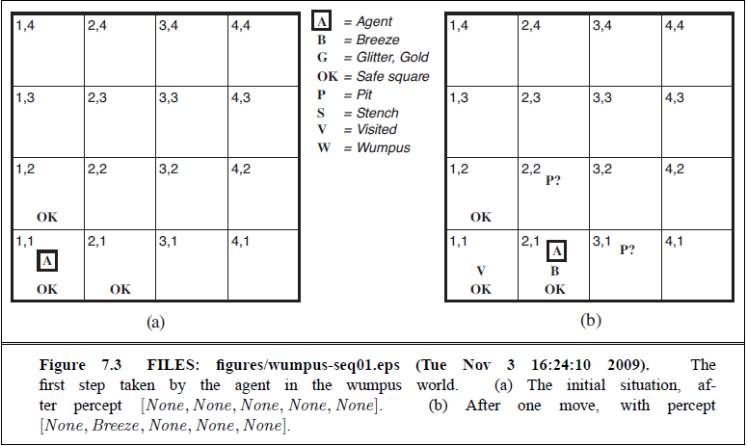
Wumpus world
Gold and wumpus locations chosen randomly
0.2 probability that a square contains a pit

Slide 8
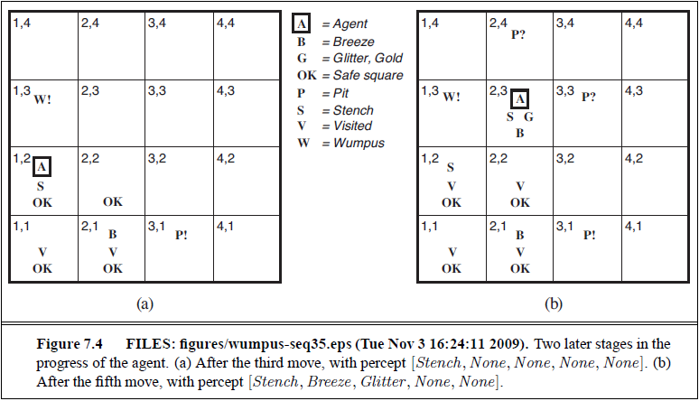
Move safely, but where?
Based on guaranteed correct updating of new knowledge
aka → Sound Rules of Inference

Slide 9
More Vocabulary
x + y = 4 is a sentence (call the sentence → alpha)
Sentence has syntax. Well formed sentence (well formed formula (wff))
Sentence has semantics
Semantics defines the truth of sentence w.r.t to each possible world
There are possible worlds in which alpha is true or false
In classical logic only possibilities are true and false
In Fuzzy logic, we can have “in-between”
There are models in which alpha is true or false (but a model need not have any connection to the real world)
A model m satisfies alpha if alpha is true in m.
Ex: m = (2, 2)
Also stated as: m is a model of alpha
M(alpha) is the set of all models of alpha
M = {(x = 0, y = 4), (x = 1, y = 3), (x = 2, y = 2), (x = 3, y = 1), (x = 4, y = 0)}
(x = 2, y = 3) is not a model of alpha and not a member of M

Slide 10
Entailment
A sentence beta logically follows from alpha
alpha entails beta
Iff M(alpha) is a subset of M(beta)
Alpha is a stronger assertion than beta, it rules out more possible worlds
x = 0 entails xy = 0, since in any world where x is 0, xy is zero

Slide 11
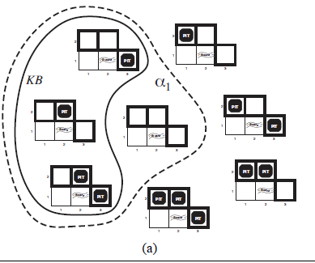
Knowledge in the Wumpus world
Possible models for the presence of pits in [1,2], [2,2], [3,1]
Each square may or may not contain pit
2^3 == 8 possibilities
KB is what is known
Cannot have pit in [2,1]
Must have pit in [2,2] or [3,1]
Consider:
alpha1 = There is no pit in [1,2]

Slide 12
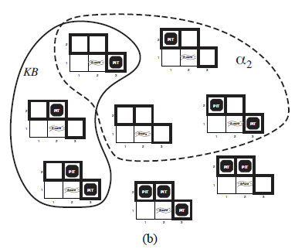
Knowledge in the Wumpus world
Possible models for the presence of pits in [1,2], [2,2], [3,1]
Each square may or may not contain pit
2^3 == 8 possibilities
KB is what is known
Cannot have pit in [2,1]
Must have pit in [2,2] or [3,1]
Consider:
alpha2 = There is no pit in [3,1]

Slide 13
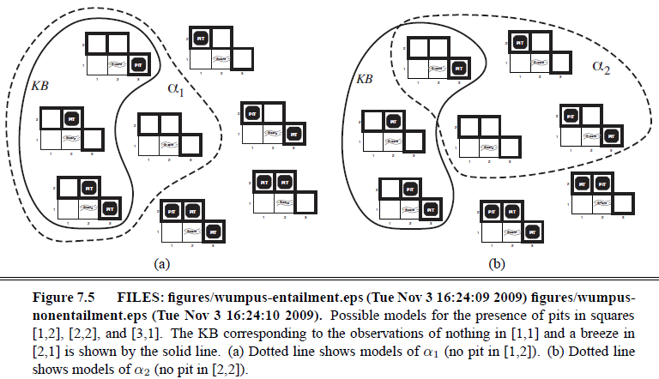
So: KB entails alpha1
KB does not entail alpha2

Slide 14
Logical inference
Entailment can be used to derive conclusions
This is Logical Inference
Model Checking checks that M(alpha) entails M(beta)
Previous figure model checked that M(KB) entails M(alpha1)
If an inference algorithm i can derive alpha from KB then
i derives alpha from KB
An inference algorithm that derives only entailed sentences is
SOUND
Model Checking is a sound procedure
Model Checking is a sound inference algorithm
An inference algorithm is complete if it can derive any sentence that is entailed
We are back to searching to check that KB entails alpha

Slide 15
Sound Inference
Guarantees that a conclusion arrived through sound inference is true in any world in which the premise (KB) is true
Sound inference operates on a representation of the real world
If good representation then this means
Conclusions correspond to aspects of the real world

Slide 16
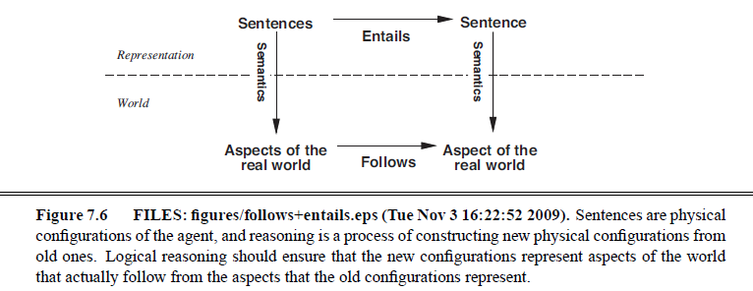
Some philosophy
Grounding
Connects the logical reasoning on a representation of the real world with the real world

Slide 17
Sad about Marcus
Marcus is a man
Marcus is a pompein
Marcus was born in 40AD
All men are mortal
All pompeins died when the volcano erupted in 79AD
No mortal lives longer than 150 years
It is now 2013AD
How do we represent this as sentences that a sound inference procedure can work with?

Slide 18
Sadder about Marcus
Man(marcus)
Pompein(marcus)
Born(marcus, 40)
A(x) [man(x) ➔mortal(x)]
Erupted(Volcano, 79)
A(x) [Pompein(x) ➔ died(x, 79)]
A(x) A(t1) A(t2) [mortal(x) & born(x, t1) & gt(t2 – t1, 150) ➔ dead(x, t2)]
Now = 2013

Slide 19
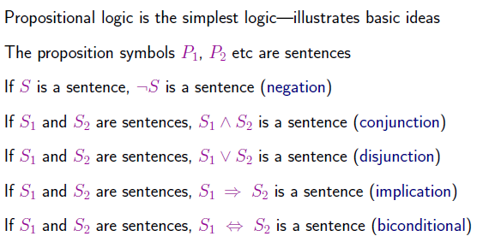
Propositional Calculus
Cannot represent all facts about the Marcus problem
What can PC represent? To find out let us define it
Syntax

Slide 20
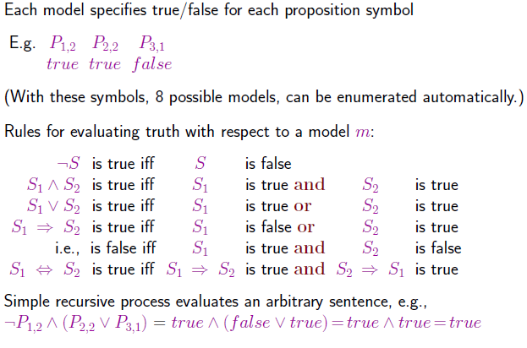
Semantics

Slide 21
Back to Wumpuses
W[1,3] ←→ ! W[2,2]. Wumpus is in [1,3] is true if and only if Wumpus is in [2,2] is false

Slide 22
Truth tables
E1 | E2 | E1&E2 | E1V E2 | E1➔E2 | !E1 V E2 | E1 ←→E2
T | T | T | T | T | T | T
T | F | F | T | F | F | F
F | T | F | T | T | T | F
F | F | F | F | T | T | T

Slide 23
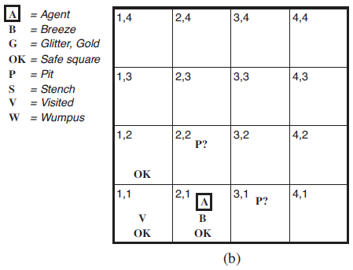
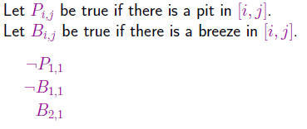
Wumpus representation

Slide 24
Wumpus Representation (2)

Slide 25
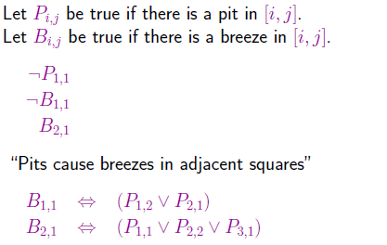
!P[1,2 ] ?
5 sentences in KB

Slide 26
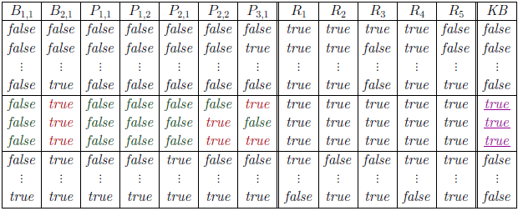
Need to model check
M(KB) entails M(!P[1,2])
Does M(KB) entail M(P[2,2]) ?

Slide 27
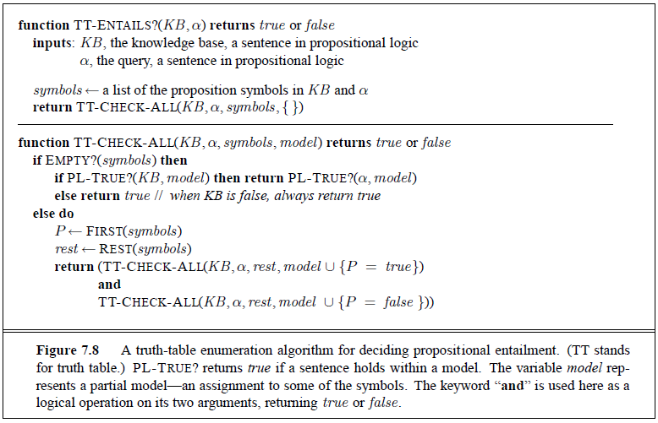
Entailment algorithm O(2^n)

