Slide 1
Artificial Intelligence
CS482, CS682, MW 1 – 2:15, SEM 201, MS 227
Prerequisites: 302, 365
Instructor: Sushil Louis, sushil@cse.unr.edu, http://www.cse.unr.edu/~sushil

Slide 2
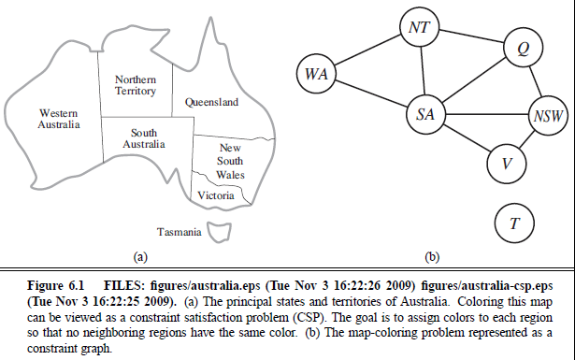
Three colour problem
Neighboring regions cannot have the same color
Colors = {red, blue, green}

Slide 3
Consider using a local search
WA | NT | NSW | Queen | Victoria | SA | Tas
{r, g, b} | {r, g, b} | {r, g, b} | {r, g, b} | {r, g, b} | {r, g, b} | {r, g, b}
- 3 to the power 7 possible states = 2187
But not all states are legal
For example: {r, r, r, r, r, r, r} is NOT legal because it violates our constraint
Suppose we do sequential assignment of values to variables
Assign r (say) to WA then we can immediately reduce the number of possible values for NT and SA to be {g, b}, and if we chose NT = {g}, then SA has to be {b}.

Slide 4
Propagation of constraints
g
r
g
r
?, ?, ?
b
b
?, ?, ?
?, ?, ?
?, ?, ?

Slide 5
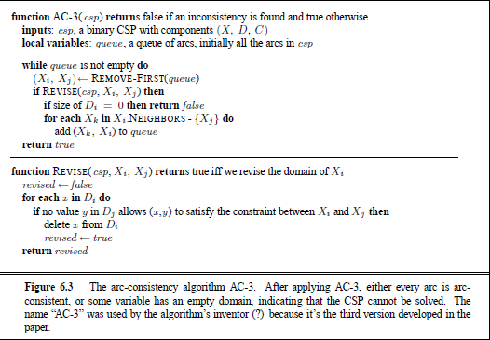
Wouldn’t it be nice to have a constraint propagation algorithm?

Slide 6
Properties
Node consistency (unary)
Arc consistency (binary)
  Network arc consistency (all arcs are consistent)
ACS3 is the most popular arc consistency algorithm
  Fails quickly if no consistent set of values found
  Start:
    Considers all pairs of arcs
    If making an arc (xi, xj) consistent causes domain reduction
      Add all neighboring arcs that go to xi to set of arcs to be considered
  Success leaves a much smaller search space for search
    Domains will have been reduced
  Suppose n variables, max domain size is d, then complexity is O(cd^3) where c is number of binary constraints

Slide 7
More constraint types and approaches
Path (triples)
Global constraints (n variables)
  Special purpose algorithms (heuristics)
  Alldiff constraints (Sudoku)
    Remove any variable with singleton domain
    Remove that value from the domains of all other variables
    Repeat
      While
        singletons values remain
        No domains are empty
        Not more variables than domain values
Resource constraints (Ex: Atmost 100)
Bounds and bounds propagation

Slide 8
Search
Constraints have been met and propagated
But the problem still remains to be solved (multiple values in domains)
  Search through remaining assignments
For CSPs Backtracking search is good
  Choose a value for variable, x
  Choose a subsequent legal value for next variable, y
  Backtrack to x if no legal value found for y

Slide 9
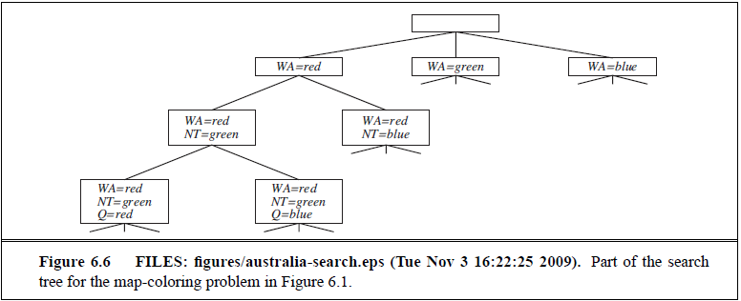
Australia coloring

Slide 10
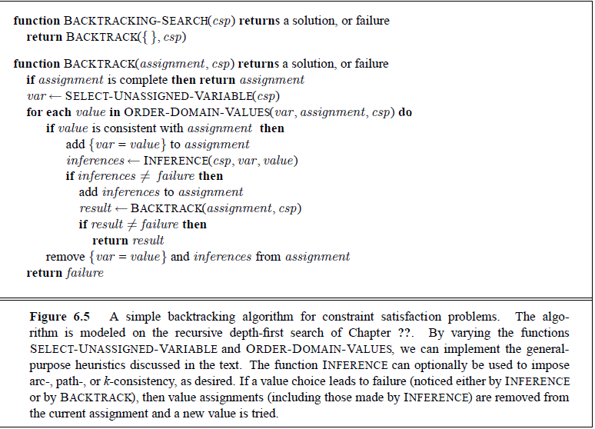
Backtracking search algorithm

Slide 11
CSP heuristics
For all CSPs
Depends on the answer to the following:
  Which var should be assigned next, and what order should it be assigned a value from the set of values available?
  What inference should be performed at each step of search?
  When the search arrives at an assignment that violates a constraint, can the search avoid repeating this failure?

Slide 12
Variable and value ordering
Choosing which variable:
  Minimum Remaining Value (MRV) heuristic aka fail-fast
    Choose the variable with the fewest remaining “legal” values
  Degree heuristic
    Choose variable that is involved in the largest number of constraints
Choosing which value:
  Least constraining value (fail-last)

Slide 13
Interleaving search & inference
AC-3 infers reductions in set of possible values before search
Inference is also powerful during search
Consider backtracking search + Forward checking
FC: After X assigned,
  For each unassigned var Y that is connected to X, delete any values from Y’s domain that is inconsistent with the value chosen for X
  After WA = red
    Forward check
  After Q = green
    Forward check
  NT = {blue}, SA = {blue}
  V = {blue} ➔ SA = {}
  Backtrack because there is no assignment for SA

Slide 14
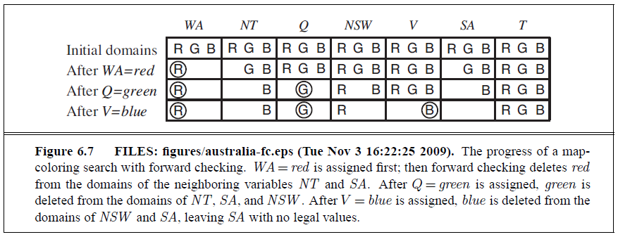
Inference + search
Backtracking + AC3 = Maintaining Arc Consistency (MAC algorithm)
  Fails faster than Backtracking + forward checking

Slide 15
Heuristic backtracking
Q = red, NSW = green, V = blue, T = red, SA = ?
  Every value of SA violates a constraint
  Should we backtrack to T = red?
  But T = red does not have anything to do with SA
Carry around a conflict set, a set of prior assignments that affects SA
{Q=red, NSW=green, V = blue} == conflict set for SA
FC may specify a conflict set!
Conflict set
  tells us not to backtrack to T
  instead to V
Back Jumping algorithm
red
green
blue
red

Slide 16
Conflict-directed back jumping
Not that simple:
Consider {WA = red, NSW = red}
  Is this possible?
  Now, assign to T,
  then to NT, Q, V, SA
  Because of earlier inconsistency
    No possible assignment
    So we backtrack to NT
      Try other values and still fail!
      NT’s conflict set {WA} is not complete
FC does not always provide enough information
Consider:
  SA fails and SA’s conflict set is (say) {WA, NSW, NT, Q}
  We backjump to Q and Q absorbs SA’s conflict set – Q
    Q’s conflict set = {NT, NSW} (we haven’t seen SA yet)
    SAcs Union Qcs - Q = {WA, NT, NSW} → no solution forward from Q given Qcs
    Backtrack to NT which absorbs {WA, NT, NSW} – {NT} = {WA, NSW}
    Back jump to NSW
red
red

Slide 17
Constraint learning
Can we learn sets of variable assignments that lead to conflicts?
  NO GOOD == {min set of variable and their values in a conflict set that lead to contradiction}

Slide 18
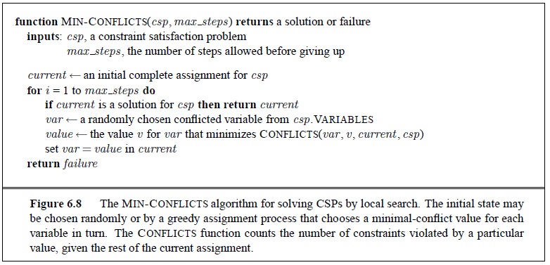
Local search for CSPs

Slide 19
CSP problem structure
Independent sub-problems
  Very nice
Tree structure (any two variables are only connected by one path)
  Linear time! O(nd^2)
Can we convert a constraint graph to a tree structure?
  1. Removing nodes (delete SA!)
    By assigning a value to SA and removing that value from all other nodes’ domains
    In general, find a cycle cutset, and return cutset’s assignment and remaining tree CSP
    d^c * (n-c)d^2

Slide 20
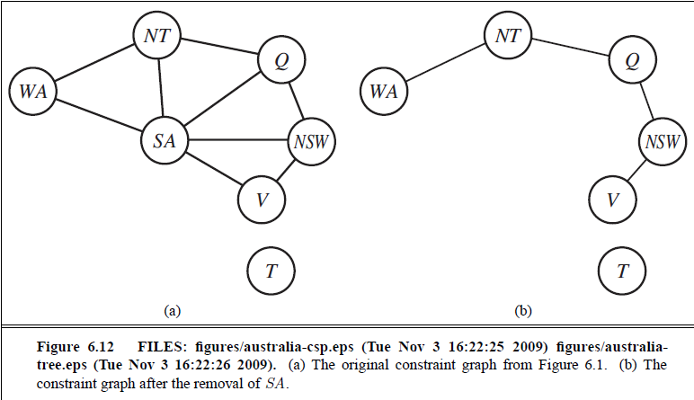
Removing nodes

Slide 21
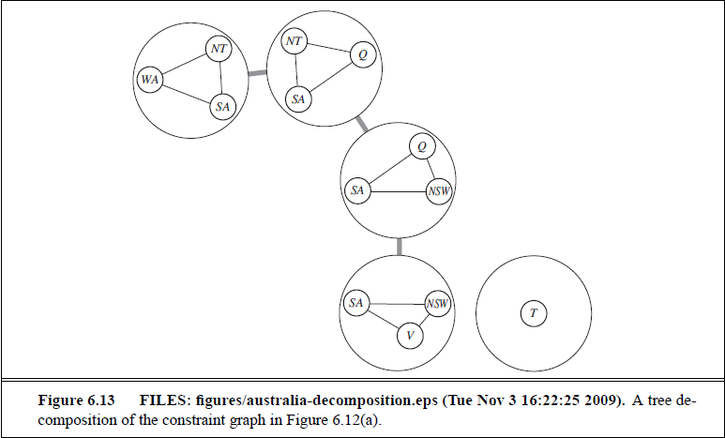
Collapsing nodes
Tree decomposition of constraint graph into a set of connected sub-problems.
  Great if tree width of Constraint Graph is small
  But
    Many possible decompositions

Slide 22
CSP Puzzle
The Englishman lives in the red house
The Spaniard owns the dog
The Norwegian lives in the first house on the left
The green house is immediately to the right of the ivory house
The man who eats Hershey bars lives in the house next to the man with the fox
Kits Kats are eaten in the yellow house
The Norwegian lives next to the blue house
The Smarties eater owns snails
The Snickers eater drinks OJ
The Ukranian drinks tea
The Japanese eats Milky Ways
Kit Kats are eaten in a house next to the house where the horse is kep
Coffee is drunk in the green house
Milk is drunk in the middle house
In five houses, each with a different color, live five persons of different nationalities, each of whom prefer a different brand of candy, a different drink, and a different pet.
Where does the zebra live?
Which house do they drink water?
What are possible representations of this CSP problem?
Which is best?

Slide 23
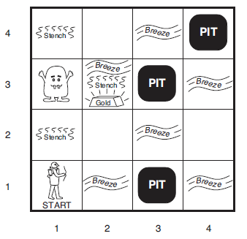
Logical Agents

