Slide 1
Artificial Intelligence
CS482, CS682, MW 1 – 2:15, SEM 201, MS 227
Prerequisites: 302, 365
Instructor: Sushil Louis, sushil@cse.unr.edu, http://www.cse.unr.edu/~sushil
Logic

Slide 2
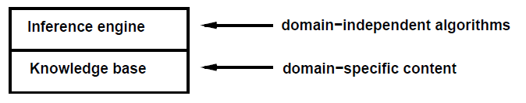
Overview
So we can use the domain independent inference engine to
  Diagnose disease
  Configure complex mainframes
  Tech support
  Wumpus world navigation
  …
The knowledge base is a set of sentences in a formal language that supports sound rules of inference

Slide 3
Logics are formal languages
Syntax
  Defines legal sentences in language
Semantics
  Defines the meaning of sentences – truth value
Inference generates new sentences from KB
  Entailment means that one thing follows from another
    KB
      Red sox won and
      Cardinals won
      Entails
      Cardinals won
  Models. m is a model of alpha if alpha is true in m’s world
  M(alpha) set of all models of alpha

Slide 4
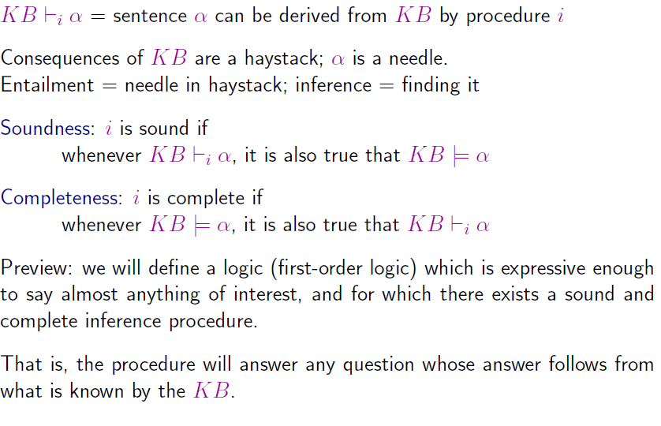
Inference

Slide 5
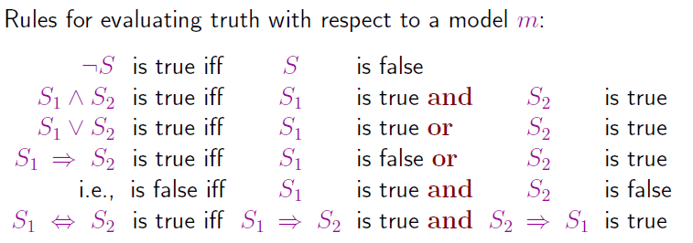
Syntax and Semantics

Slide 6
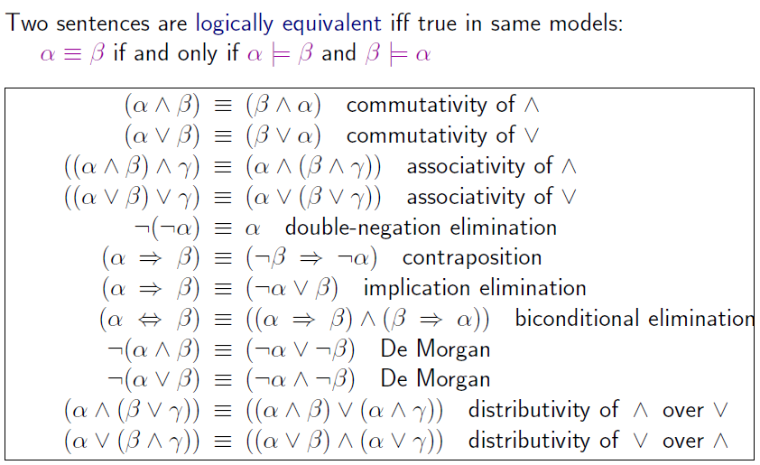
Equivalence

Slide 7
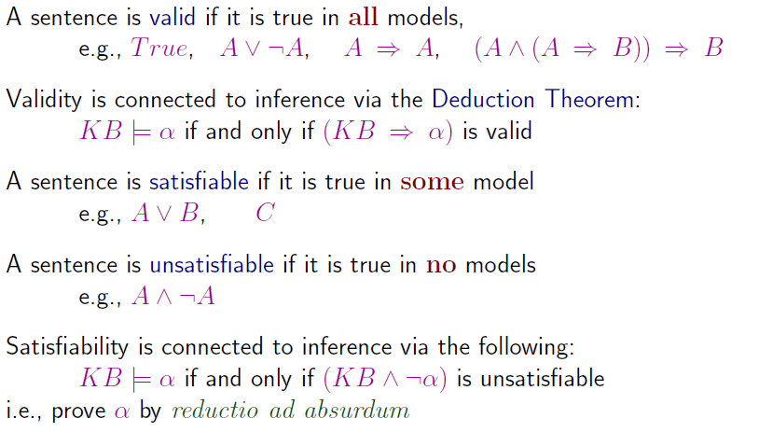
Validity, Satisfiability
SAT was first problem to be proven NP-Complete

Slide 8
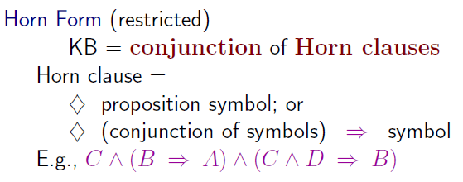
Proof methods
Application of inference rules
  Generate legitimate new sentences from old sentences using sound rules of inference
  Proof = a sequence of rule applications
    Search for this sequence using a search algorithm
  Sentences need to be in Normal Form usually
  If in Horn Clause form then searching is usually linear!!
Model checking
  Truth table enumeration
  Use search with min-conflict heuristic …

Slide 9
Modus Ponens
Use Modus Ponens to prove something
If there is an sentence of the form E1➔E2, and there is another sentence of the form E1, then E2 logically follows
If E2 is the theorem you want to prove, you are done, otherwise add E2 to the list of sentences, because E2 will always be true when all the rest of the sentences are true.
  Monotonicity
Trivial Example:
  R1: Feathers(Squigs) ➔ Bird(Squigs)
  R2: Feathers(Squigs)
  R3: Feathers(Derks)
  Then
  Prove Bird(Squigs)
  Apply Modus Ponens to R1 and R2
KB

Slide 10
Resolution is a sound rule of inference
Subsumes modus ponens
If
  E1 V E2
  !E2 V E3
Then
  E1 V E3 logically follows
Trivial Example 2
  Feathers(Squigs)
  Feathers(Squigs) ➔ Bird(Squigs)
Rewrite
  Feathers(Squigs)
  !Feathers(Squigs) V Bird(Squigs)
Resolve
  E1 V E2
  !E2 V E3
What are E1, E2, E3?

Slide 11
Resolutions proof by refutation
Assume that the negation of the theorem is T
Show that the axioms and the assumed negation of the Theorem leads to a contradiction
Conclude that the assumed negation of the theorem cannot be true because it leads to a contradiction
Conclude that the Theorem must be true because the assumed negation of the theorem cannot be true
Trivial Example
  Feathers(squigs) ➔ Bird(squigs)
  Feathers(squigs)

Slide 12
Resolution proof by refutation
Remove ➔ and rewrite
  !Feathers(squigs) V Bird(squigs)
  Feathers(squigs)
Add negation of theorem to be proven
  !Bird(squigs)
  !Feathers(squigs) V Bird(squigs)
  Feathers(squigs)
RESOLVE
  !Bird(squigs)
  !Feathers(squigs) V Bird(squigs)
  Feathers(squigs)
  Bird(squigs)
Contradiction
  !Bird(squigs)
  Bird(squigs)
Contradiction! Therefore…Nil,
Therefore !Bird(squigs) must be false,
Therefore Bird(squigs) must be true

Slide 13
Limits of PL
Both proofs were examples of forward chaining in propositional logic
  Resolution is sound and complete
There is also backward chaining
We will look at both in the context of expert systems, later…
PL is painful. Why?
Consider
  We cannot express “pits cause breezes neighboring squares”
  Instead:
    B[1,1] ⬅➔ P[1,2] V P[2,1]
    B[1,2] ⬅➔ ….
    B[1,3] ⬅➔ …
    ….
    ugh

Slide 14
The frame problem
Effect axioms correspond to the transition model of Wworld
L[1,1]0 /\ FacingEast0 /\ Forward0 ➔L[2,1]1 /\ !L[1,1]1
If I am in L[1,1] at time 0 and facing east at time 0 and I act to move Forward at time 0 then
I will be in L[2,1] at time 1 and I will not be in L[1,1] at time 1
  Fluents refers to aspects of the world that change
  Atemporal variables do not need the superscript 0, 1, …
Suppose now that I start and I move to L[2,1]
If I Ask if I am in L[2,1] ➔ can prove it
If I Ask do I have arrow in L[2,1] I cannot prove or disprove it
  I need to represent everything that remains unchanged in KB as a result of the action Forward (or any other action sentence)
  Ugh, I have to represent (have sentences) for every thing that changes ➔ this is the frame problem

Slide 15
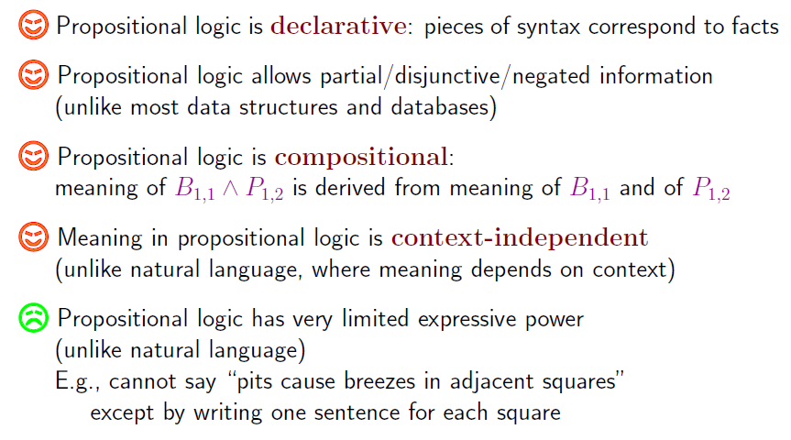
PL

Slide 16
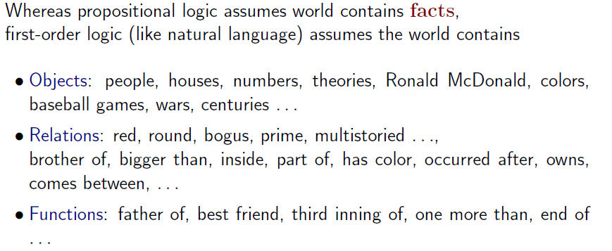
First order logic

Slide 17
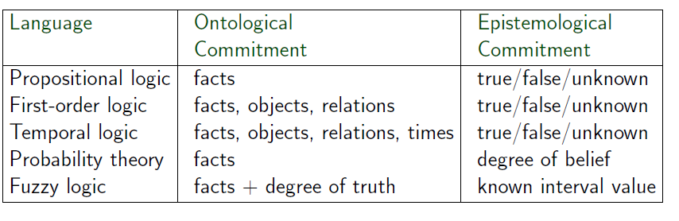
Logics:
For each logic (language)
  What are the sound rules of inference?
  Are they complete?
  What is the complexity of finding proofs?

Slide 18
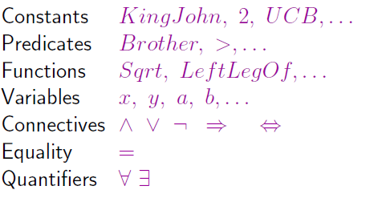
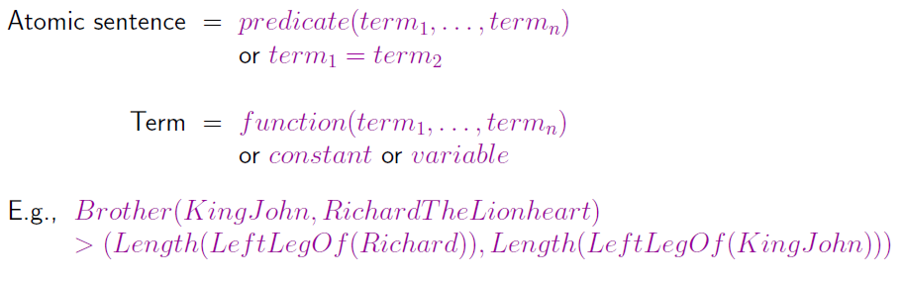
Syntax

Slide 19
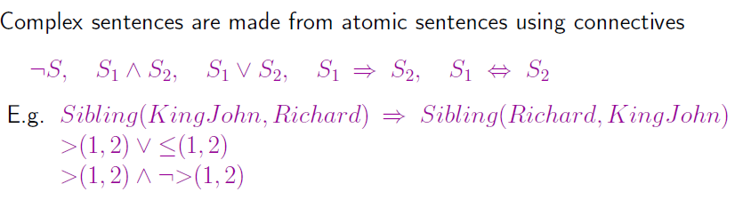
Complex sentences

Slide 20
Here’s a(nother) vocabulary
Objects + Variables == Terms
Terms + Predicates == Atomic Formulas
Atomic formulas + negation == Literals
Literals + Connectives + quantifiers == wffs
Well formed formulas (wffs)
Sentences (all variables bound)
A(x)[Feathers(x) V !Feathers(y)]
  Y is not bound

Slide 21
Interpretation
Objects in a world correspond to object symbols in logic
Relations in a world correspond to predicates in logic
Interpretation: Full accounting of the correspondence between objects and object symbols and between relations and predicates

Slide 22
Quantification
Universal
  A(x)[UNRStudent(x) ➔ Smart(x)]
  If the above expression is true it implies that you get a true expression when you substitute any object for x inside the square brackets
  Common Issue:
    Typically ➔ is the main connective with A
    A(x) [UNRStudent(x) /\ Smart(x)]
    Everyone is at UNR and Everyone is Smart

Slide 23
Existential Quantification
Existential
  E(x) [UNLVStudent(x) /\ Smart(x)]
  There exists at least one object substitutable for x inside the square brackets that makes the sentence true
  Common issue
  /\ is the main connective with E
  Typically not ➔
  E(x) [UNLVStudent(x) ➔ Smart(x)]
  Is true if there is anyone not at UNLV

Slide 24
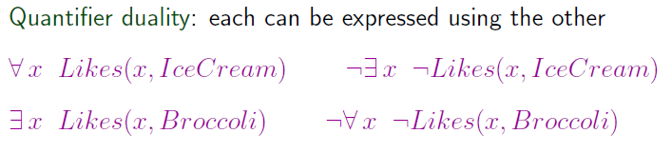
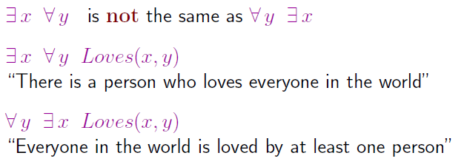
Quantifiers

Slide 25
Marcus intuition for informal proofs
Man(marcus)
Pompein(marcus)
Born(marcus, 40)
A(x) [man(x) ➔mortal(x)]
Erupted(Volcano, 79)
A(x) [Pompein(x) ➔ Died(x, 79)]
A(x) A(t1) A(t2) [mortal(x) & born(x, t1) & gt(t2 – t1, 150) ➔ Dead(x, t2)]
Now = 2013
Is Marcus alive?
  That is, what is the truth of: !Alive(Marcus, Now) or
  That is, what is the truth of: Dead(Marcus, Now)

Slide 26
Need a couple more assertions
Man(marcus)
Pompein(marcus)
Born(marcus, 40)
A(x) [man(x) ➔mortal(x)]
Erupted(Volcano, 79)
A(x) [Pompein(x) ➔ died(x, 79)]
A(x) A(t1) A(t2) [mortal(x) & born(x, t1) & gt(t2 – t1, 150) ➔ dead(x, t2)]
Now = 2013
A(x) A(t) [!dead(x, t) ➔ alive(x, t)]
A(x)A(t) [alive(x, t) ➔ !dead(x, t)]
A(x)A(t1) A(2)[died(x, t1) & gt(t2, t1) ➔ dead(x, t2)]

Slide 27
Not a resolution proof
We deduced that Marcus was not alive
We used a variety of rules and bound variables to literals
Search for rules and bindings
  Guided by what we were trying to prove
  Looking for sentences that involved Alive
Ensure you understand the proof for Wumpus world that proves that there is no pit in [1,2] and no pit in [2,1]
It would be far simpler for search to find proofs if we had a smaller branching factor for our search procedure
  Use the single resolution rule in searching for proof

Slide 28
Resolutions proof by refutation
Assume that the negation of the theorem (sentence you are trying to prove) is T
Show that the sentences and the assumed negation of the Theorem leads to a contradiction
Conclude that the assumed negation of the theorem cannot be true because it leads to a contradiction
Conclude that the Theorem must be true because the assumed negation of the theorem cannot be true
NOTE
  Sentences must be in a specific form: “Clause form”
  Once you put all your sentences in clause form, you cleverly keep applying the resolution rule until you get a contradiction (nil)

Slide 29
Steps
Eliminate implications
Move negations down to the atomic formula
Eliminate existential quantifiers
Rename variables so that no two variables are the same
Move Universal quantifiers to the left
Move disjunctions down to the literals
Eliminate conjunctions
Rename all variables so that no two variables are the same
Eliminate Universal quantifiers

Slide 30
Example
A(x)[Brick(x) ➔ (E(y) [On (x, y) & !Pyramid(y)] & !E(y)[On(x, y) & On(y, x)] &A(y)[!Brick(y) ➔ !Equal(x, y)])]

Slide 31
Step 1
Eliminate Implication
A(x)[!Brick(x) V (E(y)[On(x, y) &!Pyramid(y)] & !E(y)[On(x, y) & On(y, x)] & A(y)[Brick(y) V !Equal(x, y)])]

Slide 32
Step 2
Move negation down to the atomic formulas
!A(x) [Exp(x)] → E(x)[!Exp(x)]
!E(x) [Exp(x)] → A(x)[!Exp(x)]
A(x)[!Brick(x) V (E(y)[On(x, y) &!Pyramid(y)] & A(y)[!(On(x, y) & On(y, x))] & A(y)[Brick(y) V !Equal(x, y)])]

Slide 33
Step 2 cont’d
A(x)[!Brick(x) V (E(y)[On(x, y) &!Pyramid(y)] & A(y)[!On(x, y) V !On(y, x)] & A(y)[Brick(y) V !Equal(x, y)])]

Slide 34
Step 3
Eliminate existential quantifiers
E(x)[On(x, y) & !Pyramid(y)]
On(x, Magic(x)) & !Pyramid(Magic(x))
Magic is a Skolem function,
On(x, Support(x)) & !Pyramid(Support(x))

Slide 35
Step 4
Rename variables – because next step is to move all universal quantifiers to the left
A(x)[!Brick(x) V ((On(x, Support(x) &!Pyramid(Support(x))& A(y)[!On(x, y) V !On(y, x)] & A(z)[Brick(z) V !Equal(x, z)])]

Slide 36
Step 5
Move universal quantifiers to the left
A(x)A(y)A(z)[!Brick(x) V ((On(x, Support(x) &!Pyramid(Support(x))& !On(x, y) V !On(y, x) & Brick(z) V !Equal(x, z) )]

Slide 37
Step 6
Move disjunctions down to the literals
A(x)A(y)A(z)[ ( !Brick(x) V (On(x, Support(x)) & !Pyramid(Support(x)) ) & (!Brick(x) V !On(x, y) V !On(y, x)) & (!Brick(x) V Brick(z) V !Equal(x, z)) ]

Slide 38
Step 6 cont’d
A(x)A(y)A(z)[ ( !Brick(x) V On(x, Support(x)) ) & (!Brick(x) V !Pyramid(Support(x)) ) & (!Brick(x) V !On(x, y) V !On(y, x)) & (!Brick(x) V Brick(z) V !Equal(x, z)) ]

Slide 39
Step 7
Eliminate Conjunctions by writing each part as a separate axiom
A(x) [!Brick(x) V On(x, Support(x))]
A(x) [!Brick(x) V !Pyramid(Support(x))]
A(x)A(y)[!Brick(x) V !On(x, y) V !On(y, x)]
A(x)A(z)[!Brick(x) V Brick(z)V !Equal(x,z)]

Slide 40
Step 8
Rename variables
A(x) [!Brick(x) V On(x, Support(x))]
A(w) [!Brick(w) V !Pyramid(Support(w))]
A(u)A(y)[!Brick(u) V !On(u, y) V !On(y, u)]
A(v)A(z)[!Brick(v) V Brick(z)V !Equal(v,z)]

Slide 41
Step 9
Eliminate universal quantifiers – assume all variables are universally quantified
!Brick(x) V On(x, Support(x))
!Brick(w) V !Pyramid(Support(w))
!Brick(u) V !On(u, y) V !On(y, u)
!Brick(v) V Brick(z) V !Equal(v, z)

