Slide 1
Artificial Intelligence
CS482, CS682, MW 1 – 2:15, SEM 201, MS 227
Prerequisites: 302, 365
Instructor: Sushil Louis, sushil@cse.unr.edu, http://www.cse.unr.edu/~sushil

Slide 2
Question
Are reflex actions rational? Are they intelligent?

Slide 3
Question
How could introspection – reporting on one’s inner thoughts – be inaccurate? Could I be wrong about what I am thinking?

Slide 4
Question
To what extent are the following computer systems instances of artificial intelligence?
  Supermarket bar code scanner
  Web search engines
  Voice-activated telephone menus
  Internet routing algorithms that respond dynamically to the state of the network

Slide 5
Question
Which tasks can currently be solved by computers?
  Playing a decent game of table tennis
  Driving in the center of Cairo, Egypt
  Driving in Victorville, CA
  Buying a week’s worth of groceries at the market
  Buying a week’s worth of groceries on the web
  Playing a decent game of bridge at a competitive level
  Discovering and proving mathematical theorems
  Writing an intentionally funny story
  Giving competent legal advice in a specialized area of law
  Translating spoken English into Swedish in real-time
  Performing a complex surgical operation

Slide 6

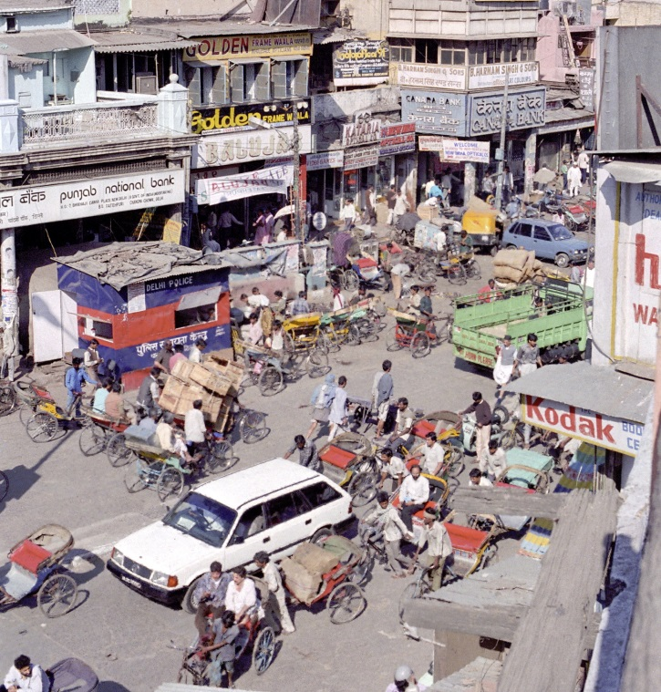
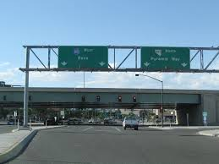
Agents
What is a rational agent?
  Optimizes performance
What are design principles for building rational agents (intelligent agents)?
Agent performance will depend on their operating Environment. Some environments will be more difficult than others
Types of environments
Design considerations for agents in these different types of environments

Slide 7
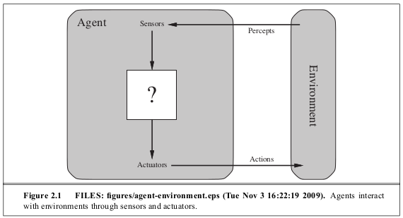
What is an agent?
Perceives an environment through sensors and acts on the environment through actuators

Slide 8
What is an Agent?
Percept: Agent’s perceptual inputs at any given instant of time
Percept sequence is the complete history of everything the agent has ever perceived
Agent’s choice of action usually depends on percept sequence but not on anything it has not perceived
Behavior is governed by an agent function that maps percept sequence to actions

Slide 9
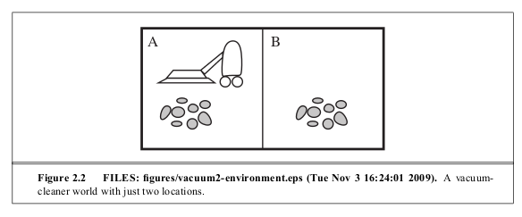
Agent example

Slide 10
Agent (Behavior) function
F (Percept sequence) → Action
Percept Sequence | Action
[A, Clean] | Right
[A, Dirty] | Suck
[B, Clean] | Left
[B, Dirty] | Suck
Agent programs implement agent functions on some architecture
This is just a table, with percept sequences on the left and actions on the right

Slide 11
Behavior function
Percept Sequence | Action
[A, Clean] | Right
[A, Dirty] | Suck
[B, Clean] | Left
[B, Dirty] | Suck
[A, Clean], [A, Clean] | Right
[A, Clean], [A, Dirty] | Suck
…
[A, Clean], [A, Clean], [A, Clean] | Right
[A, Clean], [A, Clean], [A, Dirty] | Suck
…
This is just a table, with percept sequences on the left and actions on the right
But how big?

Slide 12
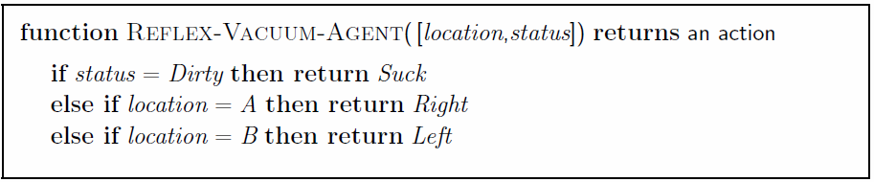
Vacuum Cleaner world
Add action “No-Op”

Slide 13
Behavior versus Good behavior
Rational
Agent’s action affect environment → changes environment’s state
A sequence of agent actions → a sequence of environment states
A performance measure on environment states differentiates good behavior from bad
  Is our vacuum cleaner agent rational?
    What is the performance metric?
    What is the agent’s prior knowledge?
    What percept sequence has the agent seen?
    What actions can agent perform?
  Suppose the performance measure is just concerned with the first T time steps of the environment, show that a rational agent’s action may depend not just on the state of the environment but also on time step

Slide 14
Rationality
Performance metric
  1 point per square cleaned?
  1 point per square cleaned in time T?
  1 point per square per time step minus one per move?
  Penalty for > k dirty squares?
  …
A rational agent chooses whichever action maximizes expected value of performance measure given the precept sequence to date

Slide 15


Rationality
Rational != omniscient
Rational != clairvoyant
Rational != successful
Rational implies
  Exploration
  Learning
  Autonomy

Slide 16
PEAS
To design a rational agent, we need to specifying a task environment
Consider automated taxi
  Performance metric?
  Environment?
  Actuators?
  Sensors?

Slide 17
PEAS
To design a rational agent, we need to specifying a task environment
Consider automated taxi
  Performance metric?
    Safety, destination, profits, legal, comfort, speed, cost
  Environment?
    US streets/freeways, traffic, pedestrians, weather, …
  Actuators?
    Steering, accelerator, brake, horn, speaker/display, …
  Sensors?
    Video, accelerometers, gauges, engine sensors, keyboard, GPS, …

Slide 18
Internet shopping agent
Performance metric?
Environment?
Actuators?
Sensors?

Slide 19
Internet shopping agent
Performance metric?
  Price, quality, efficiency, appropriateness
Environment?
  Current and future websites, vendors, shippers, shoppers
Actuators?
  Display to use, follow URL, fill forms
Sensors?
  HTML pages (text, graphics, scripts)

Slide 20
Interactive English Tutor
Performance Metric
Environment
Actuators
Sensors

Slide 21
Interactive English Tutor
Performance Metric
  Score on test
Environment
  Students, testing agency
Actuators
  Display of exercises, suggestions, corrections, …
Sensors
  Keyboard, mouse

Slide 22
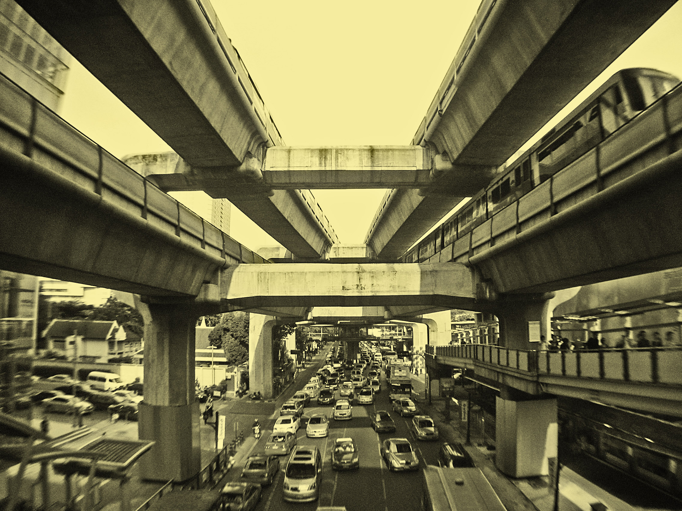
Task environment types
Fully observable or partially observable
Single agent versus multi-agent
Deterministic versus Stochastic
Episodic versus sequential
Static or Dynamic
Discrete or continuous
Known versus unknown
The real-world is partially observable, stochastic, sequential, dynamic, continuous, and multiagent

Slide 23
Types of task environments
Task Env | Observable | Agents | Deterministic | Episodic | Static | Discrete
Crossword
Chess with Clk
Poker
Taxi Driving
Medical Diagnosis
Image analysis
Part-picking robot
Refinery Controller
Interactive English Tutor

Slide 24
Types of task environments
Task Env | Observable | Agents | Deterministic | Episodic | Static | Discrete
Crossword | Fully | Single | Deterministic | Sequential | Static | Discrete
Chess with Clk
Poker
Taxi Driving
Medical Diagnosis
Image analysis
Part-picking robot
Refinery Controller
Interactive English Tutor

Slide 25
Types of task environments
Task Env | Observable | Agents | Deterministic | Episodic | Static | Discrete
Crossword | Fully | Single | Deterministic | Sequential | Static | Discrete
Chess with Clk | Fully | Multi | Deterministic | Sequential | Semi | Discrete
Poker
Taxi Driving
Medical Diagnosis
Image analysis
Part-picking robot
Refinery Controller
Interactive English Tutor

Slide 26
Types of task environments
Task Env | Observable | Agents | Deterministic | Episodic | Static | Discrete
Crossword | Fully | Single | Deterministic | Sequential | Static | Discrete
Chess with Clk | Fully | Multi | Deterministic | Sequential | Semi | Discrete
Poker | Partially | Multi | Stochastic | Sequential | Static | Discrete
Taxi Driving
Medical Diagnosis
Image analysis
Part-picking robot
Refinery Controller
Interactive English Tutor

Slide 27
Types of task environments
Task Env | Observable | Agents | Deterministic | Episodic | Static | Discrete
Crossword | Fully | Single | Deterministic | Sequential | Static | Discrete
Chess with Clk | Fully | Multi | Deterministic | Sequential | Semi | Discrete
Poker | Partially | Multi | Stochastic | Sequential | Static | Discrete
Taxi Driving | Partially | Multi | Stochastic | Sequential | Dynamic | Continuous
Medical Diagnosis
Image analysis
Part-picking robot
Refinery Controller
Interactive English Tutor

Slide 28
Types of task environments
Task Env | Observable | Agents | Deterministic | Episodic | Static | Discrete
Crossword | Fully | Single | Deterministic | Sequential | Static | Discrete
Chess with Clk | Fully | Multi | Deterministic | Sequential | Semi | Discrete
Poker | Partially | Multi | Stochastic | Sequential | Static | Discrete
Taxi Driving | Partially | Multi | Stochastic | Sequential | Dynamic | Continuous
Medical Diagnosis | Partially | Single | Stochastic | Sequential | Dynamic | Continuous
Image analysis
Part-picking robot
Refinery Controller
Interactive English Tutor

Slide 29
Types of task environments
Task Env | Observable | Agents | Deterministic | Episodic | Static | Discrete
Crossword | Fully | Single | Deterministic | Sequential | Static | Discrete
Chess with Clk | Fully | Multi | Deterministic | Sequential | Semi | Discrete
Poker | Partially | Multi | Stochastic | Sequential | Static | Discrete
Taxi Driving | Partially | Multi | Stochastic | Sequential | Dynamic | Continuous
Medical Diagnosis | Partially | Single | Stochastic | Sequential | Dynamic | Continuous
Image analysis | Fully | Single | Deterministic | Episodic | Semi | Continuous
Part-picking robot
Refinery Controller
Interactive English Tutor

Slide 30
Types of task environments
Task Env | Observable | Agents | Deterministic | Episodic | Static | Discrete
Crossword | Fully | Single | Deterministic | Sequential | Static | Discrete
Chess with Clk | Fully | Multi | Deterministic | Sequential | Semi | Discrete
Poker | Partially | Multi | Stochastic | Sequential | Static | Discrete
Taxi Driving | Partially | Multi | Stochastic | Sequential | Dynamic | Continuous
Medical Diagnosis | Partially | Single | Stochastic | Sequential | Dynamic | Continuous
Image analysis | Fully | Single | Deterministic | Episodic | Semi | Continuous
Part-picking robot | Partially | Single | Stochastic | Episodic | Dynamic | Continuous
Refinery Controller
Interactive English Tutor

Slide 31
Types of task environments
Task Env | Observable | Agents | Deterministic | Episodic | Static | Discrete
Crossword | Fully | Single | Deterministic | Sequential | Static | Discrete
Chess with Clk | Fully | Multi | Deterministic | Sequential | Semi | Discrete
Poker | Partially | Multi | Stochastic | Sequential | Static | Discrete
Taxi Driving | Partially | Multi | Stochastic | Sequential | Dynamic | Continuous
Medical Diagnosis | Partially | Single | Stochastic | Sequential | Dynamic | Continuous
Image analysis | Fully | Single | Deterministic | Episodic | Semi | Continuous
Part-picking robot | Partially | Single | Stochastic | Episodic | Dynamic | Continuous
Refinery Controller | Partially | Single | Stochastic | Sequential | Dynamic | Continuous
Interactive English Tutor

Slide 32
Types of task environments
Task Env | Observable | Agents | Deterministic | Episodic | Static | Discrete
Crossword | Fully | Single | Deterministic | Sequential | Static | Discrete
Chess with Clk | Fully | Multi | Deterministic | Sequential | Semi | Discrete
Poker | Partially | Multi | Stochastic | Sequential | Static | Discrete
Taxi Driving | Partially | Multi | Stochastic | Sequential | Dynamic | Continuous
Medical Diagnosis | Partially | Single | Stochastic | Sequential | Dynamic | Continuous
Image analysis | Fully | Single | Deterministic | Episodic | Semi | Continuous
Part-picking robot | Partially | Single | Stochastic | Episodic | Dynamic | Continuous
Refinery Controller | Partially | Single | Stochastic | Sequential | Dynamic | Continuous
Interactive English Tutor | Partially | Multi | Stochastic | Sequential | Dynamic | Discrete

Slide 33
Types of agents
Simple reflex agents
Reflex agents with state
Goal based agents
Utility-based agents
All can be turned into learning agents

Slide 34
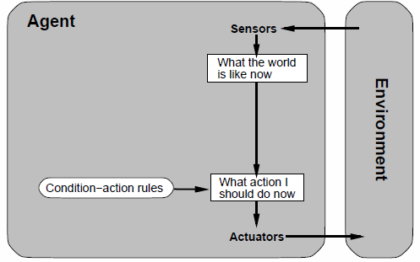
Simple reflex agents

Slide 35
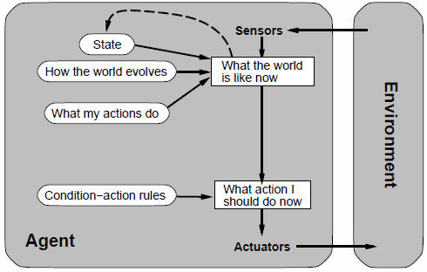
Reflex agent with state
Model-based agent

Slide 36
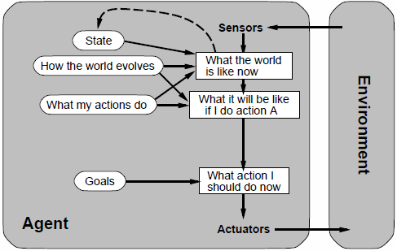
Goal-based agent
Search for ways to achieve goals. Make plans to achieve goals. Searching for plans

Slide 37
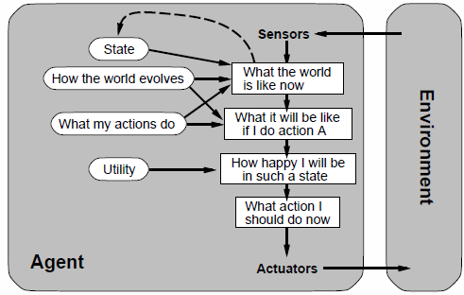
Utility-based agent
Maximizes expected utility

Slide 38
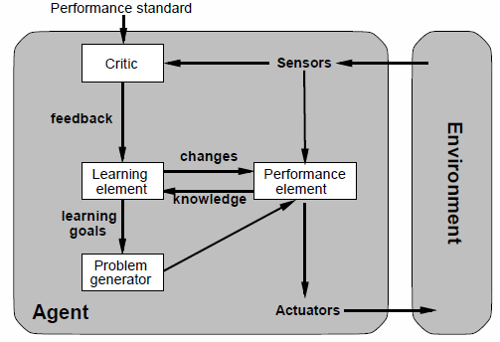
Learning agents

Slide 39
Representing environmental states
Less expressive
More Expressive

Slide 40
Summary
Agents interact with environment with actuators and sensors
Agent function describes agent behavior
Performance measure evaluates the environment sequence produced by agent actions
A perfectly rational agent maximizes expected performance
Agent programs implement agent functions on some architecture
PEAS descriptions define task environments
Environments can be categorized along
  Observerable, deterministic, episodic, static, discrete, single-agent
Several basic single-agent architectures exist
  Reflex, reflex with state, goal-based, utility-based, learning

