Slide 1
Artificial Intelligence
CS482, CS682, MW 1 – 2:15, SEM 201, MS 227
Prerequisites: 302, 365
Instructor: Sushil Louis, sushil@cse.unr.edu, http://www.cse.unr.edu/~sushil

Slide 2
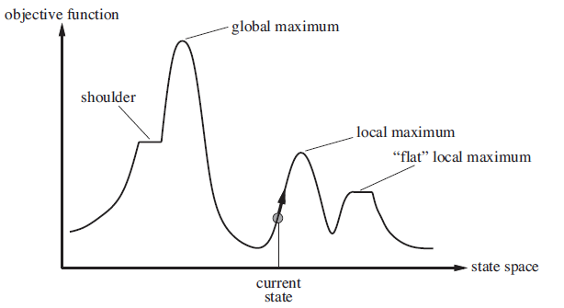
Non-classical search
- Path does not matter, just the final state
- Maximize objective function

Slide 3
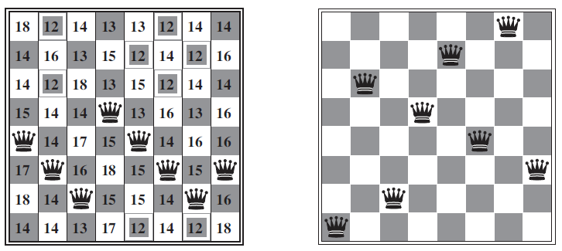
Local optimum
Heuristic: Number of pairs of queens attacking each other directly
Movement: only within your column
H = 1 but all successors have > 1
H = 17

Slide 4
Model
We have a black box “evaluate” function that returns an objective function value
Evaluate
candidate state
Obj. func
Application dependent fitness function

Slide 5
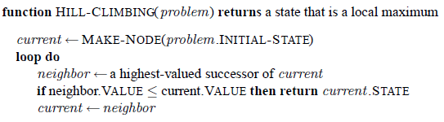
Local Hill Climbing
Move in the direction of increasing value
Very greedy
Subject to
  Local maxima
  Ridges
  Plateaux
8-queens: 86% failure, but only needs 4 steps to succeed, 3 to fail

Slide 6
Hill climbing
Keep going on a plateau?
  Advantage: Might find another hill
  Disadvantage: infinite loops → limit number of moves on plateau
    8 queens: 94% success!!
Stochastic hill climbing
  randomly choose from among better successors (proportional to obj?)
First-choice hill climbing
  keep generating successors till a better one is generated
Random-restarts
  If probability of success is p, then we will need 1/p restarts
  8-queens: p = 0.14 ~= 1/7 so 7 starts
  6 failures (3 steps), 1 success (4 steps) = 22 steps
  In general: Cost of success + (1-p)/p * cost of failure
  8-queens sideways: 0.94 success in 21 steps, 64 steps for failure
    Under a minute

Slide 7
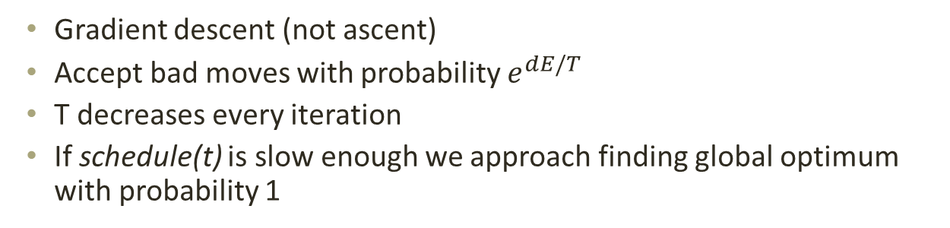
Simulated annealing
Gradient descent (not ascent)
Accept bad moves with probability $e^{dE/T}$
T decreases every iteration
If schedule(t) is slow enough we approach finding global optimum with probability 1

Slide 8
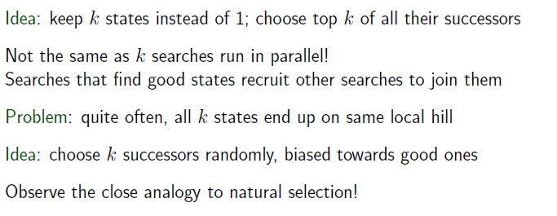
Beam Search

Slide 9
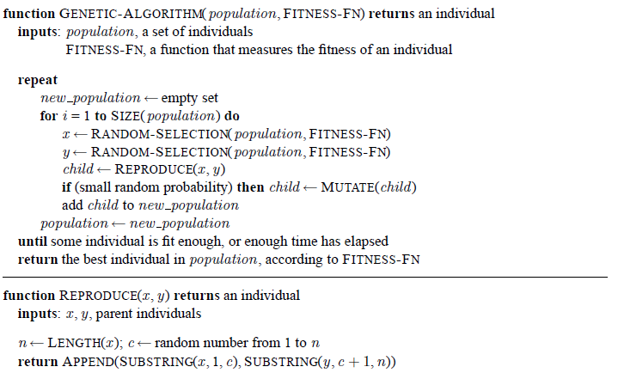
Genetic Algorithms
Stochastic hill-climbing with information exchange
A population of stochastic hill-climbers

Slide 10
More detailed GA
Generate pop(0)
Evaluate pop(0)
T=0
While (not converged) do
  Select pop(T+1) from pop(T)
  Recombine pop(T+1)
  Evaluate pop(T+1)
  T = T + 1
Done

Slide 11
Generate pop(0)
Initialize population with randomly generated strings of 1’s and 0’s
for(i = 0 ; i < popSize; i++){
for(j = 0; j < chromLen; j++){
Pop[i].chrom[j] = flip(0.5);
}
}

Slide 12
Genetic Algorithm
Generate pop(0)
Evaluate pop(0)
T=0
While (not converged) do
  Select pop(T+1) from pop(T)
  Recombine pop(T+1)
  Evaluate pop(T+1)
  T = T + 1
Done

Slide 13
Evaluate pop(0)
Evaluate
Decoded individual
Fitness
Application dependent fitness function

Slide 14
Genetic Algorithm
Generate pop(0)
Evaluate pop(0)
T=0
While (T < maxGen) do
  Select pop(T+1) from pop(T)
  Recombine pop(T+1)
  Evaluate pop(T+1)
  T = T + 1
Done

Slide 15
Genetic Algorithm
Generate pop(0)
Evaluate pop(0)
T=0
While (T < maxGen) do
  Select pop(T+1) from pop(T)
  Recombine pop(T+1)
  Evaluate pop(T+1)
  T = T + 1
Done

Slide 16
Selection
Each member of the population gets a share of the pie proportional to fitness relative to other members of the population
Spin the roulette wheel pie and pick the individual that the ball lands on
Focuses search in promising areas

Slide 17
Code
int roulette(IPTR pop, double sumFitness, int popsize)
{
/* select a single individual by roulette wheel selection */
double rand,partsum;
int i;
partsum = 0.0; i = 0;
rand = f_random() * sumFitness;
i = -1;
do{
i++;
partsum += pop[i].fitness;
} while (partsum < rand && i < popsize - 1) ;
return i;
}

Slide 18
Genetic Algorithm
Generate pop(0)
Evaluate pop(0)
T=0
While (T < maxGen) do
  Select pop(T+1) from pop(T)
  Recombine pop(T+1)
  Evaluate pop(T+1)
  T = T + 1
Done

Slide 19
Crossover and mutation
Mutation Probability = 0.001
Insurance
Xover Probability = 0.7
Exploration operator

Slide 20
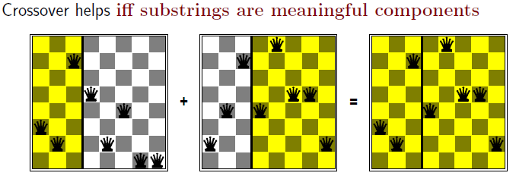
Crossover helps if

Slide 21
Crossover code
void crossover(POPULATION *p, IPTR p1, IPTR p2, IPTR c1, IPTR c2)
{
/* p1,p2,c1,c2,m1,m2,mc1,mc2 */
int *pi1,*pi2,*ci1,*ci2;
int xp, i;
pi1 = p1->chrom;
pi2 = p2->chrom;
ci1 = c1->chrom;
ci2 = c2->chrom;
if(flip(p->pCross)){
xp = rnd(0, p->lchrom - 1);
for(i = 0; i < xp; i++){
ci1[i] = muteX(p, pi1[i]);
ci2[i] = muteX(p, pi2[i]);
}
for(i = xp; i < p->lchrom; i++){
ci1[i] = muteX(p, pi2[i]);
ci2[i] = muteX(p, pi1[i]);
}
} else {
for(i = 0; i < p->lchrom; i++){
ci1[i] = muteX(p, pi1[i]);
ci2[i] = muteX(p, pi2[i]);
}
}
}

Slide 22
Mutation code
int muteX(POPULATION *p, int pa)
{
return (flip(p->pMut) ? 1 - pa : pa);
}

Slide 23
How does it work
String decoded f(x^2) fi/Sum(fi) Expected Actual
01101 | 13 | 169 | 0.14 | 0.58 | 1
11000 | 24 | 576 | 0.49 | 1.97 | 2
01000 | 8 | 64 | 0.06 | 0.22 | 0
10011 | 19 | 361 | 0.31 | 1.23 | 1
Sum |  | 1170 | 1.0 | 4.00 | 4.00
Avg |  | 293 | .25 | 1.00 | 1.00
Max |  | 576 | .49 | 1.97 | 2.00

Slide 24
How does it work cont’d
String mate offspring decoded f(x^2)
0110|1 | 2 | 01100 | 12 | 144
1100|0 | 1 | 11001 | 25 | 625
11|000 | 4 | 11011 | 27 | 729
10|011 | 3 | 10000 | 16 | 256
Sum |  |  |  | 1754
Avg |  |  |  | 439
Max |  |  |  | 729

Slide 25
GA Theory
Why fitness proportional selection?
  Fitness proportional selection optimizes the tradeoff between exploration and exploitation. Minimizes the expected loss from choosing unwisely among competing schema
Why binary representations?
  Binary representations maximize the ratio of the number of schemas to number of strings
Excuse me, but what is a schema?
Mutation can be thought of as beam hill-climbing. Why have crossover?
  Crossover allows information exchange that can lead to better performance in some spaces

Slide 26
Schemas and Schema Theorem
How do we analyze GAs?
  Individuals do not survive
  Bits and pieces of individuals survive
Three questions:
  What do these bits and pieces signify?
  How do we describe bits and pieces?
  What happens to these bits and pieces over time?

Slide 27
Schemas
What does part of a string that encodes a candidate solution signify?
1
1
1
0
0
0
A point in the search space
1
1
1
An area of the search space
Different kinds of crossover lead to different kinds of areas that need to be described
1
0
1
A different kind of area
1
*
*
0
1
*
A schema denotes a portion of the search space

Slide 28
Schema notation
Schema H = 01*0* denotes the set of strings:
  01000
  01001
  01100
  01101

Slide 29
Schema properties
Order of a schema H →O(H)
  Number of fixed positions
  O(10**0) = 3
Defining length of a schema
  Distance between first and last fixed position
  d(10**0) = 4
  d(*1*00) = 3

Slide 30
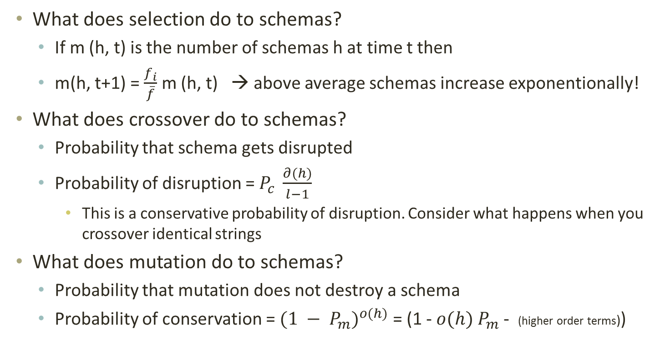
What does GA do to schemas?
What does selection do to schemas?
  If m (h, t) is the number of schemas h at time t then
  m(h, t+1) = $\frac{f_{i}}{\overline{f}}$ m (h, t) → above average schemas increase exponentionally!
What does crossover do to schemas?
  Probability that schema gets disrupted
  Probability of disruption = $P_{c} \frac{∂(h)}{l−1}$
    This is a conservative probability of disruption. Consider what happens when you crossover identical strings
What does mutation do to schemas?
  Probability that mutation does not destroy a schema
  Probability of conservation = ${(1 − P_{m})}^{o(h)}$ = (1 - $o(h)$ $P_{m}$ - (higher order terms))

Slide 31
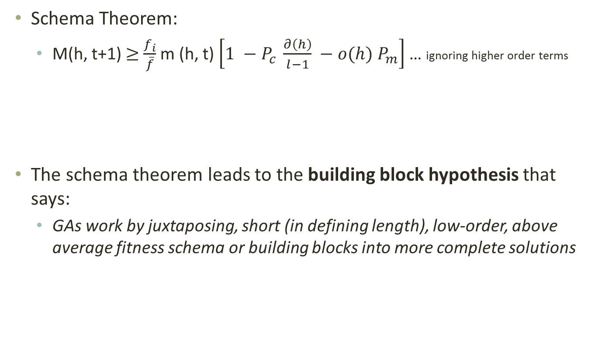
The Schema theorem
Schema Theorem:
  M(h, t+1) $≥$ $\frac{f_{i}}{\overline{f}}$ m (h, t) $\left[1 −P_{c} \frac{∂\left(h\right)}{l−1} −o(h) P_{m}\right]$ … ignoring higher order terms
The schema theorem leads to the building block hypothesis that says:
  GAs work by juxtaposing, short (in defining length), low-order, above average fitness schema or building blocks into more complete solutions

Slide 32
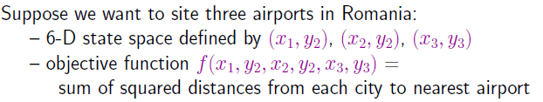
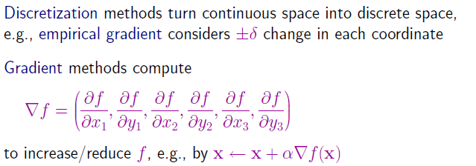
Continuous spaces
What is a good value for α ?
  Too small, it takes too long
  Too large, may miss the optimum

Slide 33

Newton Raphson Method

Slide 34
Linear and quadratic programming
Constrained optimization
  Optimize f(x) subject to
    Linear convex constraints – polynomial time in number of variables
      Linear programming – scales to thousands of variables
    Convex non-linear constraints – special cases → polynomial time
      In special cases non-linear convex optimization can scale to thousands of variables

Slide 35
Games and game trees
Multi-agent systems + competitive environment → games and adversarial search
In game theory any multiagent environment is a game as long as each agent has “significant” impact on others
In AI many games were
  Game theoretically: Deterministic, Turn taking, Two-player, Zero-sum, Perfect information
  AI: deterministic, fully observable environments in which two agents act alternately and utility values at the end are equal but opposite. One wins the other loses
Chess, Checkers
Not Poker, backgammon,

Slide 36
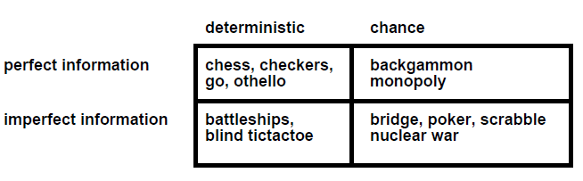
Game types
Starcraft? Counterstrike? Halo? WoW?

Slide 37
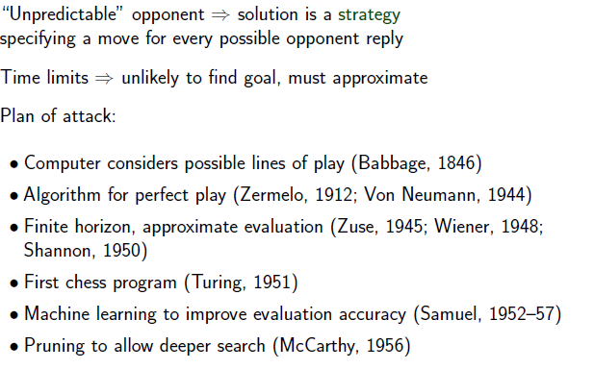
Search in Games

Slide 38
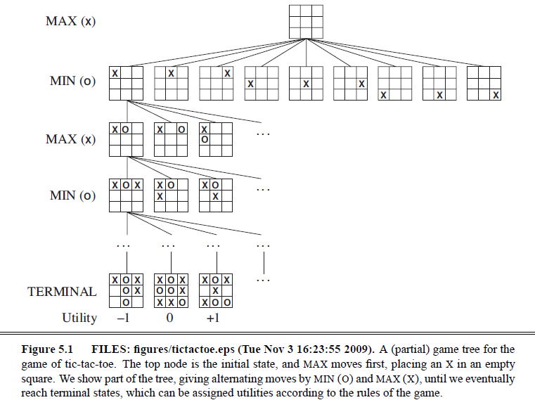
Tic-Tac-Toe

Slide 39
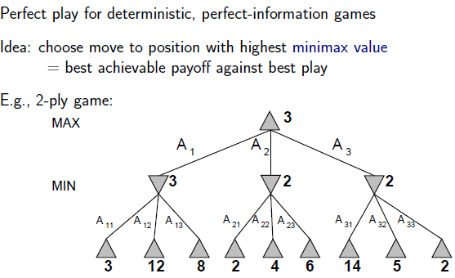
Minimax search

Slide 40
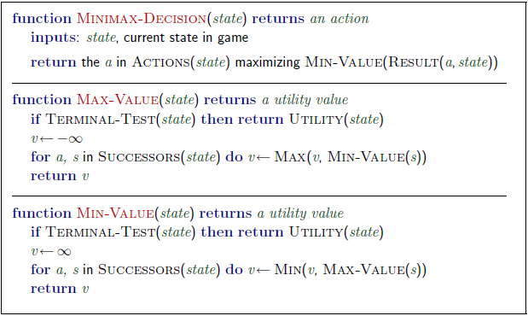
Minimax algorithm

Slide 41
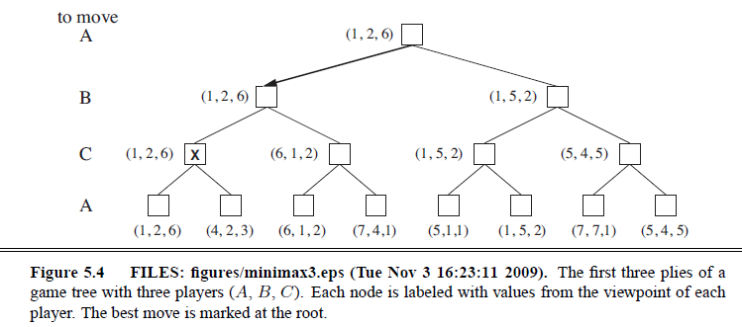
3 player Minimax
Two player minimax reduces to one number because utilities are opposite – knowing one is enough
But there should actually be a vector of two utilities with player choosing to maximize their utility at their turn
So with three players → you have a 3 vector
Alliances?

Slide 42
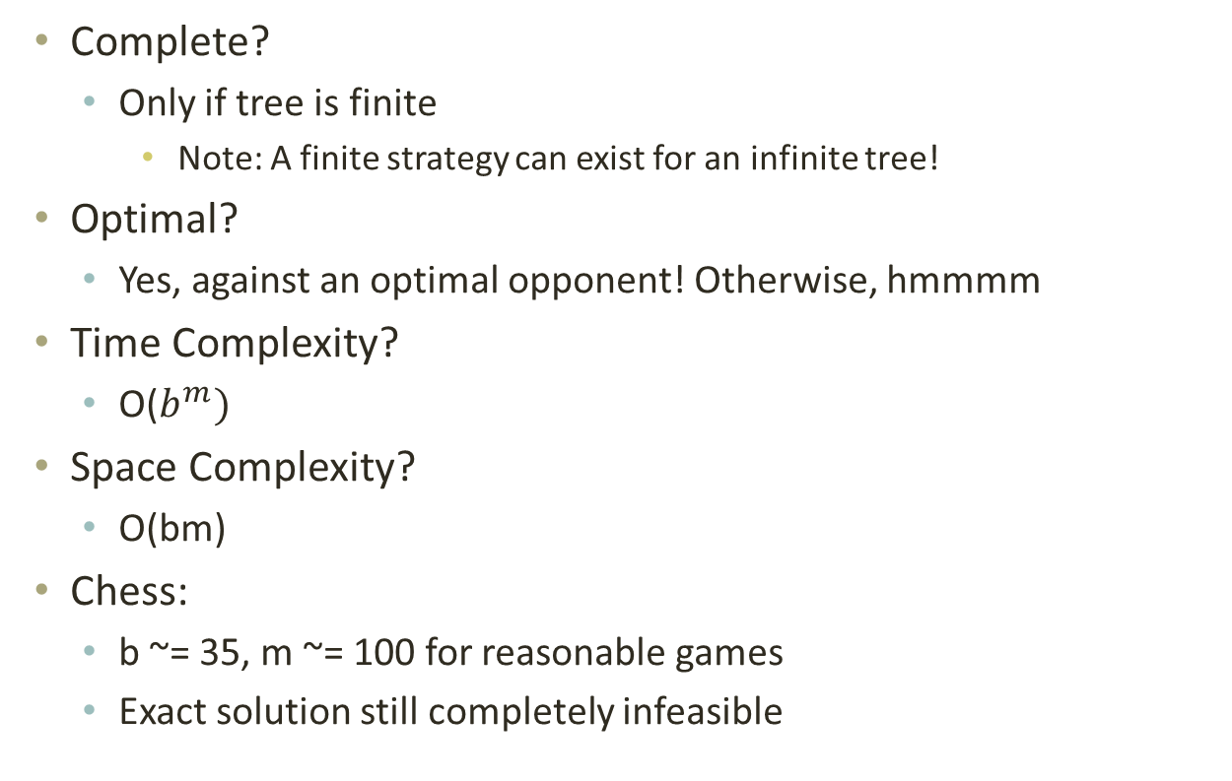
Minimax properties
Complete?
  Only if tree is finite
    Note: A finite strategy can exist for an infinite tree!
Optimal?
  Yes, against an optimal opponent! Otherwise, hmmmm
Time Complexity?
  O($b^{m})$
Space Complexity?
  O(bm)
Chess:
  b ~= 35, m ~= 100 for reasonable games
  Exact solution still completely infeasible

Slide 43
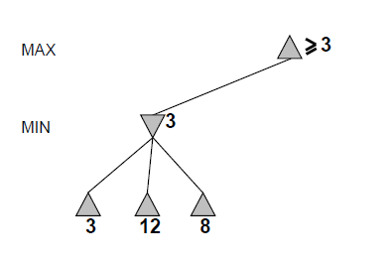
Alpha-beta pruning

Slide 44
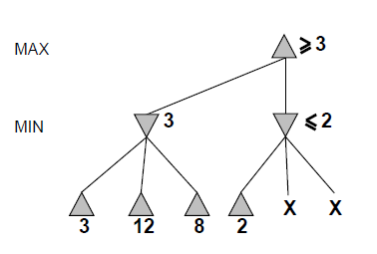
Alpha-beta

Slide 45
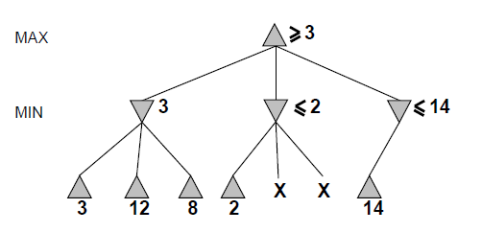
Alpha-beta

Slide 46
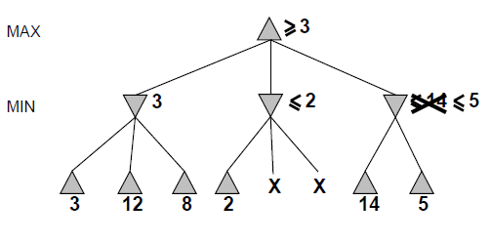
Alpha-beta

Slide 47
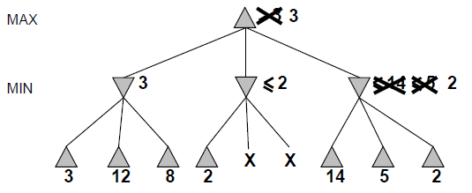
Alpha-beta

Slide 48
Alpha-beta
Alpha is the best value (for Max) found so far at any choice point along the path for Max
  Best means highest
  If utility v is worse than alpha, max will avoid it
Beta is the best value (for Min) found so far at any choice point along the path for Min
  Best means lowest
  If utility v is larger than beta, min will avoid it

Slide 49
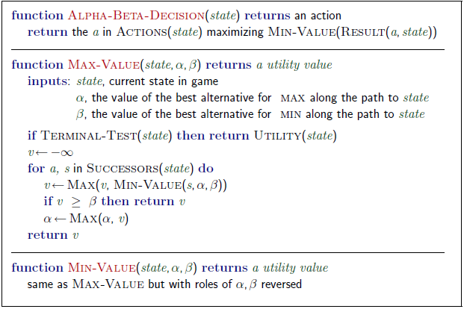
Alpha-beta algorithm

Slide 50
Alpha beta example
Minimax(root)
  = max (min (3, 12, 8), min(2, x, y), min (14, 5, 2))
  = max(3, min(2, x, y), 2)
  = max(3, aValue <= 2, 2)
  = 3

Slide 51
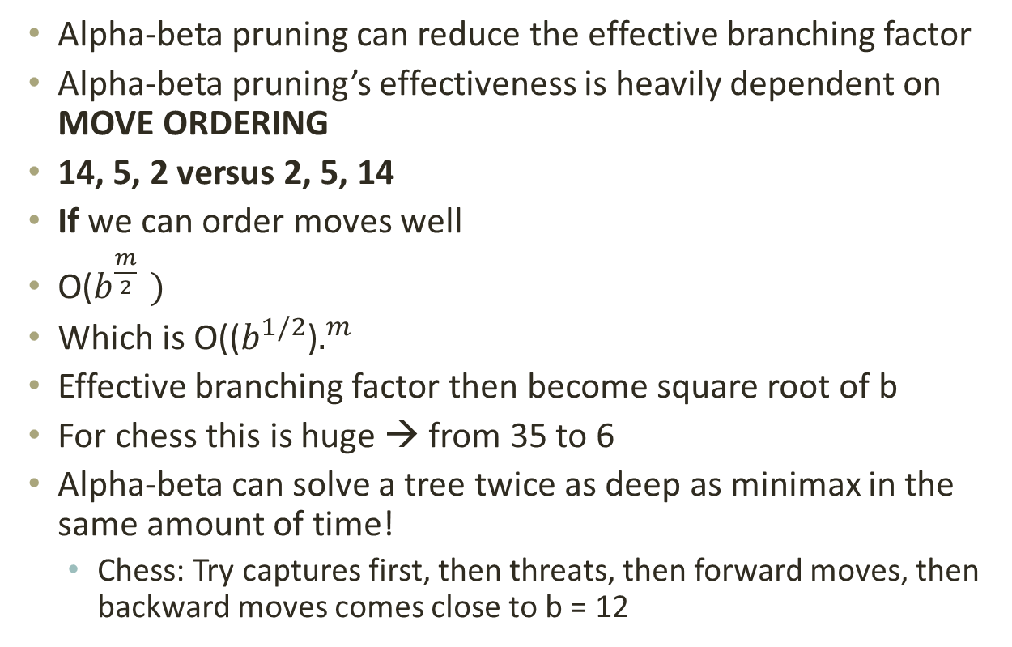
Alpha-beta pruning analysis
Alpha-beta pruning can reduce the effective branching factor
Alpha-beta pruning’s effectiveness is heavily dependent on MOVE ORDERING
14, 5, 2 versus 2, 5, 14
If we can order moves well
O($b^{\frac{m}{2} })$
Which is O(($b^{1/2}$)$.^{m}$
Effective branching factor then become square root of b
For chess this is huge → from 35 to 6
Alpha-beta can solve a tree twice as deep as minimax in the same amount of time!
  Chess: Try captures first, then threats, then forward moves, then backward moves comes close to b = 12

Slide 52
Imperfect information
You still cannot reach all leaves of the chess search tree!
What can we do?
  Go as deep as you can, then
  Utility Value = Evaluate(Current Board)
  Proposed in 1950 by Claude Shannon

Slide 53
Search
Problem solving by searching for a solution in a space of possible solutions
Uninformed versus Informed search
Atomic representation of state
Solutions are fixed sequences of actions

