Slide 1
Artificial Intelligence
CS482, CS682, MW 1 – 2:15, SEM 201, MS 227
Prerequisites: 302, 365
Instructor: Sushil Louis, sushil@cse.unr.edu, http://www.cse.unr.edu/~sushil

Slide 2
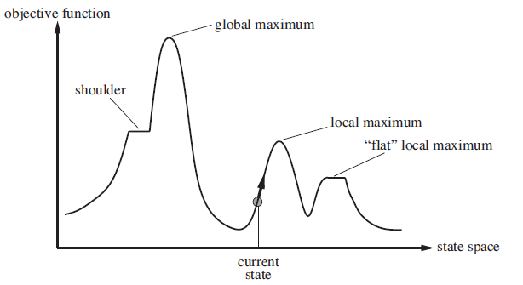
Non-classical search
- Path does not matter, just the final state
- Maximize objective function

Slide 3
How does it work
String decoded f(x^2) fi/Sum(fi) Expected Actual
01101 | 13 | 169 | 0.14 | 0.58 | 1
11000 | 24 | 576 | 0.49 | 1.97 | 2
01000 | 8 | 64 | 0.06 | 0.22 | 0
10011 | 19 | 361 | 0.31 | 1.23 | 1
Sum |  | 1170 | 1.0 | 4.00 | 4.00
Avg |  | 293 | .25 | 1.00 | 1.00
Max |  | 576 | .49 | 1.97 | 2.00

Slide 4
How does it work cont’d
String mate offspring decoded f(x^2)
0110|1 | 2 | 01100 | 12 | 144
1100|0 | 1 | 11001 | 25 | 625
11|000 | 4 | 11011 | 27 | 729
10|011 | 3 | 10000 | 16 | 256
Sum |  |  |  | 1754
Avg |  |  |  | 439
Max |  |  |  | 729

Slide 5
GA Theory
Why fitness proportional selection?
Fitness proportional selection optimizes the tradeoff between exploration and exploitation. Minimizes the expected loss from choosing unwisely among competing schema
Why binary representations?
Binary representations maximize the ratio of the number of schemas to number of strings
Excuse me, but what is a schema?
Mutation can be thought of as beam hill-climbing. Why have crossover?
Crossover allows information exchange that can lead to better performance in some spaces

Slide 6
Schemas and Schema Theorem
How do we analyze GAs?
Individuals do not survive
Bits and pieces of individuals survive
Three questions:
What do these bits and pieces signify?
How do we describe bits and pieces?
What happens to these bits and pieces over time?

Slide 7
Schemas
What does part of a string that encodes a candidate solution signify?
1
1
1
0
0
0
A point in the search space
1
1
1
An area of the search space
Different kind of crossover lead to different kinds of areas that need to be described
1
0
1
A different kind of area
1
*
*
0
1
*
A schema denotes a portion of the search space

Slide 8
Schema notation
Schema H = 01*0* denotes the set of strings:
01000
01001
01100
01101

Slide 9
Schema properties
Order of a schema H →O(H)
Number of fixed positions
O(10**0) = 3
Defining length of a schema
Distance between first and last fixed position
d(10**0) = 4
d(*1*00) = 3

Slide 10
What does GA do to schemas?
What does selection do to schemas?
If m (h, t) is the number of schemas h at time t then
m(h, t+1) = $\frac{f_{i}}{\overline{f}}$ m (h, t) → above average schemas increase exponentionally!
What does crossover do to schemas?
Probability that schema gets disrupted
Probability of disruption = $P_{c} \frac{∂(h)}{l−1}$
This is a conservative probability of disruption. Consider what happens when you crossover identical strings
What does mutation do to schemas?
Probability that mutation does not destroy a schema
Probability of conservation = ${(1 − P_{m})}^{o(h)}$ = (1 - $o(h)$ $P_{m}$ - (higher order terms))

Slide 11
The Schema theorem
Schema Theorem:
M(h, t+1) $≥$ $\frac{f_{i}}{\overline{f}}$ m (h, t) $\left[1 −P_{c} \frac{∂\left(h\right)}{l−1} −o(h) P_{m}\right]$ … ignoring higher order terms
The schema theorem leads to the building block hypothesis that says:
GAs work by juxtaposing, short (in defining length), low-order, above average fitness schema or building blocks into more complete solutions

Slide 12
GA Theory
Why fitness proportional selection?
Why crossover?
Why mutation?
Why binary representations?

Slide 13
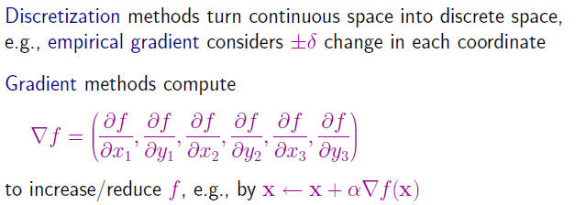
Continuous spaces
What is a good value for α ?
Too small, it takes too long
Too large, may miss the optimum

Slide 14
Newton Raphson Method

Slide 15
Linear and quadratic programming
Constrained optimization
Optimize f(x) subject to
Linear convex constraints – polynomial time in number of variables
Linear programming – scales to thousands of variables
Convex non-linear constraints – special cases → polynomial time
In special cases non-linear convex optimization can scale to thousands of variables

Slide 16
Games and game trees
Multi-agent systems + competitive environment → games and adversarial search
In game theory any multiagent environment is a game as long as each agent has “significant” impact on others
In AI many games were
Game theoretically: Deterministic, Turn taking, Two-player, Zero-sum, Perfect information
AI: deterministic, fully observable environments in which two agents act alternately and utility values at the end are equal but opposite. One wins the other loses
Chess, Checkers
Not Poker, backgammon,

Slide 17
Game types
Starcraft? Counterstrike? Halo? WoW?

Slide 18
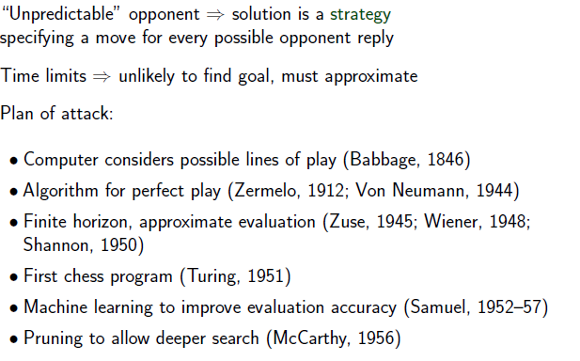
Search in Games

Slide 19
Tic-Tac-Toe
Two player, deterministic, small tree
Two players: Max versus Min
Approximately: 9! tree nodes

Slide 20
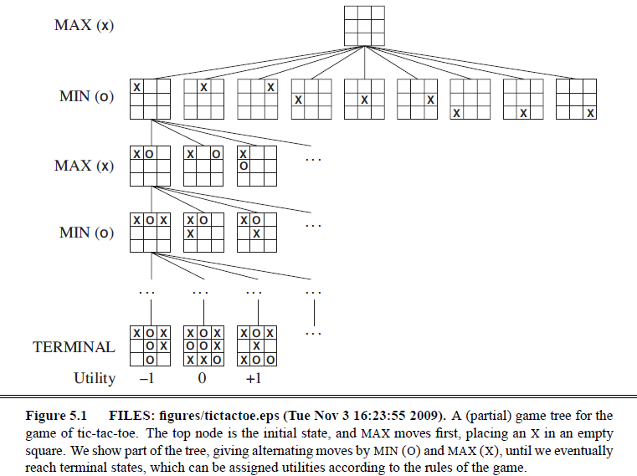
Tic-Tac-Toe

Slide 21
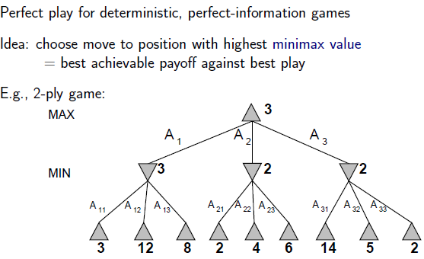
Minimax search

Slide 22
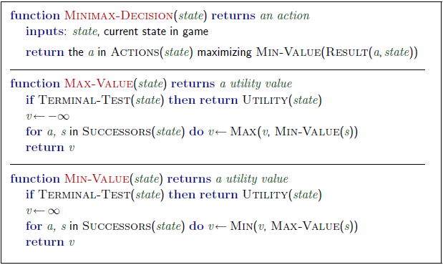
Minimax algorithm

Slide 23
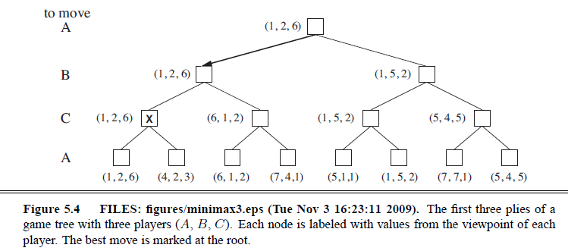
3 player Minimax
Two player minimax reduces to one number because utilities are opposite – knowing one is enough
But there should actually be a vector of two utilities with player choosing to maximize their utility at their turn
So with three players → you have a 3 vector
Alliances?

Slide 24
Minimax properties
Complete?
Only if tree is finite
Note: A finite strategy can exist for an infinite tree!
Optimal?
Yes, against an optimal opponent! Otherwise, hmmmm
Time Complexity?
O($b^{m})$
Space Complexity?
O(bm)
Chess:
b ~= 35, m ~= 100 for reasonable games
Exact solution still completely infeasible

Slide 25
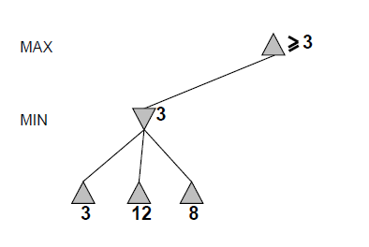
Alpha-beta pruning

Slide 26
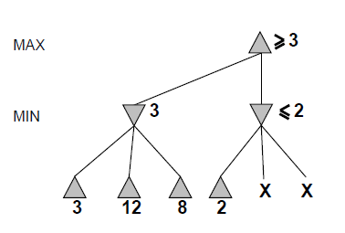
Alpha-beta

Slide 27
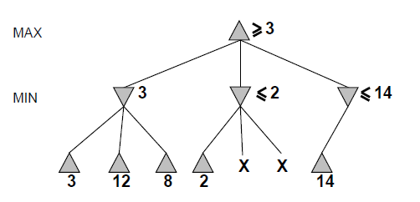
Alpha-beta

Slide 28
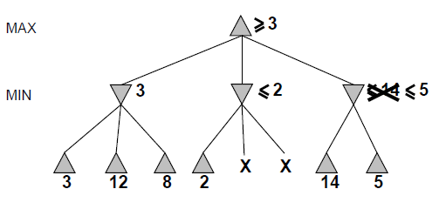
Alpha-beta

Slide 29
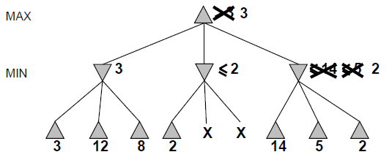
Alpha-beta

Slide 30
Alpha-beta
Alpha is the best value (for Max) found so far at any choice point along the path for Max
Best means highest
If utility v is worse than alpha, max will avoid it
Beta is the best value (for Min) found so far at any choice point along the path for Min
Best means lowest
If utility v is larger than beta, min will avoid it

Slide 31
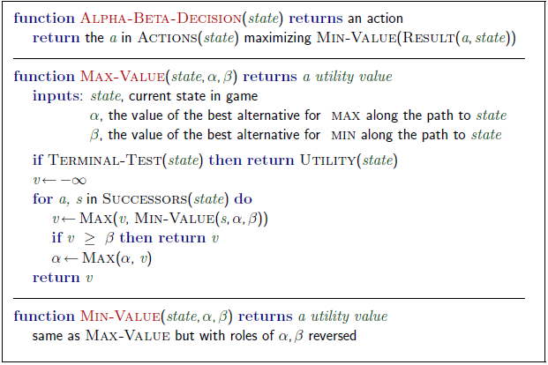
Alpha-beta algorithm

Slide 32
Alpha beta example
Minimax(root)
= max (min (3, 12, 8), min(2, x, y), min (14, 5, 2))
= max(3, min(2, x, y), 2)
= max(3, aValue <= 2, 2)
= 3

Slide 33
Alpha-beta pruning analysis
Alpha-beta pruning can reduce the effective branching factor
Alpha-beta pruning’s effectiveness is heavily dependent on MOVE ORDERING
14, 5, 2 versus 2, 5, 14
If we can order moves well
O($b^{\frac{m}{2} })$
Which is O(($b^{1/2}$)$.^{m}$
Effective branching factor then become square root of b
For chess this is huge → from 35 to 6
Alpha-beta can solve a tree twice as deep as minimax in the same amount of time!
Chess: Try captures first, then threats, then forward moves, then backward moves comes close to b = 12

Slide 34
Imperfect information
You still cannot reach all leaves of the chess search tree!
What can we do?
Go as deep as you can, then
Utility Value = Evaluate(Current Board)
Proposed in 1950 by Claude Shannon
Apply an evaluation function to non-terminal nodes
Use a cutoff test to decide when to stop expanding nodes and apply the evaluation function

Slide 35
Evaluation function
Must order nodes in the same way as the utility function
Wins > Draws > Losses
Fast
Otherwise it is better to search deeper and get more information
For non-terminal states, high evaluations should mean higher probability of winning
Chess is not a chancy game
But computational limitations make eval function chancy!

Slide 36
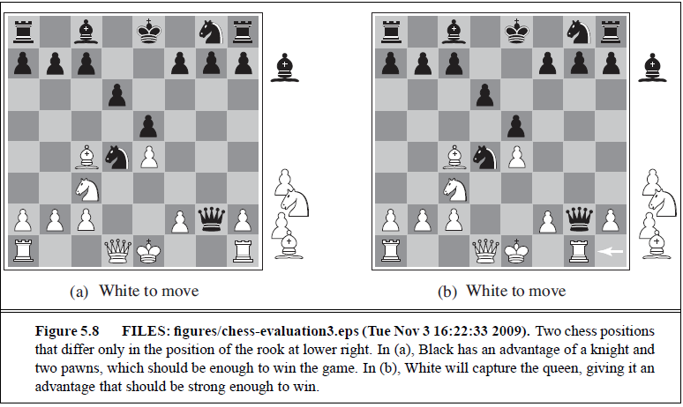
Which is better?

Slide 37
Evaluation functions
A function of board features
Use proportions of board-states with winning, losing, and drawing states to compute probabilities.
72% winning (1.0)
20% draws (0.0)
8% losses (0.5)
Then: evalFunction(board state) = (0.72 * 1) + (0.2 * 0) + (0.08 * 0.5)
Use a weighted linear sum of board features (Can also use non-linear f)
Chess book: pawn = 1, bishop/knight = 3, rook = 5, queen = 9
Good pawn structure = A, king safety = B
evalFunction(board state) = $w_{1}$* pawns + $w_{2}$ * bishops + $w_{3}$ * knight + $w_{4}$ * rook + … + $w_{n}$ * good pawn structure + ….
All this information for chess comes from centuries of human expertise
For new games?

Slide 38
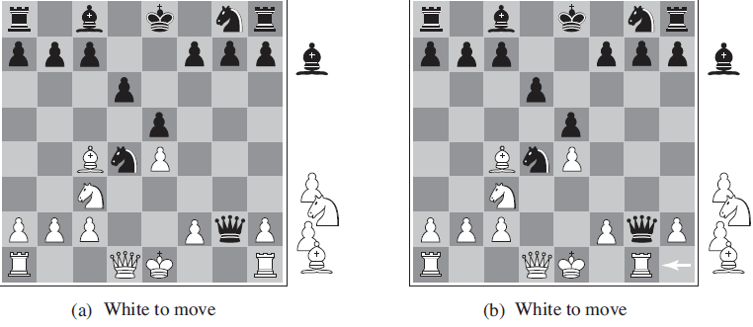
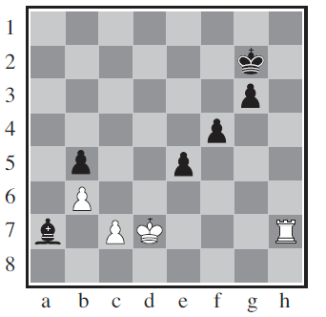
When do we cutoff search
Quiescence
Horizon effect and singular extension

Slide 39
Forward pruning
Beam search
ProbCut – learn from experience to reduce the chance that good moves will be pruned
Like alpha-beta but prunes nodes that are probably outside the current alpha-beta window
Othello
Combine all these techniques plus

Slide 40
Table lookups
Chess
Openings (perhaps upto 10 moves)
Endings (5, 6 pieces left)
King-Rook versus King (KRK)
King-Bishop-Knight versus King (KBNK)
Checkers
Is solved!

Slide 41
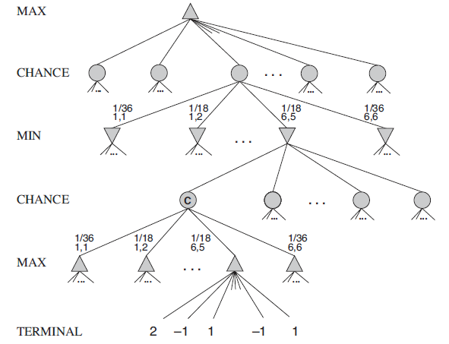
Stochastic Games
Chance is involved (Backgammon, Dominoes, …)
Increases depth if modeled like:

Slide 42
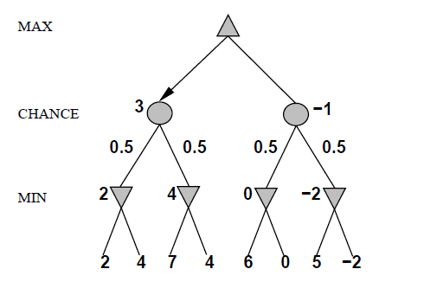
Simple example (coin flipping)

Slide 43
Expected value minimax

Slide 44
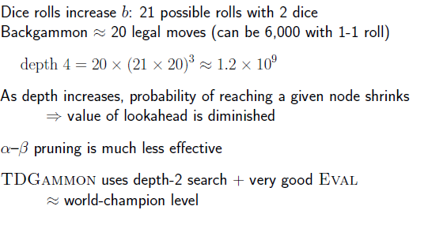
Backgammon

Slide 45
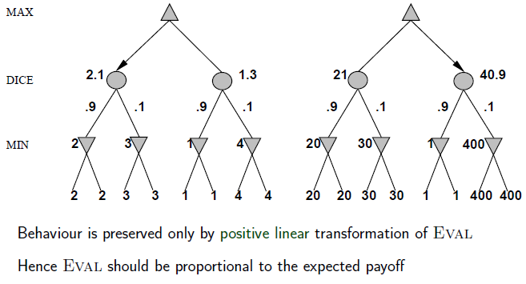
With chance, exact values matter

Slide 46
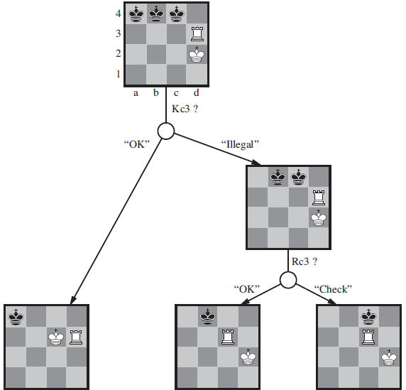
Fog of War
Use belief states to represent the set of states you could be in given all the percepts so far
Kriegspiel
You can only see your pieces
Judge says: Ok, illegal, check, …

Slide 47
Card Games
Consider all possible deals of a deck of cards, solve each deal as a fully observable game, then choose best move averaged over all deals
Computationally infeasible but:
Let us do Monte Carlo approximation
Deal a 100 deals, a 1000 deals, … whatever is computational feasible
Choose best outcome move
Read section 5.7 – state of the art game programs

Slide 48
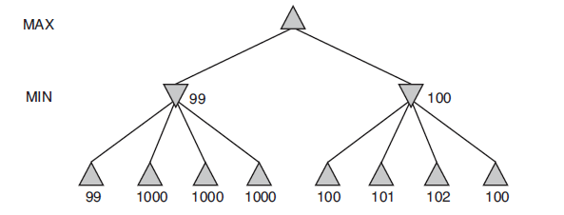
Errors in evaluation functions!

Slide 49
Summary
Games are fun to work on
They give insight on several important issues in AI
Perfection is unattainable → approximate
Think about what to think about
Uncertainty constrains assignment of values to states
Optimal decisions depend on information state, not real state
Games are to AI as grand prix racing is to automobile design

Slide 50
Searching with Nondeterministic actions

Slide 51
Search
Problem solving by searching for a solution in a space of possible solutions
Uninformed versus Informed search
Atomic representation of state
Solutions are fixed sequences of actions

